Slide 1

中国文化基础 Foundation of Chinese Cultures for Bachelor Students of Translation Studies
湖南师范大学 2022年2月21日-2021年6月6日 中国文化基础 周一第七和第八节课14:30-16:10，
上课地点：外国语学院大楼605机房 session 4
第四周2022年3月14日。助教：Deng Lulu 邓鲁露
吴漠汀特聘教授 Distinguished Professor Dr. Martin Woesler
湖南师范大学外国学院 Foreign Studies College, Hunan Normal University

Slide 2
Session 4 第四周 Mythology and Literature
Preparation for this session[edit]
Do the translation homework. Here is the link: Please create link here. Here is the link to the Joint Translation Terms.
Do the correction of the translation of your fellow student. Here is the link: Please create link here.
Read textbook text Mythology: Gods and Immortals
Take the quiz on Mythology: Gods and Immortals : Please create quiz and link it here.
Read textbook text Literature: Ancient Literature: Chinese Mythology
Take the quiz on Literature: Ancient Literature: Chinese Mythology : Please create quiz and link it here.
Mythology: God's and Immortals[edit]
student presentation This is the ppt by Yuan Ling 袁灵 on Mythology: God's and Immortals .
Literature: Ancient Literature: Chinese Mythology[edit]
student presentation This is the ppt by Li Wanying 李婉莹 on Literature: Ancient Literature: Chinese Mythology .
Homework of Session 4 for Session 5[edit]
Please do your homework here.
CULTURE2022 LIST OF HOMEWORKS

Slide 3
Schedule 学期题目
1 2.21 Organizational things, intro to intercultural communication
2 2.28
3 3.7
4 3.14
5 3.21
6 3.28
7 4.4
8 4.11
9 4.18
10 4.25
11 5.2
12 5.9
13 5.16
14 5.23
15 5.30
16 6.6
2 1 Aesthetic ideals and social customs: The Four Most Handsome Men in Ancient China 78%陈锟
2 8 Education: Historical Figures, The Four Talented Women of Ancient China 64%
3 10 Architecture: Fengshui in Chinese Architecture 61%陈诚
3 19 Architecture: The Forbidden City 55%禹紫琪
4 27 Mythology: Gods and Immortals 51%袁灵
4 30 Literature: Ancient literature: Chinese Mythology 50%李婉莹
5 2 Silk and porcelain: Celadon and Celadon Song 《青花瓷》歌词 72%喻锦博
5 11 Science and Technology: Douyin (Tik Tok) 61%欧欣榆
6 23 Beverages: Tea 53% 李思文
6 12 Beverages: Milk Tea 60%由馨凝
7 6 Traditional Cuisine: Hotpot 66%陈心怡
7 24 Traditional Cuisine: Breakfast Culture of Wuhan 53%魏静婷
8 4 Literature: Ancient literature: Chinese Classical Fairy Tales 68% 邓鲁露
8 20 Chinese Movies 55% 马菲菲
8 21 Stage entertainment: Crosstalk 相声 54% 周思睿
9 7 Clothing: Chinese Clothing 64% 刘倩仪
9 14 Facial Make-up 58% 邹享睿
10 9 Games: Mahjong: An Ancient Chinese card play 62% 李琳玉
10 29 Games: Kite Flying 51% 韩静茹
11 28 Social: Round Table Culture 51% 陈天钰
11 5 Beverages: The Liquor Culture of Ancient China 66% 燕妮
12 22 National Symbols: National Flag 54% 邓蕊欣
12 25 Chinese cultural influence on other cultures / Culture Export / Softpower 53%徐致远
13 16 Aesthetic ideals and social customs: Chinese Marriage Customs 57% 刘可仪
13 18 Money culture: The tradition of Red Envelope and Lucky Money 56%杨磊
14 3 Animals: Panda 70% 刘亦欣
14 17 Astrology: Twelve Animals of the Chinese Zodiac 56% 汪柔
14 26 Astrology: Calendar, The 24 Solar Terms 52%何明慧
15 13 Fine Arts: Painting 60%郭子瑞
15 15 Gender: Wu Zetian: The Only Female Emperor of Imperial China 58%雷珩

Slide 4
Hunan Normal University 湖南师范大学外国语学院 “理念之路” 最早的中欧间理念交流——以文学为例 吴漠汀(Martin Woesler)北京师范大学客座教授

Slide 5
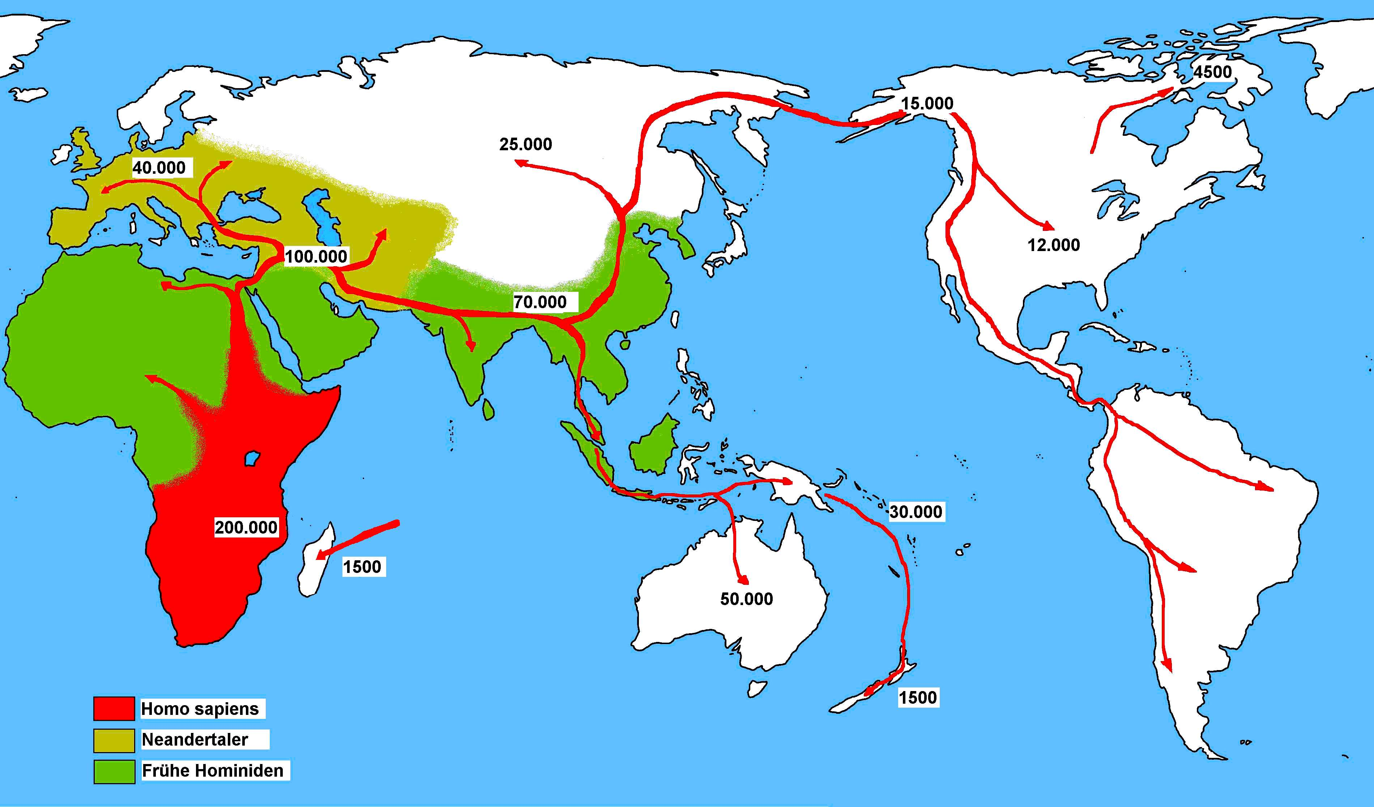
公元前10万年，人群迁移至巴勒斯坦。
大约在公元前7万年，沿着海岸线和河滨到达亚洲。
20.000
20.000

Slide 6
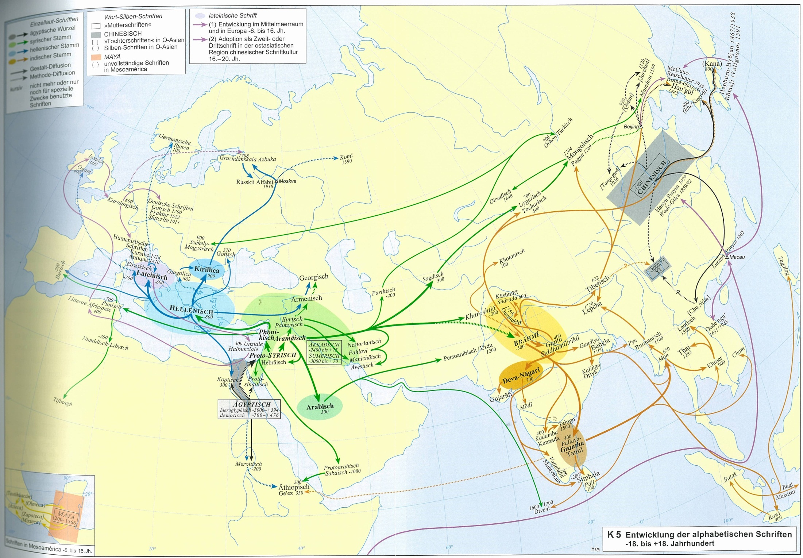
“理念之路”

Slide 7
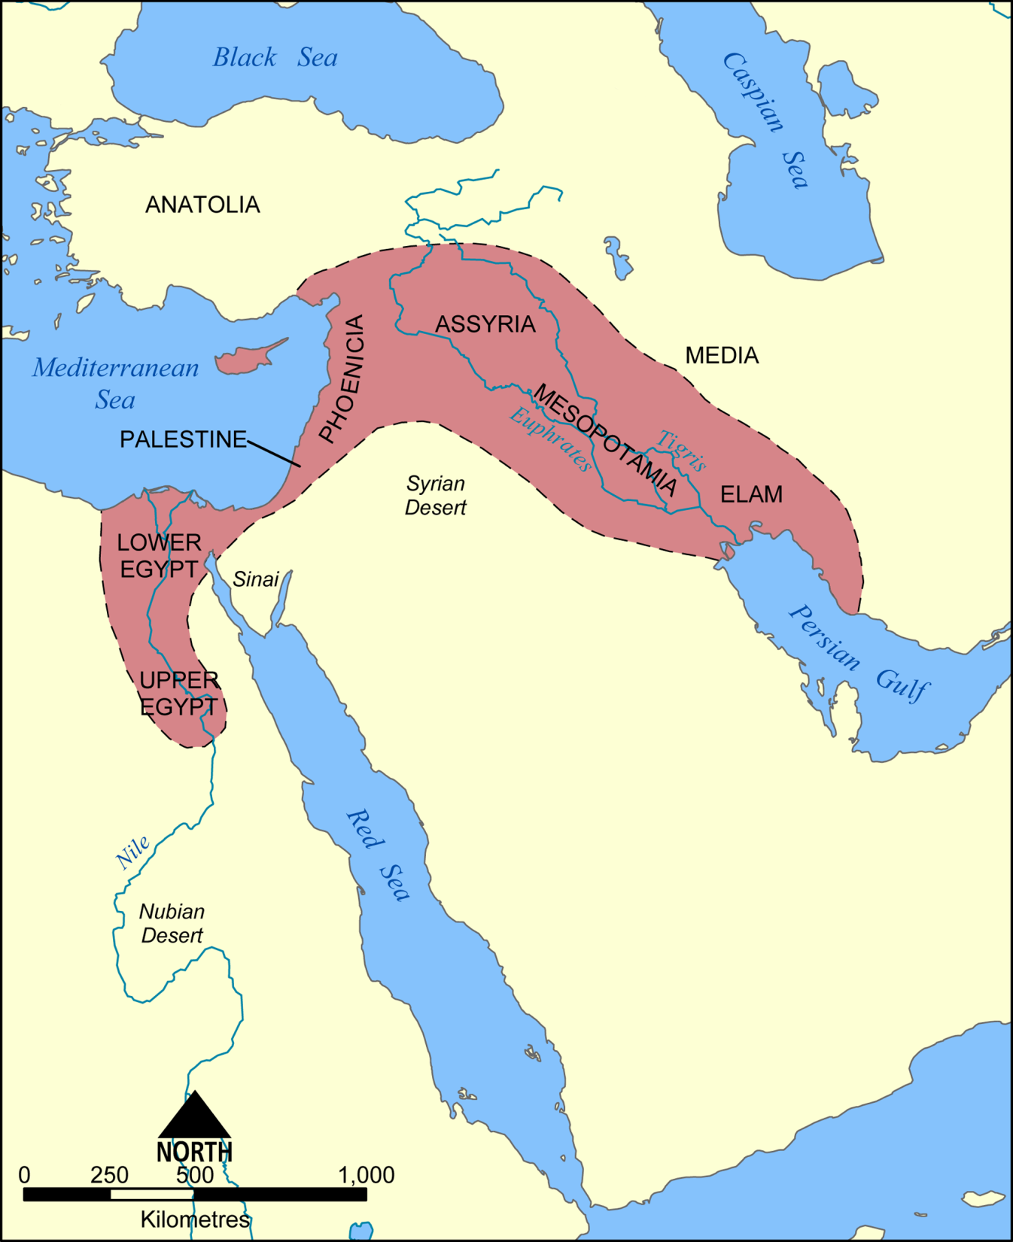
新月沃土
游牧民成为农民
公元前8千年到前7千年城市： 耶利哥、大马士革、恰塔霍裕克
公元前4千年的古文本

Slide 8
“理念之路”
-11000 驯养动物(牛、马)
-10000 培植植物(基因分析)

Slide 9
“理念之路”
-10000 猪
-8000 鸡
-5000 丝绸

Slide 10
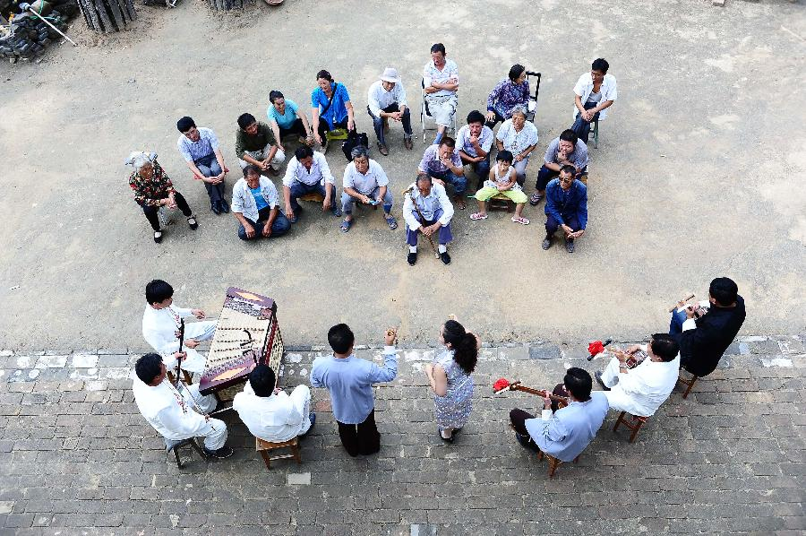
说书

Slide 11
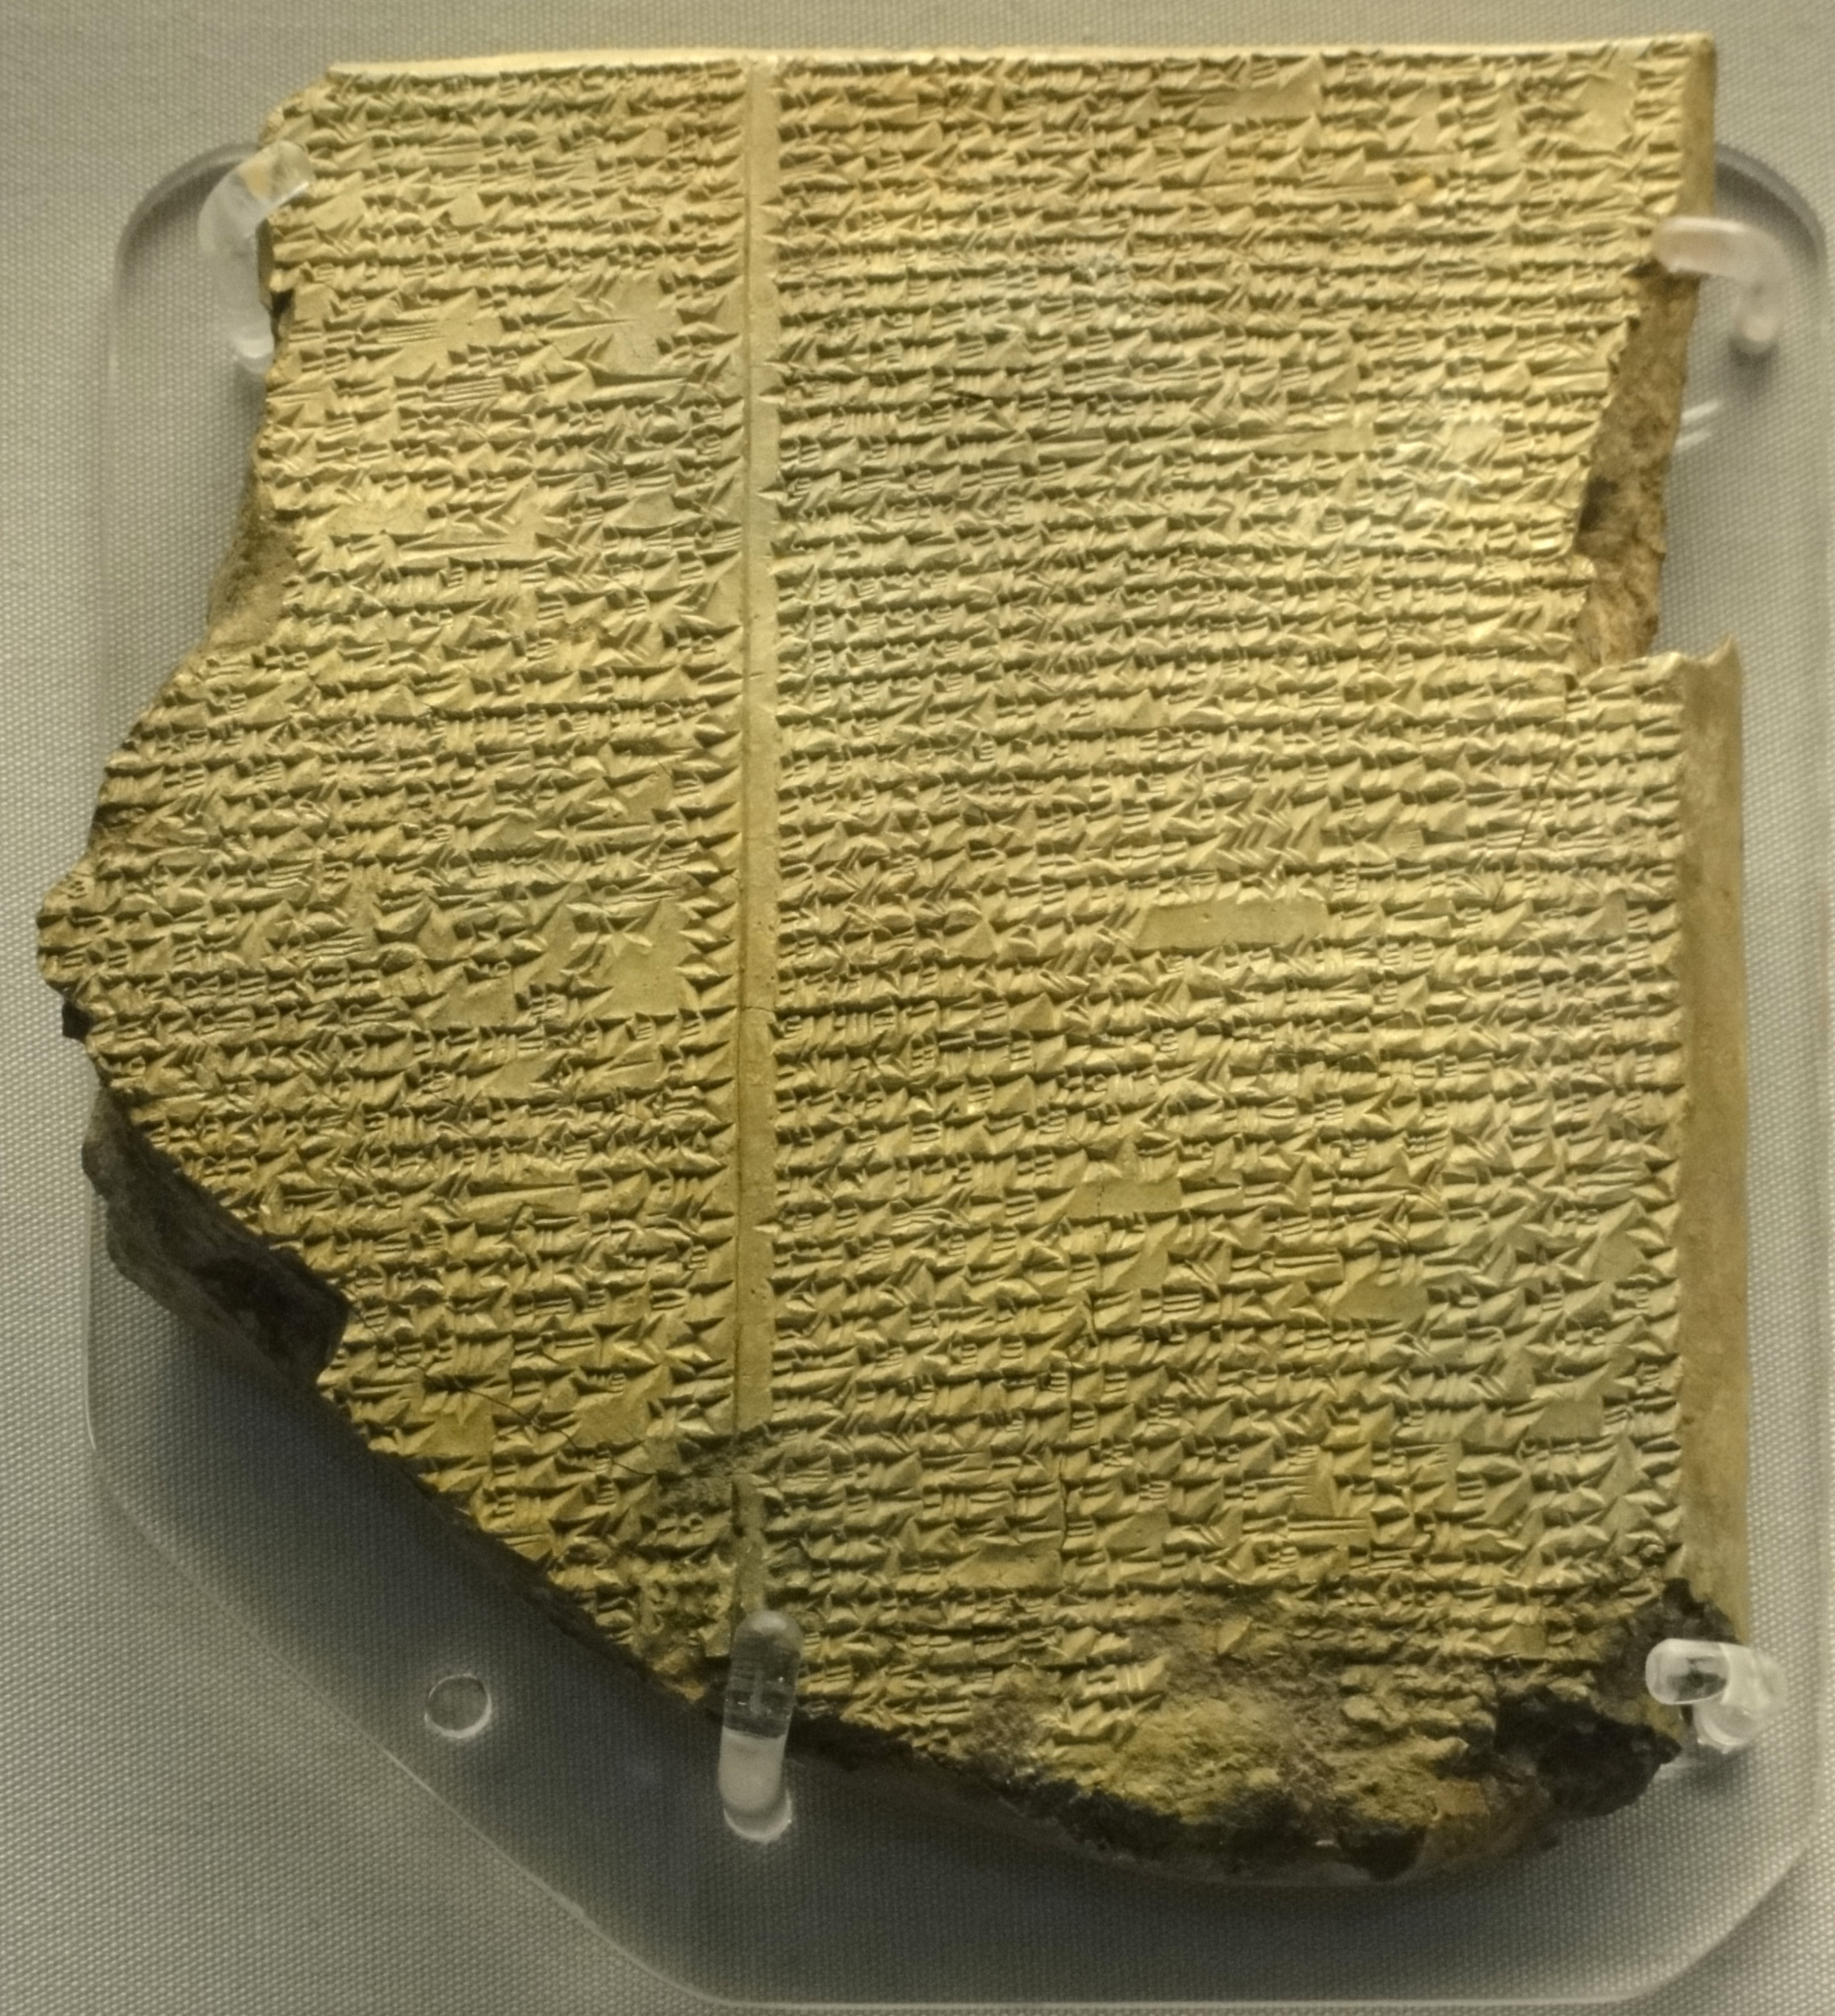
《吉尔伽美什史诗》:11公元前3000
大洪水

Slide 12
-950
诗经
-350
山海经
大洪水
-440
-3000
800
-1850
吉尔伽美什史诗

Slide 13
“理念之路”
-3000:创世记、半人半神、初夜权、众神、梦中警示、美女诱惑、乌托邦的天堂、长生不老药、蛇的形象、地下城／地狱／阴间
吉尔伽美什史诗

Slide 14
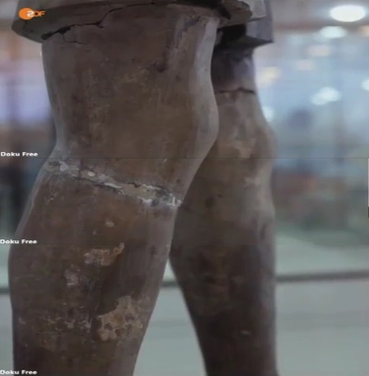

“理念之路” ?
汉书
临洮
狄奧多羅斯

Slide 15
早期其他欧洲文学汉译举目
年 | 作品 | 作家 | 翻译
1608 | 《伊索寓言》（解译） | 伊索 Aesop | 利玛窦 Matteo Ricci
1625 | 《伊索寓言》 | 伊索 Aesop | Nicolas Trigault

Slide 16
早期中国文学译成西语
First translations of Chinese literature into Western languages
年 | 作品 | 语言 | 译者 | 有没有 代表性
1703 | 《华语官话语法》(Arte de la lengua manda­ri­na): 元杂剧（赵氏孤儿 、老生儿?）和《水浒传》、《好逑传》、《玉娇梨》等小说 | 西班牙语 Spanish | 方济各 瓦罗 Francisco Varo | 元杂剧和《水浒传》有代表性
1719 | 《好逑传》Hau Kiou Choaan — The Pleasing History [怀疑] | 75% 英Eng-lish, 25% 葡萄牙语Por-tuguese | 詹姆斯 · 威尔金森 James Wilkinson | 没有 代表性
1898 | La dame aux camélias《巴黎茶花女遗事》(1848) | 法语 Alexandre Dumas fils | Wang Shoulü 王寿吕, Lin Shu 林纾 | 有

Slide 17
“理念之路”

Slide 18
谢谢大家！

Slide 19
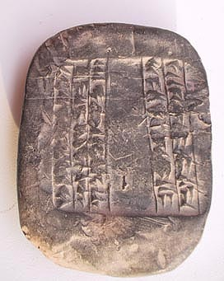
4000 BC = oldest script 最古老的文本
Sumerers in Mesopotamia 美索不达米亚
Sumerian/Protoelamic -3000, 苏美尔人，公元前3000年
Altägyptian -3000, 古埃及人，公元前3000年
Yi -3000; 古彝族，公元前3000年
Protoindian -2500 早期印度人 公元前2500年

Slide 20
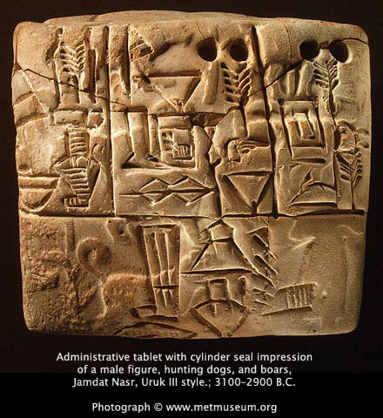
Proof of literature text from 3000 BC
The Sumerian language（苏美尔语） of Mesopotamia （美索不达米亚）(modern Iraq现代伊拉克) is the earliest known written language
Sumerians wrote in cuneiform（楔形文字） on clay tablets
bilingual cuneiform dictionaries of Sumerian and Akkadian（阿卡德语） (1800-1600 B.C.)

Slide 21
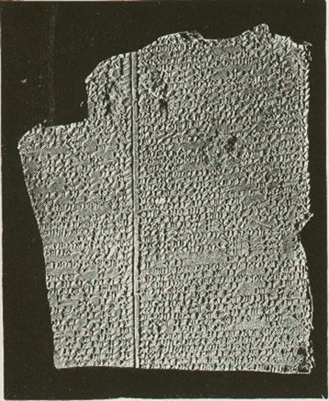
3000-2400 BC Gilgamesh Epos 公元前3000-2400年：吉尔伽美什史诗
Tablet one
The story introduces Gilgamesh, king of Uruk. Gilgamesh, two-thirds god and one-third man, is oppressing his people, who cry out to the gods for help. For the young women of Uruk this oppression takes the form of a droit du seigneur, or “lord‘s right”, to sleep with brides on their wedding night. For the young men (the tablet is damaged at this point) it is conjectured that Gilgamesh exhausts them through games, tests of strength, or perhaps forced labour on building projects. The gods respond to the people’s pleas by creating an equal to Gilgamesh who will be able to stop his oppression. This is the primitive man, Enkidu, who is covered in hair and lives in the wild with the animals. He is spotted by a trapper, whose livelihood is being ruined because Enkidu is uprooting his traps. The trapper tells the sun-god Shamash about the man, and it is arranged for Enkidu to be seduced by Shamhat, a temple prostitute, his first step towards being tamed. After six days and seven nights of continuous lovemaking she takes Enkidu to a shepherd‘s camp to learn how to be civilized. Gilgamesh, meanwhile, has been having dreams about the imminent arrival of a beloved new companion.
《吉尔伽美什史诗》围绕乌鲁克(Uruk)国王吉尔伽美什（Gilgamesh）和他的朋友恩奇都（Enkidu）的之间的友谊故事展开。

Slide 22
3000-2400 BC Gilgamesh Epos 公元前3000-2400年：吉尔伽美什史诗
Tablet two
Shamhat brings Enkidu to the shepherds‘ camp（牧羊人的营地）, where he is introduced to a human diet and becomes the night watchman（守夜人）. Learning from a passing stranger about Gilgamesh’s treatment of new brides, Enkidu is incensed and travels to Uruk to intervene at a wedding. When Gilgamesh attempts to visit the wedding chamber（洞房）, Enkidu blocks his way, and they fight. After a fierce battle, Enkidu acknowledges Gilgamesh's superior strength and they become friends. Gilgamesh proposes a journey to the Cedar Forest to slay the monstrous demi-god Humbaba in order to gain fame and renown. Despite warnings from Enkidu and the council of elders, Gilgamesh is not deterred.
Tablet three
The elders give Gilgamesh advice for his journey. Gilgamesh visits his mother, the goddess Ninsun, who seeks the support and protection of the sun-god Shamash for their adventure. Ninsun adopts Enkidu as her son, and Gilgamesh leaves instructions for the governance of Uruk in his absence.

Slide 23
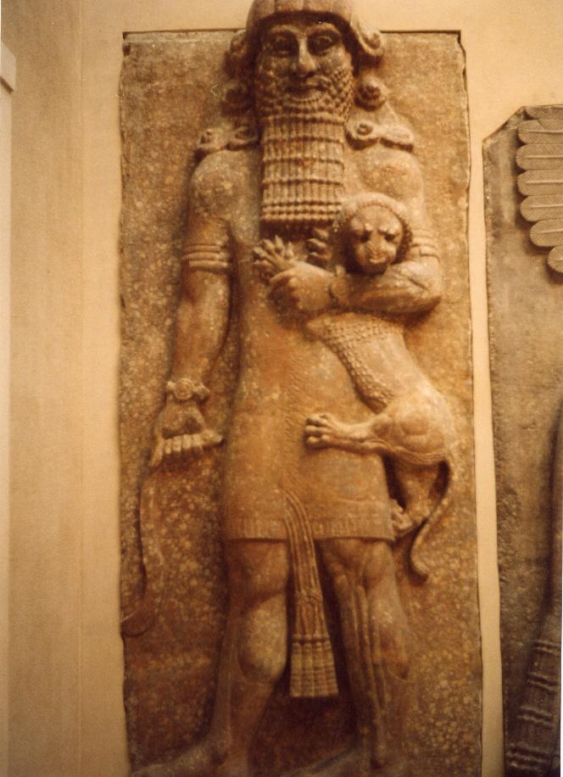
3000-2400 BC Gilgamesh Epos
Tablet four
Gilgamesh and Enkidu journey to the Cedar Forest. Every few days they camp on a mountain, and perform a dream ritual. Gilgamesh has five terrifying dreams about falling mountains, thunderstorms, wild bulls, and a thunderbird that breathes fire. Despite similarities between his dream figures and earlier descriptions of Humbaba, Enkidu interprets these dreams as good omens（好兆头）, and denies that the frightening images represent the forest guardian（森林的守卫者）. As they approach the cedar mountain（雪松林）, they hear Humbaba bellowing, and have to encourage each other not to be afraid.

Slide 24
3000-2400 BC Gilgamesh Epos
Tablet five
Tablet V of the Epic of Gilgamesh
The heroes enter the cedar forest. Humbaba, the guardian of the Cedar Forest, insults and threatens them. He accuses Enkidu of betrayal, and vows to disembowel Gilgamesh and feed his flesh to the birds. Gilgamesh is afraid, but with some encouraging words from Enkidu the battle commences（开始）. The mountains quake with the tumult and the sky turns black（群山因骚动而震动，天空变黑）. The god Shamash sends 13 winds to bind Humbaba, and he is captured. The monster pleads for his life, and Gilgamesh pities him. He offers Gilgamesh to be king of the forest, he will cut the trees for him, and be his slave. Enkidu, however, is enraged and asks Gilgamesh to kill the beast, because he knows that Humbaba is lying. Humbaba curses them both and Gilgamesh dispatches him with a blow to the neck. The two heroes cut down many cedars, including a gigantic（巨大的） tree that Enkidu plans to fashion into a gate for the temple of Enlil. They build a raft（木筏） and return home along the Euphrates（幼发拉底河）with the giant tree and the head of Humbaba.

Slide 25
3000-2400 BC Gilgamesh Epos
Tablet six
Gilgamesh rejects the advances of the goddess Ishtar because of her mistreatment of previous lovers like Dumuzi. Ishtar asks her father Anu to send Gugalanna, the Bull of Heaven, to avenge her（为她报仇）. When Anu rejects her complaints, Ishtar threatens to raise the dead who will “outnumber the living” and “devour them”（将它们吞噬）. Anu becomes frightened, and gives in to her. Ishtar leads Gugalanna to Uruk, and it causes widespread devastation（破坏）. It lowers the level of the Euphrates river, and dries up the marshes（沼泽，湿地）. It opens up huge pits that swallow 300 men. Without any divine assistance（神地帮助）, Enkidu and Gilgamesh attack and slay it, and offer up its heart to Shamash. When Ishtar cries out, Enkidu hurls one of the hindquarters of the bull at her. The city of Uruk celebrates, but Enkidu has an ominous dream about his future failure.

Slide 26
3000-2400 BC Gilgamesh Epos
Tablet seven
In Enkidu‘s dream, the gods decide that one of the heroes must die because they killed Humbaba and Gugalanna. Despite the protestations（声明） of Shamash, Enkidu is marked for death. Enkidu curses the great door he has fashioned for Enlil’s temple. He also curses the trapper and Shamhat for removing him from the wild. Shamash reminds Enkidu of how Shamhat fed and clothed him, and introduced him to Gilgamesh. Shamash tells him that Gilgamesh will bestow great honors upon him at his funeral, and will wander into the wild consumed with grief. Enkidu regrets his curses and blesses Shamhat. In a second dream, however, he sees himself being taken captive（战俘，俘虏） to the Netherworld by a terrifying Angel of Death. The underworld is a “house of dust” and darkness whose inhabitants eat clay, and are clothed in bird feathers, supervised by terrifying beings. For 12 days, Enkidu‘s condition worsens. Finally, after a lament（哀悼，痛惜） that he could not meet a heroic death in battle（不能在战场上英勇地死去）, he dies.

Slide 27
3000-2400 BC Gilgamesh Epos
Tablet eight
Gilgamesh delivers a lamentation for Enkidu, in which he calls upon mountains, forests, fields, rivers, wild animals, and all of Uruk to mourn for his friend. Recalling their adventures together, Gilgamesh tears at his hair and clothes in grief. He commissions a funerary statue, and provides grave gifts from his treasury（宝藏，财宝） to ensure that Enkidu has a favourable reception in the realm of the dead. A great banquet（宴会，宴请） is held where the treasures are offered to the gods of the Netherworld. Just before a break in the text there is a suggestion that a river is being dammed, indicating a burial in a river bed, as in the corresponding Sumerian poem（苏美尔诗歌）, The Death of Gilgamesh.

Slide 28
3000-2400 BC Gilgamesh Epos
Tablet nine
Tablet nine opens with Gilgamesh roaming the wild wearing animal skins, grieving for Enkidu. Fearful of his own death, he decides to seek Utnapishtim (“the Faraway”), and learn the secret of eternal life（学习永生的秘密）. Among the few survivors of the Great Flood, Utnapishtim and his wife are the only humans to have been granted immortality by the gods. Gilgamesh crosses a mountain pass at night and encounters a pride of lions. Before sleeping he prays for protection to the moon god Sin. Then, waking from an encouraging dream, he kills the lions and uses their skins for clothing. After a long and perilous（危险的） journey, Gilgamesh arrives at the twin peaks of Mount Mashu at the end of the earth. He comes across a tunnel, which no man has ever entered, guarded by two terrible scorpion-men. After questioning him and recognizing his semi-divine nature, they allow him to enter it, and he passes under the mountains along the Road of the Sun. In complete darkness he follows the road for 12 “double hours”, managing to complete the trip before the Sun catches up with him. He arrives at the Garden of the gods, a paradise full of jewel-laden trees（满是宝石树的天堂）.

Slide 29
3000-2400 BC Gilgamesh Epos
Tablet ten
Gilgamesh meets alewife Siduri, who assumes that he is a murderer or thief because of his disheveled （凌乱的，不整洁的）appearance. Gilgamesh tells her about the purpose of his journey. She attempts to dissuade（劝阻） him from his quest, but sends him to Urshanabi the ferryman（摆渡者，船夫）, who will help him cross the sea to Utnapishtim. Gilgamesh, out of spontaneous rage, destroys the stone-giants that live with Urshanabi. He tells him his story, but when he asks for his help, Urshanabi informs him that he has just destroyed the only creatures who can cross the Waters of Death, which are deadly to the touch. Urshanabi instructs Gilgamesh to cut down 120 trees and fashion them into punting poles. When they reach the island where Utnapishtim lives, Gilgamesh recounts his story, asking him for his help. Utnapishtim reprimands（惩戒，谴责） him, declaring that fighting the common fate of humans is futile and diminishes（减少） life's joys.

Slide 30
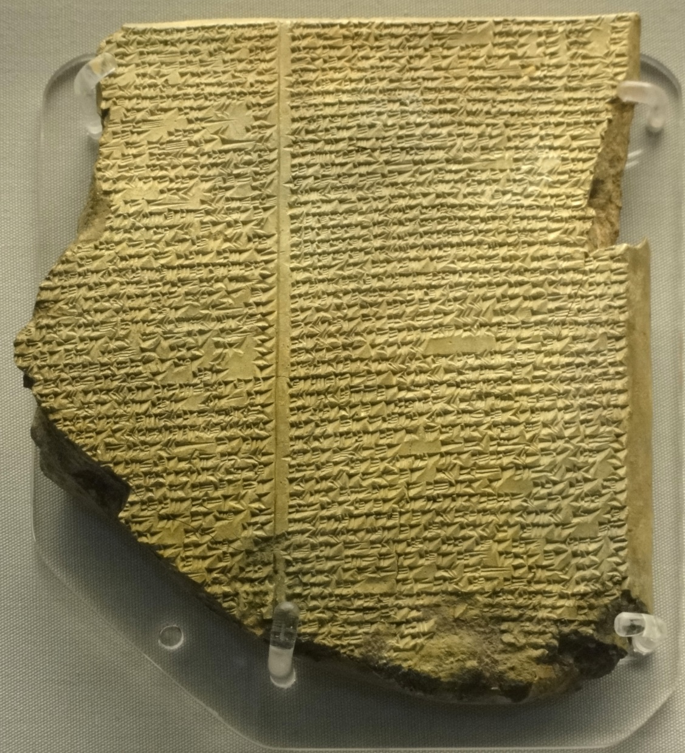
Tablet eleven
Gilgamesh observes that Utnapishtim seems no different from himself, and asks him how he obtained his immortality. Utnapishtim explains that the gods decided to send a great flood. To save Utnapishtim the god Ea told him to build a boat. He gave him precise dimensions, and it was sealed with pitch and bitumen（用树脂和沥青封好）. His entire family went aboard together with his craftsmen and “all the animals of the field”. A violent storm then arose which caused the terrified gods to retreat to the heavens. Ishtar lamented the wholesale destruction of humanity, and the other gods wept beside her. The storm lasted six days and nights, after which “all the human beings turned to clay”. Utnapishtim weeps when he sees the destruction. His boat lodges on a mountain, and he releases a dove, a swallow, and a raven（乌鸦）. When the raven fails to return, he opens the ark and frees its inhabitants. Utnapishtim offers a sacrifice to the gods, who smell the sweet savor and gather around. Ishtar vows that just as she will never forget the brilliant necklace that hangs around her neck, she will always remember this time. When Enlil arrives, angry that there are survivors, she condemns him for instigating the flood. Ea also castigates him for sending a disproportionate punishment. Enlil blesses Utnapishtim and his wife, and rewards them with eternal life. This account matches the flood story that concludes the Epic of Atrahasis (see also Gilgamesh flood myth).
The main point seems to be that when Enlil granted eternal life it was a unique gift. As if to demonstrate this point, Utnapishtim challenges Gilgamesh to stay awake for six days and seven nights. Gilgamesh falls asleep, and Utnapishtim instructs his wife to bake a loaf of bread on each of the days he is asleep, so that he cannot deny his failure to keep awake. Gilgamesh, who is seeking to overcome death, cannot even conquer sleep. After instructing Urshanabi the ferryman to wash Gilgamesh, and clothe him in royal robes, they depart for Uruk.
Photo: By Fæ, CC BY-SA 3.0

Slide 32
3000-2400 BC Gilgamesh Epos
As they are leaving, Utnapishtim‘s wife asks her husband to offer a parting gift. Utnapishtim tells Gilgamesh that at the bottom of the sea there lives a boxthorn-like plant（枸杞状的植物） that will make him young again. Gilgamesh, by binding stones to his feet so he can walk on the bottom, manages to obtain the plant. Gilgamesh proposes to investigate if the plant has the hypothesized rejuvenation ability by testing it on an old man once he returns to Uruk.
'There is a plant that looks like a box-thorn, it has prickles like a dogrose, and will prick one who plucks it. But if you can possess this plant, you'll be again as you were in your youth'
‘This plant, Ur-shanabi, is the “Plant of Heartbeat”, with it a man can regain his vigour. To Uruk-the-sheepfold I will take it, to an ancient I will feed some and put the plant to the test!’^{[12]} Unfortunately, when Gilgamesh stops to bathe, it is stolen by a serpent, who sheds its skin as it departs. Gilgamesh weeps at the futility of his efforts（他的努力是徒劳的）, because he has now lost all chance of immortality（不朽）. He returns to Uruk, where the sight of its massive walls prompts him to praise this enduring work to Urshanabi.

Slide 33
3000-2400 BC Gilgamesh Epos
Tablet twelve
This tablet is mainly an Akkadian translation of an earlier Sumerian poem, Gilgamesh and the Netherworld (also known as “Gilgamesh, Enkidu, and the Netherworld” and variants), although it has been suggested that it is derived from an unknown version of that story.^{[3]:42} The contents of this last tablet are inconsistent with previous ones（内容与前面的部分不一致）: Enkidu is still alive, despite having died earlier in the epic. Because of this, its lack of integration（综合，一体化） with the other tablets, and the fact that it is almost a copy of an earlier version, it has been referred to as an ‘inorganic appendage’（附属物，依附的人） to the epic.^{[13]} Alternatively, it has been suggested that "its purpose, though crudely handled, is to explain to Gilgamesh (and the reader) the various fates of the dead in the Afterlife" and in "an awkward attempt to bring closure",^{[14]} it both connects the Gilgamesh of the epic with the Gilgamesh who is the King of the Netherworld,^{[15]} and is "a dramatic capstone whereby the twelve-tablet epic ends on one and the same theme, that of "seeing" (= understanding, discovery, etc.), with which it began."^{[16]}

Slide 34
3000-2400 BC Gilgamesh Epos
Gilgamesh complains to Enkidu that various of his possessions (the tablet is unclear exactly what — different translations include a drum and a ball) have fallen into the underworld. Enkidu offers to bring them back. Delighted, Gilgamesh tells Enkidu what he must and must not do in the underworld if he is to return. Enkidu does everything which he was told not to do. The underworld keeps him. Gilgamesh prays to the gods to give him back his friend. Enlil and Suen don't reply, but Ea and Shamash decide to help. Shamash makes a crack in the earth, and Enkidu's ghost jumps out of it. The tablet ends with Gilgamesh questioning Enkidu about what he has seen in the underworld.

Slide 35
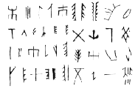
Script in China 中国的文本
Non-script: Banpo 6000 BC 公元前6000年的半坡遗址没有文本
Emergence: Yi 3000 BC 公元前3000年在古彝族出现文本
Chinese (Shang): 1250 BC 公元前1250年在商朝
Early ethnics also non-Chinese
早期非中国人的人种

Slide 36
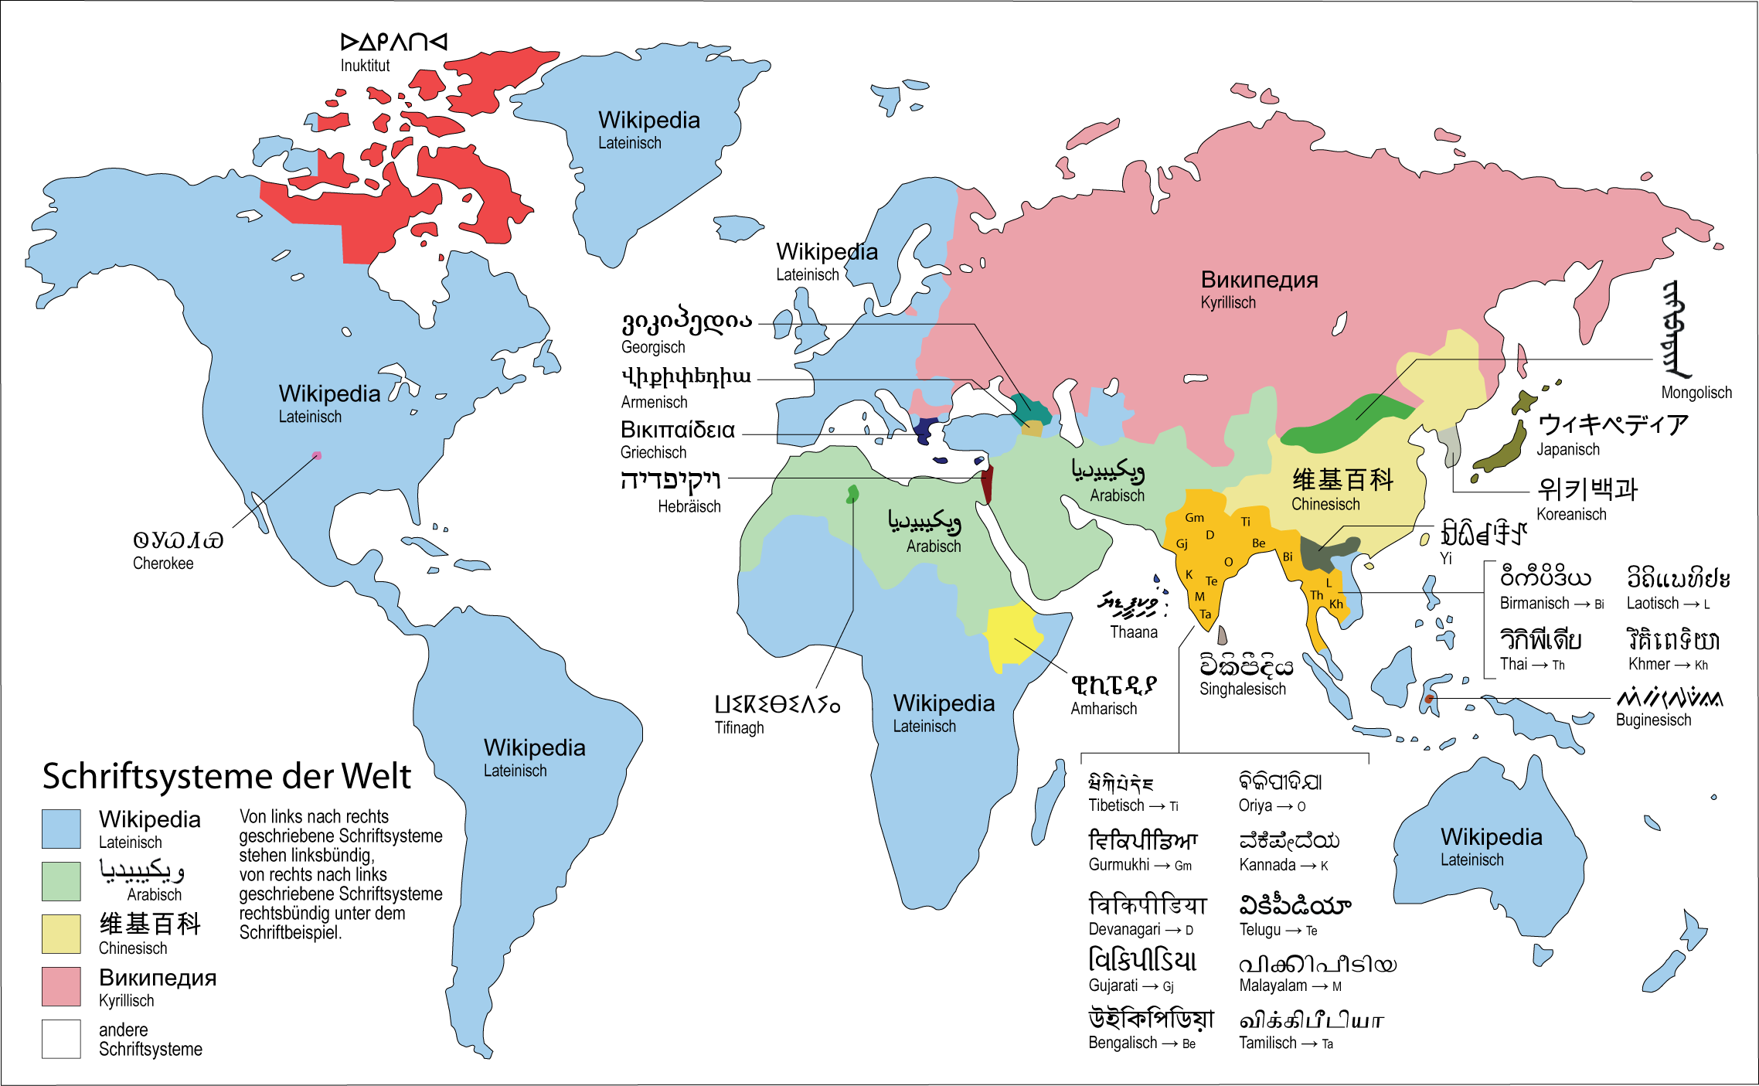
Scripts of the world 世界的文本
Source: Wikipedia

Slide 37
There has always been an exchange between Chinese and Europeans. We find early relics, of both civilizations, on both sides (The first European coins in China date from around 535 CE.). Lukas Nickel, University of London, suggests that the Chinese copied the Terracotta soldiers from ancient 12 metre high Greek statues, which were received by Qin Shi Huangdi and later copied. The statues were dressed in foreign robes and may not have come from Greece, but from one of the kingdoms influenced by Alexander the Great. Nickel’s proof is that there were only smaller two-dimensional statues before this time. Additionally, with Standbein/Spielbein, we find examples of life-size statues of half-naked acrobats and dancers in a non-public excavation storage room. The historian Ban Gu, of the Han Dynasty, criticized Qin Shi Huangdi for the "heavenly taboo" that "he who recklessly follows foreign models will encounter disaster." As a result, the Chinese stopped reproducing foreign statues for nearly 2000 years.
Sources: Lukas Nickel quotes Sima Qian and Ban Gu. Here is the full quote from Ban Gu: “In the 26th Year of the Emperor (221 BC) daren appeared that were 5 zhang tall and had feet of a size of 6 chi, all dressed in foreign ( yidi 夷狄) robes. There were 12 of them and they appeared in Lintao. A heavenly taboo once said that he who recklessly follows foreign models will encounter disaster. In the same year, however, the Emperor succeeded in subjecting the six states, so he reinterpreted the appearance as an auspicious sign. Therefore, he melted down the weapons of all-under-heaven and cast the twelve bronze men to represent those [the daren from Lintao].
Sources: Nickel quotes the historian Diodorus Siculus, who wrote about an altar compound which Alexander erected at the most easternly point his army reached: Thinking how best to mark the limits of his campaign at this point, [Alexander] first erected altars of the twelve gods each fifty cubits high, and then traced the circuit of the camp three times the size of the existing one. Here he dug a ditch fifty feet wide and forty feet deep . . . he directed the infantry to construct huts each containing beds five cubits long, and the cavalry . . . to build two mangers twice the normal size. In the same way, everything else which would be left behind was exaggerated in size. His idea in this was to make a camp of heroic proportions and then leave to the natives evidence of men of huge stature, displaying the strength of giants.

Slide 38
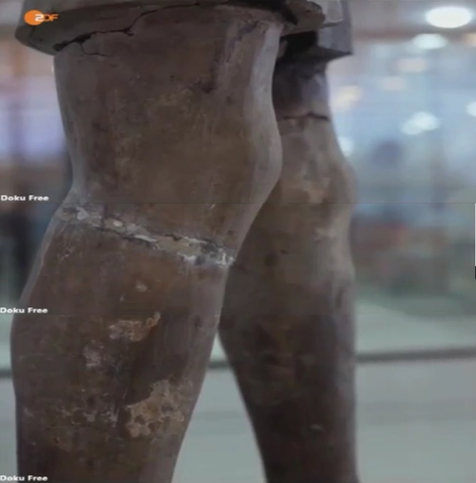
兵马俑与古希腊雕塑
兵马俑
古希腊雕塑

Slide 39
史料一：
前1世纪古希腊的历史学家狄奧多羅斯写了：
“莫非“[亚历山大]想表现出，他与他的军队达到了东边的最远处。所以他建立了12神的纪念坛，每座高50多英尺，然后他包围营地包围得比真的存在的大三倍。这里，他挖了一个50英尺宽，12英尺深的沟。他让步兵建立小屋，里面有五肘长的床，并建立比普通大一倍的的骑兵。这样所有的要留在那里的都是夸张大小。他的想法是创造和英雄比例一样的雕像，留下给当地人一些身形和力量巨大的巨人的证据。”

Slide 40
史料二：
班固在《汉书》中记载：
“皇帝二十六年，初兼天下，改诸侯为郡县，一法律，同度量。大人来见临洮，其长五丈，足迹六尺。”

Slide 41

伦敦大学的Lukas Nickel教授
—秦始皇兵马俑之前的中国所出土的雕像都是2D的；
—德国电视二台曾经报道过，在兵马俑博物馆里有一个非开放的片区里，他们找到了一个半身裸体的舞者雕塑有承重腿，而这是古希腊雕塑手法所特有的（在埃及的雕像里也有承重腿）；

Slide 42
Belege für griechischen Ursprung der Terracotta-Armee
Historiker Diodorus Siculus (1. Jh. v. Chr.):
“[Alexander 356-323 v. Chr.] überlegte, wie er den weitesten Punkt [östlich], den er mit seinem Heer erreicht hatte, markieren konnte, errichtete er erst Altare der 12 Gottheiten, jeder höher als 50 Ellen und markierte dann eine dreifach größere Umrandung des Lagers als es bestand.
Hier hob er einen 50 Fuß breiten und 12 Fuß tiefen Graben aus. Er wies die Infanterie an, Hütten mit je fünf Ellen langen Betten zu bauen, und die Kavalerie … zwei Krippen der doppelten Größe zu errichten. Auf dieselbe Weise wurde alles, was zurück gelassen wurde, in der Größe übertrieben.
Seine Idee war es, ein Lager von heldenhaften Proportionen zu schaffen und den Eingeborenen Belege für Menschen großer Statur zu hinterlassen, die die Kraft von Giganten hatten.”
Notes:
Historiker Diodorus Siculus:
“[Alexander] überlegte wie er den weitesten Punkt [östlich], den er mit seinem Heer erreicht hatte, markieren konnte, errichtete er erst Altare der 12 Gottheiten, jeder höher als 50 Ellen und markierte dann eine dreifach größere Umrandung des Lagers als es bestand.
Hier hob er einen 50 Fuß breiten und 12 Fuß tiefen Graben aus. Er wies die Infanterie an, Hütten mit je fünf Ellen langen Betten zu bauen, und die Kavalerie … zwei Krippen der doppelten Größe zu errichten. Auf dieselbe Weise wurde alles, was zurück gelassen wurde, in der Größe übertrieben.
Seine Idee war es, ein Lager von heldenhaften Proportionen zu schaffen und den Eingeborenen Belege für Menschen großer Statur zu hinterlassen, die die Kraft von Giganten hatten.”

Slide 43
Belege für griechischen Ursprung der Terracotta-Armee
Chinesischer Historiker Ban Gu:
“Im 26. Jahr des Kaisers [Qin Shihuang di] (221 v. Chr.) wurden 5 zhang (12 Meter) hohe Statuen mit Füßen von 6 Chi entdeckt. Alle in fremder Kleidung (yidi 夷狄).
Es gab 12 und sie wurden in Lintao entdeckt. Ein himmlisches Tabu sagte einst, dass der, der unbedacht ausländischen Modellen folgt, eine Katastrophe erleben wird.
Im selben Jahr gelang es dem Kaiser, die sechs Staaten zu unterwerfen, weshalb er die Entdeckung als ein gutes Zeichen re-interpretierte.
Deshalb ließ er Waffen von überall-unter-dem-Himmel einschmelzen und ließ daraus 12 Bronze-Menschenfiguren gießen, um diese [die 12 von Lintao] zu repräsentieren.”
Notes:
Chinesischer Historiker Ban Gu:
“Im 26. Jahr des Kaisers [Qin Shihuang di] (221 v. Chr.) erschienen 5 zhang (12 Meter) hohe Statuen mit Füßen von 6 Chi. Alle in fremder Kleidung (yidi 夷狄).
Es gab 12 und sie erschienen in Lintao. Ein himmlisches Tabu sagte einst, dass der, der unbedacht ausländischen Modellen folgt, eine Katastrophe erleben wird.
Im selben Jahr gelang es dem Kaiser, die sechs Staaten zu unterwerfen, weshalb er das Erscheinen als ein gutes Zeichen re-interpretierte.
Deshalb ließ er Waffen von überall-unter-dem-Himmel einschmelzen und ließ daraus 12 Bronze-Menschenfiguren gießen, um diese [die 12 von Lintao] zu repräsentieren.”

Slide 44
班固：《汉书》
为何皇帝令人在铭文中加入“大人”出自临洮的说法？班固对此提供了一个解释。"史記秦始皇帝二十六年，有大人長五丈，足履六尺，皆夷狄服，凡十二人，見于臨洮．天戒若曰，勿大為夷狄之行，將受其禍．是歲始皇初并六國，反喜以為瑞，銷天下兵器，作金人十二以象之．"他详细叙述了已知的信息，提示道，公元前221年出现的12个大人都着外国的（夷狄！）服装。他提到了一则预言，预言说道，遵循外国的习俗会导致灭亡；雕像的出现应视为消极的征兆。然而同一年始皇帝成功征服了六国中的最后一个，因此他逆转了预兆，认为那预示着幸运：“銷天下兵器，作金人十二以象之。”(“因此他销熔了天下的兵器，浇铸为十二个青铜人，来模仿那些[巨人（雕塑）]的形象。”)
《汉书》, 第1472页。

Slide 45
Belege für griechischen Ursprung der Terracotta-Armee
nur 2-dimensional
geringere Größe
lebensgroße Figuren mit Standbein/Spielbein
“himmlisches Tabu”
Lukas Nickel
Notes:
- Lukas Nickel (Universität London) Vor Qin Shihuang’s Terracotta-Armee gabe es nur 2-dimensionale Statuen von geringerer Größe
- In einem nicht-öffentlich zugänglichen Seitenraum des Museums der Terracotta-Armee, das das ZDF besuchte, finden wir Beispiele für lebensgroße Figuren von halbnackten Akrobaten und Tänzern mit Standbein/Spielbein, eine Erfindung der Altgriechen (bei den Ägyptern waren die Beine noch gleich belastet),
- Auch das “himmlische Tabu” erklärt, warum fast 2000 Jahre lang nach der Terracotta-Armee keine ausländischen Figuren in dieser Art mehr nachgeahmt wurden

Slide 46
结论
The silk road does not just have a history of several thousand years. It is as old as mankind is in Eurasia. The road was built from the early developed regions (in this case the fertile crescent Mesopotamia) into the directions of the later developed regions (Europe, India, China) and since 11000 BC goods (domesticated animals, plants) were transported from Mesopotamia to these places. Together with these goods, cultural goods and ideas, oral and later written literature was distributed and adopted in the cultures, while the archetypes at their core (the great flood, love marriage, ...) remained the same. Until telephone, electronic transmission and finally the internet made physical transportation partially obsolete, the land and maritime silk roads played an important role of developing the peripheral (Europe and China being civilized from Mesopotamia) and later of keeping the cultural poles of Europe and China, which had developed distant cultures and became alienated to the extend that the authenticity of reports from the other pole were doubted, in touch.

Slide 47
Preparation for next week
Please prepare all texts of Session 2:
Rank 2 Silk and porcelain: Celadon and Celadon Song 《青花瓷》歌词 72%喻锦博
Rank 11 Science and Technology: Douyin (Tik Tok) 61%欧欣榆
Take the quizzes
Translate your part of HLM
Correct a fellow student‘s translation

Slide 48
Always here for you! 随时为你们服务
Professor Dr. Martin Woesler 吴漠汀 湖南师范大学特聘教授，博士导师
Office / 办公室: 外国语学院415
国际汉学中心309
Phone / 电话: (150) 1138 8818 (德国+49 178 2073538) Email / 电子邮件: wmt@hunnu.edu.cn

Slide 49
Thank You

