Slide 1
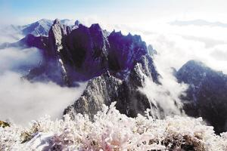

Landscape
Five Famous Mountains
戴沐雨
.

Slide 2
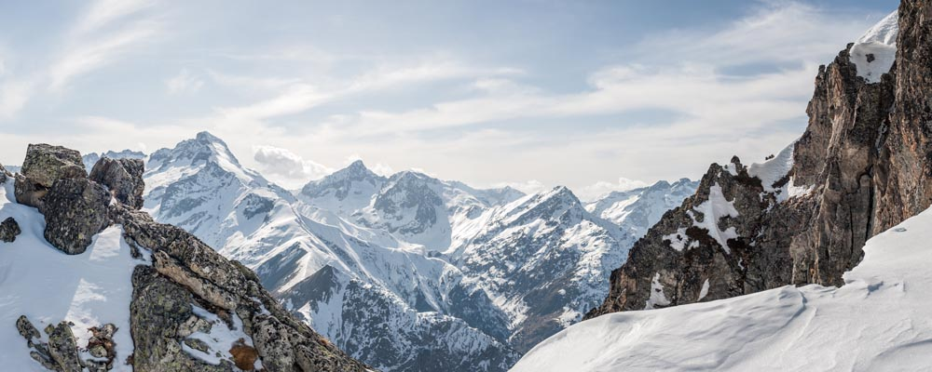
CONTENTS
The Development of Wuyue
The Introduction to Five Famous Mountains
The Translation
.

Slide 3
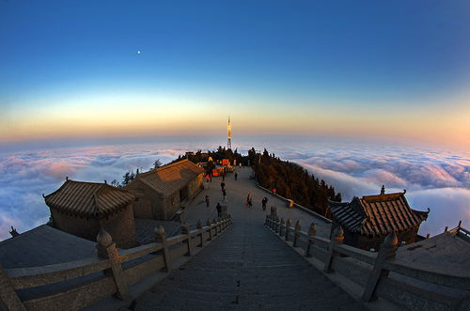
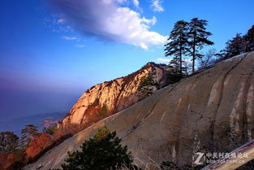
PART 1
The Development of Wuyue
.

Slide 4
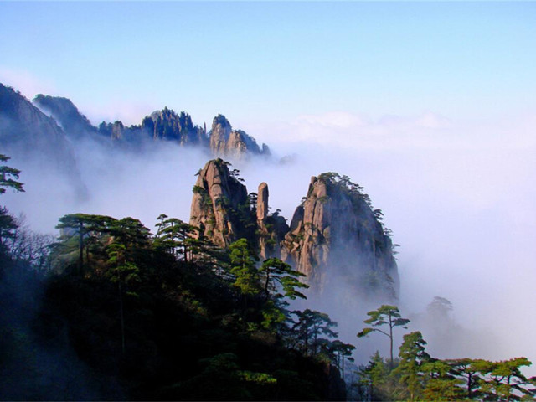
Wuyue is the general name of the five famous mountains in Chinese Han culture and is the product of the combination of ancient folk mountain god reverence, the concept of the Five Elements and imperial excursions and meditation in ancient times. The mountains are popular tourist attractions and are well developed featuring good tourist and transport services and several are national AAAAA rated scenic sites.
.

Slide 5

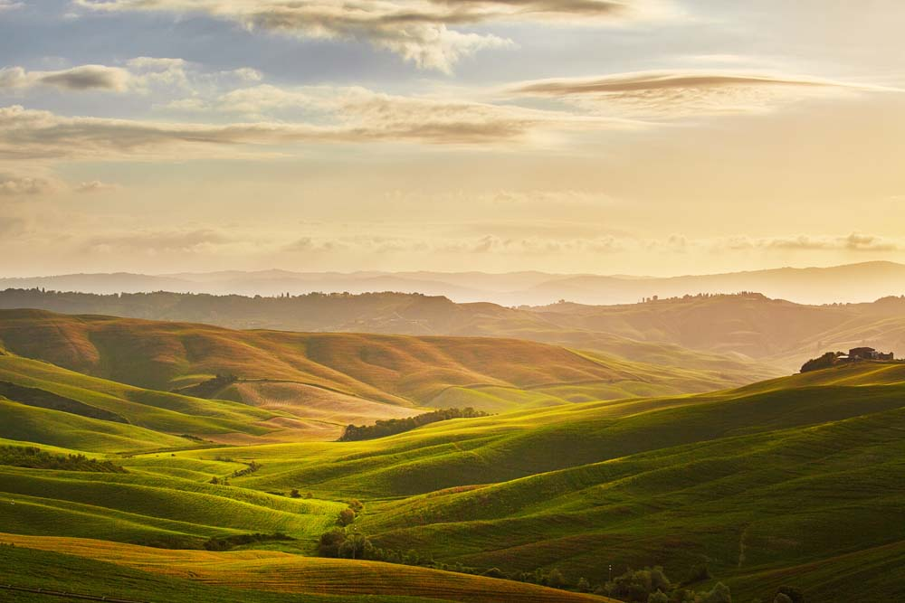



Nowadays
Confucianism
Taoism
Buddhism
The Last Dynasy in 1911
The Wei, Jin and Southern and Northern Dynasties
Han Dynasty

Slide 6
PART II
The Introduction to Five Famous Mountains
.

Slide 7
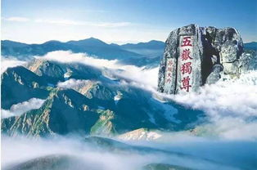
Province:
Wuyue East Great Mountain
Mount TAI
(泰山)
Shandong
Height:
1,533 metres (5,030 ft)
.

Slide 8
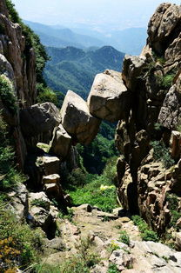
Mount Tai
National AAAAA level tourist attraction
Mount Tai has been worshipped since the Shang culture, roughly 3,000 years ago. Emperors of China would come to this mountain to meditate and offer sacrifices, similar to writers and artists who for centuries have visited Mount Tai for inspiration.
Given its long-running history of worship, the mountain has been preserved with little alteration. It is also considered one of the most climbed mountains in China. The hike is not an easy one and may take most of the day to reach the top.
.

Slide 9
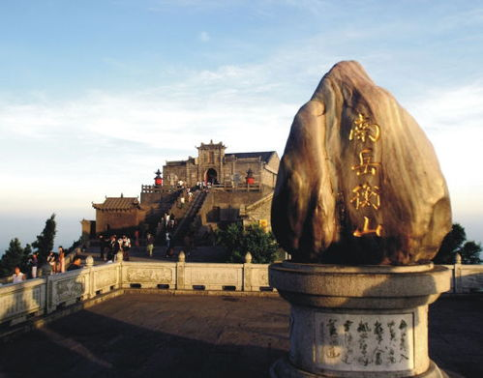
Province:
Mount Heng
(Hunan)
(衡山)
Wuyue South Great Mountain
Hunan
Height:
1,300 metres (4,265 ft)
.

Slide 10
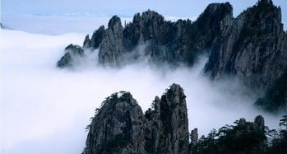
Mount Heng (Hunan)
Mount Heng in the south has a total of 72 peaks. The Huiyan Peak is the south end of the peaks, Yuelu Mountain in Changsha City is the north end, and the Zhurong Peak is the highest at 1,300 metres (4,300ft) above the sea level.
At the foot of the mountain stands the largest temple in southern China, the Grand Temple of Mount Heng (Nanyue Damiao), which is the largest group of ancient buildings in Hunan Province. The temple has survived many dynasties, with the earliest records of its existence dating back to the 8th century AD. Although the temple was severely damaged during the Cultural Revolution, it retains its religious significance to many believers.
.

Slide 11
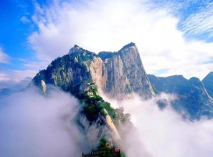
Province:
Wuyue West Great Mountain
Mount Hua
(华山)
Shanxi
Height:
2,160 metres (7,087 ft)
.

Slide 12
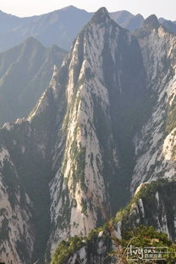
Mount Hua
National AAAAA level tourist attraction
Mount Hua is a popular destination for those staying in the ancient capital of Xi’an, featuring skywalk, temples, stone formations, caves, waterfalls etc.
The mountain complex consists of five major peaks, all of which are accessible for hiking. Nevertheless, a number of narrow paths and rugged steps make it a challenging climb, and at the south peak, the narrow plank walk running along the side of the mountain will challenge anybody’s relationship with heights. While walking along two narrow planks (attached with harness to the edge of the mountain), you can move along the mountain.
.

Slide 13
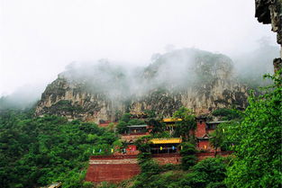
Province:
Mount Heng
(Shanxi)
(恒山)
Wuyue North Great Mountain
Shanxi
Height:
2,017 metres (6,617 ft)
.

Slide 14
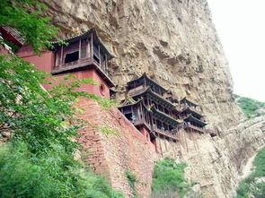
Mount Heng (Shanxi)
Similar to many other revered mountains in China, Mount Heng holds meaning for the followers of the Taoist faith. The mountain may not be as popular as the other four, given its northern location, but that can be seen as advantage for a hiker seeking peace and isolation.
Located at the foot of the mountain is the Hanging Monastery (Xuankong Si) running along the side of the mountain. The wooden structure is supported by dozens of wooden pillars, and despite its feeble appearance welcomes many visitors every year.
.

Slide 15
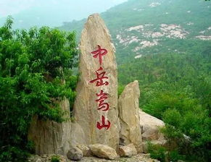
Wuyue Center Great Mountain
Province:
Mount Song
(嵩山)
Henan
Height:
1,500 metres (4,921 ft)
.

Slide 16
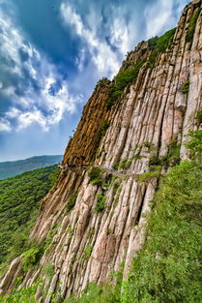
Mount Song
National AAAAA level tourist attraction
Mount Song is located on the bank of the Yellow River, close to the ancient capital of Luoyang. It is noted for its rich cultural heritage as the birthplace of Zen (禅宗), the Taoist holy land, and the origin of kung fu.
Mount Song is best known as the location of the Shaolin Temple, the birthplace of Chan Buddhism, and thus retains religious significance to followers of both Buddhism and Taoism. The Shaolin Temple attracts curious visitors who want to observe the practitioners of martial arts demonstrating superb strength and coordination. The area around the mountain peaks has a number of other Taoist and Buddhist monasteries.
.

Slide 17
PART III
The Translation
.

Slide 18
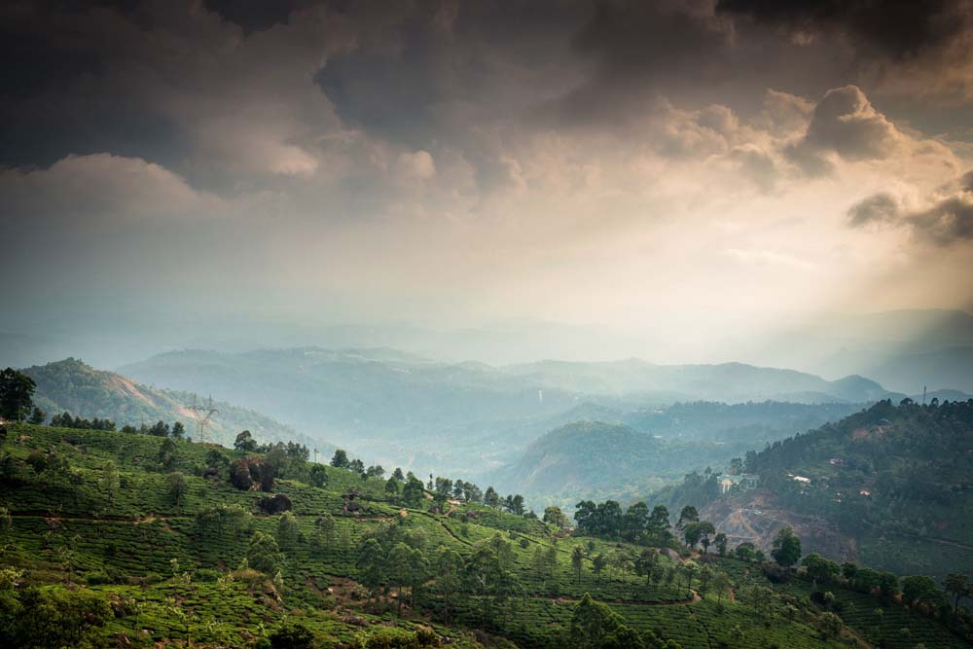
Wuyue
Five Sacred Mountains
Five Great Mountains
五岳
东岳泰山 Mount Tai/Leading Peaceful Mountain
西岳华山 Mount Hua/Splendid Mountain
南岳衡山 Mount Heng/Balancing Mountain
北岳恒山 Mount Heng/Permanent Mountain
中岳嵩山 Mount Song/Lofty Mountain
.

Slide 19

THANKS
戴沐雨
.

