Slide 1

How the Language Shapes the Mind
Partners: 徐舞 颜媛 李欣 黎溢佳 聂薇
汇报人：徐舞 时间：2022年4月

Slide 2

Lera Boroditsky (born c.1976[1]) is a cognitive scientist and professor in the fields of language and cognition. She is one of the main contributors to the theory of linguistic relativity.[2] She is a Searle Scholar, a McDonnell Scholar, recipient of a National Science Foundation Career award, and an American Psychological Association Distinguished Scientist.[3] She is Professor of Cognitive Science at UCSD. She previously served on the faculty at MIT and at Stanford.
(From Wikipedia, the free encyclopedia)

Slide 3
For a long time, the idea that language might shape thought was considered at best untestable and more often simply wrong. However, research by Lera Boroditsky and her peers has helped reopen this question. They have collected data around the world: from China, Greece, Chile, Indonesia, Russia, and Aboriginal Australia. What they have learned is that people who speak different languages do indeed think differently and that even flukes of grammar can profoundly affect how we see the world. But how does this happen?

Slide 4
01
Space
02
Time
Content
03
Color
04
Object

Slide 5
Space

Slide 6

Space
English
"There's an ant on your southeast leg."
Right Left Forward Back
"Move the cup to the northwest a little bit."
"Where are you going?"
Kuuk Thaayorre
North South East West
" Southeast, in the middle distance."

Slide 7
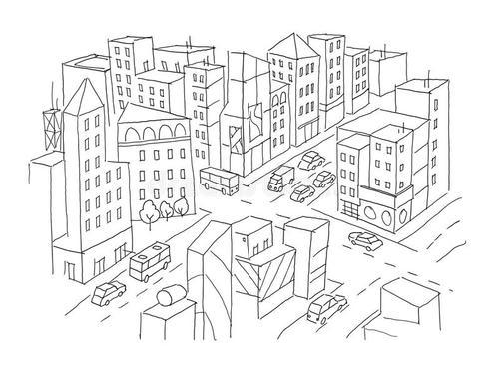


English speaker
Kuuk Thaayorre Speaker

Slide 8
Time

Slide 9



Time

Slide 10
Time
English speaker
Hebrew speaker

Slide 11
Time
The Kuuk Thaayorre: they arranged it from east to west.
Facing South
Facing North

Slide 12
Time
English Speaker
The best is ahead of us.
horizontal spatial metaphor
The worst is behind us.
The next month is the "down month".
Mandarin speaker
vertical metaphor for time
The last month is the "up month".

Slide 13
How do we know that it is language itself that creates these differences in thought and not some other aspect of their respective cultures?

Slide 14
Time
One way to answer this question is to teach people new ways of talking and see if that changes the way they think. In Lera’s lab, they’ve taught English speakers different ways of talking about time. In one such study, English speakers were taught to use size metaphors (as in Greek) to describe duration (e.g., a movie is larger than a sneeze), or vertical metaphors (as in Mandarin) to describe event order. Once the English speakers had learned to talk about time in these new ways, their cognitive performance began to resemble that of Greek or Mandarin speakers. This suggests that patterns in a language can indeed play a causal role in constructing how we think.

Slide 15
Color

Slide 16
Color
Beyond abstract or complex domains of thought like space and time, languages also meddle in basic aspects of visual perception — our ability to distinguish colors, for example. Different languages divide up the color continuum differently: some make many more distinctions between colors than others, and the boundaries often don't line up across languages.

Slide 17
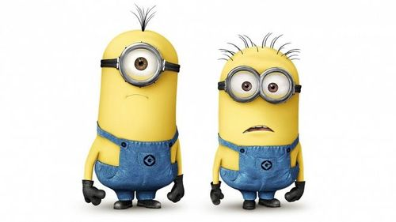



Color
Light blue (goluboy)
Dark blue (siniy)
Russian speaker
Blue
English speaker

Slide 18
Object

Slide 19
Object
Even what might be deemed frivolous aspects of language can have far-reaching subconscious effects on how we see the world. Take grammatical gender. In Spanish and other Romance languages, nouns are either masculine or feminine. In many other languages, nouns are divided into many more genders ("gender" in this context meaning class or kind). What it means for a language to have grammatical gender is that words belonging to different genders get treated differently grammatically and words belonging to the same grammatical gender get treated the same grammatically. Languages can require speakers to change pronouns, adjective and verb endings, possessives, numerals, and so on, depending on the noun's gender.

Slide 20

Object
hard heavy jagged metal serrated useful
German
Spanish
golden intricate little lovely shiny tiny

Slide 21
Object
They also show that it is aspects of language per se that shape how people think: teaching English speakers new grammatical gender systems influences mental representations of objects in the same way it does with German and Spanish speakers. Apparently even small flukes of grammar, like the seemingly arbitrary assignment of gender to a noun, can have an effect on people's ideas of concrete objects in the world.

Slide 22
Conclusion

Slide 23
Conclusion
These results show that linguistic processes are pervasive in most fundamental domains of thought, unconsciously shaping us from the nuts and bolts of cognition and perception to our loftiest abstract notions and major life decisions. Language is central to our experience of being human, and the languages we speak profoundly shape the way we think, the way we see the world, the way we live our lives.

Slide 24
Thank you!

Slide 25

The Relationship between Language and Sexism
Speaker：Li Yijia
Group member: 李欣、徐舞、聂薇、颜媛

Slide 26
Lead in
There are many research indicating that languages can shape the way we think. Then here’s a question for you.
Is there gender discrimination in languages?

Slide 27
Feminist linguistics
Feminist linguistics originated from the western women's liberation movement in the 1960s. The linguistic study from a female perspective forms feminist linguistics. "Women's liberation through language" is one of the slogans of feminism, and revealing the existence of sexism in English is the focus of feminist linguistics research.

Slide 28
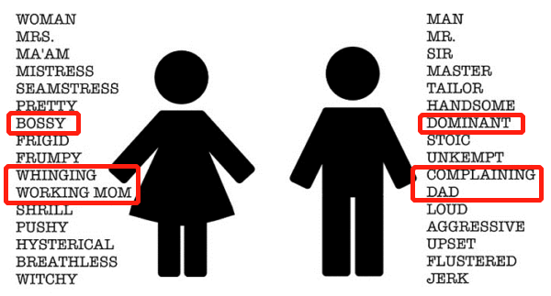
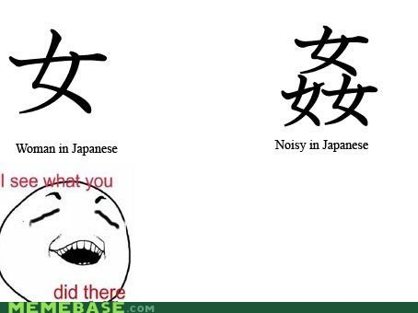
Discrimination against Women
Female linguists believe that the cultural environment restricted by religion and hierarchies makes language essentially reflect the contents of the male world picture, which is Asymmetry. Their criticism is mainly about the language of discrimination against women.

Slide 29
4 parts
Word Formation
1
2
Proverbs
4
3
Word Arrangement
Connotative meaning

Slide 30

The five suffixes used to form "female" in English
feminine personal noun ending in -ess/ress,
1
actor-actress（女演员） host-hostess（女主人） manager -manageress （女经理 ） prince -princess（公主）
2
feminine personal noun ending in-enne
comedienne （女喜剧演员） tragedienne（女悲剧演员）
3
feminine personal noun formed with -ina
ballerina（女芭蕾舞演员） Czarina（女沙皇，沙皇皇后）。
4
feminine noun ending in-ine, meaning "of”
hero-heroine （女英雄） landgrave-landgravine（女伯爵)
feminine noun ending in-trix/-rix, meaning "with."
5
executrix（女遗嘱执行人） inheritrix（女继承人）

Slide 31
Five Typesof Chinese Characters mean "female"
Viewing women as tools for procreation or playthings for men
Reflecting the status of women being occupied and enslaved in marriage
Indicating female sexuality as evil, greedy and immoral.
meaning obedience, ignorance and lowliness
The value of women in a male-centered society seems to be judged only by their looks
“娶”“嫁” “婚”
“妒”“妖” “妨”
“奸” “婊”
“妇” “奴” “如”
“安”“娓” “姻”
“好””姝””妙” “妍”“娟
“姓” “妊” “娠” “妃”
“嫖” “妾”
Chinese characters with a “女”

Slide 32

Proverbs
Proverbs, as a special form of language expression, vividly reflect the social culture and people's thoughts in different periods of different countries. Some linguists compare it to the mirror of a nation with a living fossil of language.

Slide 33

Proverbs in English VS Chinese
reflects the defects of the female sex
reflects that women are the curse
A woman is the weaker vessel.
三个女人一台戏。 红颜女子多是非。
Bad women can do more than the devil.
女人上屋屋要塌，女人上船船要翻。
reflects the ignorance of women
reflect the existence of sexism in marriage
Every woman would rather be beautiful
than good.
女子无才便是德。
Daughters and dead fish are not keeping wares.
嫁出去的女儿，泼出去的水。

Slide 34


Other semantic sexism
Word arrangement
husband and wife, son and daughter, host and hostress
夫妻、儿女、男女、父母
Although there may be occasions when women are put ahead of men like “ladies and gentlemen”, the perception is that women are more vulnerable and in need of more attention from men.
This also embodies the male-centered idea of the main creator and user of language.
Connotative meanings of words
“小姐”has a variety of meanings and can refer to a female sexual worker in China.
“King” and “queen”
“queen” can mean a male homosexual who dresses like a woman or a mistress.

Slide 35
Reasons for gender discrimination in English and Chinese

Slide 36
Reasons
01
02
03
Historical
Cultural
social
The transition from matriarchal society to patriarchal society.
In the history of the East and the West, great achievements have been attributed to men, and the destruction of a country and a family is caused by women, which shows the concept of male superiority over female inferiority.
In western countries, people's thoughts are deeply influenced by the Bible, in which Eve was derived from a rib of Adam.
Chinese culture is mainly influenced by Confucianism, which advocates that women should observe the three obediences and four virtues.
Once get married, women’s choice is to take care of their husband and raise their children. Therefore, women only have two identities : wife and mother.
However, women are not paid the same as men for equal work. This is employment discrimination on the basis of sexual orientation.

Slide 37
Thanks for listening!

