Slide 1


Mogao Grottoes
speaker：Pan Tong

Slide 2


Contens
Histry
01
Protection
02
My Feelings
03

Slide 3

01
History
the Northern Dynasties
Five dynasties to the Song Dynasty
Sui and Tang dynasties
Western Xia to Yuan Dynasty

Slide 4
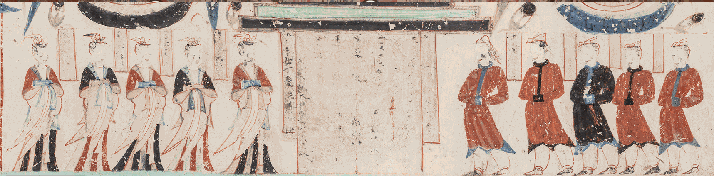
the Northern Dynasties
供养人像及题榜 Cave285
https://www.e-dunhuang.com/cave/10.0001/0001.0001.0285
In 366 AD, the monk Yuezun built the cave on the cliff, and monk Faliang joined him.
After that, Influenced by the custom of worshipping Buddha statues, the Mogao Grottoes began to develop.

Slide 5
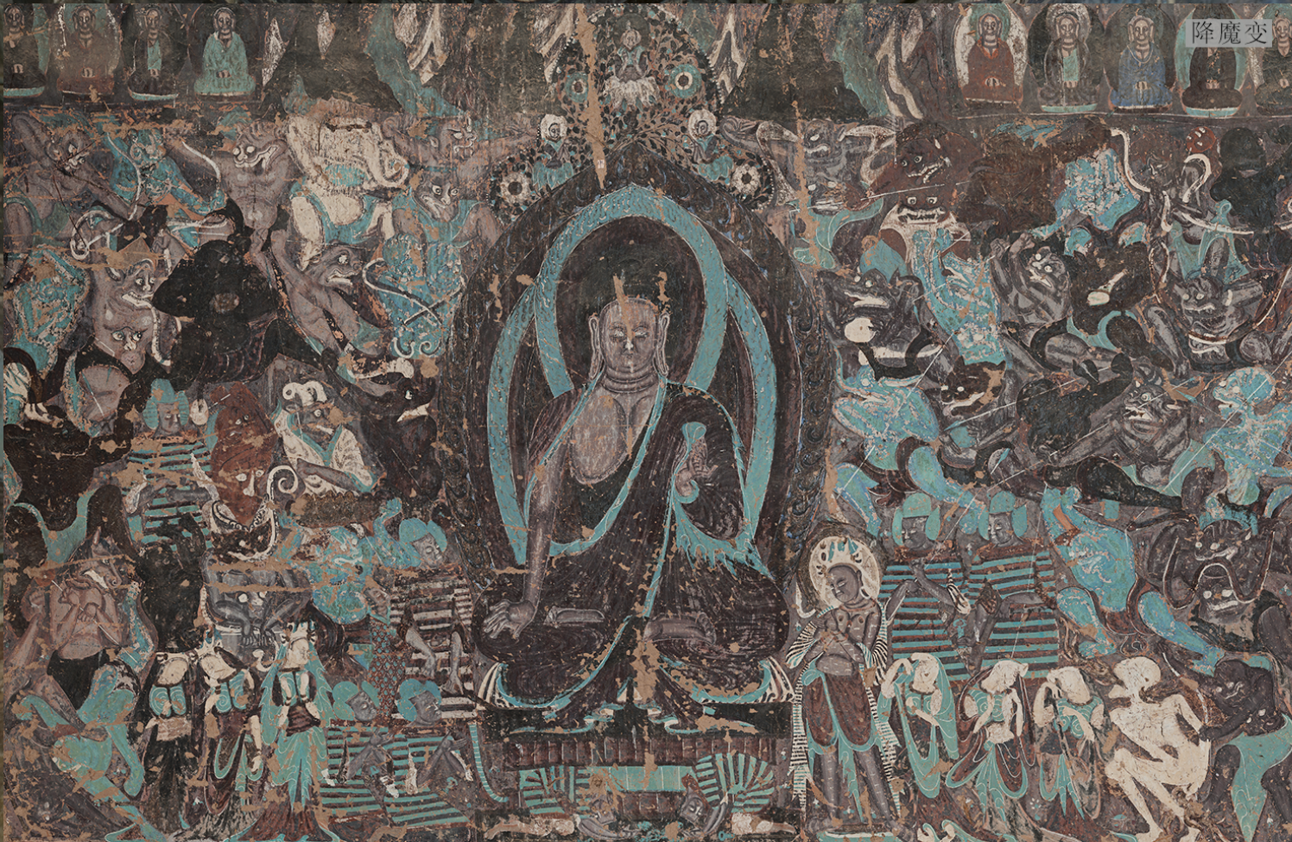
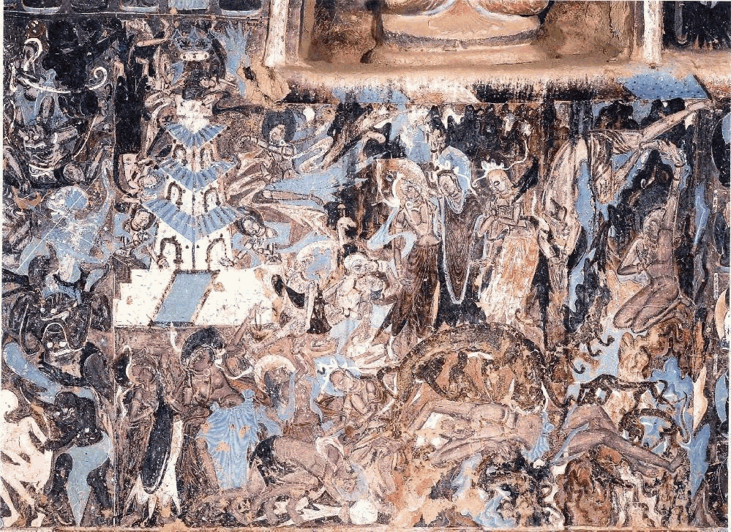
the Northern Dynasties
Cave254
https://www.e-dunhuang.com/cave/10.0001/0001.0001.0254
This picture adopts the form of "different times in the same picture", telling multiple storylines in one picture, using mountain and forest patterns as the separation, showing ingenious composition, clear layers, prominent themes, and tragic atmosphere.
舍身饲虎

Slide 6
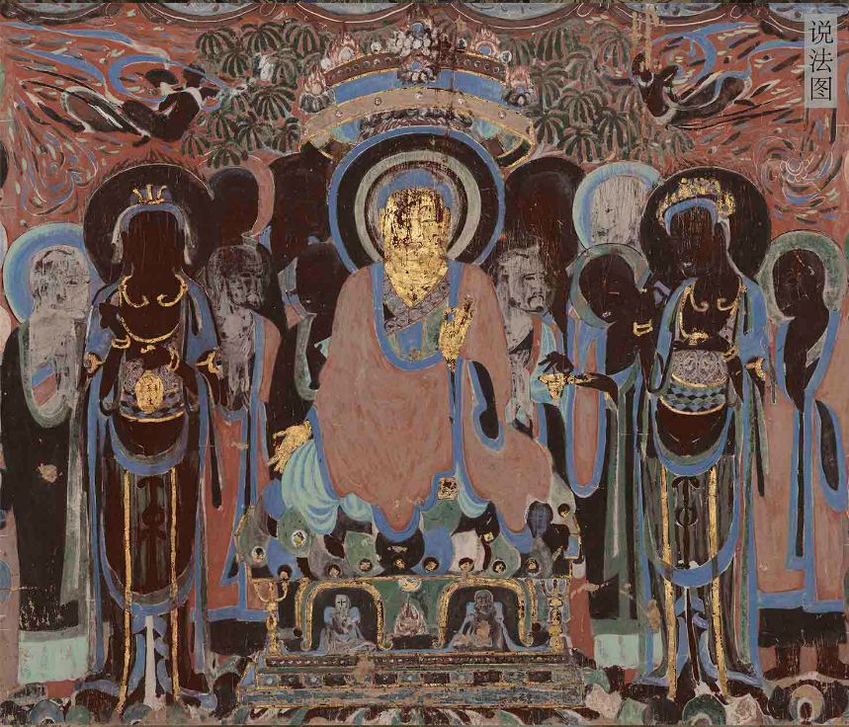
Sui and Tang dynasties
During this period, Dunhuang became the main commercial hub and important religious center of the Silk Road. So the Mogao Grottoes entered its heyday, becaming a place of pilgrimage for all parties.
420窟说法图
In this time, large numbers of caves were built, accounting for more than 60% of the total. The murals are rich in themes, magnificent scenes, and beautiful colors. The art of figure modeling, color blending and line drawing has reached an unprecedented level.

Slide 7
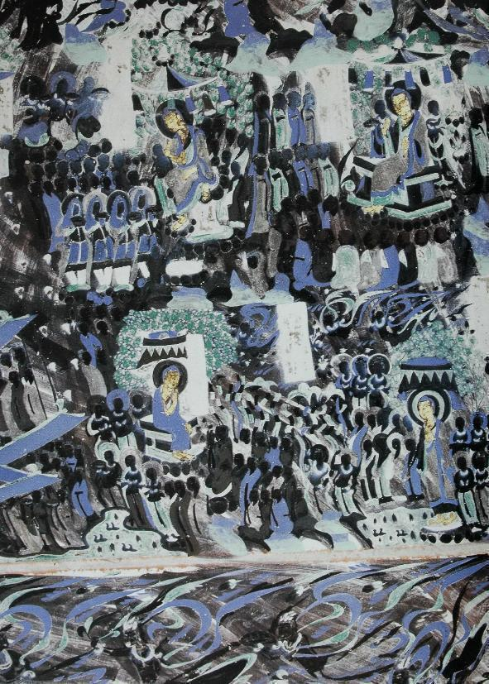
Sui dynasties
Sui d
The murals of this time were a transition. A new Sutra Paintings appeared. The screen is generally smaller and the content is simpler.
Cave420
https://www.e-dunhuang.com/cave/10.0001/0001.0001.0254
Sutra Paintings use paintings to explain the ideological content of a particular sutra.
Cave 420 inherits the artistic style of the Northern Dynasties and reflects the development of Buddhism in the Central Plains. The whole cave roof is painted by Sutra Paintings, using trees, temples, flying flowers, clouds and other scenes as the boundary. Such a grand picture set a precedent for the development of large-scale Sutra Paintings in the Tang Dynasty

Slide 8
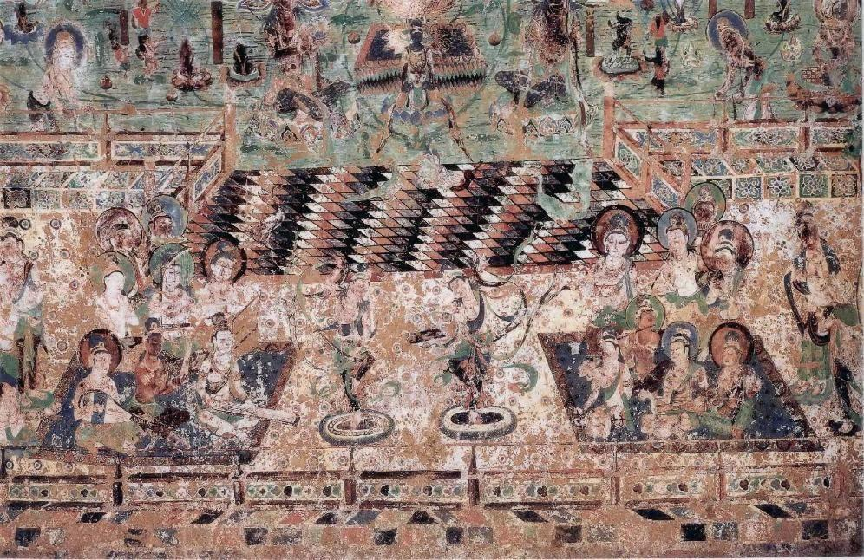
Tang dynasties
The main subject matter of the murals in this time is all kinks of Sutra Paintings, and types appeared in later stages.
Cave220
https://www.e-dunhuang.com/cave/10.0001/0001.0001.0220
The north wall is painted with the "Medicine Buddhas"(《药师经变》). Its band part is composed of more than 10 people. They hold various musical instruments, blowing, plucking, playing, and playing. It is a true portrayal of the prosperity of music and dance in this time.

Slide 9
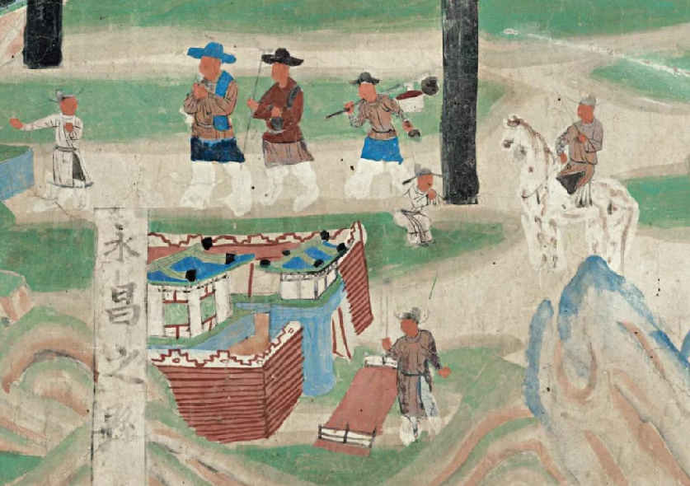
Five dynasties to the Song Dynasty
Cave61
五台山图
https://www.e-dunhuang.com/cave/10.0001/0001.0001.0061
永昌之县
In 914 AD, Cao Yijin(曹议金) began to rule Dunhuang. In the following 120 years, the Cao family built a new cave, completely rebuilt the caves, and painted a large area of open-air murals on the cliff.
In 1036 and 1227 A.D., this place was ruled by the Western Xia, Mongol regimes. Although there are still constructions and repairs, but with the importance of the Silk Road less and Dunhuang economic depression, Mogao Grottoes has been declining.

Slide 10
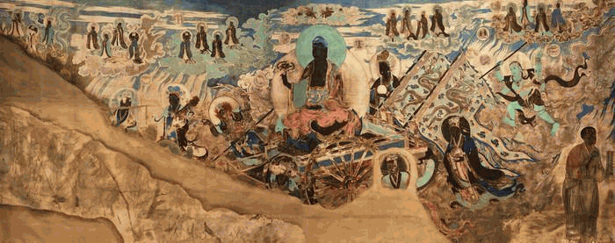
Five dynasties to the Song Dynasty
Cave61
https://www.e-dunhuang.com/cave/10.0001/0001.0001.0061
The Dunhuang murals of the five dynasties inherited the afterglow of the late Tang Dynasty. There are still large-scale monuments in the caves.
On the two walls of Cave 61, there are the "Blazing Light Buddha Map"(《炽盛光佛图》) and the "Zodiac Zodiac Star Chart"(《黄道十二宫星象图》) repainted in the late Western Xia and early Yuan Dynasty. The subject matter is unique among the murals of the Mogao Grottoes.

Slide 11
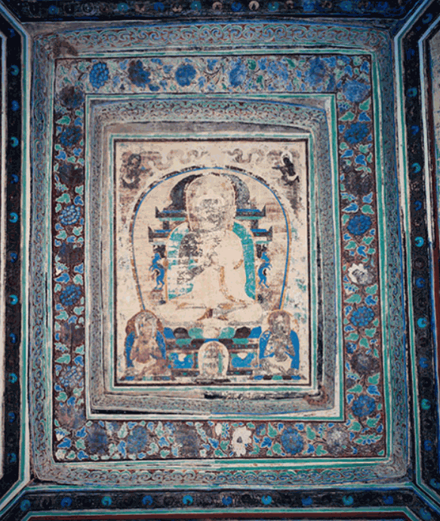
Western Xia to Yuan Dynasty
Cave465
Western Xia is mostly restored old cave, repainted murals. Murals, although many, few new themes, and the composition of the Sutra Paintings is simplified. The character images are too programmed and lifeless.
The number of caves in the Yuan Dynasty is very small. The murals in Caves 465 and 3 represent two different styles of painting at the time. After the Yuan, the cave was stopped.
窟顶藻井-大日如来井心

Slide 12
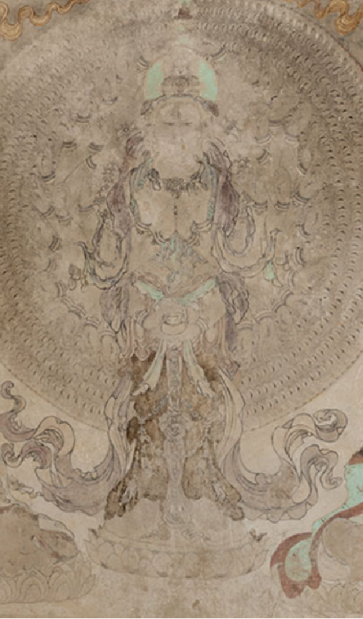
Western Xia to Yuan Dynasty
Western Xia to Yuan Dynasty
Cave3
https://www.dha.ac.cn/info/1425/3628.htm
Cave 3 of Yulin Caves has both Chinese Buddhism and Tibetan Buddhism. It reflects the inclusiveness of Buddhism in the Western Xia.
南壁-十一面千手千眼观音菩萨及其眷属

Slide 13
02
Protection

Slide 14
The Artistic Value
mural
colored sculpture
building
第329窟藻井
九层楼
205窟中心佛坛南侧-彩塑右胁侍菩萨

Slide 15
演示文稿是实用的工具，可以是演示，演讲，报告等。大部分时间，它们都是在为观众服务。
historic value
technological value
The Library Cave provides a large amount of valuable materials for the study of ancient history, geography, religion, economy, politics, ethnicity, language, literature, art, science and technology of China and Central Asia. It is known as "the encyclopedia of the Middle Ages"(中古时代的百科全书) and "the ocean of ancient scholarship"(古代学术的海洋).
The murals also show many scenes of people farming, traveling and marching, and feasting, which provides valuable information to study the agricultural system, tools, crops, vehicles, combat equipment, glassware, and so on at that time
青绿山水图

Slide 16

Wang Yuanlu
Stein
Pelliot
Warner
In 1900, Wang Yuanlu stumbled upon the Library Cave. He tried several times to protect it, but failed.
In 1907, the British Stein came to Dunhuang, and swindled away nearly 10,000 volumes of documents and 500 silk paintings of Buddha statues.
In 1908, The Frenchman Pelliot snatched all the best of the Scrolls, robbed more than 10,000 cultural relics.
In 1924, Warner used glue to steal the twelve-sided murals after shoveling countless murals.

Slide 17
演示文稿是实用的工具，可以是演示，演讲，报告等。大部分时间，它们都是在为观众服务。
演示文稿是实用的工具，可以是演示，演讲，报告等。大部分时间，它们都是在为观众服务。
Protection
In 1944, the National Dunhuang Art Research Institute was established. Lots of copying, exhibition, cleaning, surveying, and mapping work was done.
There have been comprehensive developments after the reform and opening up, including the publication of the contents of the caves, the compilation of archaeological reports.
In 1961, the Mogao Grottoes were listed as a national cultural relics protection unit. The Dunhuang Institute of Cultural Relics began the textual recording and photographic work.
The conservation became internationalized and institutionalized, with the Dunhuang Institute of Cultural Heritage renamed the Dunhuang Research Institute in 1984, and the Dunhuang Mogao Grottoes inscribed on UNESCO's World Heritage List in 1987.

Slide 18
Protection
Cultural and creative products
Digital Creative Communication Project
postcards, blind box, refrigerator sticker
“云游敦煌”小程序、点亮莫高窟等
tourism industry
"Digital Dunhuang" website
https://www.e-dunhuang.com/
Programs, Documentaries, Dunhuang Animated Drama
International cooperation
https://dunhuang.ds.lib.uw.edu/Dunhuang-Exhibitions/
《丝路花雨》《敦煌盛典》《又见敦煌》

Slide 19
03
My Feelings

Slide 20
The understanding of Mogao Grottoes has gradually deepened.
The stability of a society greatly affects the development of culture.
Inherit and develop the culture of Mogao Grottoes, so that more people in the world will know about this treasure of human civilization.

Slide 21
Related links
百度百科：https://baike.baidu.com/item/%E8%8E%AB%E9%AB%98%E7%AA%9F/303038#2-1
知乎：
https://zhuanlan.zhihu.com/p/74532799
数字敦煌：
https://www.e-dunhuang.com/
威斯康星大学敦煌项目：https://dunhuang.ds.lib.uw.edu/Dunhuang-Exhibitions/

Slide 22
Thank you!

