Slide 1
The Name and Nature of Translation Studies
Speaker: Liu Shengnan

Slide 2
Con
1
The development of translation studies
Contents
2
The Holmes/Toury “map”
3
The explanations of the Holmes/Toury “map”

Slide 3
01
Chapter
The development of translation studies

Slide 4


The study of translation as an academic subject began in the second half of the twentieth century. In the development of translation studies into an independent discipline, James S. Holmes’s seminal paper published in 1972, “the Name and Nature of Translation Studies”, has a far-reaching impact.

Slide 5
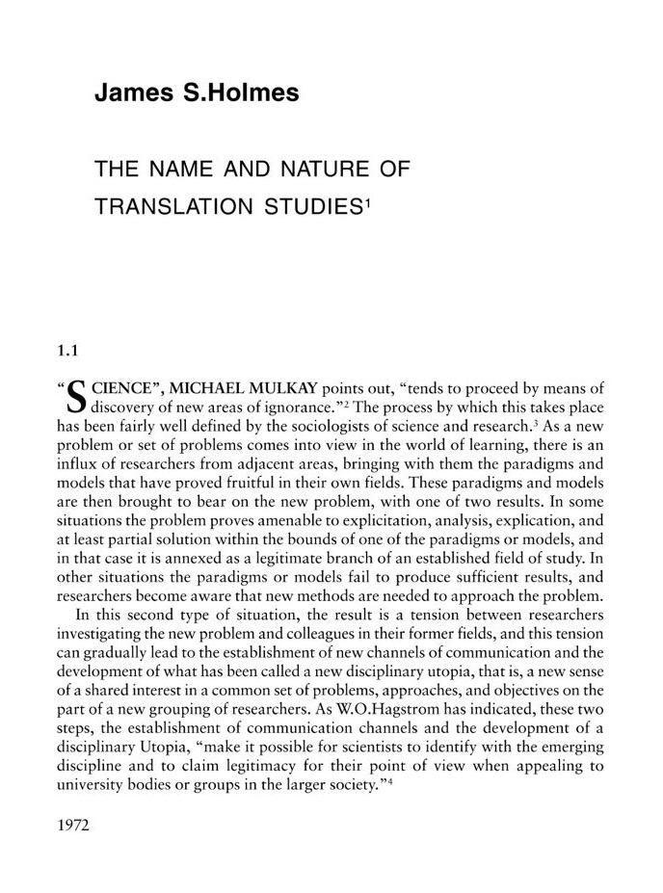
“Nevertheless, the designation ‘translation studies’ would seem to be the most appropriate of all those available in English, and its adoption as the standard term for the discipline as a whole would remove a fair amount of confusion and misunderstanding.” (Holmes, 1988b/2004:181)

Slide 6
“A greater impediment than the lack of a generally accepted name in the way of the development of translation studies is the lack of any general consensus as to the scope and structure of the discipline.” (Holmes, 1988b/2004:181)

Slide 7
02
Chapter
The Holmes/Toury “map”

Slide 8
Holmes put forward an overall framework, describing what translation studies covers. And this framework was subsequently presented by the leading Israeli translation scholar Gideon Toury. (Munday 2014:10)

Slide 9
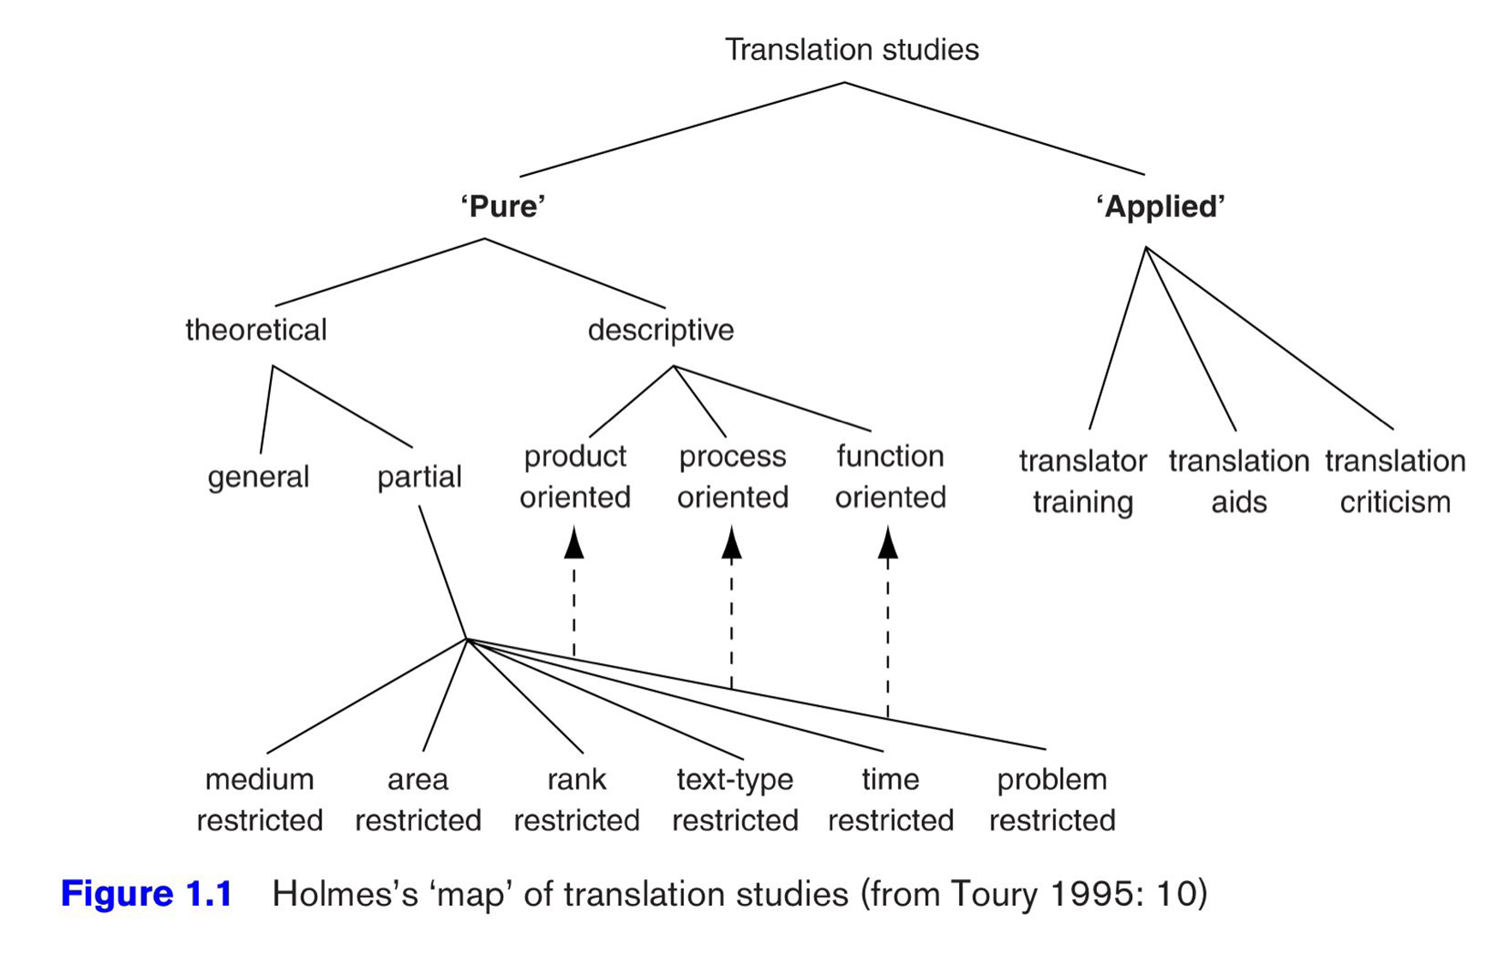

Slide 10
03
Chapter
The explanations of the Holmes/Toury “map”

Slide 12
Translation studies
“Pure”
theoretical
Descriptive
“Applied”
general
partial
Product-oriented
Process-oriented
Function-oriented
Medium restricted
Area restricted
Rank restricted
Text-type restricted
Time restricted
Problem restricted

Slide 13
Translation studies
“Pure”
“Applied”
Translator training
Translation aids
Translation criticism

Slide 14
References
[1]Munday, Jeremy. Introducing Translation Studies: Theories and Applications, 2014.
[2]Holmes, J. S. (1988b/2004) “The Name and Nature of Translation Studies”, in L. Venuti(ed) (2004),pp.180-92.
[3]Toury, G. Descriptive Translation Studies-And Beyond, Amsterdam and Philadelphia, PA: John Benjamins.
[4]张冬梅.翻译学的实证性学科定位再思——霍姆斯、图里翻译学架构图问题思考之一[J].北京第二外国语学院学报,2015,37(06):23-29.
[5]董广才,马亚莉. 霍姆斯的描写翻译浅谈——《翻译学的名与实》评介[J]. 辽宁师范大学学报,2005,(04):112-113.

Slide 15
Thanks
Thanks for your listening!

