Slide 1
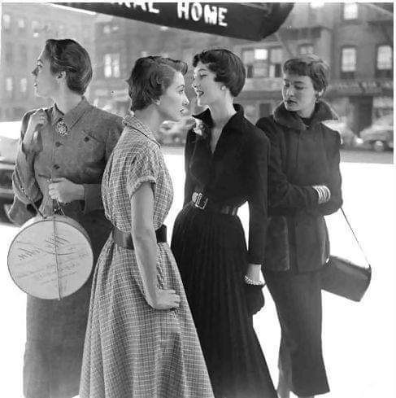
Vintage Clothing: A Timeless Fashion Journey
Exploring the History, Styles, and Trends

Slide 2
The importance of vintage fashion is reflected in several aspects:
Cultural Heritage: Vintage fashion is a tribute to history, allowing us to glimpse the fashion styles of the past and understand the cultural and social contexts of different eras. By wearing vintage-style clothing, we can experience the charm of history and feel the passage of time.

Slide 3
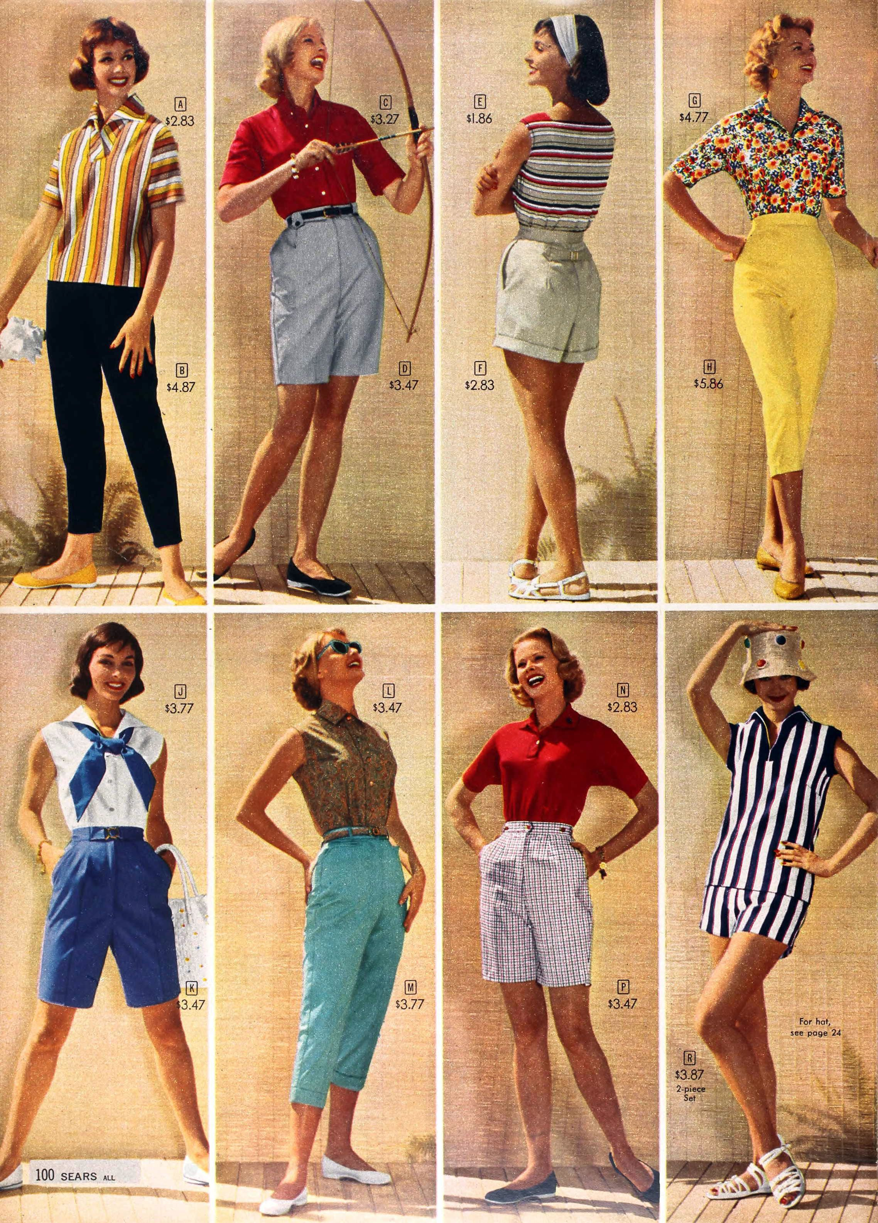
personal expression:
In today's pursuit of individuality, vintage fashion provides a unique way of self-expression. It allows people to choose different era styles based on their preferences, thereby showcasing distinctive personalities and tastes.

Slide 4
Sustainability: With the rise of environmental awareness, vintage fashion serves as a sustainable fashion choice, encouraging people to wear second-hand or vintage clothing, reducing reliance on fast fashion, and thus minimizing the environmental impact of clothing production and consumption.
Fashion Cycle: Vintage fashion proves that fashion is cyclical. Popular elements from decades ago may come back into vogue today. This cycle not only reduces waste but also provides designers and consumers with endless sources of inspiration.
Art and Creativity: Vintage fashion stimulates the creativity of designers, who draw inspiration from the past to create new fashion pieces. This reinterpretation and innovation of the past is an indispensable part of the fields of art and design.
Social Impact: Vintage fashion also reflects societal changes and trends. It is not just clothing but a social phenomenon that reflects people's different views on the past and present, as well as their expectations for the future.

Slide 5
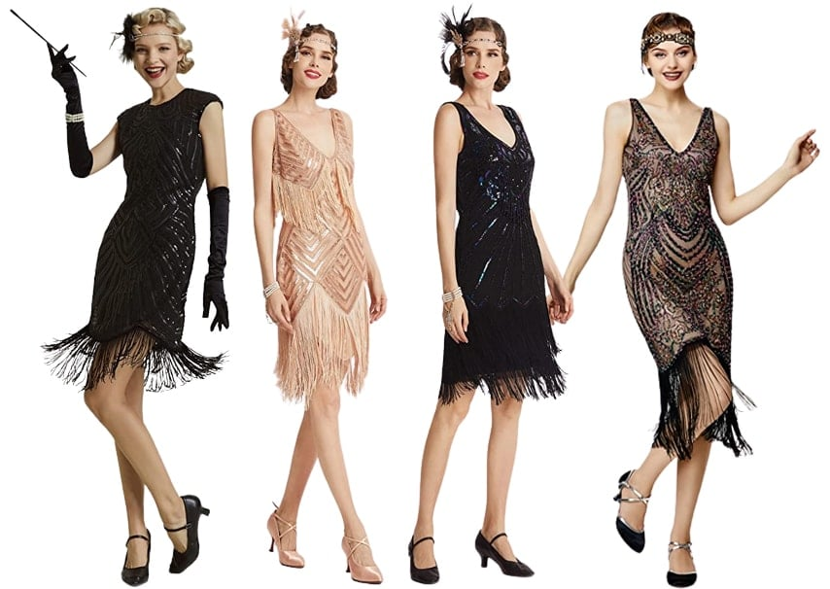
Vintage clothing has a history of hundreds of years, becoming popular in the 1960s.
1920s: Flapper dresses and T-strap shoes
The Flapper style of the 1920s originated in the U.S .after World War I, as women began to pursue freedom and equality. They discarded corsets in favor of more comfortable undergarments. With makeup, bobbed hair, and high heels, they attended fashionable parties. The Flapper dress became their "battle dress," characterized by a loose, straight silhouette, low neckline, shorter length to reveal the calves, and a dropped waistline, presenting a free-spirited fashion party girl image. The fabric was mainly luxurious silk velvet, with exquisite beaded details.

Slide 6
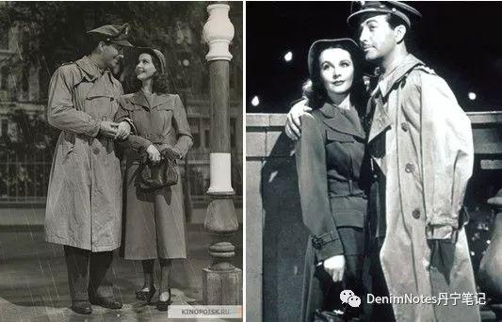
1940s: Wartime fashion, military styles
In the 1940s, due to the influence of World War II, military styles were particularly popular. Women's clothing began to incorporate some characteristics of military uniforms, with a more rigid cut, shorter skirts, and more suitable for everyday wear. Clothing was made from various low-cost synthetic fabrics, and colors preferred low-key solids, such as gray-blue and brown. The suit jackets featured single-breasted buttons without any decoration, sometimes even shortening the sleeves or eliminating chest pockets to save fabric. The sharp shoulder pads on the suits added a touch of strength to women, bringing endless courage.

Slide 7
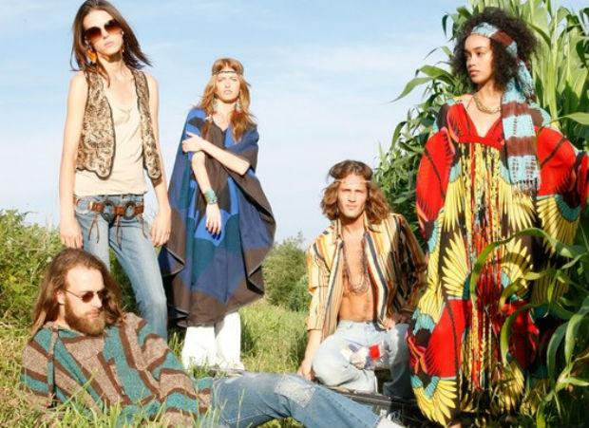
1960s: Hippie style and the influence of Woodstock
The 1960s saw the Hippie style and the Woodstock music festival have a profound impact on fashion. Young people of this era were strongly rebellious, pursuing peace, love, and challenging authority. The Hippie style, with its loose clothing, bright colors, and Bohemian elements, became a symbol of the 1960s culture. The Woodstock music festival was a concentrated display of this spirit of the times. It was not only a music event but also a fashion feast, influencing the way a generation dressed.

Slide 8
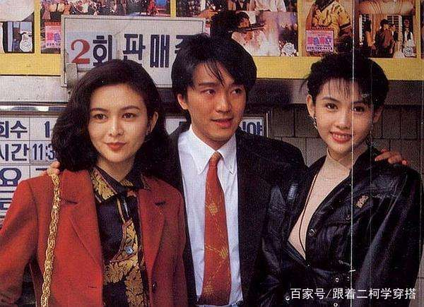
1980s: Bold colors and shoulder pads
The fashion of the 1980s was marked by bold colors and shoulder pads. Women's roles were redefined during this period, with the inverted triangle silhouette of wide shoulder pads and narrow waists becoming the typical image of professional women. This design was not only a fashion trend but also a symbol of women's power and identity. Professional women in the 1980s were in a similar situation to those in the 1940s, with thick shoulder pads appearing on suits, as it was believed that extended shoulder lines and rigid shoulder angles could elevate women to the same level as men in the workplace.

Slide 9
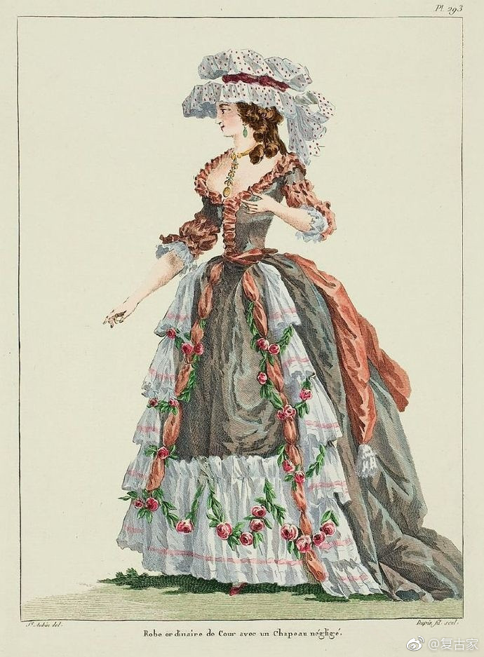
Vintage fashion refers to modern clothing inspired by the styles of the past. This style is not merely a replication of old-fashioned attire but rather a reinterpretation and innovation of classic design elements. The popularity of vintage fashion trends plays a crucial role in contemporary fashion

Slide 10
Thanks for listening!

