Slide 1
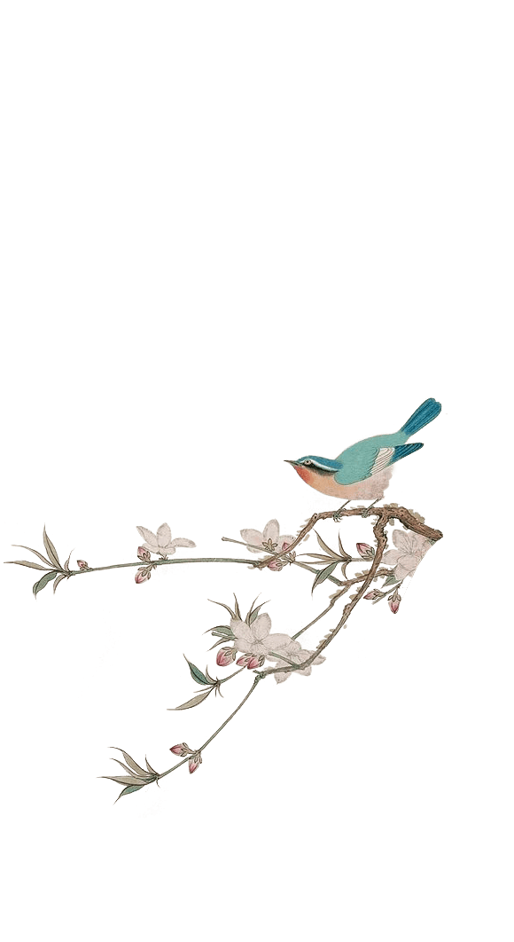


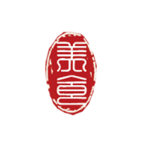
The Four Famous Styles
of Embroidery in China
presented by Qu Miao瞿淼

Slide 2
Contents
壹
A brief introduction of the four famous styles of embroidery in China
贰
Translation difficulties and skills

Slide 3
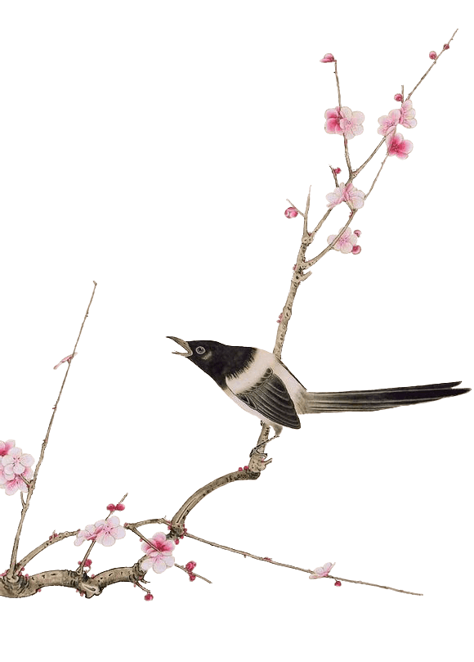
1
Part
A brief introduction of the four famous styles of embroidery in China:
Xiang Embroidery
Su Embroidery
Shu Embroidery
Yue Embroidery

Slide 4
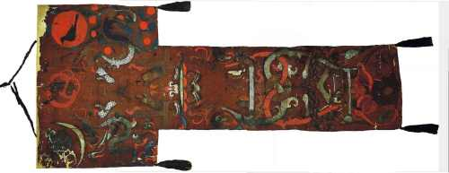
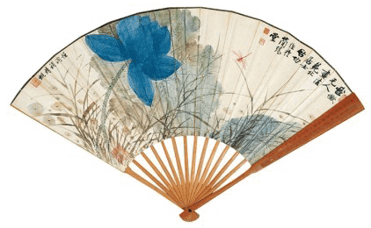
1. Xiang Embroidery
Xiang embroidery is well known for its time-honored history, excellent craftsmanship and unique style.
The earliest piece of Xiang embroidery was unearthed at the No. 1 Tomb of Mawangdui, Changsha City of the Han Dynasty (206 BC-220 AD).
西汉·马王堆一号墓T型帛画

Slide 5
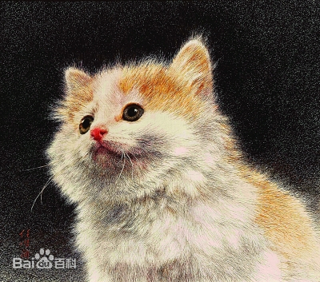
2. Su Embroidery
Su embroidery features a strong, folk flavor and its weaving techniques are characterized by the following: the product surface must be flat, the rim must be neat, the needle must be thin, the lines must be dense, the color must be harmonious and bright and the picture must be even.
With a history of more than 3,000 years, Su embroidery is the general name for embroidery products in areas around Suzhou, Jiangsu Province.
Stare(凝视）
A represemtative Su Embroidery work by Lin Huixian

Slide 6
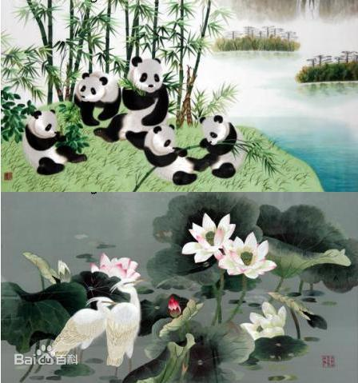
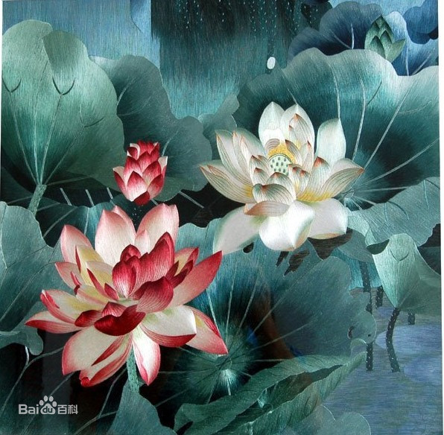
3. Shu Embroidery
Shu embroidery is also called Chuan embroidery. It is the general name for embroidery products in areas around Chengdu, Sichuan Province. Shu embroidery enjoys a long history. As early as the Han Dynasty, Shu embroidery was already famous.
Chracteristics: smooth, bright, neat and influenced by the geographical environment, customs and cultures.

Slide 7
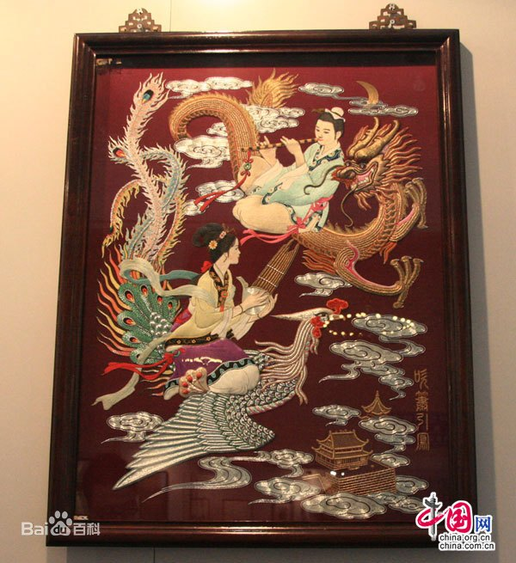
4. Yue Embroidery
Yue embroidery, also called Guang embroidery, is a general name for embroidery products of the regions of Guangzhou, Shantou, Zhongshan,Fanyu and Shunde in Guangdong Province.
The embroidered pictures are mainly of dragons and phoenixes, and flowers and birds, with neat designs and strong, contrasting colors.
Yue Embroidery work: Playing Flute to Fancinate Phonix (by Qiu Size)

Slide 8
2
Part
Translation difficulties and skills

Slide 9
oringinal text：
古币瓦当纹钱褡
translation 1:
Pouch with patterns of ancient coins and wadang
translation 2:
Pouch with patterns of ancient coins and wadang (a kind of traditional Chinese construction accessory）for exorcism, both of which are ancient scholars' collections.
Contents of patterns+Chinese phonetic alphabet+explanation

Slide 10
Thanks for your attention!

