Slide 1
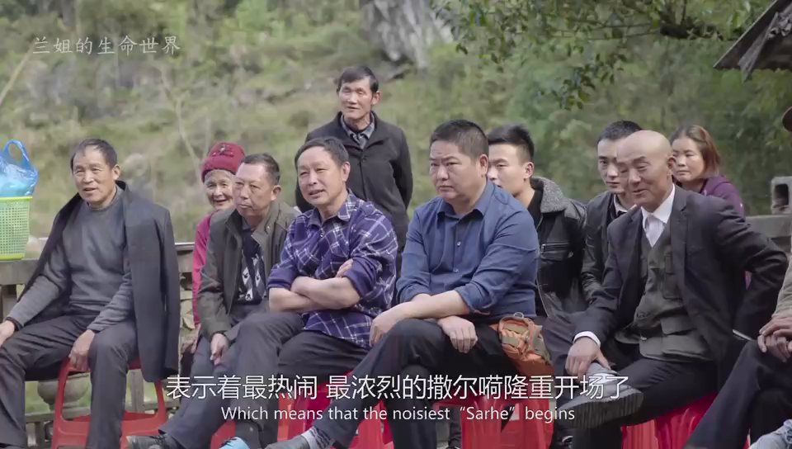
The Crying Marriage Custom

