Slide 1

T
C
M
Traditional Chinese Medicine
reporter: 姜睿

Slide 2

Contents
01
Introduction of TCM
Introduction of minority medicine (Tibetan, Dai, Miao, Tujia)
02
03
Conclusion
04
Discussion

Slide 3
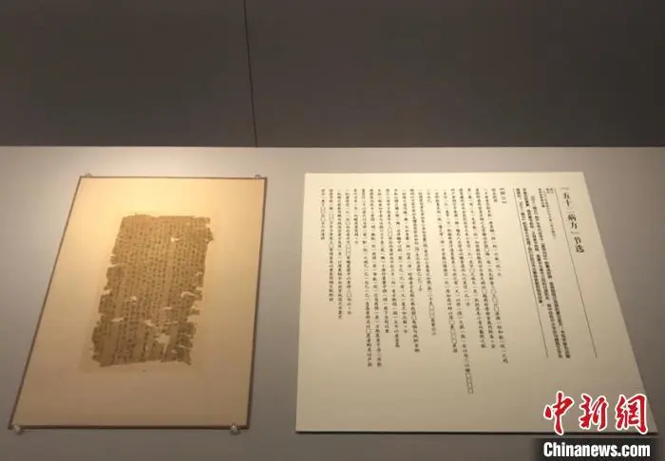
The earliest existing medical book in China
In 1973, a medical book of the Western Han Dynasty was unearthed in Mawangdui（马王堆）, Changsha, Hunan, which is considered to be the earliest existing medical book in China.
The book has no title. According to the information in the catalogue, the staff named it "Fifty-two Sickness Sides"（《五十二病方》）.
It was once exhibited in the Hunan Museum.

Slide 4
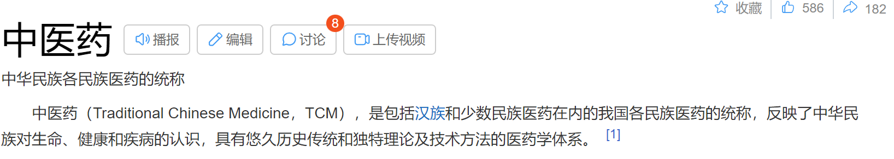
Traditional Chinese Medicine (TCM) is a general term for the medicines of various nationalities in our country, including the medicines of the Han and the minority. TCM reflects the understanding of life, health and disease of the Chinese people. It is a medical system with a long historical tradition and unique theoretical and technical methods.
In a broad sense, TCM refers to the medicine of all ethnic groups in China.
In the narrow sense, TCM refers to the medicine of the Han nationality.

Slide 5
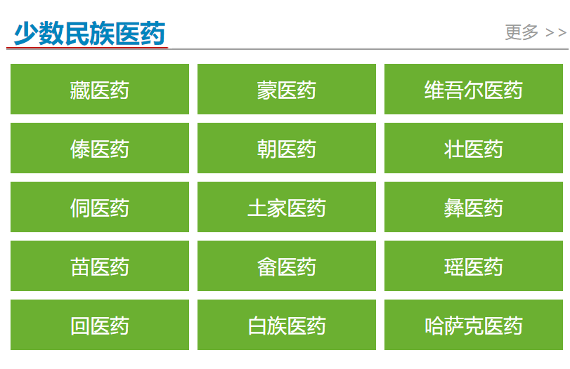
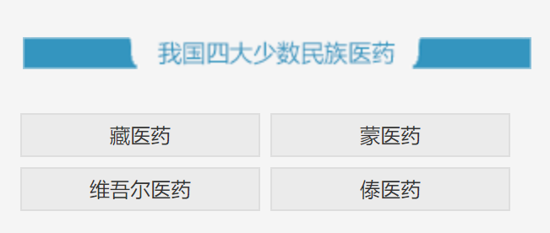

Slide 6
01
Tibetan Medicine
PART ONE

Slide 7
Overview
Since the emergence of human beings, the snow-covered plateau has give birth to a distinctive traditional Tibetan medicine with its unique geographical environment and humanistic characteristics. In the process of long-term struggle against diseases in an extremely harsh environment, the Tibetan people have formed a complete theoretical basis and practical experience of Tibetan medicine, and have formed unique technologies in preventive health care, disease diagnosis and other various medical activities. It has occupied an important position in the field of traditional Chinese medicine.
Characteristic medical science:
1.Where there is poison there is medicine. （有毒就有药） simple dialectical
2.Tibetan medicine believes that there are three major factors in the human body: "Long"（隆） (similar to the "wind" in the theory of the five elements), "Chiba"（赤八） (similar to "fire"), "Peigen" （培根）(referring to human body fluids).

Slide 8
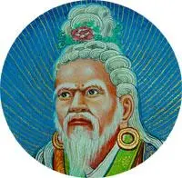
Features
1. Long history: With a history of 3,000 years, it is one of the oldest in traditional Chinese medicine.
2. Strong integration:
Yutuo Yundan Gongbu（玉妥·云丹贡布）, the most important representative of the development of Tibetan medicine. He traveled all over the world, extensively collected and studied folk medicine, summed up the experience of folk medicine. He went to Mount Wutai, India, Nepal and other places to study from famous Chinese and foreign doctors as teachers. He also invited medical scientists from various countries to Tibet to exchange medical skills.

Slide 9
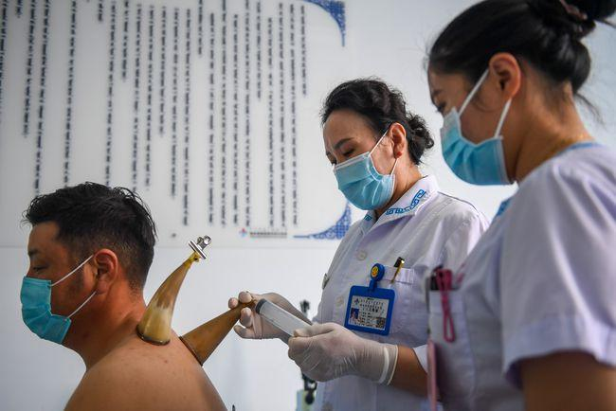
Characteristic therapy
Horned bloodletting牛角放血法:
A treatment in which a knife is used to puncture specific areas and release a small amount of blood, for joint pain and swelling. It's like cupping.（拔火罐）

Slide 10
02
Dai Medicine
PART TWO

Slide 11
Overview
In the long-term practice of disease prevention and treatment, the Dai people have continuously explored, practiced, perfected, and accumulated a variety of diagnosis and treatment experience and prescriptions for disease treatment.
Characteristic medical science:
Dai people believes that there are “four towers”（四塔） of wind, soil, water and fire in nature, and the human body is also composed of four towers. The balance of the four is healthy. It is also similar to the theory of the five elements of TCM.

Slide 12
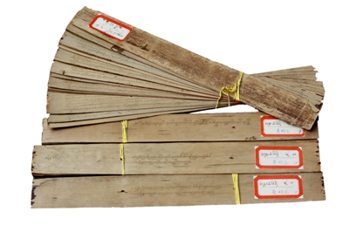
Features
1. Influenced by Buddhist culture: Because the Dai people are mainly distributed in Yunnan Province which is close to some Buddhist countries, Dai medicine is deeply influenced by Buddhist culture. With most of the Dai Buddhists, the medical books there are mostly part of Buddhist scriptures, written on the Beiye leaf, called Beiye scripture （贝叶经）.
The Ancient Book of Dai Medicine--《桑格龙》
2.The therapies of Dai are very diverse. External therapies are particularly abundant.

Slide 13
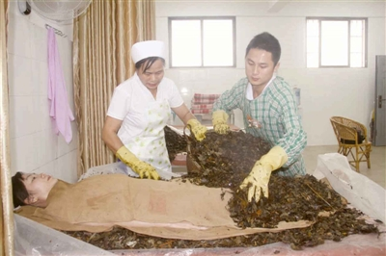
Characteristic therapy
暖雅Nuanya (sleeping medicine therapy):
an external therapy that covers the whole body of the patient with Dai medicine and hot medicine by lying down. It is one of the ten traditional therapies for Dai medical treatment and has been listed as the third batch of national Intangible Cultural Heritage.

Slide 14
03
Miao Medicine
PART THREE

Slide 15
Overview
Miao has a long history and is one of the four major ethnic minorities in China, and it is also distributed in Hunan. There is a famous story in the history of Miao medicine, that is, the story of Yaowang（药王）.
Yaowang is the founder of Miao medicine. In folklore, he is a man of God who is transparent, shaped like glass, winged and able to fly. He braved difficulties and obstacles to find a cure for the people. This legend has spread widely. Up to now, Miao people in Qianxi still respect Yaowang very much. In the process of practicing medicine, they still sacrifice the Yaowang by killing chickens.
Characteristic medical science:
1.Miao medicine believes that Qi, blood and water are the basic substances that constitute the human body.
2.Poison is the source of all diseases. Illness is caused by the poison of water, Qi, fire, and is caused by emotion waves and injury.

Slide 16
Features
1. Adapting to local conditions: Miao people are mainly living in warm and humid mountain areas. They are prone to fall and injury when walking in the mountains, and are troubled by snakes and insects. Therefore, the research of Miao medicine in bone injury and poison treatment is more prominent. Bone injury, snake wound therapy of Miao medicine have been listed as the second batch of national Intangible Cultural Heritage.
2.Combination of witchcraft and medicine: influenced by its wizard culture, early Miao medicine performed as "Combination of witchcraft and medicine"（巫医结合）. The formation of Miao witchcraft can be traced back to the primitive society. At that time, out of awe of the natural world, the earliest worship of ghosts and gods appeared. In order to better communicate with ghosts and gods and pray for the protection of gods, this special group of wizards came into being.
Miao Wizards are the masters of Miao culture. In addition to practicing various witchcraft skills, they also need to master basic medical knowledge and play the role of doctors in the village.
化水疗法
The wizard had the water scooped up in a bowl, then burned paper of character（符纸）, and began to draw and chant spells. This spelled water was used to cure diseases.

Slide 17
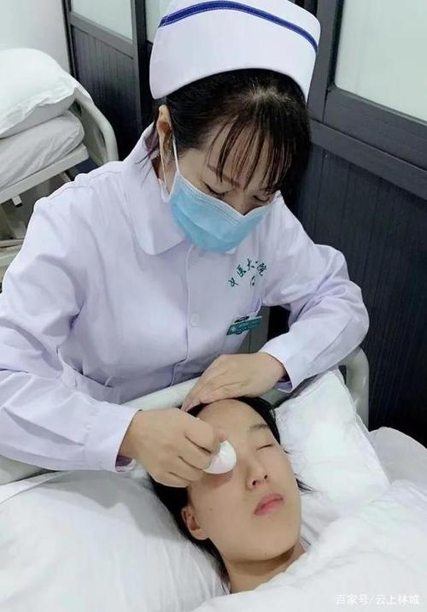
Characteristic therapy
rolled egg therapy（滚蛋疗法）
the treatment that uses boiled hot eggs or cold raw eggs rolling in the patient's affected areas.

Slide 18
04
Tujia Medicine
PART FOUR

Slide 19
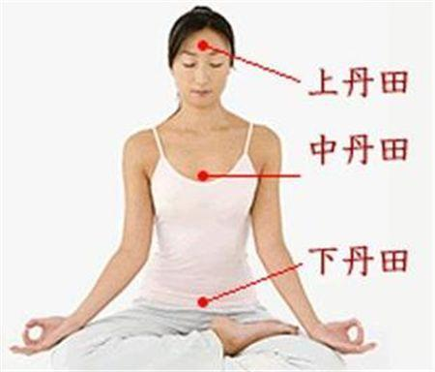
Overview
Tujia is a minority with a large population in China, which has lived in Wuling mountain area adjacent to Hunan, Hubei, Guizhou and Chongqing. Tujia medicine has a long history, rich drug resources and relatively perfect medical theory. Its medical technology has distinctive characteristics and significant clinical efficacy.
Characteristic medical science:
"Ternary Theory" of "Heaven, Earth, and Humanity"（“天、地、人”的“三元学说”）
The Tujia medical book uses the ternary theory to understand the structure of the human body. The structure of the human body is composed of three elements: upper, middle and lower（上、中、下三元）. The upper refers the sky, the middle is the ground, and the lower is the water.

Slide 20
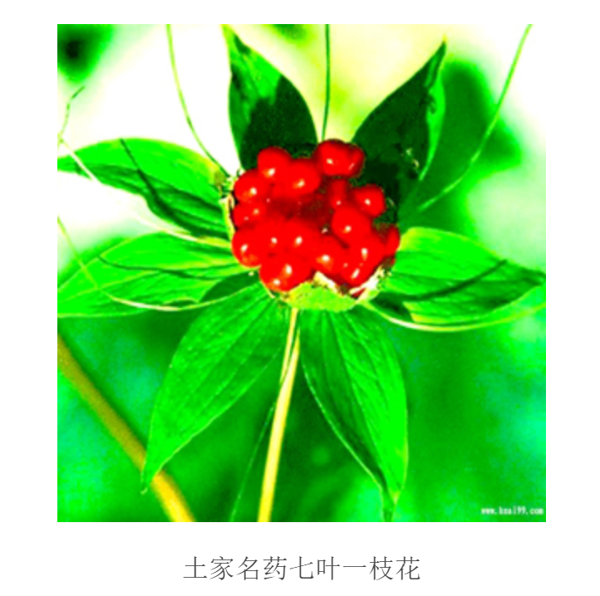
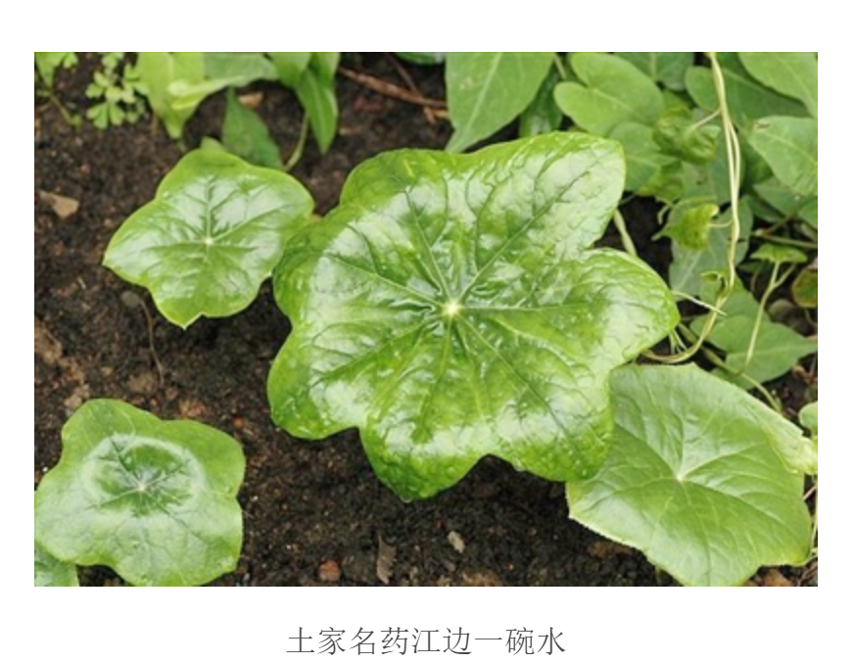
Features
Rich reserve of medical materials:
Tujia people live in Wuling Mountain area. Its special geographical environment and biodiversity make it become an important producing area of national medical materials.

Slide 21
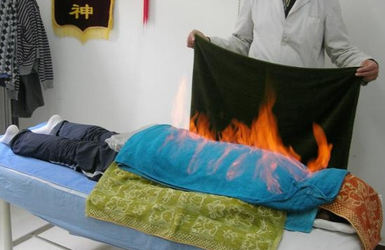
Characteristic therapy
Wine fire therapy（酒火疗法）:
a traditional treatment method of treating diseases with the flame of medicinal wine burning in the patient's disease. Suitable for lower back pain and leg pain.

Slide 22
Conclusion
1. The characteristic of medicine in ethnic minority areas are greatly influenced by their geographical location.
2. Ethnic medicine and mainstream Chinese medicine still have a lot in common.
3. The medical culture of ethnic minorities presents various characteristics, which greatly enriches the diversity of Chinese medical culture. The culture of any ethnic group is the treasure of Chinese culture and an important part of Chinese cultural resources.

Slide 23
Reference
1. Baidu Encyclopedia 百度百科: minority medicine 民族医药 https://baike.baidu.com/item/%E6%B0%91%E6%97%8F%E5%8C%BB%E8%8D%AF/2027986?fr=ge_ala
2. China Traditional Chinese Medicine Network 中国中医药网. http://www.cntcm.com.cn/index.html
3. Journal of Ethnic Medicine 民族医药报: Policy interpretation | How to develop ethnic minority medicine? The 14th Five-Year Plan for the Development of Traditional Chinese Medicine says so 政策解读 | 如何发展少数民族医药？《“十四五”中医药发展规划》这样说https://mp.weixin.qq.com/s?__biz=MzU5Mjc4MzYyMQ==&mid=2247497019&idx=1&sn=097214cac29baf42ceb39cea5558b7f8&chksm=fe18c551c96f4c477eb716a1b29337e536744f5143e01246d956a82a143f63b1fba176199a4f&scene=27

Slide 24
Thanks for your listening!

