Slide 1






Chinese Ancient Mythology
中国古代神话
Presenter: 吴松芸

Slide 2

Contents:
1
Origin and Features
2
Typical Mythology
3
Mythology Around the World

Slide 3
Origin and Features

Slide 4
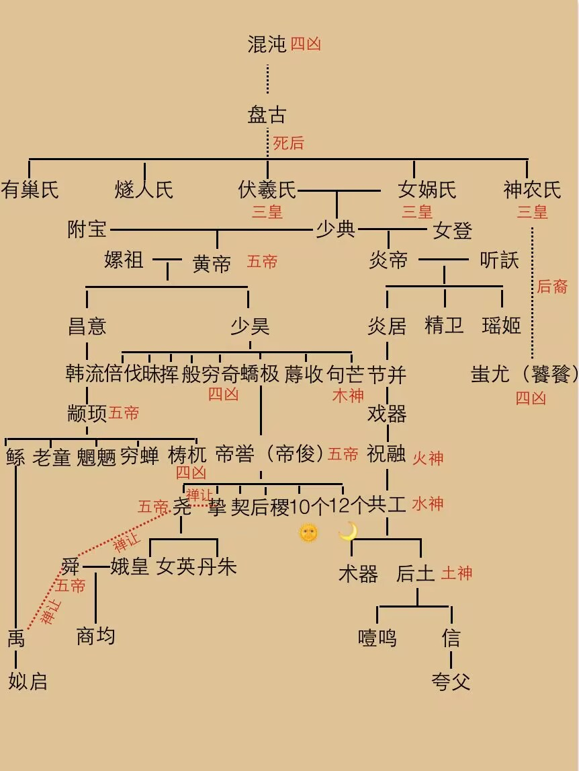
Origin and Features
Earliest recorded mythical stories :
Shan Hai Jing (passed down orally before that)
Reason:
1. to explain the world, natural phenomena, and the difficulties they faced
2. deterred by the power of nature
3. ancient humans’ desire to conquer nature (Kuafu chasing the sun)
4. the yearning of ancient humans for beautiful things (Chang'e Flying to the Moon)
Features:
1. influenced by the country's religious and philosophical traditions: Taoism, Confucianism, Buddhism
2. involves important concepts in Chinese culture (Yin and Yang)
3. contains a variety of mythical creatures and different creation myths

Slide 5
Typical Mythology

Slide 6
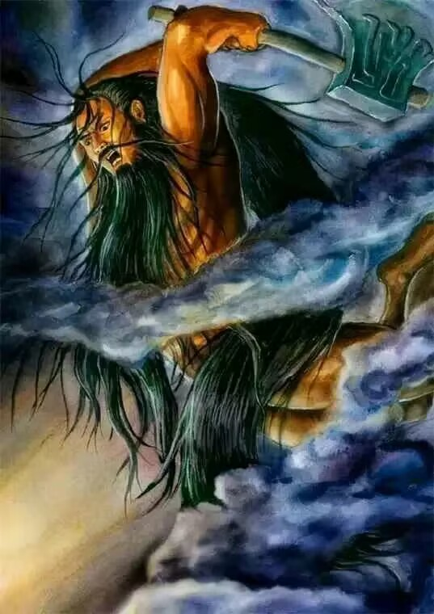
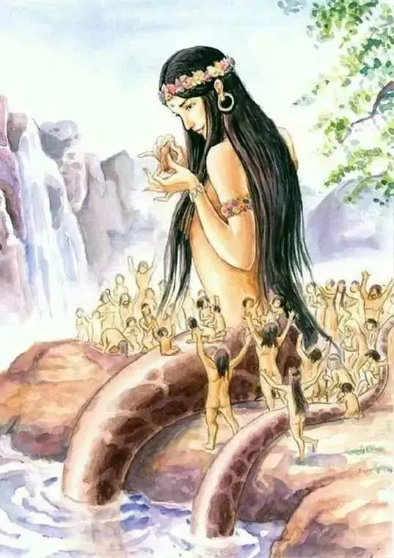
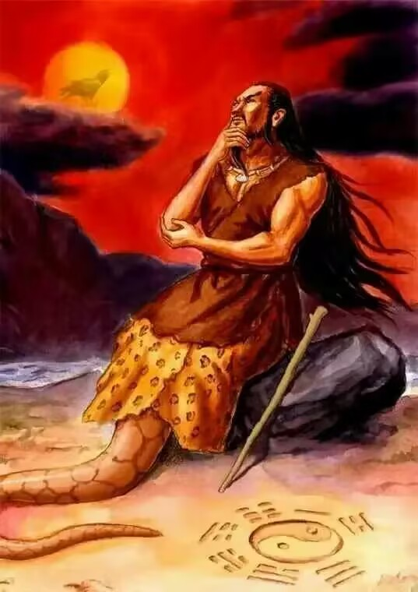
Panku Created the World
NuWa Created Human Beings
Fushi Taught the People

Slide 7
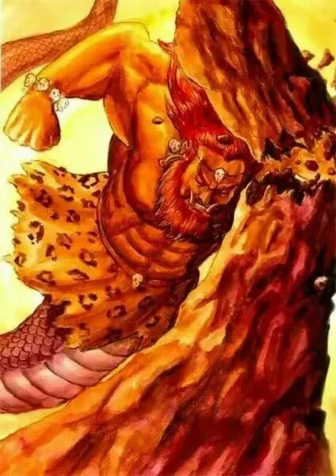
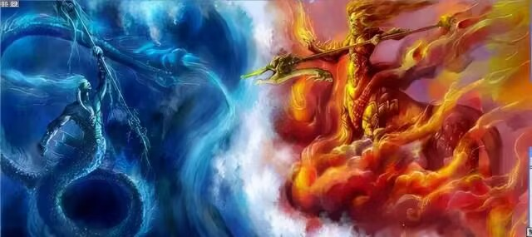
water war
水神：共工、火神：祝融之战

Slide 8
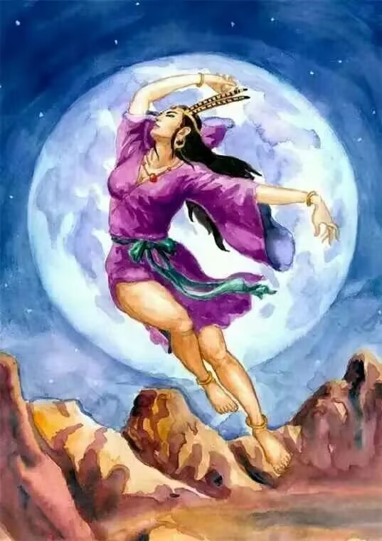
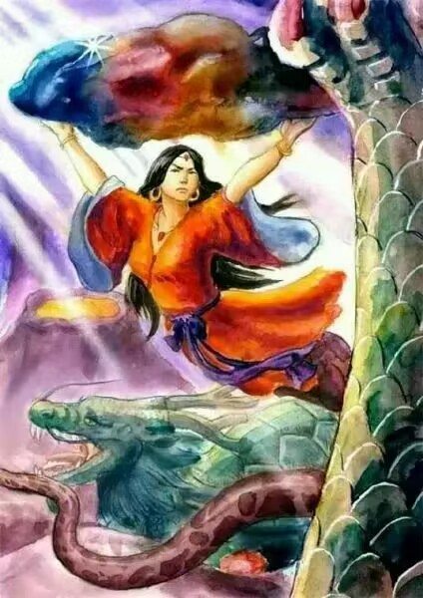
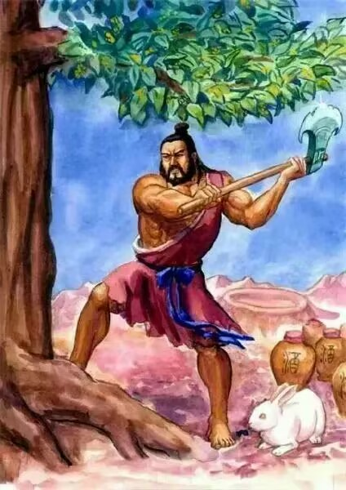
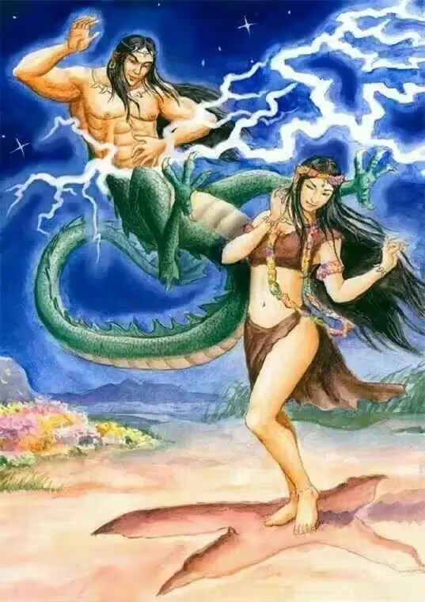
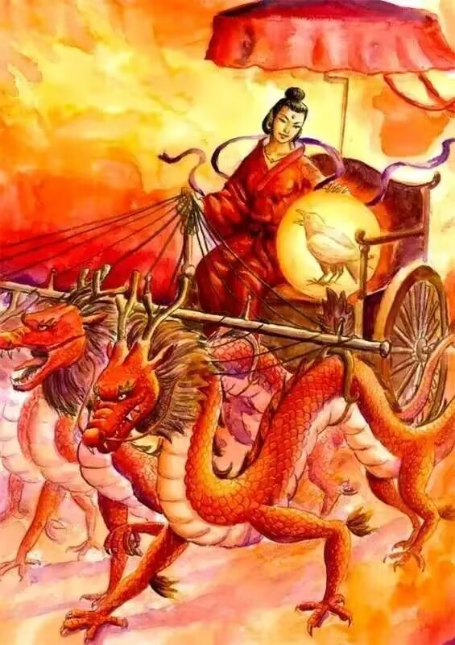
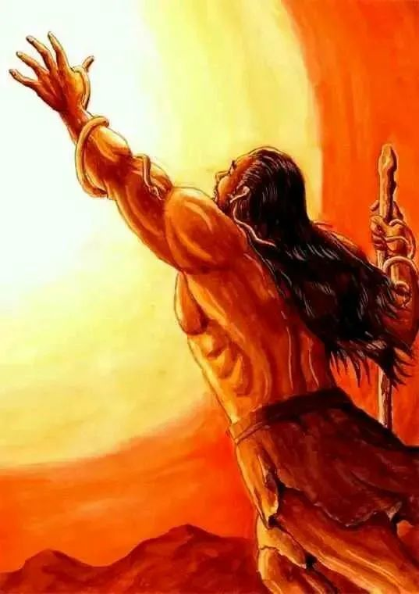
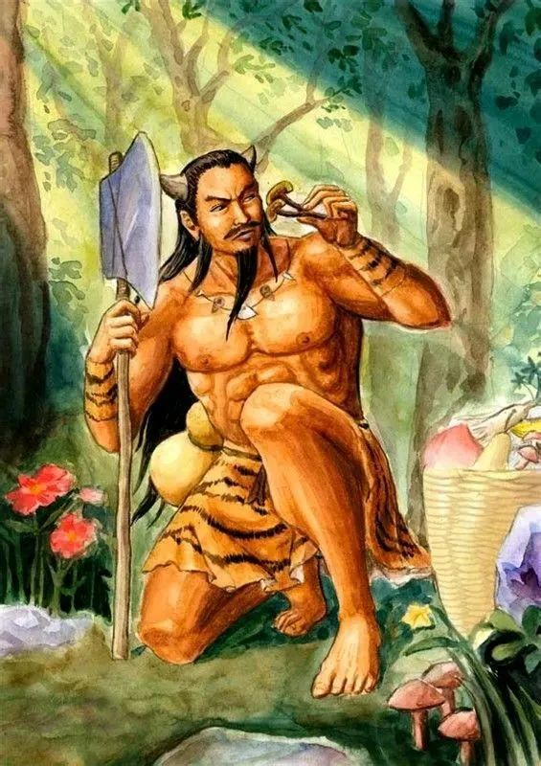
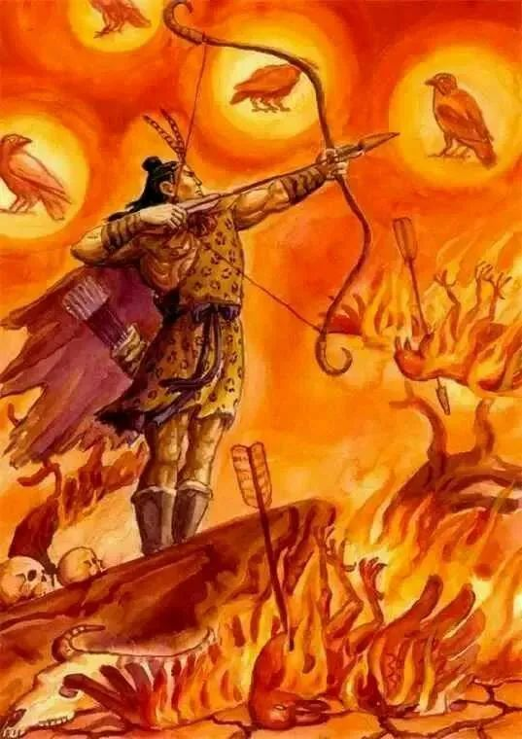
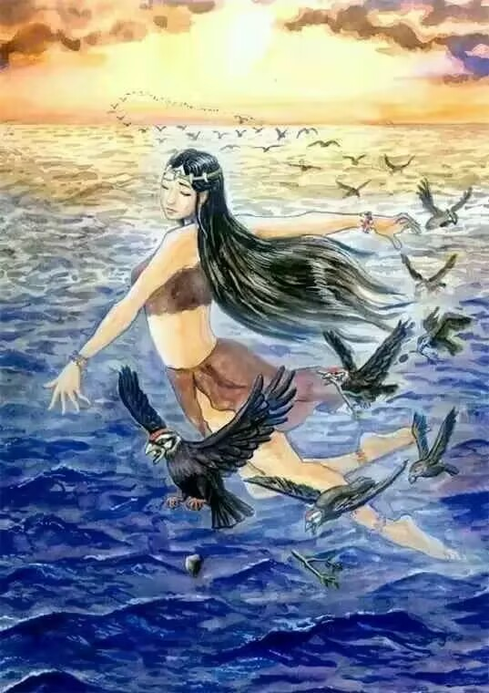

Slide 9
Mythology Around the World

Slide 10
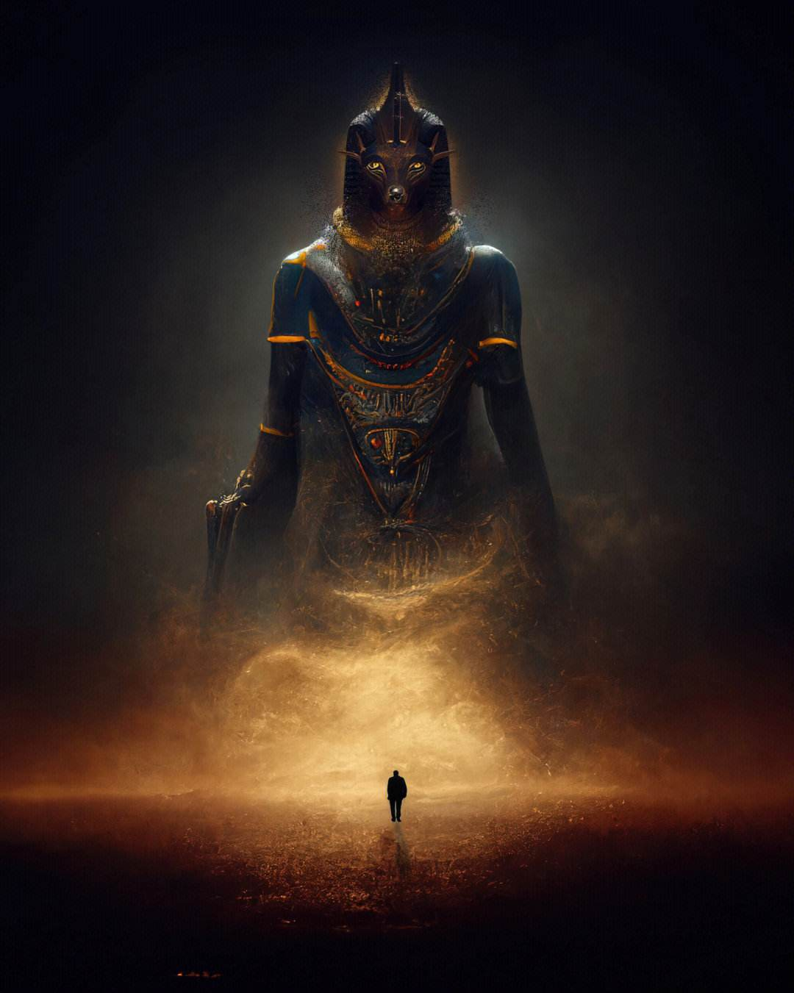
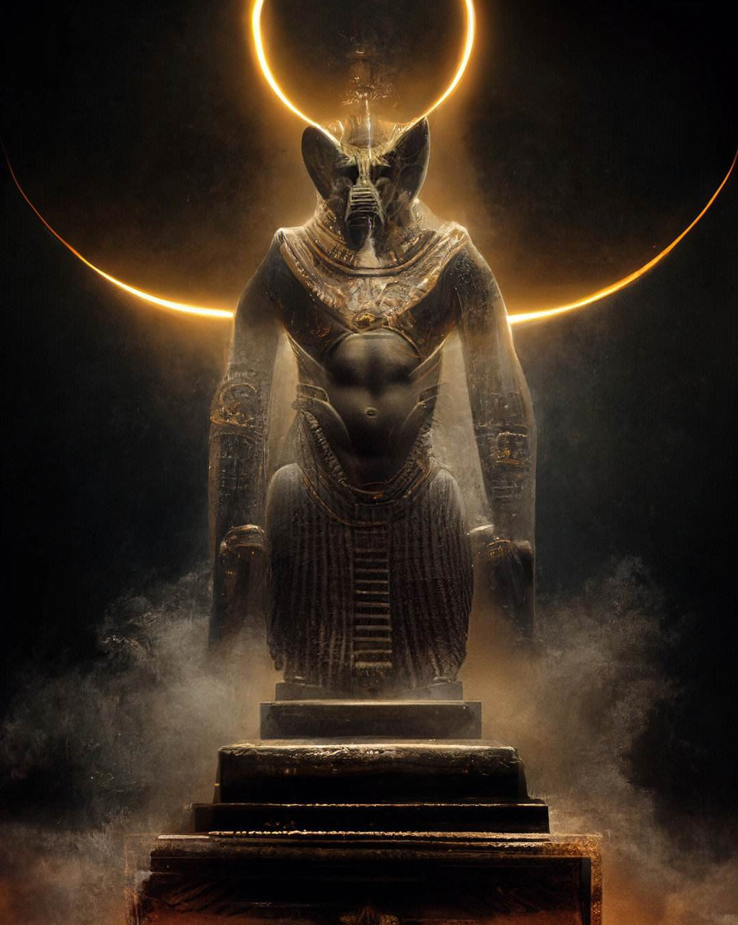
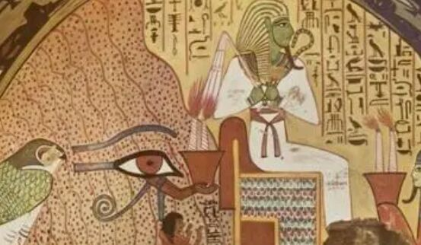
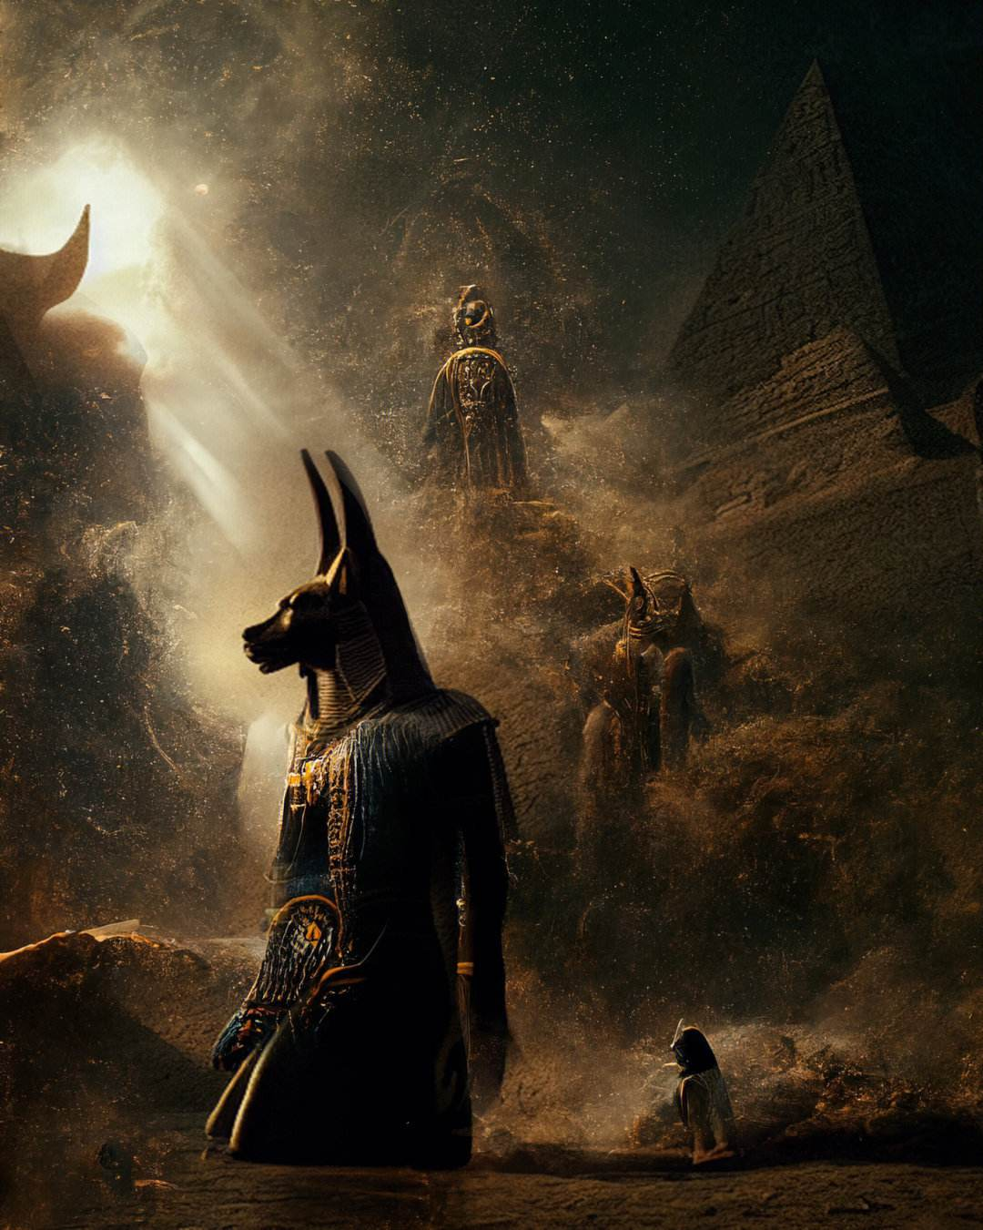
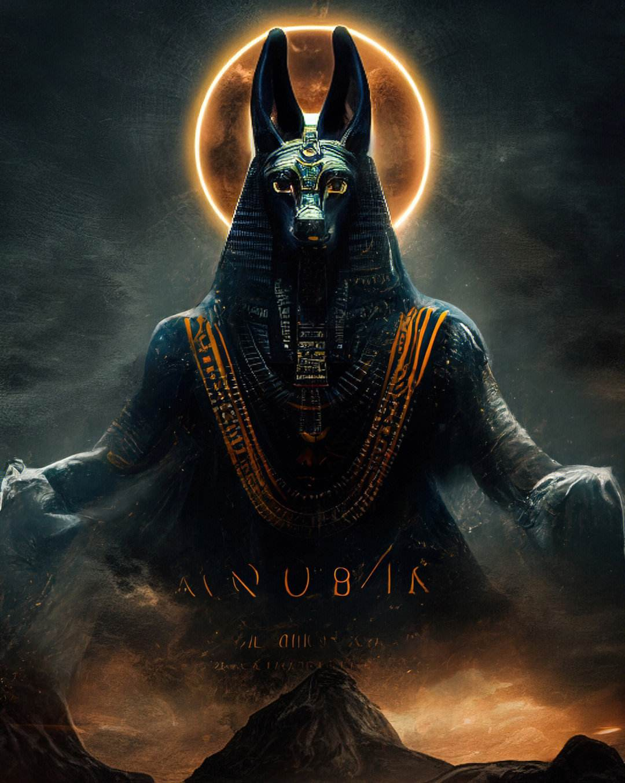
Egyptian Mythology
（埃及神话）

Slide 11
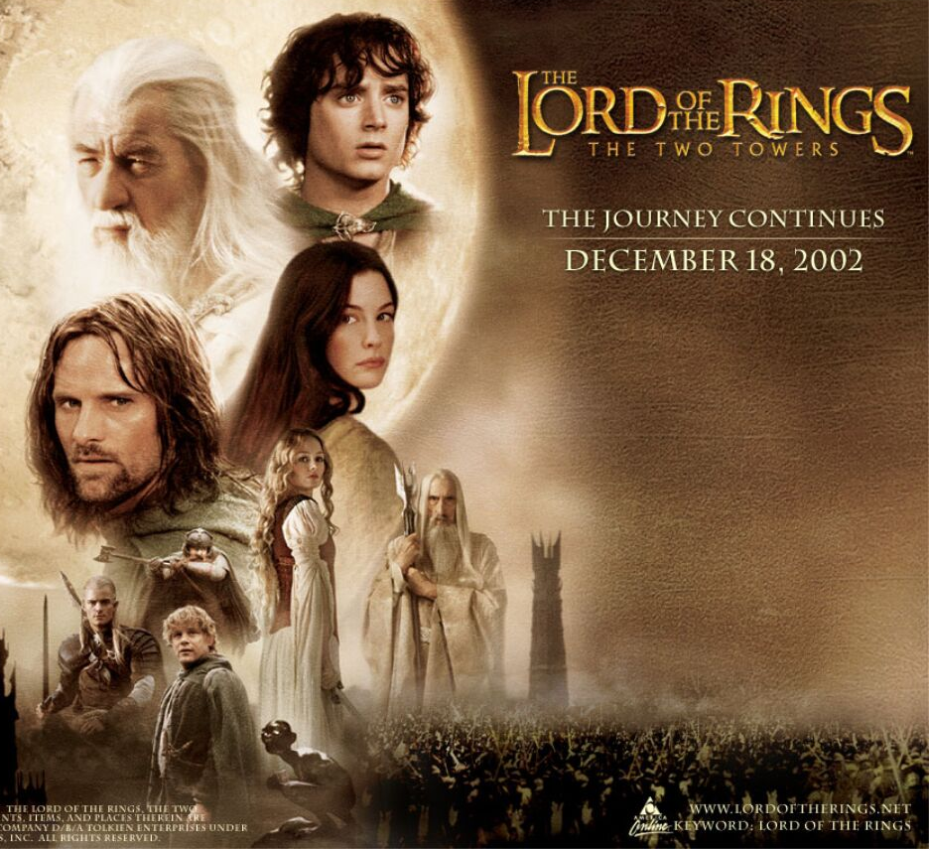
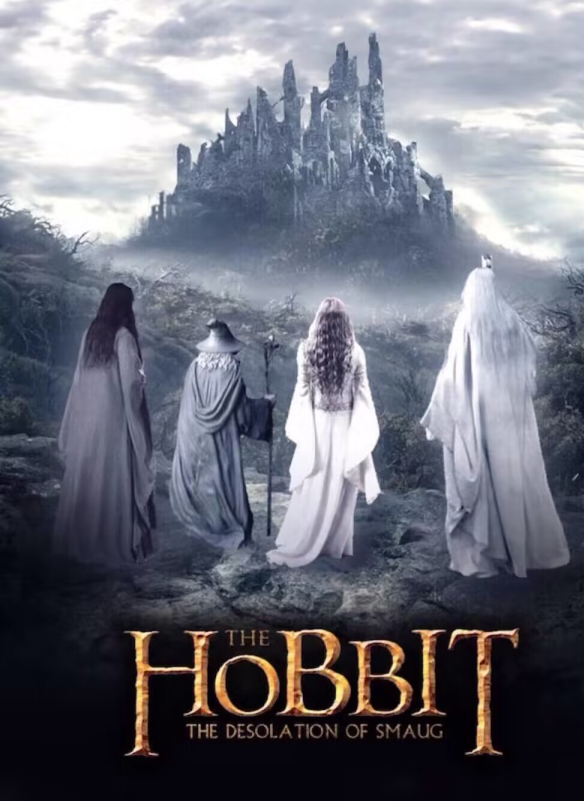
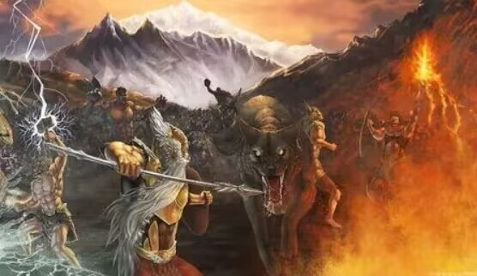
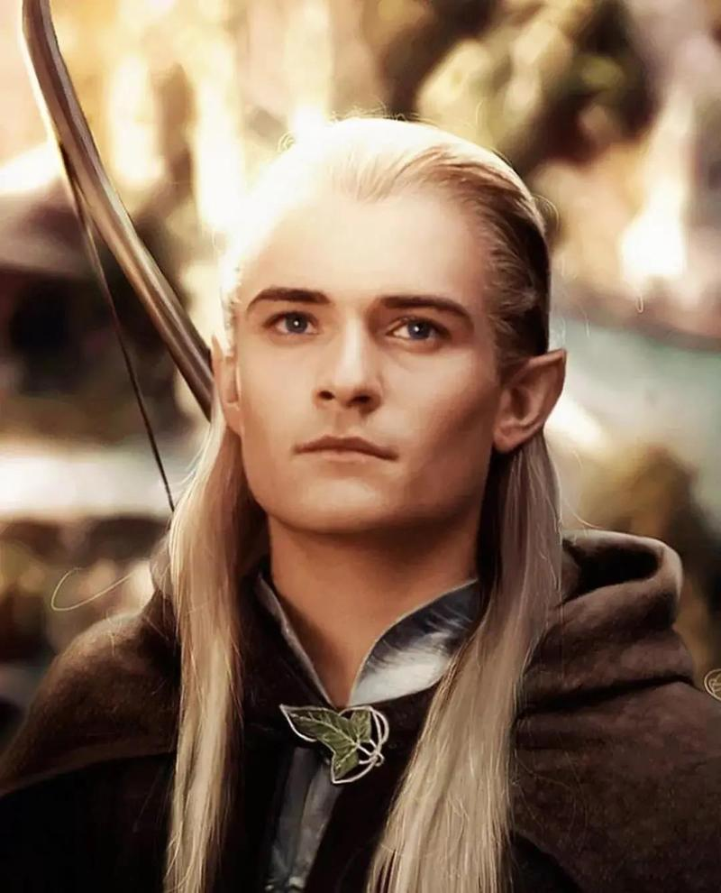
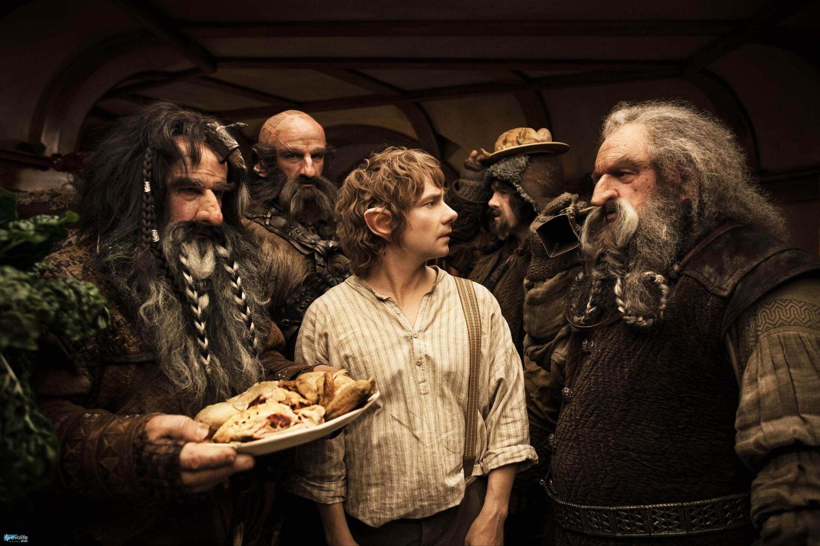
Norse Mythology (北欧神话)

Slide 12
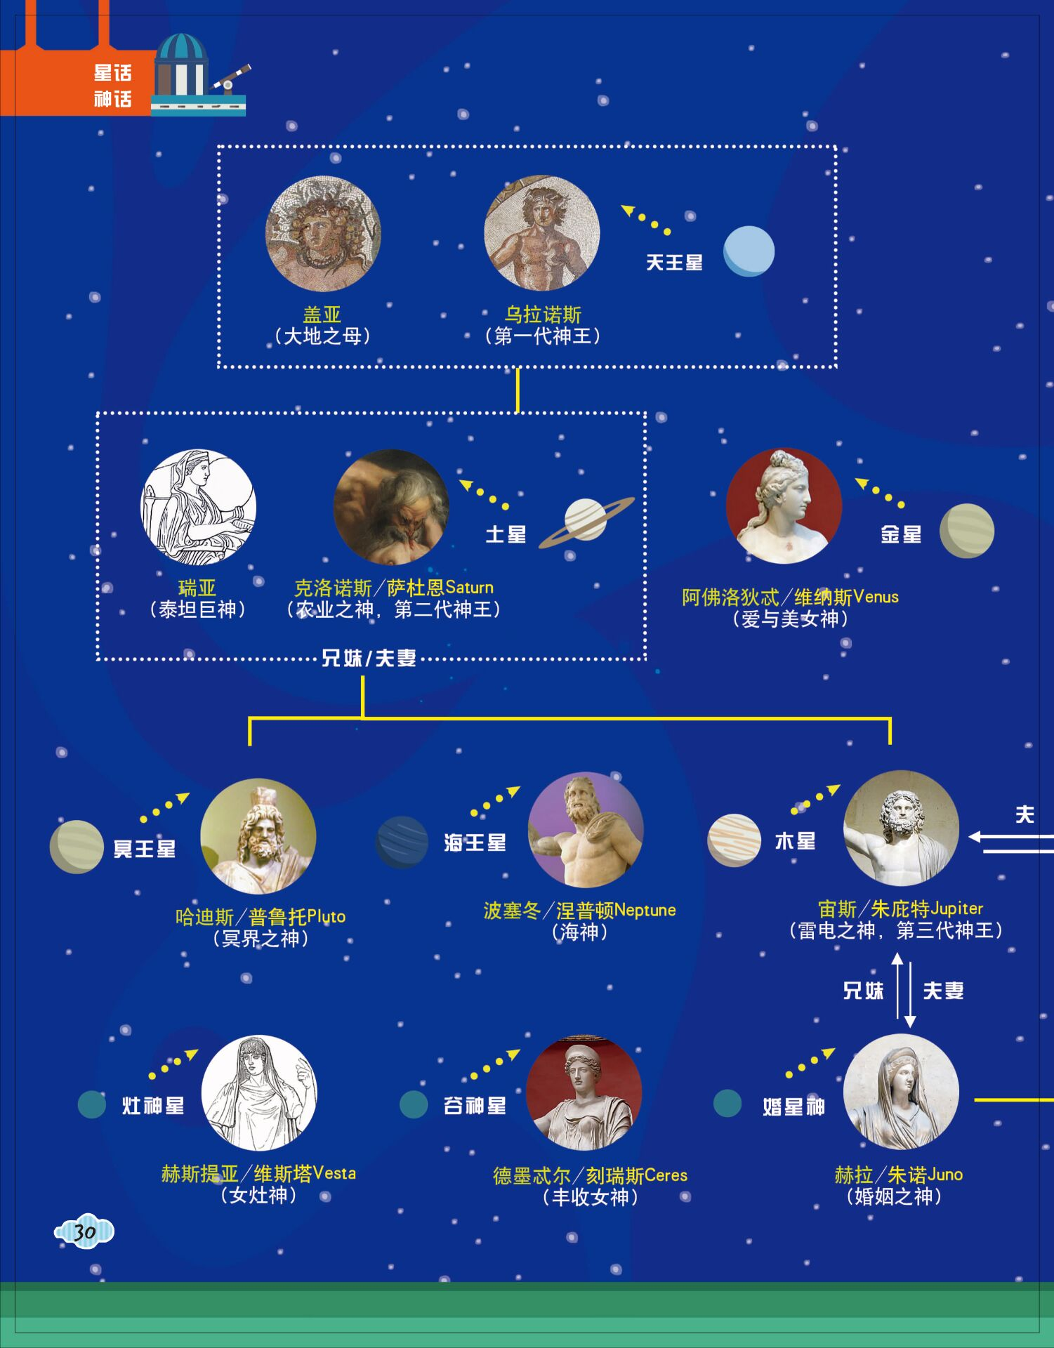
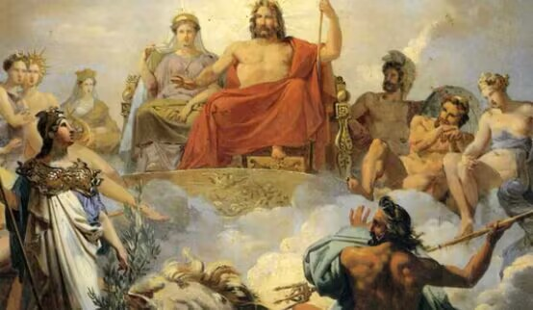
Greek Mythology

Slide 13
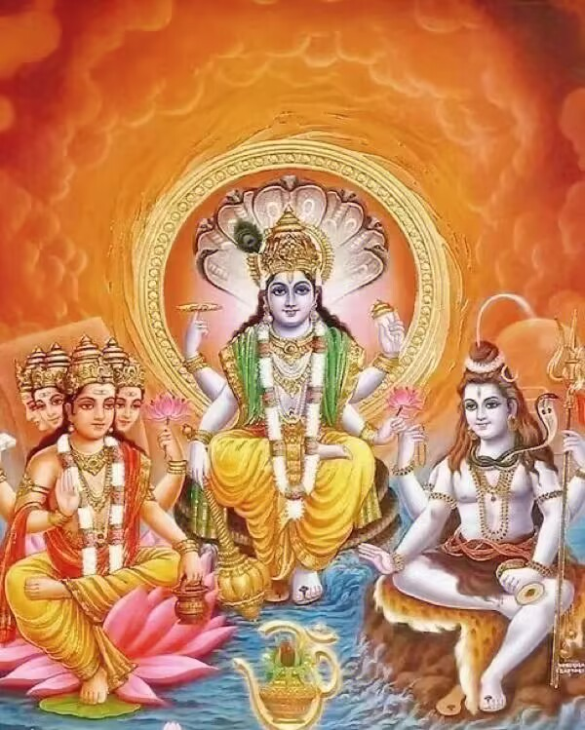
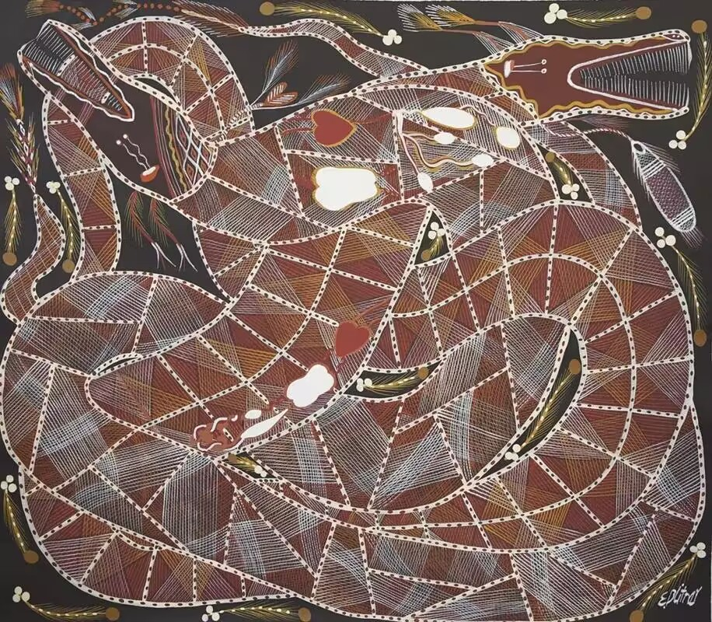
Aboriginal Mythology
（澳洲神话）
Hindu Mythology
（印度神话）

Slide 14
Thank You for Listening!

