Slide 1
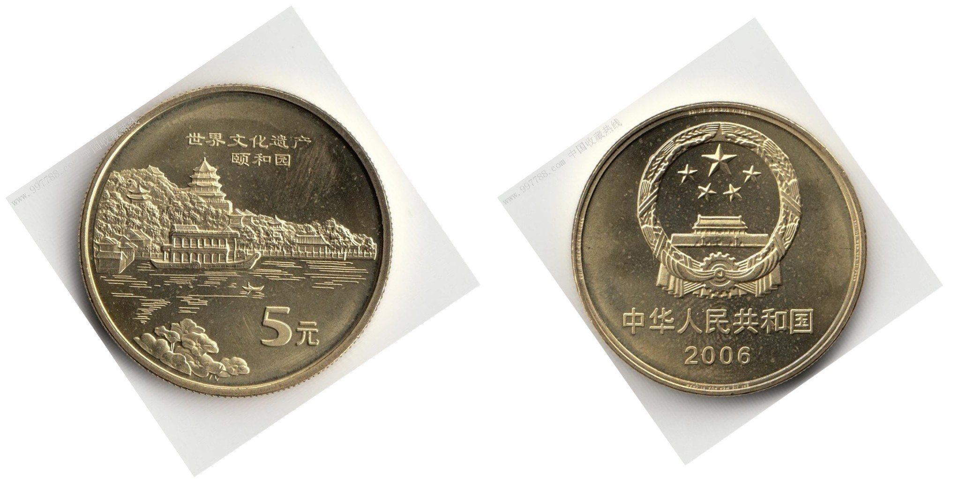
The World Culture Heritage
—— The Summer Palace

Slide 2
Why it's named the Summer Palace？

Slide 3
A .Cixi and emperor escape heat from the April to the October every year.
B.Emperor Kangxi’s Summer Mountain Resort in Chengde also named the Summer Palace.
C.In history,there is old Summer Palace. Later it becamed the Summer Palace.

Slide 4
·Historical background
·General situation of the Summer Palace
·Landscape layout
·Cultural significance

Slide 5
History
During the reign of Emperor Qianlong (1735-1796), the name of the mountain was changed to the Longevity Hill and the lake to Lake Kunming. The entire area was called Qingyiyuan (the Park of Pure Ripples).
In 1888, Empress Dowager Cixi ordered the Summer Palace to be rebuilt and enlarged with funds originally designated for the Chinese navy.
It became a public park in 1924 after Puyi, the last Qing emperor, abdicated and was ousted from the Forbidden City.

Slide 6
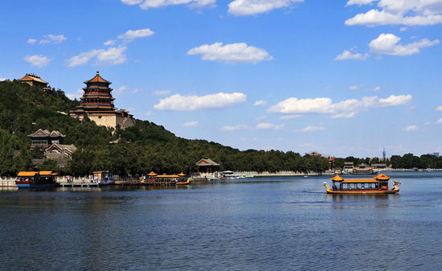
General situation of the structure
Location
Situated in western outskirts of Beijing, the Summer Palace is 10 kilometers from the central city.
Structure
The two main elements of the garden are Longevity Hill and Kunming Lake. Kunming Lake, with an exquisite building in the middle, takes up three quarters of the garden's 290 hectares.

Slide 7
Landscape Layout
The royal palaces
The Summer Palace
The residential quarters
The garden

Slide 8
1
The royal palace

Slide 9
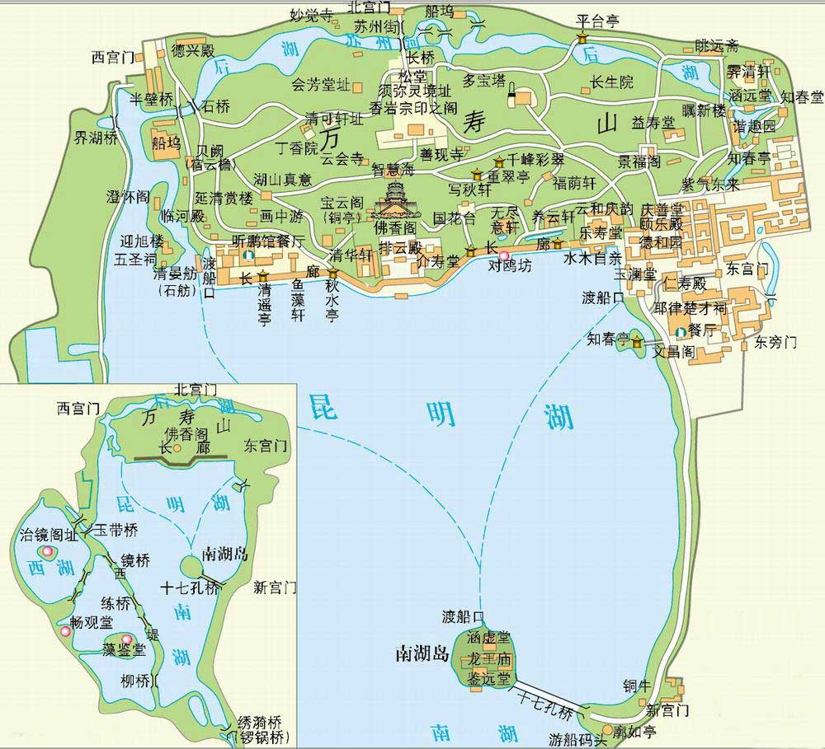
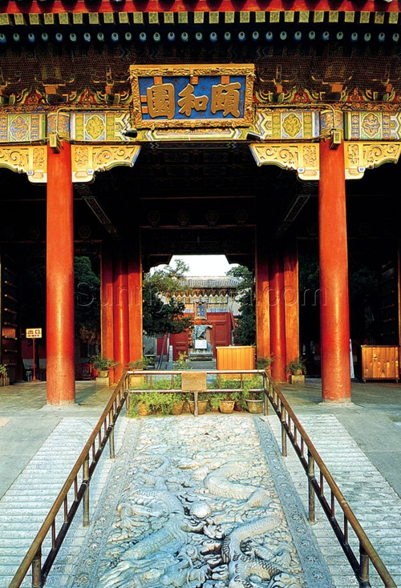
政治活动区

Slide 10
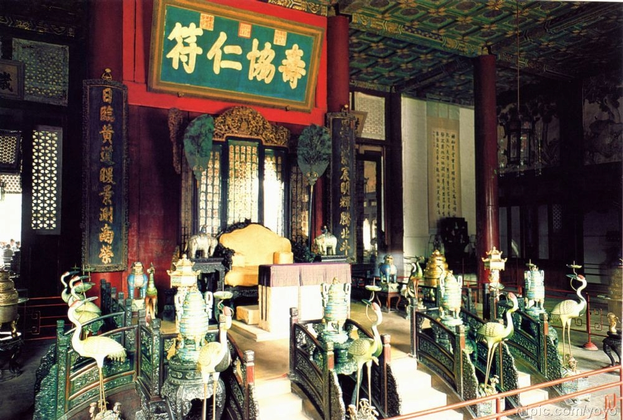
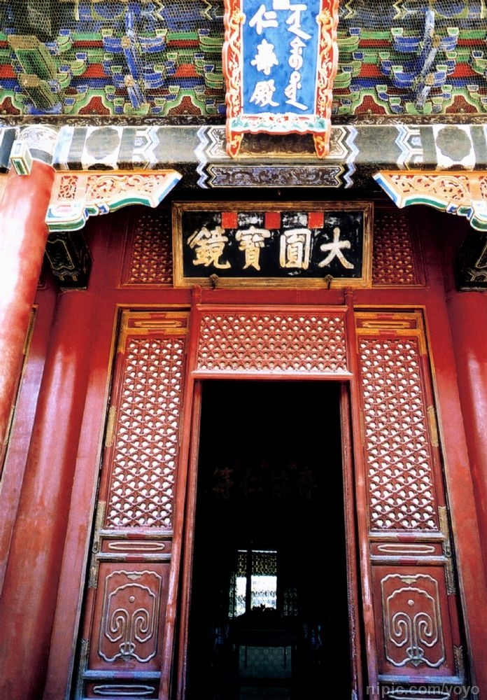
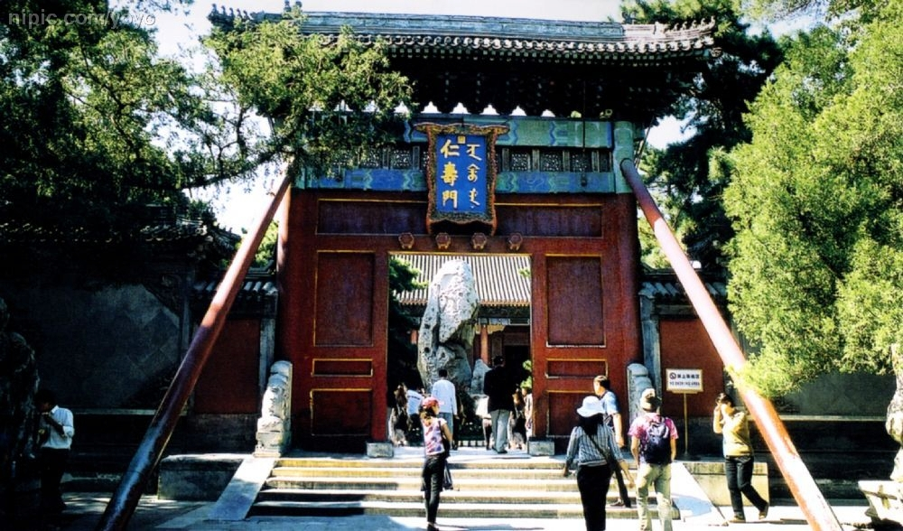

Slide 11
2
The residential quarters

Slide 12
生活居住区

Slide 13
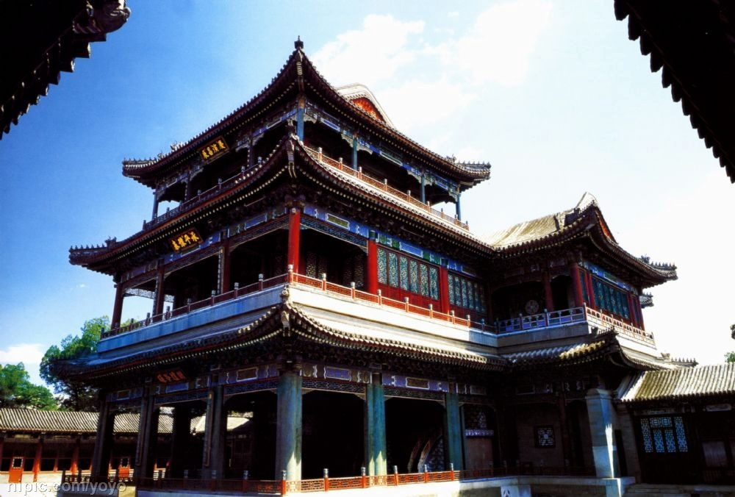
De Heyuan

Slide 14
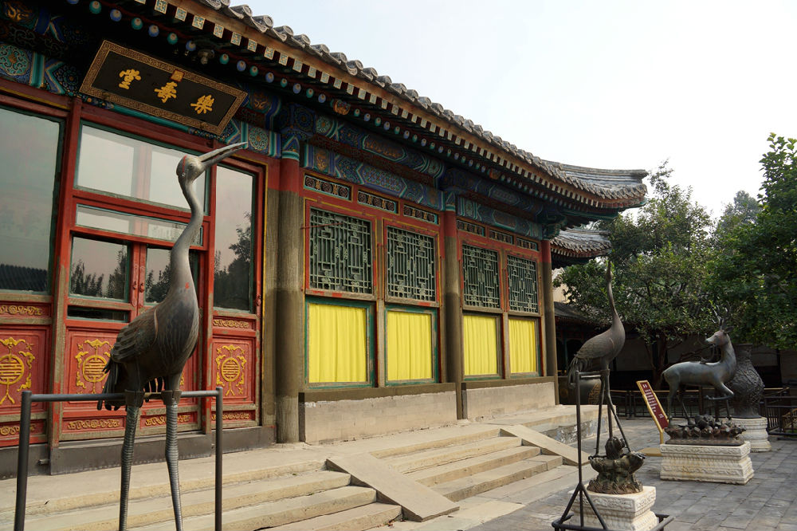
The Hall of Joyful Longevity

Slide 15
3
The garden
The Longevity Hill
Lake Kunming

Slide 16
万寿山前山

Slide 17
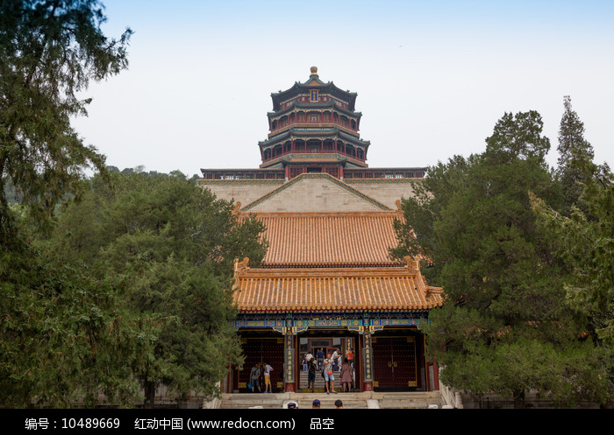
Paiyundian

Slide 18
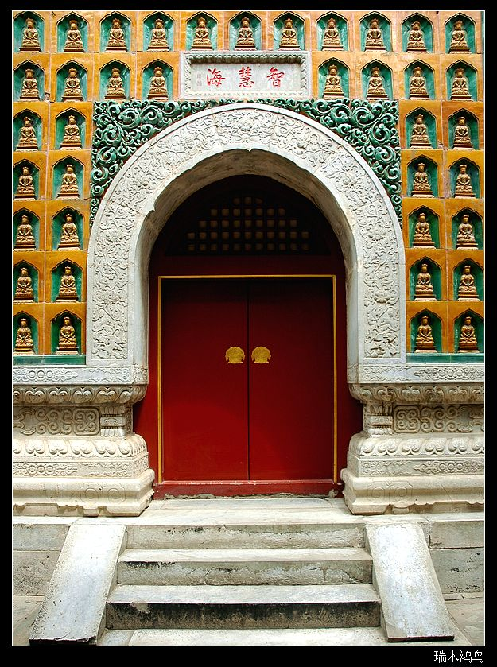
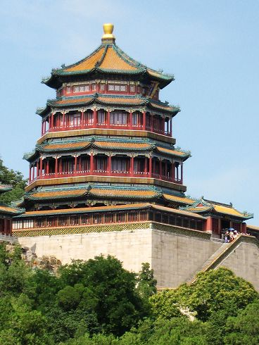
FoXiange

Slide 19
Lake Kunming

Slide 20
昆明湖

Slide 21
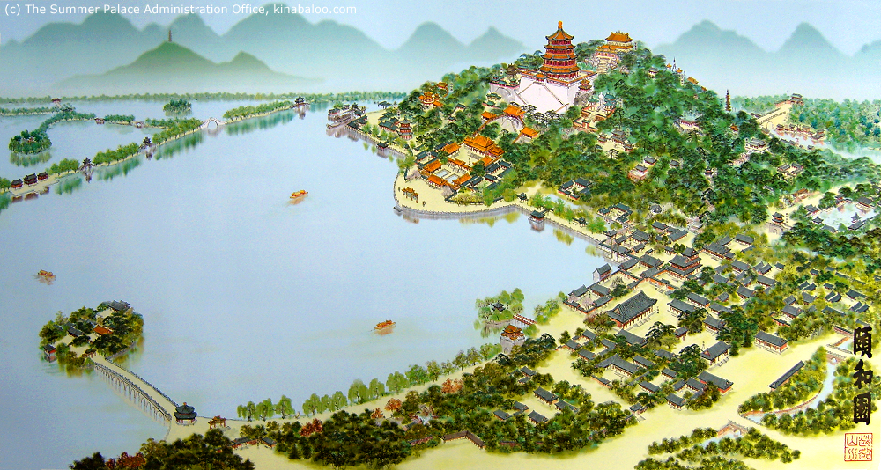
Southern Lake Island

Slide 22
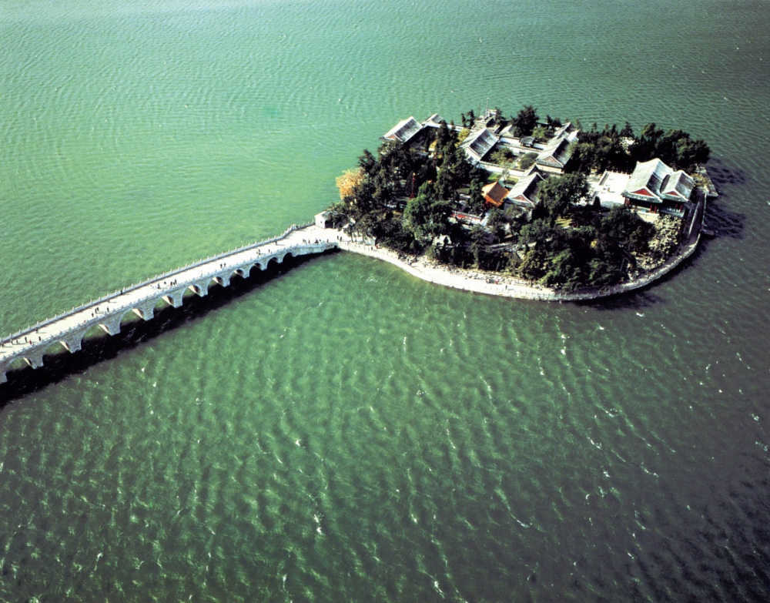
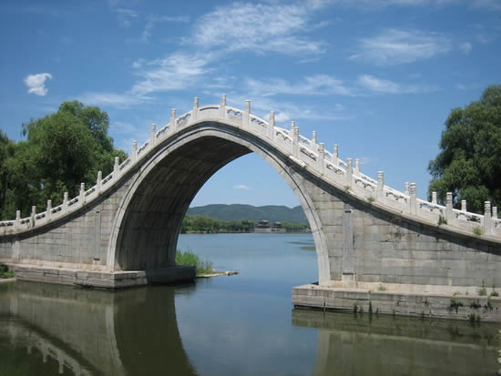

Slide 23
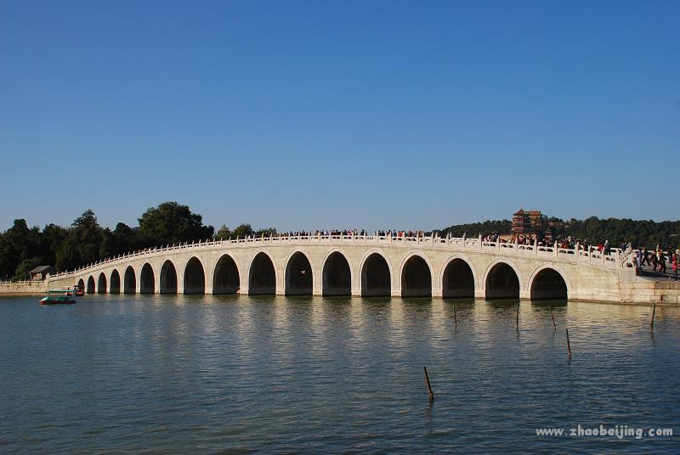
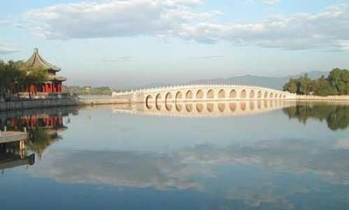

Slide 24
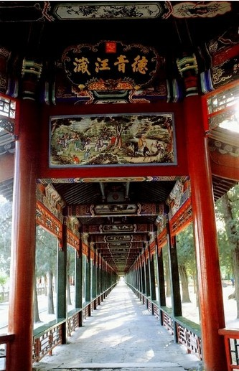
Long Corridor

Slide 25
Back Hill Area

Slide 26
后山后湖景区

Slide 27
Back Hill Area
The Garden of Harmonious delight
(Xiequyuan)
the fishing site of Empress Dowager Cixi
An imitation of the Jichang Garden of Wuxi
A garden within a garden

Slide 28
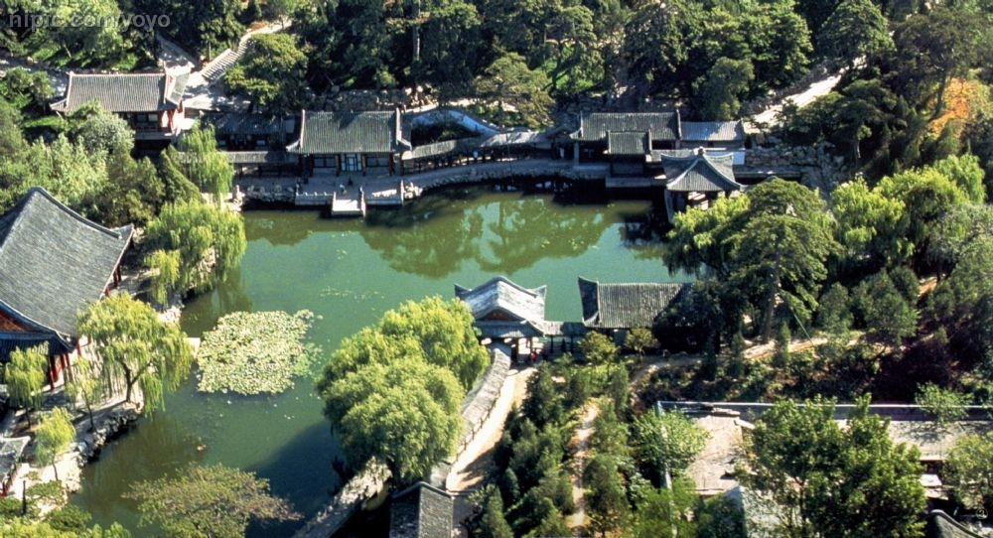
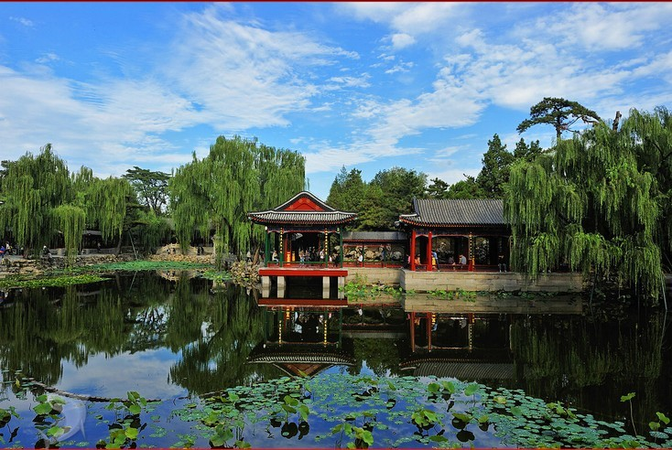

Slide 29
Suzhou Street (the Emperor’s Shopping Street )
Emperor Qianlong’s tours of south
Commercial prosperity
Imitate the styles of shops along the waterways in Suzhou
(“the Venice of the East”)
1860 destroyed
1888 rebuilt (Cixi)
1986 restored

Slide 30
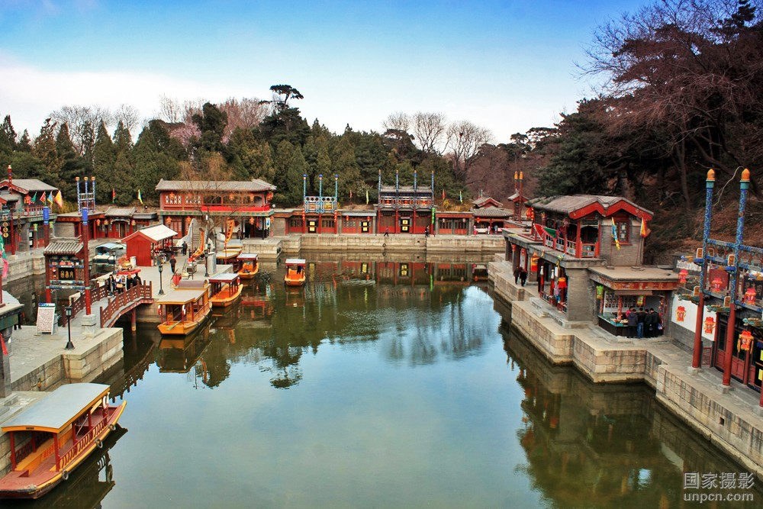
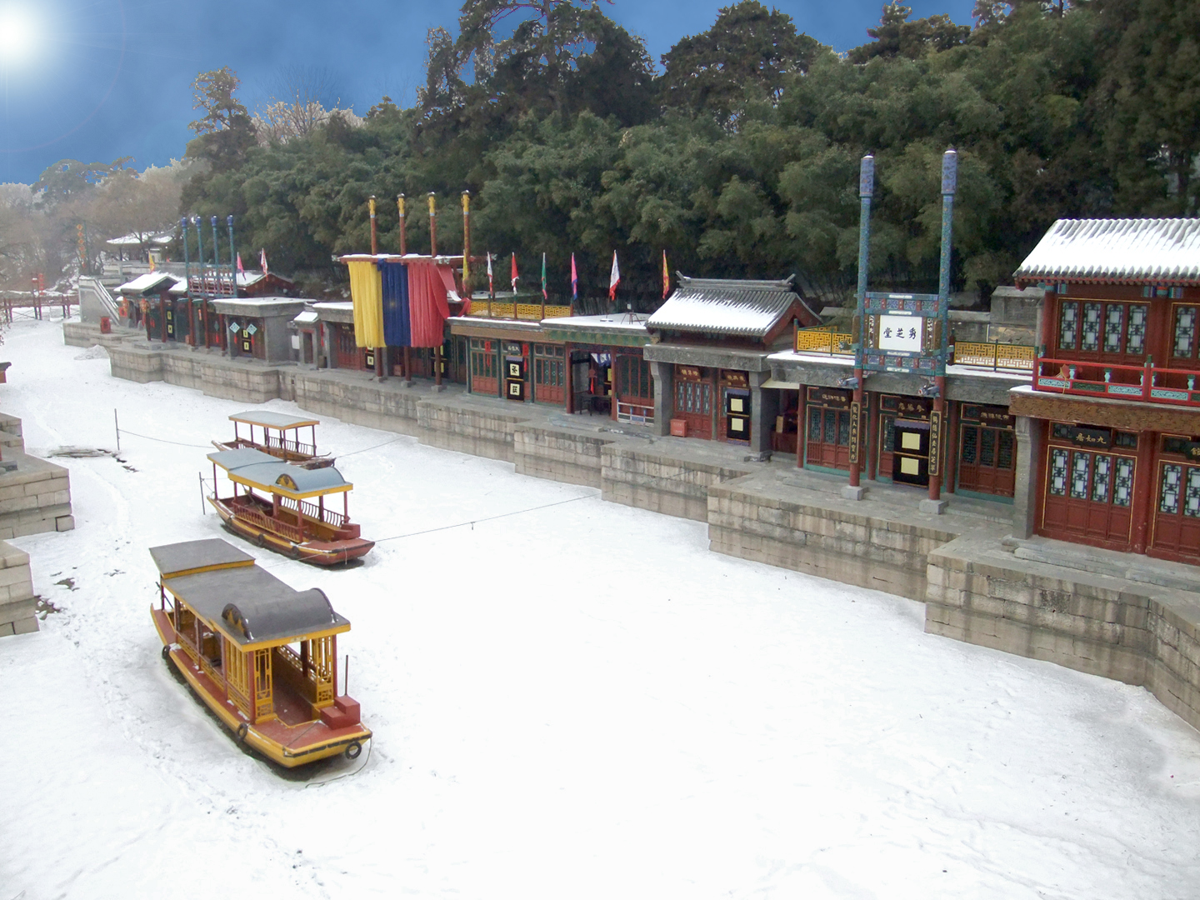
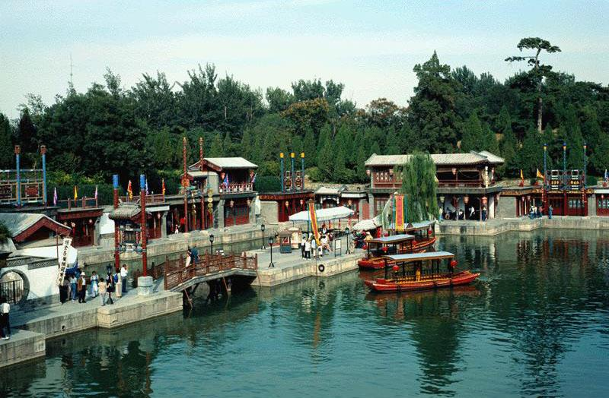

Slide 31
Cultural significance
The Summer Palace is not only a beautiful royal garden but also a treasure of Chinese history and culture. It embodies rich historical and cultural connotations, representing one of the finest examples of traditional Chinese garden artistry. When visiting the Summer Palace, visitors can delve into China's history and culture, experiencing the unique charm of traditional Chinese gardens. Moreover, the Summer Palace carries the historical memories and national sentiments of the Chinese nation, making it a cultural heritage site worthy of exploration by every Chinese individual.

Slide 32
Thank you ~

