Slide 1

Nine-Rank Official Selection System
汇报人：Zhou Yicen
2024-09-11

Slide 2


Introduction
Recommendatory System
Cao Cao’s policy of Meritocracy
The birth of Nine-Rank Official Selection System
目录

Slide 3
The content of Nine-Rank Official Selection System
The importance of one’s family
The impacts of Nine-Rank Official Selection System
Conclusion
目录

Slide 4

Introduction
01

Slide 5
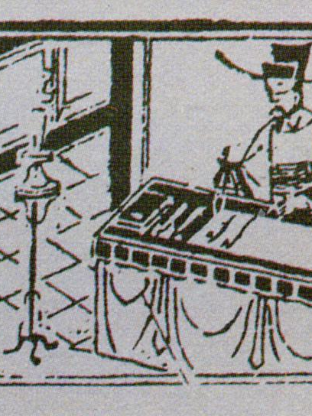
It originated from Cao Cao's idea of "Meritocracy" in the late Eastern Han Dynasty (184 AD-220 AD), and was not officially implemented by Cao Pi, the king of Wei, until 220 AD.
In order to understand the system, we must be clear about the development of Recommendatory system, which appeared before Nine-Rank Official Selection System and coexisted in the Sui and Tang dynasties.

Slide 6
Recommendatory System
02

Slide 7
Recommendatory System refers to the local governors, such as the governor and assassins, recommending talents to the court according to Xiaolian(literally filial and incorrupt). This system was born in the early years of the Western Han Dynasty, initially to break the monopoly of the officialdom caused by the hereditary official system of the father's death and the son's succession since the pre-Qin Dynasty and to inject new blood into the officialdom, which was of advanced significance at that time.

Slide 8
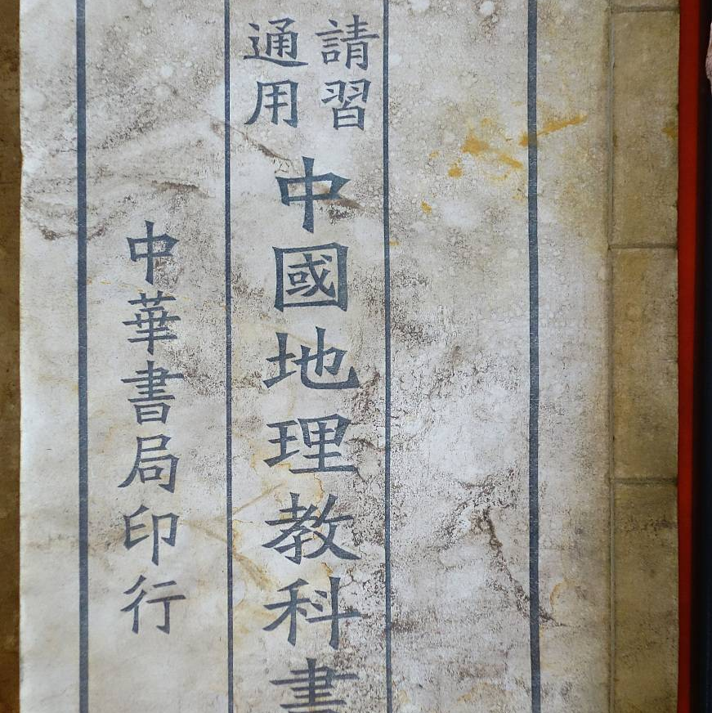
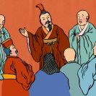
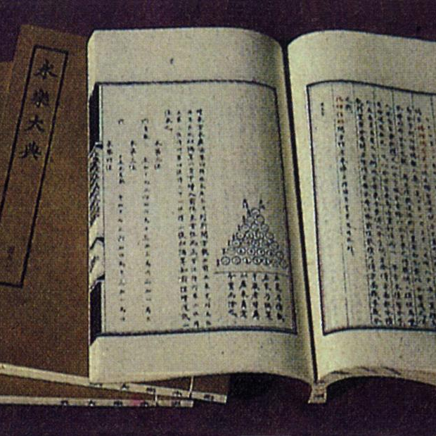
Limits
Officials have limited energy to fully understand the talent
Xiaolian is difficult to examine and rely on reputation
Official favors and corruption

Slide 9
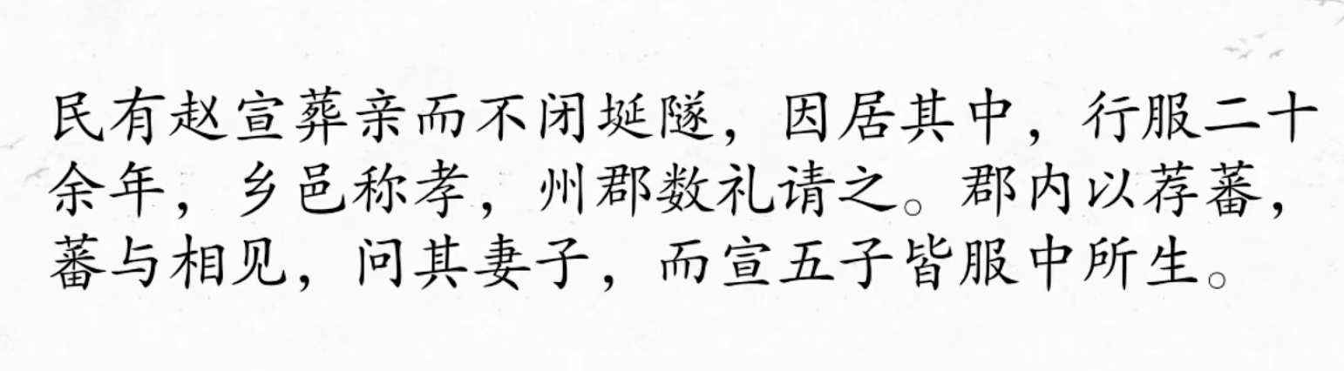
Zhao Xuan, a man from Le'an, after burying his parents but not closing the tomb passage and living in it in mourning for more than 20 years, was praised by the townspeople, but he quietly gave birth to five children in the tomb.

Slide 10
Cao Cao’s policy of Meritocracy
03

Slide 11
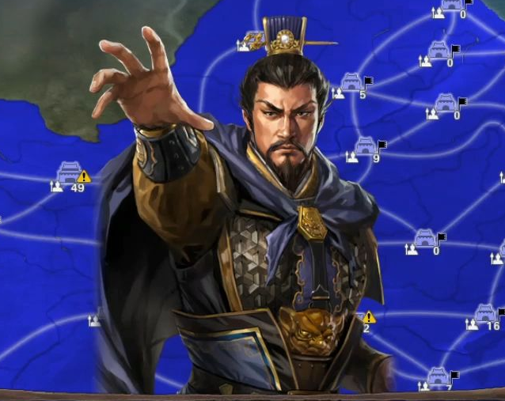
To address the shortcomings of Recommendatory System
01
Expanding Talent Selection Pathways
02
A radical approach to the search for talent
03

Slide 12
The birth of Nine-Rank Official Selection System
04

Slide 13
Cao Pi adopted Chen Qun's advice during the Cao Wei period
It was promoted as a system for selecting officials

Slide 14
The content of Nine-Rank Official Selection System
05

Slide 15
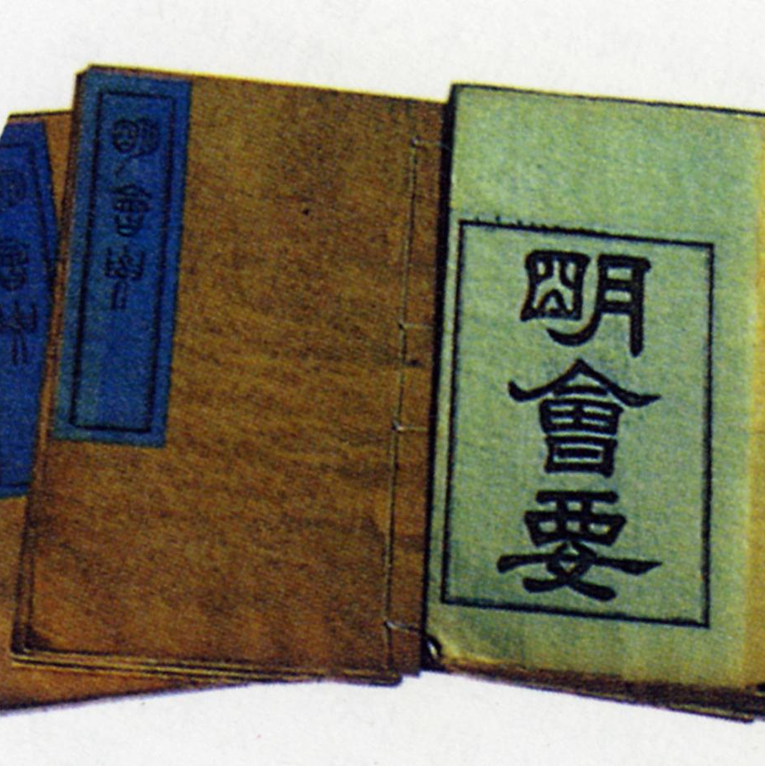
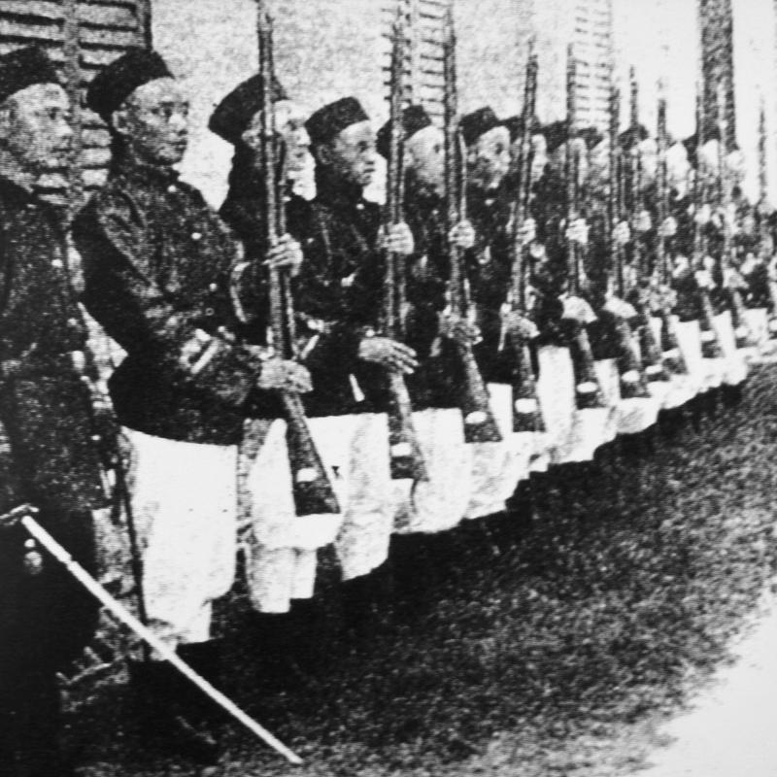
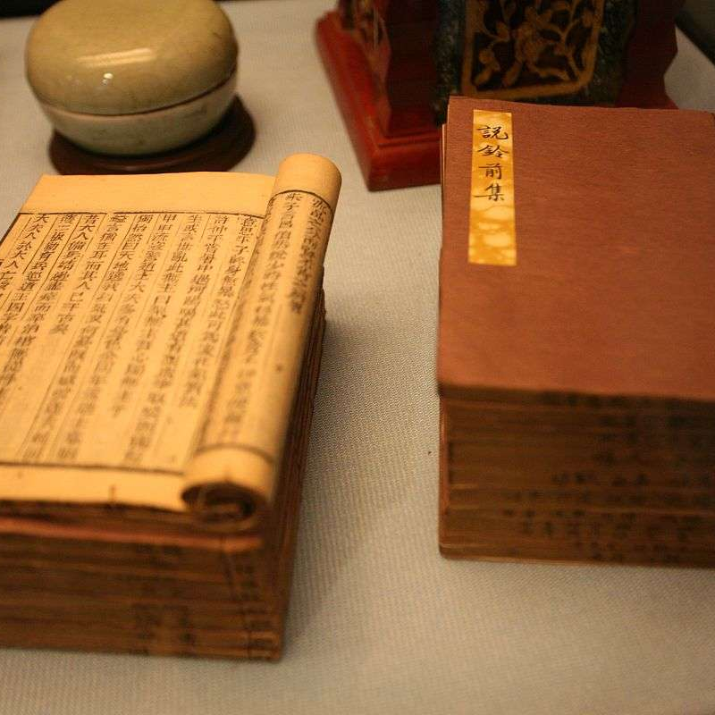
The central government choose Rectifiers（中正官）, and regions（州） and commanderies（郡） have Senior Rectifiers and Junior Rectifiers respectively
Evaluation of “virtue”, “talent” and family , with a distinction of nine ranks
What is evaluated: family, virture and talent to determine the rank（But after the Jin Dynasty, rank was based entirely on family lineage.

Slide 16
First, the Junior Rectifiers will consider, to a large extent, the position held by the candidate's ancestors and the number of generations in office. Next, the Junior Rectifiers continues to examine the candidate's merits. Then, the Junior Rectifiers will submit their ranks to Senior Rectifiers , who will check the correctness of the ranks and submit it to the Minister of Personnel. Finally, the Minister will select the officials and appoint them to their positions.
The official rank corresponds to the rank of each candidate.
Every three years, the Rectifiers will submit his recommendations to the Ministry of Personnel. In his recommendations, the Rectifiers will express his opinion as to whether or not an official who has already been given a position should be promoted.

Slide 17
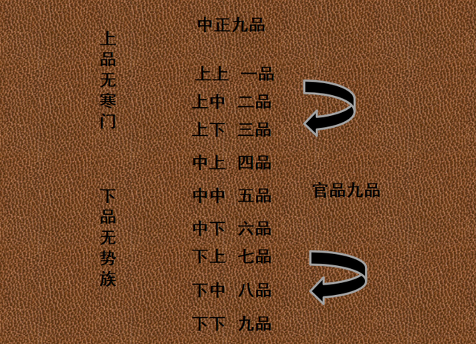
superior-superior 上上
superior-intermediary 上中superior-inferior上下
intermediary-superior 中上
intermediary-intermediary 中中
intermediary-inferior 中下
inferior-superior 下上
inferior-intermediary 下中
and inferior-inferior 下下

Slide 18
The importance of one’s family
06

Slide 19
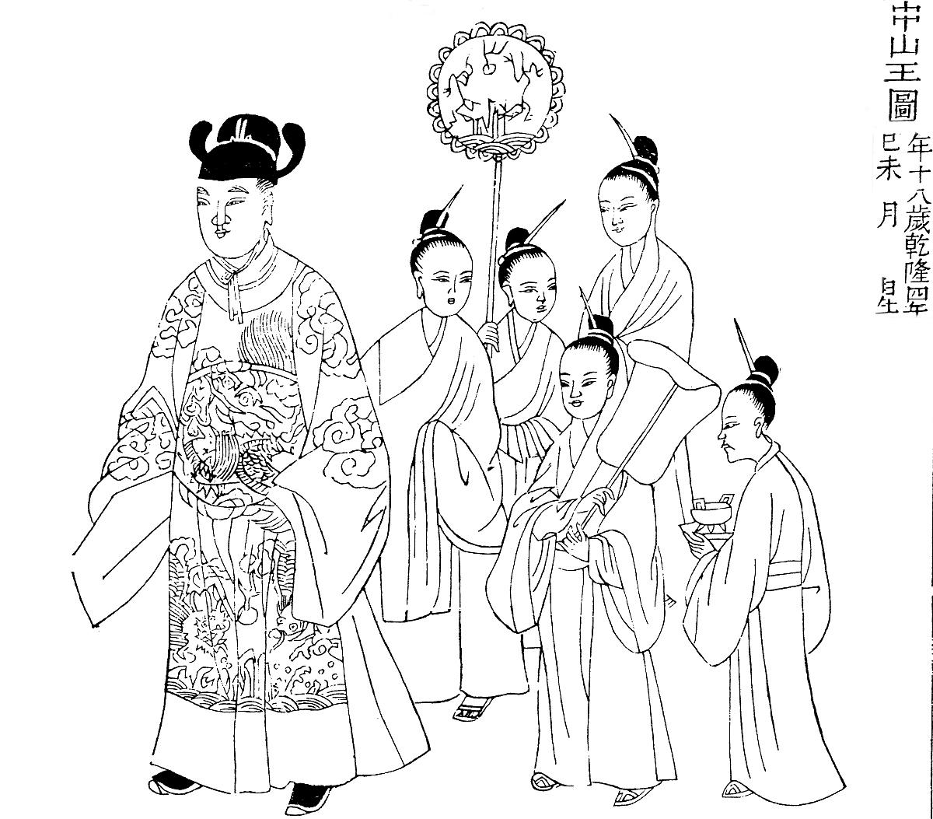
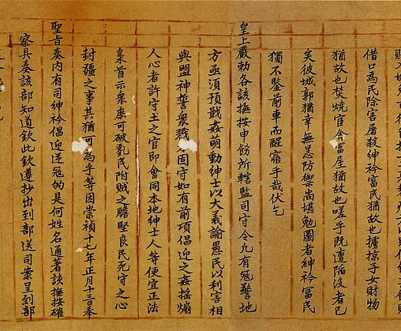
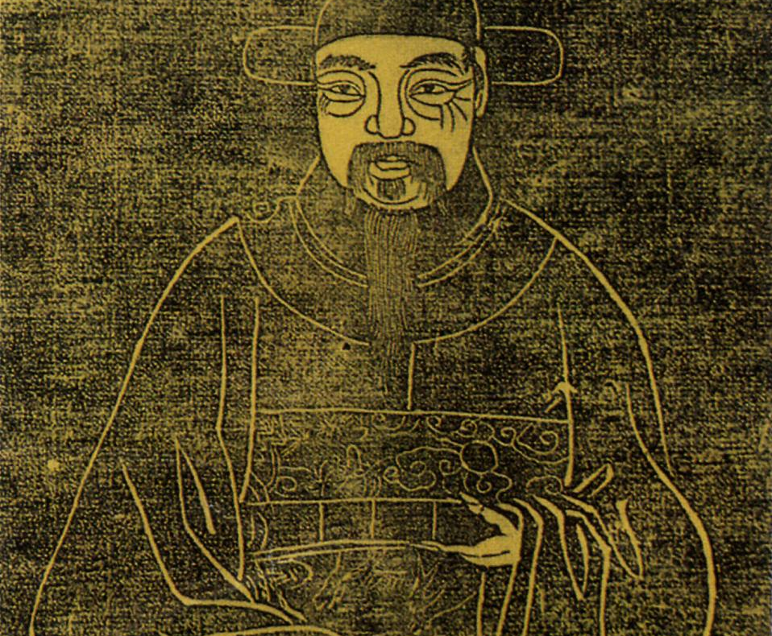
In ancient times, studying was actually a luxury, and the better the family lineage the easier it was to get hold of quality educational resources
The actual implementation of to find talent is not an easy thing。How do you find talent a little easier, look at his family background
The internal tacit agreement of the great families, i.e., to give higher grades to the children of the families with which they have dealings of interest.

Slide 20
The impacts of Nine-Rank Official Selection System
07

Slide 21
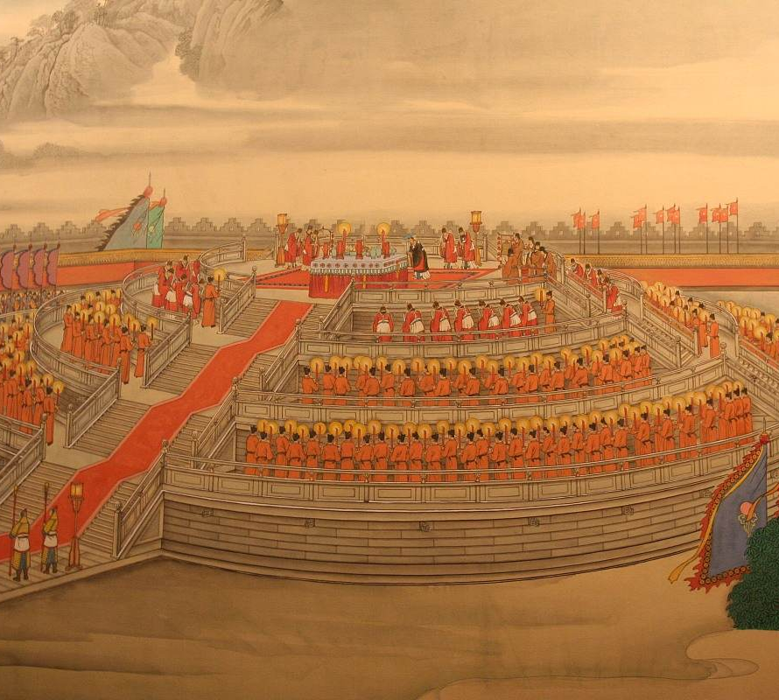
1
It did get a lot of talent in the early days
2
Favors centralization of power
3
Alleviating the conflict with the great families

Slide 22
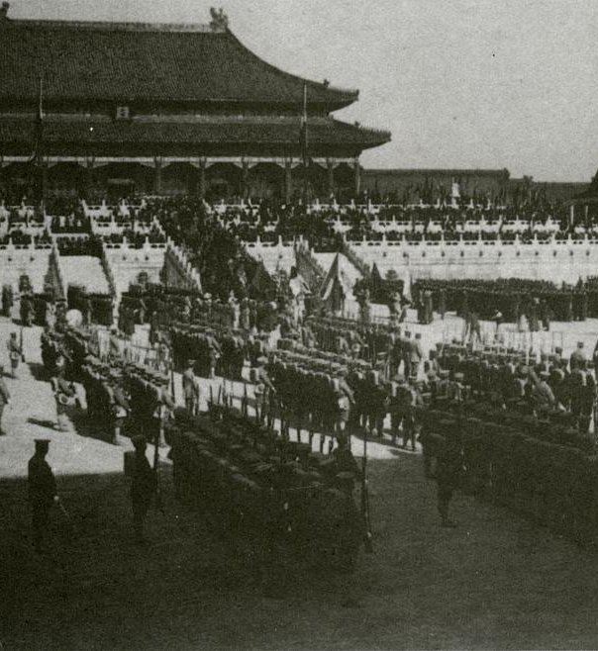
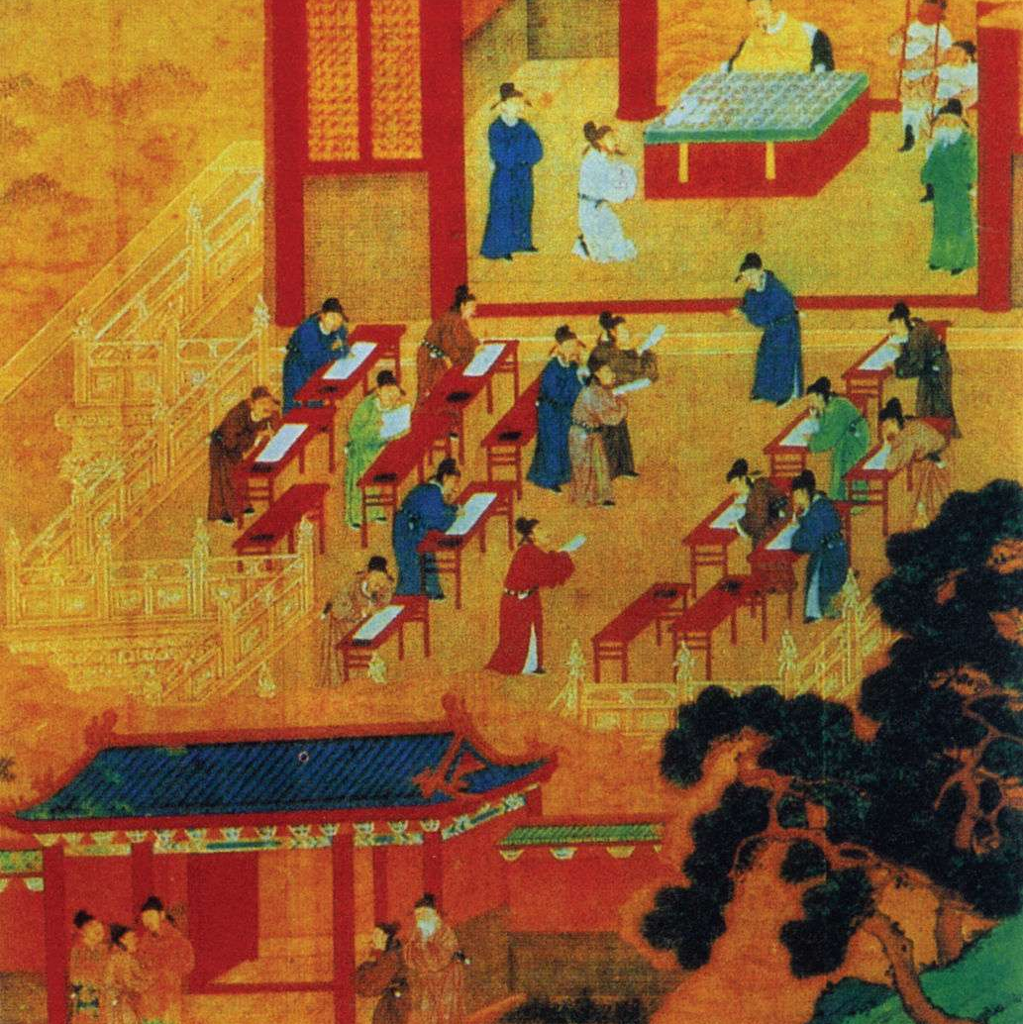
01
It became a tool for the big families to control the government.
02
03
The system could not continue with the decline of the great families in the latter part of the period
Toward the end of the Southern Dynasty, abolished under the Sui Wendi Emperor

Slide 23
8
Conclusion

Slide 24
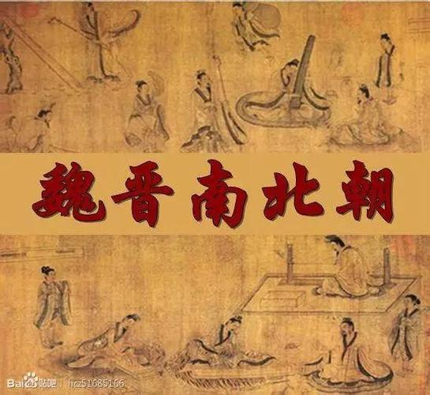
01
02
03
Nine-Rank Official Selection System is a supplement and improvement to Recommendatory System.
Positive in the beginning, but later exploited by the great families
The inevitability and limitations of historical development

Slide 25

THANKS
感谢您的观看

