Slide 1
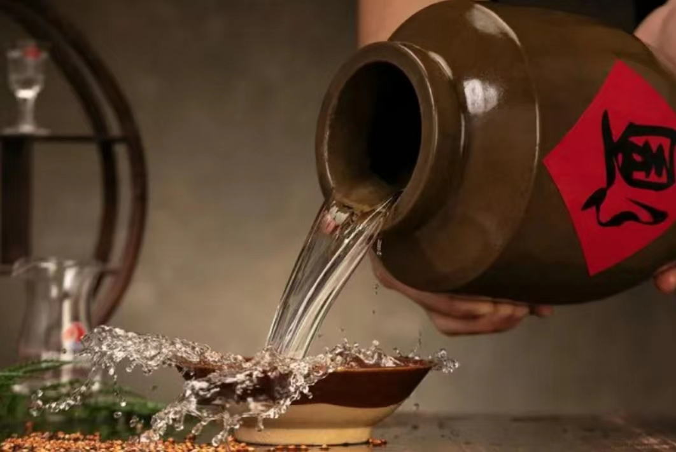
The Liquor Culture of Ancient China

Slide 2

CONTENTS
Part 01
Origin
Part 02
Drinking Vessel
Part 03
Types
Liqour culture
Part 04

Slide 3
A.
Part 01
Origin

Slide 4
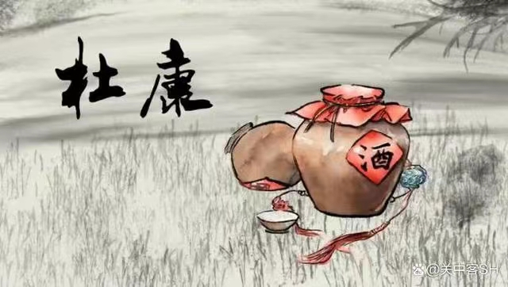
Origin
汉代史官撰写的《世本》称：“仪狄始作酒醪，变五味，少康（杜康）作秫酒。”
Who?
Some recordings:
《酒诰》、《世本》、《说文解字》、《战国策》、《汉书》
Some poems:
如曹操的“何以解忧，唯有杜康”，
白居易的“杜康能散闷，萱草解忘忧”，
苏轼的“从今东坡室，不立杜康祀”，
邵雍的“吃一辈子杜康酒，醉乐陶陶”等等
The Chinese Dionysus
标题文字内容
The synonym of liquor
标题文字内容
ENTER THE TITLE HERE
ENTER THE TITLE HERE

Slide 5
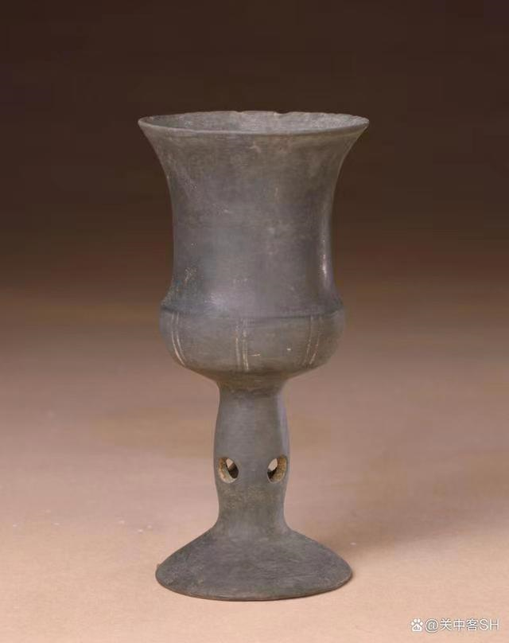
Uncertain
Origin
How?
According to the legend,one day it rained suddenly while Du Kang was herding the sheep.Hastily driving the sheep back to the sheepfold, he forgot some husked sorghum rice in a hollowed trunk by accident, and when he came back after a few days, the rice he left there became so fragrant that he couldn’t help tasting some. Surprisingly, it was palatable.
晋代文人江统的《酒诰》中有段的介绍：“酒之所兴，肇自上皇；或云仪狄，一曰杜康。有饭不尽，委之空桑，积郁成味，久蓄气芳，本出于此，不由奇方”。
标题文字内容
标题文字内容
ENTER THE TITLE HERE
ENTER THE TITLE HERE

Slide 6
B.
Part 02
Drinking Vessel

Slide 7
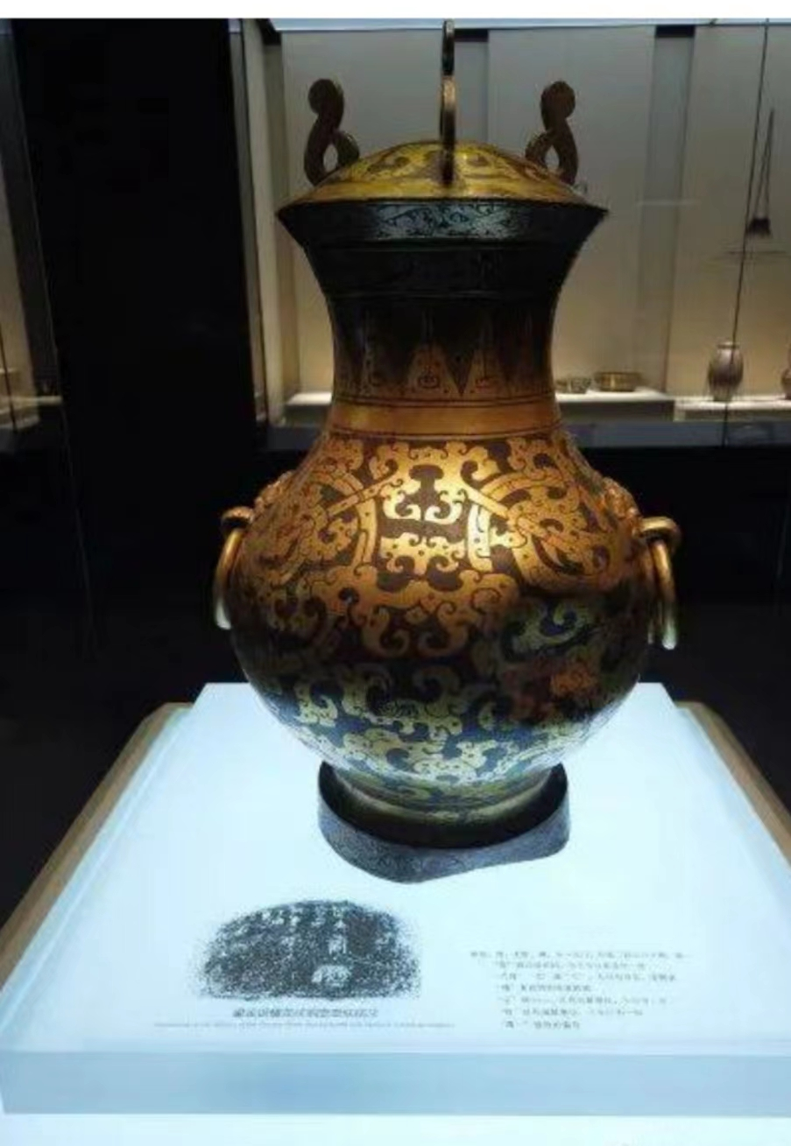
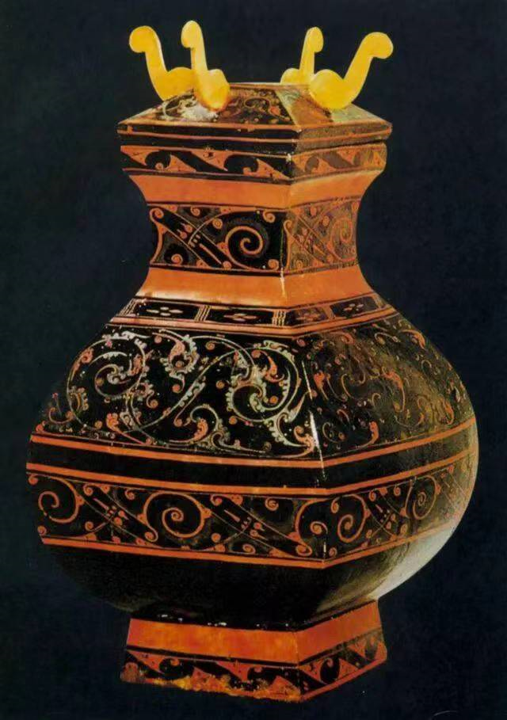
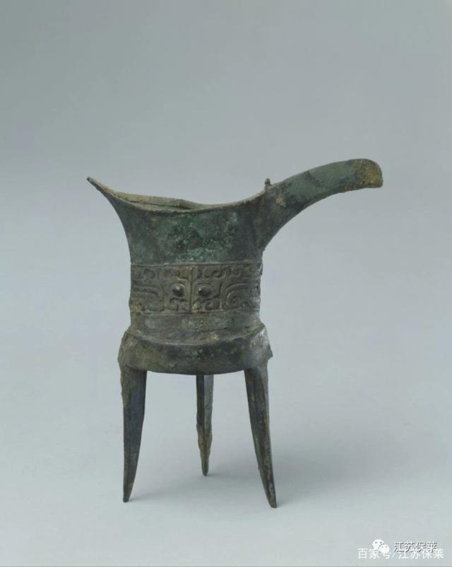
The history of the drinking vessel
In different historical periods, due to the continuous development of
society and economy, the production technology, materials, and
appearance of wine vessels naturally has undergone corresponding
changes
The Neolithic culture period.(新石器时代）
Wine vessels should be general utensils, such as bowls, bowls and other large vessels
Liquor utensils was
differentiated from ordinary eating utensils.Full-time wine set makers also emerged.
The Shang and Zhou Dynasties
Bronze ware （青铜器）reached its heyday
Qin and Han dynasties to Southern and Northern Dynasties
Bronze wine ware and lacquer wine ware（漆酒器） were developed equally.
In ancient times, wine was unfiltered mash, mushy and semi-liquid, and for this kind of wine, it was not suitable for drinking, but for eating
All aspects of society and culture are developing rapidly. At the end of the Eastern Han Dynasty, the turbulent situation caused by successive wars made people's thoughts extremely active.
The quality of wine set often become a symbol of the status of the drinker.
The brewing industry and the tin and bronze production technology developed.

Slide 8
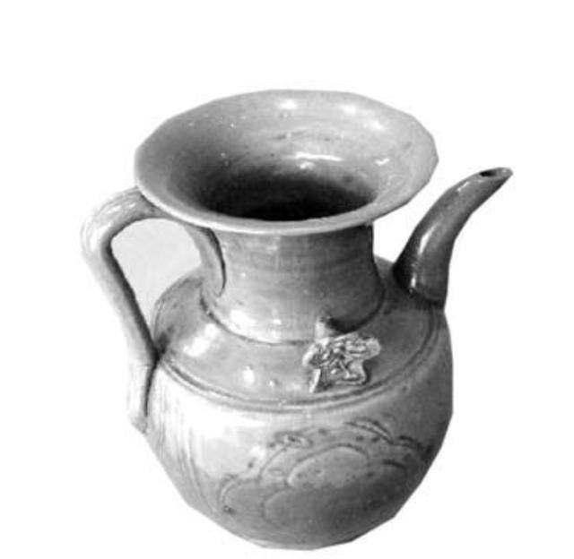
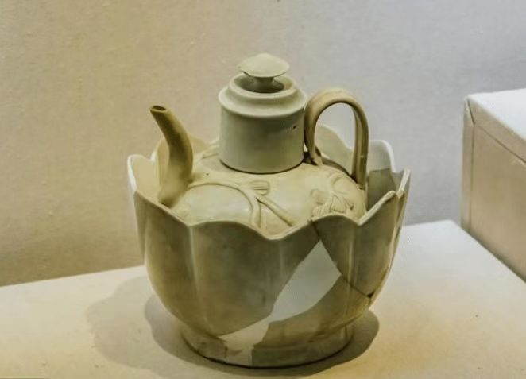
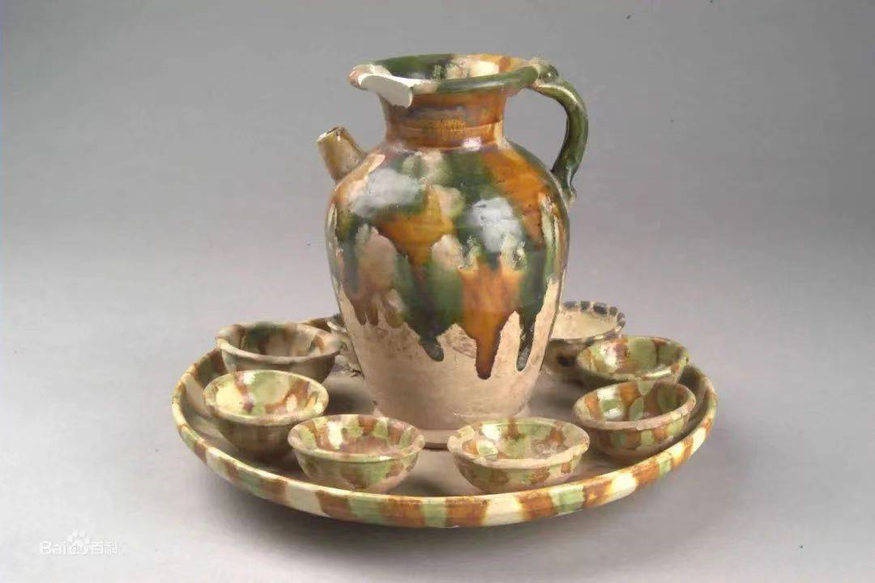
The history of the drinking vessel
Song and Yuan Dynasties
The development of porcelain wine vessels has formed a scale, and supporting small pieces are rich and diverse.
Sui and Tang Dynasties
The porcelain wine ware was the main, supplemented by gold and silver wine ware.
In Sui dynasty,
porcelain had beautiful shape and glazed smooth.
By the Tang Dynasty, the development of porcelain wine ware and gold and silver wine ware reached its peak. During this period, tang Tri-glazed pottery was created.
The social and political situation was relatively stable, and the unification and integration of various ethnic groups promoted the exchange and compatibility of diverse cultures.
The porcelain firing technology (瓷器烧造技术）had reached a high level.
The market had strong demand and production technique was promoted.

Slide 9
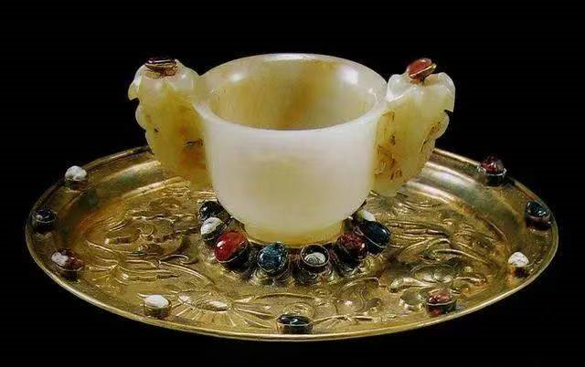
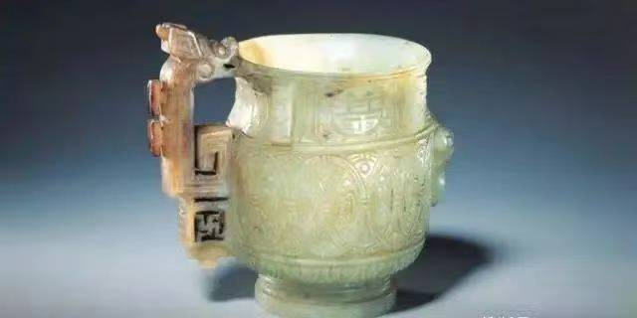
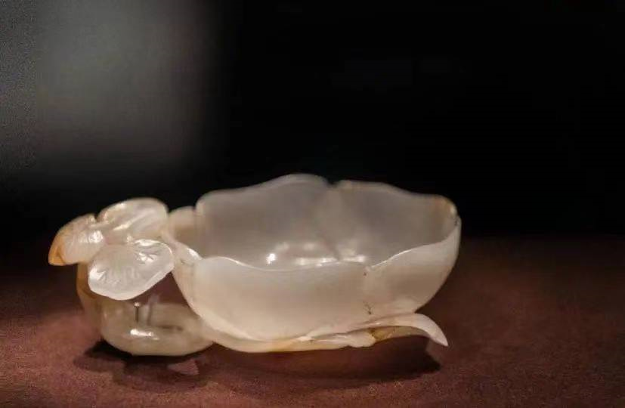
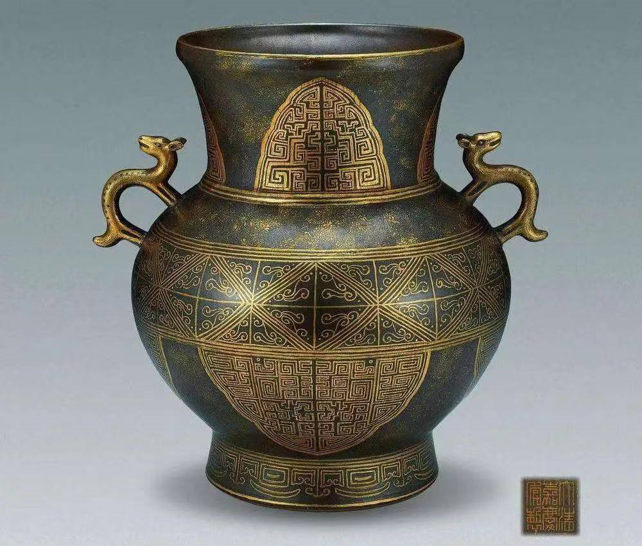
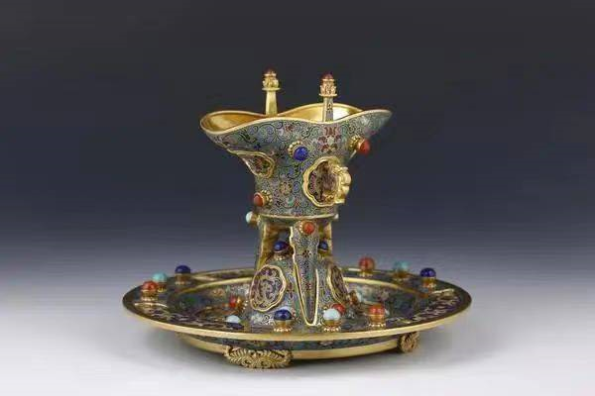
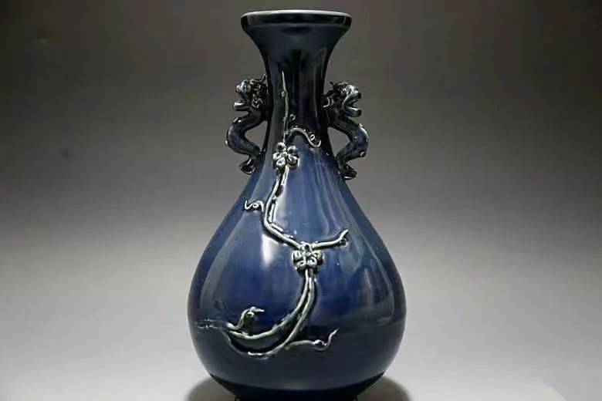
The history of the drinking vessel
Gold and silver wine vessels and jade wine vessels
The Ming Qing dynasties. The Ming and Qing dynasties were the heyday of the development of China's ancient porcelain wine ware.
After the Ming Dynasty, Jingdezhen became the most important and largest kiln factory, which continued for five or six hundred years in the Ming and Qing dynasties. The white glaze and blue and white porcelain produced in this area are quite famous, which are not only famous at home, but also become the main commodities of foreign trade.
Many antique device

Slide 10
C.
Part 03
Types

Slide 11
Different properties
fermented wine
distilled liquor
Yellow rice wine
Baijiu
prepared beverage wine
Beer, wine, rice wine , fruit wine
虎骨酒，参茸酒，竹叶青

Slide 12
D.
Part 04
The liquor culture

Slide 13
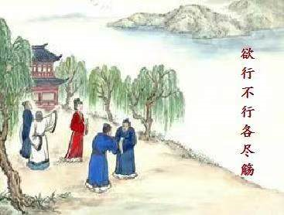
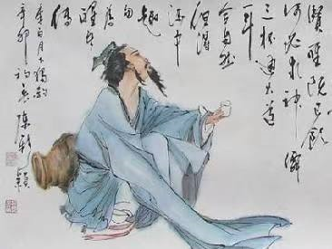
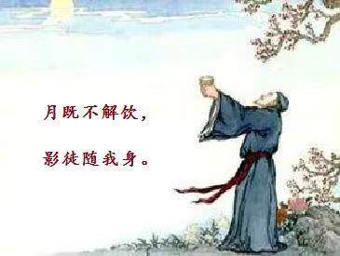
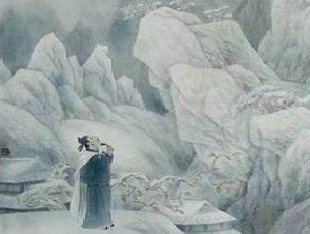
Liquor and literature
金陵酒肆留别 李白
风吹柳花满店香，吴姬压酒唤客尝。
金陵子弟来相送，欲行不行各尽觞。
请君试问东流水，别意与之谁短长。
On poems：
月下独酌 李白
花间一壶酒，独酌无相亲。
举杯邀明月，对影成三人。
月既不解饮，影徒随我身。
暂伴月将影，行乐须及春。
我歌月徘徊，我舞影零乱。
醒时同交欢，醉后各分散。
永结无情游，相期邈云汉。
山中与幽人对酌 李白
两人对酌山花开，一杯一杯复一杯。
我醉欲眠卿且去，明朝有意抱琴来。

Slide 14
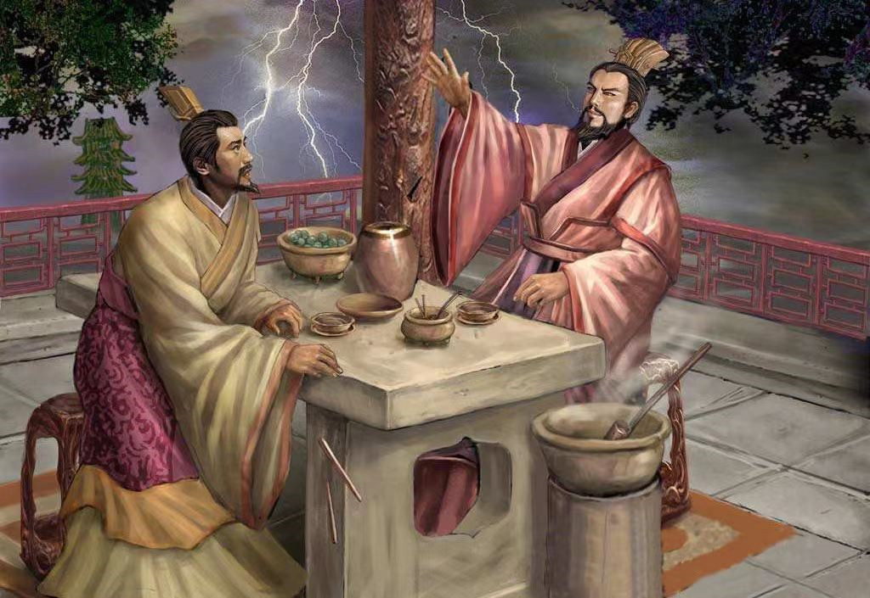
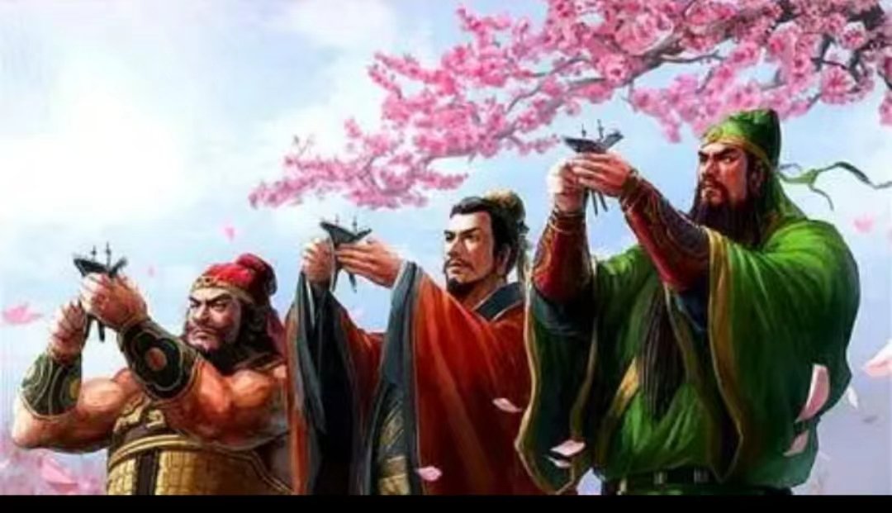
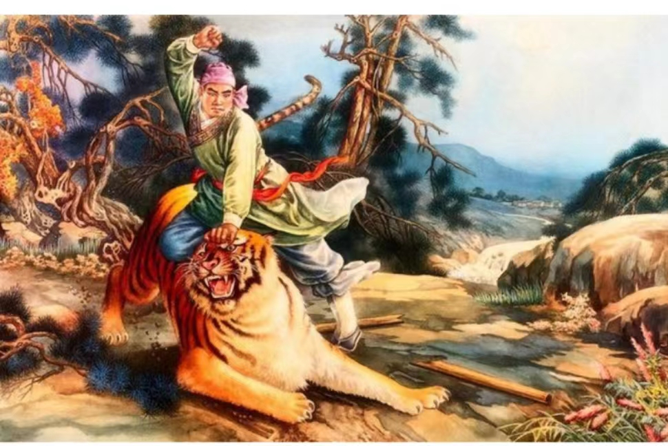
Liquor and literature
On fictions：

Slide 15
Liqour and traditional customs
Drinking played an important role in socializing. At the same time, in the traditional customs of ethnic minorities, the traditional etiquette and customs of "wine" are everywhere, expressing the welcome and sincerity to guests sincere passion.
In marriage custom
In social custom
In fete
输标题
It has the function of agreeing vows. The prelude to marriage is "engagement", many ethnic engagement custom, are the word of wine as the head, so the wedding curtain is opened by wine. In Northeast China, for example, the first step after a couple gets married through a matchmaker is to drink "blind date wine."
During ancestor worship, families of all ages would burn paper and liquor to the tombs of their ancestors to offer libation, meaning to bring money, wine and meat to the deceased. Burn paper, drink wine, points on a cake firecrackers, meaning to invite ancestors here "drink and recieve money".

Slide 16
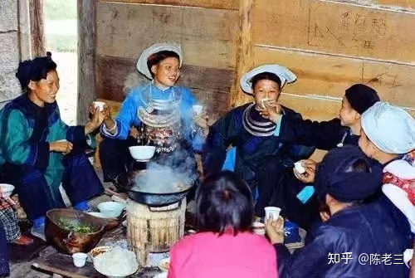
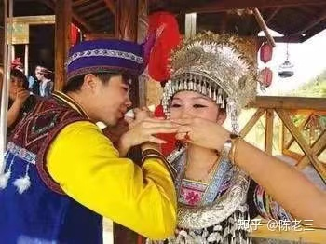
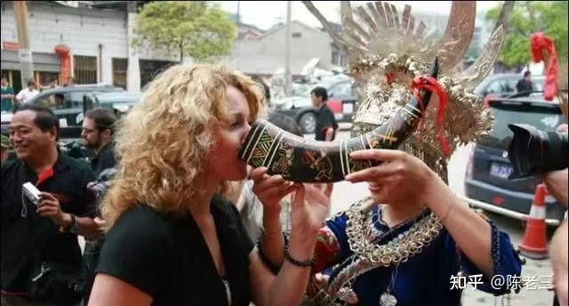
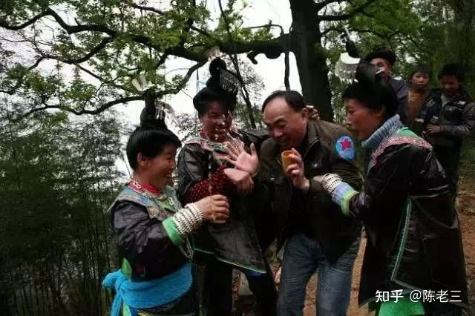
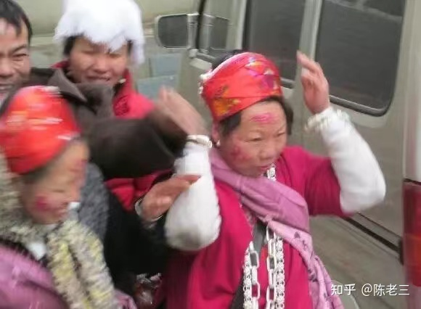
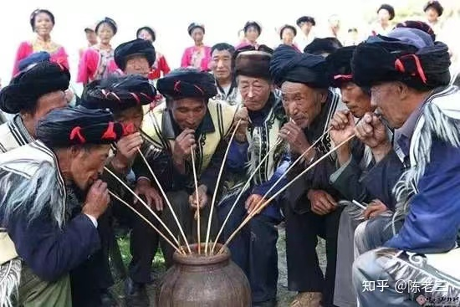
转转酒
交杯酒
拦路酒
送客酒
咂酒
打印酒

Slide 17
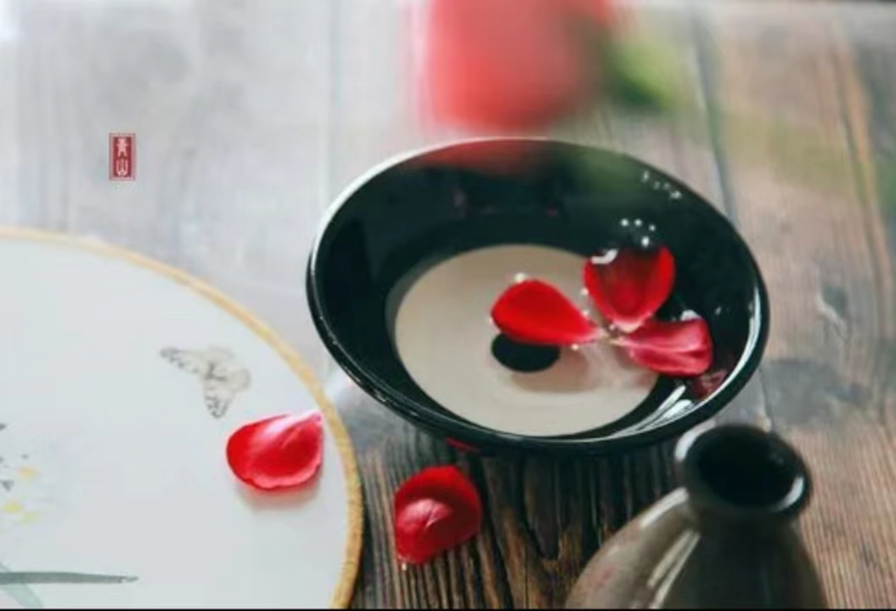
Chinese traditional wine culture has rich spiritual and cultural characteristics, which embodies abundant personal hope and social expectation。

Slide 18
感谢您的观看
THANKS

