Slide 1
漢朝
Han Dynasty
(206 B.C. – 220 A.D.)

Slide 2
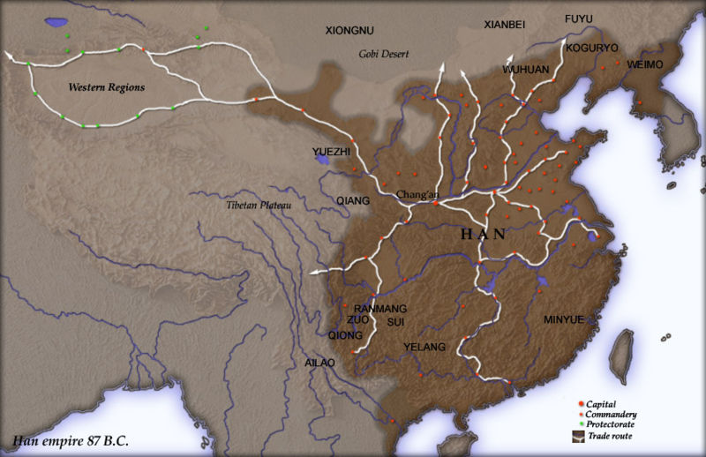
(206 B.C. – 220 A.D.)

Slide 3
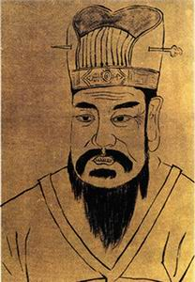
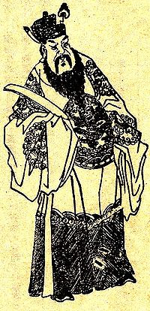
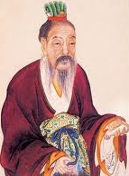
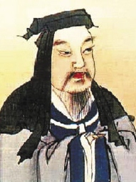
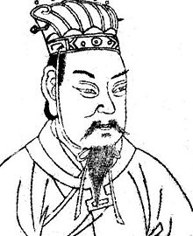
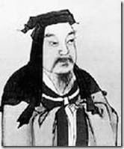
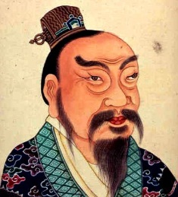
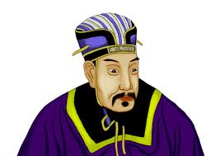
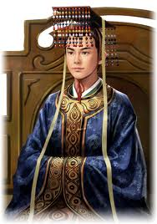
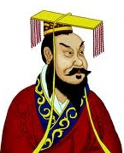
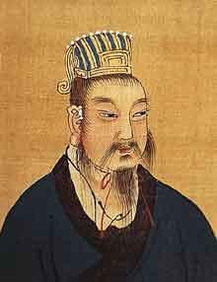
impostor
9 A.D.
189 A.D.
208 A.D.
220 A.D.
206 B.C.
193 B.C.
184 B.C.
202 B.C.
5 B.C.
157 B.C.
189 A.D.
HAN TIME LINE
Western Han
Eastern Han

Slide 4
HOW DID THE HAN DYNASTY START?

Slide 5
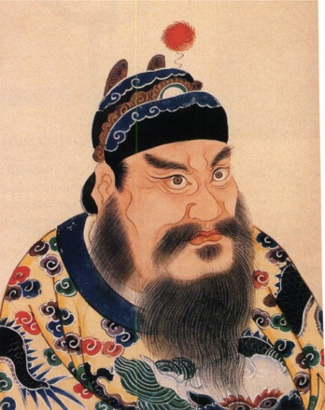
秦始皇
Qin Shi Huang

Slide 6
210 B.C.
秦始皇
Qin Shi Huang

Slide 7
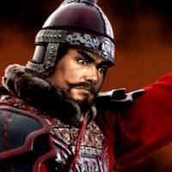
與
VS
項羽楚Xiang Yu
Of Chu
漢劉邦
Liu Bang
Of Han

Slide 8
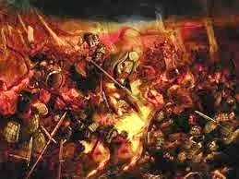
垓下之戰
The Gaixia Battle

Slide 9
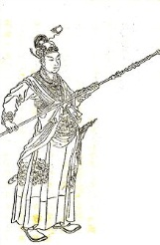
KIDNAPS THE WIFE
漢韓信
Han Xin
of Han

Slide 10
KIDNAPS THE WIFE
OF
Xiang Yu
of Chu
漢韓信
Han Xin
of Han

Slide 11
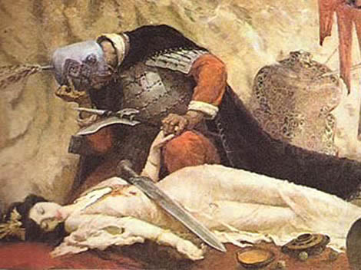
項羽死了

Slide 12
項羽死了

Slide 13
項羽死了

Slide 14
Gaozu
漢劉邦
Liu Bang
漢高祖
Emperor
成為
becomes

Slide 15
Gaozu rules with Xiao He

Slide 16
Gaozu rules (202-195 B.C.)

Slide 17
-ushered in the Western
Han Dynasty
-emerged from the
peasant class
-preferred Confucianism
Gaozu rules (202-195 B.C.)
-set up Capital at Luoyang
-died from an arrow wound from rebels

Slide 18
Wen rules with Cao Can

Slide 19
Wen rules (180 – 157 B.C.)

Slide 20
Wen rules (180 – 157 B.C.)
-Emperor Gaozu’s son
-put down the Lu
rebellion
-into Daoism
-a Kind Emperor
-built many Temples

Slide 21
Wu rules (141 – 87 B.C.)

Slide 22
Wu rules (141 – 87 B.C.)
-favored Confucianism
-expanded the Empire
-obsessed with immortality
-died with no heir

Slide 23
GuangWu rules (5 B.C. – 57 A.D.)

Slide 24
GuangWu rules (5 B.C. – 57 A.D.)
-restores Han Dynasty (in 25) from
Wang Mang of Xin,
who usurped
power from
the Hans.
-put down
many
uprisings.
-thrift and
efficient
-died in 57 A.D.

Slide 25
Xian ruled with Dong Zhuo

Slide 26
Xian rules (189 – 220 A.D.)

Slide 27
Xian rules (189 – 220 A.D.)
-struggles with
Cao Cao
-loses power
to Cao Pi

Slide 28
The Han Dynasty
漢朝

Slide 29
The Han Dynasty
漢朝
-FOUR CENTURIES!
-THE GOLDEN AGE OF CHINA
-TODAY, MANY ARE “HANS”
-EVEN THE LANGUAGE IS “HAN”

Slide 30
WORKS CITED http://en.wikipedia.org/wiki/Battle_of_Gaixia http://en.wikipedia.org/wiki/Emperor_Gaozu_of_Han http://en.wikipedia.org/wiki/Emperor_Wen_of_Han http://en.wikipedia.org/wiki/Han_Dynasty http://en.wikipedia.org/wiki/Emperor_Wu_of_Han http://en.wikipedia.org/wiki/Emperor_Guangwu_of_Han http://en.wikipedia.org/wiki/Emperor_Xian_of_Han

