Slide 1
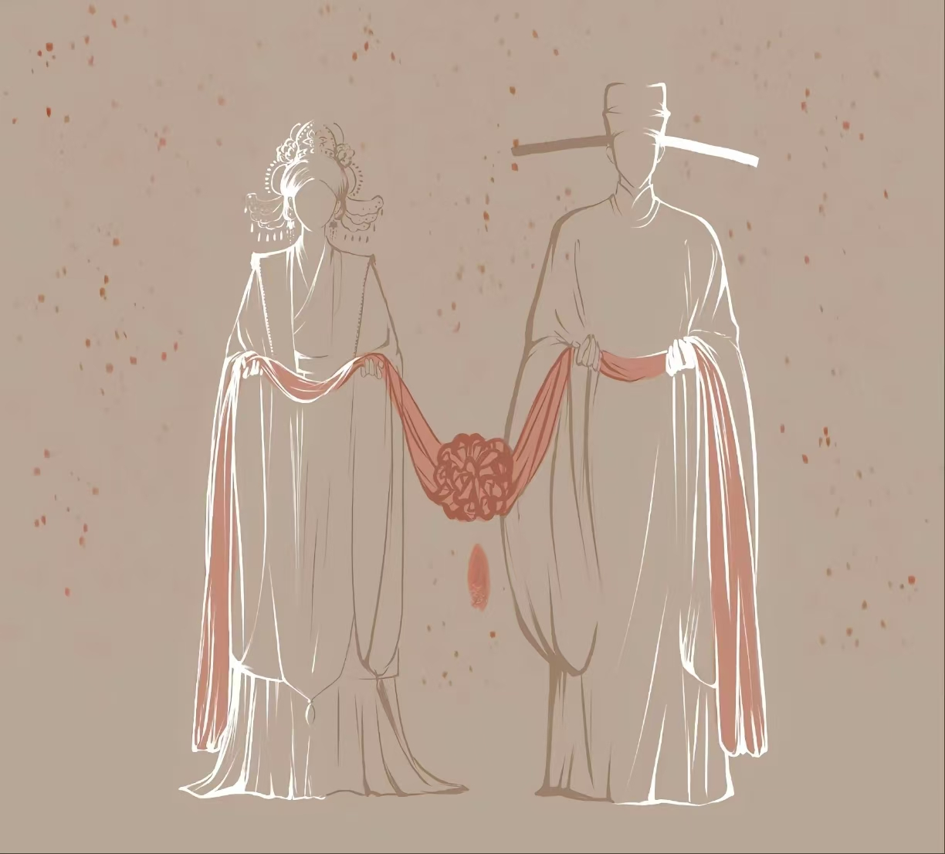
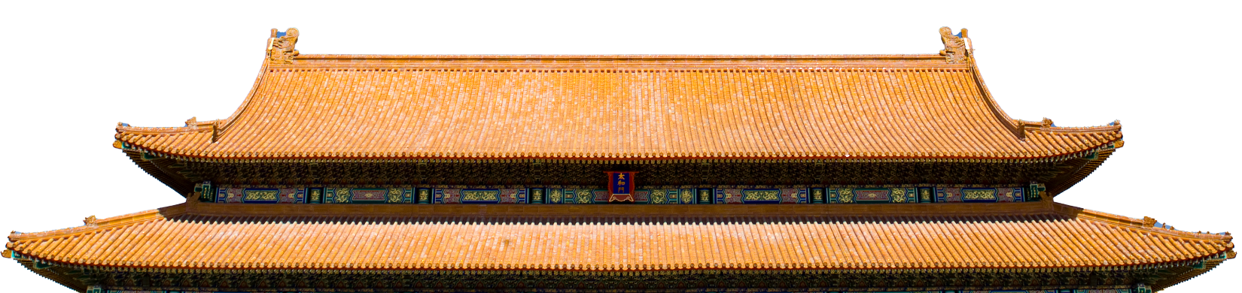
Chinese Marriage Custom
Xu Huanchang

Slide 2
Catalogue
01
Marriage customs of various dynasties
02
Essence and dross in inheritance

Slide 3


01
Marriage customs of various dynasties

Slide 4
Wei, Jin, and Northern & Southern Dynasties
Song Dynasty
now
Zhou Dynasty
Tang Dynasty
Ming Dynasty

Slide 5
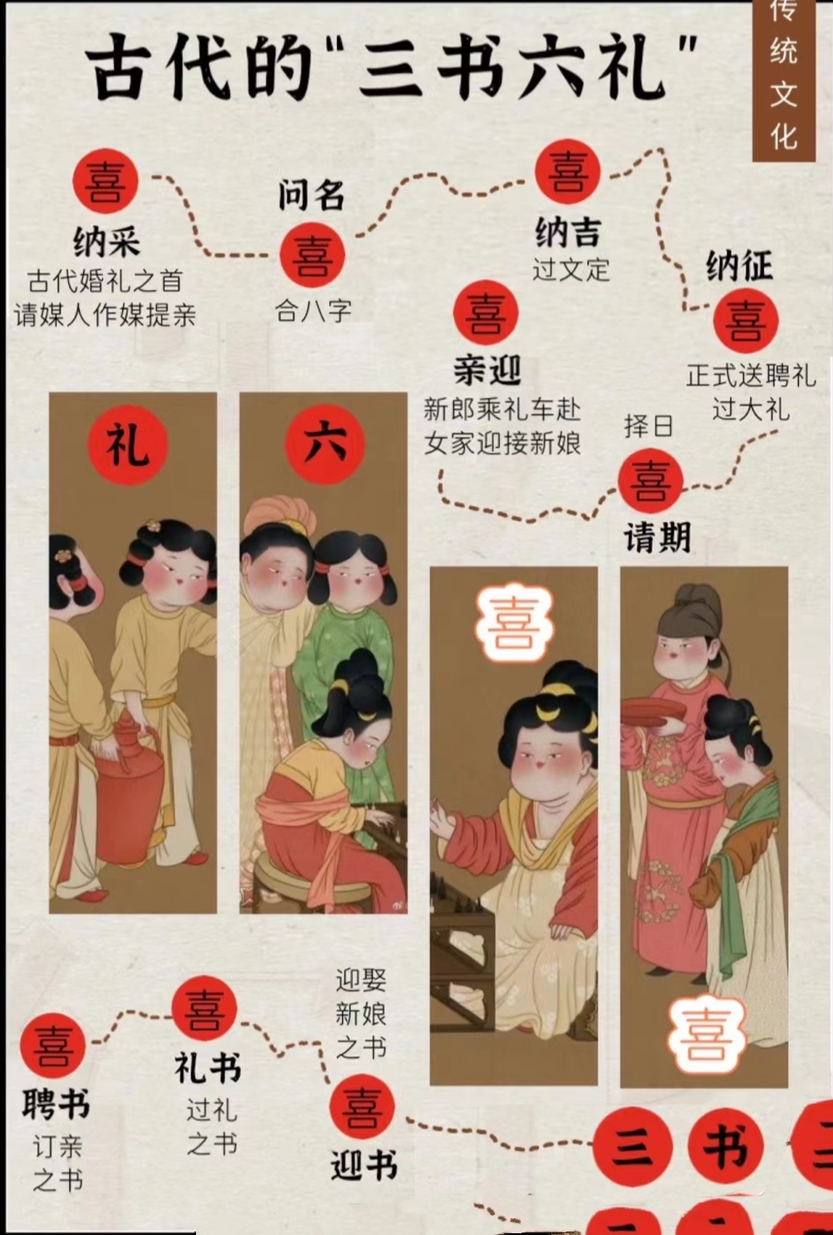
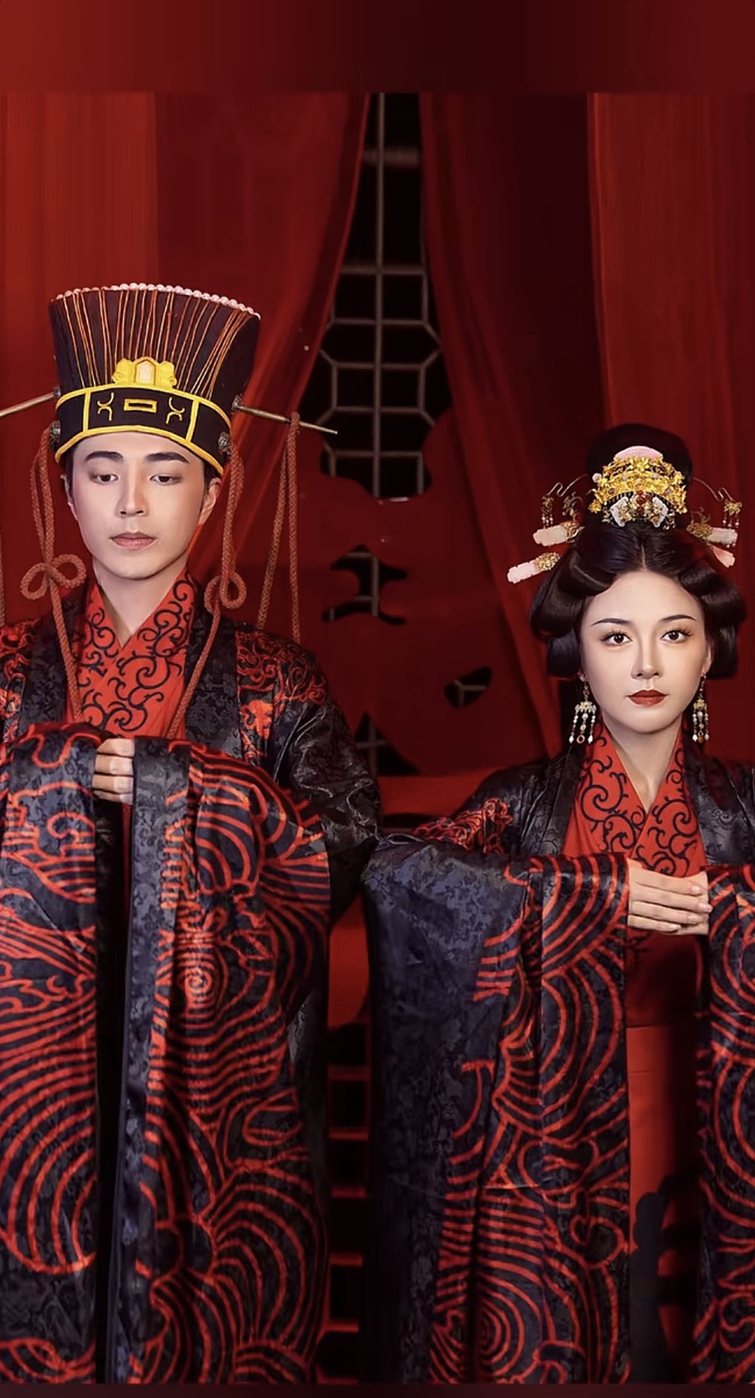
Zhou Dynasty
·Three Letters:
1. Betrothal Letter (formal engagement certificate)
2. Gift Letter (detailed list of betrothal gifts)
3. Wedding Letter (proof of marriage ceremony completion).
·Six Etiquettes:
1. Nacai (proposal solicitation);
2. Wenming (birthdate matching for astrological compatibility);
3. Naji (engagement confirmation); 4.Nazheng (presentation of betrothal gifts);
5. Qingqi (selection of auspicious wedding date);
6. Qinying (bridal procession and formal marriage rites).

Slide 6
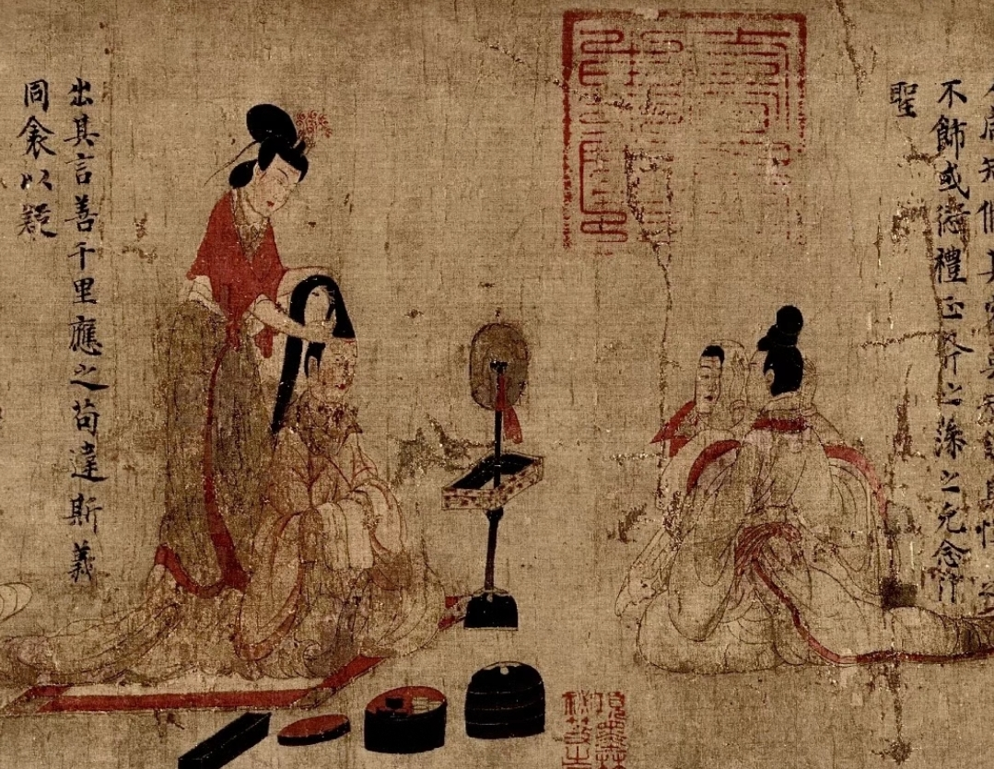
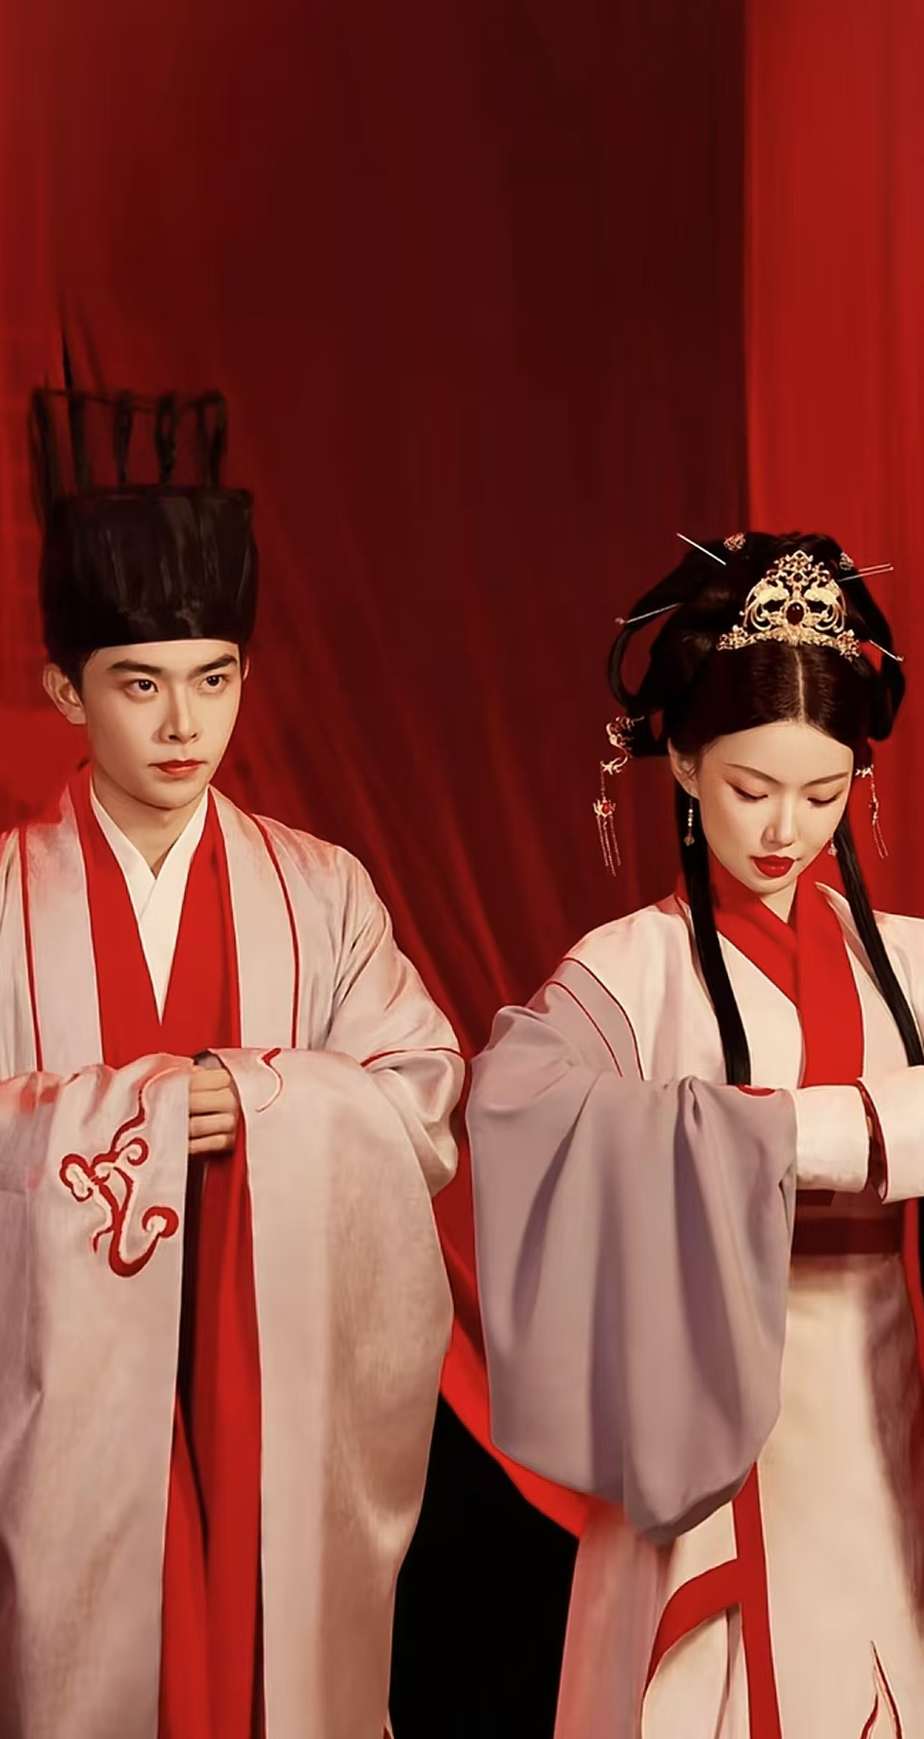
Wei, Jin, and Northern & Southern Dynasties
·Ritual Tent Ceremonies (Qing Lu Jiao Bai): Exchange of vows in blue-draped tents, blending nomadic traditions with Han rituals.
·Caste Solidification through Marriage
. Divorce Practices: Women could initiate"mutual separation agreements" (He Li)
·Groom's "Hastening the Bride" Poems (Cui Zhuang Shi):
Poetic verses composed by the groom to playfully urge the bride to prepare for the ceremony

Slide 7
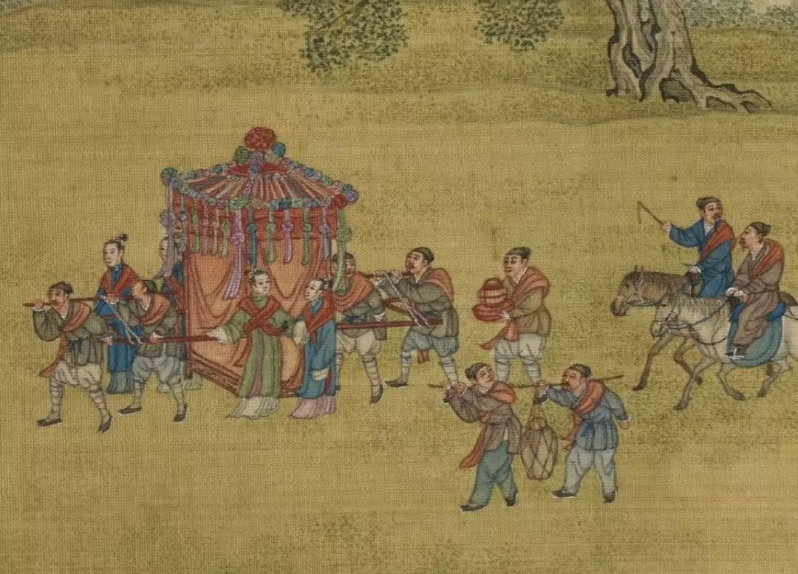

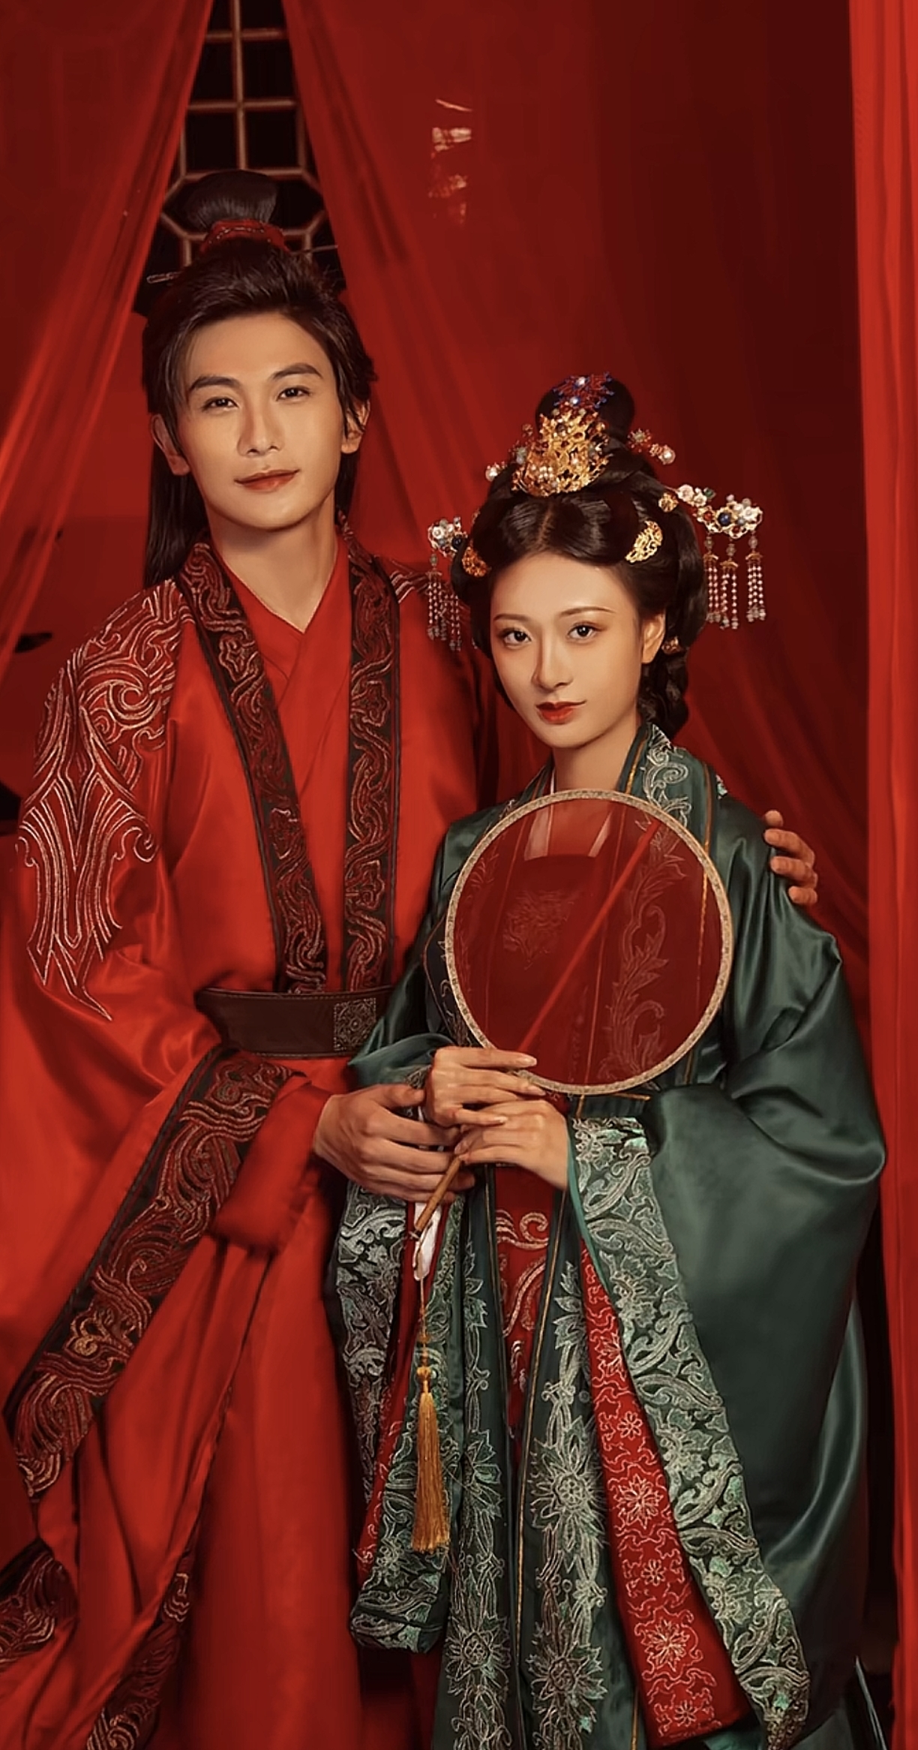
Tang and Song Dynasty
·Wedding Attire:
Distinctive "red robes for men, green gowns for women"
"Six Etiquettes" condensed into three core steps:
1. Nacai
2.Nazhen
3. Qinying
·Fan Veiling Ritual (Que Shan Li):
The bride concealed her face with a decorative fan until the groom recited poetry.
· Tang Liberality:
Elevated female status permitted remarriage (23 Tang princesses remarried per New Book of Tang), with divorce agreements recognizing mutual consent.
·Song Conservatism:
Neo-Confucianism enforced female chastity norms ("starving is trivial, losing virtue grave" Cheng Yi).

Slide 8
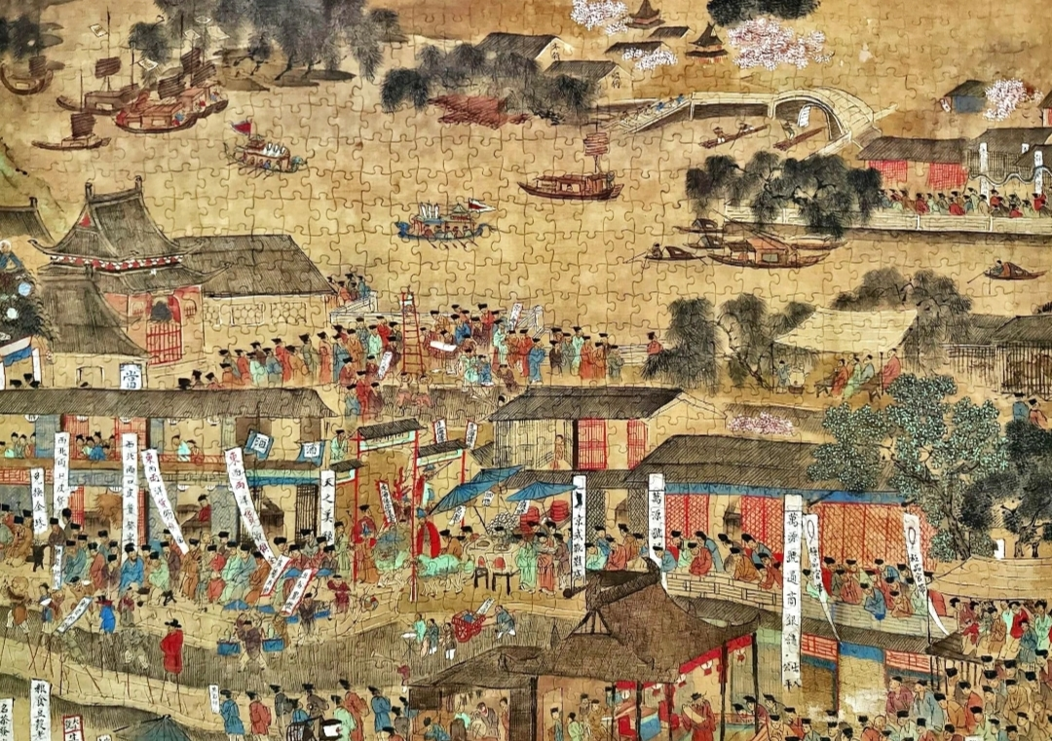
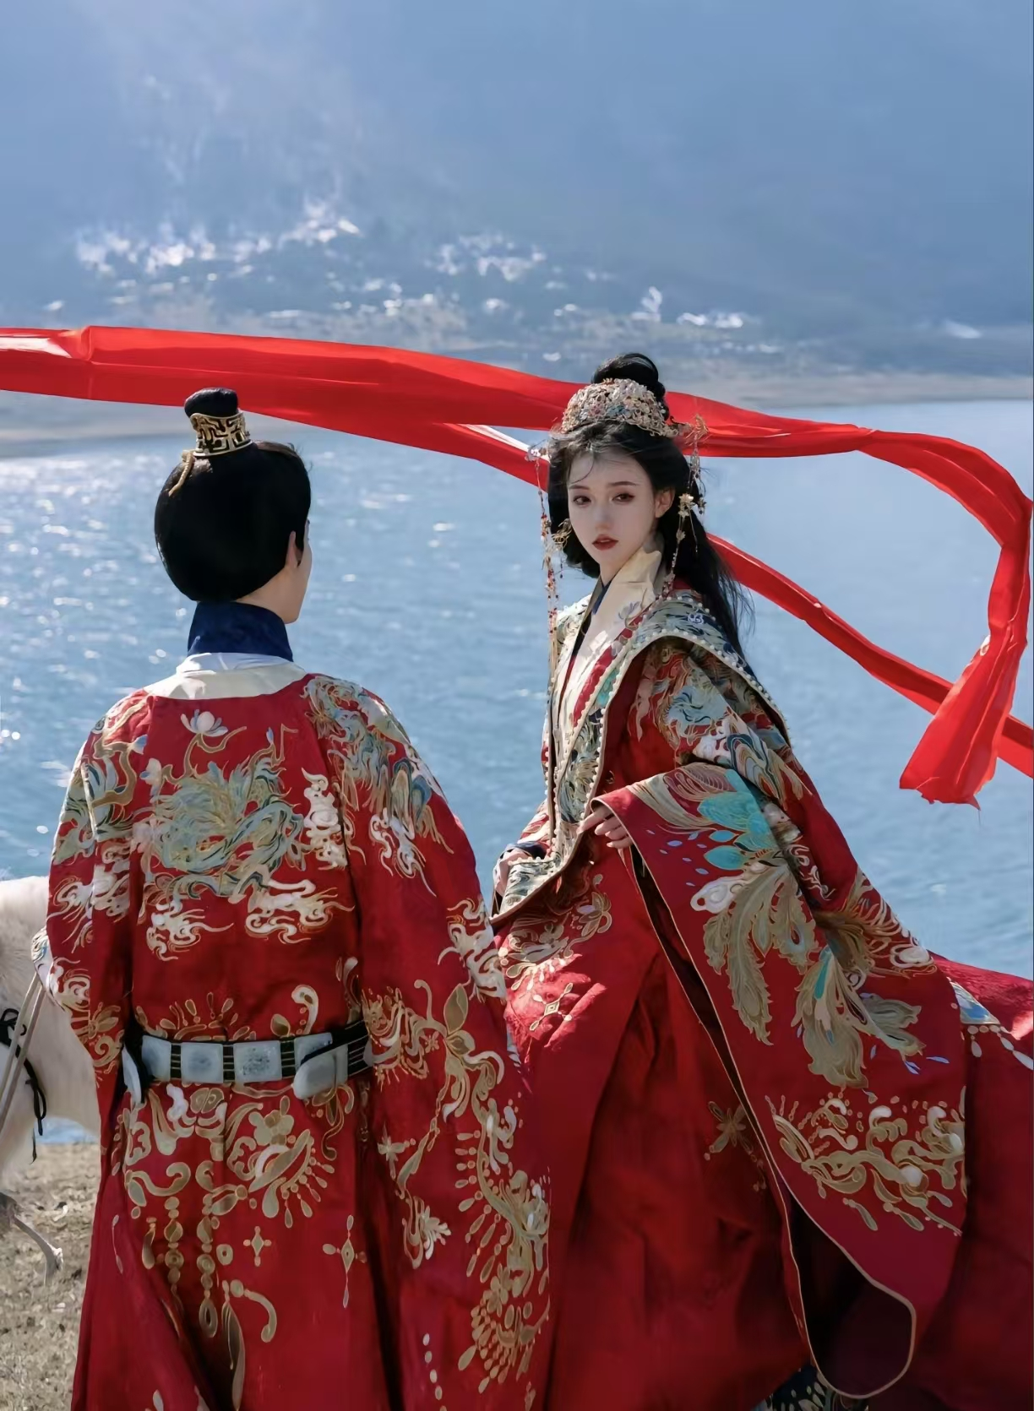
The Ming Dynasty
1. Refinement of Etiquette in Marriage
The phoenix coronet and xiapei (a ceremonial dress for women) were emphasized, laying stress on the sense of ritual.
2.Complications of the Six Rites of Marriage
For the "offering of betrothal gifts" (Na Zheng) in the six rites, it was required to have "64 palanquins carrying the betrothal gifts", which was a heavy burden for ordinary families to bear.
3. Shackles of Chastity
The concepts of "chaste women and heroic martyred women" emerged, and remaining a widow became a moral benchmark.
4. The Rise of the Custom of Wedding Troubles

Slide 9
02
Essence and dross in inheritance

Slide 10
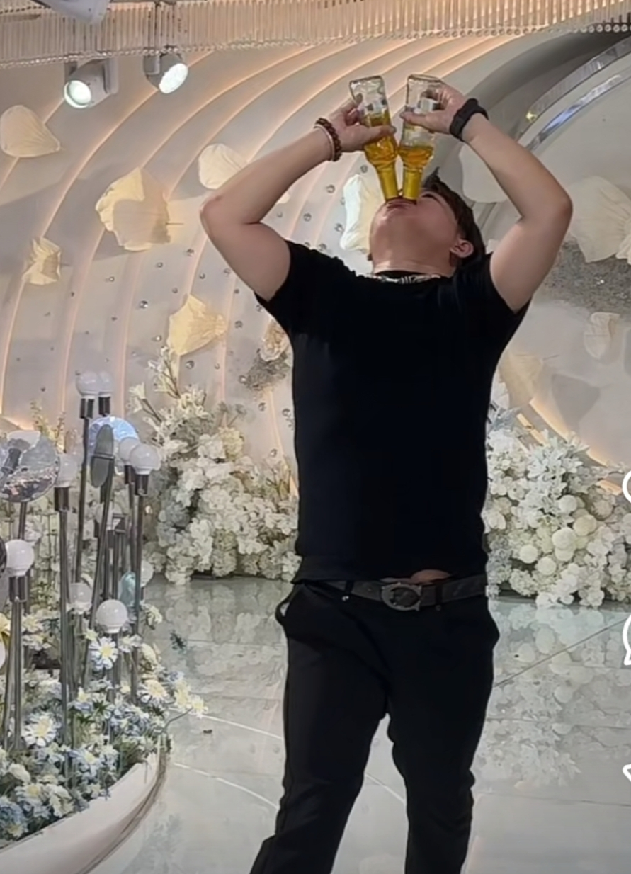
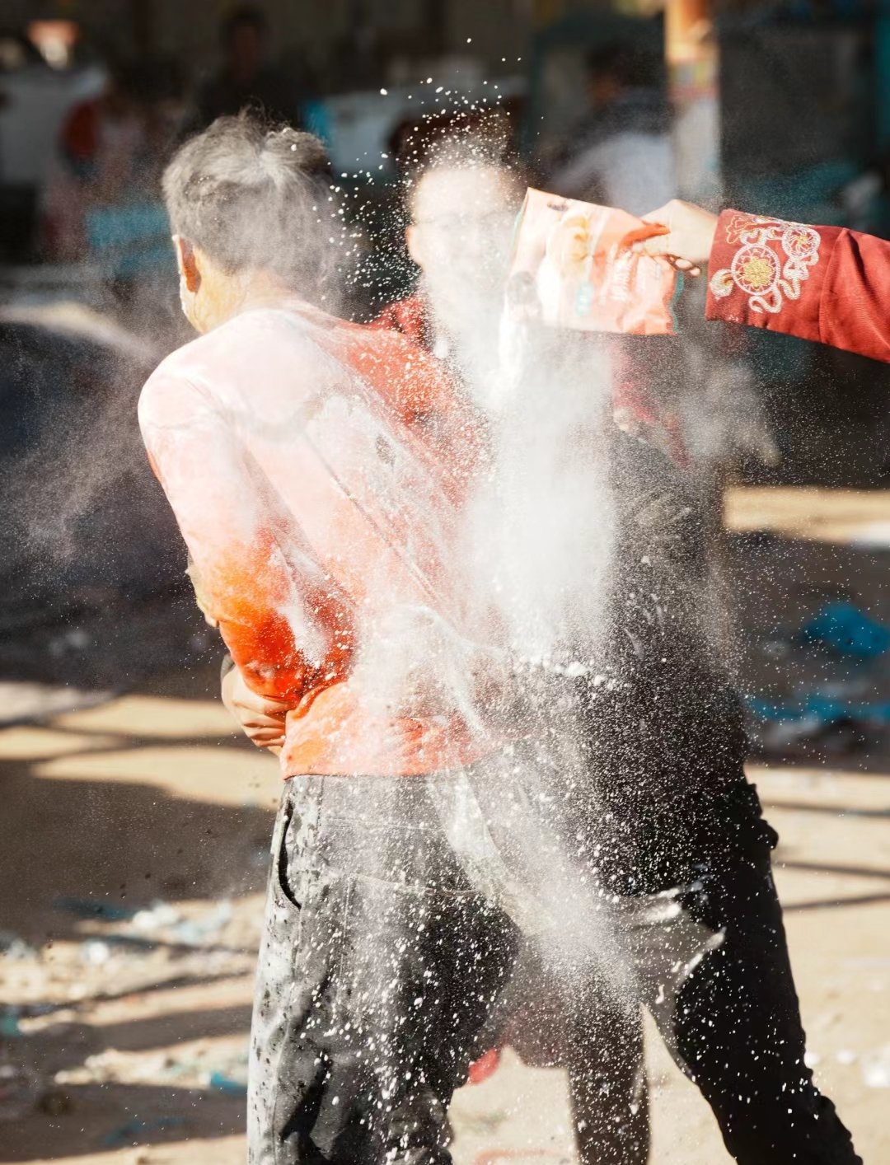

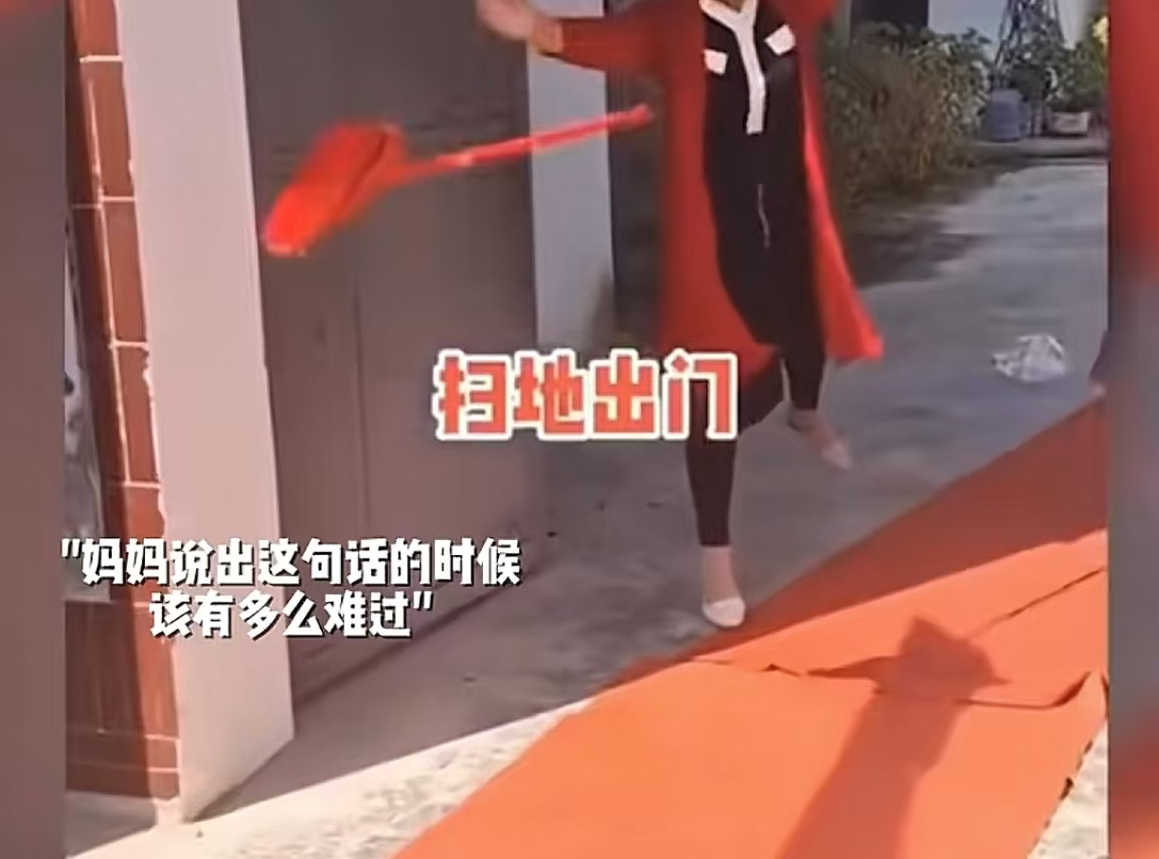
The Dross in Chinese Wedding Custom Culture
The Dross in Chinese Wedding Custom Culture：
① Vulgar Wedding Pranks
Carrying out pranks on the
bride and groom .
② excessive forced drinking .
③ sexual harassment.

Slide 11
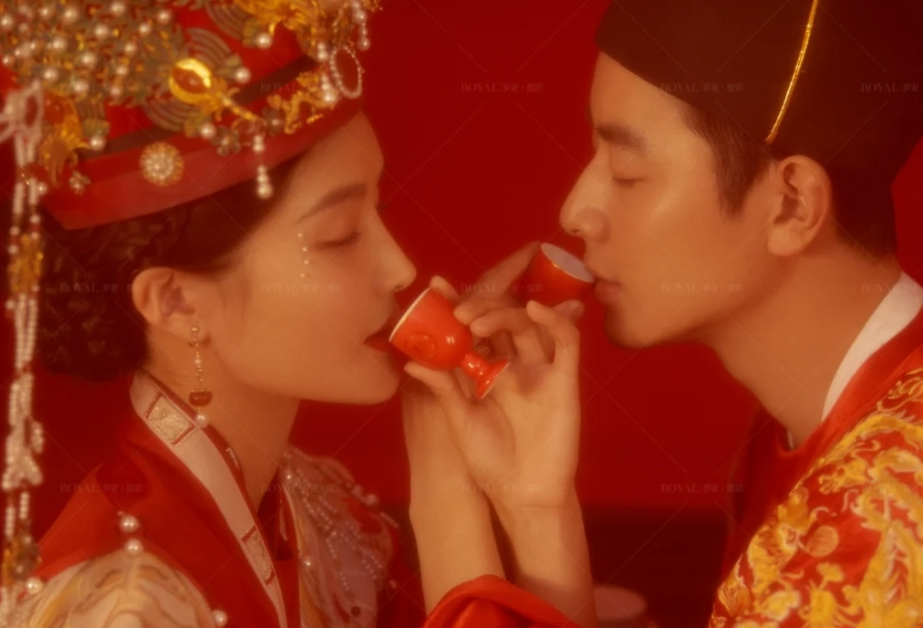
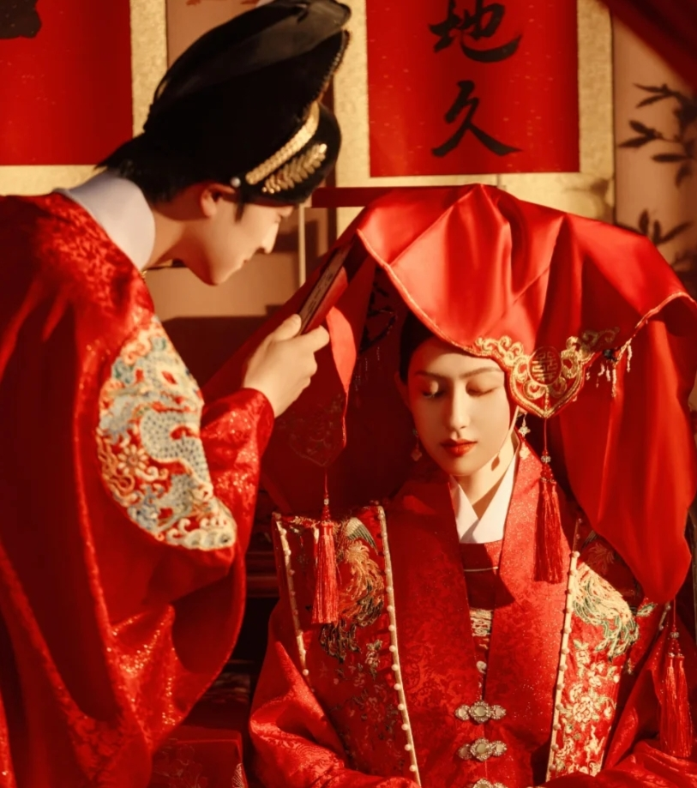
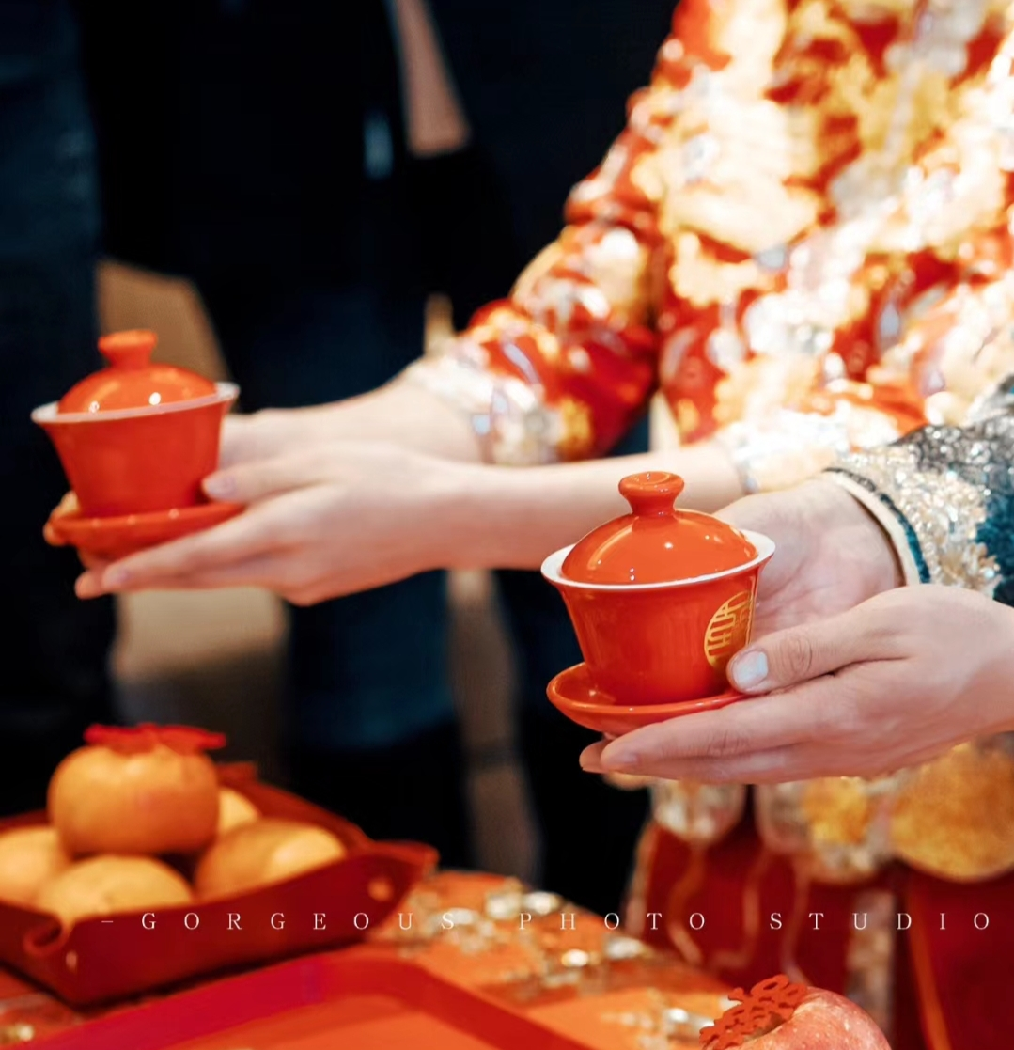
Inheritance of the Essence
Inheritance of the Essence
Ethical Values:
- The "Tea - Offering Ceremony" (continuously practiced from the Ming and Qing Dynasties) represents gratitude to parents and helps to strengthen family bonds.
- The marriage contract in ancient times →the legal awareness of modern marriage registration.
- The "Hejin Wine" in the Zhou Dynasty → the modern "Cross - Cup Wine", symbolizing unity of hearts.
- The "Que Shan Ceremony" in the Tang Dynasty → the "Lifting the Veil" in Chinese - style weddings, which adds an interactive sense of ritual.
01
02

Slide 12
Epilogue
Traditional wedding customs are like a multifaceted prism. They not only shine with the radiance of cultural heritage but also cast the shadows of the limitations of the times. We should embrace their "harmonious" elements and discard their "oppressive" aspects.

Slide 13
Thanks！

