Slide 1
“Middle Brow Literature”
Closing the Gap in China

Slide 2
Highbrow, Middlebrow, Lowbrow
What is highbrow, middlebrow, lowbrow.
Of, relating to, or being highly cultured or intellectual
One having uncultivated tastes
In-between usually closer to highbrow

Slide 3
Formation Middle Brow Literature
Late 1800s to early1900s
1977 middlebrow fiction
Avoided by most literary scholars
Western influence as well as traditionally
Notes:
Term used to describe traditional style novels a cut or two below the very great, produced largely in the late-ch’ing and early republic era.

Slide 4
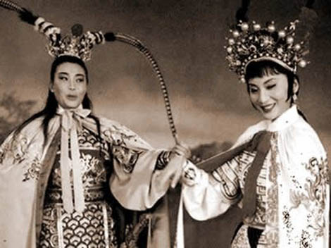
Examples of Middlebrow
Marriage as retribution
Sing song girls of Shang Hai
The flower in the sinful sea
Notes:
MAR: ameliorative satire
SSGofSH: the first realistic novel exclusively devoted to the examination of courtisan life. Flowers, interweaving charaters, Time together, gay quarters of Shanghai, opening of closing using a dream
FSS
This rather unknown novel was written by Zeng Pu (1872-1935) and was published in 1905 as a writing of social criticism. Zeng Pu only continued a work that has been begun by Jin Songcen. Both writers criticize the degeneration of the higher scholars and statesman of the late Qing period. Although the novel is full of citings from traditional literature and thus is very heavy to understand for people that are not familiar with antique literature, it is also influenced by Western literature. Some of the heroes are veiled representations of real persons, making this novel a real critic of intellectual and court life

Slide 5
Mandarin Duck and Butterfly
Applied to almost any popular work of the era
Very highly entertaining
1920
Usually avoided by scholars
Gave rise to much of the chinese
Notes:
Duck :At first it just meant classical-style love stories, usually the troubled romance of a poor scholar and a beauty. But beginning in the early 1920s, young writers emerging from the May Fourth movement began applying the term to all forms of popular old-style fiction, which in the 1920s and 1930s grew to feature, in addition to love stories, knight-errant novels, scandal novels, detective novels and many others.
Histories of modern literature usually omit discussion of the MDB school of fiction, regarding it as middlebrow, escapist entertainment for a mass readership, unworthy of serious academic and critical discussion. While it did degenerate into soap opera in the 1920s, and into pulp fiction in the 1930s, writers practicing MDB were hugely successful commercially. And were the precu

