Slide 1
Translation
By Lin Yutang
Speaker：Xie Jiafen谢佳芬
Handout：Yan Lili颜莉莉

Slide 2

contents
1
Introduction
2
Representative works
3
Translation
4
Conclusion

Slide 3

01
Introduction

Slide 4
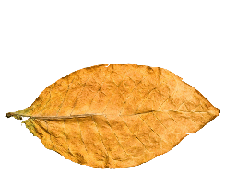
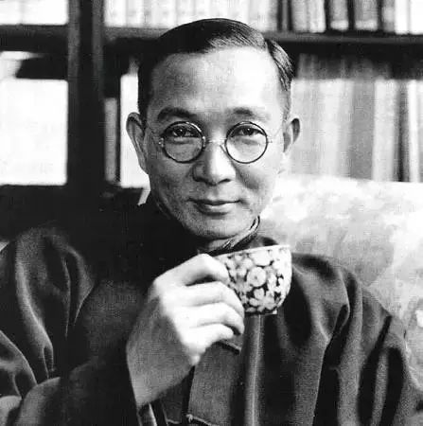
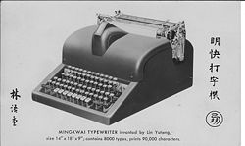

Lin Yutang was a Chinese writer, translator, essayist , and inventor, who was the first person that translated humour into 幽默.
He successfully built a Chinese typewriter, overcoming few initial hurdles and failures

Slide 5
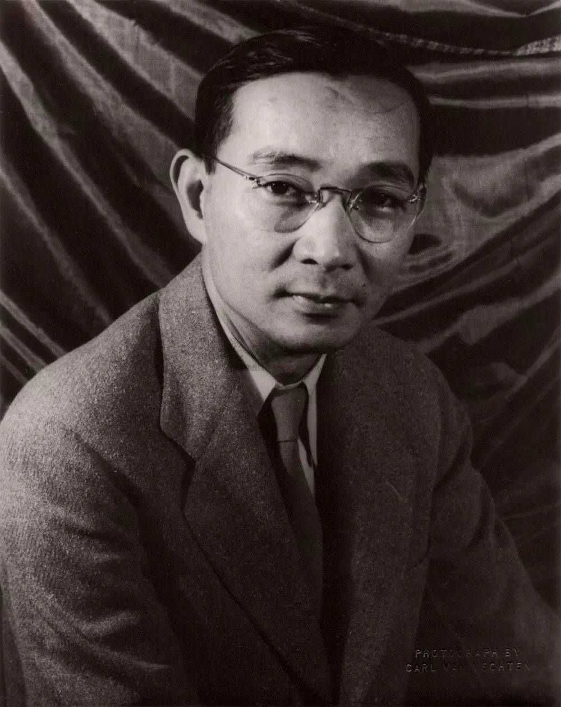

Lin Yutang’s Youth
Lin was born on October 10, 1895 in the town of Banzai in Zhangzhou, in southeastern China's Fujian province.
His father Lin ZhiCheng (林至诚) was a Christian minister. His mother was Yang ShunMing (杨顺命) and Lin Yutang was the fifth son of eight children. His father, ZhiCheng worked as a farmer while serving as a local minister.

Slide 6

Education background
In 1912. Lin studied for his bachelor‘s degree at Saint John’s University in Shanghai, After graduation, he taught at Tsinghua University
In 1919. Lin received a half-scholarship to continue study for a doctoral degree at Harvard University.
In 1920. Facing financial difficulties, Lin left Harvard early and moved to work in France and eventually to Germany, where he completed his requirements for a doctoral degree in Chinese philology at the University of Leipzig.

Slide 7
02
Representative works

Slide 8
Writing
Translation
My Country and My People
Moment in Peking
A Leaf in the Storm
The Importance of Living
The Gay Genius: The Life and Times of Su Tungpo
Kaiming English Books
Kaiming English Grammar
Six Chapters of a Floating Life《浮生六记》
Pygmalion 《卖花女》
Mozi 《墨子》
Peach Blossom Spring 《桃花源记》
Preface of the Orchid Pavilion《兰亭集序》
Selections from works of Su Tungpo《东坡诗文选》

Slide 9
03
Translation

Slide 10
Early translation theory
《对于译名划一的一个紧要提议》
An urgent suggestion for the uniformity of translation
1. From the pronunciation of Chinese, readers can infer the original words’ spelling
2. Form the standard of Chinese pronunciation compared with western pronunciation, and hope the translator to follow this standard
Notes:
The third part, translation theories.

Slide 11

The Argument on Translation
The requirements for the translator's basic qualities
1. A thorough understanding of the content of the source text;
2. Translator should be familiar with Chinese and can write Chinese clearly and smoothly
3. Translator should have correct opinions on translation standards.

Slide 12
Lin Yutang’s Translation Views
Faithfulness 忠实
The responsibility to the original author.
Smoothness 通顺
The responsibility to readers
Beautifulness美
The responsibility to the art

Slide 13
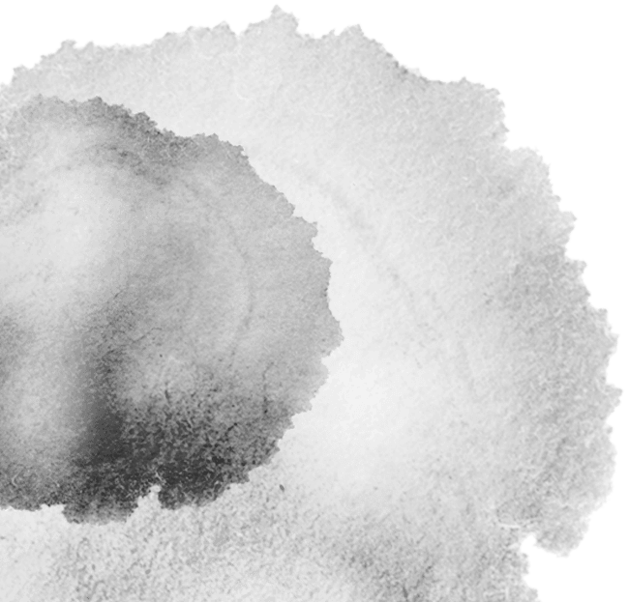
Faithfulness 忠实
Faithfulness means that the translator should first consider accurately restoring the content and meaning that the author wants to express in the process of translation.
忠实非字字对译之谓
不但须求达意 ,还须以传神为目的

Slide 14

Six Chapters of a Floating Life《浮生六记》
Source text: “闺房记乐”“闲情记趣”“坎坷记愁”“浪游记快”
Translation: Wedded Bliss, The Little Pleasure of Life, Sorrow, The Joys of Travel
Source text: 芸始放声痛哭。
Translation: Yun broke down completely and wept bitterly aloud.

Slide 15

Smoothness通顺
Must be based on sentence
Must be completely based on Chinese mindset.
Translators need to consider how sentence structure should be transformed and how each content should be expressed so that target readers can better understand and accept it

Slide 16
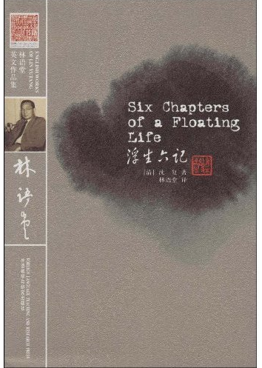
Six Chapters of a Floating Life《浮生六记》
Source text:
余如其言。
时天颇暖……此辛酉正月十六日也。
Translation:
I took her advice and started off on the sixteenth of the
first moon in 1801. The weather was quite mild……

Slide 17
Beautifulness 美
An ideal translator should regard his work as an art, love it as much as art and treat it with prudence and meticulousness, so that translation can be called a kind of art
It is advocated that the translation should not only translate the quality of the source text, but also the style, including the external genre and the internal genre.

Slide 18
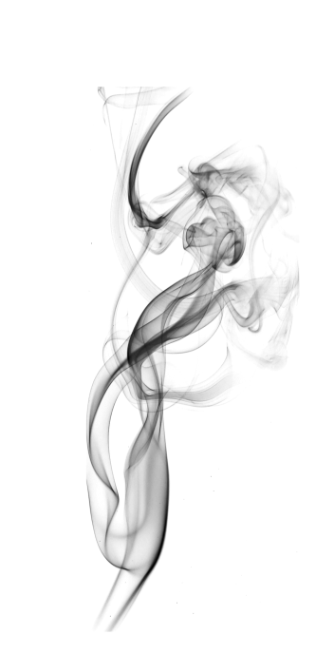
Six Chapters of a Floating Life《浮生六记》
Source text:
“秋侵人影瘦，霜染菊花肥。”
Translation:
“Touched by autumn, one’s figure grows slender,
Soaked in frost, the chrysanthemum blooms full.”

Slide 19
04
Summary

Slide 20

“The Bridge Between Chinese Culture and Western Culture,
Fascinated By The Comments On The Articles of Whole World”
两脚踏东西文化 , 一心评宇宙文章
Lin Yutang has made great contributions to the Chinese translation community, and proposed three criteria for translation: faithfulness, smoothness, and beautifulness. At the same time, he translated a large number of Chinese classical books.
As his motto said, he was one of the pioneers who promoted Chinese culture to the world. With his knowledge and wisdom, he successfully introduced the essence of Chinese culture to the West, promoted the exchange of Chinese and foreign cultures.

Slide 21

Thank you for your listening!
Xie Jiafen & Yan Lili
谢佳芬、颜莉莉

