Slide 1


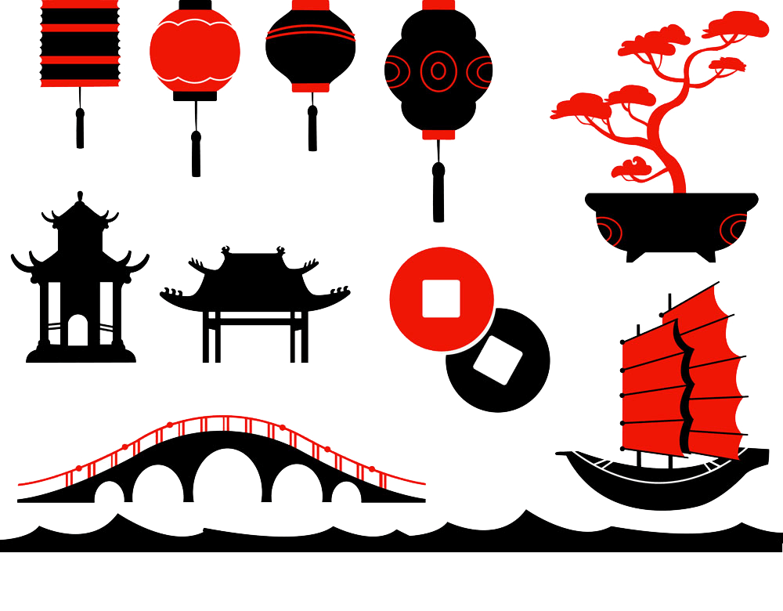
Architecture
Fengshui in Chinese Architecture
吴倩

Slide 2
Contents
I
The Introduction of Fengshui
Fengshui
II
Major Principles of Fengshui
III
Representative---The Imperial Palace

Slide 3
I
Introduction of Fengshui

Slide 4
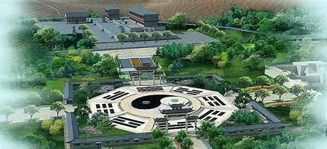
Fengshui
A system of landscape assessment
finding propitious places for architectures
in regard to location selection and layout of ancient Chinese architectures
An art
covering both science and superstition
One of three old architecture theories
together with gardening theory and construction theory
The core concept
The harmonious coexistence between human beings and nature.

Slide 5
History
long
It originated in early human settlement
observing soil
The ideal base
In the Zhou Dynasty (1046-258BC)
tasting water
investigating terrain
In the Warring States period (475-221BC)
The famous militarist and politician of the Qin State, Yan Junji predicted the future by observing the geographical features.
In the Han Dynasty (202BC-220AD)
The basic theories of Fengshui formed, based on observing surrounding geographical characteristics.

Slide 6
History
In the Tang,Song, and Yuan Dynasties (618 – 1368 AD)
These theories matured.
In the Ming and Qing Dynasties (1368 AD-1911AD)
These theories perfected.

Slide 7
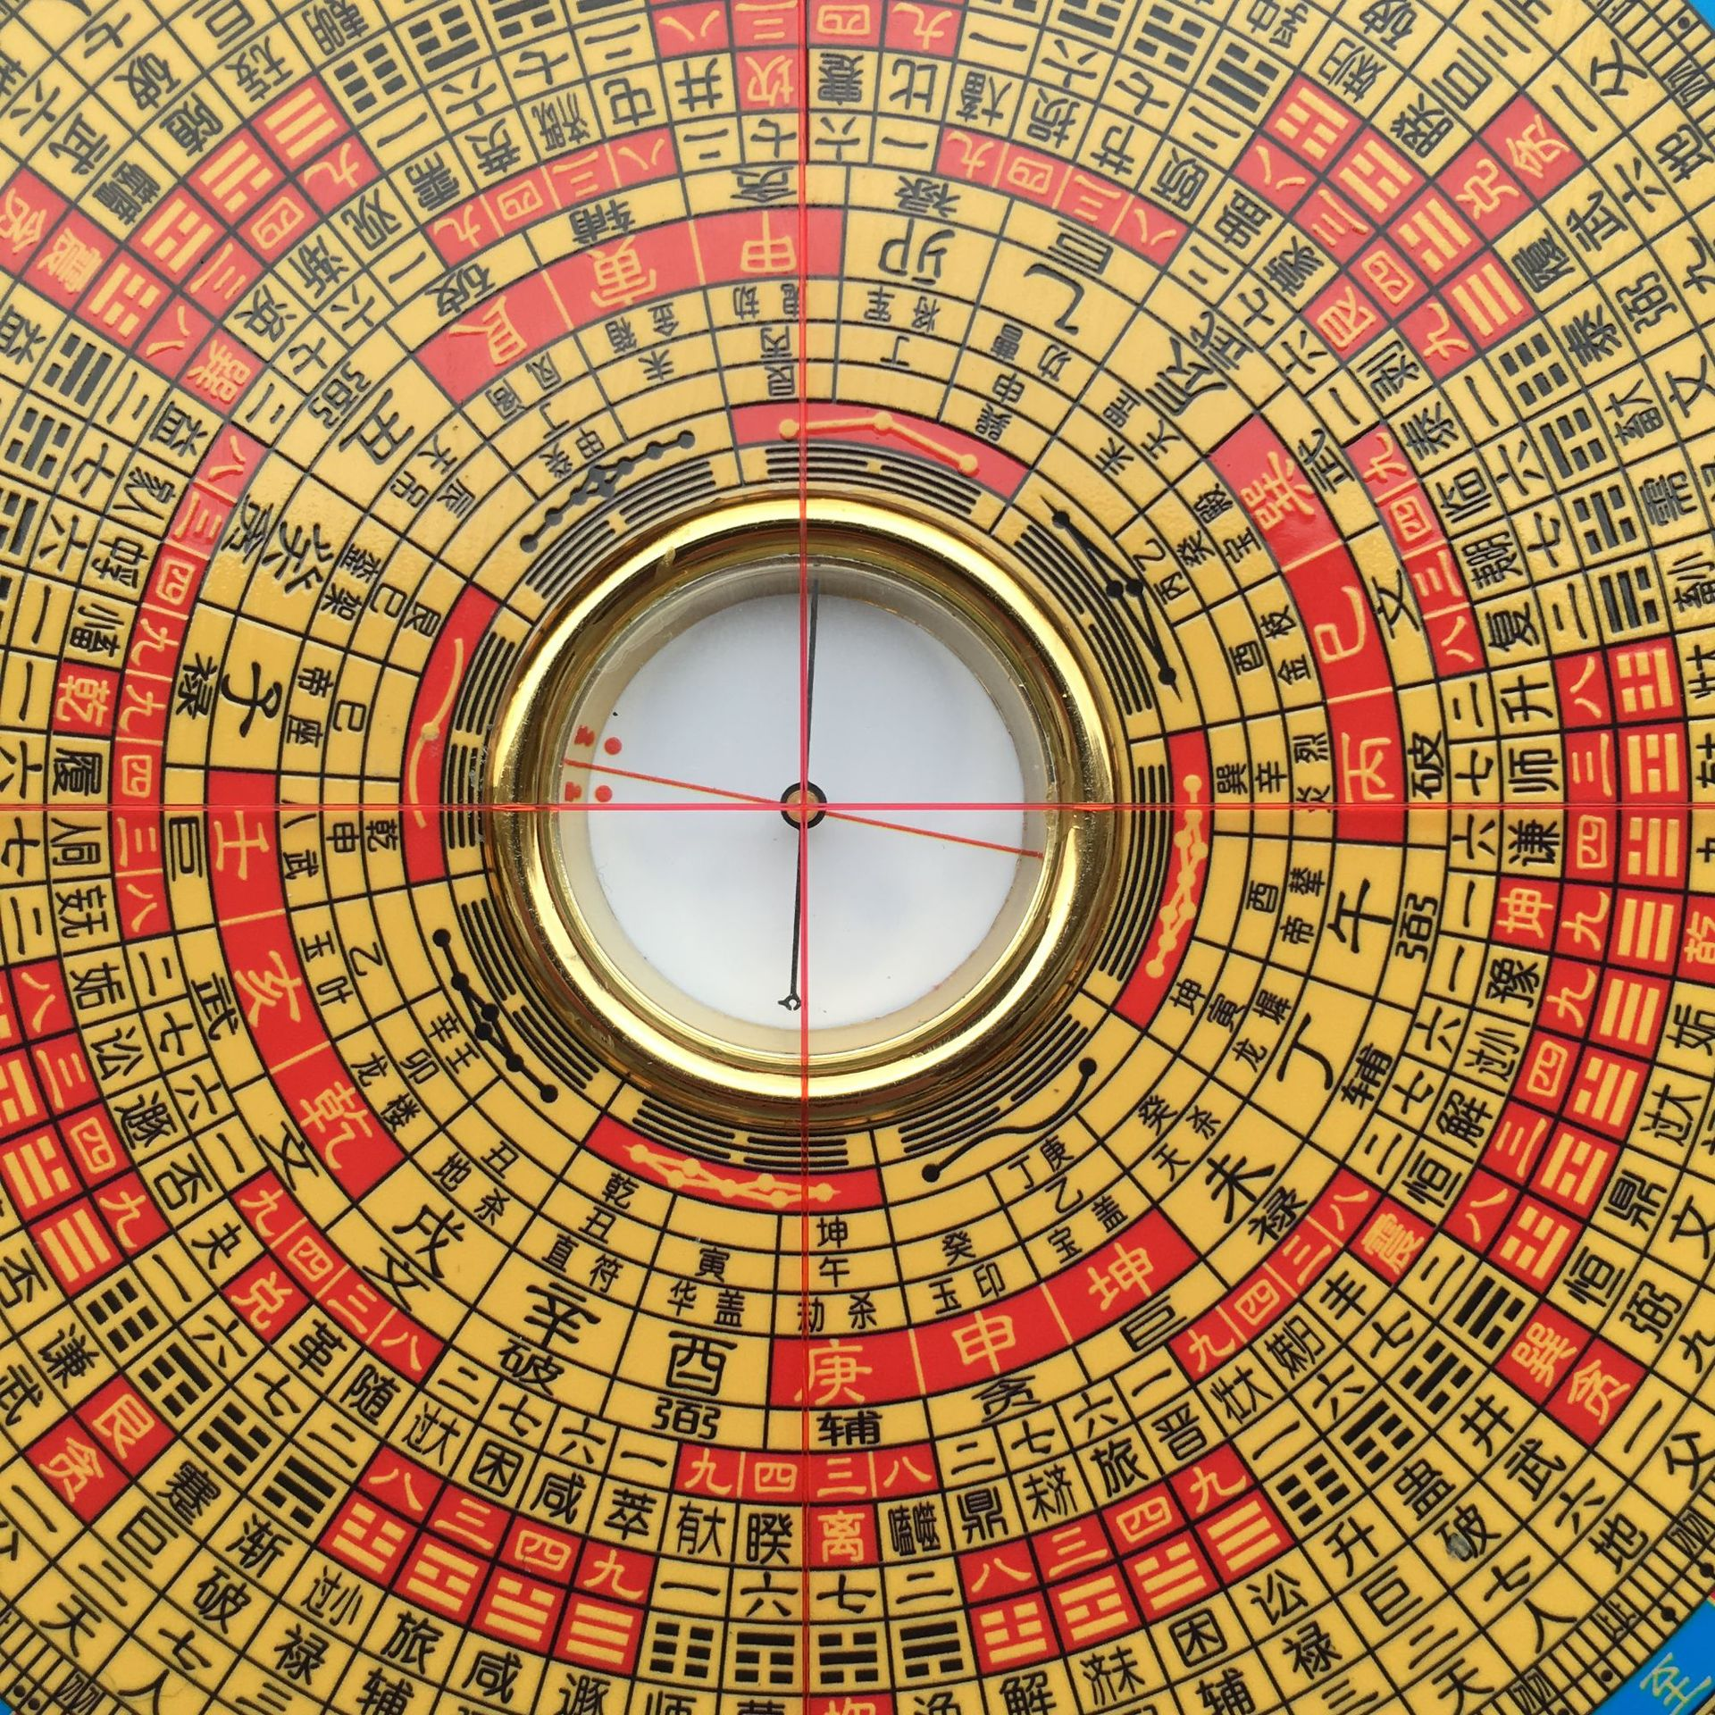
Different Schools
Xingshi School（形势派）
Liqi School（理气派）
It pays more attention to the position, orientation and layout of architecture .
The main method: eight diagrams and twelve earthly branches（八卦十二地支）, which mainly derive from The Book of Changes 《易经》and astronomy（天文学）.
The most famou tool: Fengshui compass
It focuses on the study of mountains and rivers as well as the site selection for architecture.
The main method:examining soil and tasting water.
Advocating the followers’houses should be built at the mountain foot, encircled by mountains, exposed to the sun, and facing water.

Slide 8
II
Major Principles

Slide 9
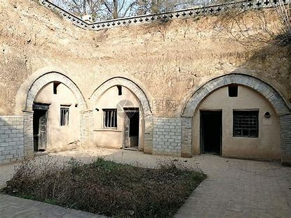
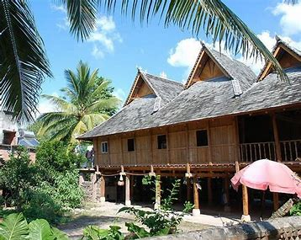
In accordance with local conditions（因地制宜）
It is to adopt a lifestyle suitable to nature, based on the objectivity of the environment.
China is a vast country with a wide range of climates, different soils and various forms of architectures.
In Northwest China
dry
cave-dwellings
In the Southwest
wet and rainy
bamboo-cottages

Slide 10
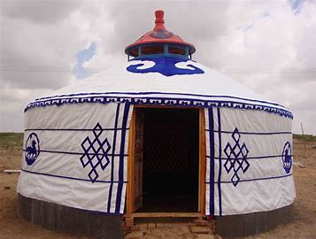
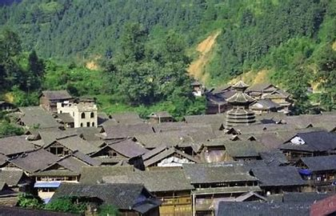
In accordance with local conditions（因地制宜）
The nomads（游牧民） use the yurt（圆顶帐篷） as a house as it is easily moved.
In the Inner Mongolia
In the mountainous areas of Guizhou construct
They lived the houses with mountains and stones.

Slide 11
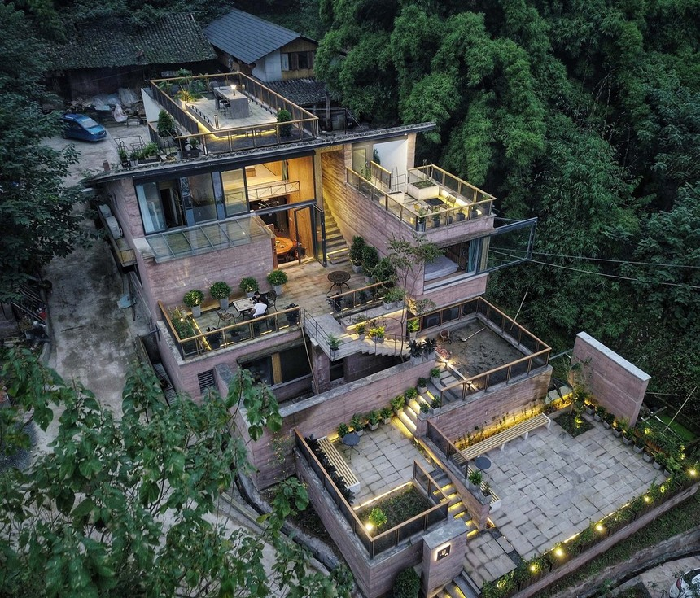
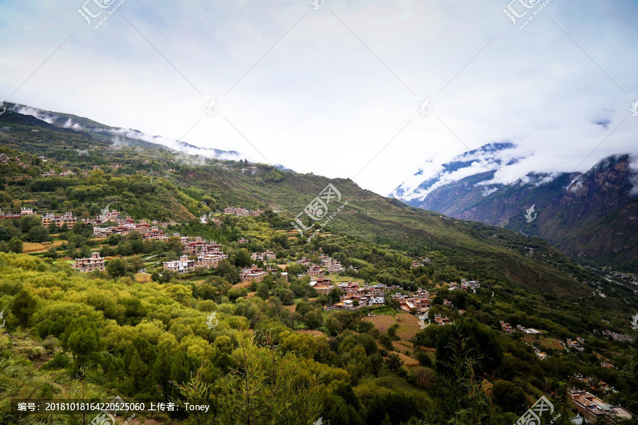
Leaning against mountains and facing rivers（依山傍水）
Two types of ‘leaning against mountains’.
“Mountains encircling the house”--- The house is surrounded by mountains on the northern, western and eastern sides while its southern side is open and flat with water flowing by.
”Houses covering the mountain”--- vast stretches of houses cover the mountain slope, from mountain foot all the way up the mountainside.
Many villages along the middle and lower reach of the Yangtze River are built in the way of “houses covering the mountain”.
Mountains are the skeletons of the earth and water is the source of all living things. People could not survive without mountains and water. That is why some Fengshui masters think a house leaning against mountains and facing rivers is auspicious and can bring good luck to people who live in it.

Slide 12
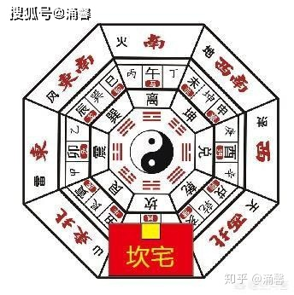
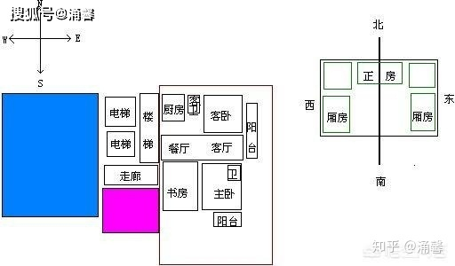
Facing south（朝南）
Locating in the northern hemisphere, east of Eurasia, Most of China’s territory is located to the north of the Tropic of Cancer, so the sun shines from the south all year around. The houses facing south can easily absorb sunshine.
It is not only for the light, but also for avoiding the north wind.
bleak and cold

Slide 13
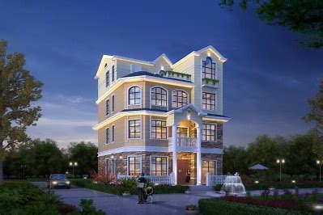
Moderate size and middle situation(适中居中）
The golden mean（中庸）
It is just right, not biased, not too big, not too small, not too high, not too low, as much as possible to optimize, close to the best and most beautiful.
This principle was produced in the Qin Dynasty.
First, the size of a house must be moderate, neither too big or too small.
A big house with few people is not auspicious, neither a small house with many people.
Then, the situation of the house must be middle, neither too high nor too low.
And this principle also calls for stressing the center. The layout must be neat and other facilities should surround the central house.

Slide 14
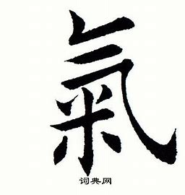
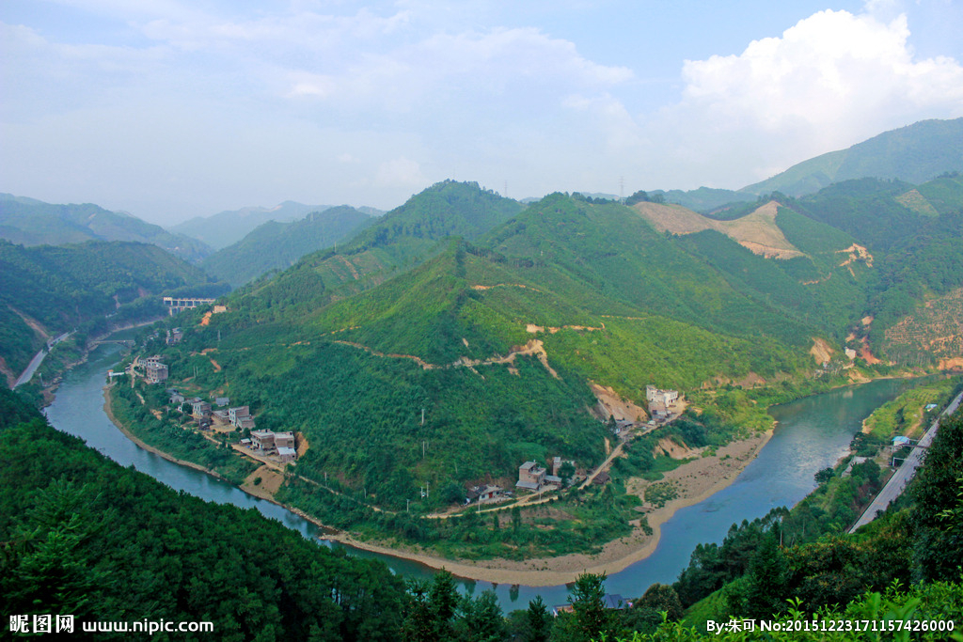
Taking advantage of qi（气）
Gathering "qi" into a region or house, making a household, a village, or even a country more vibrant and dynamic.
The term "Fengshui" comes from Guo Pu's Book of Burial《藏经》；“气乘风则散，界水则止，古人聚之使不散，行之使有止，故谓之风水”
Qi is the origin of all things. And Fengshui requires people build architecture in which is full of qi. In this way, people can live longer and heathier.
If there is a road or a river loop in front of the house, the house has the qi. People who live in it will gain more energy. It is also convenient for them to communicate. If there is no road or river, there is no qi, which represents the ominous.

Slide 15
III
Representative
---The Imperial Palace

Slide 16
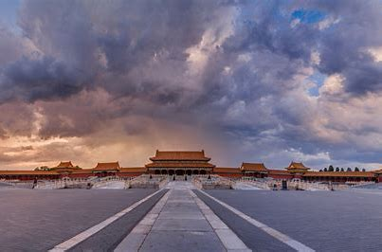
The Imperial Palace
The Imperial Palace, also known as the Forbidden City, is the royal palace of China in the Ming and Qing Dynasties. It is located in the center of the Peking axis and takes the three main halls（太和殿、中和殿、保和殿）as the core, occupying 72hm2.

Slide 17
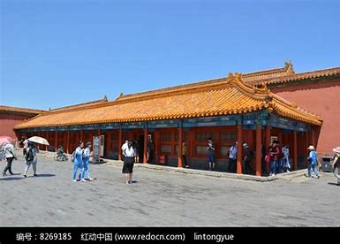
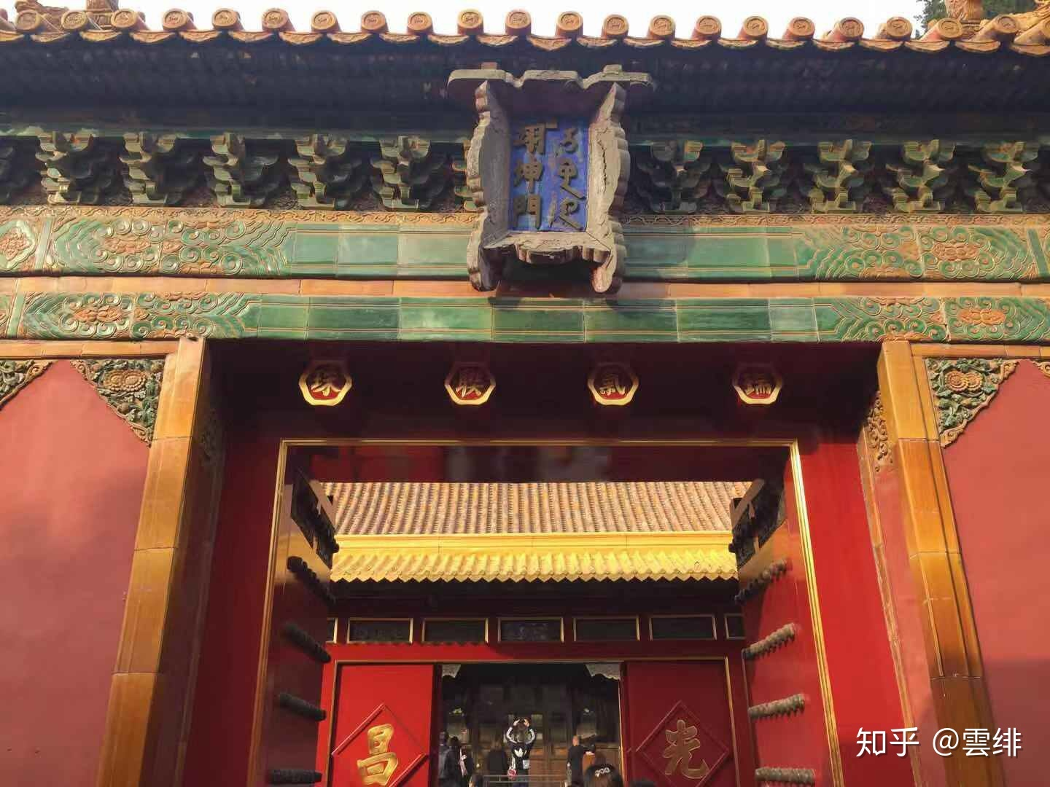
The Imperial Palace
There are more than 70 palaces which contain nearly 10000 houses. The Imperial Palace is the representative of Fengshui-architecture in ancient China. The core of the Imperial Palace was an axis line, which traveled through the palace in a south-north direction. It is used to divide the Imperial Palace into two parts: the East and the West. The East belongs to Yang（军机要务处） while the west belongs to Yin（后宫）. The main halls on the central axis all face south. The left is Yang, from which the sun rises; the right is Yin, where the sun falls down. The Imperial Palace is backed by Jingshan Mountain and Longevity Hill and surrounded by the moat, the Golden Stream. Here just some of the principles of Fengshui the Imperial Palace embodies: leaning against mountains and facing rivers, facing south, taking advantage of qi.

Slide 18
Conclusion
I believe that "dissolution"（化解） is the main outline of Fengshui in the Forbidden City, because the fate and qi that people used to lived there were different. It is because of the method of “dissolution” that the Forbidden City has sufficient qi and is a representative of an excellent Fengshui place.
And there are still lots of mysteries of Fengshui waiting to be explored.

Slide 19
Thanks for your watching!

