Slide 1

The reception of the red chamber dreams in the west

Slide 2
Translation in the west
the first eight chapters
In 1892 by H. Bencraft Joly
the first fifty-six chapters
In 1868 by Edward Charles Bowra
In 1812 by Robert Morrison
The first recorded attempt at translating the Red Chamber Dreams
In 1819 John Francis Davis
a short excerpt from chapter 3
In this period, only some scraps of the novel was translated. In 1842, Karl Gützlaff published an article "Hung Lau Mung, or Dreams in the Red Chamber“, in which some passages of the original work was criticized and some critical misunderstandings about the novel exist. It has been marginalized and instrumentalized.
Still the novel was translated little by little but with complete chapters translated.
E.J. Eitel reviewed Joly's translation and condemned the novel, saying that Chinese read it "because of its wickedness.“, while Herbert Giles took a more favorable view and wrote a twenty-five page synopsis in 1885 which improved its status.
Notes:
1. As for reception, we must learn the history of translating first. The first recorded attempt at translating the novel into English was done by the noted Protestant missionary and sinologist Robert Morrison (1782–1834) in 1812 when he translated part of chapter four of the novel. 2. Edward Charles Bowra of the Chinese Imperial Maritime Customs published a translation of the first eight chapters in 1868[47] and H. Bencraft Joly of the first fifty-six chapters in 1892.

Slide 3
In 1929
An abridged translation by Wang Chi-Chen which emphasized the central love story was published
Through this work the West feels most clearly the symbolic or universal value" of the characters and the Red Chamber Dreams “was ranked foremost" among the novels of classic Chinese literature.
Notes:
The first recorded attempt at translating the novel into English was done by the noted Protestant missionary and sinologist Robert Morrison (1782–1834) in 1812 when he translated part of chapter four of the novel. 2. Edward Charles Bowra of the Chinese Imperial Maritime Customs published a translation of the first eight chapters in 1868[47] and H. Bencraft Joly of the first fifty-six chapters in 1892.

Slide 4
Then the stream of translations and literary studies in the West grew steadily, building on Chinese language scholarship.

Slide 5
Fruits
The 1932 German translation by Franz Kuhn
The Dream of the Red Chamber, by Florence and Isabel McHugh published in 1958
And later the French version of The Dream of the Red Chamber came out
Bramwell Seaton Bonsall, completed a translation in the 1950s, Red Chamber Dream, a typescript of which is available on the web
Notes:
There are some actual fruits we got.

Slide 6
Here we are in 1958
According to what Anthony West has wrote in The New Yorker, the novel is to the Chinese “very much what The Brothers Karamazov《卡拉玛佐夫兄弟》 is to Russian and Remembrance of Things Past《追忆似水年华》 is to French literature” and Kenneth Rexroth’s comment in a 1958 review of the McHugh translation it is the "greatest works of prose fiction in all the history of literature", for it is "profoundly humane".
Notes:
It was called the brother karamazov and remembrance of things past of China.
Also was praised as the "greatest works of prose fiction in all the history of literature",

Slide 7
The first complete and literal English version translated by the respected and prolific team Gladys Yang and Yang Hsien-yi, A Dream of Red Mansions (Beijing: Foreign Language Press, 3 volumes, 1978–1980).
The second complete English translation published by David Hawkes some century and a half after the first English translation.
In the late 20th century: The most famous and wide-accepted translations
With the spreading of the translations, the Red Chamber Dreams and its author have been described as among the most significant works of literature and literary figures of the past millennium.

Slide 8
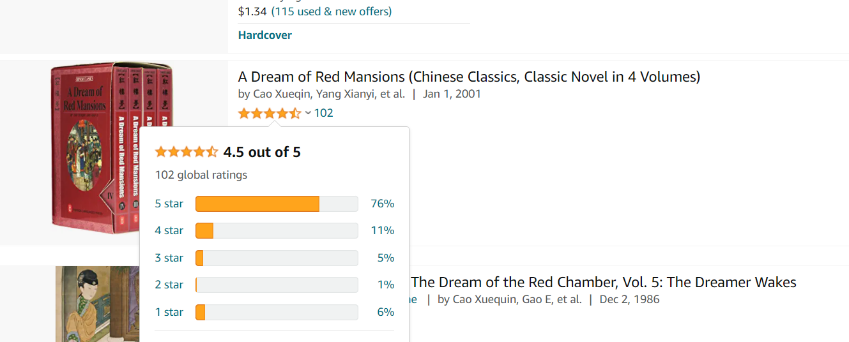
Nowadays: The novel has won an increasing number of readers across the world
Notes:
We can see it from the below pictures, the novel rank high, rating 4.5 in Amazon.

Slide 9

According to Worldcat:
3017 Non-Chinese Region libraries collected The Dream of the Red Chamber
356 Non-Chinese Region libraries collected The Dream of the Red Chamber (Chinese Version)
Notes:
Here are some comments on the amazon.

Slide 10
The Dream of the Red Chamber or (Hung Lou Meng) (Hong Kong: Kelly & Walsh) 1891, 1892. Hung Lou Meng, from the Project Gutenberg, Hong Kong: Kelly & Walsh, 1892–1893, paper published edition is also available. Wildside Press, ISBN 0-8095-9268-1; and Hard Press, 3 November 2006, ISBN 1-4069-4079-8. Text of the 1892–1893 English translation Archived 7 September 2015 at the Wayback Machine at University of Adelaide; rpr. with a new foreword by John Minford (1982-1986), Tokyo; North Clarendon, Vt.: 2010 ISBN 0-8048-4096-2
Minford, John (1999). "Rereading the Stone". China Review International. 6 (2): 308–309. doi:10.1353/cri.1999.0035. JSTOR 23732171.
Herbert Allen Giles, The Hung Lou Meng 红楼梦 : Commonly Called the Dream of the Red Chamber Monograph ([S.l.]: Read 16th of April, 1885); A History of Chinese Literature pp. 355-384
Rexroth, Kenneth. "The Chinese Classic Novel in Translation". University of Pennsylvania School of Arts and Sciences, original from Kenneth Rexroth 1958. Archived from the original on 31 July 2010.
"CNN.com - Millennium - Profiles". The LIFE Millennium. Time Inc. & CNN.com.

Slide 11


Thank you!

