Slide 1
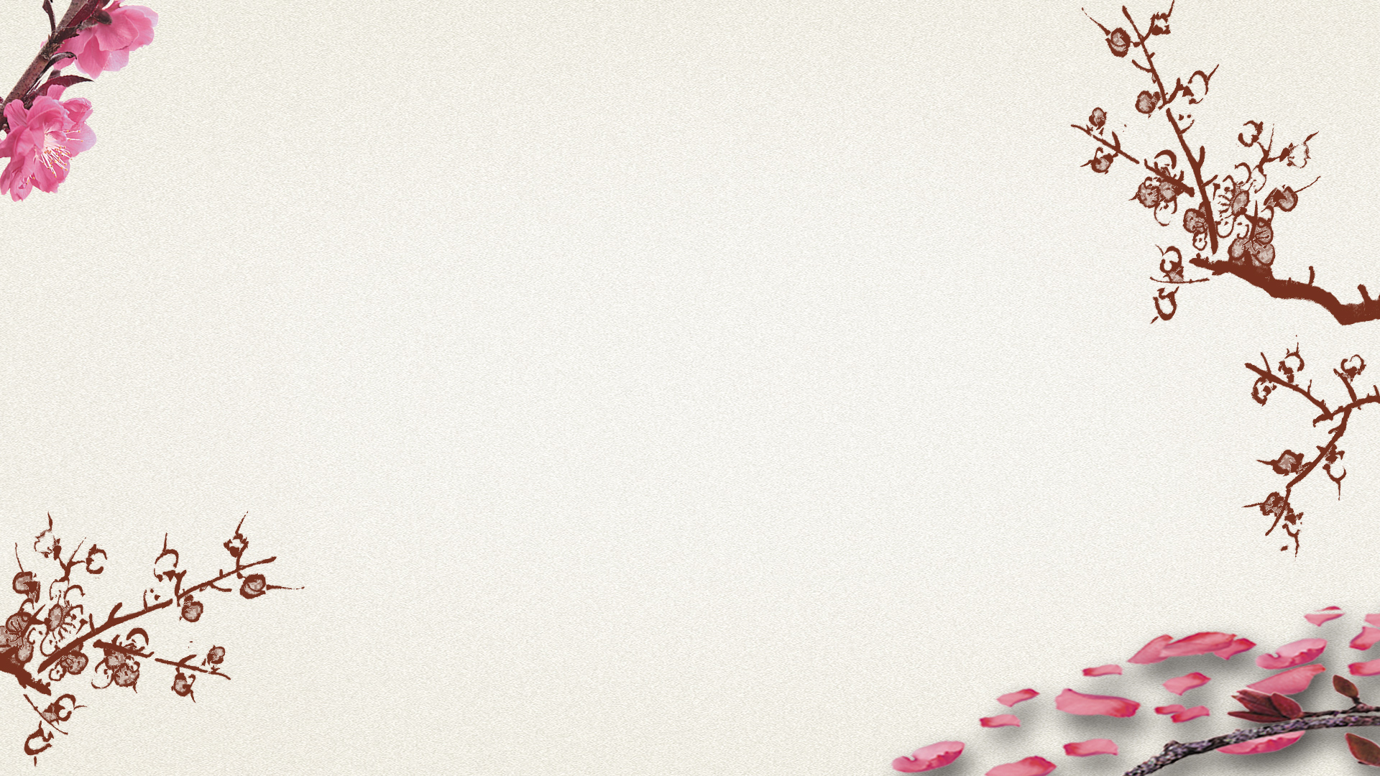
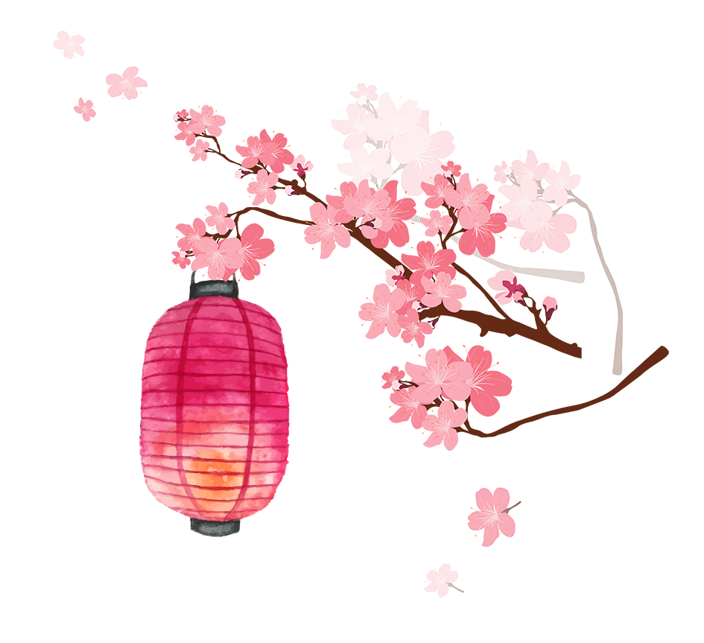
Acupuncture
and
Moxibustion
吴一露 司妤

Slide 2
Acupuncture
Contents
Moxibustion
Difficulties in Translation

Slide 3
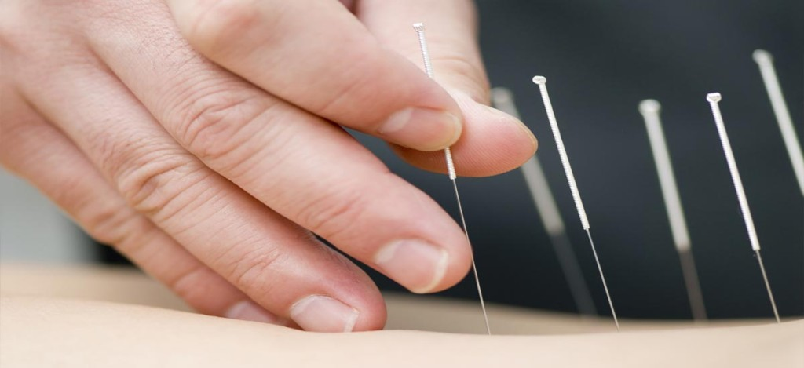
What is acupuncture?
Acupuncture is the practice of penetrating the skin with thin, solid, metallic needles which are then activated through gentle and specific movements of the practitioner's hands or with electrical stimulation.

Slide 4


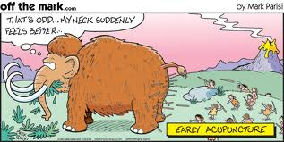
What does acupuncture feel like?
minimal pain feel energized feel relaxed

Slide 5
How does acupuncture affect the body?
1
stimulate the central nervous system
releases chemicals into the muscles, spinal cord, and brain
2
3
stimulate the body's natural healing abilities and promote physical and emotional well-being.

Slide 6
Considerations when choosing acupuncture
01
Discuss acupuncture with your doctor first.
02
Do not rely on a diagnosis of disease by an acupuncture practitioner.
Conside-rations
Choose a licensed acupuncture practitioner.
03
04
Consider costs and insurance coverage.

Slide 7
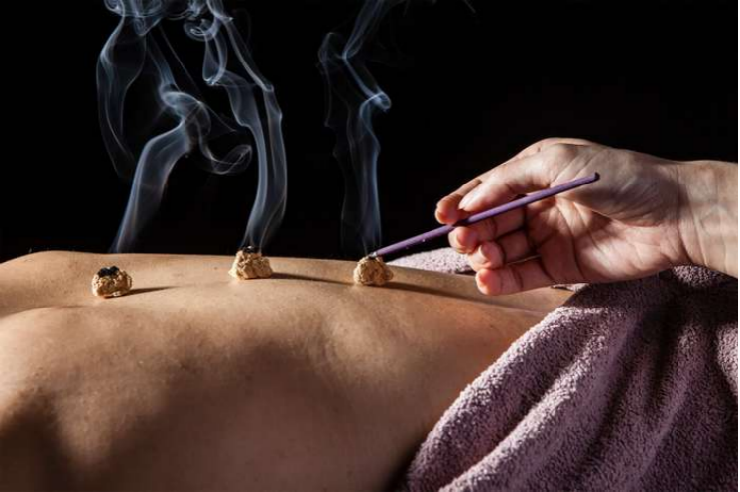
What is Moxibustion？
Moxibustion is performed by burning small cones of dried leaves on certain designated points of the body, generally the same points as those used in acupuncture.

Slide 8
Uses
increase the flow of vital energy
help treat the health problems

Slide 9
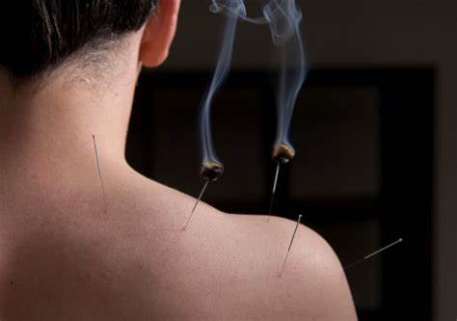
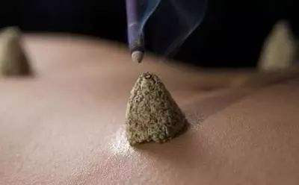
What Moxibustion Involves ?
indirect
direct

Slide 10
Difficulties in Translation
Words
transliteration is a good choice and tool
Sentences
exact understanding in the process of translation lest some confuse be caused

Slide 11
Difficulties in Translation
【原文】“阴”“阳”“少阴”“少阳”
【译文】 Yin, Yang, Shao-yin, Shao-yang.
【原文】“应以内膝眼、膝眼、百虫窝、鹤顶、为主穴”
【译文】“The Neixiyan, Xiyan, Baichongwo and Heding should be treated as the master points”.

Slide 12
Difficulties in Translation
【原文】“艾叶苦辛，能回垂绝之阳，通十二经，走三阴，理气血，逐寒湿，暖子宫，止诸血，温中开郁，调经安胎……以之灸火，能透诸经而除百病。是以御风邪以汤药、针灸、蒸熨，皆能愈疾至于火艾，特有其能，针，药，汤，散皆所不及者，艾为最要。”
【译文】“Moxa leaf, sour and acrid, can make the deadly back to life, dredge the meridians, shaoyin, taiyin, jueyin, harmonize qi and blood, remove cold-dampness, warm uterus, stop bleeding, warm the middle and open depression, regulate menstruation and prevent abortion, and can dredge all the meridians and cure all diseases when burnt. Therefore, as long as the wind-evil can be cured by decoction, acupuncture or steam ironing, it can be treated by moxibustion, what’s more, moxibustion has special efficacy beyond needle, medicine and decoction with wormwood as its priority.”

Slide 13
Thank you

