Slide 1
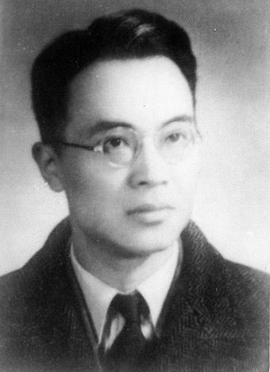
Qiang
Zhong Shu 1910 -
By Erica B. Oaks pic from http://www.danwei.com/

Slide 2
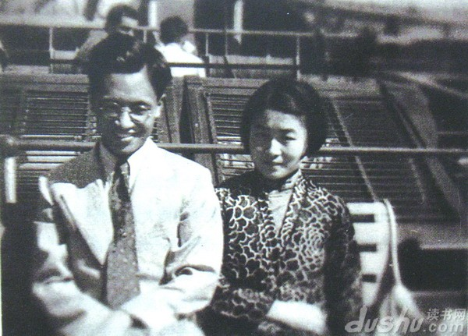
We meet at school - Two brilliant minds – Qian Zhongshu and Yang Jiang,1935
http://www.chinaheritagequarterly.org

Slide 3
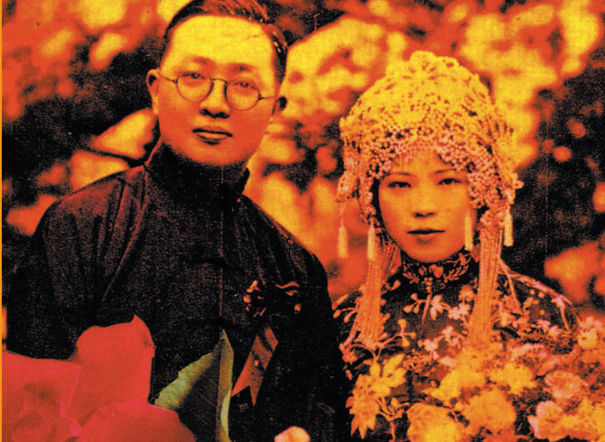
Marriage of Qian Zhongshu and Yang Jang.
photo www.notodo.com

Slide 4
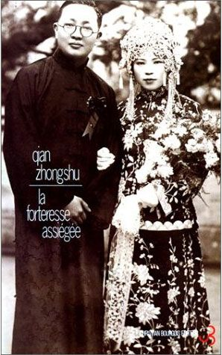
Marriage of Qian Zhongshu and Yang Jang.
http://www.librairielephenix.fr

Slide 5
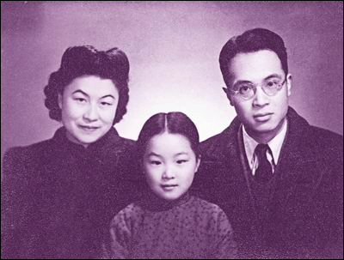
Qian family around 1947 photo www.for68.com

Slide 6
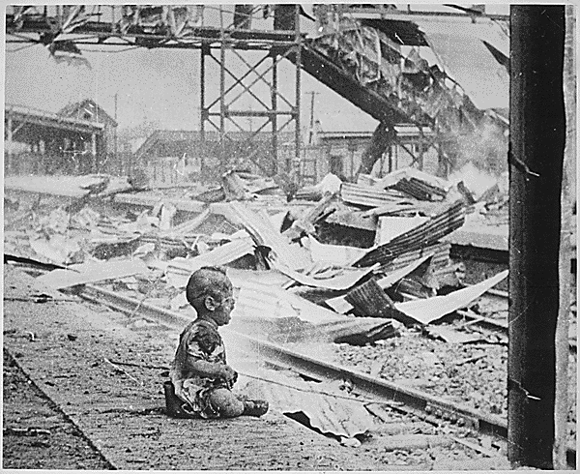
impt EVENTS THAT HAPPENED Through OUT His LIFE IN THE WORLD This terrified baby was almost the only human being left alive in Shanghai's South Station after brutal Japanese bombing. China, August 28, 1937.
http://en.wikipedia.org/

Slide 7
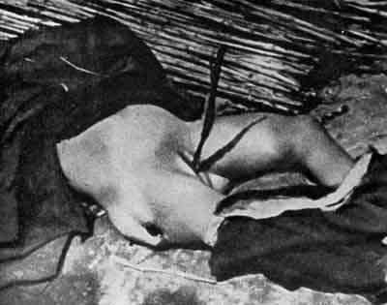
Nanjing Massacre rape killed – Second Sino-Japanese War http://en.wikipedia.org/

Slide 8
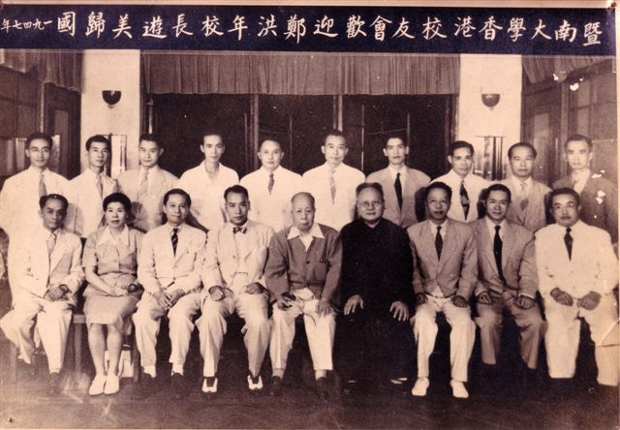
The university engaged a party of eminent scholars, like Qian Zhongshu, Liu Dajie, Hu Yuzhi, Sun Guiding, Chen Kui, Cao Weifeng, Zhou Xuliang, Tan Qixiang, Chen Wenbin, and Yi Chaoding.
http://www.jnmba.org/about.aspx?NID=6811

Slide 9
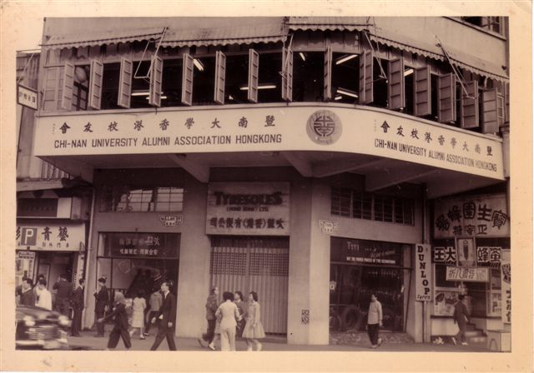
China won the Anti-Japanese War ,1945. Jinan University moved to Shanghai
http://www.jnmba.org/about.aspx?NID=6811

Slide 10
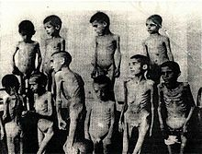
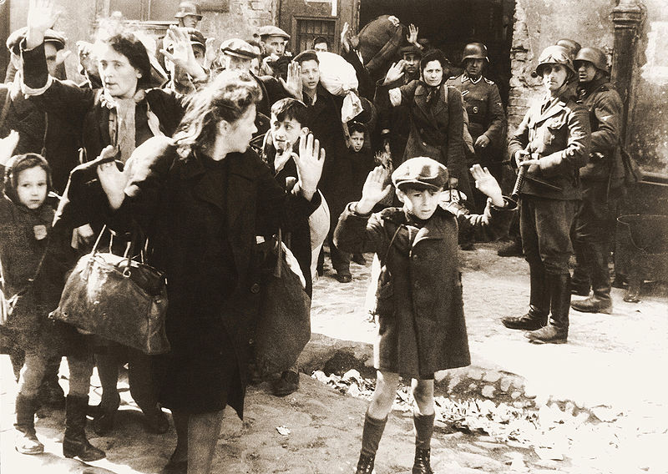
Concentration and labor camps (1933–1945)
Ghettos (1940–1945)
http://en.wikipedia.org/

Slide 11
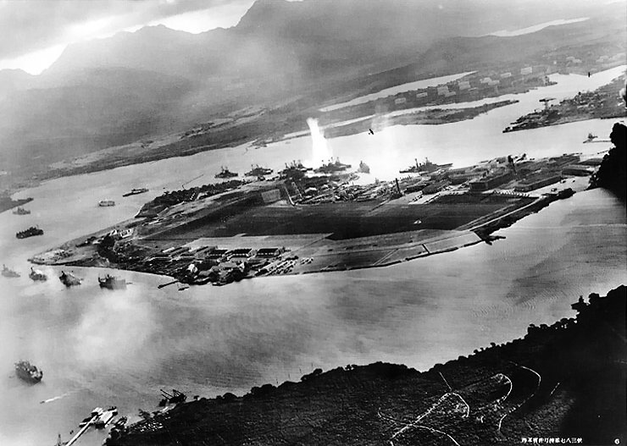
Photograph from a Japanese plane of Battleship Row at the beginning of the attack. The explosion in the center is a torpedo strike on the USS Oklahoma. Two attacking Japanese planes can be seen: one over the USS Neosho and one over the Naval Yard. Attack of Pearl Harbor - December 7, 1941

Slide 12
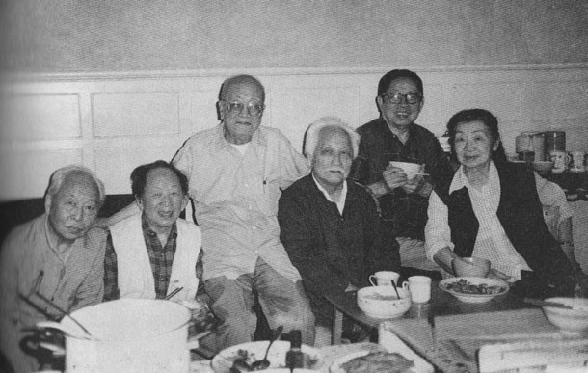
A gathering of members of Layabouts Lodge in the 1990s. Left to right: Wu Zuguang, Huang Miaozi, Tang Yu, Zhang Ding, Ding Cong and Yu Feng. (Source: Tang Yu 唐瑜, Accounts from the Master of The Layabouts Lodge, p.77)
Photo from: www.Chinaquarterly.org

Slide 13
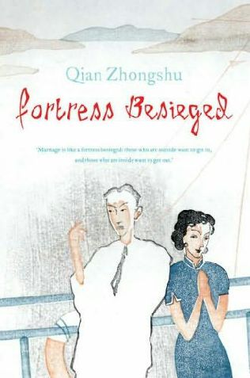
Qian Zhongshu Fortress Besieged 1946 - 1947
www.fantasticfiction.com

Slide 14
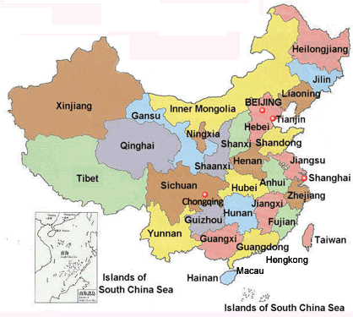
China map http://www.chinatourism.ch Nanjing in Jiangsu - Shanghai

Slide 15
All of the pictures presented in here are Copyright © and All rights reserved by the authors or websites. This material was used for Educational purposes only. Erica Bazalar-Oaks 2012.

