Slide 1

Kar Wai Wong
Presentation by:
Keeley Xie

Slide 2
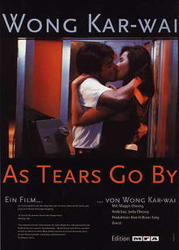
Early Life
Kar Wai Wong, known as Wong Kar Wai in the United States, was born in Shanghai, China on July 17th 1956.
When he was only 5, he left Shanghai and traveled with his mother to Hong Kong.
Dropped out of art school and never attended a film school.
Spent almost a decade writing scripts before making a movie
Made his first full length movie As Tears Go By in 1988
His first real hit was Days of Being Wild which is also considered to be the first of an informal trilogy that later includes In the Mood for Love and 2046

Slide 3
Filmography
1988 As Tears Go By
1990 Days of Being Wild
1994 Chungking Express/Ashes of Time
1995 Fallen Angels
1997 Happy Together
2000 In the Mood for Love
2004 2046
2007 My Blueberry Nights
2012 The Grandmasters (in post production)
Filmography

Slide 4
Style
Wong is known for his signature art house films
Time
Romance
Being “stuck”
Pre-Production
Editing

Slide 5
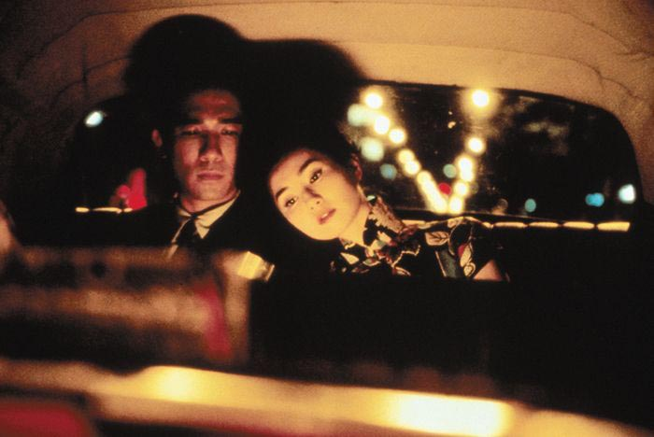
In the Mood for Love
Trailer
This movie is the second in his informal trilogy and is about a man and a woman who find out their spouses are having an affair and the relationship they develop.

Slide 6
Awards
1991 Hong Kong Film Awards, Best Director (Days of Being Wild)
1995 Hong Kong Film Awards, Best Director (Chungking Express)
1997 Cannes Film Festival, Best Director (Happy Together)^{[4]}
2000 European Film Awards, Screen International Award (In the Mood for Love)
2001 César Award, Best Foreign Film (In the Mood for Love)
2004 European Film Awards, Screen International Award (2046)

Slide 7
Bibliography
http://www.imdb.com/name/nm0939182/bio
http://en.wikipedia.org/wiki/Wong_Kar-wai
http://www.avclub.com/articles/wong-karwai,13700/
http://www.time.com/time/magazine/article/0,9171,501041004-702208,00.html
http://mubi.com/cast_members/1700
http://www.filmmisery.com/2011/12/wong-kar-wai-marathon-the-informal-trilogy/10596/

