Slide 1

Unit 7 Architecture and Gardens

Slide 2
Questions Concerning Section A Architecture
1. How long is the history of wooden structures in China?
2. What are the 3 categories of traditional Chinese wood buildings?
3. Which category is the most popular? How is it formed?
4. What is dou-gong? What’s its function?
5. What is the most widespread residential structure in North China? How is it related to Confucianism?
6. What is the general layout of Chinese architectural complex like?

Slide 3
7. Is the palace complex in Beijing the only one remaining in the whole country?
8. Is the construction of Buddhist temples important in Chinese architecture? What is the general layout of a Buddhist temple like?
9. What are Buddhist pavilion and pagodas? Could you name some important Buddhist pagodas in China?
10. What styles do traditional Chinese buildings' roofs have?
11. How are traditional Chinese buildings decorated?
12. How are colors used in the decoration of old buildings?
13. Have you ever been amazed at an old Chinese buildings?

Slide 4
14. Why are traditional Chinese roof tips pointing upwards?
15. Whom belonged yellow roof tiles to?

Slide 5
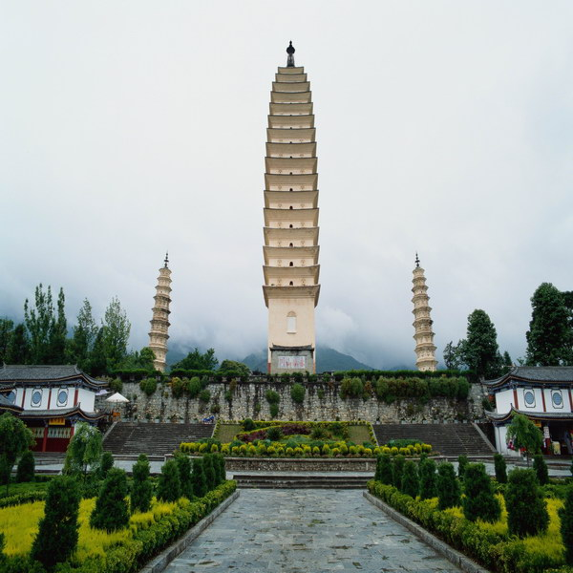
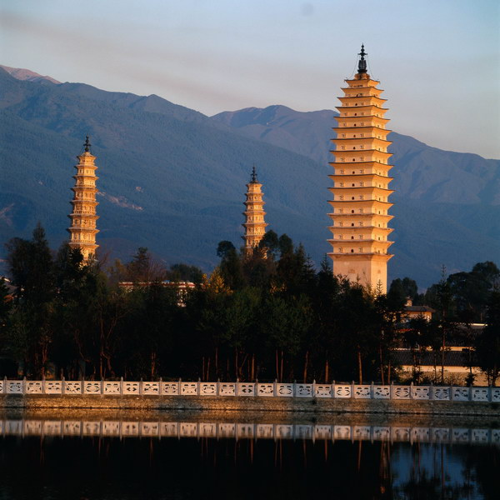
Buddhist towers

Slide 6
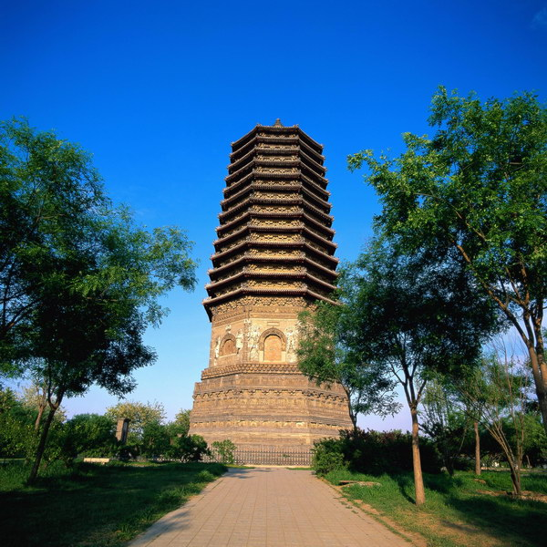
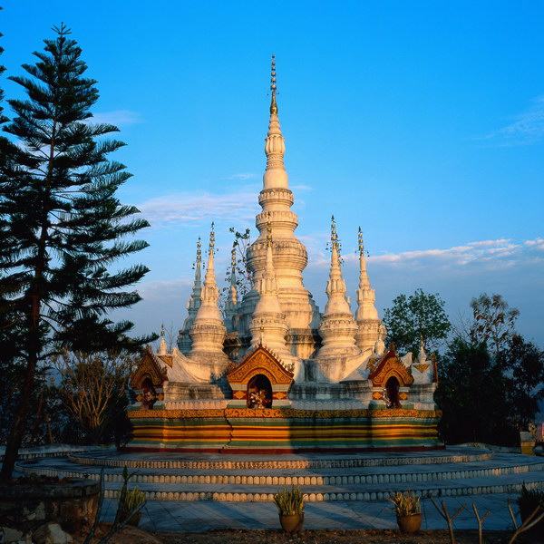
Buddhist tower & pagoda

Slide 7

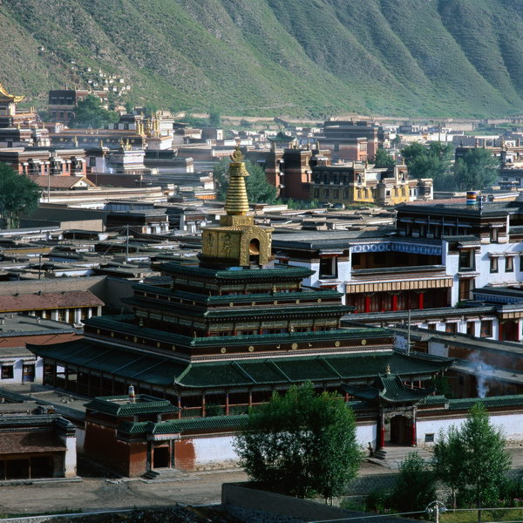
Buddhist pagodas

Slide 8
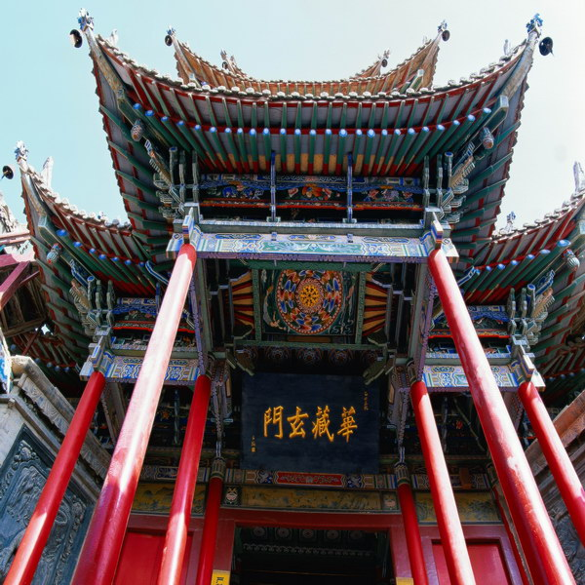
Decorations of Chinese pavilions

Slide 9
Questions Concerning Section B Gardens
1. How did the Chinese garden grow into its present form?
2. What’s the greatest difference between European gardens and Chinese ones?
3. What are the major categories of Chinese gardens?
4. What do you know about China’s imperial gardens? In which part of China are they located? How many of them can you name?
5. What functions do they have?
6. How are China’s imperial gardens laid out? How are they decorated?

Slide 10
More Questions Concerning B Gardens
1. In which part of China are most private gardens located? How are they laid out?
2. How are the scenes connected?
3. What do you know about the private gardens of Suzhou? What gardens there demonstrate the styles of Song, Yuan, Ming and Qing dynasties?
4. What styles do gardens in Yangzhou and Guangdong demonstrate?
5. What landscape gardens do you know? How are poets and painters related to landscape gardens?

Slide 11
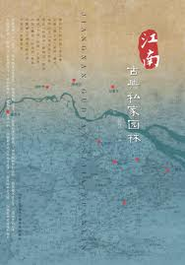
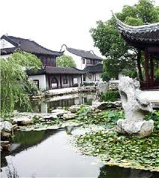
Private gardens south of the Yangtze River

Slide 12
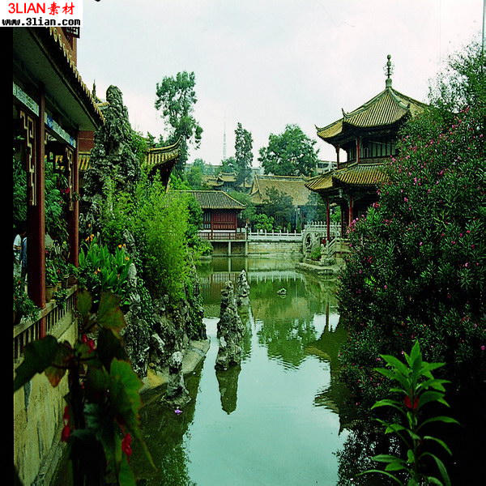
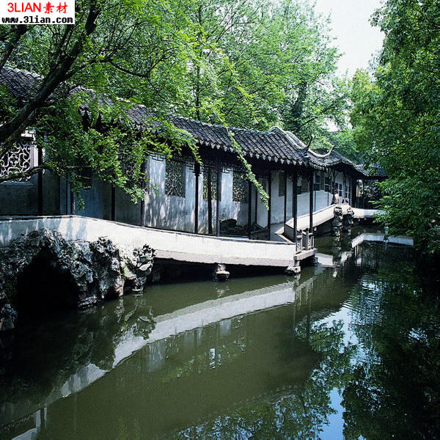
Riverside pavilions and a sightseeing veranda

Slide 13
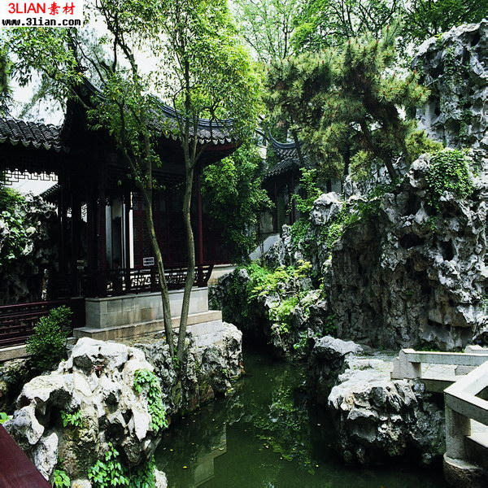
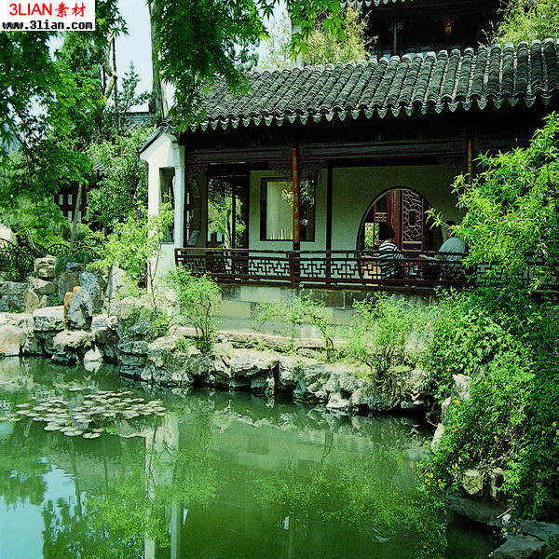
Rockery in a Chinese garden

Slide 14
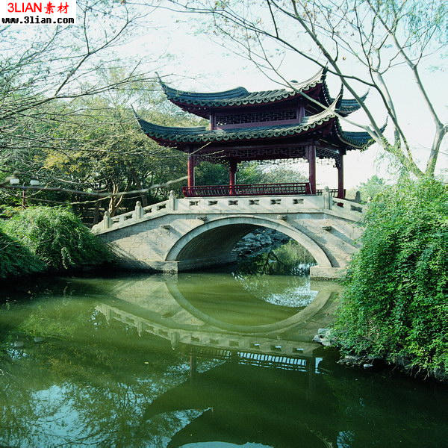
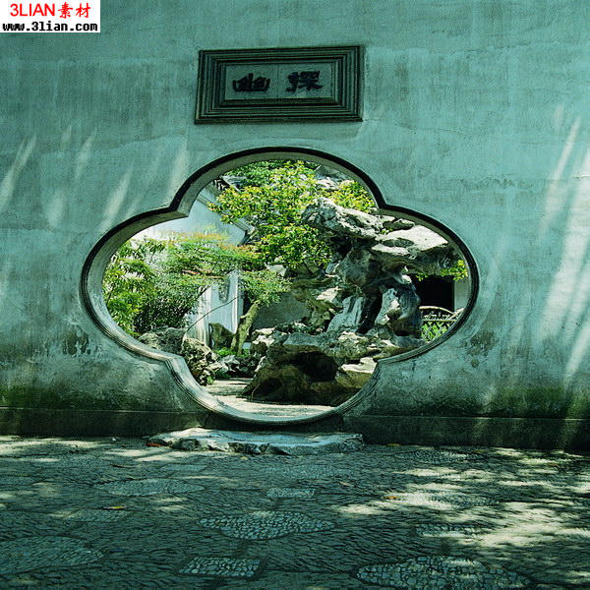
A flower-patterned door & a one-arch roofed bridge

Slide 15
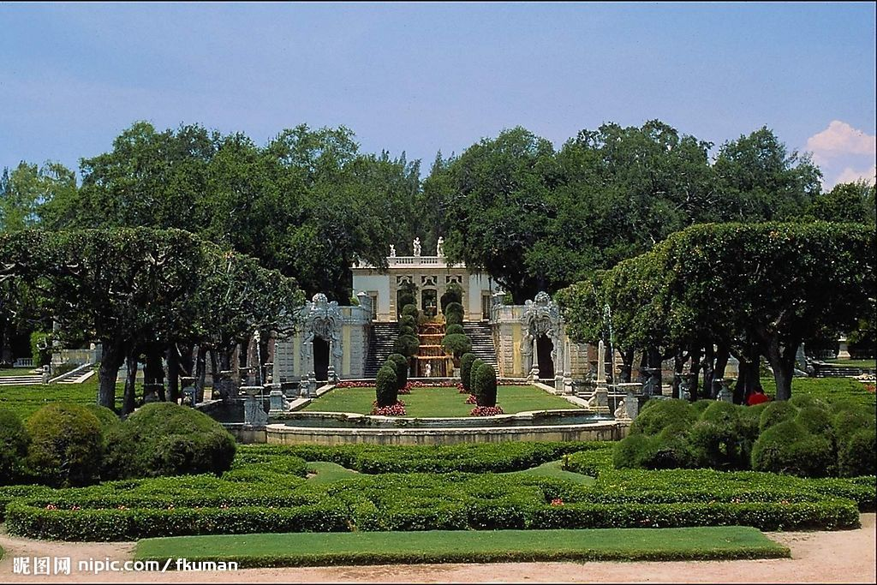
A western garden with geometrical patterns

Slide 16
Yuanmingyuan
Showcase for Western architecture and illusions
Combination of Chinese and Western arts
How do you feel about the destruction?
Should it be rebuilt?

Slide 17
Questions Concerning Section C Summer Palace
1. What else was the Summer Palace called?
2. What did the Anglo-French invading troops do to it in 1860?
3. How did Empress Cixi have it rebuilt?
4. How important is the park in traditional Chinese gardening?
5. What’s the general layout like?

Slide 18
6. What do know about the halls in the park?
7. What is the park dominated by?
8. What do you know about the Cloud-Dispelling Hall?
9. What do you know about Cixi’s 70th birthday portrait?
10. What do you know about the Long Corridor?
11. What do you know about the Garden of Harmonious Delight?
12. What do you know about the Suzhou Street?

Slide 19
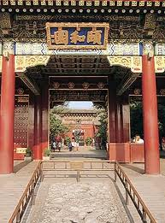
The Summer Palace

Slide 20
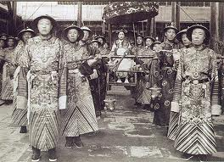
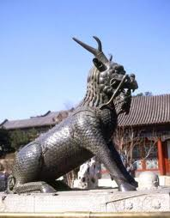
Empress Cixi & her eunuchs in the Summer Palace

Slide 21
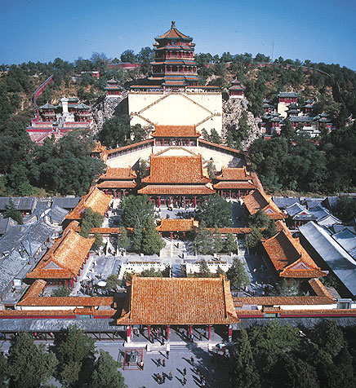
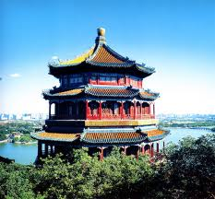
The palace on the Longevity Hill

Slide 22
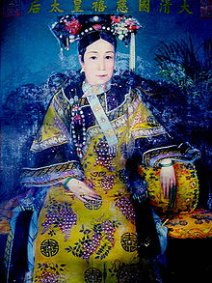
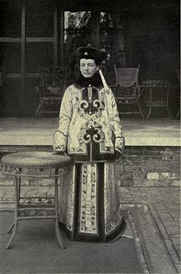
Empress Cixi and Katherine Carl in 1903

Slide 23
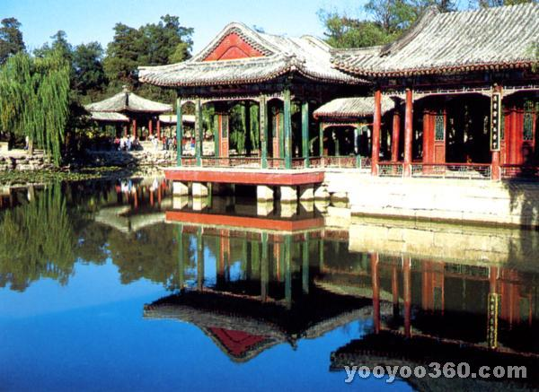
The Garden of Harmonious Delight

Slide 24
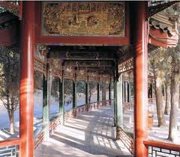
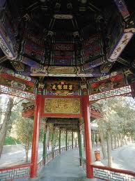
The Long Corridor, 728 m. in length, is the longest sightseeing corridor in the world.

Slide 25
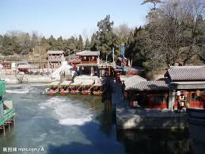
The Suzhou River in winter

Slide 26
Katharine Augusta Carl (1865–1938)
She was an American painter and author who spent nine months in China in 1903 painting a portrait of the Empress Dowager Cixi for the St. Louis Exposition. On her return to America, she published a book about her experience, entitledWith the Empress Dowager.
Katharine Carl was commissioned in the summer of 1903 to paint a portrait of the Empress Dowager Cixi for the Chinese exhibit at the 1904 Louisiana Purchase Exposition. She spent a total of nine months in China and painted four portraits of the Empress Dowager, later recording her memories as the only foreigner to live within the precincts of the Chinese imperial court in its last days in a book that was published in 1906.

Slide 27
Carl's writings of her time in China provide a unique and intimate assessment of the Empress Dowager Cixi. In the book's introduction, she says she wrote the book because "After I returned to America, I was constantly seeing in the newspapers (and hearing of) statements ascribed to me which I never made." These statements were usually at the expense of the Dowager's reputation, and Carl felt strongly enough about it to defend the Empress Dowager in writing and to try to dispel an incorrect image of Cixi that still lingers today.
Carl describes Cixi as a kind and considerate woman for her station. Cixi, though shrewd, had great presence, charm and graceful movements resulting in "an unusually attractive personality." She loved dogs and had a kennel maintained by eunuchs at the Summer Palace where she had "some magnificent specimens of Pekingese pugs and of a sort of Skye terrier." She did not like cats and some of the eunuchs who had cats made sure to keep them "within rigid bounds, on no condition allowing them to come within Her Majesty's ken.”

Slide 28
Carl describes Cixi as a loyal person, saying of her retinue: she "nursed Her Majesty through a long illness, about 25 years since, and saved her life by giving her mother's milk to drink. Her Majesty, who never forgets a favor, has always kept this woman in the Palace. Being a Chinese, she had bound feet. Her Majesty, who cannot bear to see them even, had her feet unbound and carefully treated, until now she can walk comfortably. Her Majesty has educated the son, who was an infant at the time of her illness, and whose natural nourishment she partook of. He is now a Secretary in a good yamen."
Carl described Cixi as enjoying boating on the lake, walks through the gardens and grounds of the Palace (the Imperial family rode in sedan chairs, so the eunuchs did the walking), and presentations of Chinese opera. Cixi smoked Chinese water pipes as well as European cigars through a cigar holder. At 69 Cixi was in good physical shape that when providing a tour of the Opera House to Carl, Cixi "mounted the steep and difficult steps with as much ease and lightness as I did, and I had on comfortable European shoes, while she wears the six-inch-high Manchu sole in the middle of her foot, and must really walk as if on stilts."

Slide 29
Translation exercises
中国是世界四大文明古国之一，有着悠久的历史，劳动人民用自己的血汗和智慧创造了辉煌的中国建筑文明。中国的古建筑是世界上历史最悠久、体系最完整的建筑体系，从单体建筑到院落组合、城市规划、园林布置等在世界建筑史中都处于领先地位，中国建筑独一无二地体现了的“天人合一”的建筑思想。
古代世界的建筑因文化背景的不同，曾经有大约七个独立体系，其中有的早已中断，或流传不广，成就和影响也相对有限，如古埃及、古代西亚、古代印度和古代美洲的建筑等，只有中国建筑、欧洲建筑、伊斯兰建筑被认为是世界三大建筑体系，又以中国建筑和欧洲建筑延续时代最长，流域最广，成就也更为辉煌。

Slide 30
Translation exercises
园林艺术是人们为了游览、娱乐的方便，用自己的双手创造风景的一种艺术。由于各民族、各地区人们对风景的不同理解，也就出现了不同风格的园林。归结起来，世界上的园林可分为三个系统——欧洲园林、西亚园林和中国园林。中国园林有着悠久的历史，那“虽有人作，宛自天开”的艺术原则，那熔传统建筑、文学、书画、雕刻和工艺等艺术于一炉的综合特性，在世界园林史上独树一帜，享有很高的地位。
我国地域广大，各地的地理条件各不相同，因而园林也常表现出明显的地方特性。归总起来，江南地区、广东沿海和四川一带的园林较富特色，于是便有所谓江南园林、岭南园林和蜀中园林的称谓。而北京四周及山东、山西、陕西等地的园林风格较为相像，统称为北方园林。

Slide 31
Translation exercises
世界遗产委员会评价：北京颐和园始建于公元1750年，1860年在战火中严重损毁，1886年在原址上重新进行了修缮。其亭台、长廊、殿堂、庙宇和小桥等人工景观与自然山峦和开阔的湖面相互和谐、艺术地融为一体，堪称中国风景园林设计中的杰作。
概况：颐和园是世界著名的皇家园林，它地处北京西北郊外，距京城约15公里，旧称“清漪园”。1888年重建，改名“颐和园”，耗银3000万两，历时十年。颐和园规模宏大，占地面积达293公顷，主要由万寿山和昆明湖两部分组成。各种形式的宫殿园林建筑3000余间，大致可分为行政、生活、游览三个部分。

Slide 32
Topics for discussion
1. Have you ever been to a magnificent palace, a big temple or an unusual residential house? What there impressed you most deeply?
2. Have you ever been to an imperial garden or a well-known private one? What there impressed you most deeply?
3. What buildings or gardens have been inscribed by UNESCO in the List of World Cultural Heritage?

Slide 33
See you next time!

Slide 34
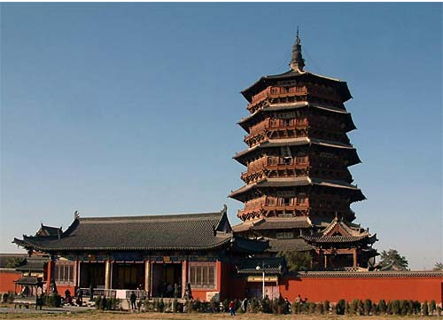
How long is the history of wooden structures in China?
世界上最高的木建筑：应县木塔

Slide 35
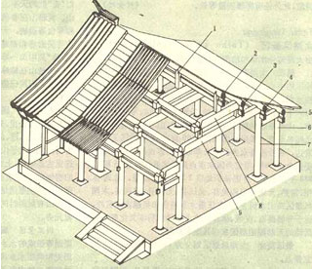
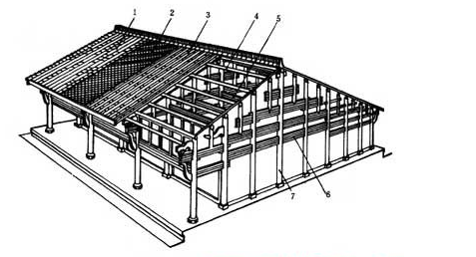
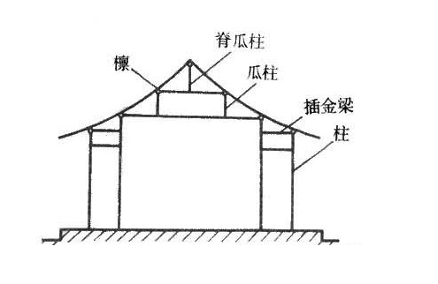
What are the 3 categories of traditional Chinese wood buildings?
穿斗式
抬梁式
井干式

Slide 36
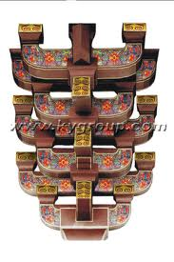
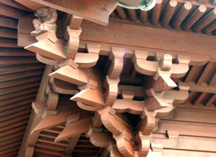
What is dou-gong? What’s its function?
A set of corbel brackets

Slide 37
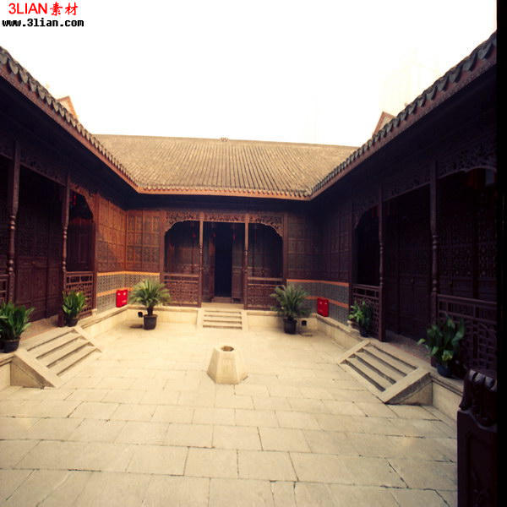
What is the most widespread residential structure in North China? How is it related to Confucianism?

Slide 38
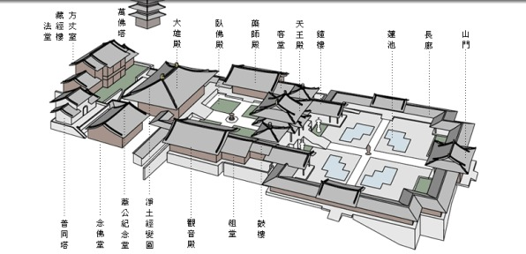
Is the construction of Buddhist temples important in Chinese architecture? What is the general layout of a Buddhist temple like?

Slide 39
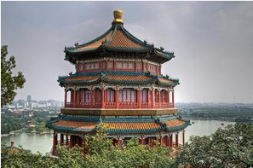
What are Buddhist pavilion and pagodas? Could you name some important Buddhist pagodas in China?

Slide 40
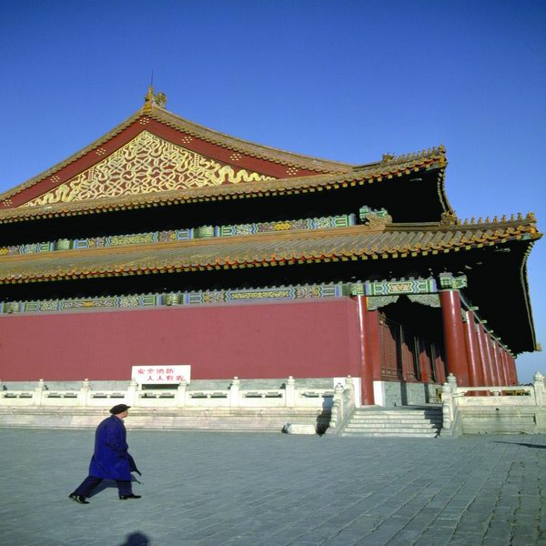
What styles do traditional Chinese buildings' roofs have?
Hipped and gabled roof of double eaves

Slide 41
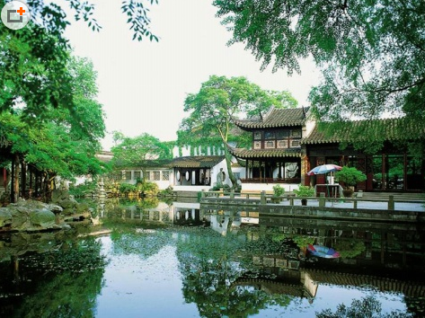
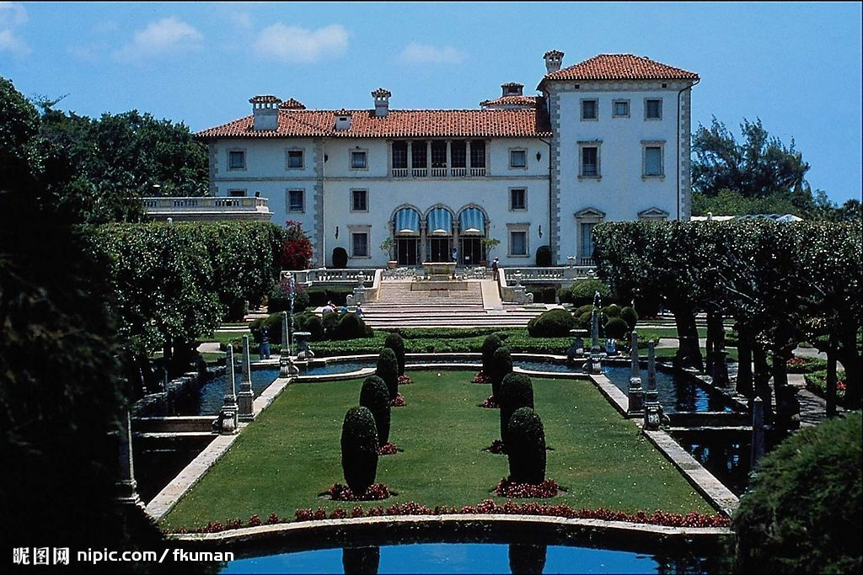
What’s the greatest difference between European gardens and Chinese ones?

Slide 42
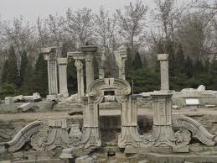
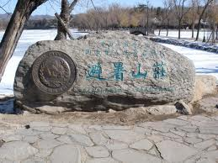
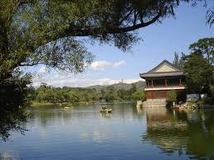
What do you know about China’s imperial gardens? In which part of China are they located? How many of them can you name?

Slide 43
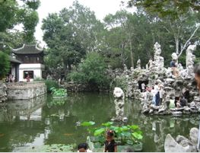
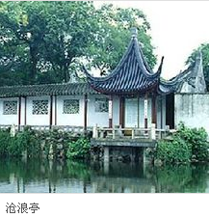
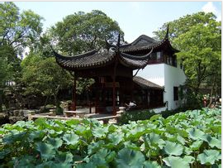
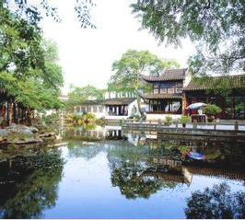
What do you know about the private gardens of Suzhou? What gardens there demonstrate the styles of Song, Yuan, Ming and Qing dynasties?
狮子林
拙政园
留园

Slide 44
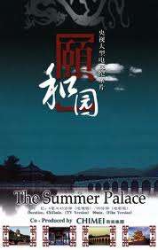
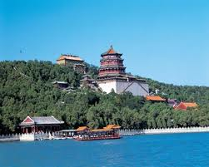
What else was the Summer Palace called?

Slide 45
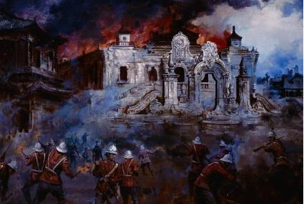
What did the Anglo-French invading troops do to it in 1860?

Slide 46
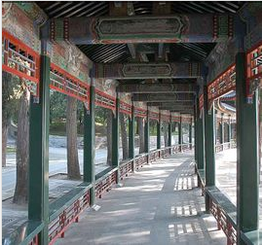
What do you know about the Long Corridor?

