Slide 1

History of Translation in Ancient China
Li Yu Ling Zijin

Slide 2
Contents
01.
Introduction
02.
Translation before Sui Dynasty
03.
Translation in Sui and Tang dynasty
04.
Translation in Yuan Dynasty
05.
Translation in Ming Dynasty

Slide 3
01
Introduction

Slide 4
01
Inrtoduction
China has an over five thousand-year long history of human civilization and a three thousand-year history of translation.Translation has played an essential role in the process of western learning and the making of national culture in China.Understanding the history of translation is conducive to a deeper understanding of translation itself.

Slide 5
02
Translation Before Sui Dynasty

Slide 6
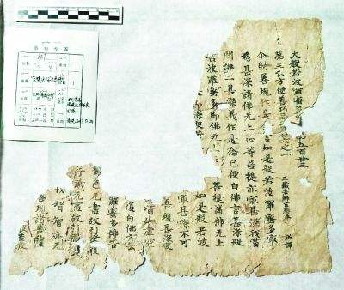
Translation Before Sui Dynasty
Han dynasty (206 BC - 220 BC) : translation became a medium for the dissemination of foreign learning.
The middle of the first century: Buddhism began to penetrate China.
The Buddhist scriptures needed to be translated into Chinese to meet the need of Chinese Buddhists.

Slide 7
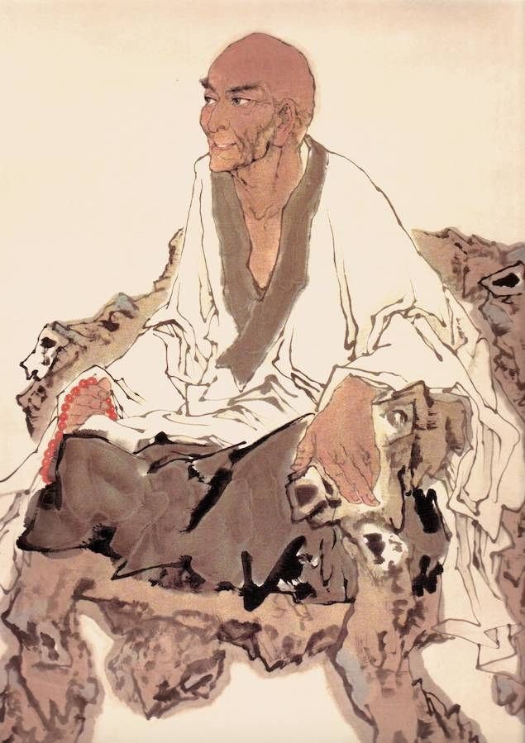
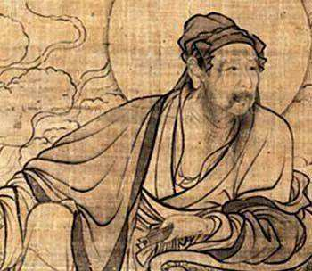
Reprensentatives:
An Shigao: free translation
Zhi Qian: literal translation

Slide 8
03
Translation in Sui and Tang Dynasty

Slide 9
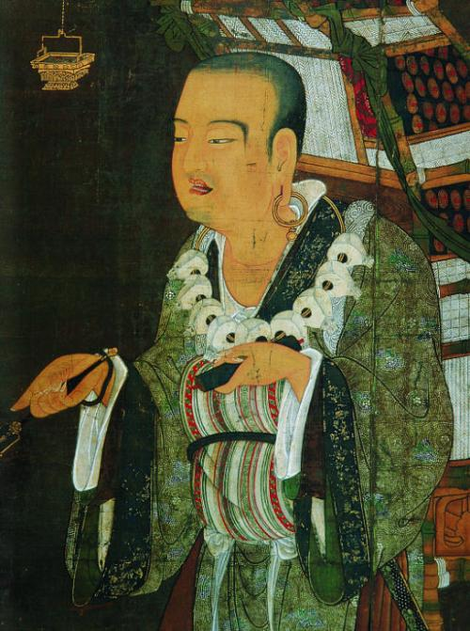
Translation in Sui and Tang Dynasty
Sui dynasty (581-618) to the Tang dynasty (618-907)：Translators in this period were mainly Buddhist monks. They not only had a very good command of Sanskrit but had also thoroughly studied translation theory.
Reprensentative: Xuan Zang.
Translation criteria: translation"must be both
truthful and intelligible to the populace."
He tries to have the best of two worlds
—literal translation and free translation

Slide 10
04
Translation in Yuan Dynasty

Slide 11
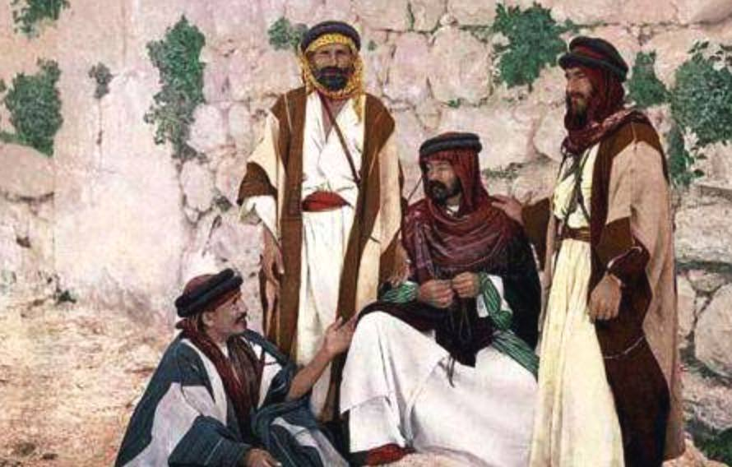
Translation in Yuan Dynasty
Background: Arabs began to settle in China
Translation activity：scientific works from Arabic or European languages
Characteristic: scientific merit was minimal,
and of no great significance.

Slide 12
05
Translation in Ming Dynasty

Slide 13
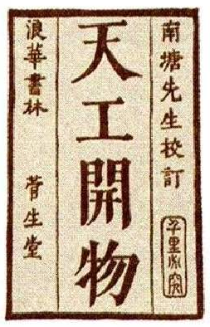
Translation in Ming Dynasty
Background: China came into contact with Europe in various scientific and technological fields
Major translators: western Christian missionaries
Translation activity:western science and technology
as well as Christian texts
Influence:
A. Laid a foundation for further research
B. Facilitated the scientific and technological development of ancient China

Slide 14
Thank you

