Slide 1
Language Style
(official, formal, written, colloquial, slang, sociolects, dialects, regionalects etc.）
IDEA
Hu Xinyi- English Interpreting
Zhuang Haokang- Korean Translation

Slide 2
CONTENTS
Definition of Language Style
Categories of Language Style

Slide 3
PART 01
What is Language Style?
The Definition of Language Style

Slide 4
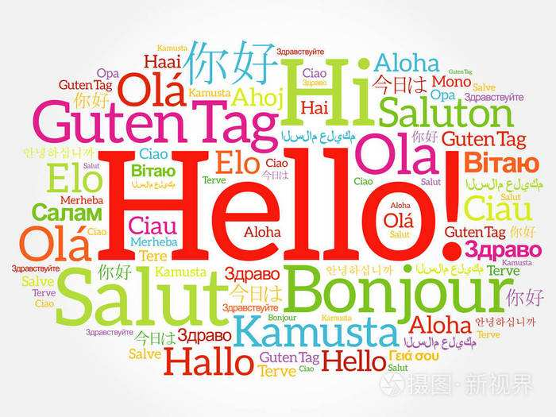
What is Language Style?
Definition
Language style is the way of speaking/writing depending on circumstances of doing that, person (or people) to whom you are speaking or writing.
In any language, different styles of expression are appropriate in different situations.

Slide 5
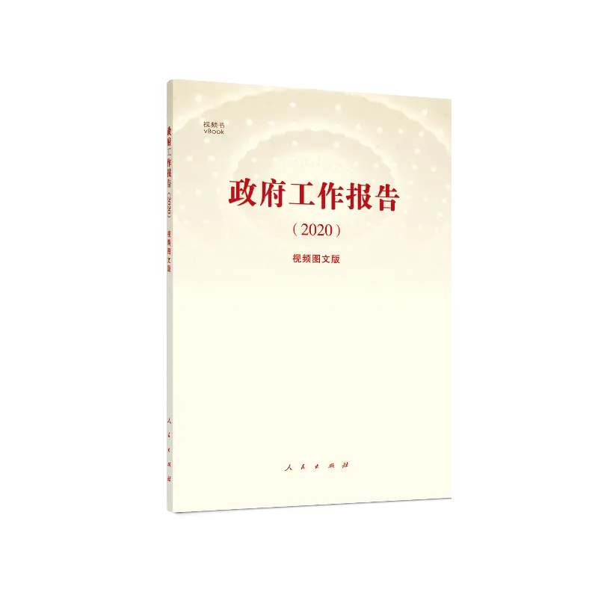
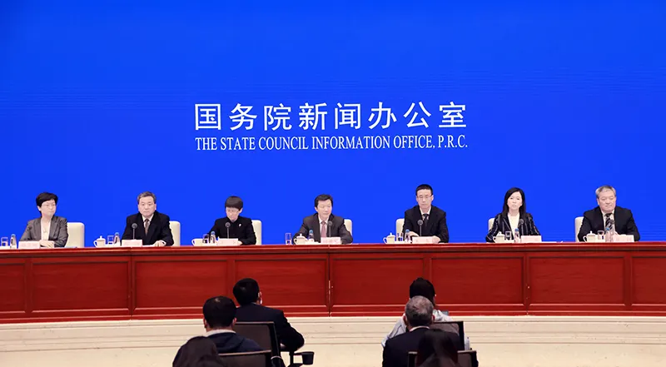
Official Language Style
Official language style is a language that is used in a particularly special legal status. Typically, it is revealed on report on the work of the government and a statement by The State Council.
It may involve with a lot of jargon and termiologies from an objective perspective.

Slide 6
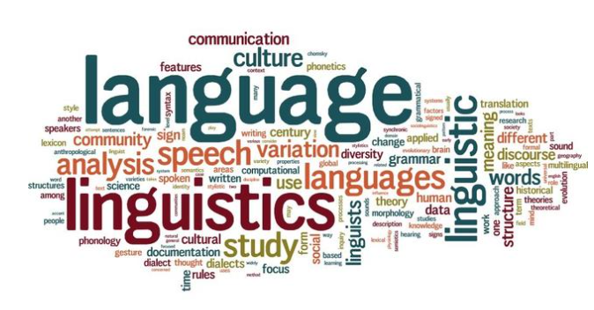
Formal Language Style
We use the terms standard, polite and formal to refer to language that sticks to the rules and is essentially presented as the ‘proper’ form of language.
This type of style is typical for research papers, essays, technical reports, scholarly materials, like books or articles, and orations.

Slide 7
Features
Complex
Introduce, elaborate and conclude each point.
Longer and more complex sentences.
Objective
State mainpoints confidently and support arguments.
Avoid emotional language.
Third Person/ Impersonal
You may not include anything personal in formal writing.

Slide 8

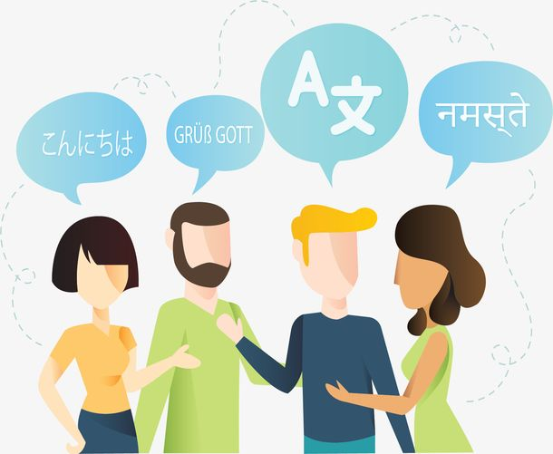
Written language and Colloquial language style:
Generally speaking, written language is always more formal than spoken language.
Colloquial language style is informal as the aim is to communicate rather than stick rigidly to rules, so it is where we see contractions and idiomatic language being used.

Slide 9
Examples:
Spoken：他嫌他的妻子太小气了。
Written：他嫌弃他的妻子十分吝啬。
Meaning: He despises that his wife is so stingy.
Spoken:扯皮
Written:纠纷
Meaning: Dispute.

Slide 10
Slang
1.A kind of language occurring chiefly in casual and playful speech, made up typically of coinages and figures of speech that are deliberately used in place of standard terms for added raciness, humor,
irreverence, or other effect.
2. Language peculiar to a group;
e.g:
打这儿：从此之后 from now on.
兜圈子，绕弯子：有话不直说，talk in a roundabout way.
比上不足比下有余：worse off than some, better off than many.

Slide 11


Social Dialect
Social dialects emerge like dialects, but within a specific class or culture, instead of a region (though they can be further developed to fit certain regions).
They are varieties of language used by groups defined according to class, eductaion, age, gender, and a number of social parameters.
women: generally discuss their personal feelings than men.
men: appear to prefer non-personal topics such as sport and news.

Slide 12
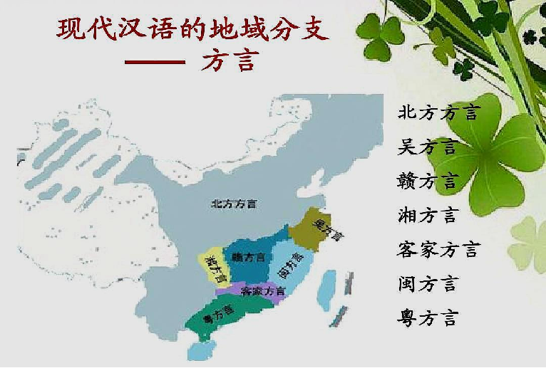
Regional Dialect
Regional dialects are varieties of language that emerge based on regionally specific use. It refers to a subgroup variety of a language associated with a particular geographical area.
e.g:
Wife 妻子
湖南（Hunan province): 堂客 Tang ke
四川、重庆：婆娘
北方大部分地区：媳妇儿
广东话 （Cantonese）

Slide 13
IDEA
THANK
YOU

