Slide 1
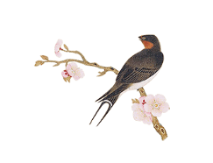
ROUND TABLE
by. C-SKY

Slide 2
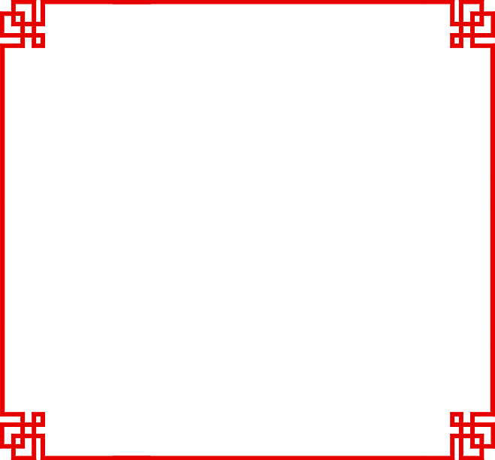

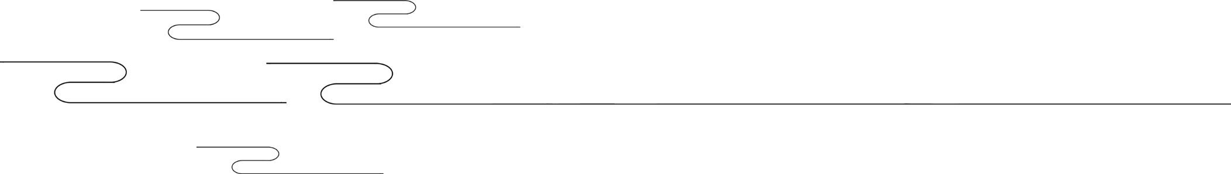
CONTENTS
壹
Round Table Culture in China
贰
Round Table Culture in Western Countries
叁
Round Table Culture in my memories

Slide 3

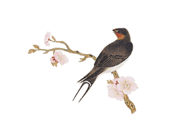

Round Table Culture in China
The most distinctive feature of a round table is its roundness. "Round " is an omnipresent, universal symbol with extensive meanings. Without beginning or end, without sides or corners, this geometric shape represents perfection, unity, wholeness and spirituality. "Round", a typical totem of Chinese traditional culture, mainly represents perfection and wholeness and has always been advocated by Chinese people.
Part 1
harmony
tolerance
equality
reunion

Slide 4
Round Table Culture in Western Countries
The birth of “round-table conference”:Legend has it that King Arthur held a conference in the sixth century BC. He wanted the knights in his court to be considered equal; he did not want them fighting over status or rank. Therefore, they congregated around a round table to have their conference. As its name suggests, a round table has no edges or corners, implying that everyone who sits around it has equal status.
Part 2
equality

Slide 5
Round Table culture in My memories

Slide 6
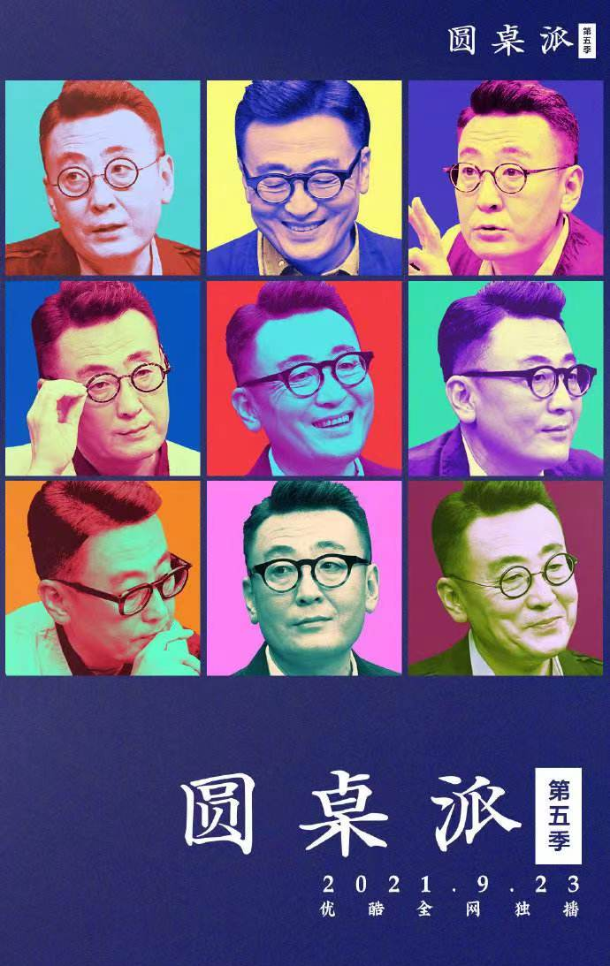
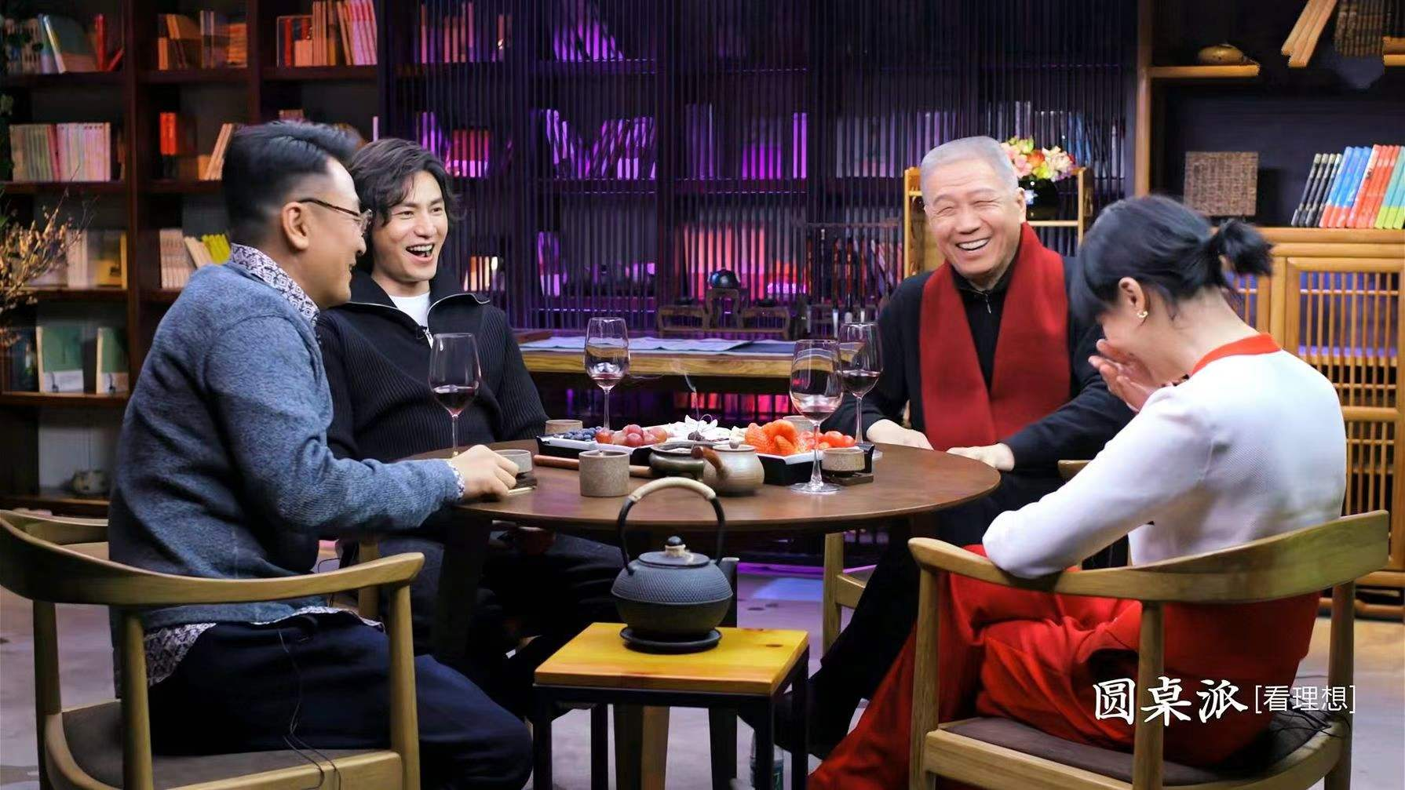
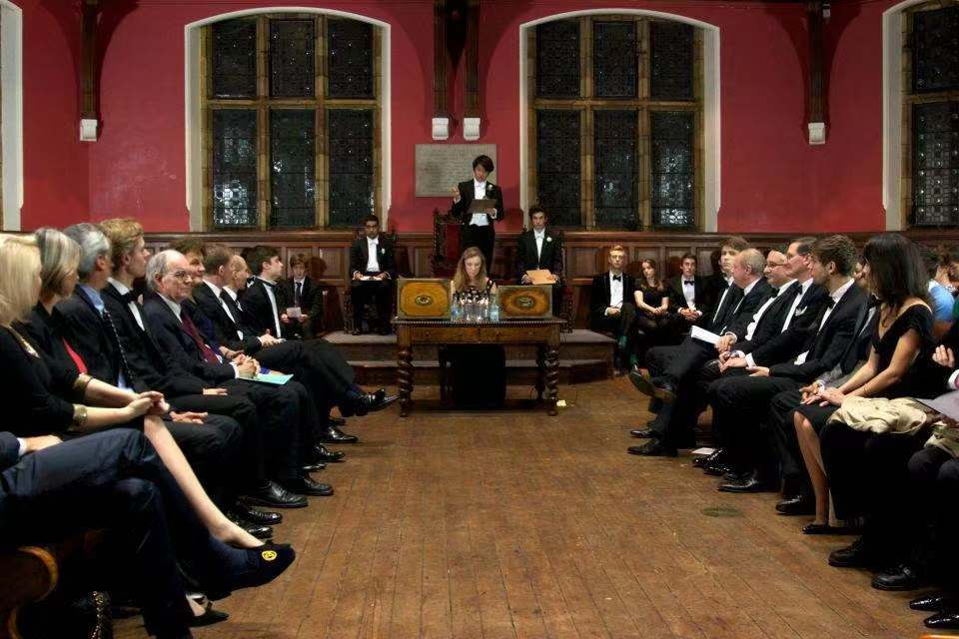
the harmony and conflict of thoughts
Compared with other forms of communication, the “round-table conference” is more likely to provide people who hold different or even totally opposite opinions a chance to sit together and share their stories and point of views freely and more equally. It is a collision of thoughts and confusion of souls.

Slide 7
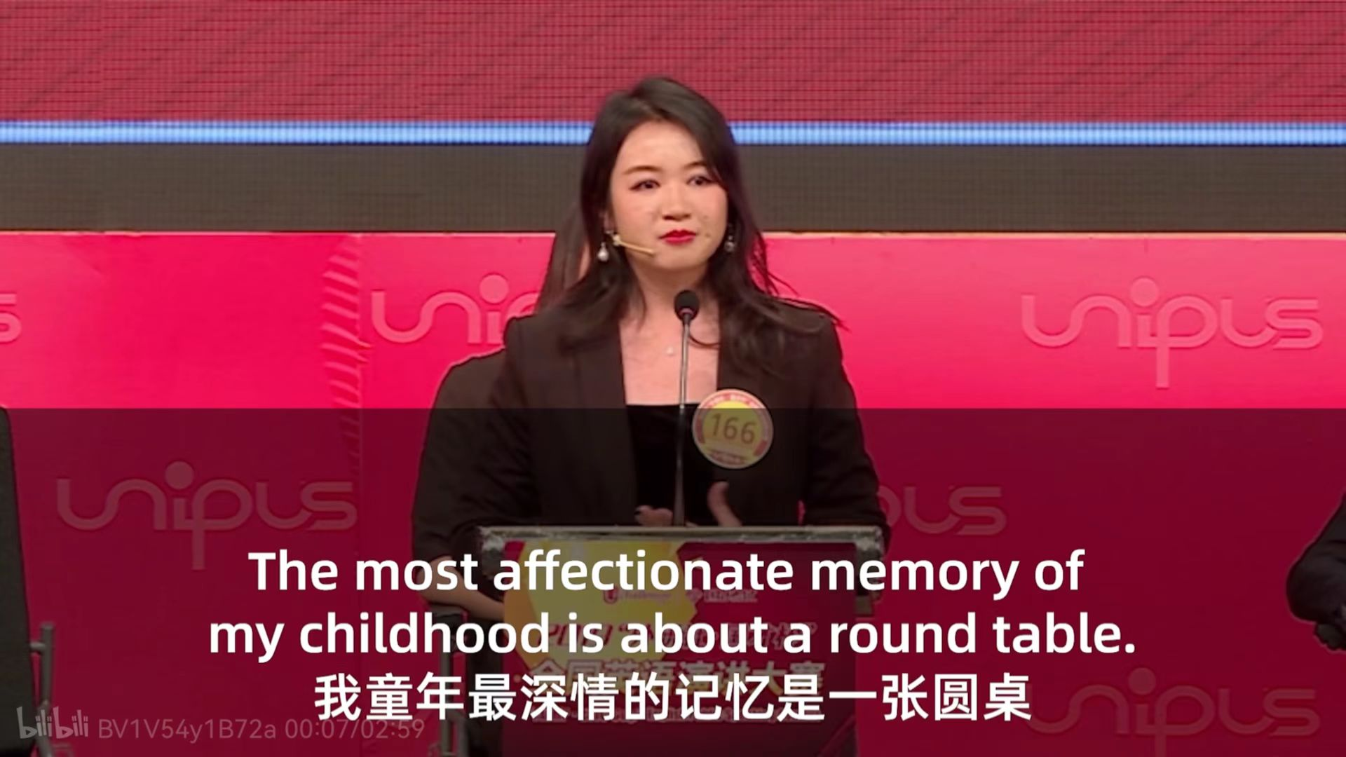
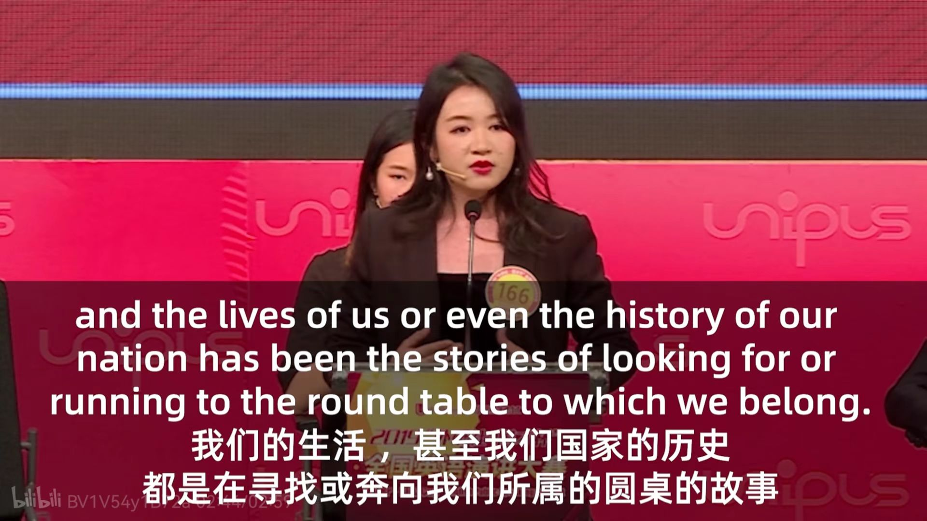
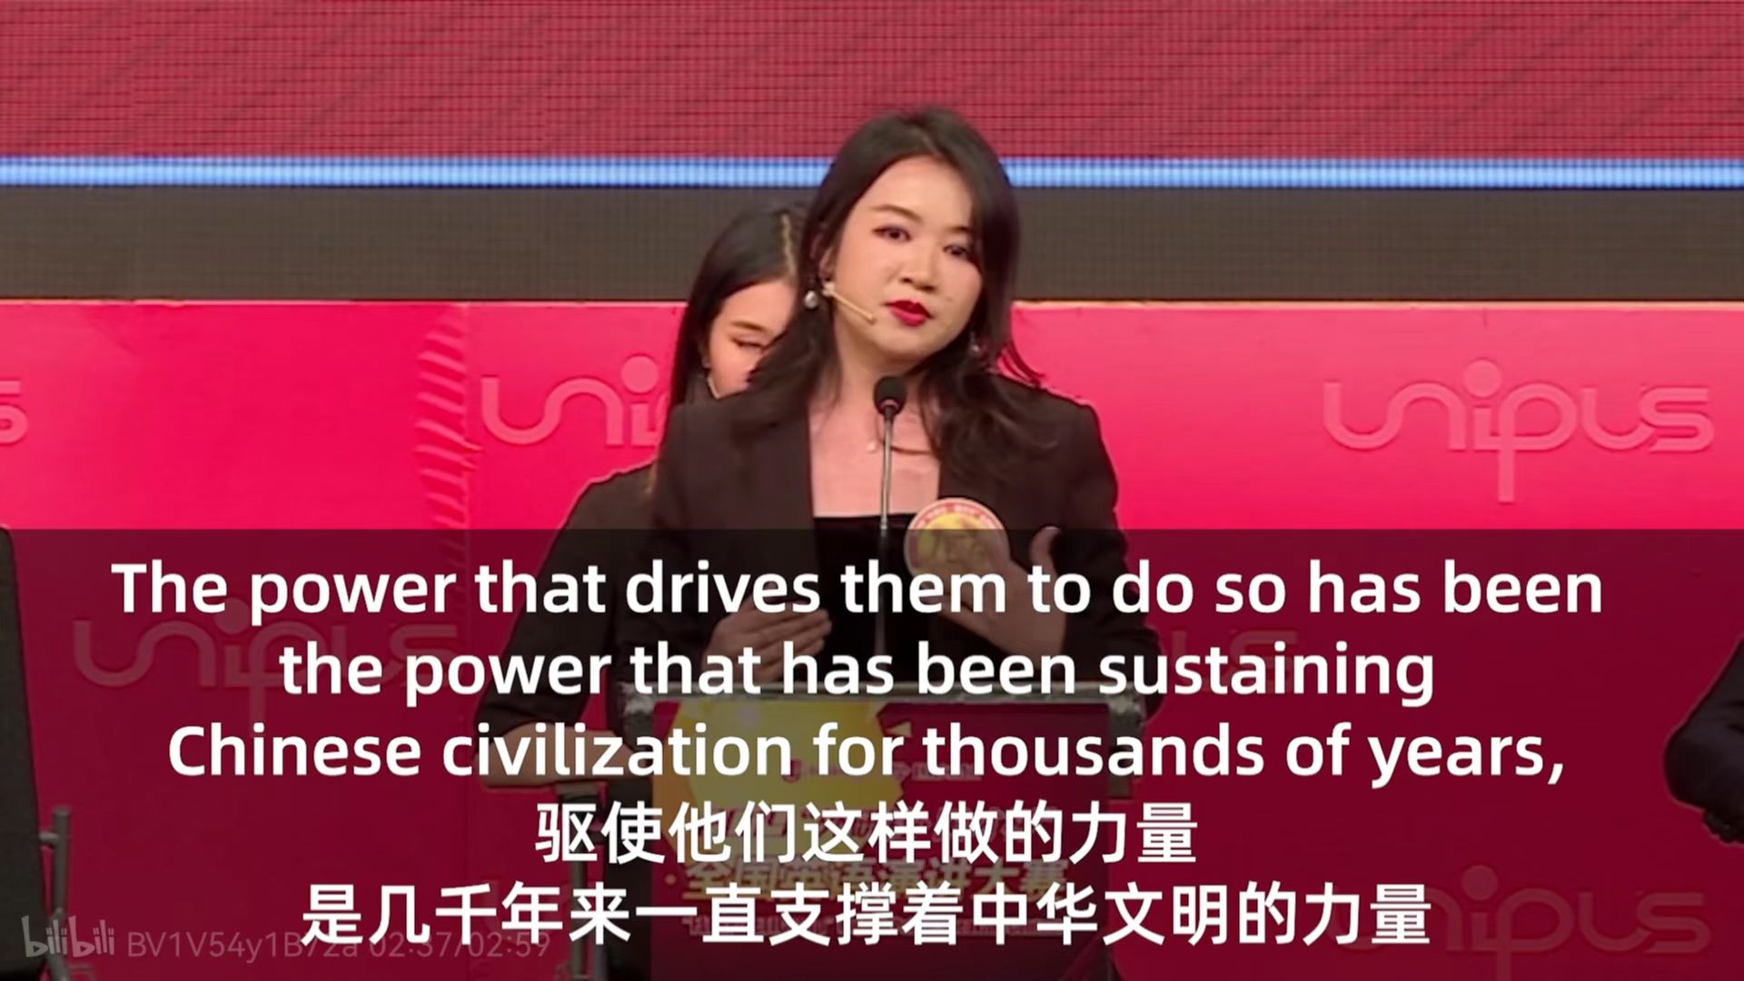
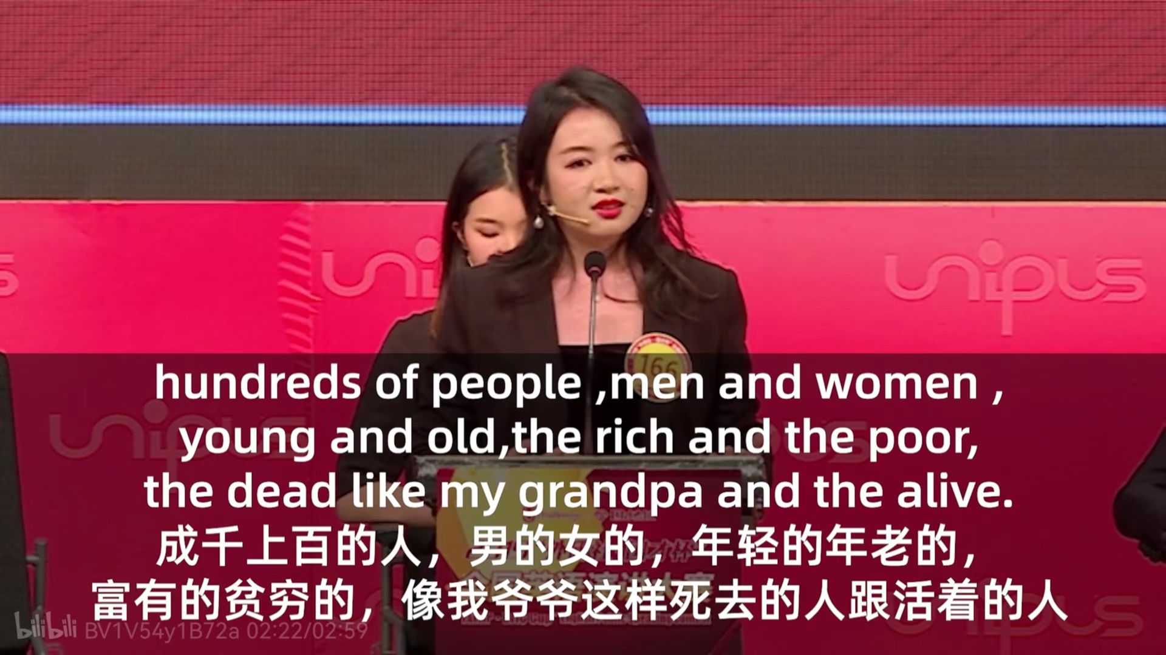
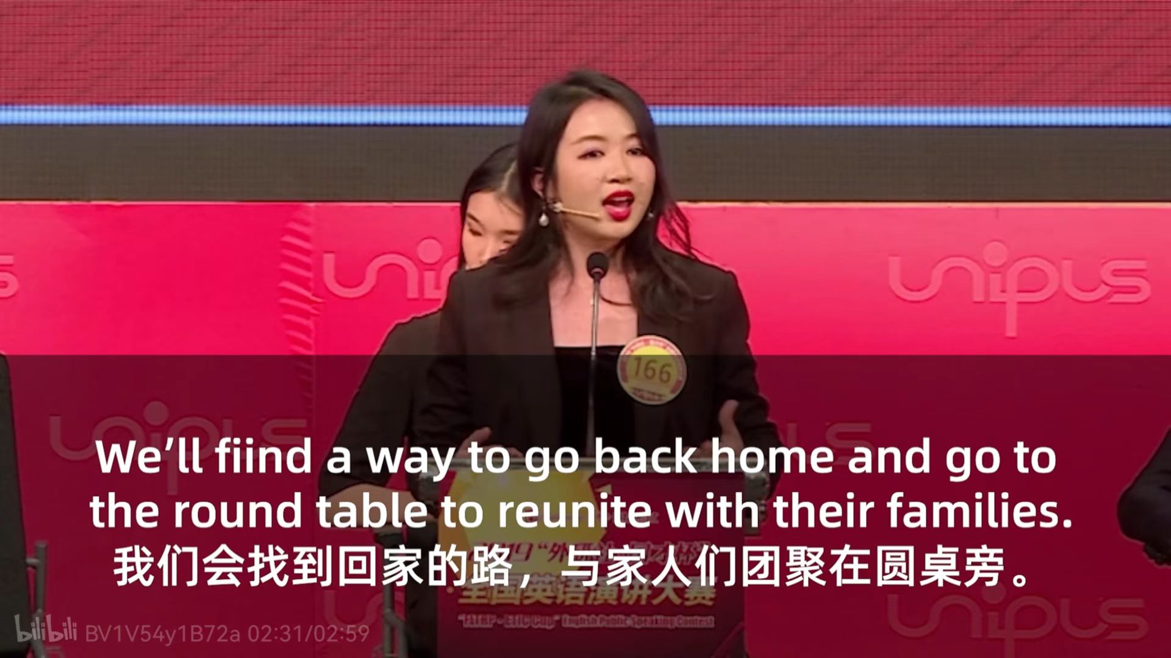
the memories of beloved ones
The round table has always been a medium carrying the stories happened in our daily lives and shared when we gather together with our beloved ones. The stories, the people, the dishes are all the precious memories we have on the round table. And thousands of pieces of stories unite together and form the history of our nation. The round table is the symbol of Chinese culture and symbol of family.

Slide 8
