Slide 1
Chinese Names

Slide 2

Chinese Surnames
目 录
Contents
Chinese Given Names

Slide 3
Chinese Surnames

Slide 4
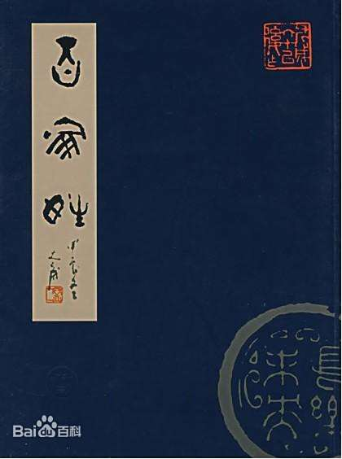
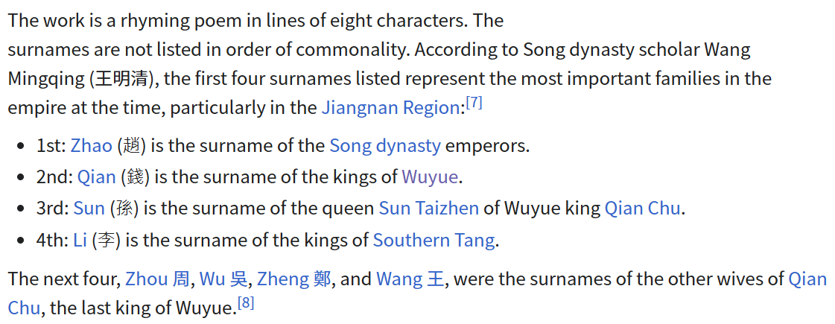
Family Names in Hundreds
When you hear the word “surname,” what book comes to mind?
Do you know what the first four surnames in the book are?
Why they're arranged in this order?

Slide 5

Chinese surnames
monosyllabic surnames
polysyllabic surnames
Fiefs
Official positions
Occupations
Orientation

Slide 6

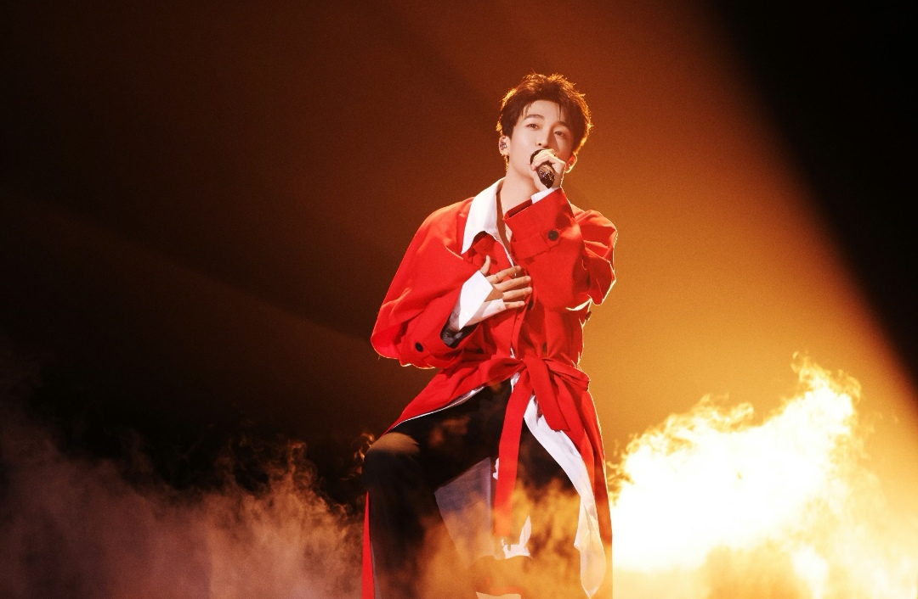
黄子弘凡
易烊千玺

Slide 7
Chinese Given Names

Slide 8
1
Given names Composition
Almost all Chinese given names are made up of one, two, or three Chinese characters.
2
Influential Factors
auspicious meaning, the child’s birthtime, family genealogy, the Five Elements and Bazi.

Slide 9
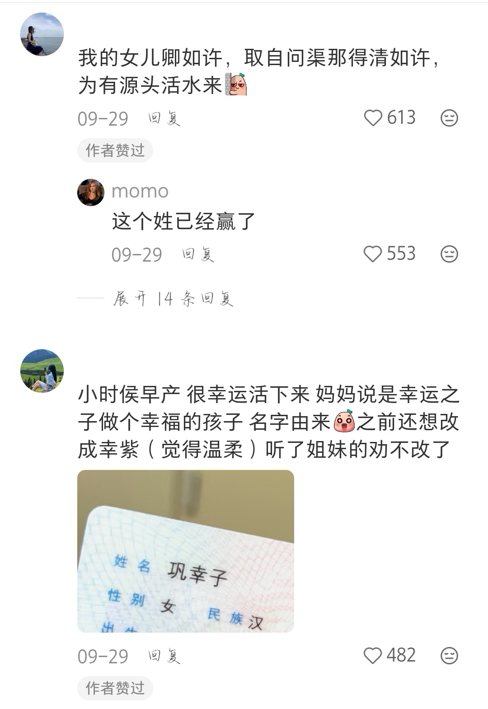
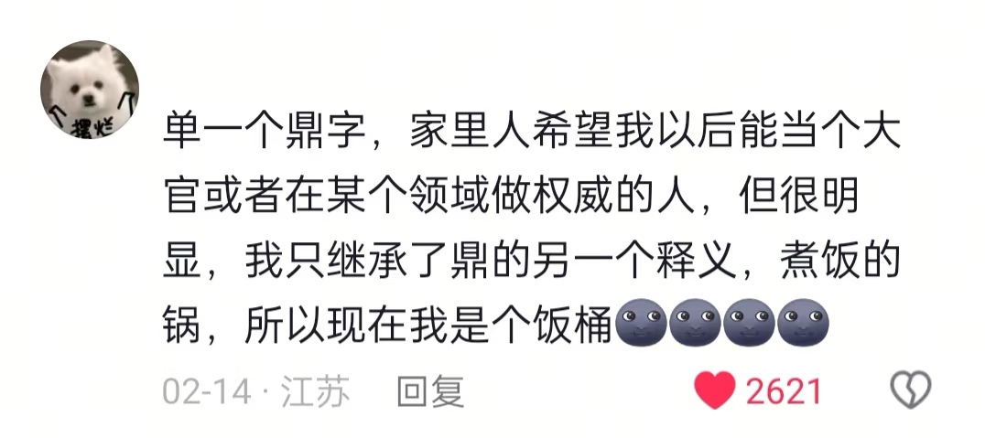

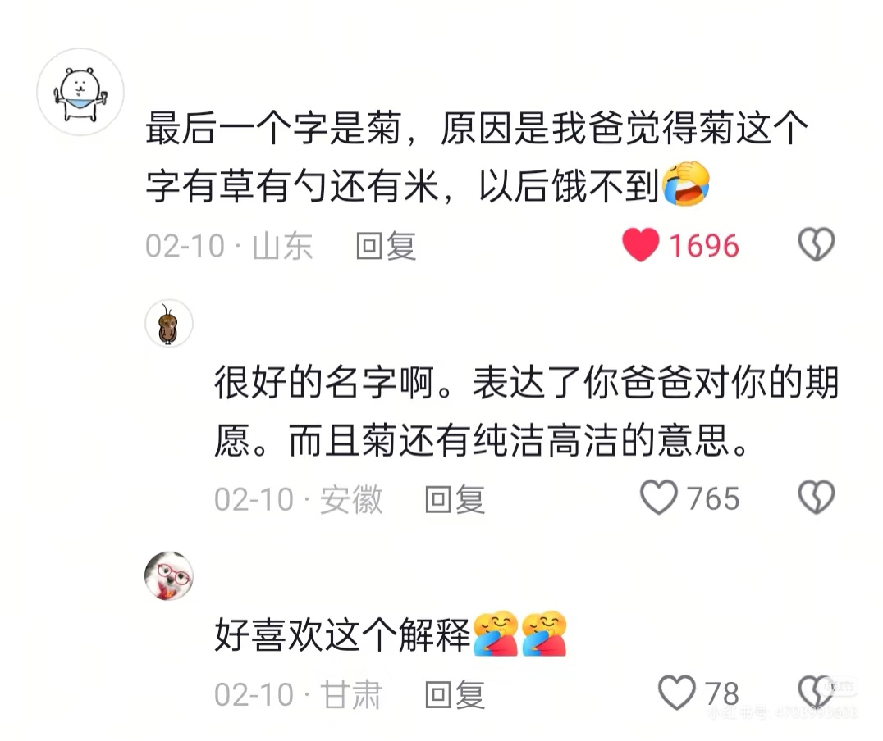
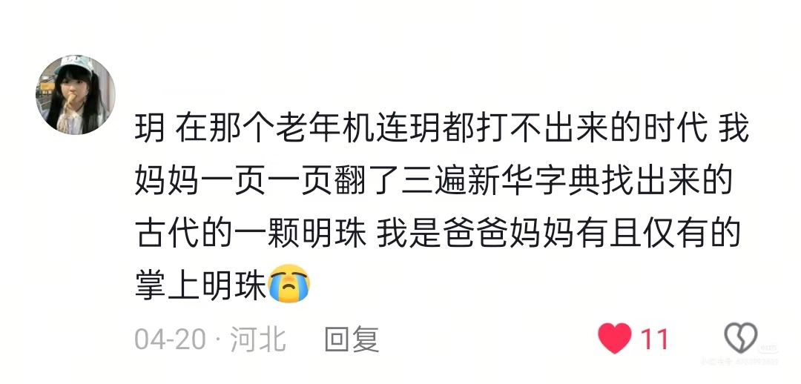

Slide 10
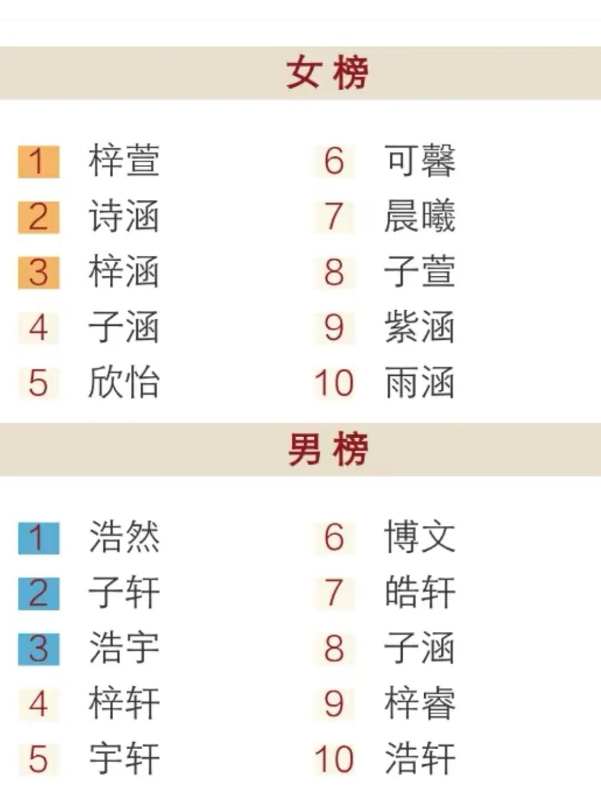
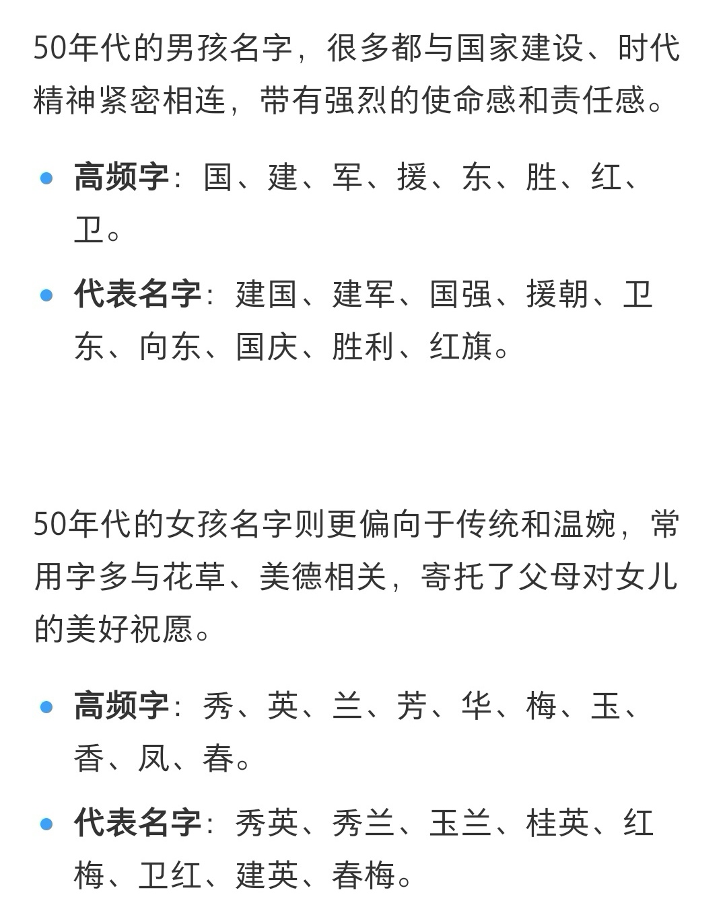
1950s
Popular names:
2010s

Slide 11
Thank You !
Resources: 《姓名与中国文化》; 《中国文化课本2025版》; Wikipedia; 小红书

