Slide 1

Rice Noodle Roll
Presenter: Zhu Yehui
2025.11.27

Slide 2
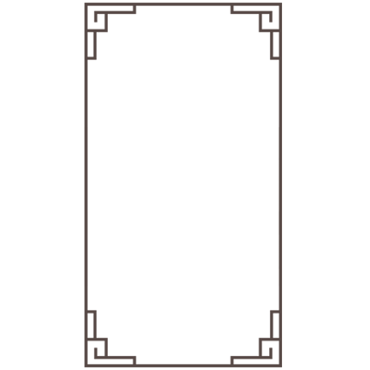
Content
1
The Origin
2
The Making Process
3
The Comparison

Slide 3
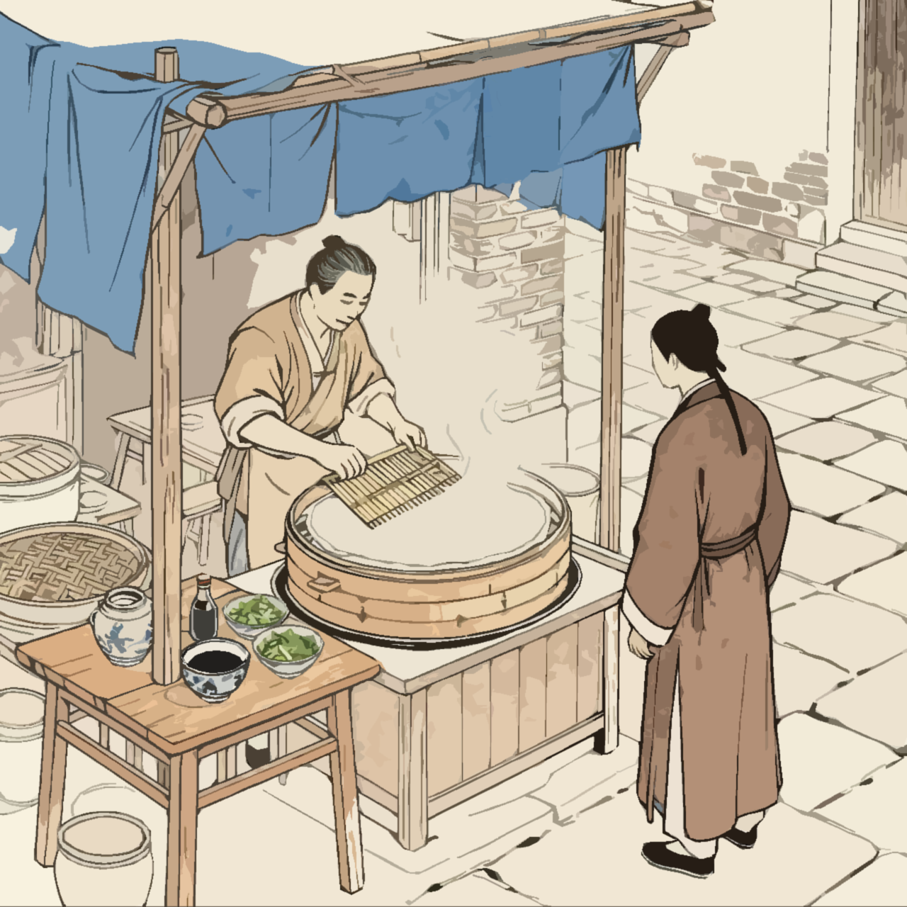
1
The Origin

Slide 4
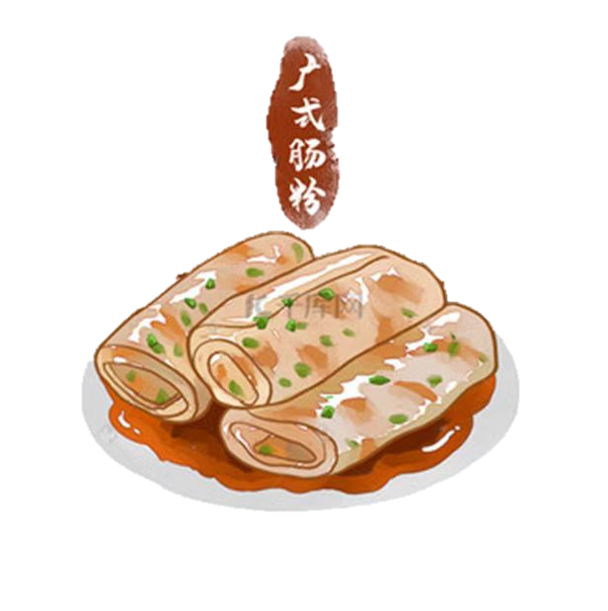
Quiz
Which emperor is related to the origin of Rice Noodle Roll?
Emperor Qian Long
Emperor Kang Xi
Emperor Yong Zheng

Slide 5
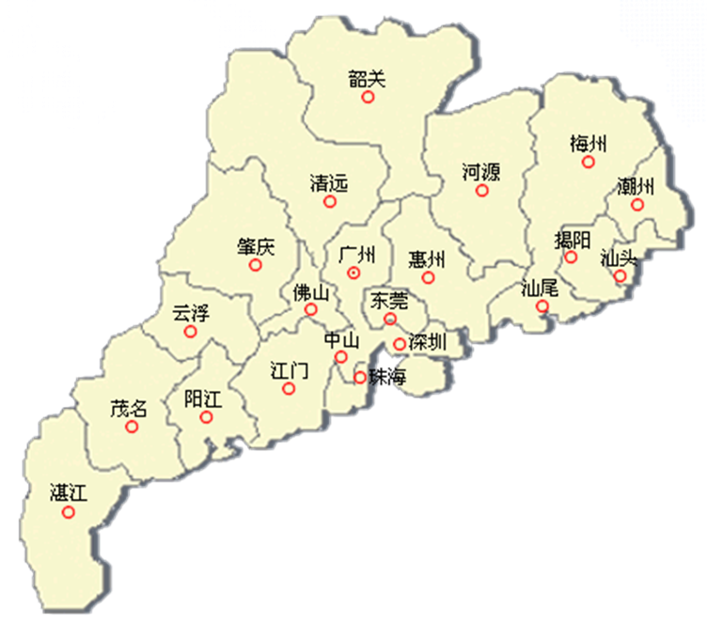
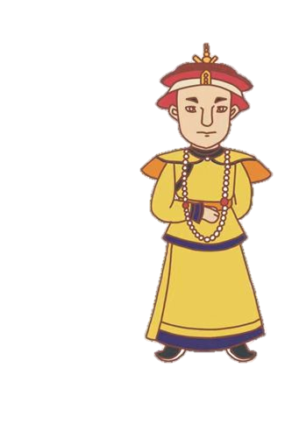
The Origin
Longkan Mochi（龙龛糍）
Crisp!
Tender!
Smooth!
Luoding 罗定
Let’s call it “肠粉“
（Rice Noodle Roll）

Slide 6
2
The Making Process

Slide 7
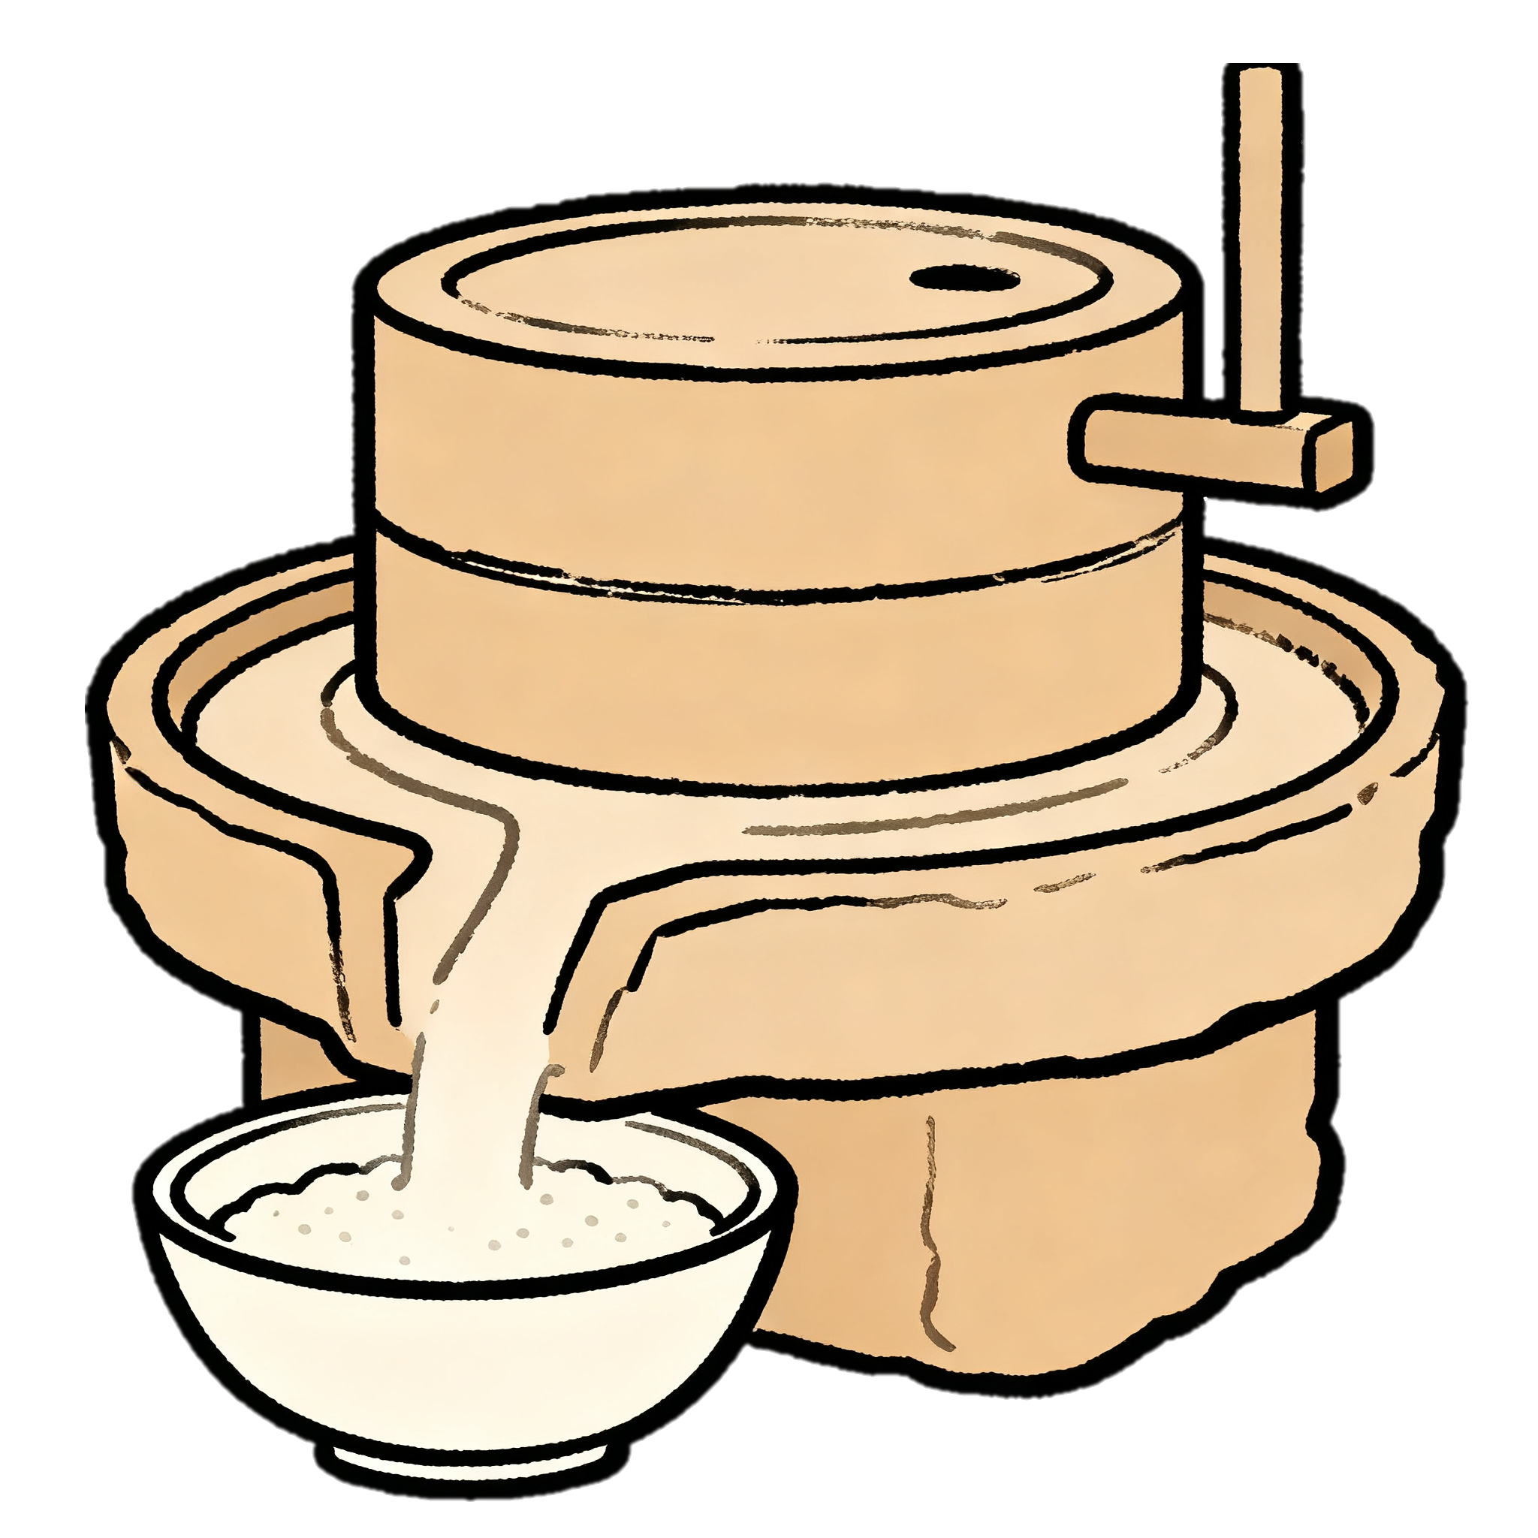
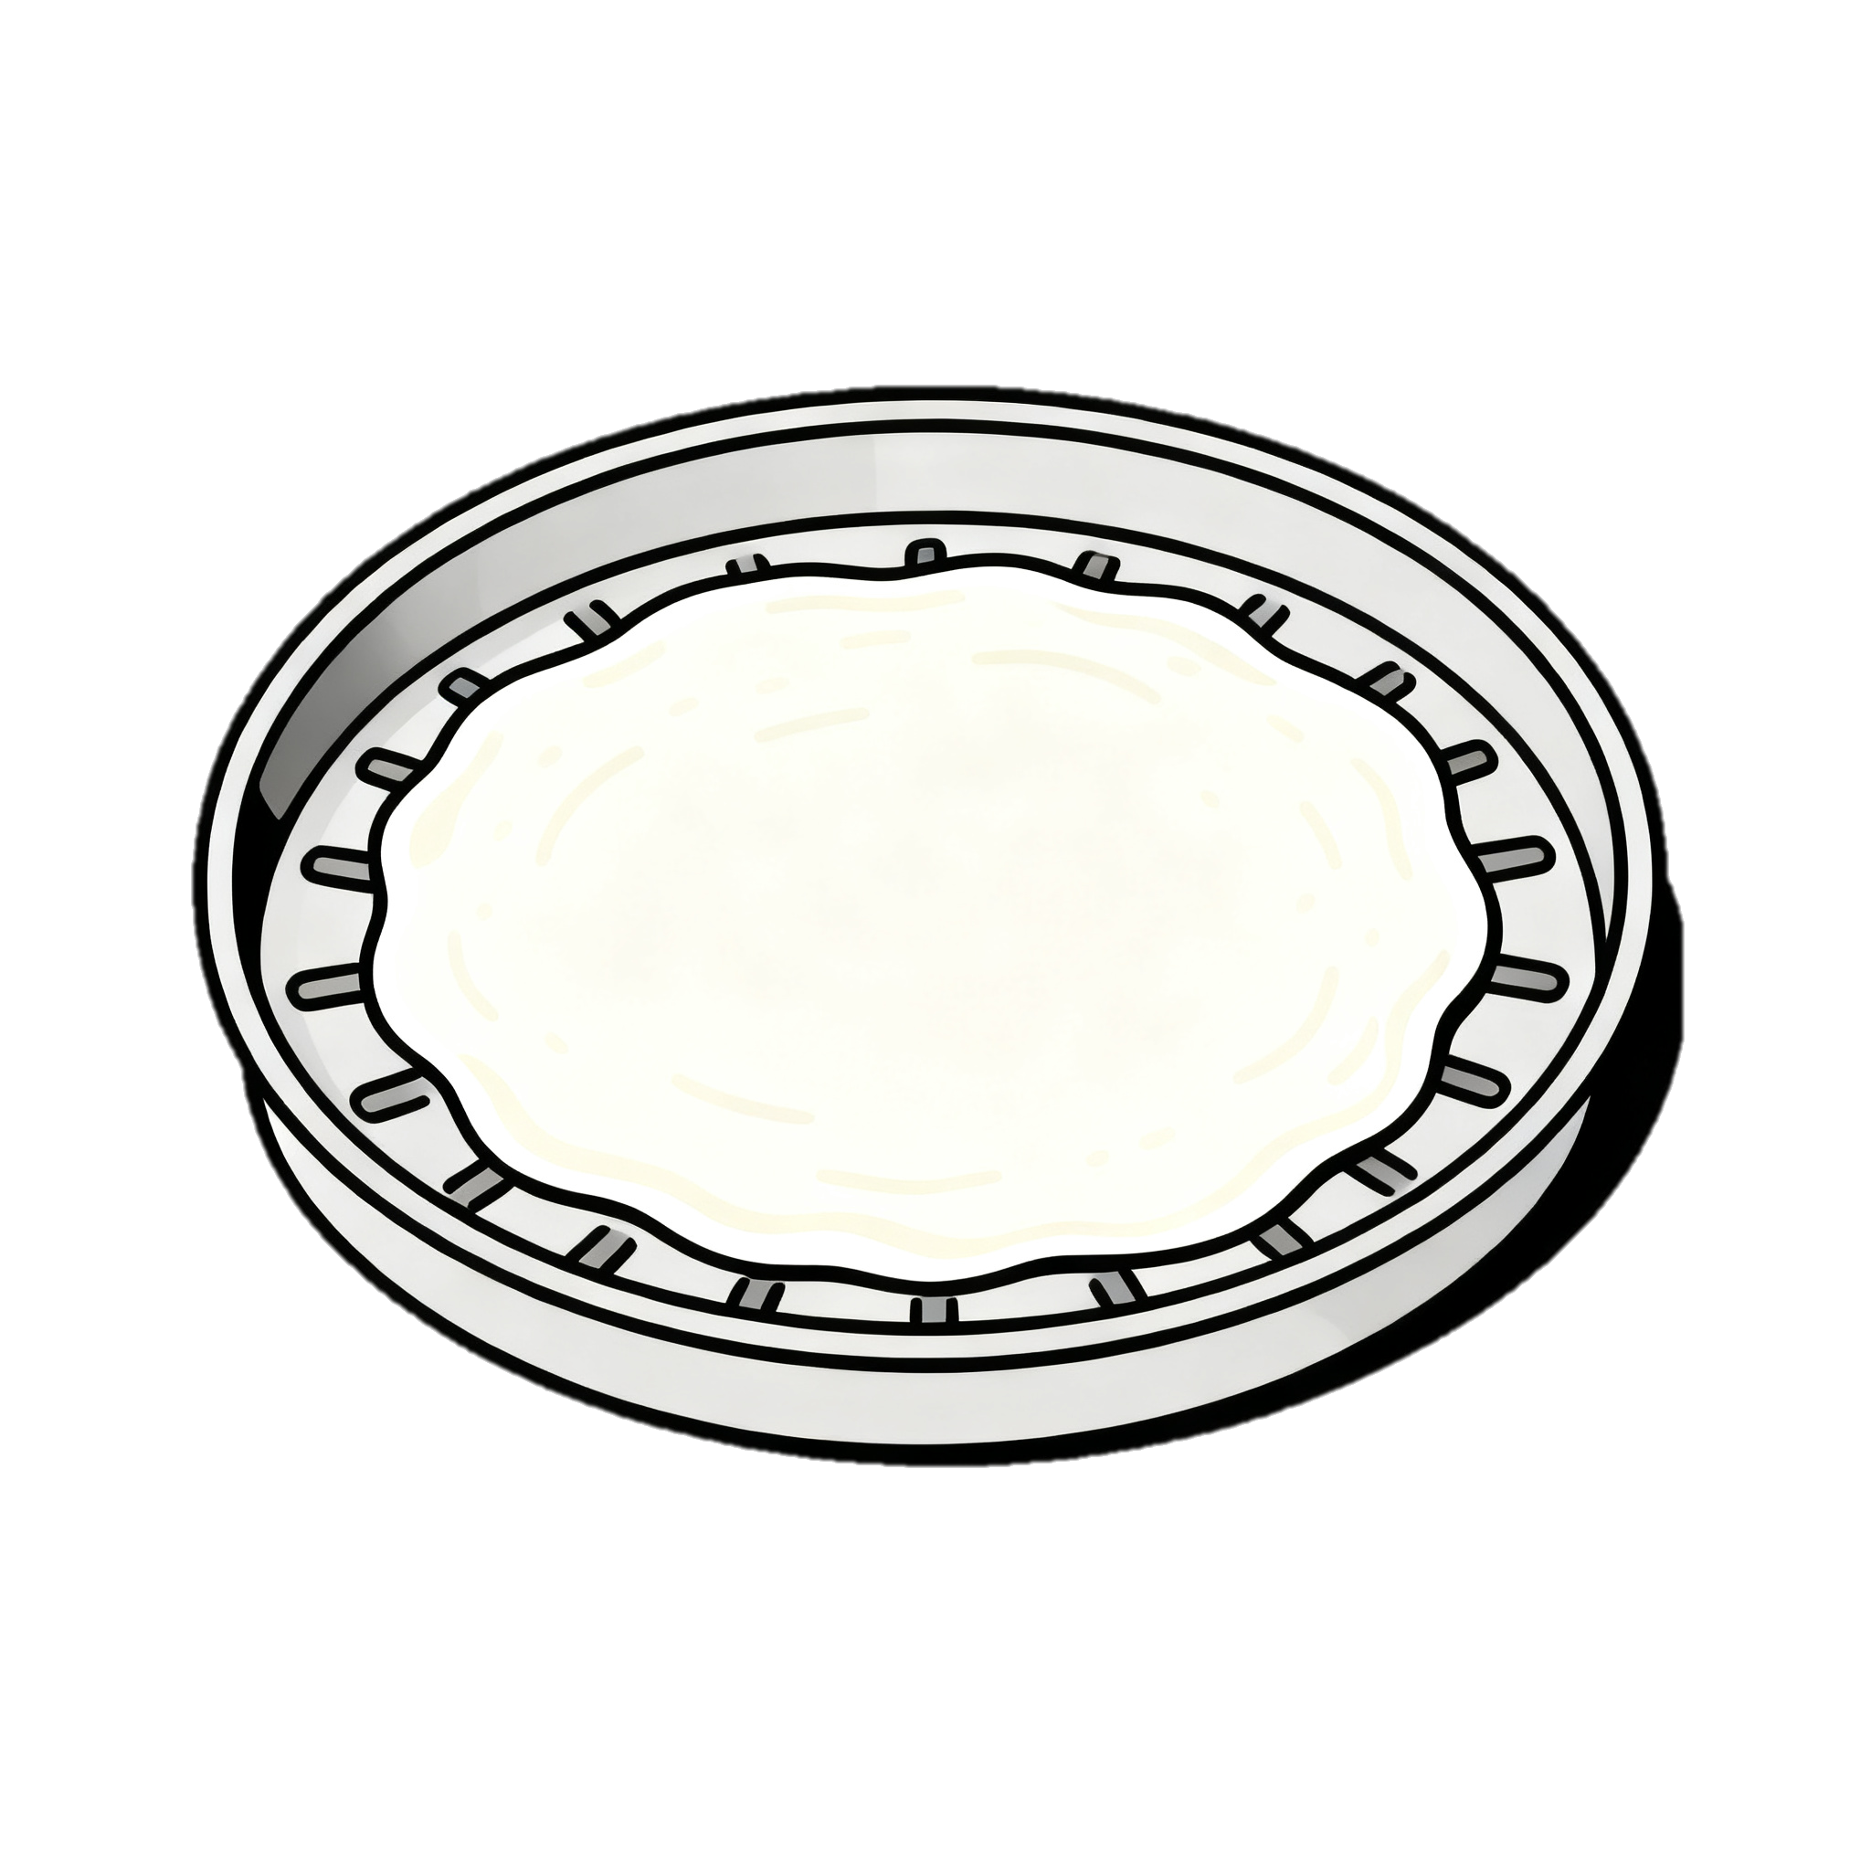
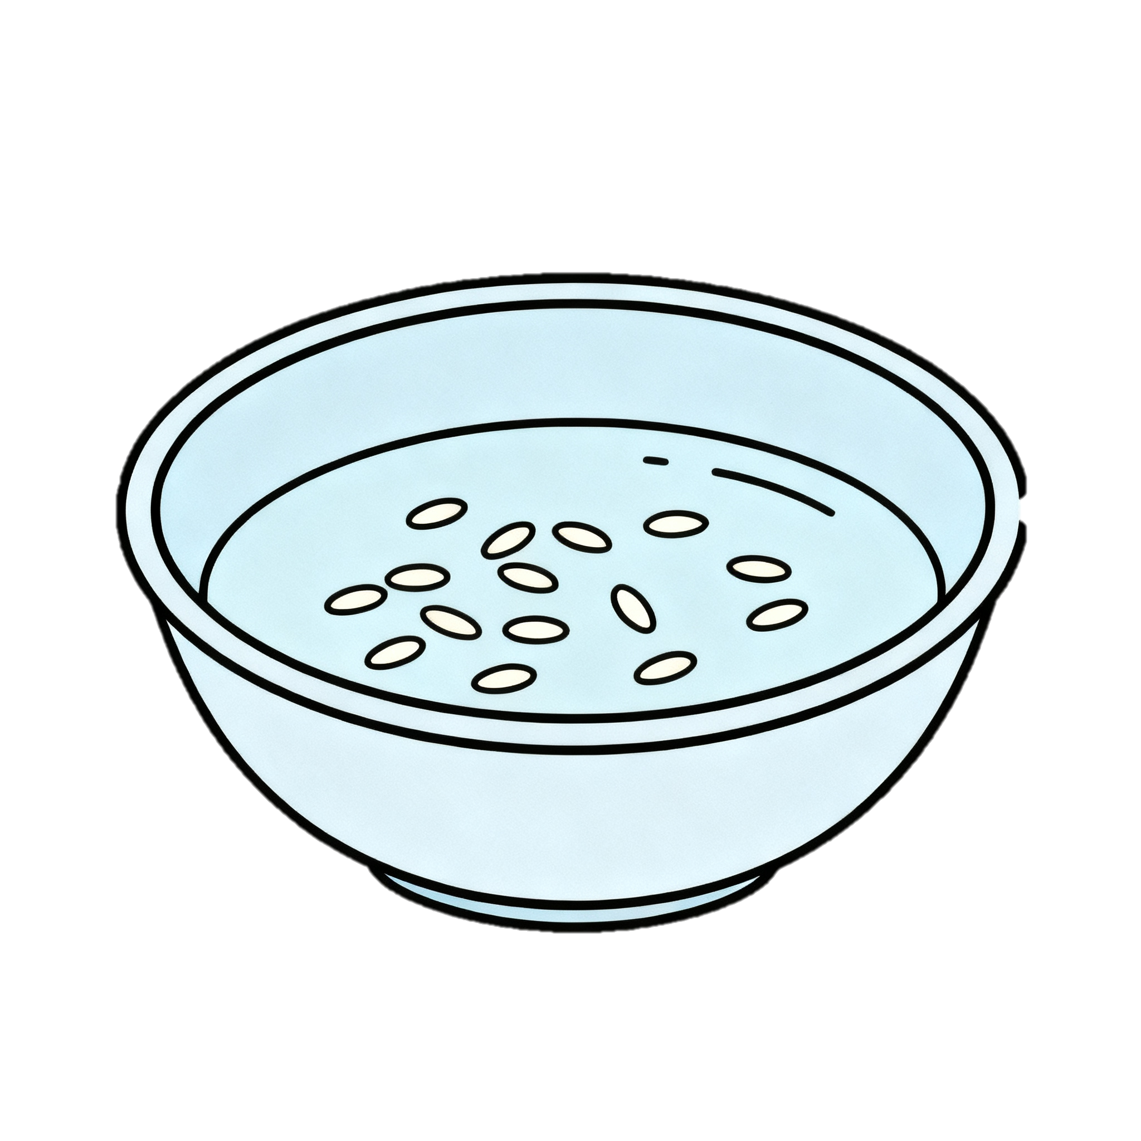
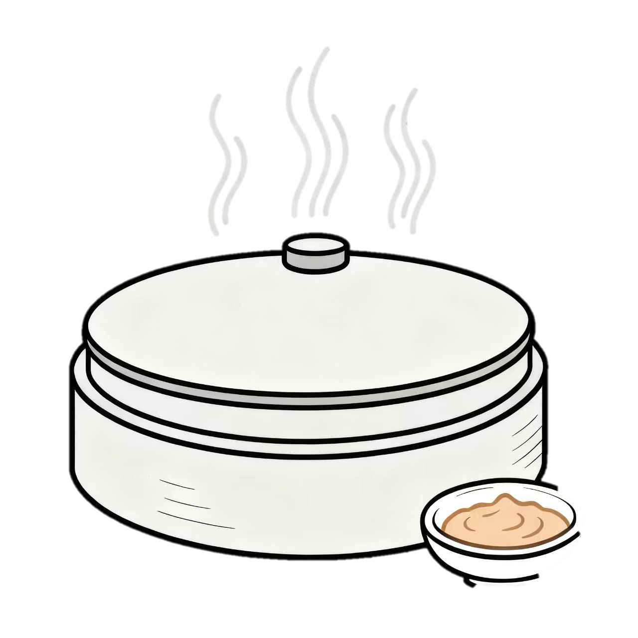
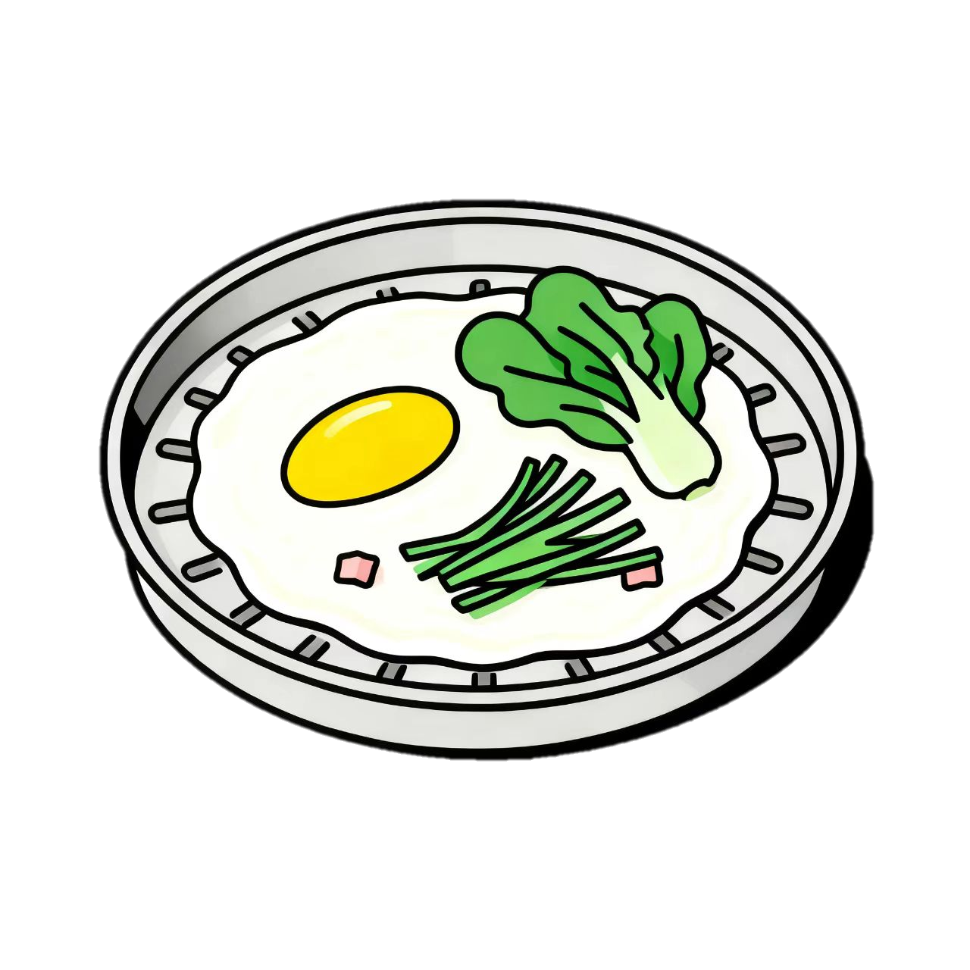
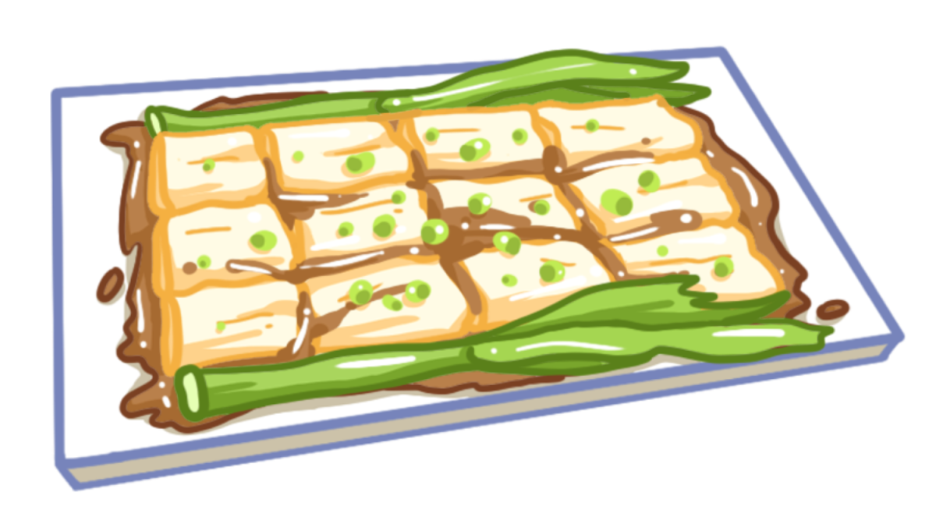
The Making
2. Rice Grinding
3.Spreading the Rice Paste Evenly
1. Rice Selection and Soaking
6. Done!
4. Adding the Ingredients
5. Steaming

Slide 8
3
The Comparison

Slide 9
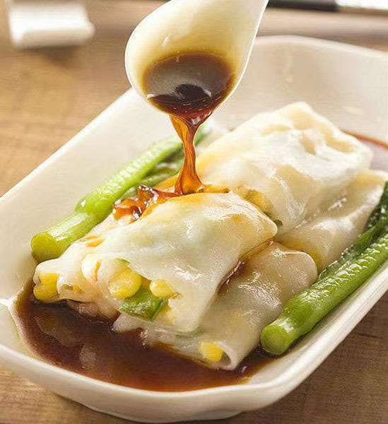
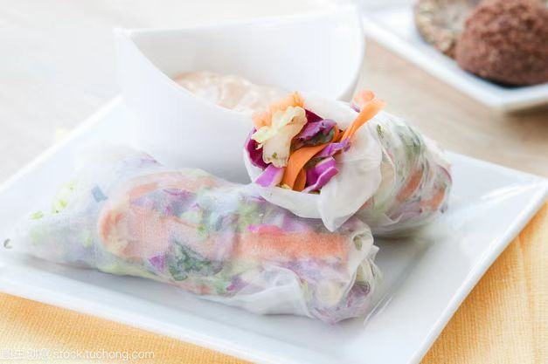
The Comparison
Thai Spring Roll
Rice Noodle Roll
fresh and raw vegetables
cooked ingredients
sweet chili sauce
soy sauce

Slide 10
Thanks For Listening
Pictures from: Baidu, Doubao, Xiaohongshu
Texts from: the textbook

