Slide 1
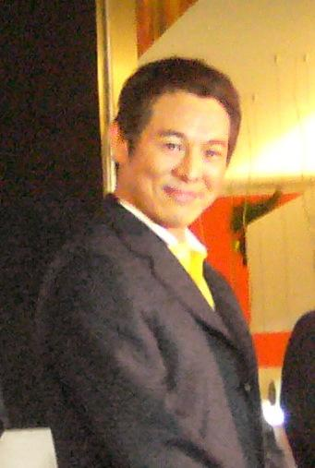
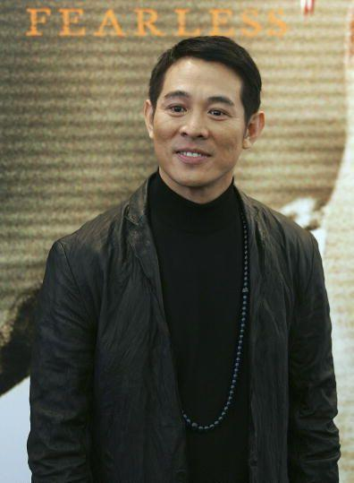
Jet Li!!

Slide 2
The life of Jet Li
Youngest of five kids
Two older brothers and two older sisters
Father died at the age of 2
Birth name is Li Lian Jie
Joined a Wushu Academy at a young age
http://www.youtube.com/watch?v=0qSsMmRD3jM

Slide 3
Film Career
film career began in 1982 with The Shaolin Temple.
Starred in many Chinese films after that
Eventually made a debut in the U.S.
http://www.youtube.com/watch?v=adnXzutxWcQ

Slide 4
Quotes
(On his personal philosophies)
"Everything I want to say is in those three movies, the message of Hero is that your personal suffering is not as important as the suffering of your country. The point of Danny the Dog is that violence is not a solution. Fearless is actually about personal growth — about a guy who decides that in the end his greatest enemy is himself" (AsianBite).
http://www.youtube.com/watch?v=WTIrIGI-lvc
or
http://www.youtube.com/watch?v=eTsKEgUJyUQ

Slide 5
Quotes
(On working with Jackie Chan)
“I have met Jackie Chan about 6 times up 'til now . . . and even though many people think we are natural enemies, I personally think he is a cool bloke and would honestly love to work with him in a film one time - that would a well brilliant movie!” (imdb).
http://www.youtube.com/watch?v=gcPJ5qSnrEI

Slide 6
Quotes
(On the future of his career)
“I stepped into the martial arts movie market when I was only 16. I think I have proved my ability in this field and it won't make sense for me to continue for another five or 10 years. Fearless (2006) is a conclusion to my life as a martial arts star” (imdb).

