Slide 1
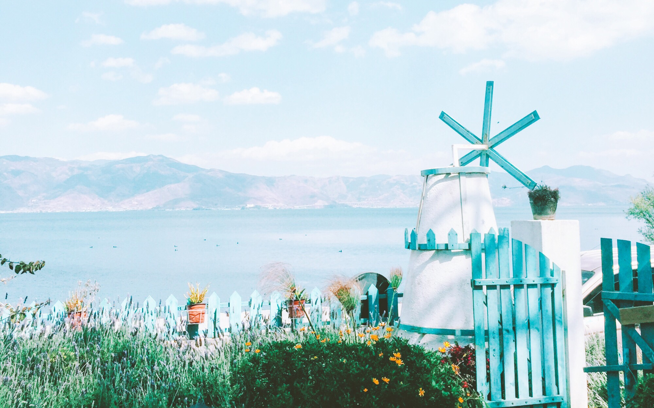
Poem Translation
Yang Hairong
Zhang Yujie

Slide 2
A Brief Introduction of Poetry
01
Translatability and Untranslatability of Poetry
02
CONTENTS
Principles of Poem Translation
03
The Translation of Poem Image
04

Slide 3
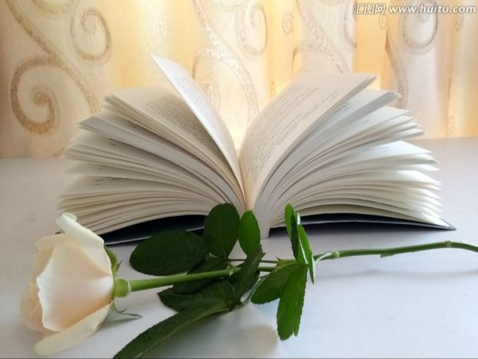
PART ONE
A Brief Introduction of Poetry
Poetry may be defined as a kind of writing that formulates a concentrated imaginative awareness of experience in language chosen and arranged to create a specific emotional response through its meaning, sound, and, rhythm.

Slide 4

Translatability and Untranslatability of poetry
1. Phonetic
Differences in Language: 2. Writing structure
3. Rhetoric
PART TWO
Untranslatability
1. The culture of bible
Differences in Cultures: 2. Ancient Greek mythology
3. Buddhist culture
4. Geography culture
Example:
An example of geography cultural difference:
Shall I compare thee to a summer's day?
Thou are more lovely and more temperate.
-Shakespeare's sonnet
我想将你比作迷人的夏日，
可是你却比她更加可爱迷人。

Slide 5

1. the thinking power to reason logically
2. the feelings to express joy or sorrow
3. living in the same world regardless of race
Translatability

Slide 6
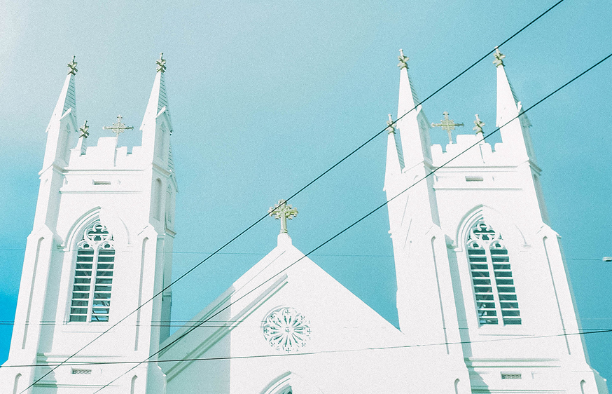
PART THREE
Principles of Poem Translation
Sense Beauty
Sound Beauty
Form Beauty
Theory of Three Beauties:

Slide 7


Relationship of The Three Beauties:
Beauty of Sense ---- the first-rate importance
Beauty of Sound --- the second-rate importance
Beauty of Form ---- the third-rate importance
Principles of Poem Translation
Example
《西厢记》
盼不到博陵旧冢,血泪洒杜鹃红。
When can we reach the burial ground so far away?
Alas! Azaleas turn red，
with tears of blood we shed.
—— Translated by Xu Yuanchong

Slide 8

Non-Figurative Images:
the image that the poet really perceives, exists in the poetic world described by the poet.
Figurative Images:
an image with rhetorical meaning, exists in a certain rhetorical way.
PART FOUR
The Classification of Poem Image
Example
The Translation of Poem Image
Non-Figurative Images:
The love we thought would never stop,
Now cools like a congealing chop.
The kisses that were hot as curry,
Are bird-pecks taken in a hurry.
我们原以为没有止境的爱,
现在象冻结的肉冷下来。
原先的吻如咖喱般热火,
现在是鸟儿匆忙的一嚼。

Slide 9
Translation of Non-Figurative Images:
1.Generally the translator has no right to change, add or delete, and must strictly reproduce the image in the original poem.
For example:
花间一壶酒，
独酌无相亲。
举杯邀明月，
对影成三人。
—— 李白《月下独酌》
From a pot of wine among the flowers I drank alone.
There was no one with me,
Till, raising my cup,
I asked the bright moon,
To bring me my shadow and make us three.
-- Tranlated by Witter Bynner
点击添加标题
The Translation of Poem Image

Slide 10
Translation of Non-Figurative Images:
2. But in some cases, non-figurative images will also be changed, added or deleted. There are mainly the following situations:
(1) According to the meaning of the original poem, the translator makes the image implicit in the words of the original poem explicit, and there are more images than the original poem.
(2) For the harmony of rhythm, some images may be replaced by the above meanings.
(3) Some proper nouns are not easily understood by the target language readers and can be replaced with ordinary images or omitted.
The Translation of Poem Image

Slide 11
Example
客心争日月，
来往预期程。
秋风不相待，
先到洛阳城。
—— 张说《蜀道后期》
My eagerness chases the sun and the moon.
I number the days till I reach home.
The winds of autumn they wait not for me,
But hurry on thither where I would be.
--Translated by Fletcher
Luoyang Home
The Translation of Poem Image
If you are ever in trouble, don't try to be brave, just run, just run away. If you are ever in trouble, don't try to be brave, just run, just run away.
If you are ever in trouble, don't try to be brave, just run, just run away. If you are ever in trouble, don't ry to be brave, just run, just run away.

Slide 12
The Translation of Figurative Images
Situations
The original figurative image:
Such images should be preserved as much as possible and there should be no normalizing.
2. The figurative image that the connotation has faded:
Such images should be retained, but should be normalizing.
3. Figurative images composed of cultural names, place names, and allusions:
Such images should be normalized if they are difficult to understand.
The Translation of Poem Image

Slide 13
3. Figurative images composed of cultural names, place names, and allusions
Example
朱雀桥边野草花，
乌衣巷口夕阳斜。
旧时王谢堂前燕，
飞入寻常百姓家。
—— 刘禹锡《乌衣巷》
Of old times swallows flew before the halls of Wang and Xie ×
great homes √
The Translation of Poem Image

Slide 14
The Translation of Figurative Images
Situations
4. The figurative image formed by the use of borrowed pronouns has other meanings:
The object of borrowing should be translated or adapted.
5. Some figurative images that are not original:
Such images should be flexibly changed if they do not conform to the language habits of the target language.
The Translation of Poem Image

Slide 15
THANK YOU

