Slide 1
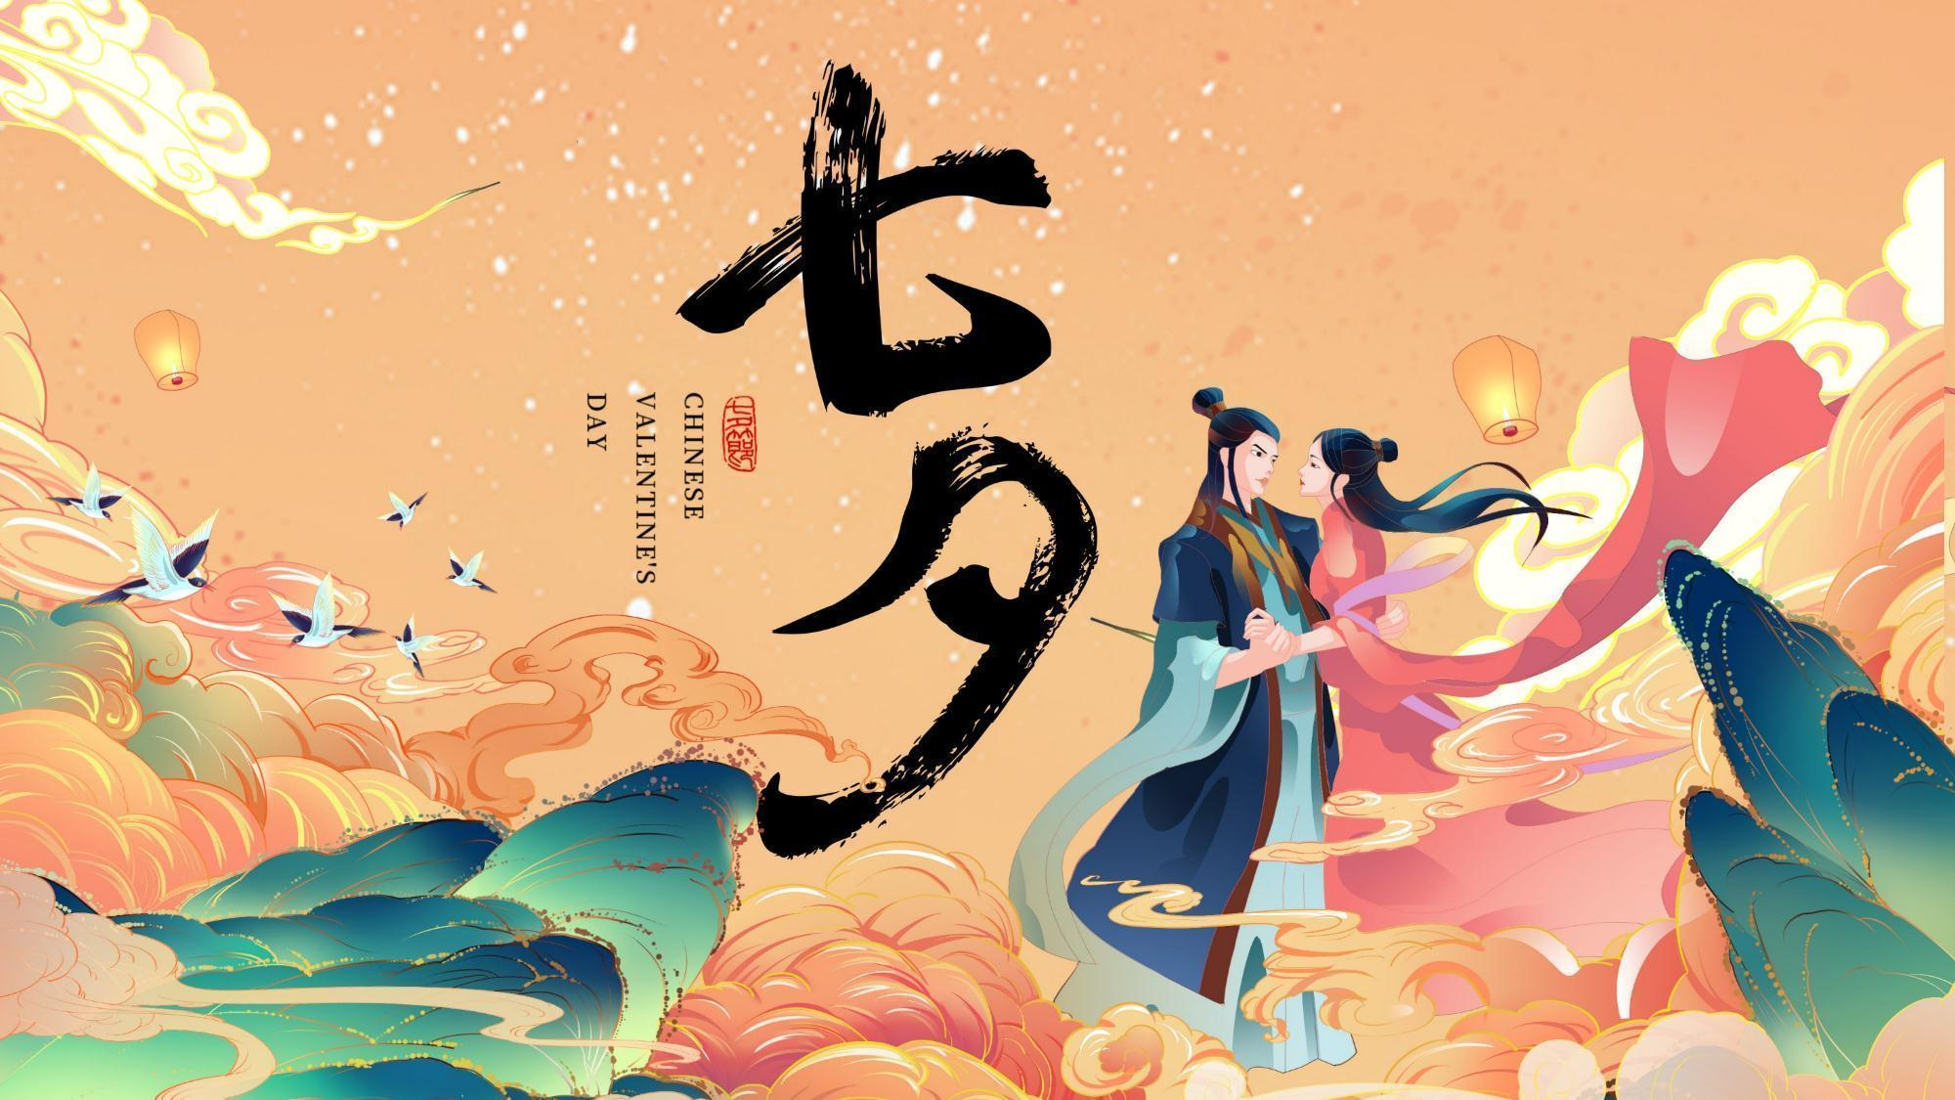
23级英语笔译 李如 Lee

Slide 2
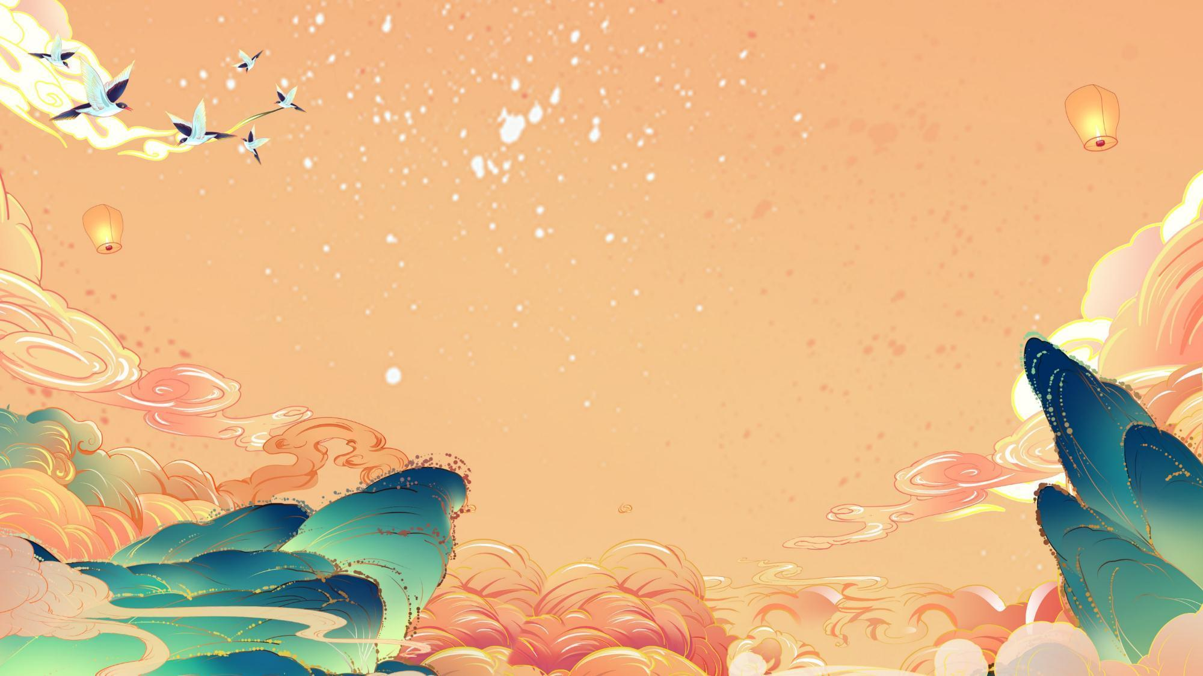
Contents
Origins and Development
Customs and Food
Related Poetry
Significance and Impact

Slide 3


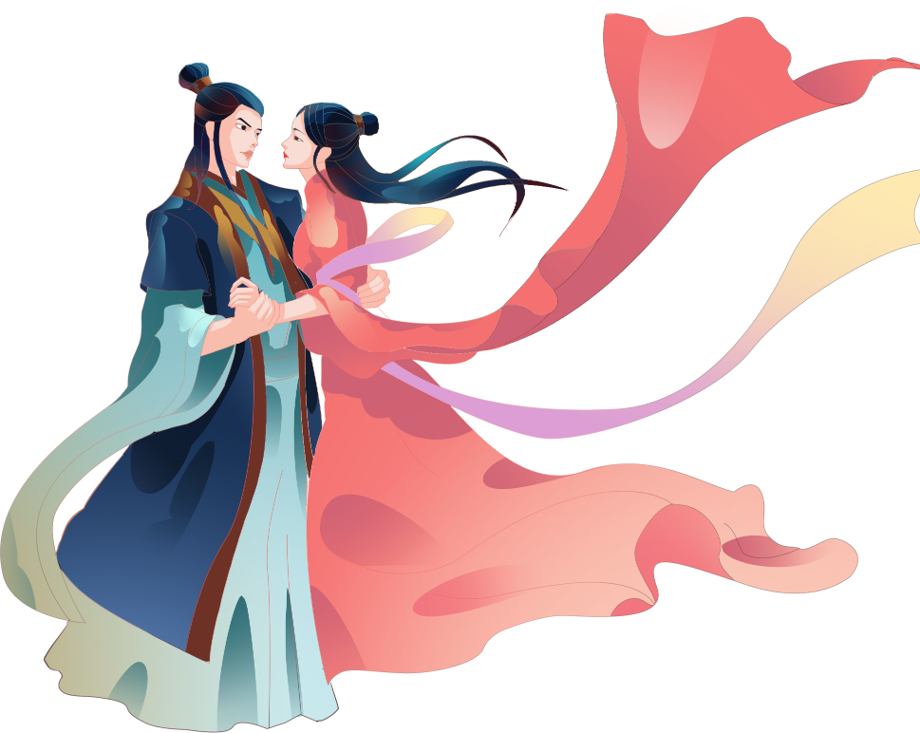
ONE
Origins and Development

Slide 4
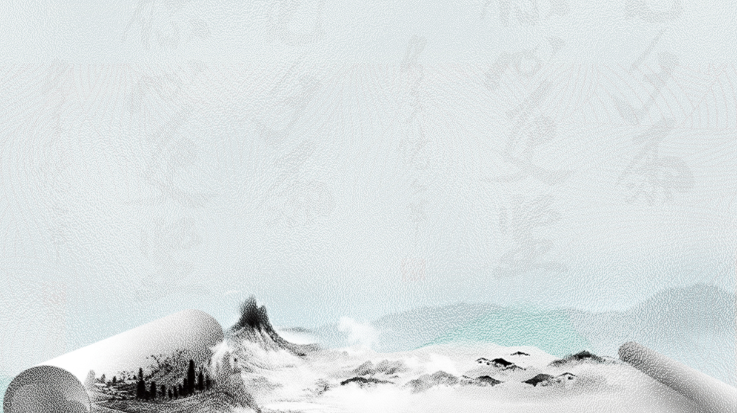
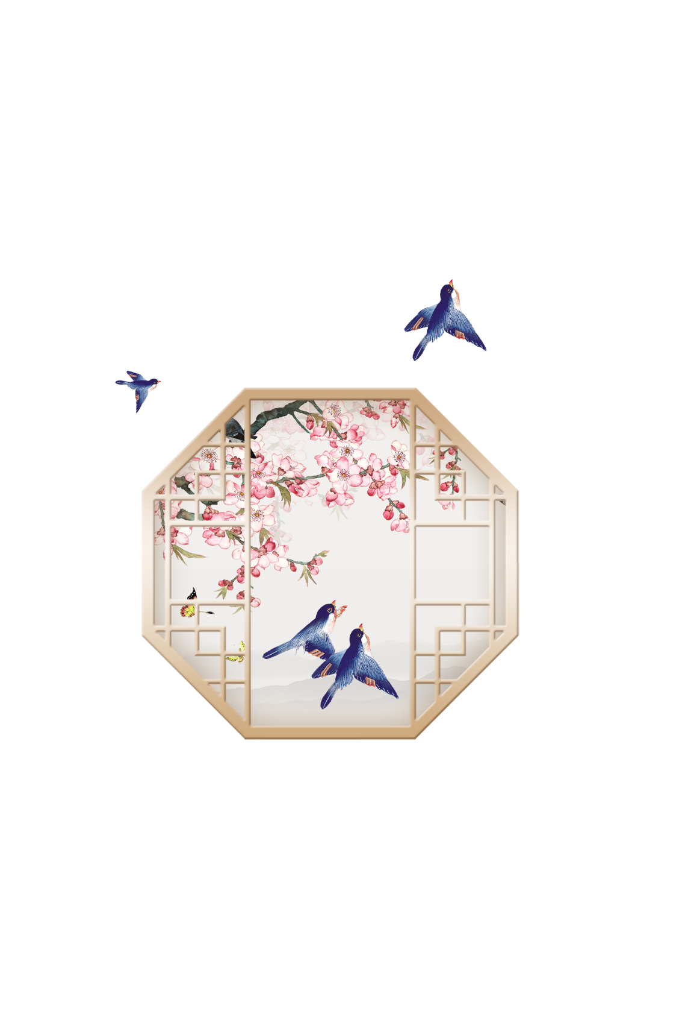

Origins
Qixi Festival, also known as Qiqiao Festival, Qijie Festival, Daughter’s Day, Qinianghui Festival, etc., is a traditional Chinese folk festival.

Slide 5
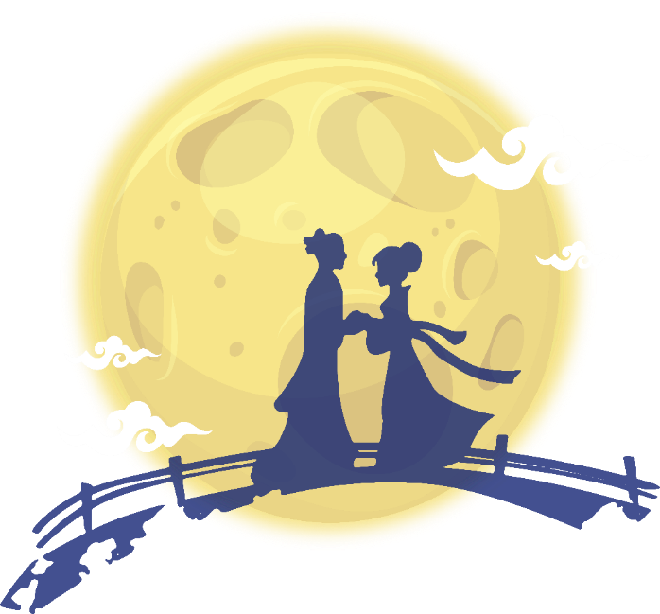

Origins
Qixi Festival evolved from the worship of stars.
According to historical records, it can be traced back to the Han Dynasty.
Notes:
模板来自于： 第一PPT https://www.1ppt.com/

Slide 6
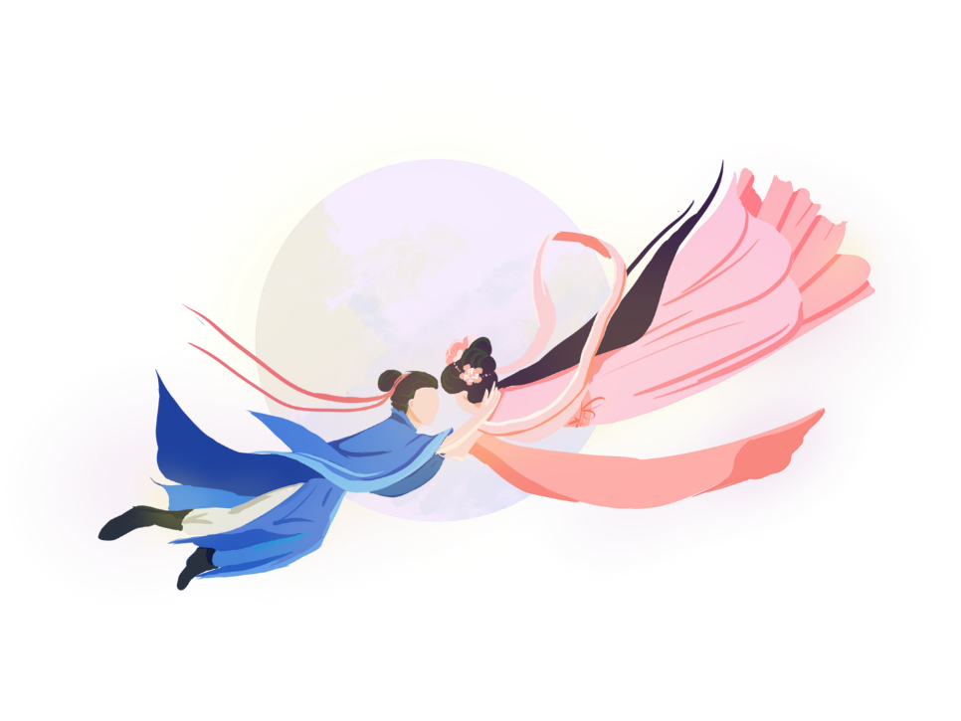
Development
After historical development, Qixi Festival has been given the beautiful love legend of Cowherd and Weaver Girl, making it a festival symbolizing love.

Slide 7
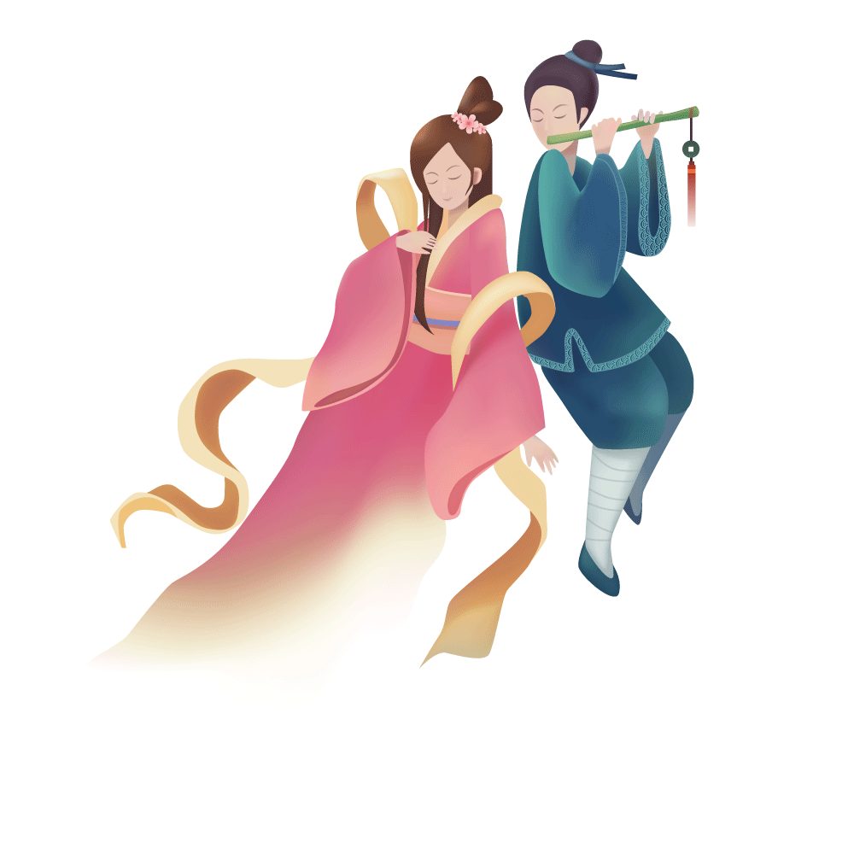
Development
Therefore, it is regarded as the most romantic traditional festival in China, and has produced the cultural meaning of Chinese Valentine’s Day in modern times.

Slide 8

TWO
Customs and Food

Slide 9
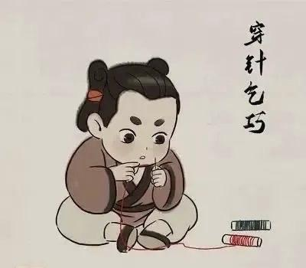
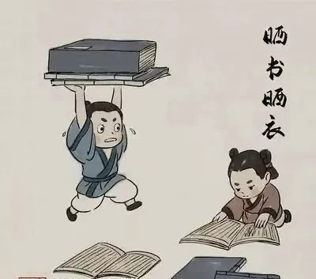
Customs
1. Thread Weaving: the faster one threads, the more dexterity they are believed to have begged for.
2. Sunbathing Books and Clothes: A display of erudition and wealth.

Slide 10
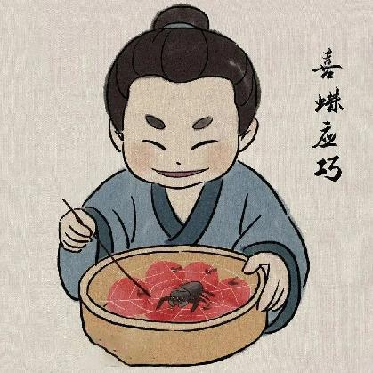
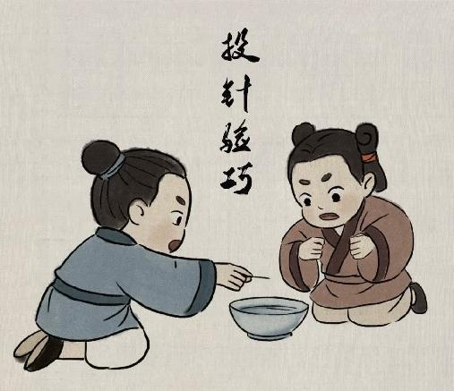
Customs
3. Happy Spider Response: Placing spiders on melons to divine skillfulness based on the density of their webs.
4. Needle Throwing Test: Throwing needles into water to divine skillfulness based on the shape of the needle’s shadow at the bottom of the water.

Slide 11
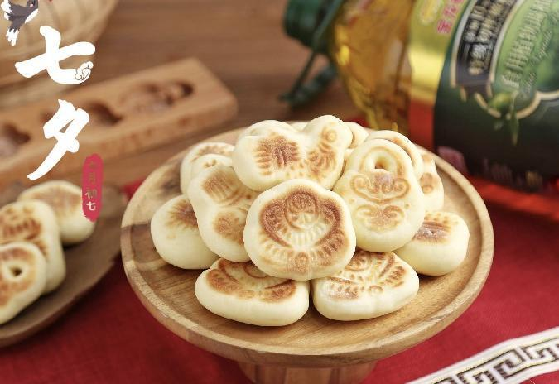
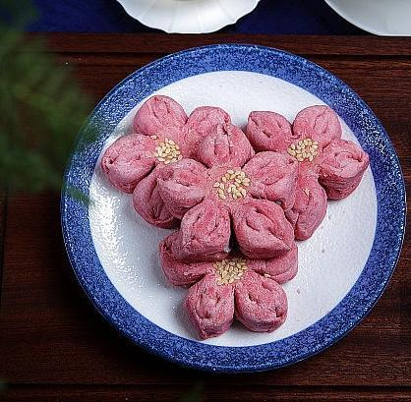
Food
Qiáo Guǒ
巧果
Qiǎo Sū
巧酥

Slide 12
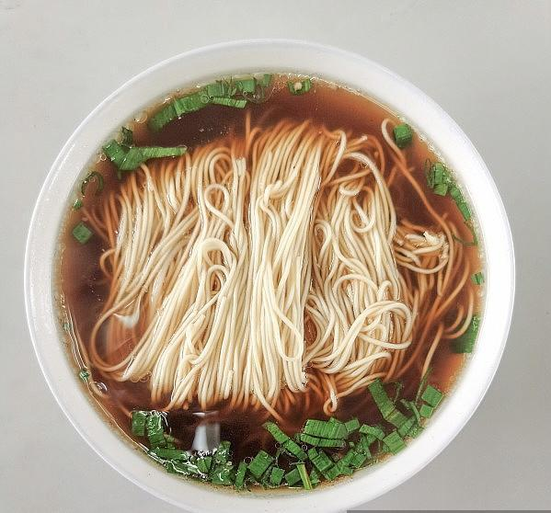
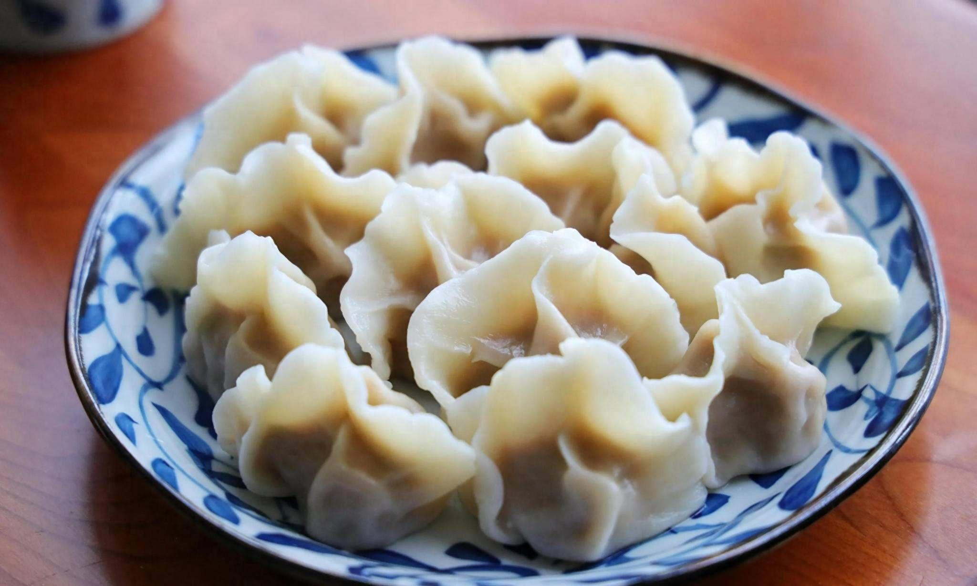
Food
Qiǎo Qiǎo Bǎn
巧巧板
Yún Miàn
云面

Slide 13
THREE
Related Poetry

Slide 14
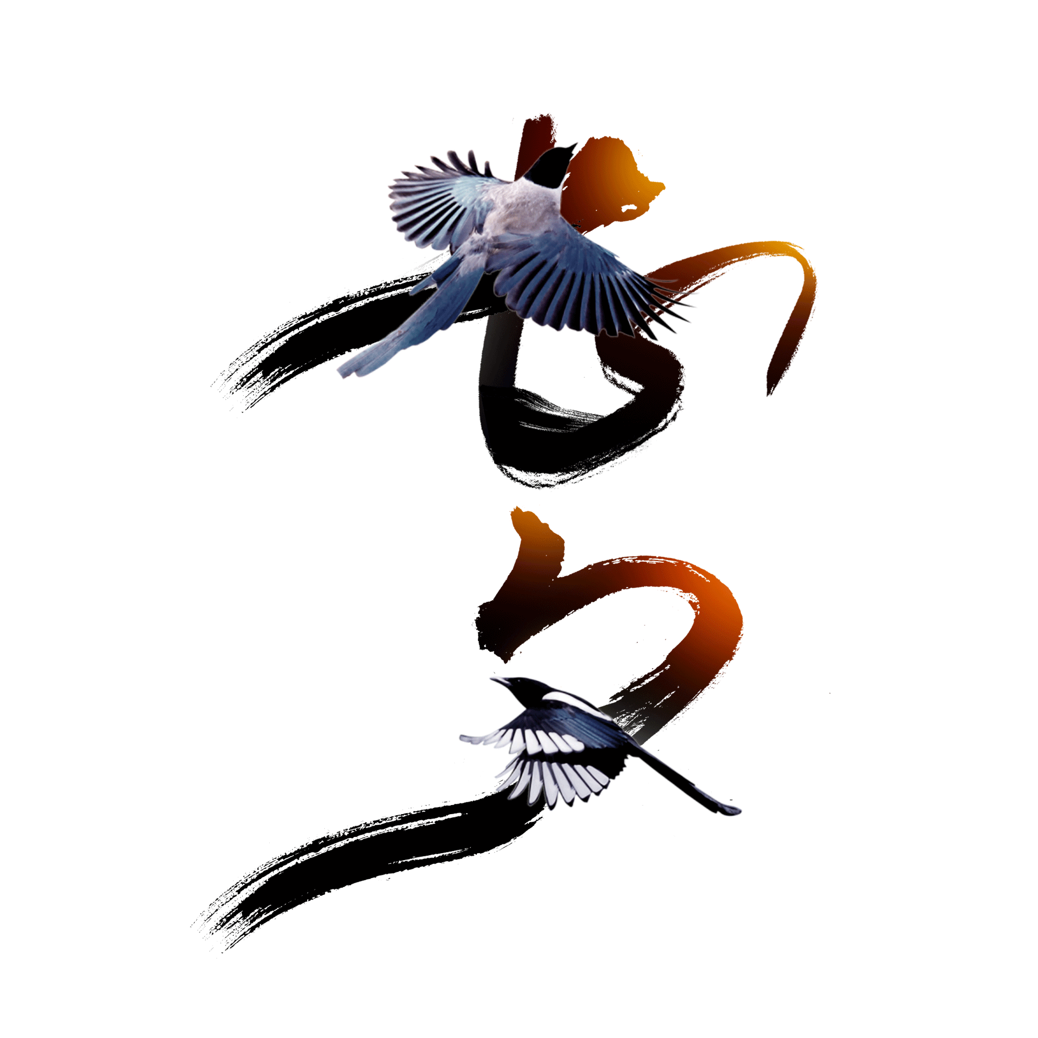
Poetry
鹊桥仙 宋 秦观
纤云弄巧，飞星传恨，银汉迢迢暗渡。金风玉露一相逢，便胜却人间无数。
柔情似水，佳期如梦，忍顾鹊桥归路。两情若是久长时，又岂在朝朝暮暮。
Immortals at the Magpie Bridge
Clouds float like works of art, Stars shoot with grief at heart, Across the Milky Way the Cowherd meets the Maid. When Autumn’s Golden Wind embraces Dew of Jade, All the loves screens on earth, however many, fade.
Their tender love flows like a stream, Their happy date seems but a dream, How can they bear a separate homeward way? If love between both sides can last for aye, Why need they stay together night and day?
（许渊冲 译）

Slide 15
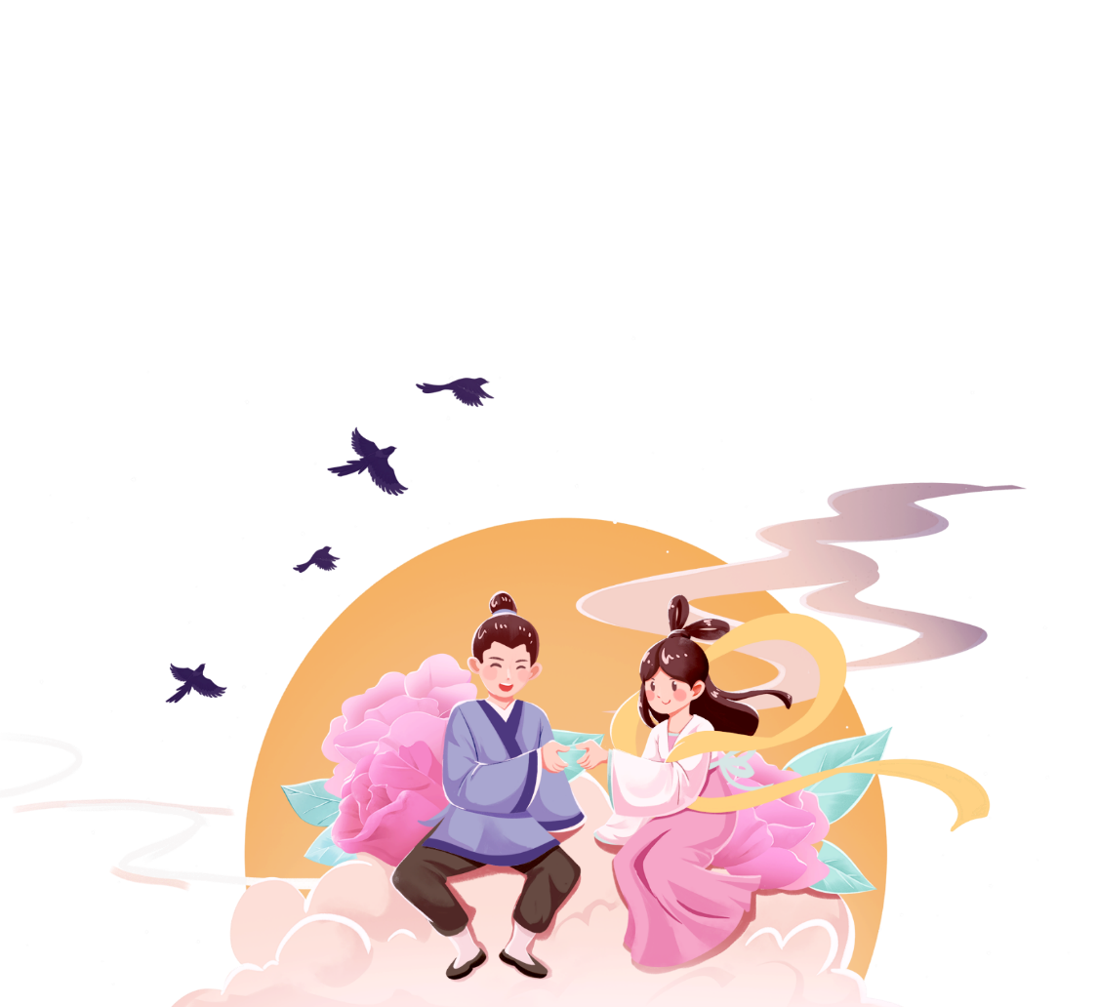
Poetry
《古诗十九首·迢迢牵牛星》
迢迢牵牛星，皎皎河汉女。
纤纤擢素手，札札弄机杼。
终日不成章，泣涕零如雨。
河汉清且浅，相去复几许。
盈盈一水间，脉脉不得语。

Slide 16
FOUR
Significance and Impact

Slide 17


Significance
As a traditional Chinese festival, Qixi Festival carries ancient myths and legends and beautiful blessings.
It is not only a celebration of love but also a desire for family and reunion.
Notes:
模板来自于： 第一PPT https://www.1ppt.com/

Slide 18
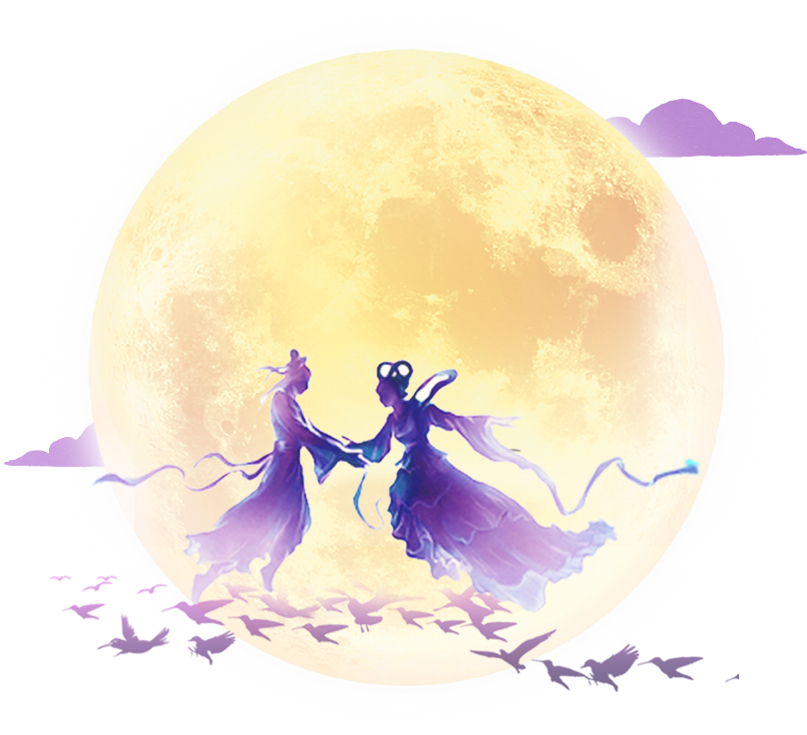
Impact
Its impact on people’s lives and culture is reflected in the inheritance of traditional culture and the shaping of modern concepts of love, while also promoting the development of related cultural industries, such as festival celebrations, tourism, and gift markets.

Slide 19
Quizzes
1. What are the other names for Qixi Festival?
2. What are some traditional customs of Qixi Festival?
3. What are some foods associated with Qixi Festival?

Slide 20
THANKS

