Slide 1

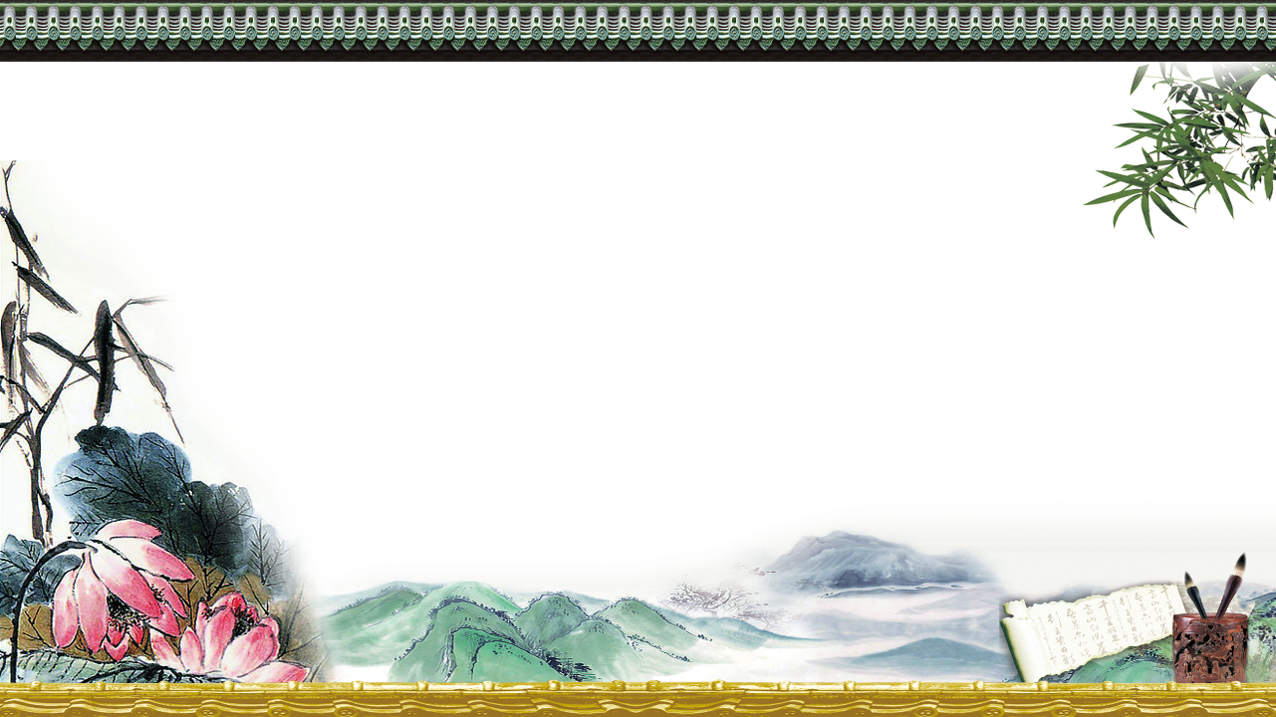
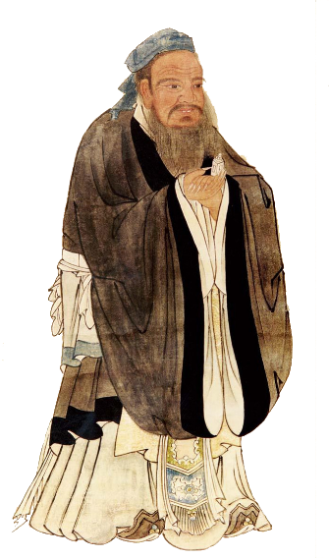
Confucianism
Presenter：李丽丽
Partner： 罗维嘉
Notes:
本PPT模板部分元素使用了幻灯片母版制作。如果需要修改，点击-视图-幻灯片母版-修改；完成后关闭编辑母版即可。

Slide 2

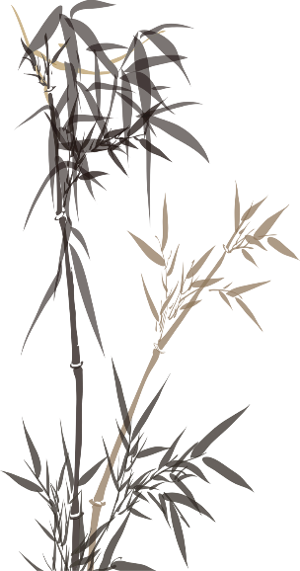
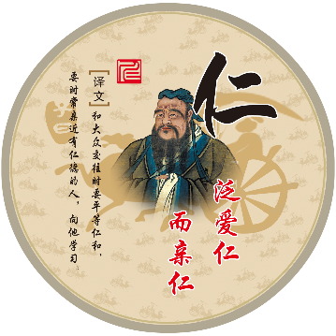
1
Confucius
2
Confucianism
3
Translation Strategies

Slide 3
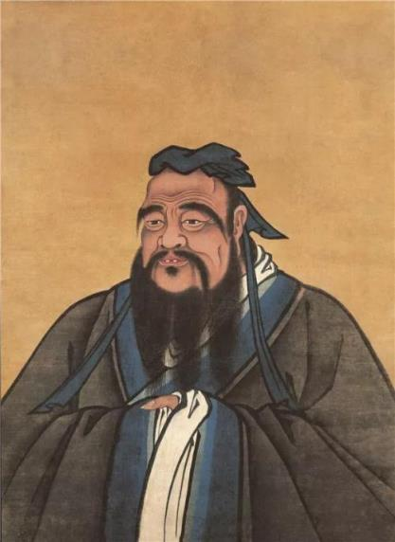
Confucius is regarded as a great philosopher and a great sage of ancient China. In China , Confucius is called Kong Qiu or Kong Fuzi (Master Kong).
Confucius was born at Qufu in the state of Lu (now Shandong Province) in about 551 B.C. and died in 479 B.C. He was born in a age called the Spring and Autumn Period.
His thouhts were recorded in the Analects.
He is one of the top ten cultural celebrities in the world.

Slide 4
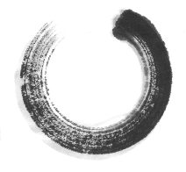
Thoughts of Confucius
壹
Ren “仁”
贰
Teaching according to abilities
叁
Restrain oneself and follow social norms

Slide 5

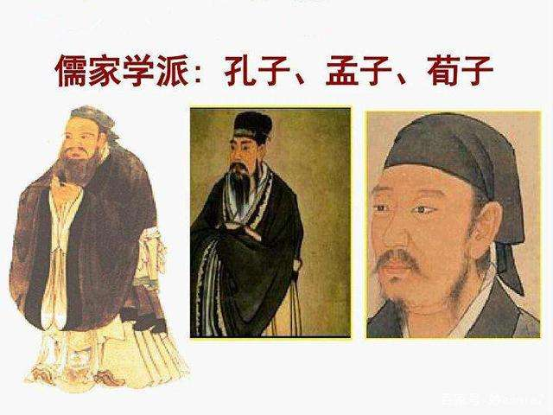
Confucian Development
1
The Spring and Autumn Period and the Warring States Period
Ren and Benevolent Government

Slide 6
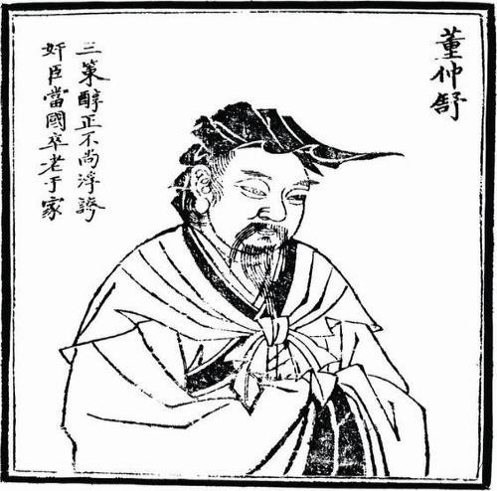
2
Han Dynasty
Deposing other schools of thought and respecting Confucianism only.
(罢黜百家，独尊儒术)

Slide 7
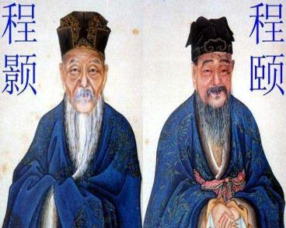
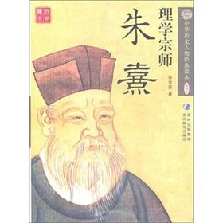
3
Song and Ming Dynasty
The principle of heaven is the origin of all things in the universe
Keeping The Justice, Eliminating The Desire(存天理，灭人欲)

Slide 8
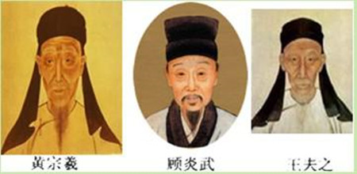
4
Ming and Qing Dynasty
一、People are master and the monarch is the guest;
二、Being practical;
三、Material keeping changing & a simple dialectical thought

Slide 9


Five important virtues of Confucianism
Integrity (xin)
Ren
Righteousness (yi)
Wisdom (zhi)
Propriety (li)

Slide 10
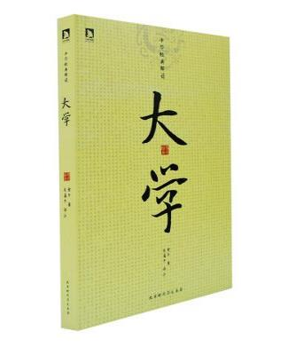
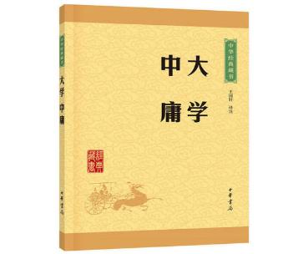
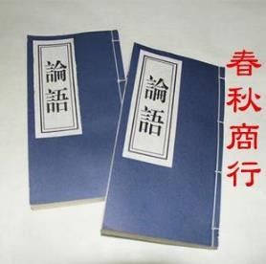
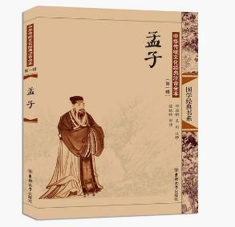
Four books

Slide 11
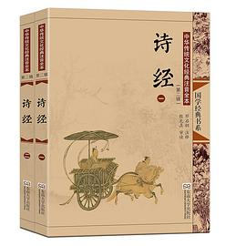
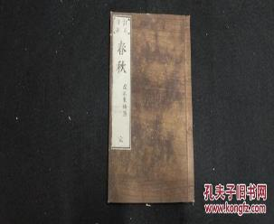
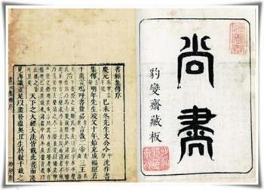
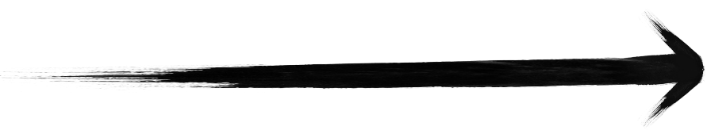
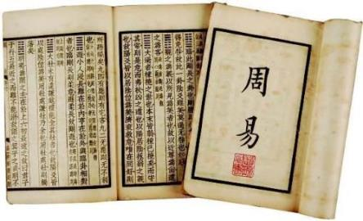
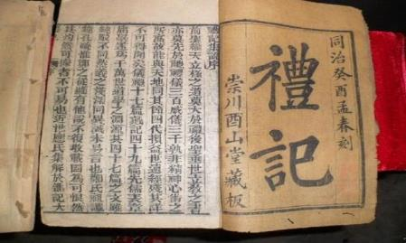
Five Classics
单击此处添加文本单击此处添加文本单击此处添加文本单击此处添加文本单击此处添加文本单击此处添加文本
单击此处添加文本单击此处添加文本单击此处添加文本单击此处添加文本单击此处添加文本单击此处添加文本
单击此处添加文本单击此处添加文本单击此处添加文本单击此处添加文本单击此处添加文本单击此处添加文本
单击此处添加文本单击此处添加文本单击此处添加文本单击此处添加文本单击此处添加文本单击此处添加文本

Slide 12

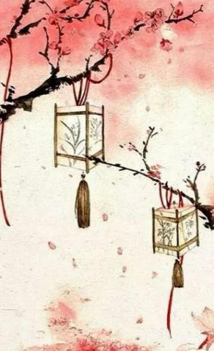
Transaltion Strategies
1.Adaptation（Domestication）
天---God
天命---the Laws of God
圣人---holy man
除善扬恶---Eliminate what is negative and promote what is positive

Slide 13
2. Foreignization
A:Transliteration
Eg:仁---Ren
B: Transliteration and Annotation
Eg:子游为武城宰。
武城---Wucheng(an important town in Lu, in today’s Shandong Province)
灌---Guan(the first practice of pouring of the libation on the ground by the Emperor)

Slide 14
Thanks
Notes:
本PPT模板部分元素使用了幻灯片母版制作。如果需要修改，点击-视图-幻灯片母版-修改；完成后关闭编辑母版即可。

