Slide 1
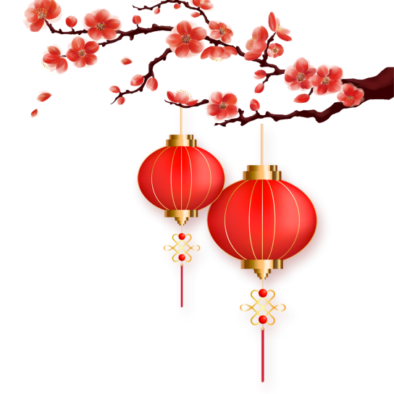
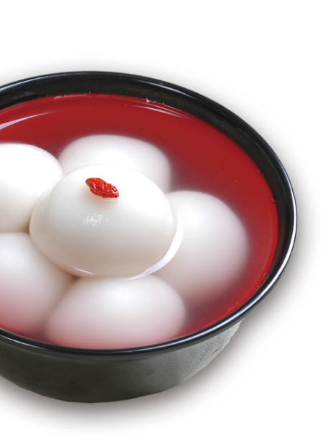

Tang yuan

Slide 2
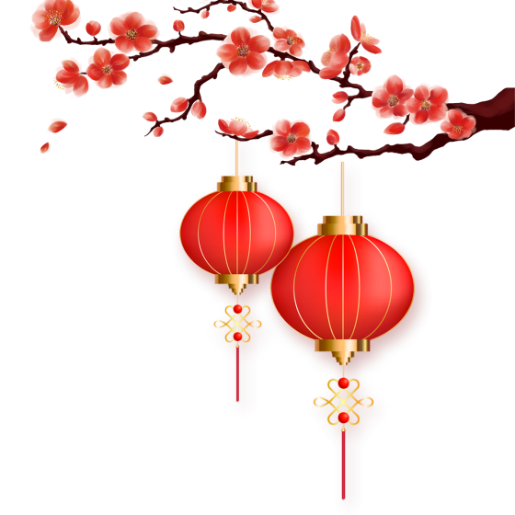
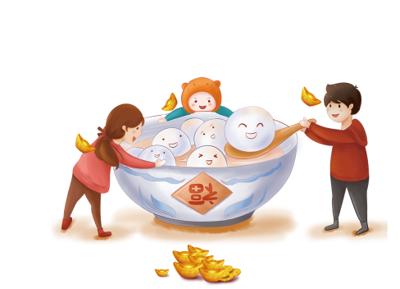
Introduction

Slide 3
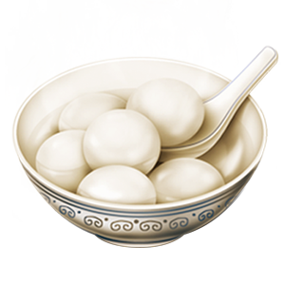
Tangyuan, also known as Yuanxiao, is both a traditional Chinese dessert made from glutinous rice flour and a festive food during the Lantern Festival.
Shape：sticky, sweet and round.
Skin：glutinous rice flour
Filling：sesame, peanuts, red beans, and even fruits.
Meanings： reunion, happiness, togetherness and harmony.

Slide 4
The origin of Tangyuan

Slide 5
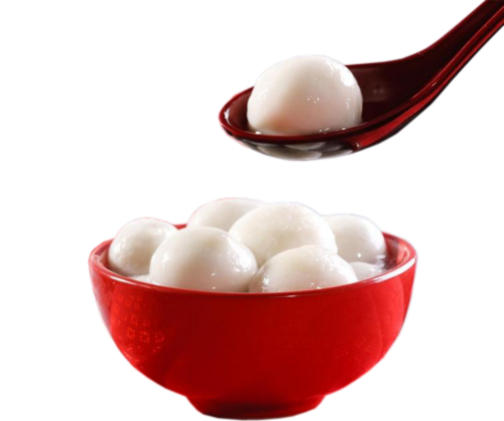
Tangyuan was developed in the Song dynasty(960-1279) in Mingzhou (明州) (current Ningbo City, Zhejiang Province). It was also called Yuanxiao, the same name as the Lantern Festival in China.
In Jiangnan, eating Tangyuan during the winter solstice is a traditional custom, which symbolizes reunion with family members and good fortune.
Historically, a number of different names were used to refer to Tangyuan. It is often called “Yuanxiao” in the north, while "Tangyuan" in the south, which is said to be related to Yuan Shikai. Because the name Yuanxiao sounded identical to “remove Yuan” (“袁消”), he gave orders to change the name to Tangyuan.

Slide 6
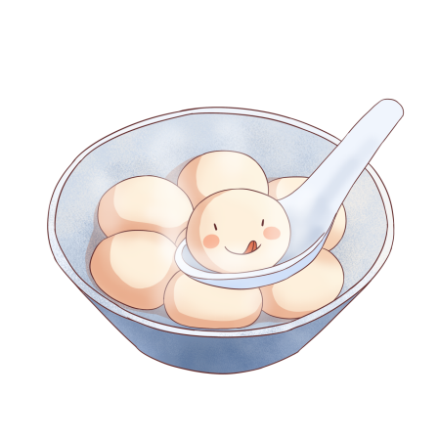
Differences between Yuanxiao and Tangyuan
Yuanxiao:
Tangyuan:
Fillings：sweet, solid, thick broth
Fillings: soft, either sweet or salty, thinner soup
Making: The filling is dipped into
water then the dry glutinous rice flour repeatedly, until a round shape is achieved.
Making: Tangyuan is made by wrapping the soft filling in a glutinous rice "dough" and shaping it into a ball.
Storage: be stored frozen for a long time
Storage: a short shelf life

Slide 7
Types of Tangyuan

Slide 8
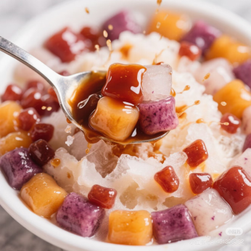
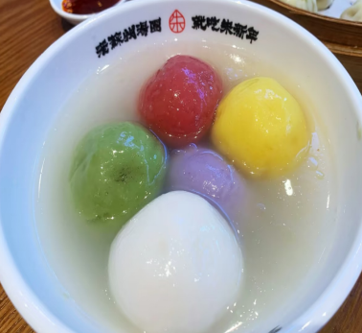
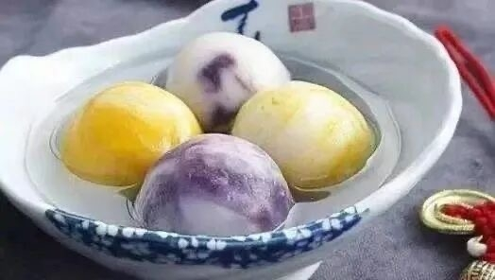
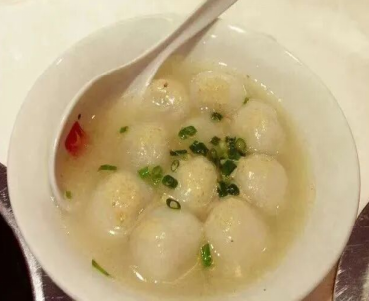
Ling Tangyuan of Chongqing
Five-colored Tangyuan in Suzhou
4-flavor Tangyuan in Guangdong Province
Chicken Tangyuan in Xingyi of Guizhou Province

Slide 9
Steps of making Tangyuan

Slide 10
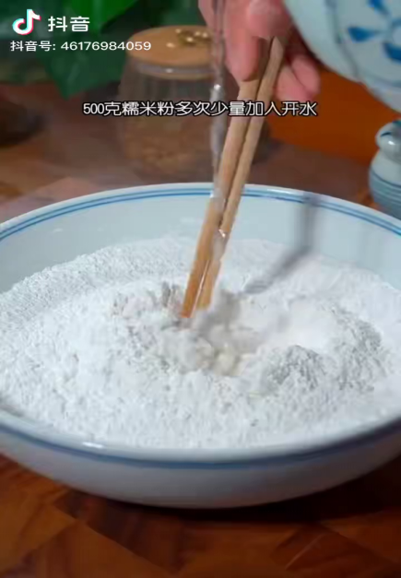
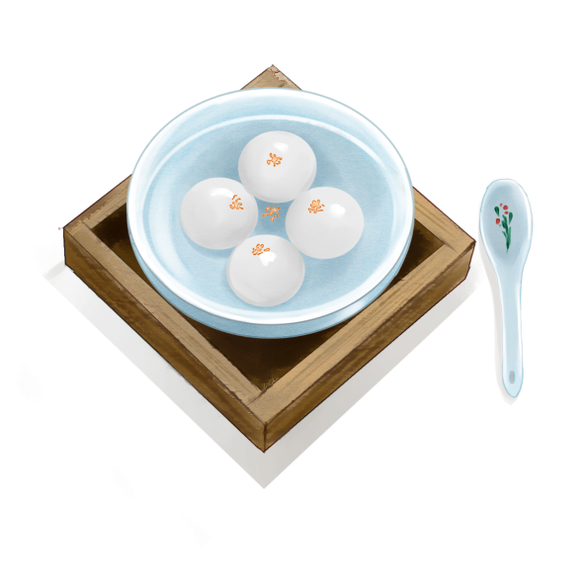

Slide 11
Sources：
REDnote
Douyin：https://v.douyin.com/uuPHoi052OQ/
Thank you

