Slide 1


Traditional and Modern Views on Marriage and Love
Wu Ting 吴婷

Slide 2
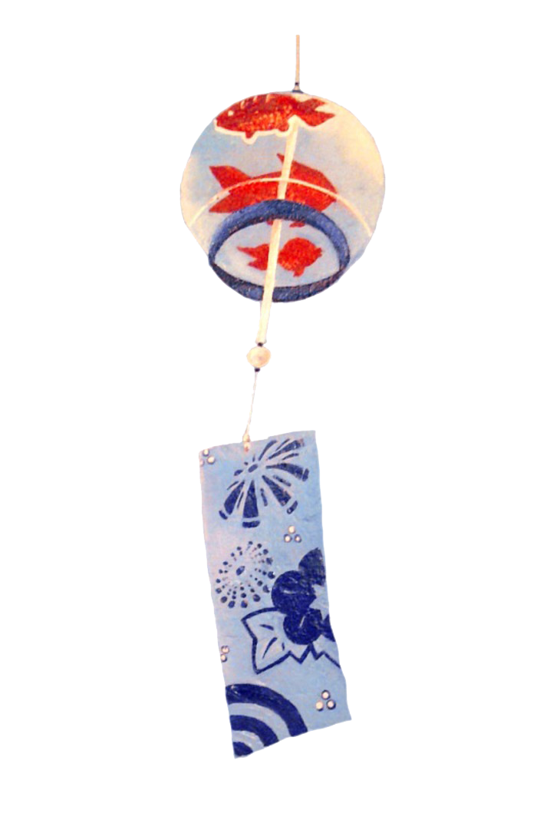
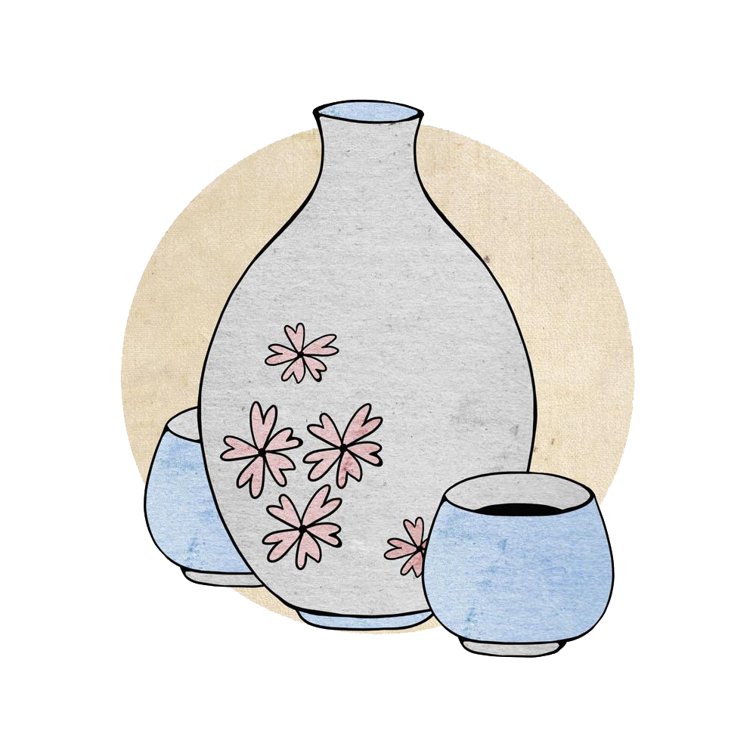

Foreword
Traditional Views
Modern Views
CONTENT
Changes

Slide 3
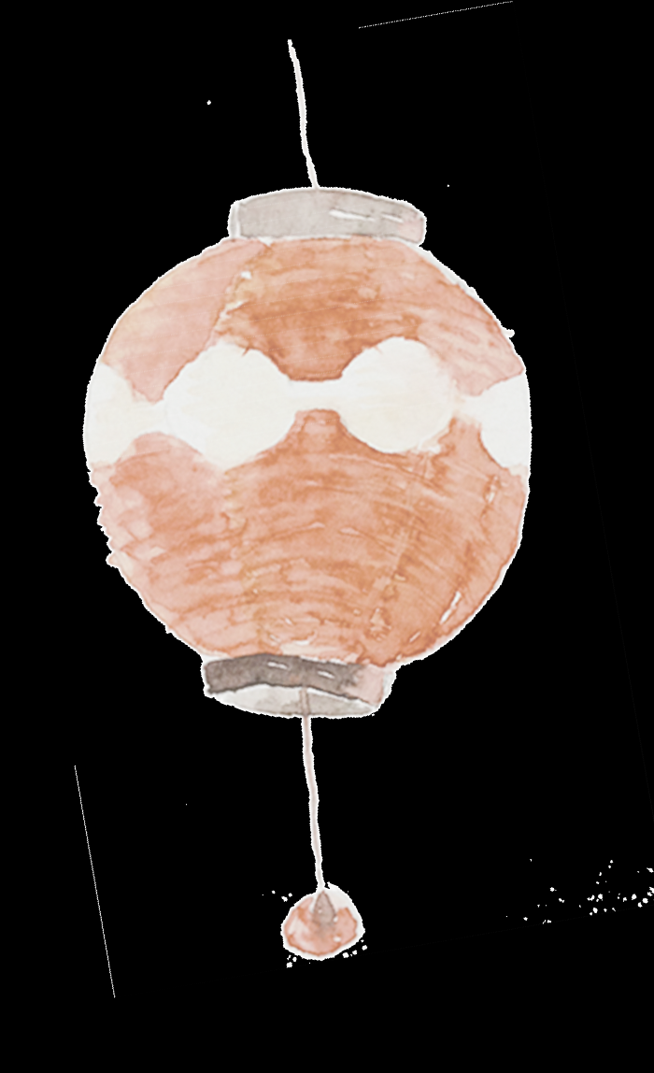
Foreword

Slide 4
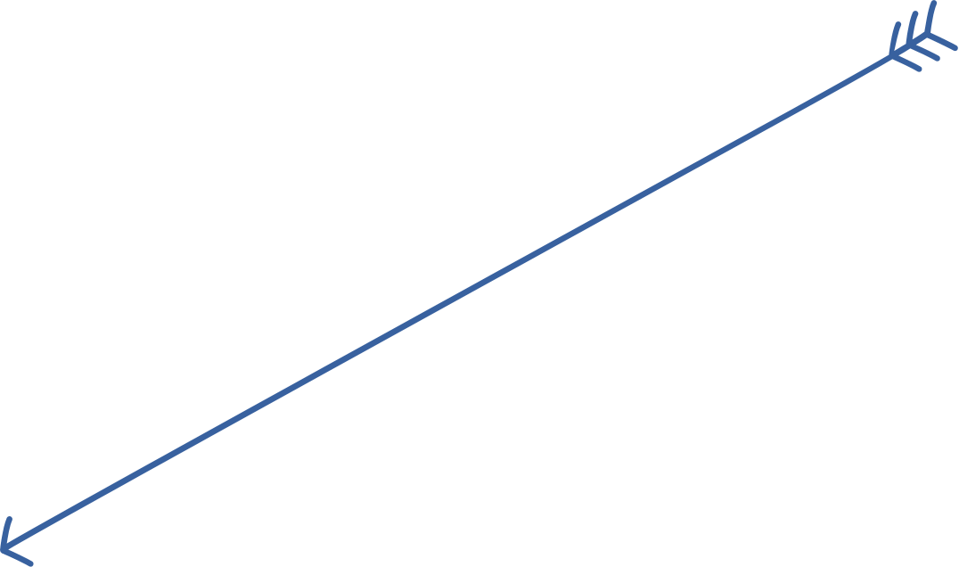
LOVE
The formation of the view on love and marriage has its complicated social and historical factors as well as individual subjective factors.In recent years, due to the influence of China's social and economic development and diversified changes in values, people's understanding of love and marriage has undergone great changes, and many new phenomena have appeared in the past periods.

Slide 5
Traditional Views

Slide 6
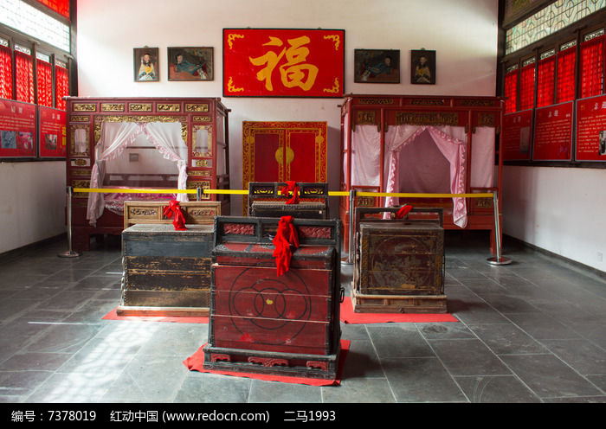
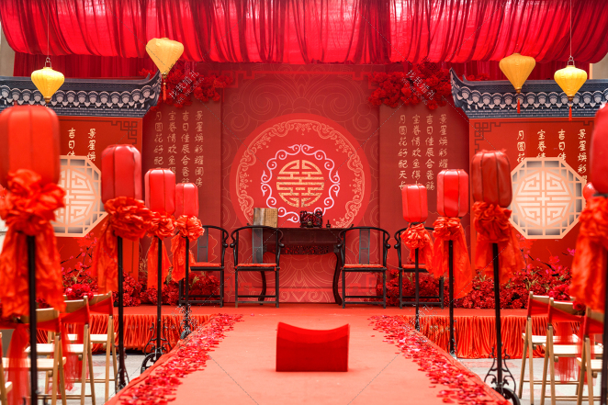
Although there was the general mood of free love among the people, the proper way of contracting a marriage was the command of parents and the good offices of a go-between.
父母之命，媒妁之言

Slide 7
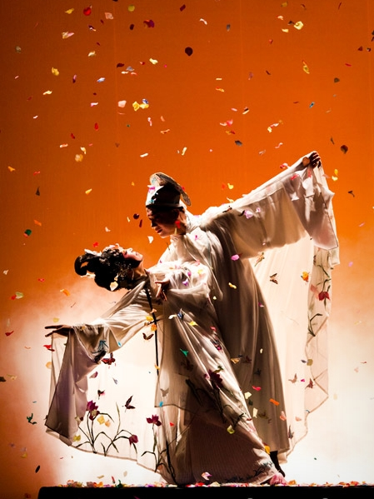
True love only happens in more special intimate relationships. Just like a very pleasing ancient love novel, Liang Shanbo and Zhu Yingtai. Two people loved each other to the end, and both died in love. You may find that true love in traditional love tends to break the rules, and is more likely to occur when there is a conflict of status or class between two people, and the result of such a relationship is adultery（通奸）, elopement（私奔） or even martyrdom（殉情）.

Slide 8
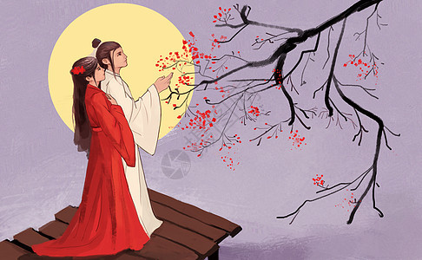
In ancient times, a normal marriage is one of matching families, bearing children, carrying on the family line, supporting husband and educating children. So in a traditional marriage, love is an anomaly.（反常事物）

Slide 9
Modern Views

Slide 10
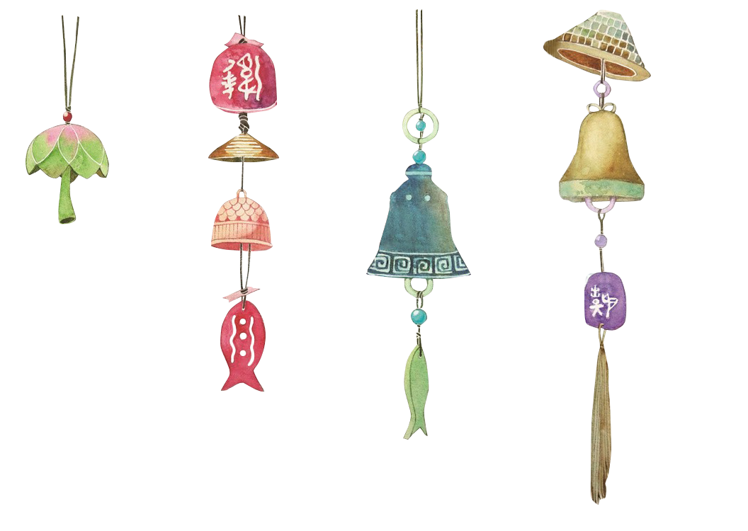
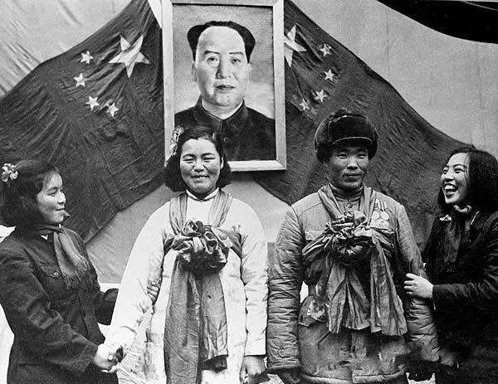
the widespread practice of monogamy in the 1950s
In modern Chinese marriage, love has become a necessity of life and a factor that people attach great importance to when getting married. It’s the biggest difference between Chinese modern marriage and traditional marriage. After the 1950s, free love, free marriage and free divorce became the mainstream ideology.

Slide 11
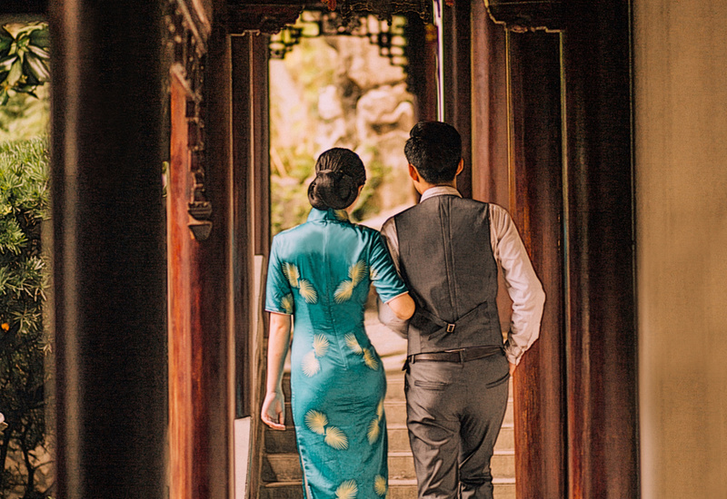
Modern people think that love is being loyal to one’s spouse. Love, is the heartbeat of meeting, is the appreciation of each other, is the acceptance of his or her shortcomings, and is the company in simple life. The couple do not have unreasonable demands or make blind efforts, but grow together, nourish each other, fight for the same goal and have mutual achievements.

Slide 12
Changes

Slide 13
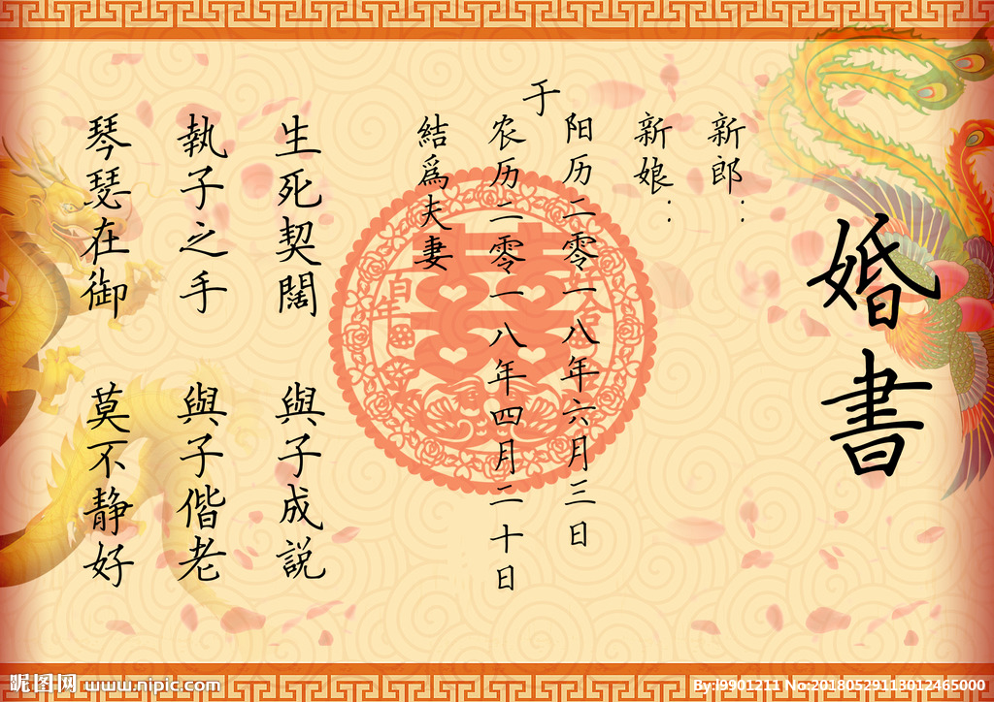
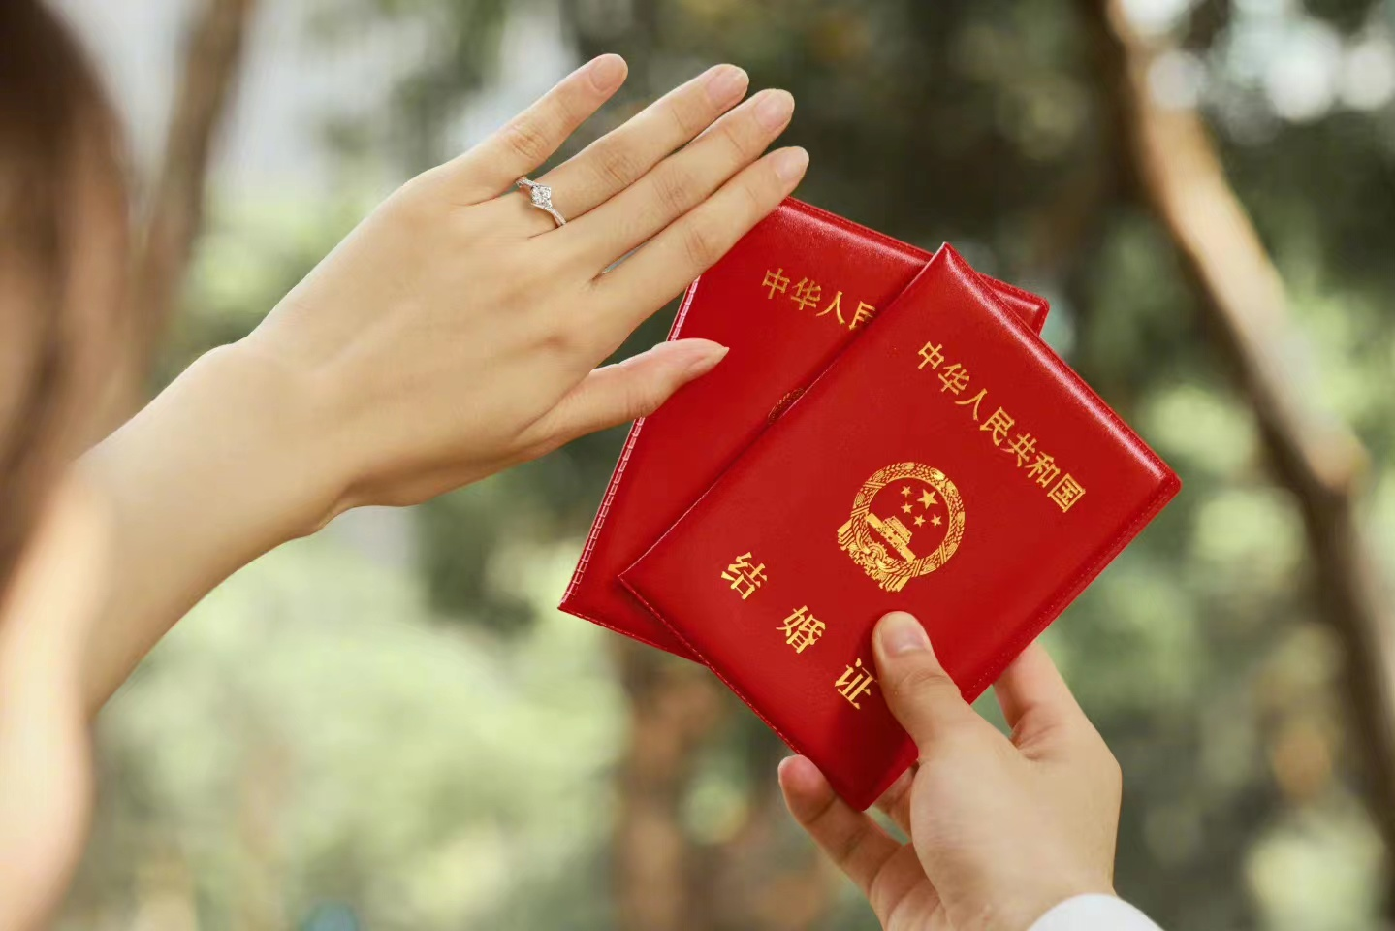
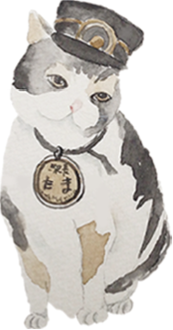
1.mate selection views
internal qualities
(personal feelings and knowledge)
matching family status
2. celibacy（独身）
the principle of male master outside and female master inside（男耕女织）
the prevalence of celibacy and a falling birth rate

Slide 14
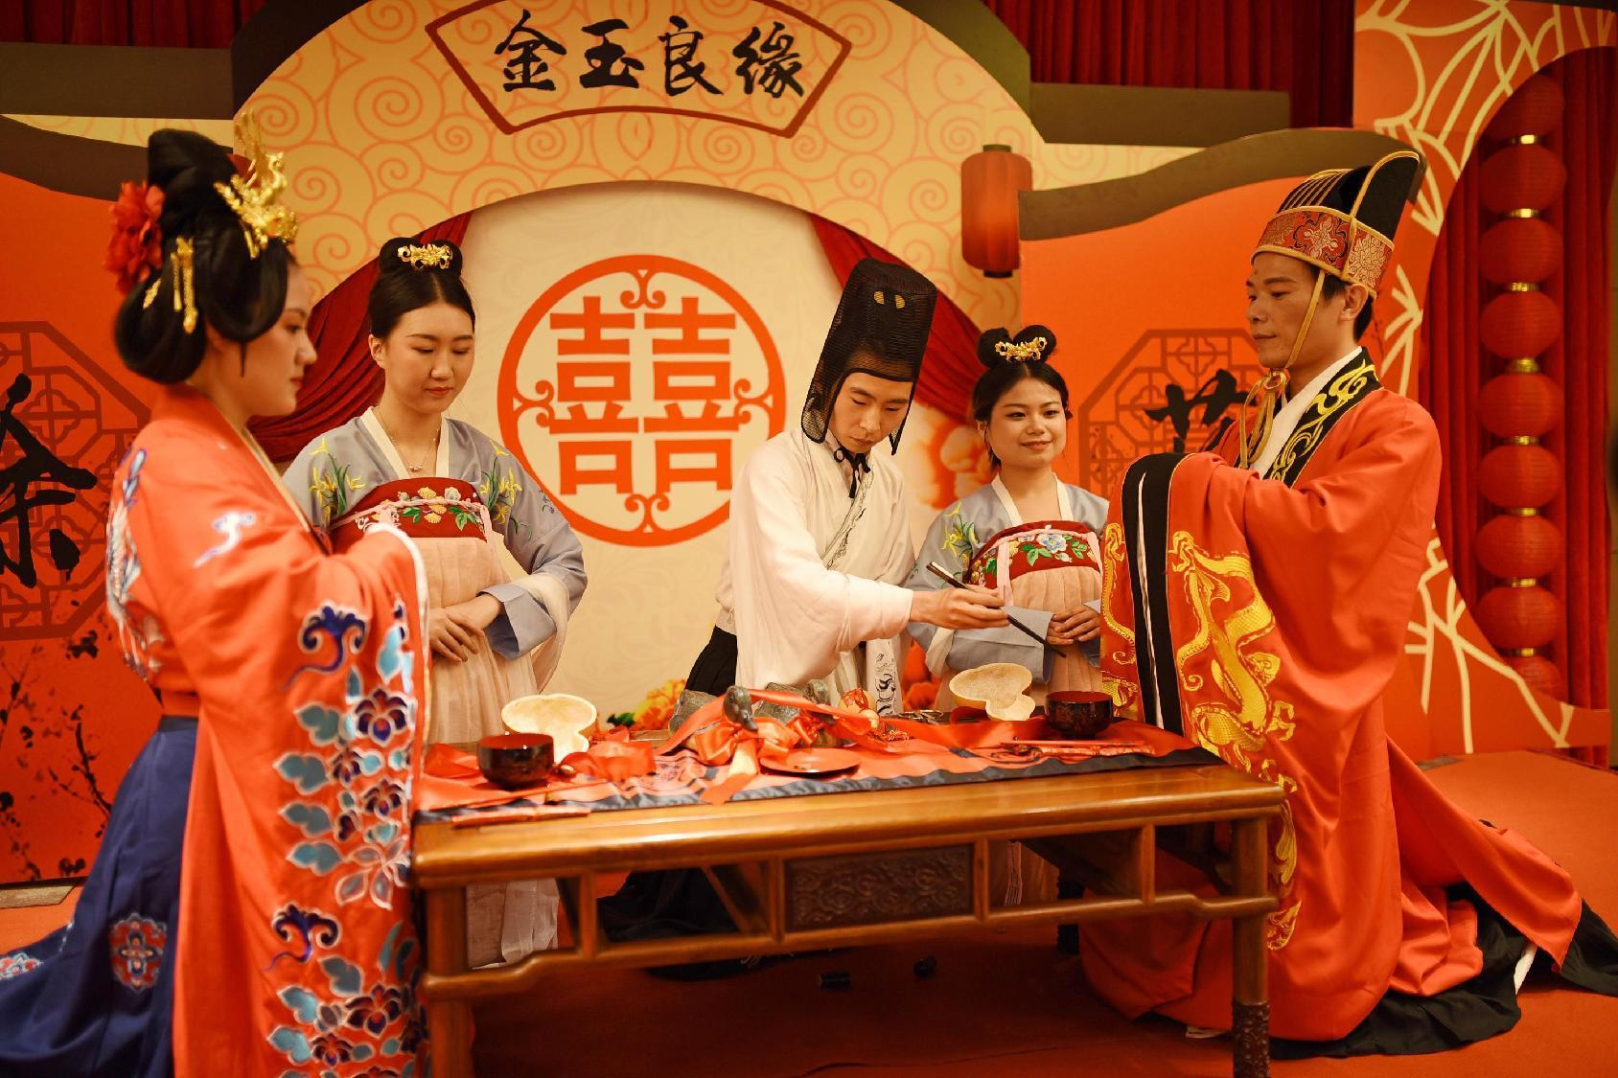
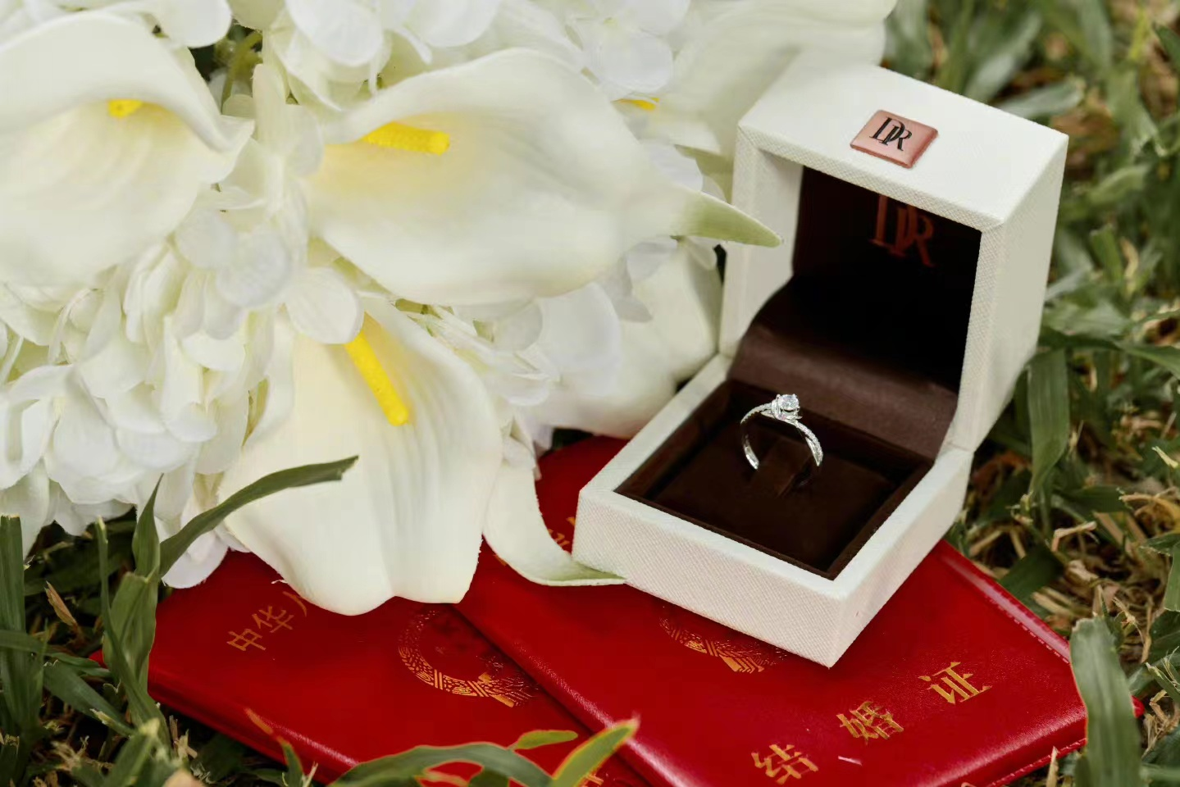
3. marriage autonomy
the order of parents, matchmakers, three wives and four concubines, etc.,
freedom of love, freedom of marriage, freedom of divorce
4. the age of first marriage
the age of 14 or 15
the age of 20 or 22
At the end of the Qing Dynasty and the beginning of the Republic of China, feminism rose.

Slide 15
Thank you!

