Slide 1

Two traditional dishes of China
Yuan Tianyi
&
Zhang Weihong

Slide 2


Pork cooked with green chilli

Slide 3

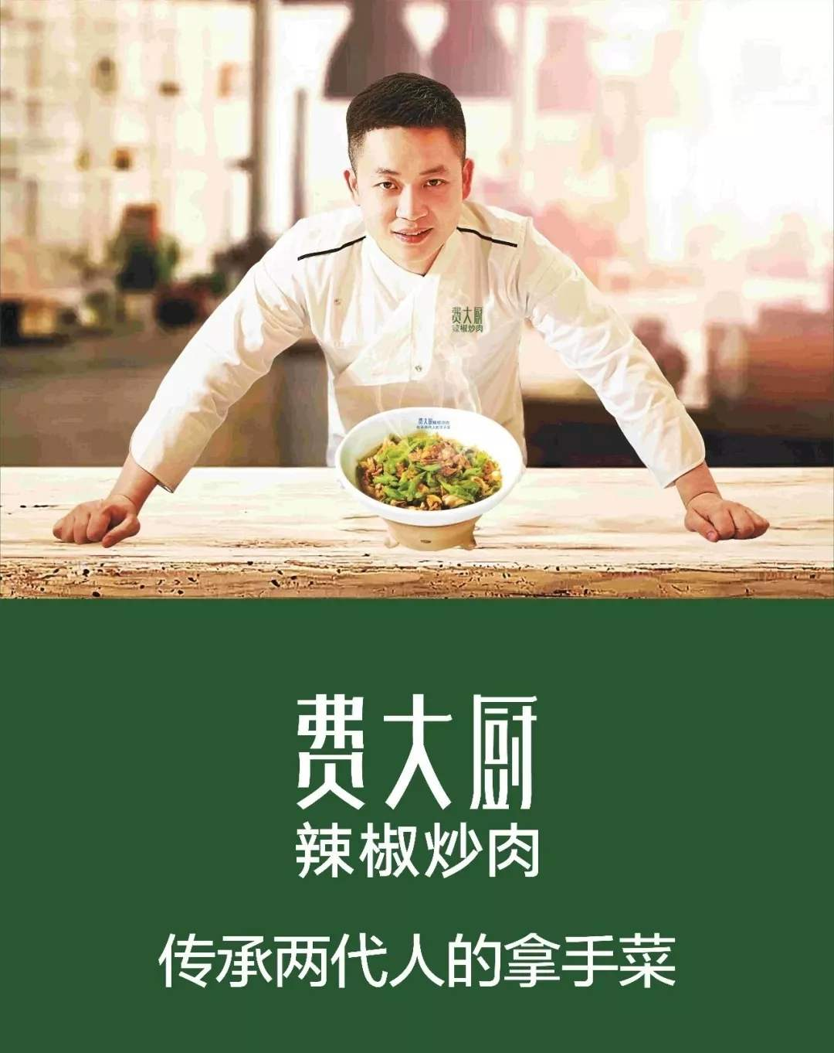
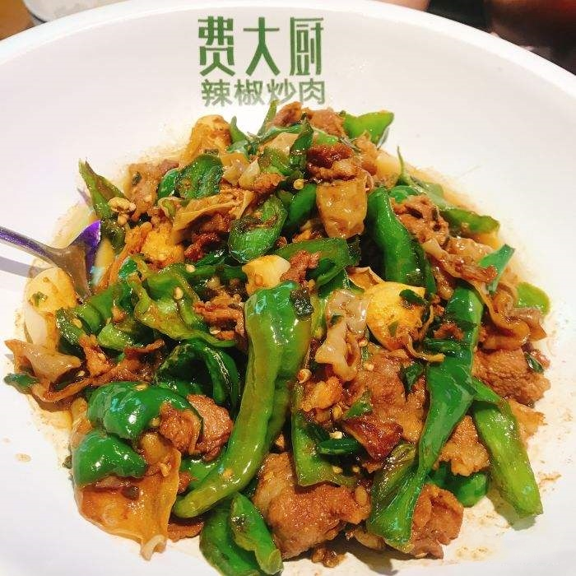

Slide 4
Nutritional value

Slide 5
Green Chilli
vitamin C, help control heart disease;
antioxidant substances, prevent cancer and other chronic diseases;
appetite;
blood circulation, improve coldness, frostbite and vascular headache;
accelerate the metabolism and achieve the effect of burning body fat, helping lose weight.

Slide 6
Pork
high quality protein and essential fatty acids, and provides heme (organic iron) and cysteine,

Slide 7
Stinky Tofu

Slide 8
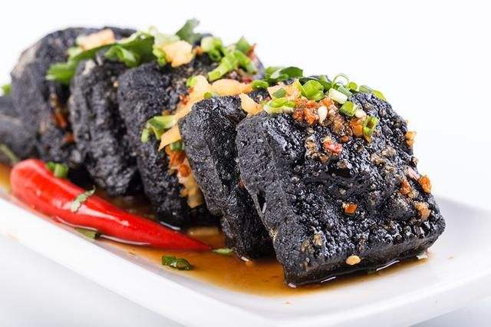
Is It Really Stinky?

Slide 9
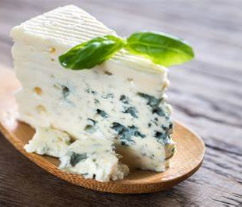
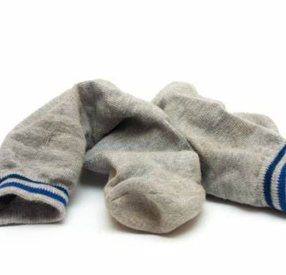
Smell
It absolutely stinks.
‘old socks’
‘gone off blue cheese’
‘rotting garbage’

Slide 10
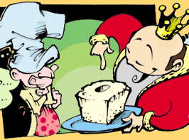
History
Wang Zhihe

Slide 11
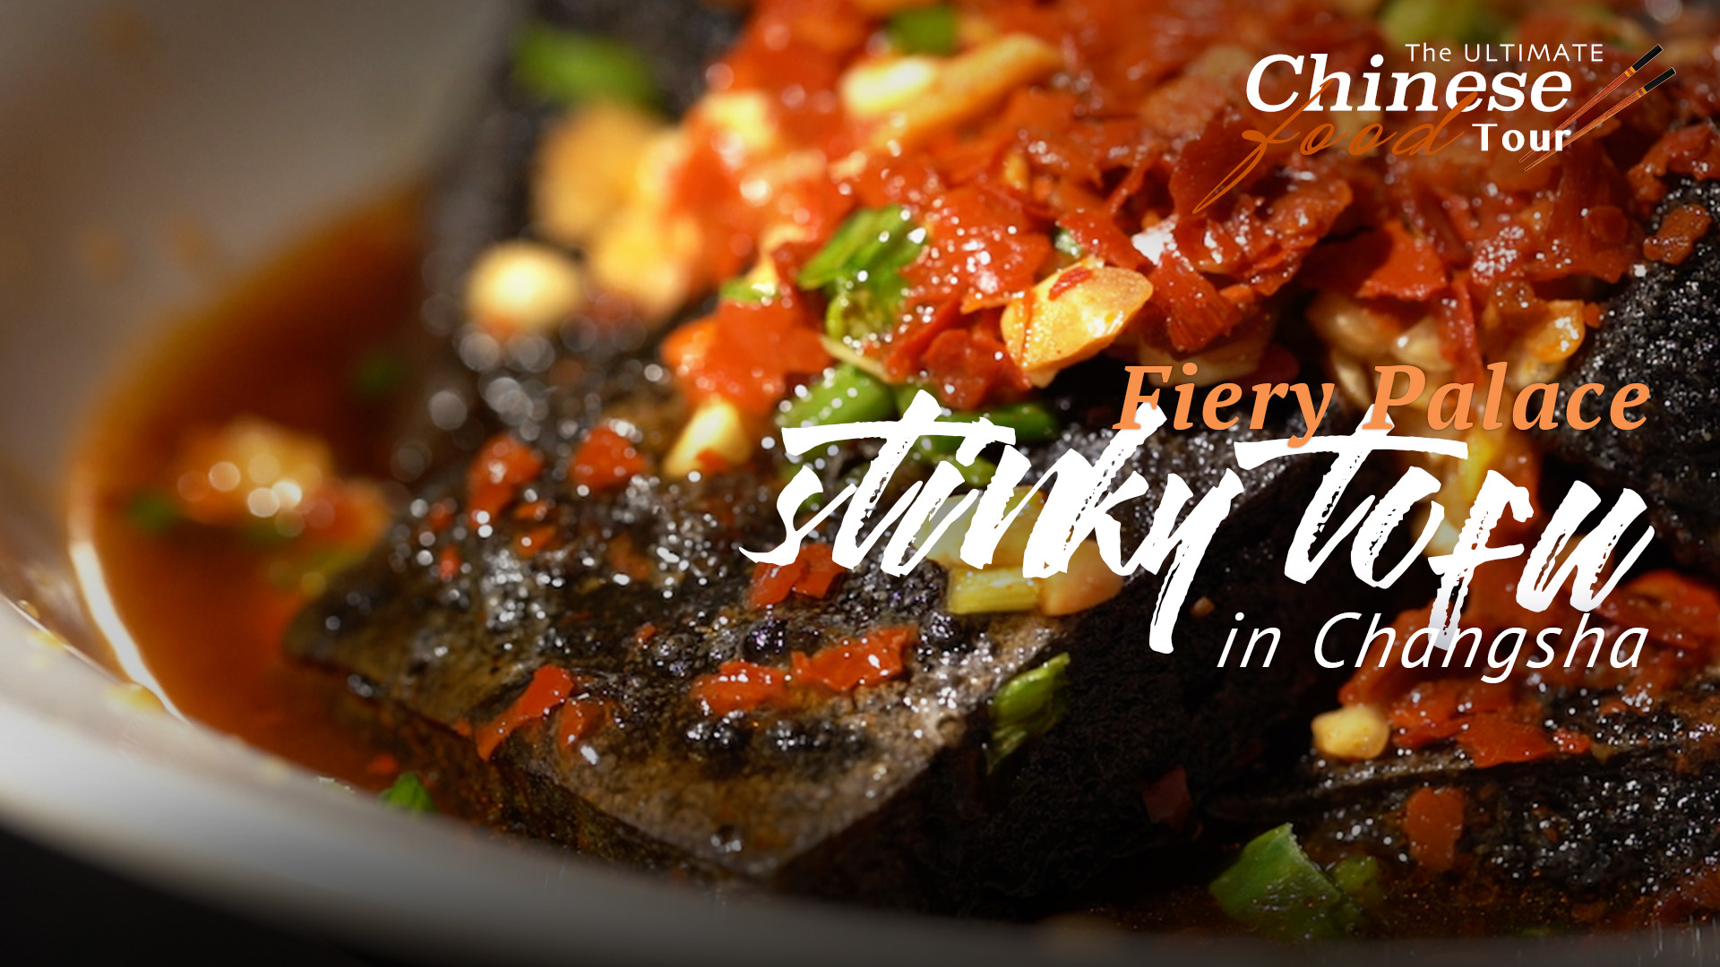
Variations around China
Changsha-style
Nanjing-style
Sichuan-style

Slide 12
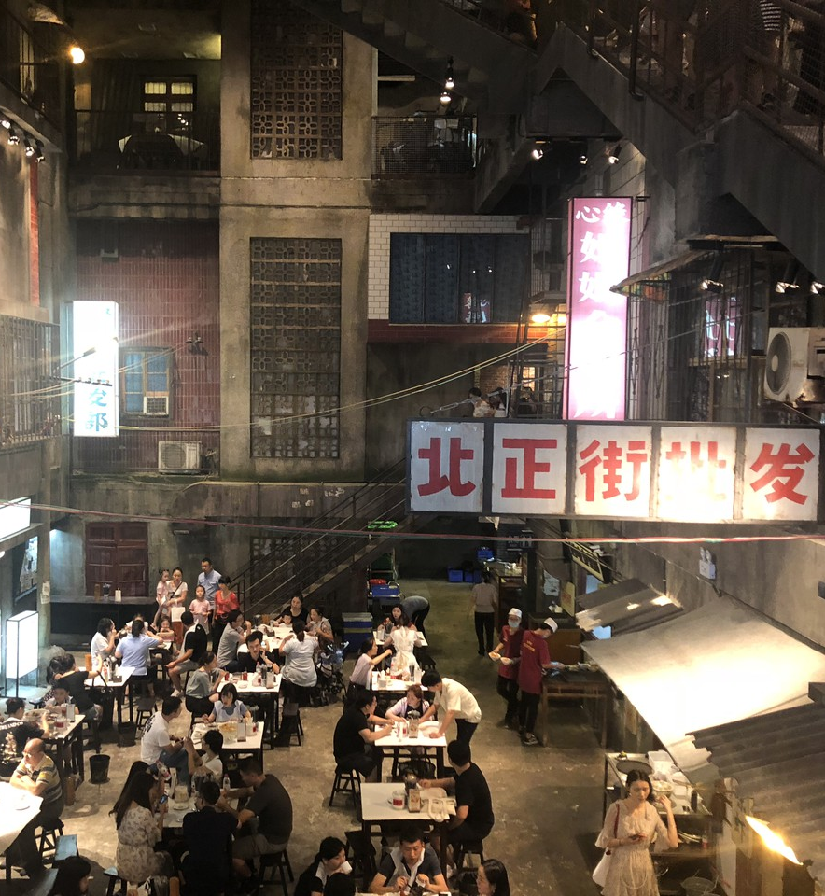
Changsha-style
"Chòu Gānzï"
spicy flavor
black crackling
brine composed of winter bamboo shoot, koji, and shiitake mushrooms
surface grow white and to be fried.

Slide 13

Taste
smells bad but tasty

Slide 14
Translation of Chinese dishes

Slide 15
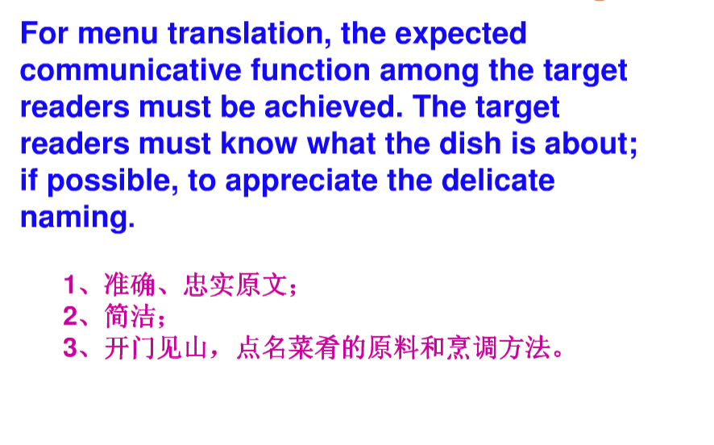

Slide 16
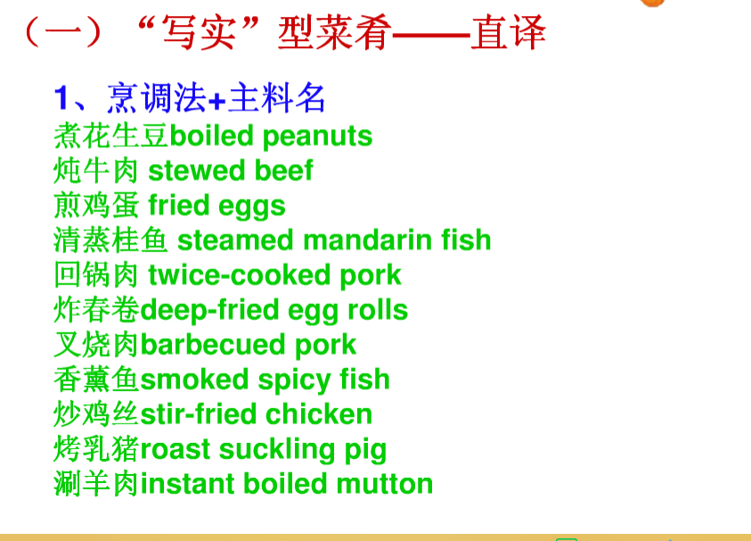

Slide 17
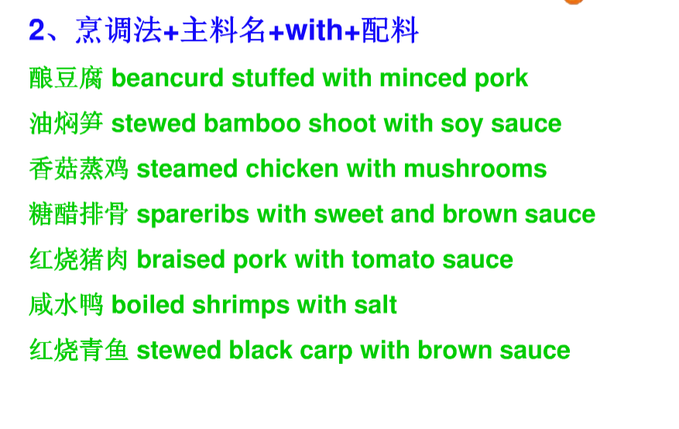

Slide 18
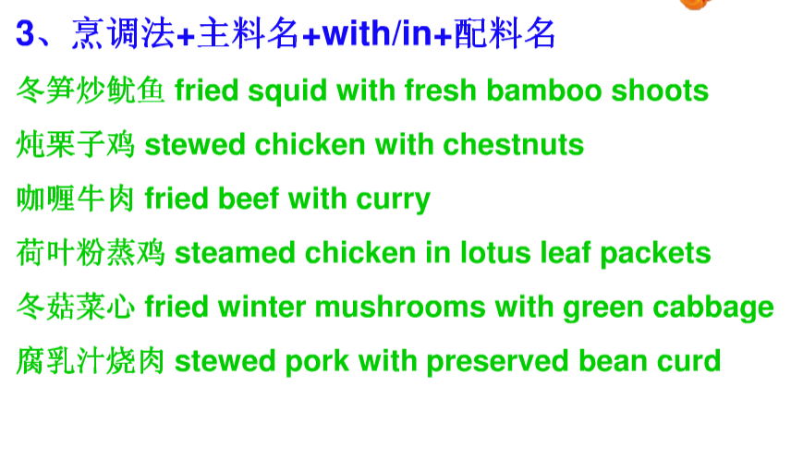

Slide 19
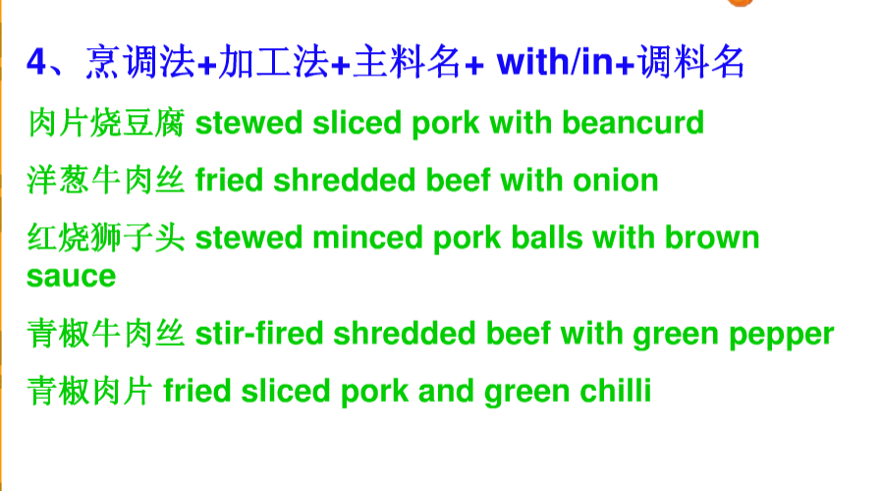

Slide 20
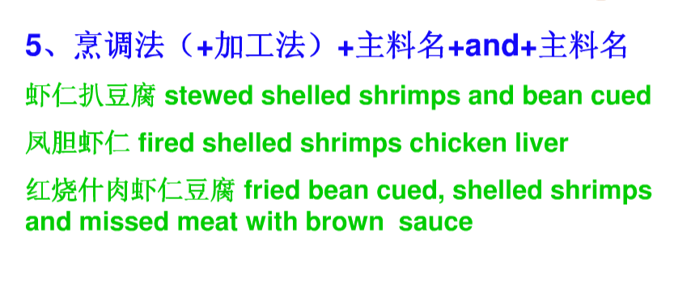

Slide 21
Thanks!

