Slide 1
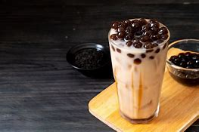
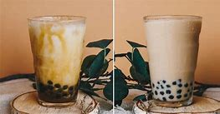
Milk Tea
By: Tang Yingzi

Slide 2
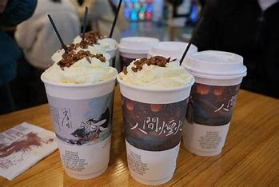

CONTENTS
History
Side effects

Slide 3
HISTORY

Slide 4
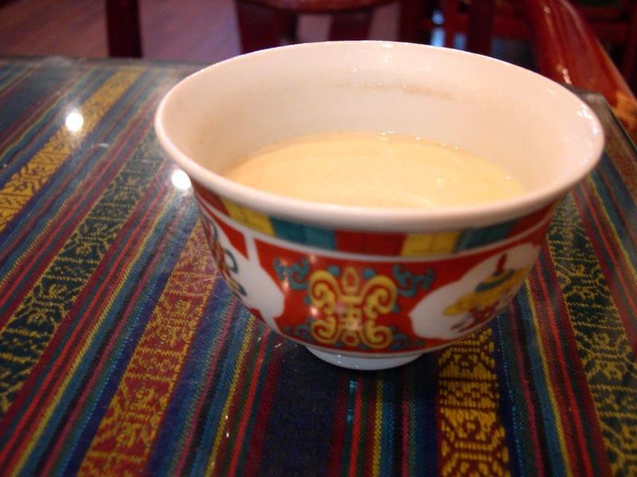
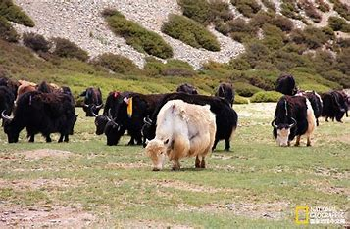
Origins
The way of drinking tea by adding dairy to it – namely, butter– was originally invented by the Tibetan people. They liked butter tea not only for its taste, but also because they believed that it eased digestion. Tibetans used goat milk 🐐 or cow milk 🐄 to make it.

Slide 5
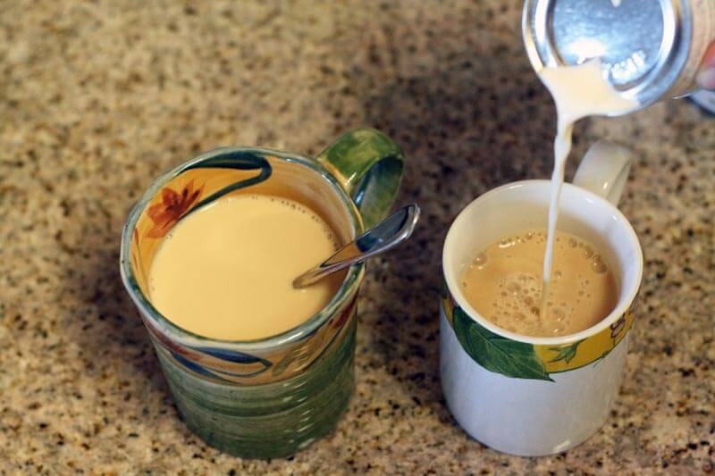
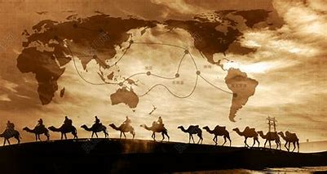
India
Silk road
Indians, with their rich culinary history, adapted the recipe and added spices to it. This version of milk tea, known as Masala tea 印度马莎拉奶茶 quickly became popular all over the country.

Slide 6
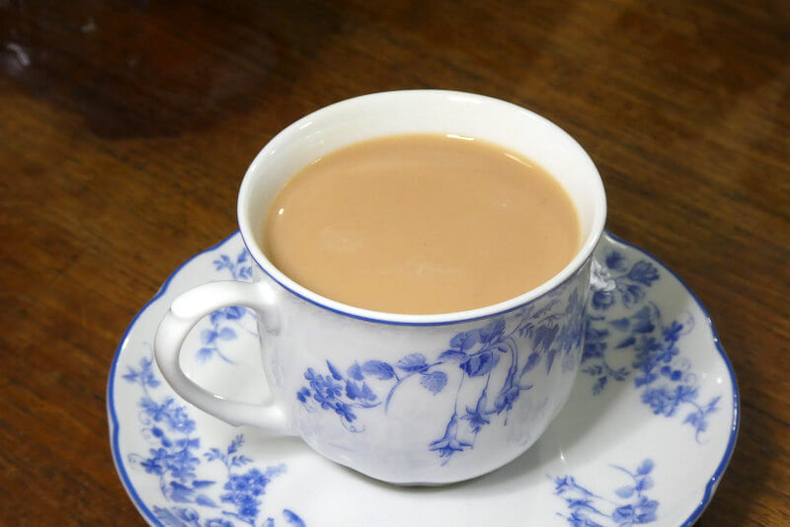
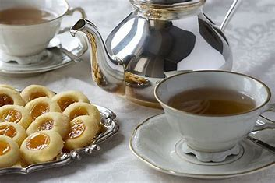
Europe
Later, the Brits brought the milk tea recipe from India. The rest is history – now, as we all know, ‘tea with milk’ has become an essential part of the British culture. More recipes came to life then, invented and perfected by British aristocrats. The Indian recipes lost their ‘spiciness’, and were replaced by sweeter, softer versions of this tea with sugar and honey.

Slide 7
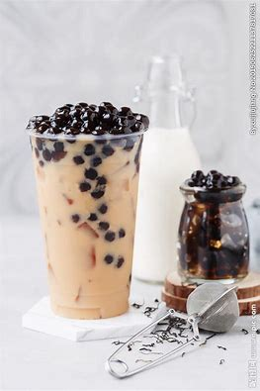
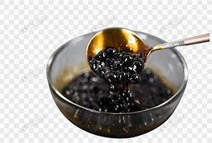
Taiwan
tapioca balls
Then, during the Second World War, the European recipe came to Taiwan. It kept evolving with time – until a creative vendor added tapioca balls to his recipe, and invented bubble tea, a famous drink that we all know.

Slide 8
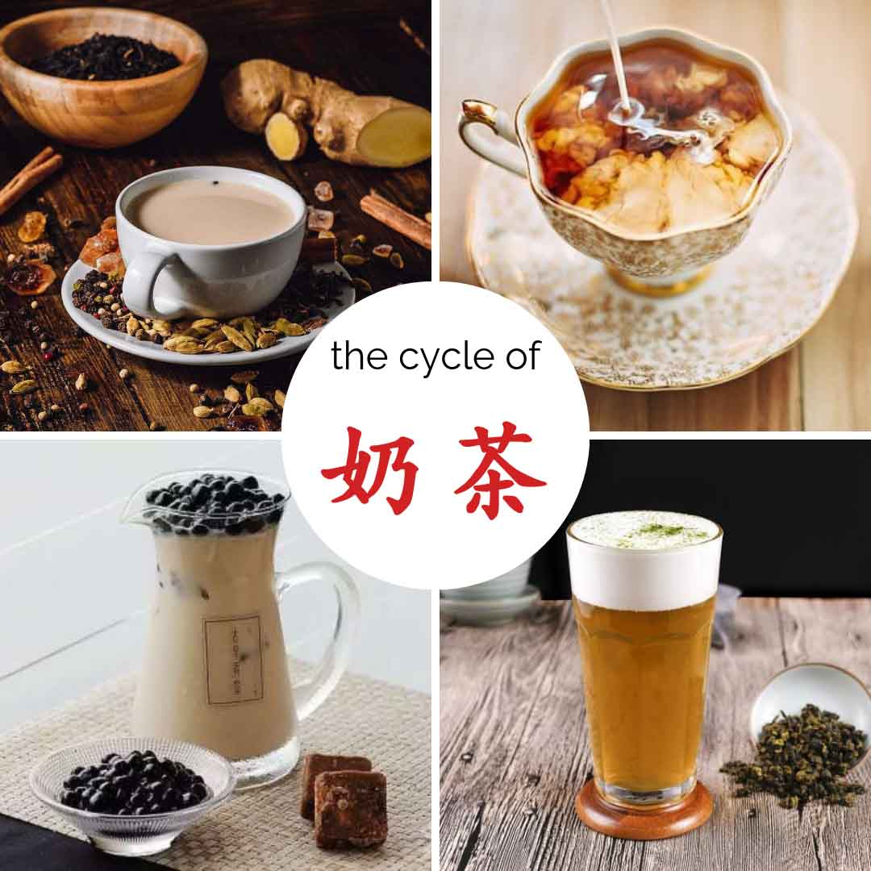
Modern China
In the mid-1990s, with the popularity of Pearl Milk Tea in Taiwan, many companies opened their tea-shops in mainland China – namely, the Hong Kong region – where milk tea became popular at once. However, competition forced some tea-shops to use low-quality tea with lots of flavor compounds and sweeteners. In the recent years in China, milk tea with cheese or milk cover 芝士奶盖 has also grown extremely popular.

Slide 9
Side effects
1. Can cause insomnia 失眠
2. Leads to anxiety
3. May cause pimples
4. Triggers constipation 便秘
5. Creates blood pressure imbalance
6. Raises the possibilities of miscarriage 流产
7. Causes bloating 腹胀

Slide 10
THANKS

