Slide 1
Chinese Characters and Scripts
English Translation
Yang Siyin 杨思吟

Slide 2


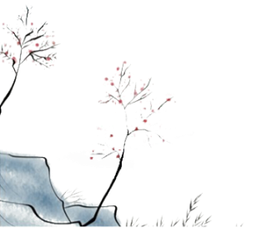
Jiagu Wen
(Jin Wen or Zhongding Wen)
Da Zhuan
(great seal script)
Xiao Zhuan or small seal script
Suti Zi or Lishu (clerical script)
The running hand
Xing shu
Kai Shu or
the regular script
Zhangcao or old cursive script
the Song typeface

Slide 3
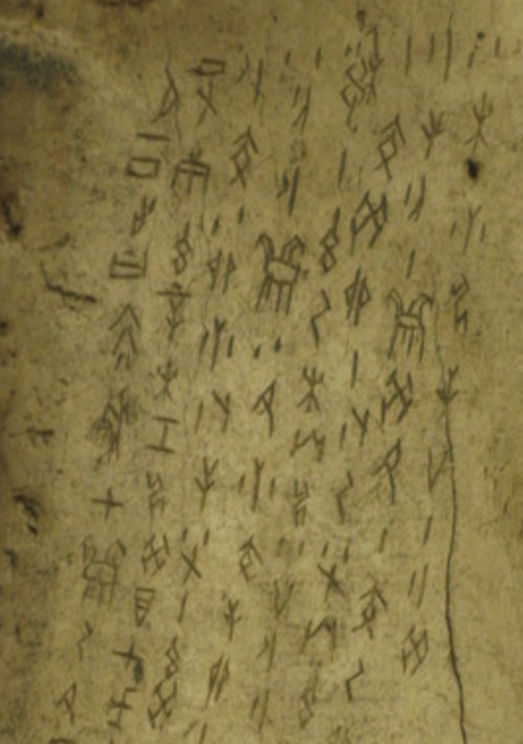
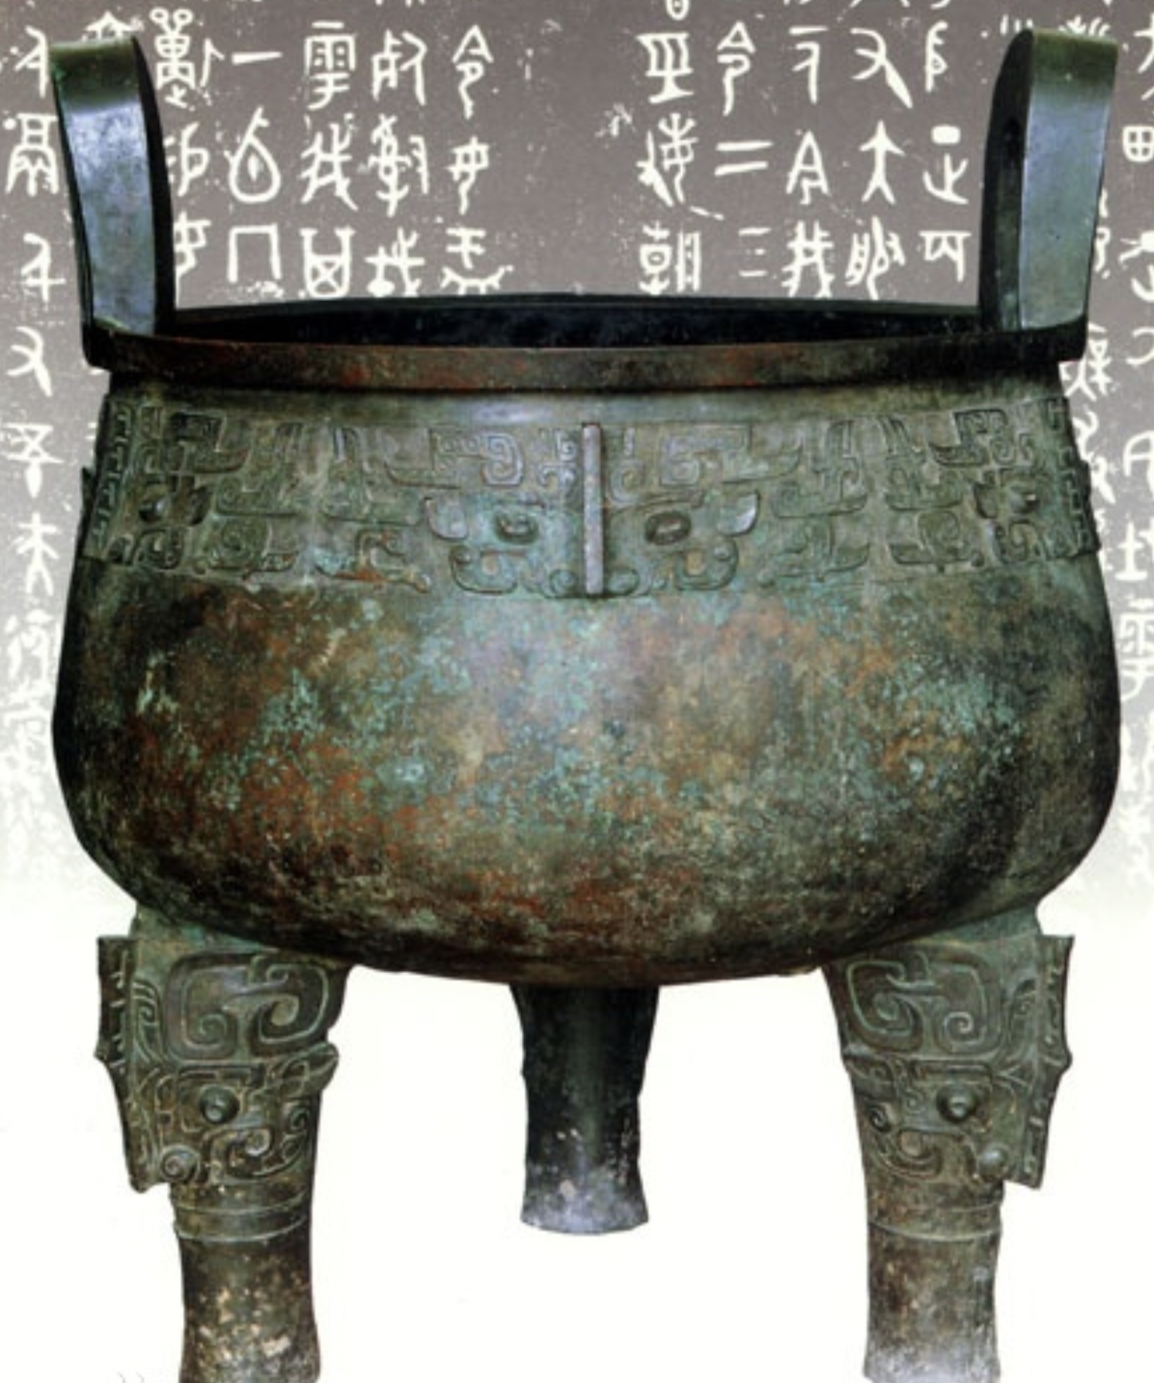
Jiagu Wen
ancient Chinese characters carved on tortoise shells or animal bones
It is the oldest Chinese characters.
During the late Shang and early Zhou dynasties, Jin Wen or Zhongding Wen occurred to recorded important events and activities.

Slide 4
Da Zhuan (great seal script)
Up to the late Western Zhou period, Jiagu Wen had been made uniform to conform to one type called Da Zhuan (great seal script).

Slide 5
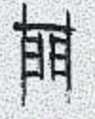
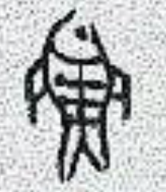

Slide 6
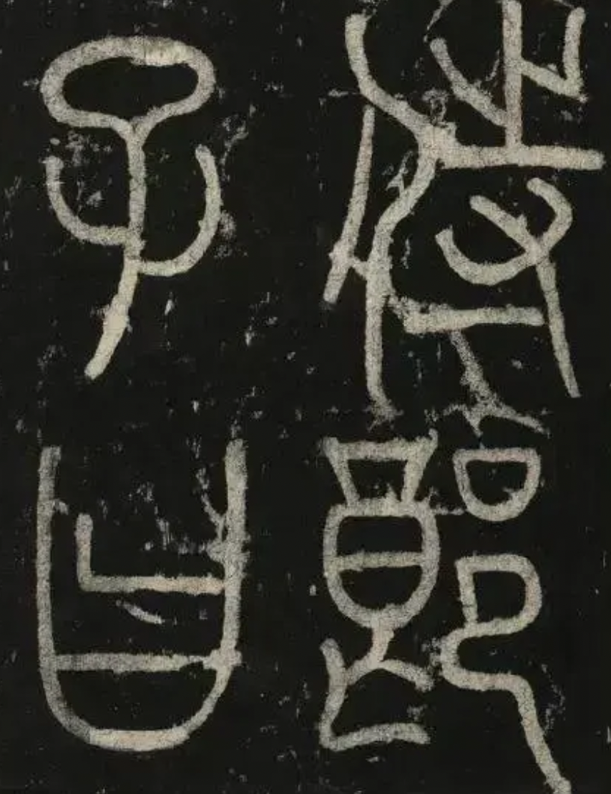
Xiao Zhuan, or small seal script
In Qin Dynasty, Li Si unified the various calligraphic styles and create the standardized Xiao Zhuan, or small seal script.

Slide 7
Lishu (clerical script)
Soon after the small seal script became the official script, Suti Zi occurred.
It (the commoner style) was initially used among the common people, eventually some official documents came to be written in Suti Zi.
This script came to be called Lishu (clerical script).

Slide 8
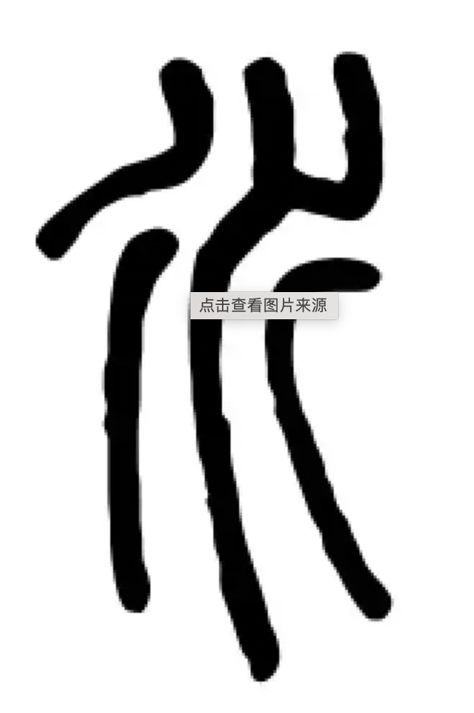
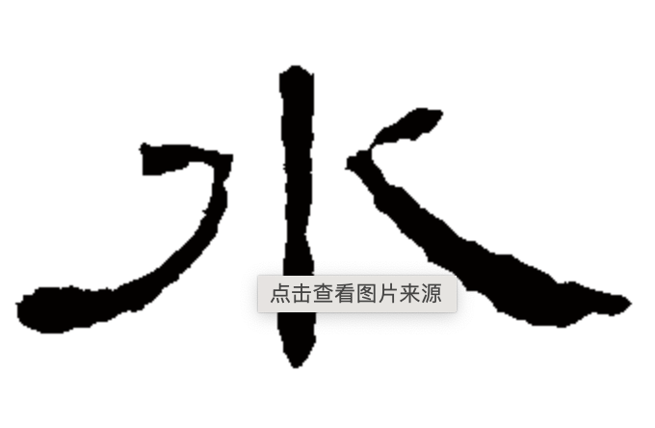

Slide 9
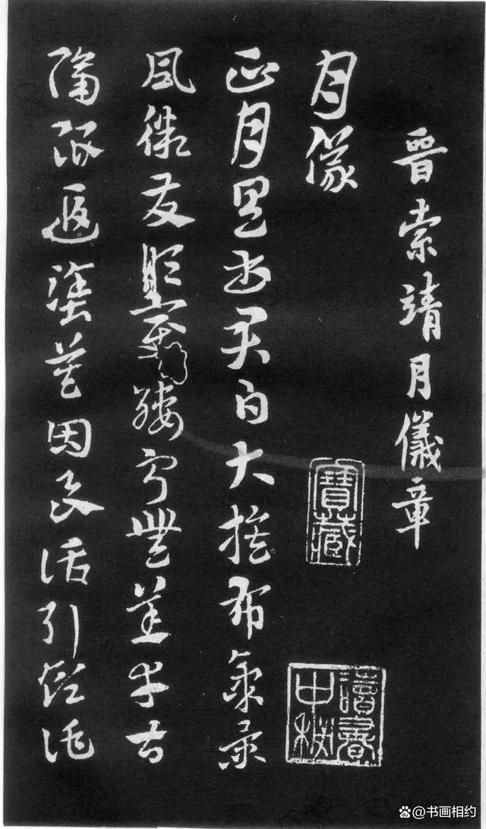
Zhangcao or old cursive script
In the late Qin and early Han periods, Zhangcao or old cursive script appeared.
Its strokes were linked together.
Its horizontal strokes still ran upward, while the ends of its left-falling stroke and right-falling stroke retained the clerical style.

Slide 10
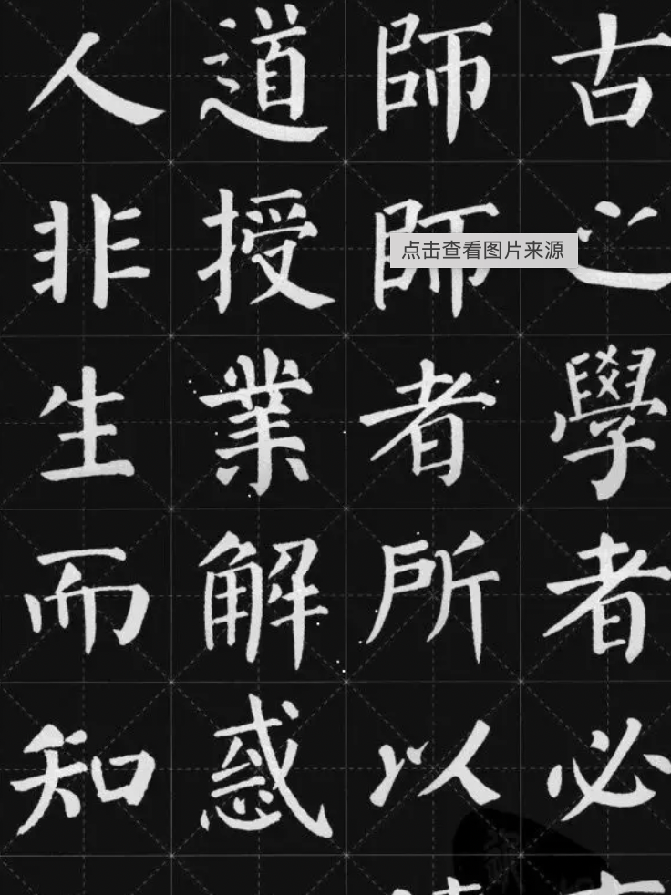
Kaishu (the regular script, or standard script)
After the Eastern Han Dynasty and the Cao Wei State, a new style of script known as Kaishu came into being.
Each of the strokes placed slowly and carefully.

Slide 11
The running hand: Xing shu
Different from other scripts, it did not have a specific style of its own. The strokes were rather flexible and natural.
Since the Jin Dynasty, most master calligraphers excelled at the running hand.

Slide 12
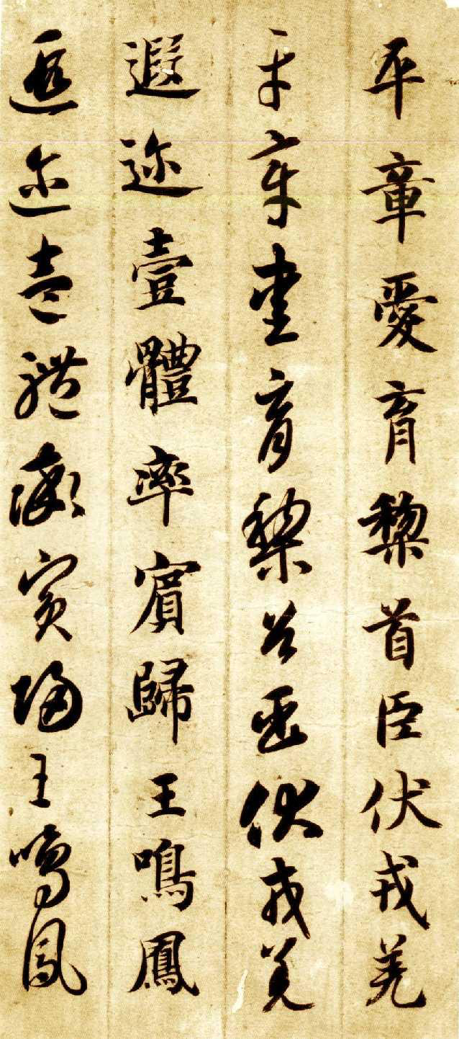
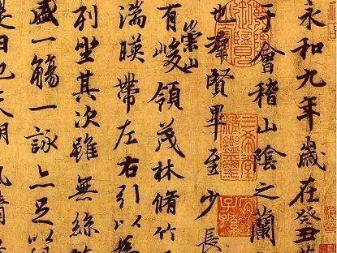

Slide 13
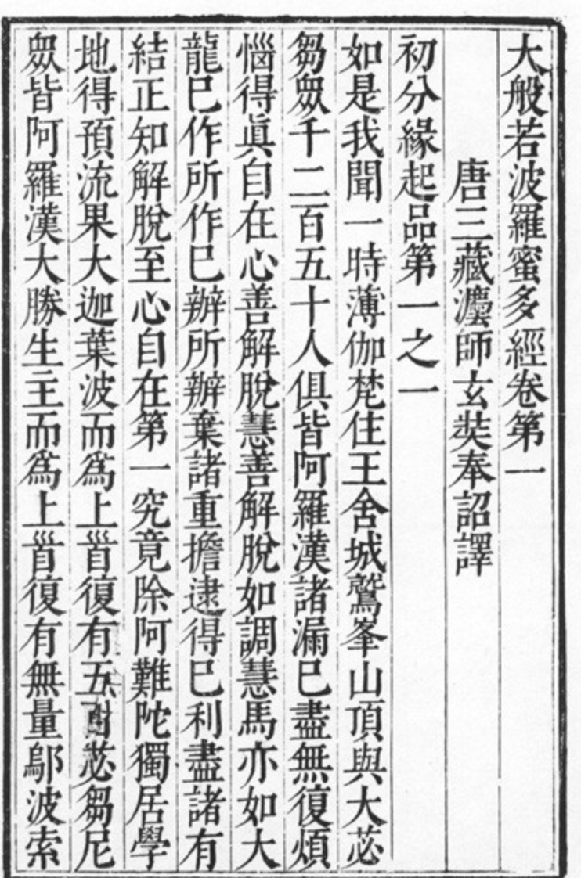
the Song typeface
Between the late Ming and early Qing dynasties, there appeared a new style of characters: square-shaped characters featuring light horizontal strokes and heavy falling strokes.
Since the square-shaped script developed from the printing fonts of the Song Dynasty, it is widely used in printing newspapers and books nowadays.

Slide 14
Thanks for your watching

