Slide 1
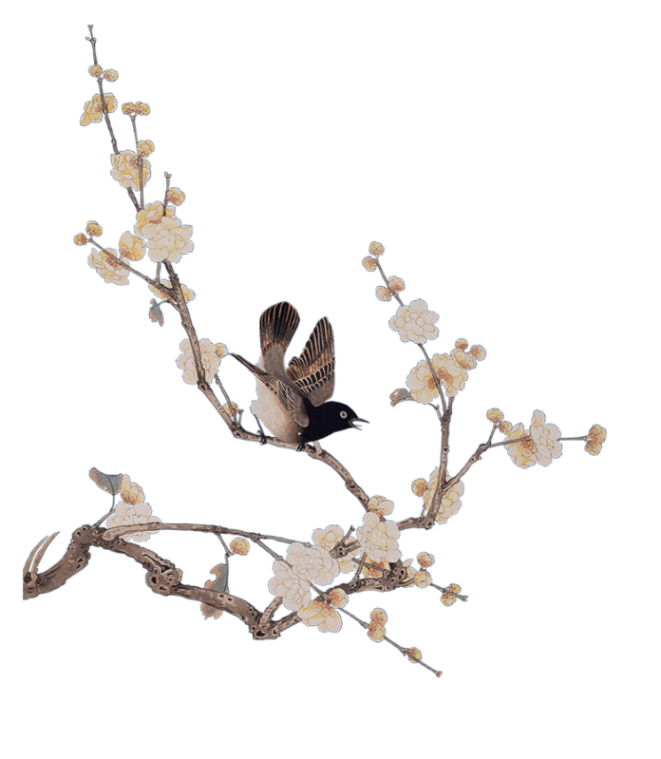
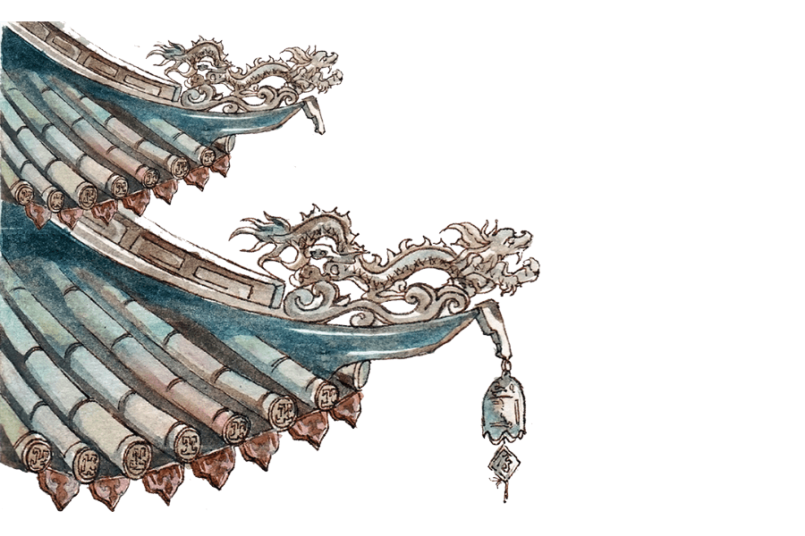
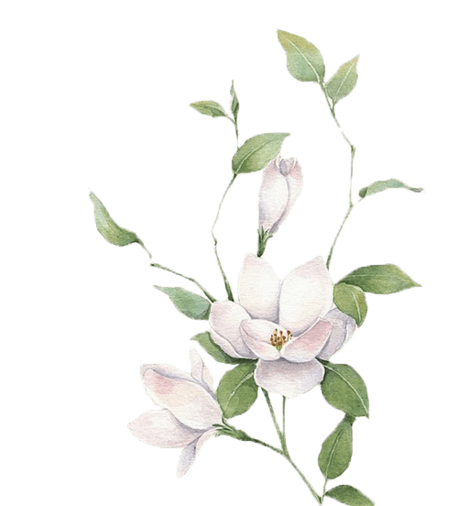

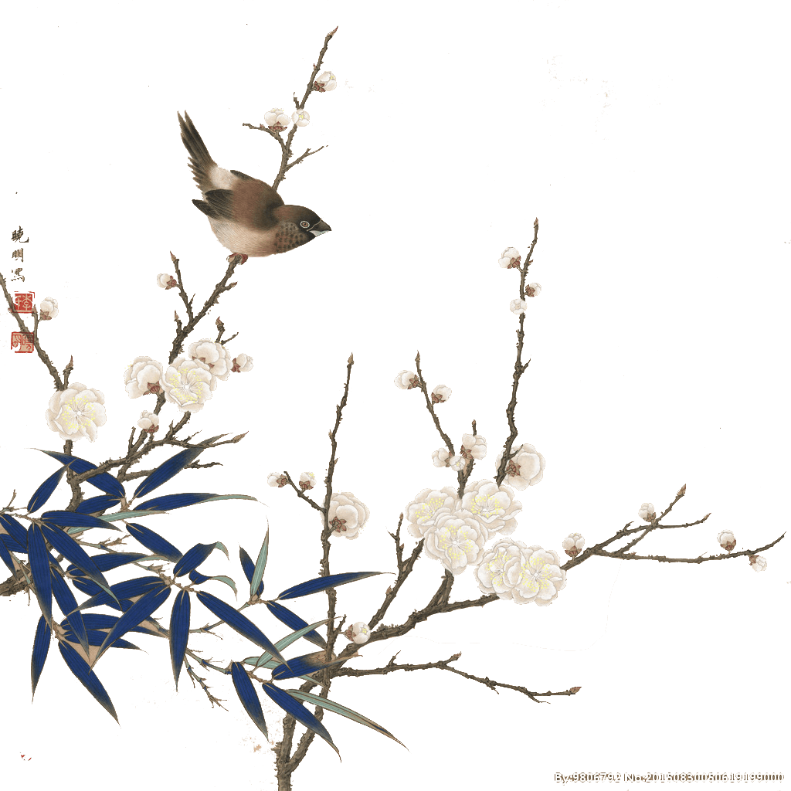

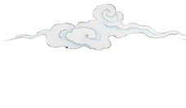
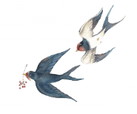
Chinese
Clothing

Slide 2



1
Introduction
2
Chinese traditional clothing
Contents
3
Details
4
Conclusion

Slide 3


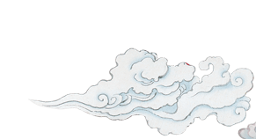
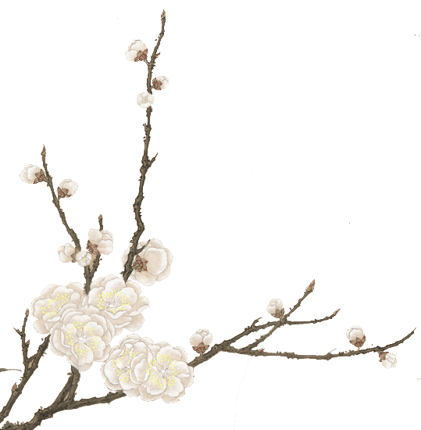
1
Introduction

Slide 4

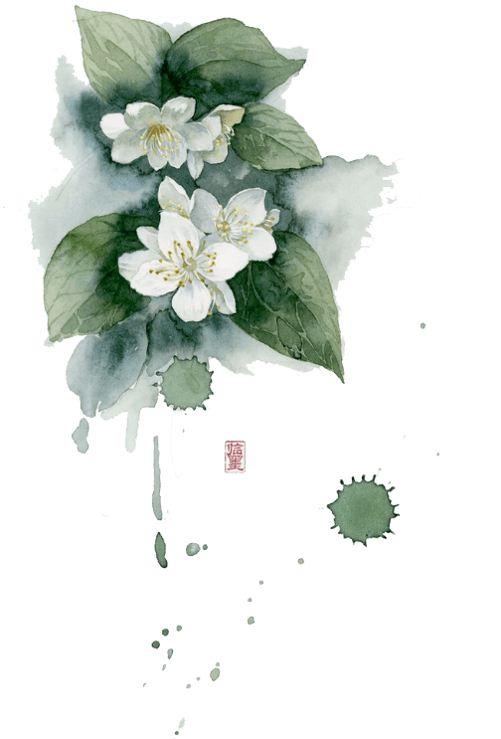
Introduction
Chinese Clothing has a long history while Han people dominate most periods in history.
Clothing manufacture in China dates back to prehistoric times, at least 7,000 years ago.
For thousands of years, generations of clothing
designers have devoted themselves to building the Kingdom of Clothes, making the garments that cover the human body into an important component of Chinese culture.

Slide 5
2
Chinese traditional clothing

Slide 6
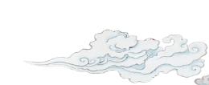
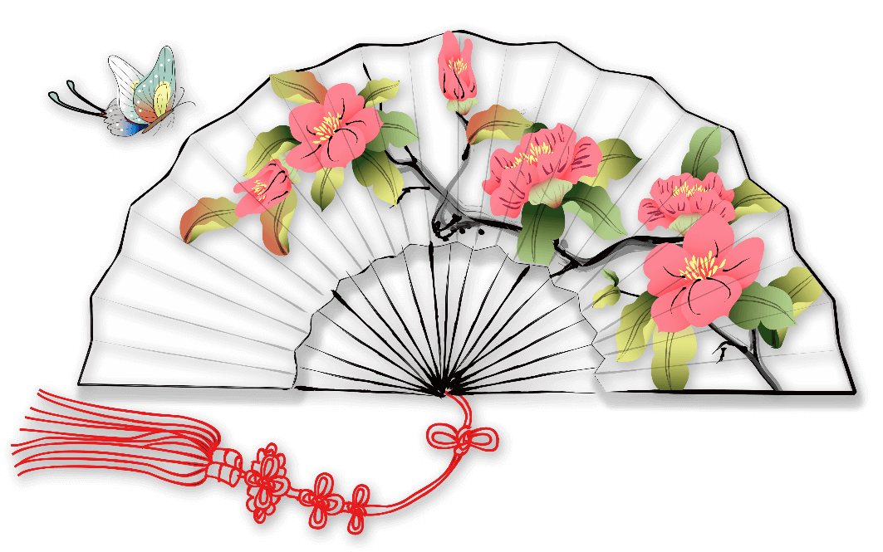
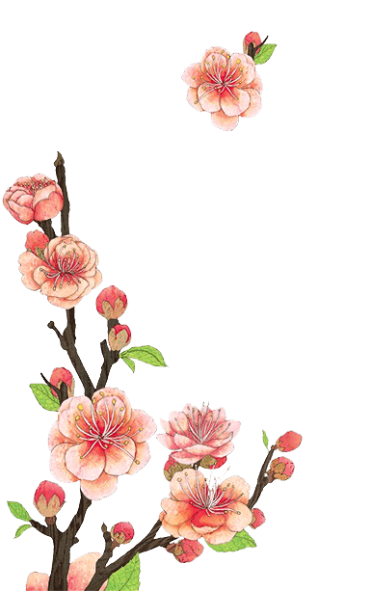
Traditional Han Chinese Clothing (Hanfu)
It refers to the attire worn by the Han people from the enthronement of the Yellow Emperor(about 2698BC) till the late Ming Dynasty (1368-1644AD).
Why is the ancient Chinese Clothing called Hanfu?
It became known as the Han Fu(fu means 'clothes" in Chinese)because the fashion was improved and popularized during the Han Dynasty.

Slide 7
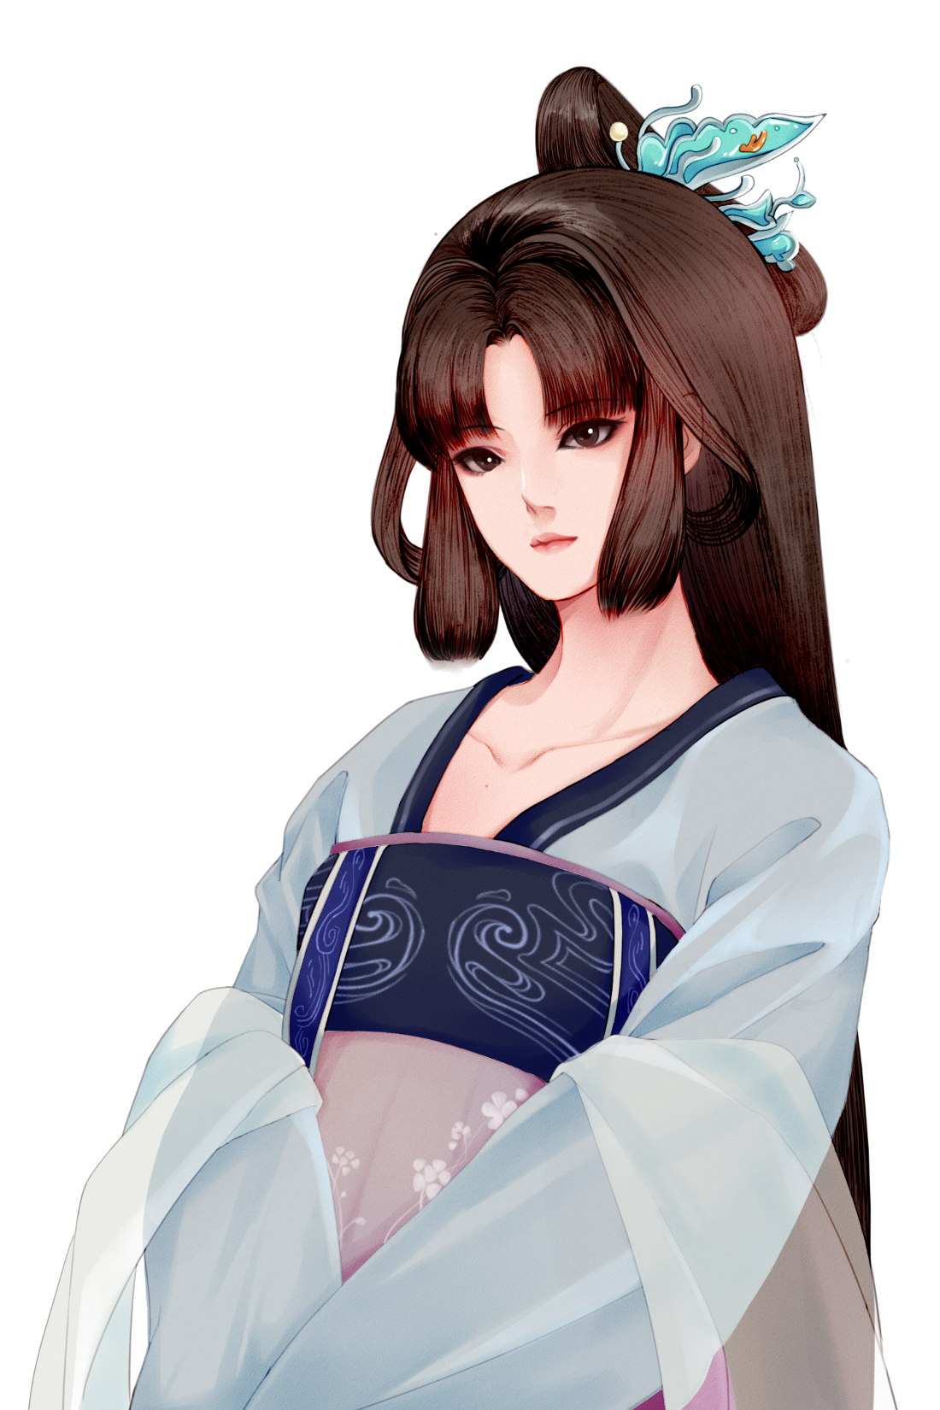
Traditional Han Chinese Clothing (Hanfu)
1
It is usually in the from of long gown, cross collar, wrapping the right lapel over the left, loose wide sleeves and no buttons but a sash.
There are several representative styles of hanfu, such as the ruqun (an upper-body garment with a long outer skirt), the aoqun (an upper-body garment with a long underskirt), the beizi and the shenyi.
2

Slide 8
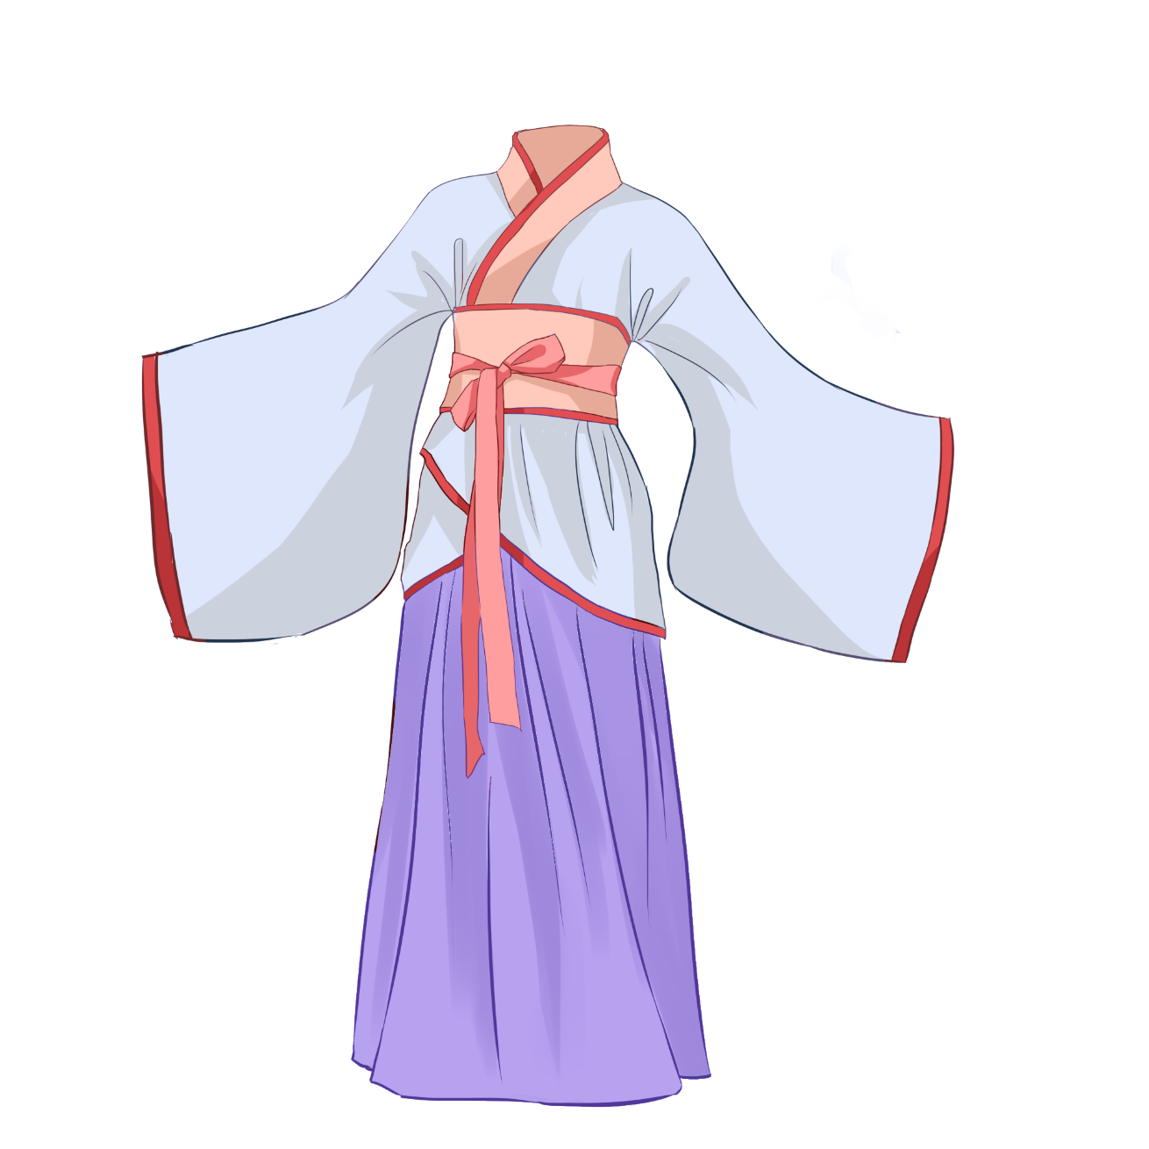
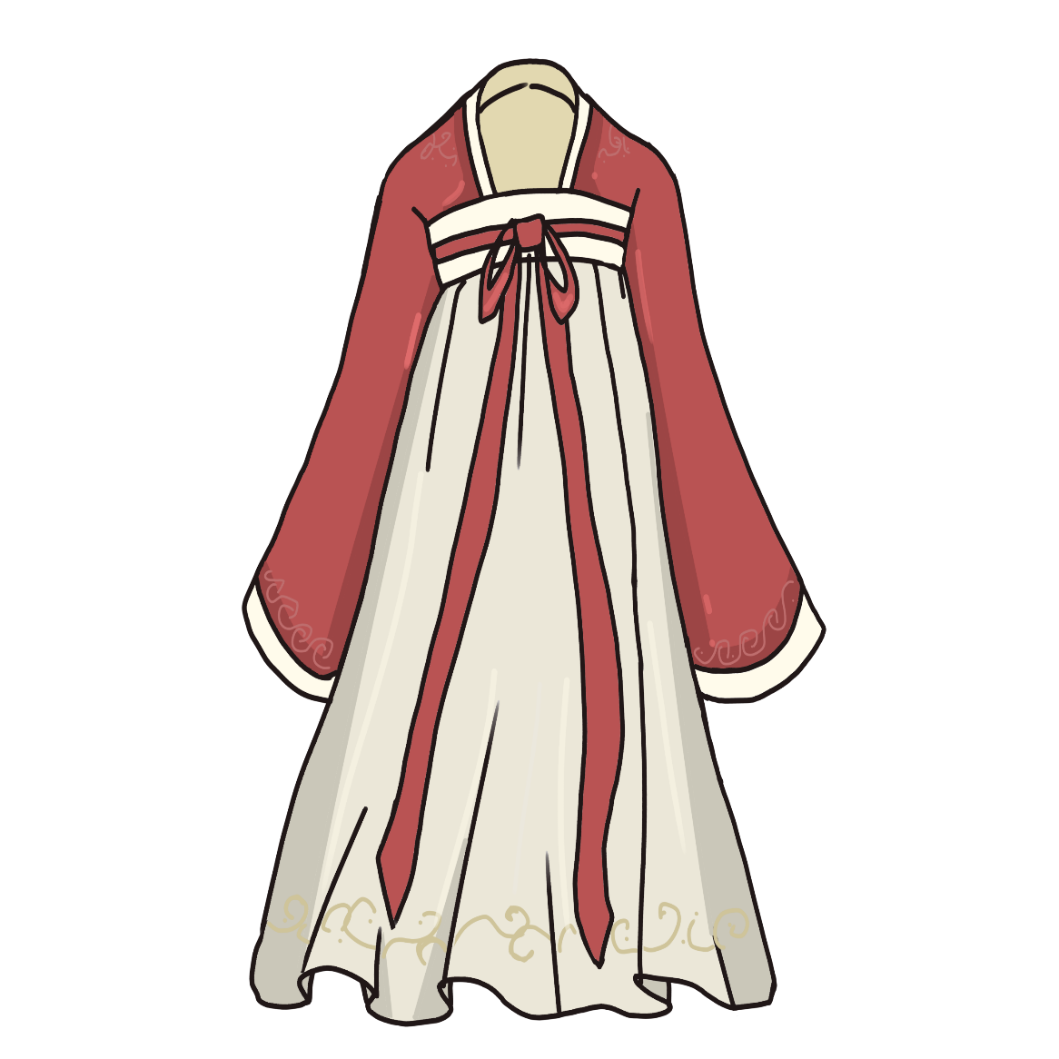
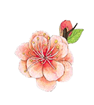
Traditional Han Chinese Clothing (Hanfu)
ruqun
shenyi

Slide 9
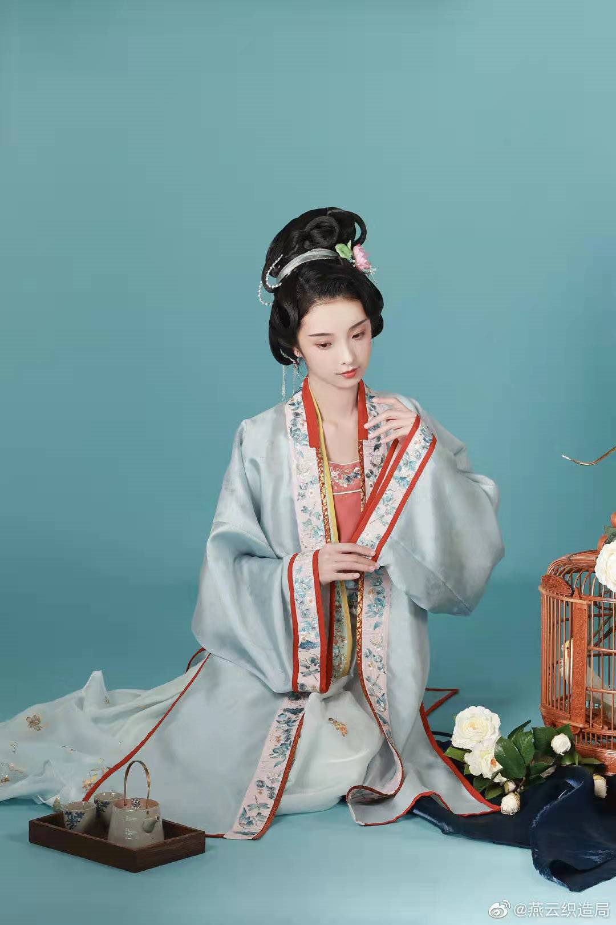
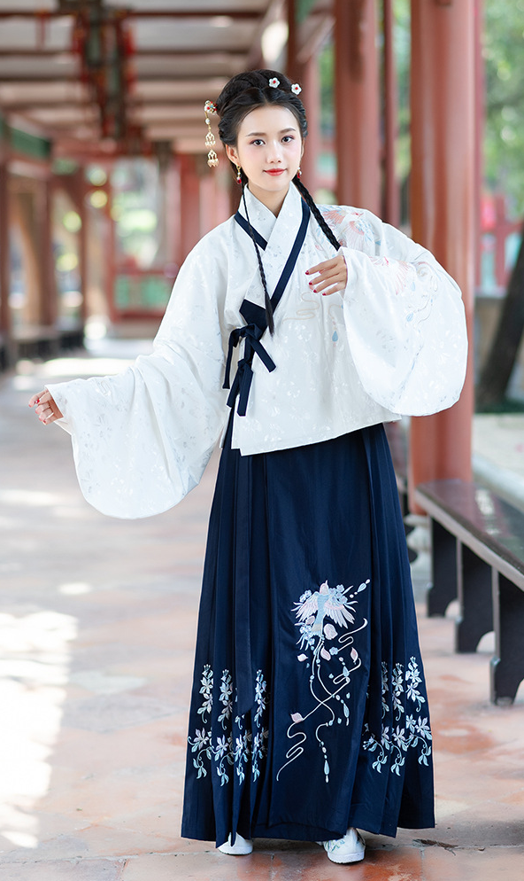
Traditional Han Chinese Clothing (Hanfu)
beizi
aoqun

Slide 10
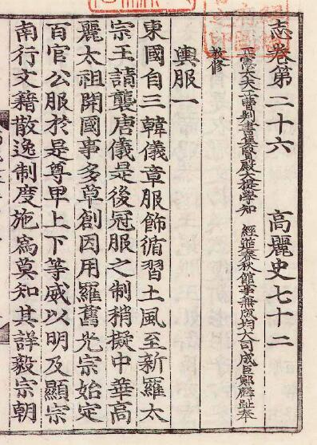
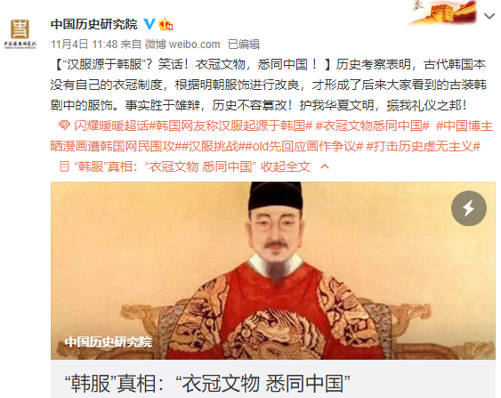
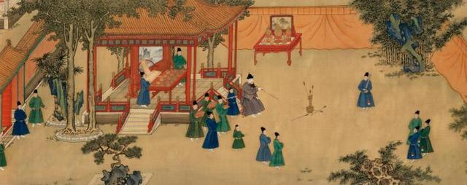
Traditional Han Chinese Clothing (Hanfu)
Hanfu has also influenced the traditional clothing of many neighbouring cultures, such as the Korean hanbok and the Japanese kimono.
During the Ming Dynasty, Emperor Zhu Yuanzhang had allowed Joseon as a Vassal state to China for their nobles to wear the same clothes as those nobles in China.

Slide 11

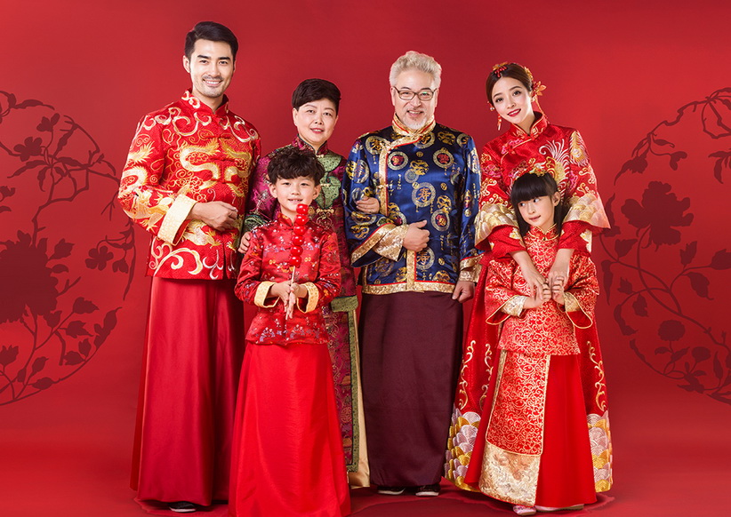
Chinese Suit(Tang Zhuang)
It is a combination of the Manchu male jacket of the Qing Dynasty and the western style suit. It is usually straight collared, with coiled buttons down the front. Its color and design are in traditional Chinese style but tailoring is western.

Slide 12
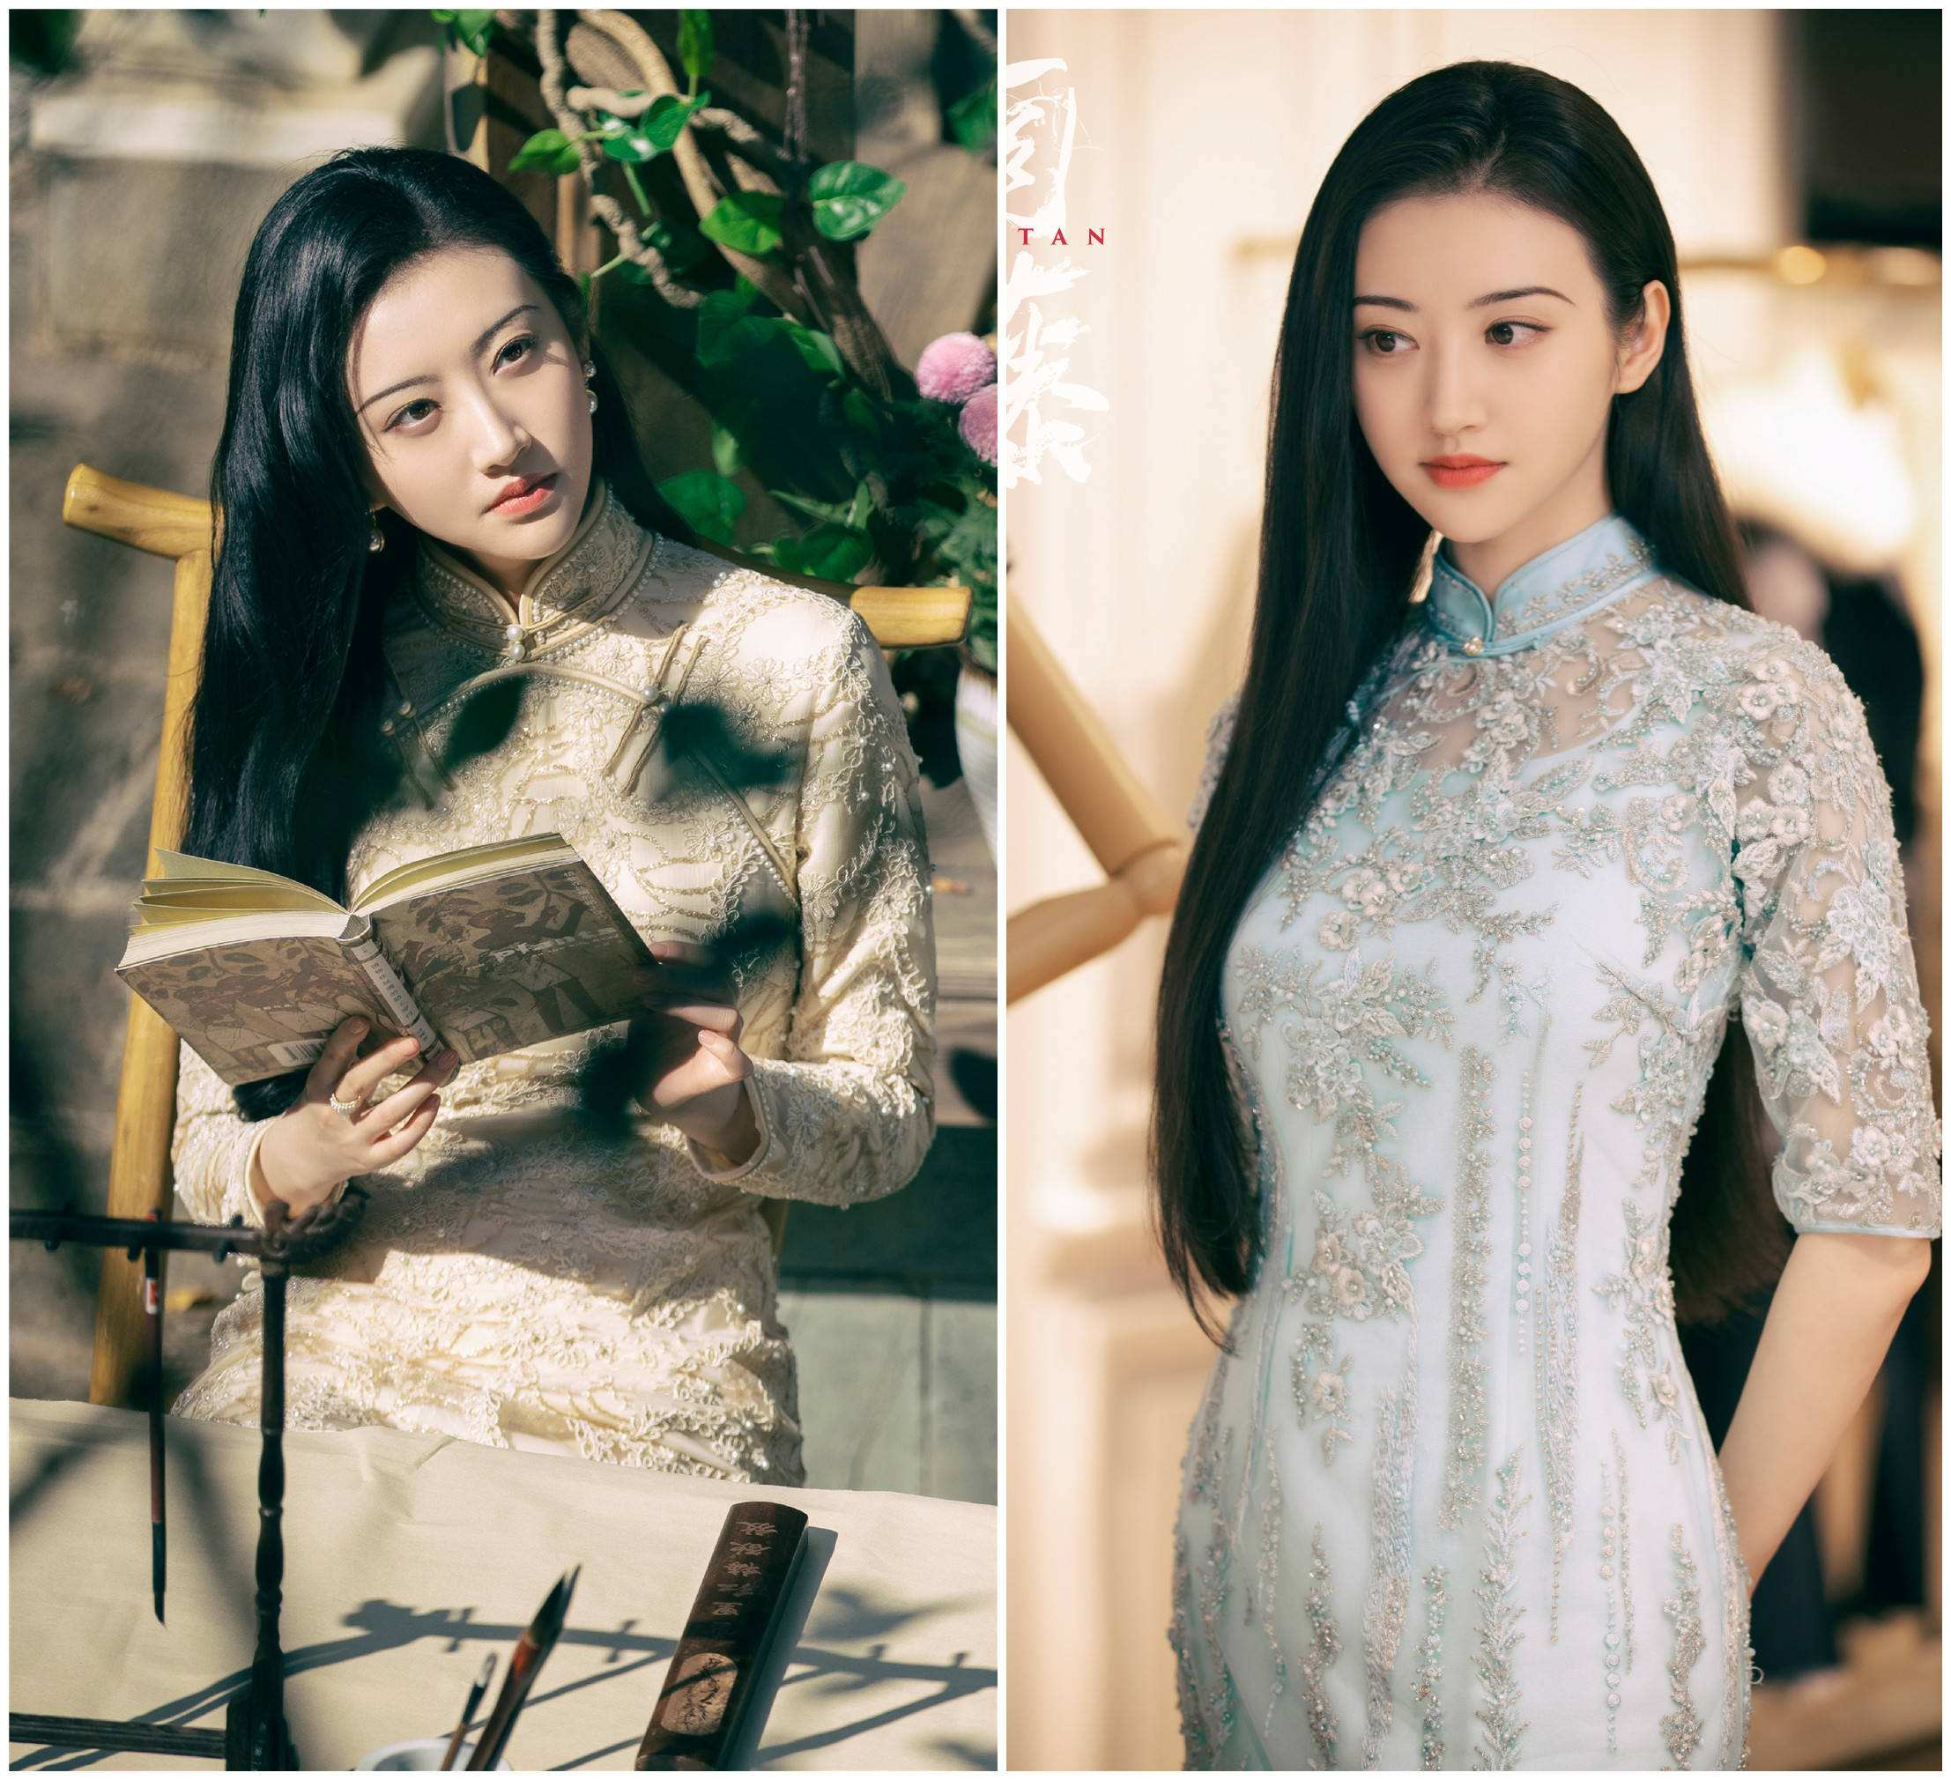
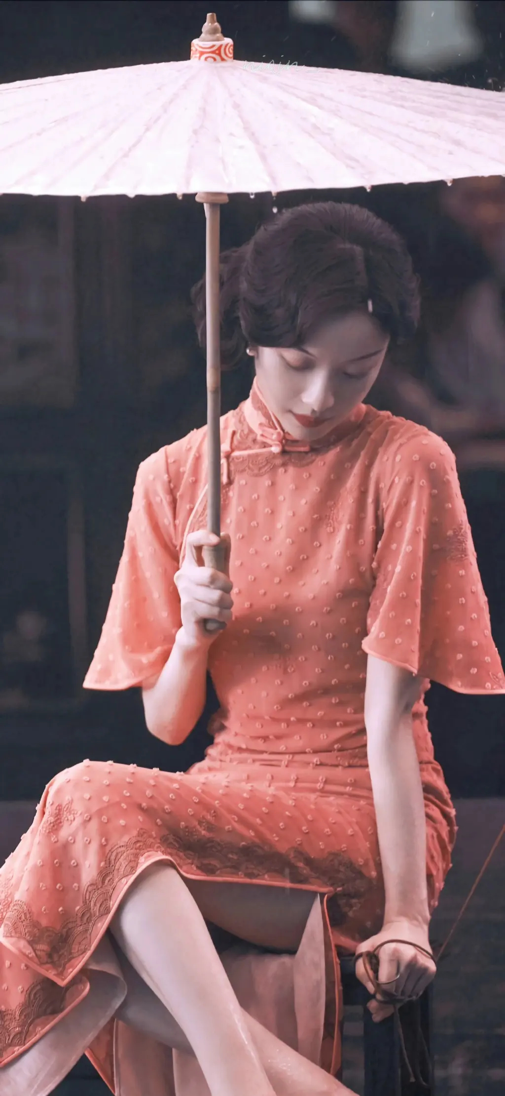
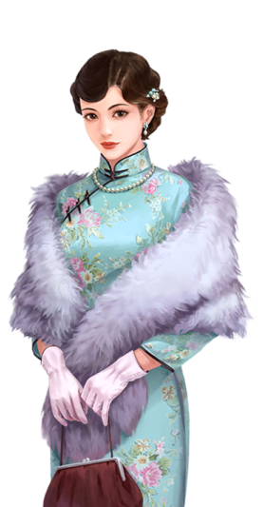
Cheongsam(Qi Pao)
Originated from the Manchu female clothes, it evolved by merging with western patterns that show off the beauty of a female body.
Its features are straight collar, strain on the waist, coiled buttons and slits on both sides of the dress.
Materials used are usually silk, cotton and linen.

Slide 13
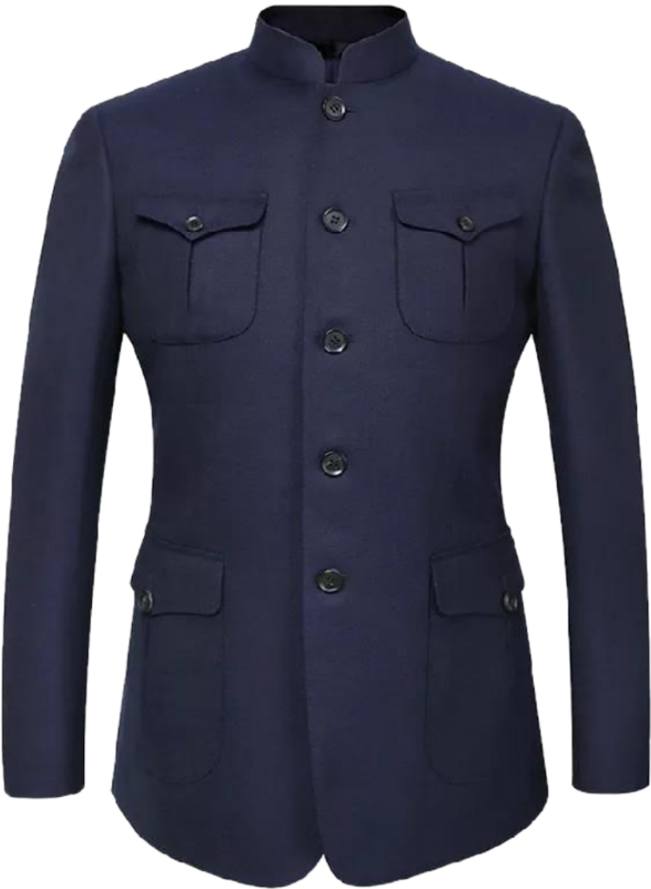
Chinese Tunic Suit (Zhongshan Zhuang)
Also called the Yat-sen Suit , it is designed by Dr. Sun Yat-sen by combining the western-style suit and Chinese attire.
It has a turn-down collar and four pockets with flaps.

Slide 14
3
Details

Slide 15
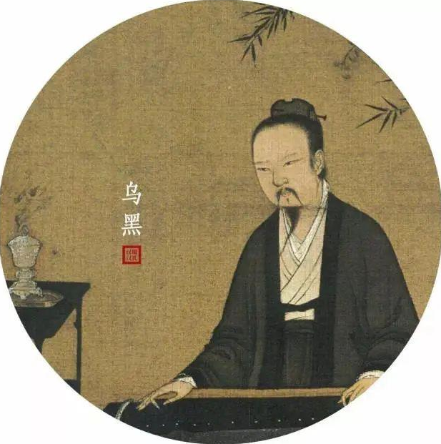
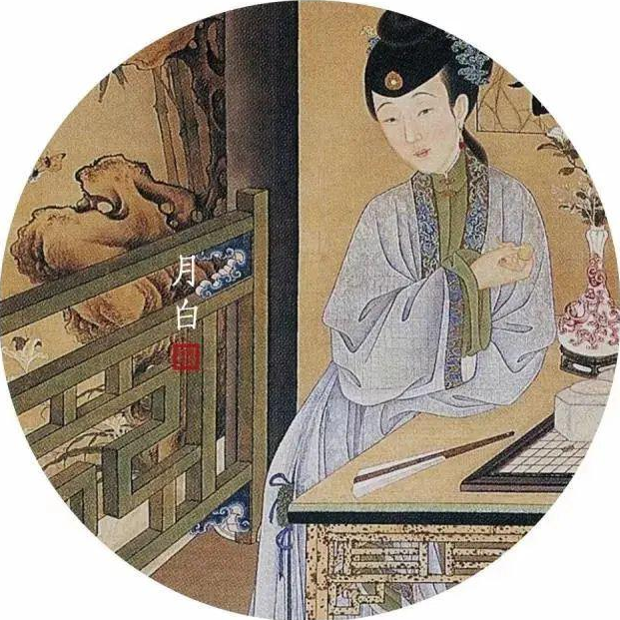
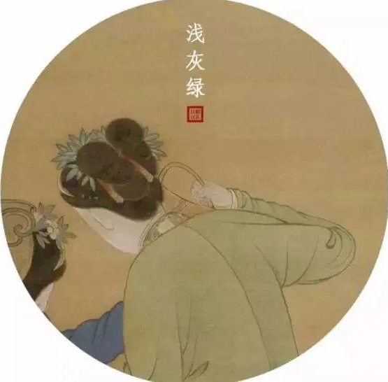
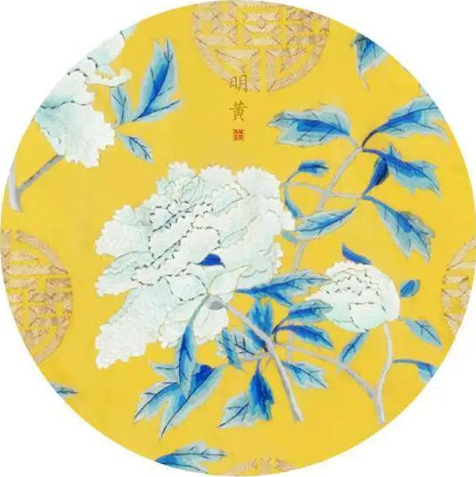
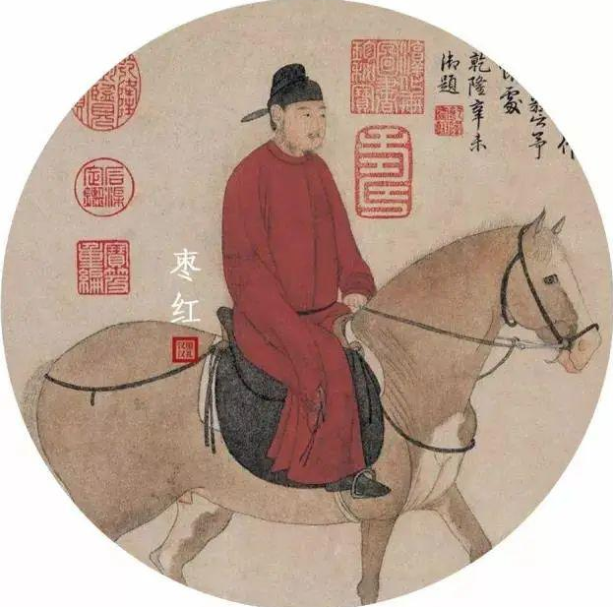
Chinese Traditional Clothing colors
Green, white, yellow, red, black , the five colors, form the Chinese traditional color system.
添加标题

Slide 16
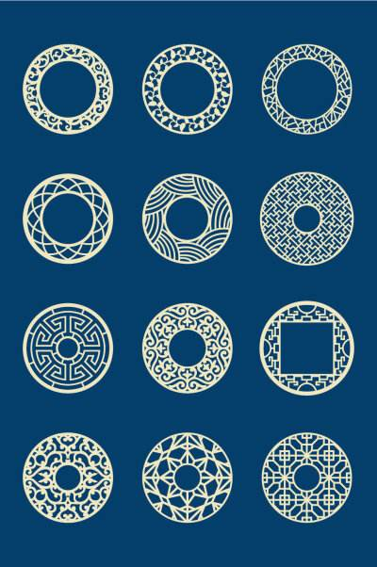
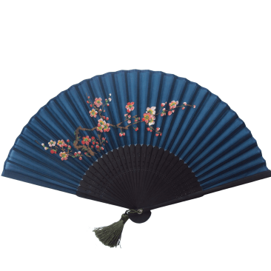
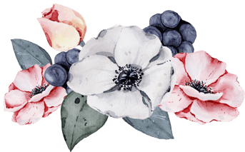
Chinese Traditional Clothing Elements
These elements include: Chinese silk , cloth of brocade, hemp, blue printed fabric; chirpaur, Chinese -style chest covering, Chinese tunic suit, collar,
surplice, mandarin and split etc; colorful ethnic colors: such as bright red, green, yellow and blueetc. ;Neolithic patterns, bronze patterns in Shang and Chou dynasties, ancient lacquer were pattern in Qin and Han dynasties.
Different times has their unique cultural connotations and form elements, which include Chinese architecture, costumes, traditional Chinese painting and folk art etc.

Slide 17
4
Conclusion

Slide 18
Conclusion
Chinese traditional culture is an indispensable source of inspiration in fashion design. Therefore, we should build up cultural confidence to conserve and promote Chinese traditional culture.

Slide 19
Thank you for listening!
https://www.bilibili.com/video/BV19f4y1z7Ar?spm_id_from=333.788.top_right_bar_window_history.content.click

