Slide 1




Twelve
Animals
of the
Chinese
Zodiac
鲍沁雯
Bao Qinwen

Slide 2
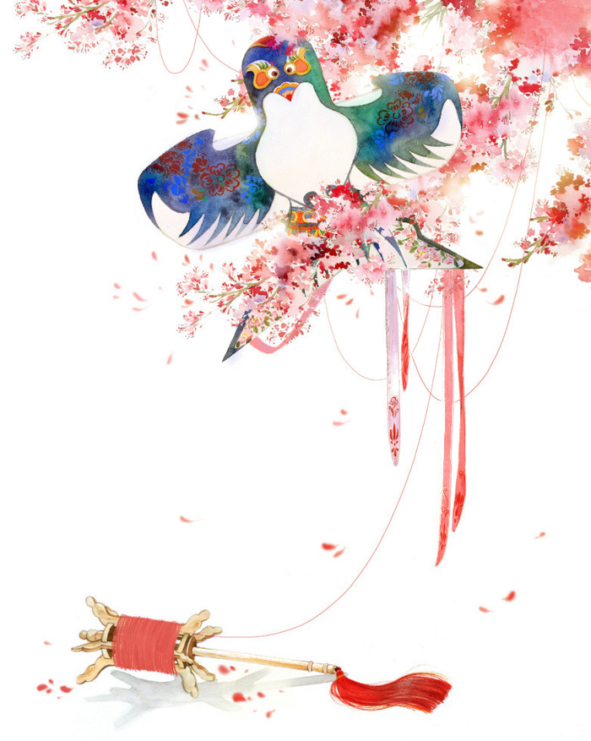

壹
An introduction to Chinese Zodiac
目
录
贰
Cultural knowledge about the relevant term translation
叁
Conclusion

Slide 3
01
An introduction to Chinese Zodiac
Best wishes best wishes best wishes best wishes best wishes best wishes best wishes best wishes

Slide 4

An introduction to Chinese Zodiac
1. Origin
2. The folk culture and belief about it

Slide 5
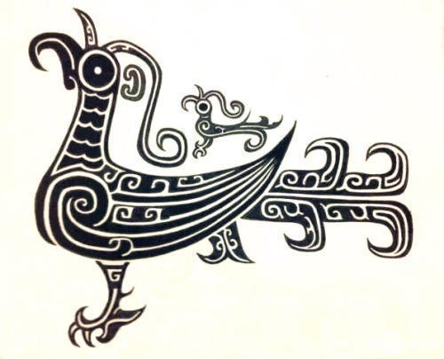
1. Origin
Theory Two
The Earthly Branches and the Ten Heavenly Stems
（天干地支说）
Theory One
A myth：“The Great Race”
贰
Theory Three
Totems of ancient tribes(部落图腾说）
The Jade Emperor, Ruler of the Heavens, wanted to devise a way to measure time, so he organized a race. At the end, the first twelve animals who made it across the river were the winners and so they earned themselves a spot on the zodiac calendar in the order they arrived.
壹
叁
Here the twelve animals refer to the totems at ancient times and different surname tribes use different animals as their totems. Therefore, the twelve animals of Chinese zodiac was developed from the totems of ancient tribes.

Slide 6
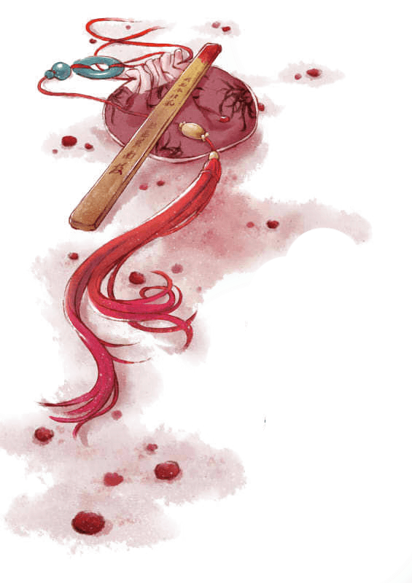
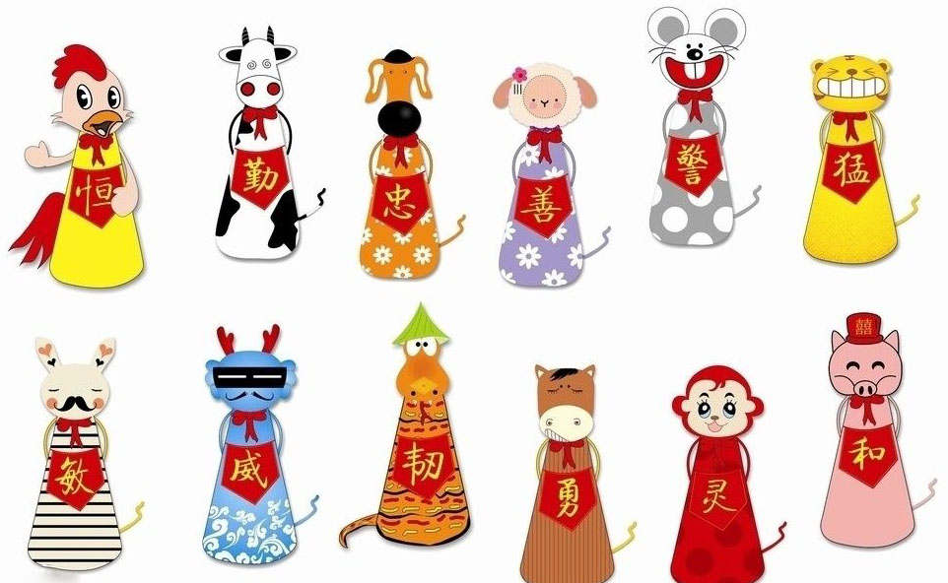
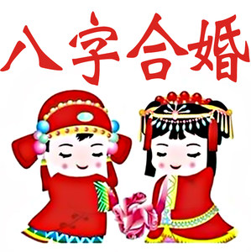
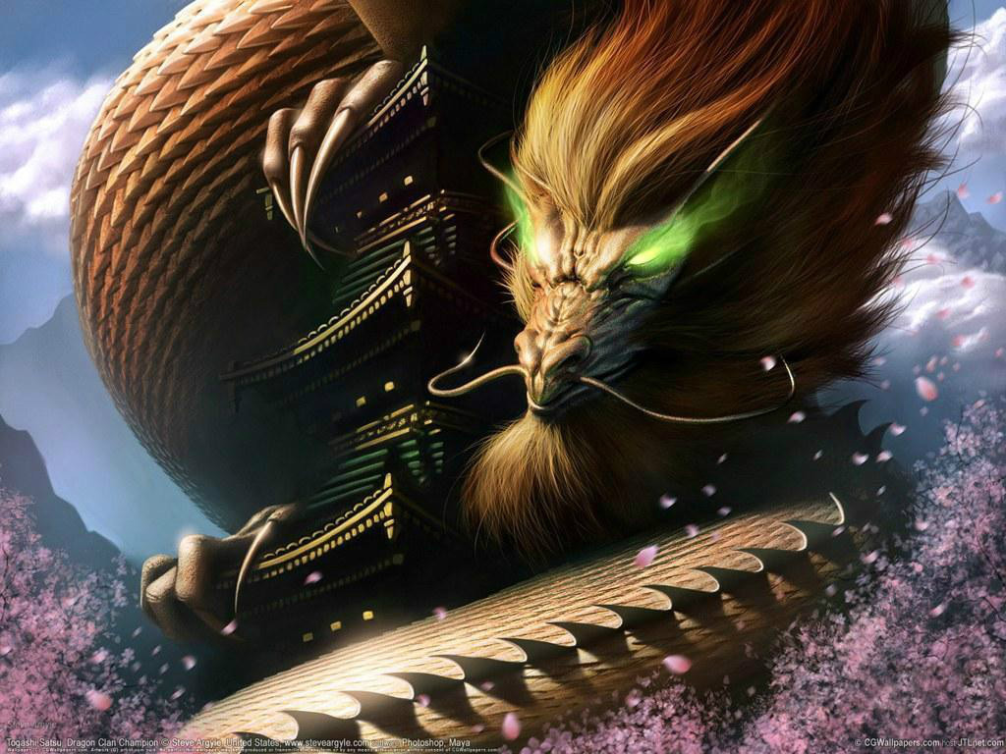
2. The folk culture and belief about it
3) Compatibility for zodiac signs
Endowments given by different zodiacs
Chinese people believe certain animals get on better than the others, so the zodiac has had a great impact on marriage as well. And this is the reason why men and women would like to evaluate their Eight Characters(生辰八字) before they get married.
According to superstitious belief in China, Zodiac animals are combined with the Five Elements to tell one's destiny. For example, people born in the years of Metal Rat are believed to have a promising future; people born in the years of Fire Rat are deemed to be clever and intelligent.
2) Zodiacal preferences
Chinese have always had a strong affection for the Dragon since dragon is regarded as the auspicious and divine creature, so the children born in these years of dragon are believed to have fortune. These folk beliefs have influenced prospective parents’ reproductive behavior in the Chinese society.

Slide 7
02
Some cultural knowledge
about the relevant term translation

Slide 8
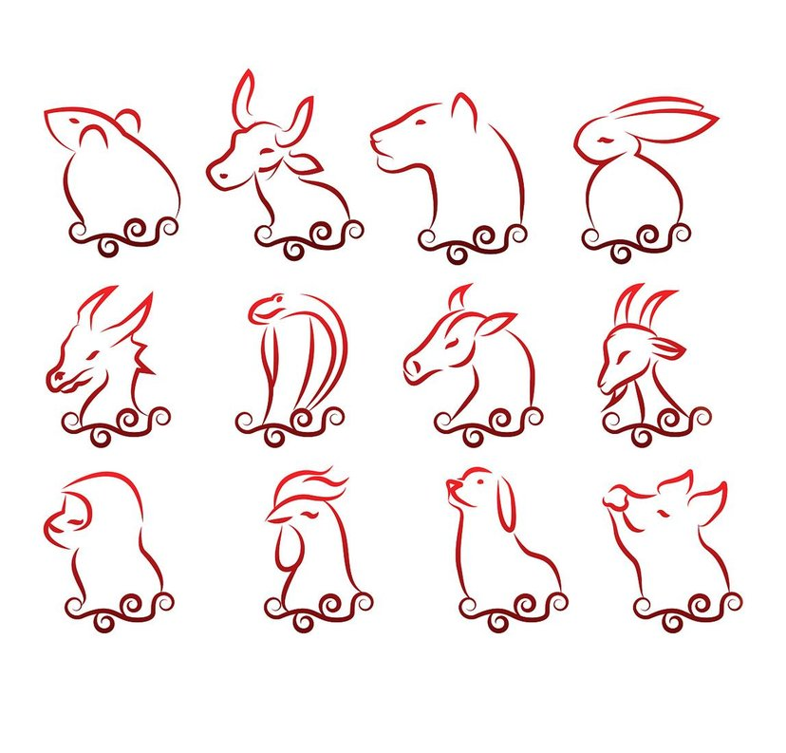
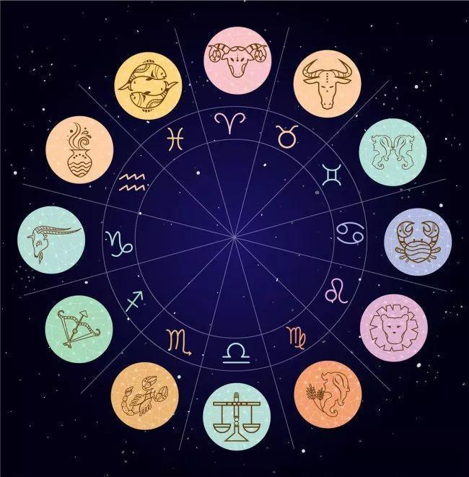
1. Chinese Zodiac
十二生肖
The zodiac is a diagram used by astrologers to represent the positions of the planets and stars. It is divided into twelve sections, each of which has its own name and symbol. The zodiac is used to try to calculate the influence of the planets on people’s lives.
The Chinese twelve animals’ signs are similar to western twelve constellations(十二星座), namely the zodiac signs, both in their functions and expressions, so we translate the “十二生肖” into Chinese zodiac.

Slide 9
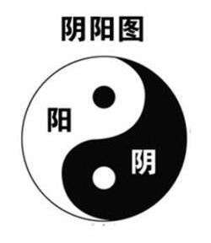
2. Yin-Yang and five elements 阴阳五行
Yin-Yang: (generally known as the two opposing principles in nature) ----an apparent transliteration foreign word(音译)
Why?
"yin" would be dark, passive, cold, contracting, downward, and weak;
"yang” would be bright, active, upward, hot, strong, and expanding.
Yin to yang and yang to yin, causing everything to happen: just as things expand and contract, temperature changes from hot to cold, and the moon waxes and wanes.
The expansiveness and abstractness of its meaning
Chinese unique cultural implication

Slide 10
2. Yin-Yang and five elements 阴阳五行
Five elements : Wood, Fire, Earth, Metal and Water
According to traditional Chinese medicine and philosophy, the Five Elements are the fundamental components of the universe.
The Five Elements theory identifies the five different modes (elements) in which chi energy (气能量) may manifest itself. The five are arranged into a cyclical sequence that represents the flow of energy between these elements as “phases”.
The five elements reflect the Chinese ancients’ thoughts about the universe and philosophy.

Slide 11
3.The Earthly Branches and Heavenly Stems
天干地支
Introduction:
It is the traditional Chinese way of timing. It derives from the trunk branches of a tree because of their orderly distribution. Ten Heavenly Stems(甲、乙、丙、丁、戊、己、庚、辛、壬、癸)match the twelve Earthly Branches(子、丑、寅、卯、辰、巳、午、未、申、酉、戌、亥)in turn, 60 pairs per cycle. In the Yin Dynasty, the inscriptions were used to record the days. Now the lunar year is still indicated by this chronology.
Translation
Version 1
The Earthly Branches and Heavenly Stems
loan translation(借译)
Version 2
sexagenary cycle
60-year cycle
free translation(意译)

Slide 12
03
Conclusion

Slide 13
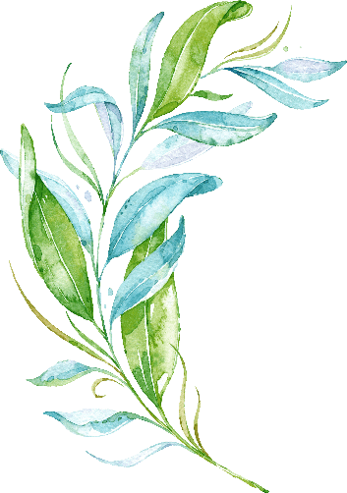

Conclusion
Chinese zodiac is a complex scheme which combines the traditional Chinese astrology in it. Based on the Five Elements theory, Yin and Yang system and Heavenly Stems and Earthly Branches system, the traditional scheme has developed a profound connotation and implications through generations. Over thousands of years, this popular culture has affected people’s major decisions in naming, marriage, giving birth and attitude towards each other. But people have to consider zodiac in a rational and scientific way. Perhaps the zodiac may help us to understand what we’re given, but it cannot determine our destiny. We should treat it as the precious cultural heritage and explore the profound culture and historical traces embodied in it.

Slide 14
Thanks

