Slide 1
Jiangxi Cuisine
赣菜
日语笔译姜佳宇Jiang Jiayu
202570081768

Slide 2
Introduction to Jiangxi cuisine
General term for Jiangxi culinary culture,
a representative southern Chinese cuisine.
The name Jiangxi is derived from JiangNanXi Canton set up by Emperor Xuanzong of Tang, and the short name Gan is associated with the Gan River--the longest river in Jiangxi Province.

Slide 3


Traditional Jiangxi Cuisine is primarily a fusion of the culinary styles from Nanchang, Shangrao, Jiujiang, Eastern Jiangxi, and Southern Jiangxi, which have integrated and absorbed characteristics from other regions within Jiangxi to create a distinct identity.
Over time, Jiangxi Cuisine has evolved to be mainly constituted by Yuzhang, Xunyang, Ganzhou, Shangrao, and Pingxiang styles.

Slide 4
History of Jiangxi Cuisine
赣菜形成的历史背景

Slide 5
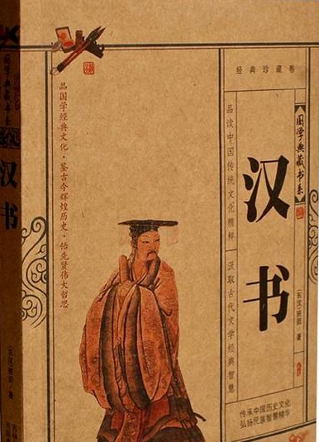
Jiangxi Cuisine has a long history, with earliest records in the Book of Han and the Book of the Later Han.
饭稻羹鱼,或火耕而水耨,果隋蠃蛤,不待贾而足
the people take rice as staple food, and fish as the secondary; they burn the wasteland for farming and hoe the weed for cultivating; the local fruits and seafood are rich enough for self-sufficiency without bargaining

Slide 6
In the early periods, due to Jiangxi's long agricultural culture, the cuisine leaned more towards rural flavors.
During the Song and Ming dynasties, as the pursuit of official positions became prevalent, a multitude of literary talents emerged from Jiangxi.

Slide 7
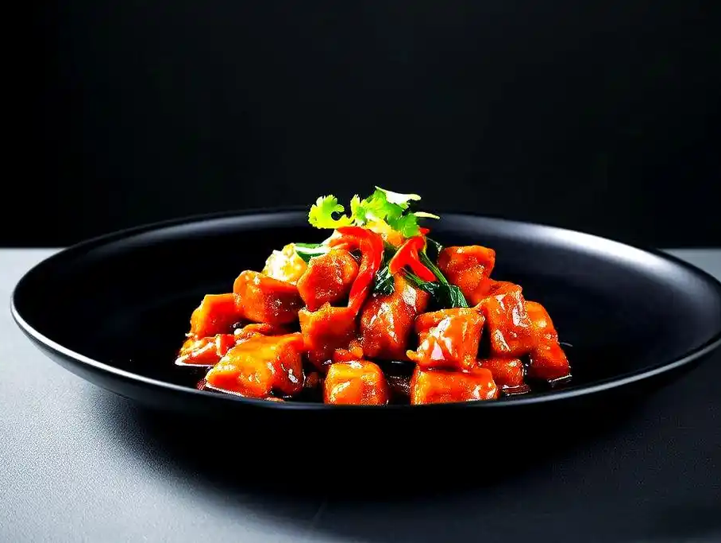
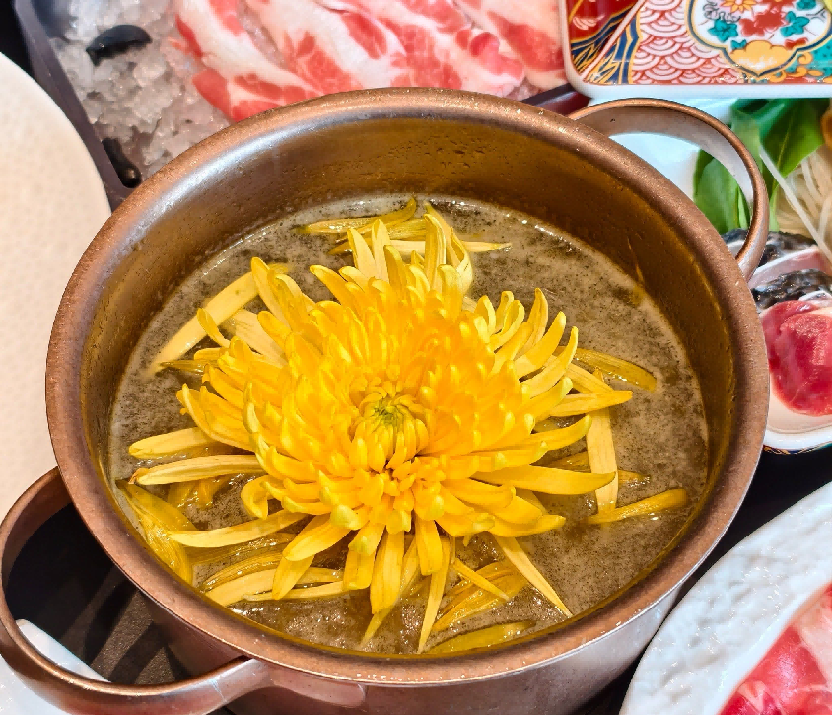
" Wenshan Diced Meat " associated with Wen Tianxiang
"Chrysanthemum Hotpot"
linked to Tao Yuanming

Slide 8
Main Features of Jiangxi Cuisine
赣菜主要特色

Slide 9
Cooking Techniques
Jiangxi Cuisine had a variety of cooking techniques such as baking, braising, stewing, steaming, and stir- frying during the Han Dynasty, also serving as the main methods.

Slide 10
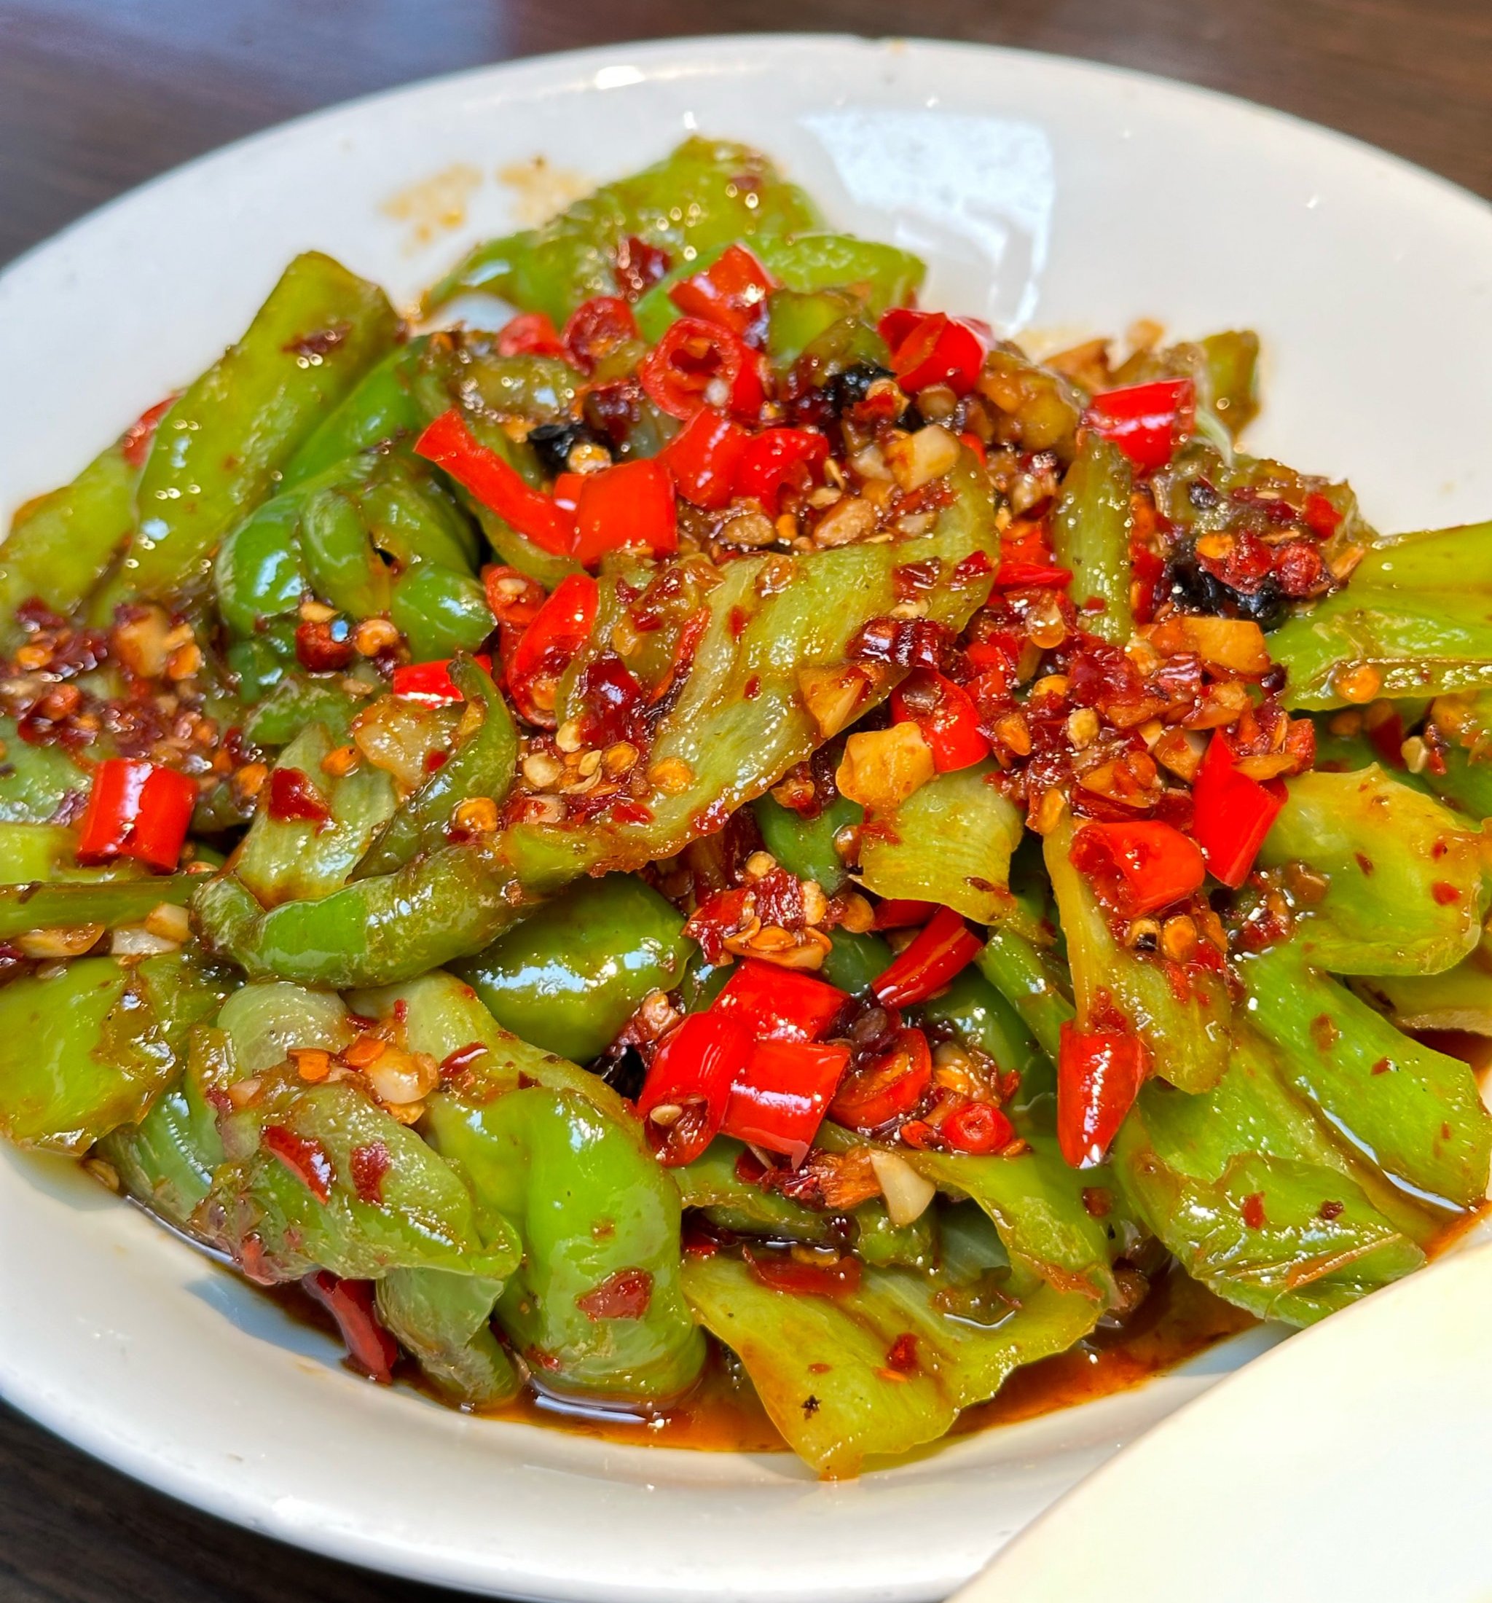
Flavor Types
Jiangxi Cuisine is known for its "spicy" flavor.
Jiangxi Cuisine's spiciness is characterized by its fragrant and fresh heat.

Slide 11
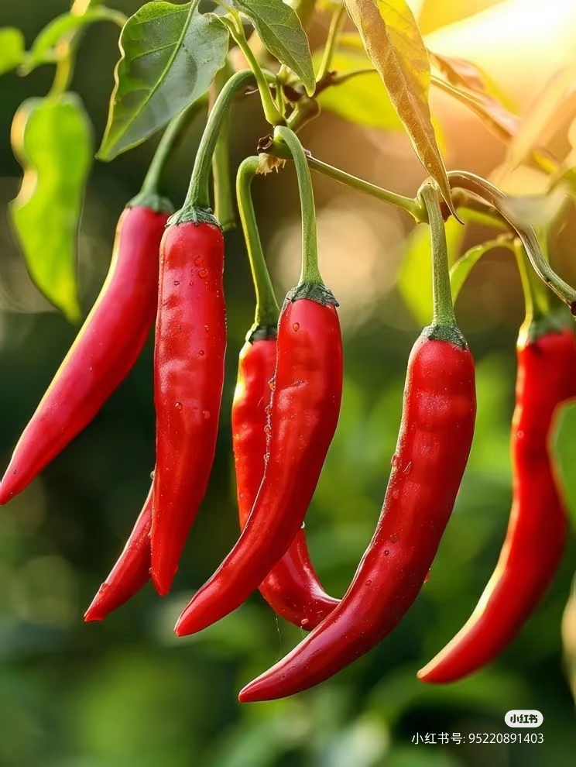
Flavor Types
The habit of eating spicy food is closely related to Jiangxi's geographical location.
Chili peppers serve to dispel cold and dampness, leading to the development of Jiangxi people's dietary habit of eating spicy food.

Slide 12
Famous Jiangxi Dishes and Snacks
赣菜名菜名点

Slide 13
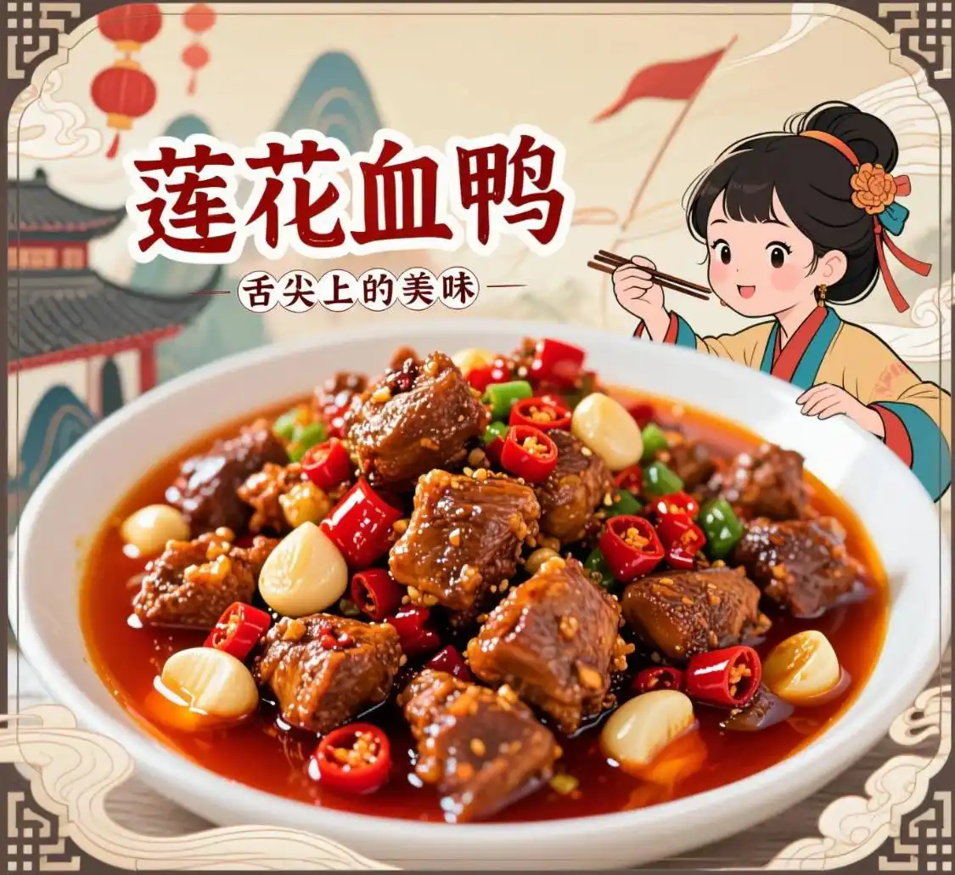
Lianhua Blood Duck
Lianhua Blood Duck is a specialty of Pingxiang, named after Lianhua County.
It is mainly made from chopped old duck and cleaned duck blood, cooked with chili and other auxiliary ingredients through stir- frying, braising, and stewing.

Slide 14
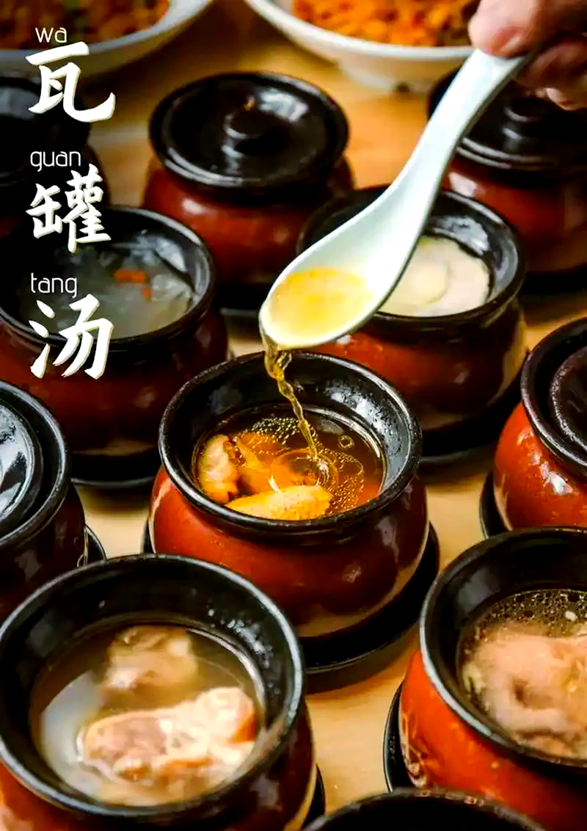
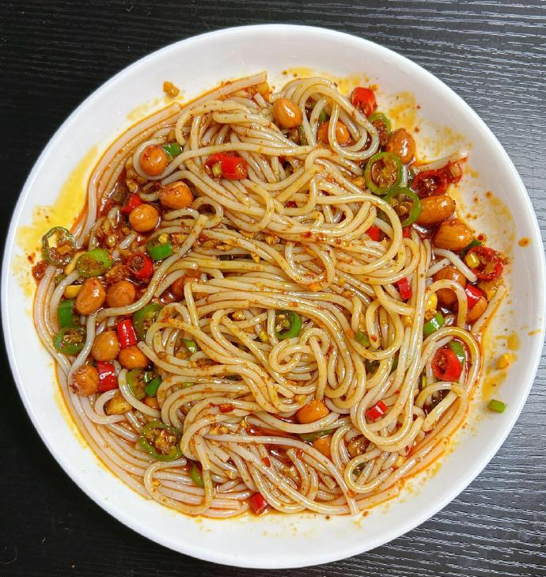
Nanchang Rice Noodles and Clay Pot Soup
perfect match
Nanchang Rice Noodles are usually made with seasonings for breakfast. Each noodle is coated with sauce, resulting in a smooth and delicious texture.
Clay pot soup is a special soup in Nanchang, with each ingredient placed individually in a small clay pot.

Slide 15
Jiangxi is rich in fish, rice, and mountain delicacies, which form the staple ingredients of Jiangxi Cuisine.
Jiangxi Cuisine has developed its unique style and gained popularity among the public.

Slide 16
内容及图片来源：百度、小红书、网易有道翻译、
中国文化课本

Slide 17
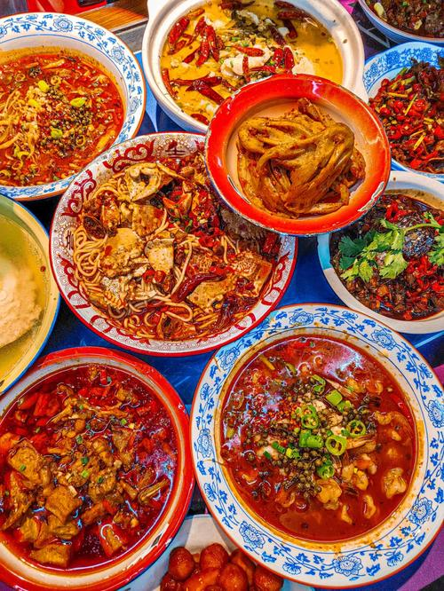
Thank You

