Slide 1

Mobile Games

Slide 2
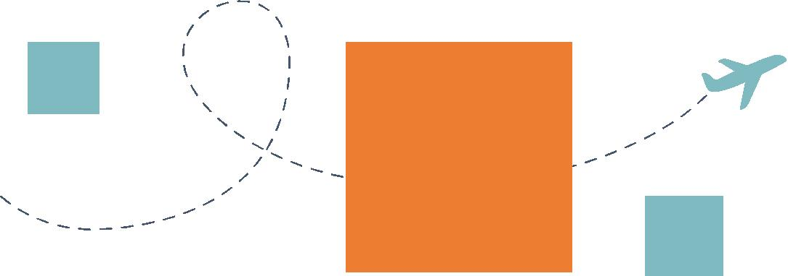



CONTENTS
01
02
03
The Early Era
The Smart Phone Era
The Socialized Era
04 The “3A” Era

Slide 3
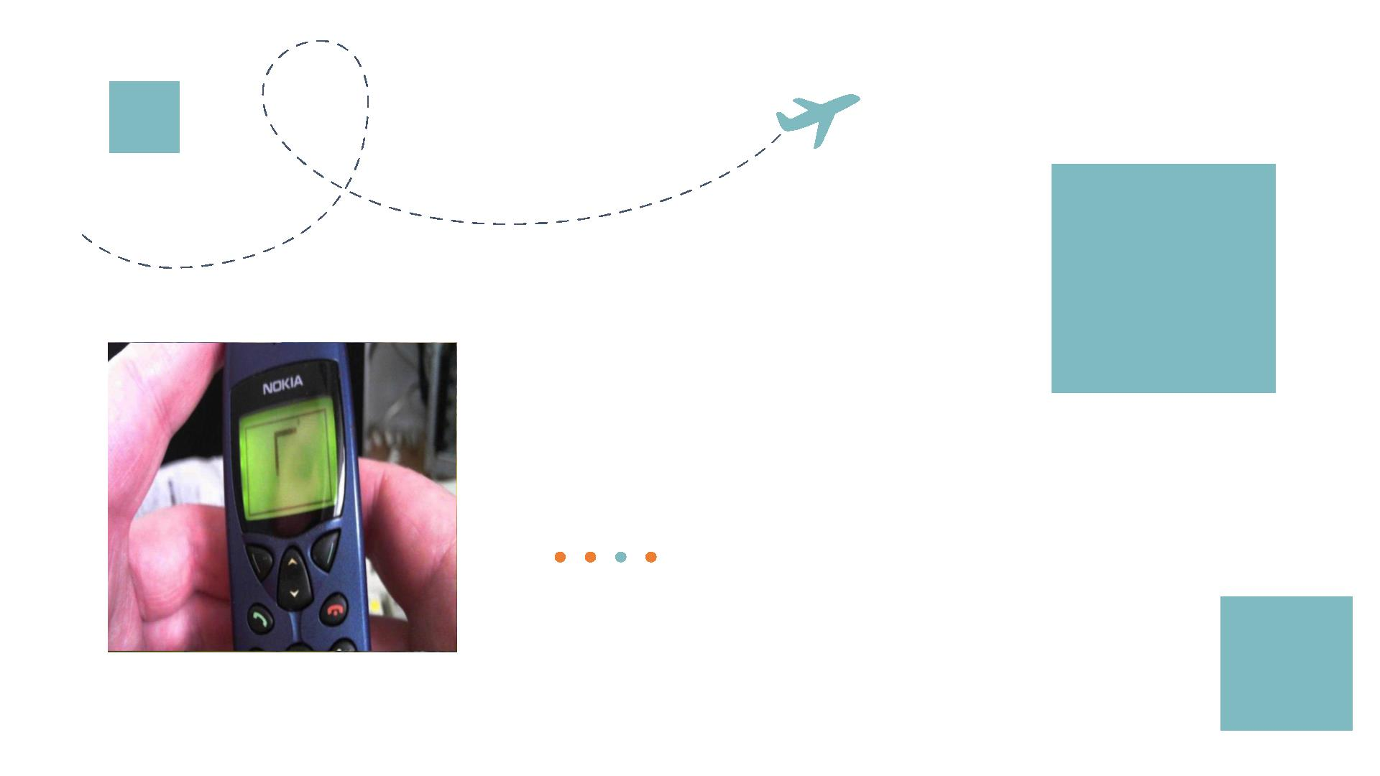
PA RT 01
The Early Era

Slide 4
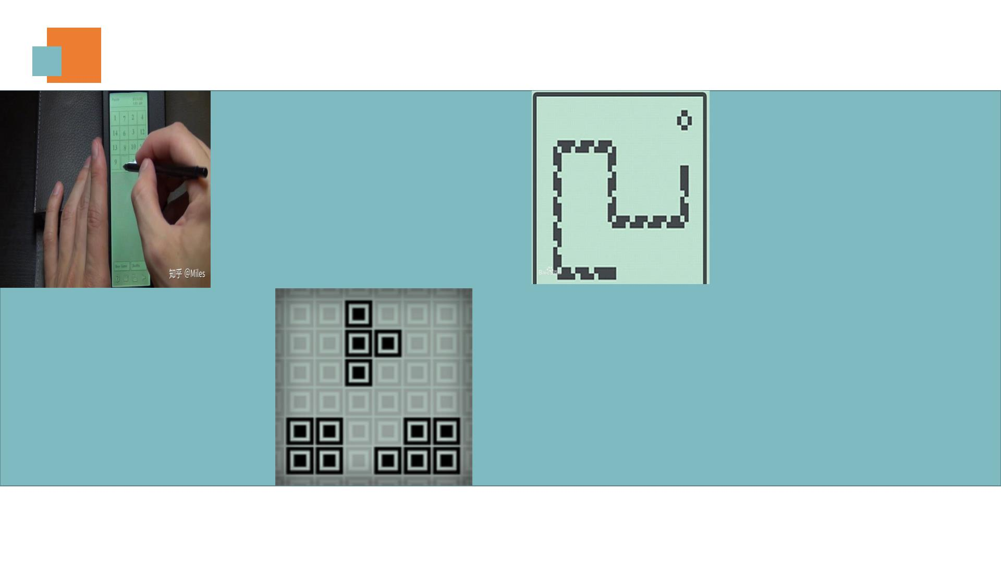
The Early Era
The Earliest Mobile Games
Limited by the technological
limitations of their era, these
earliest mobile games
Tetris
featured simple gameplay and
minimalist visuals, yet they
delivered immense joy and
entertainment to people at
that time, so they are
Scramble
Snake
milestones in the evolution of
mobile gaming.

Slide 5
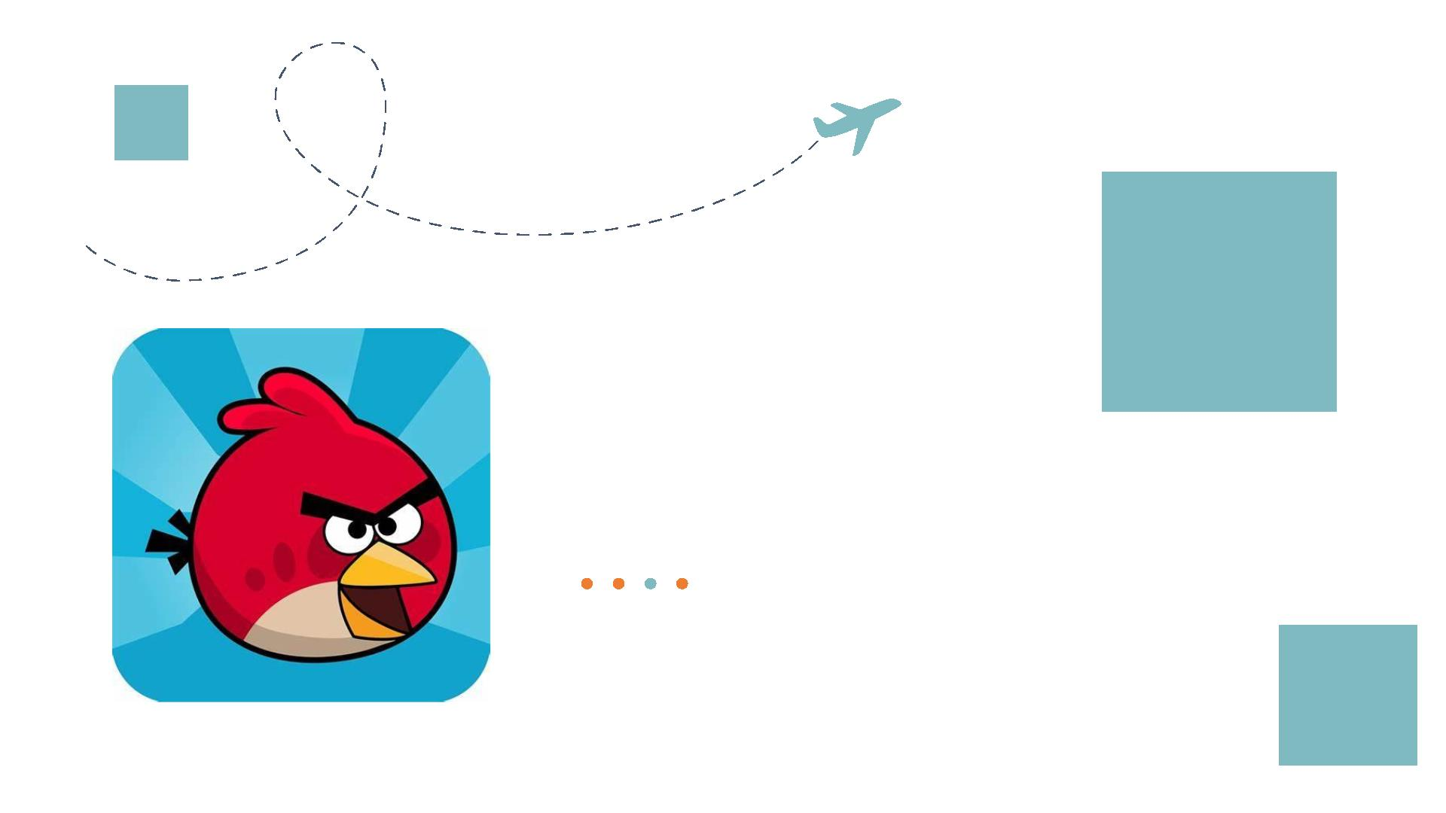
PA RT 02
The Smart Phone Era

Slide 6
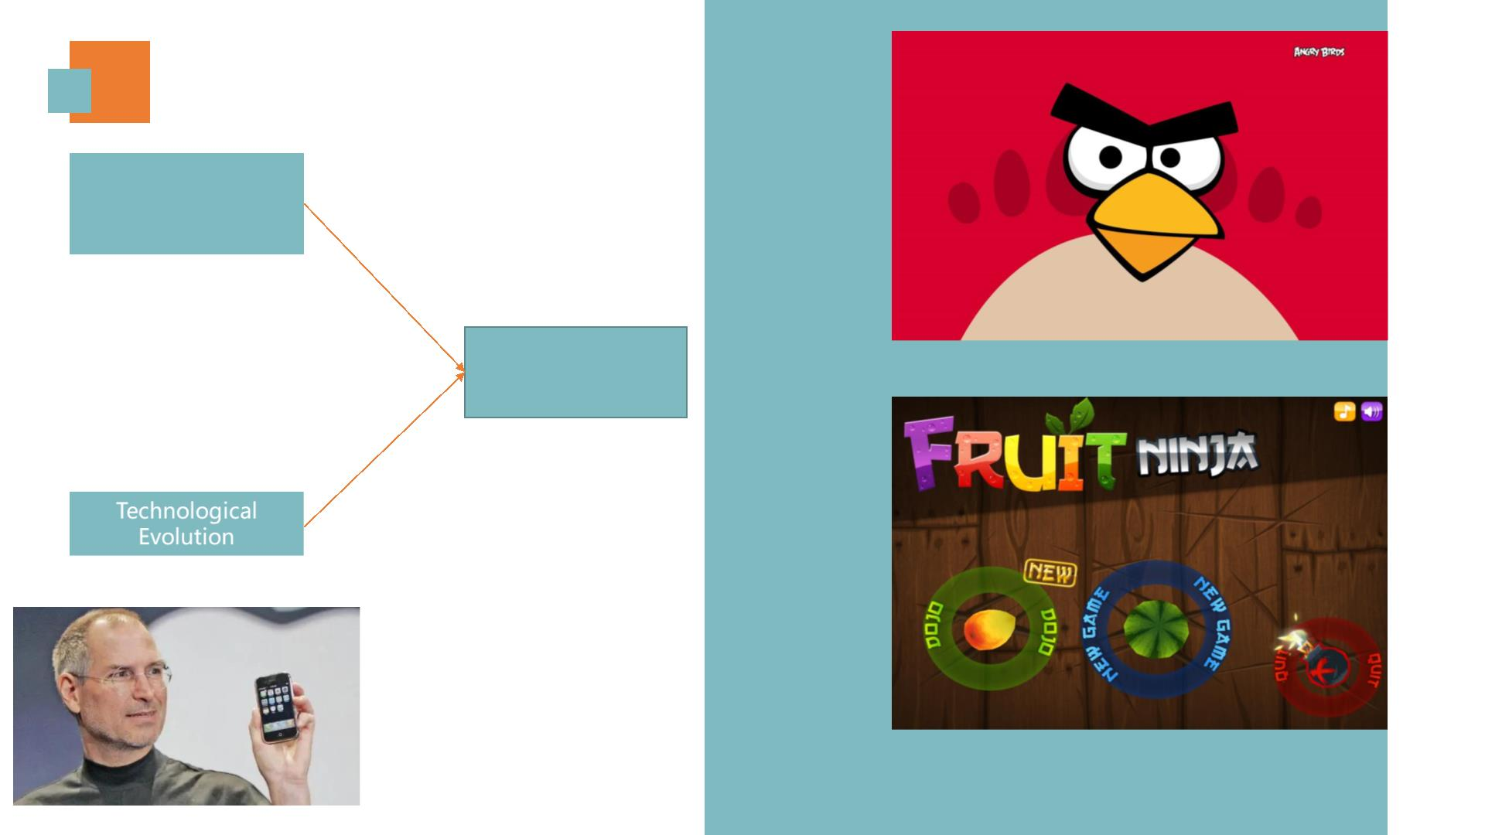
The Smart Phone Era
Angry
Birds
People‘s Increasing
Needs of
Entertainment
New Progress in
Game Design
Fruit
Ninja
The Announcement of
First iPhone

Slide 7
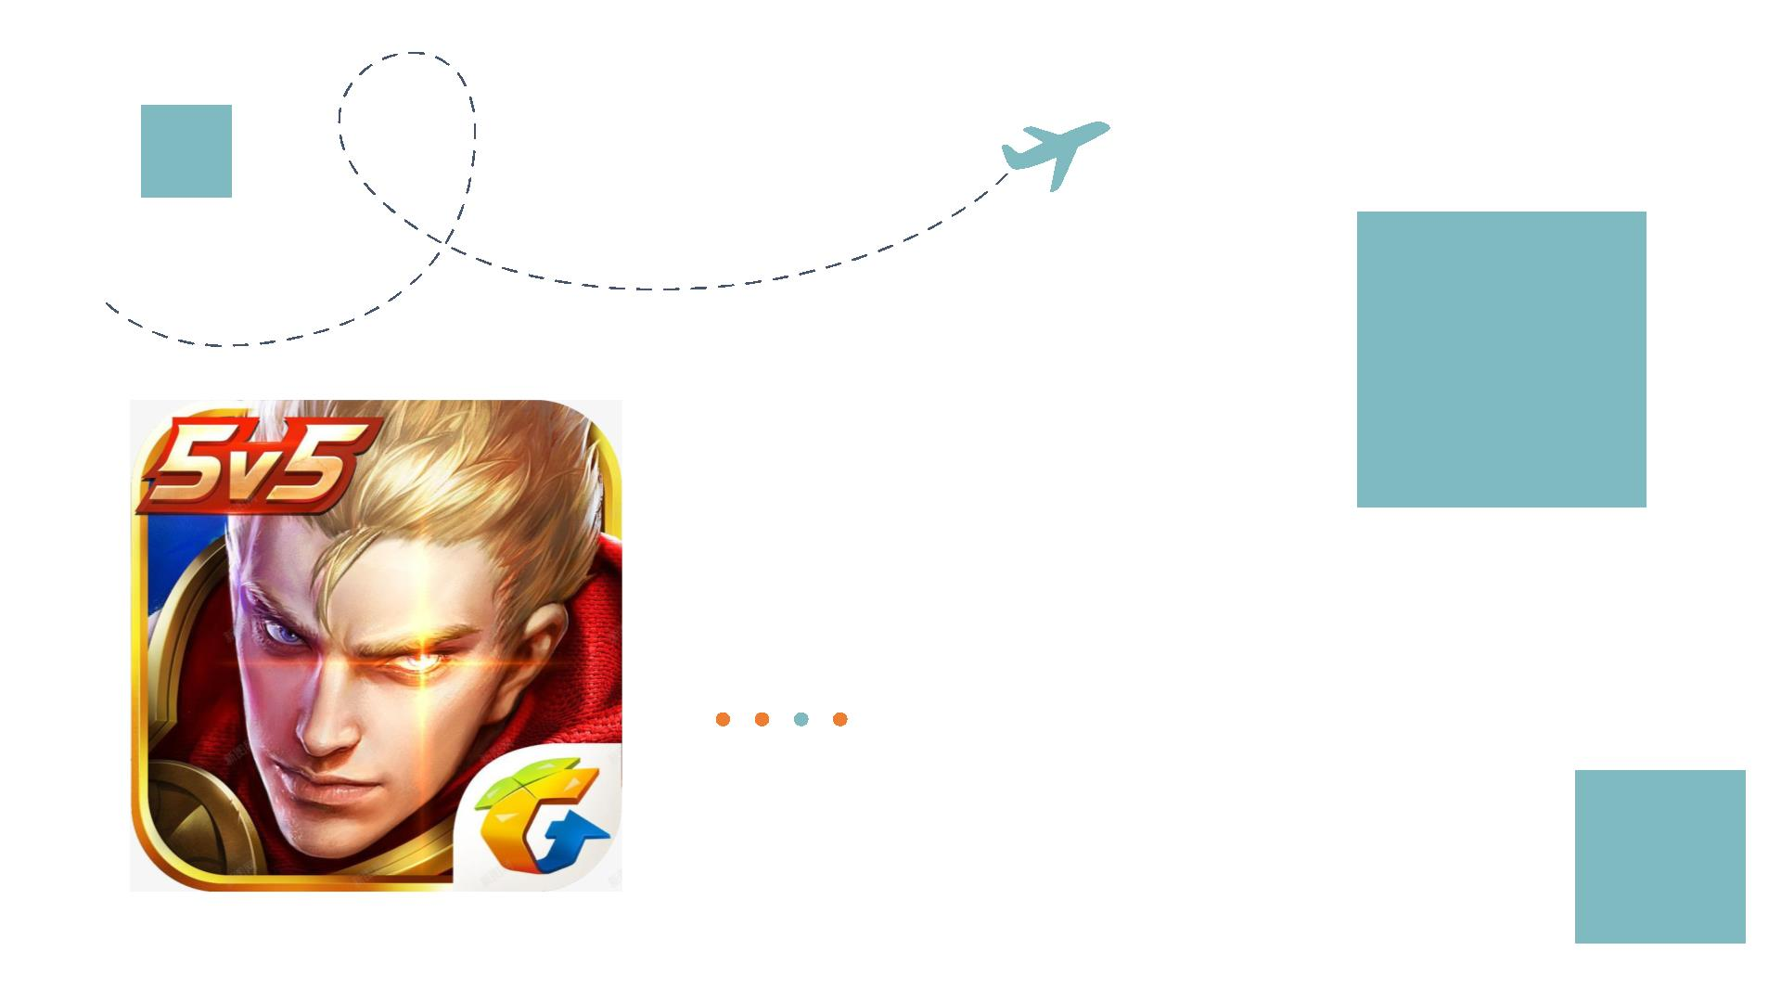
PA RT 03
The Socialized Era

Slide 8

The Socialized Era
如果有可能，
我带你去远行。
爬上那座山，
Honor of Kings
Happy Wonderland
听最圣洁的经。
PUBG Mobile
Minecraft

Slide 9
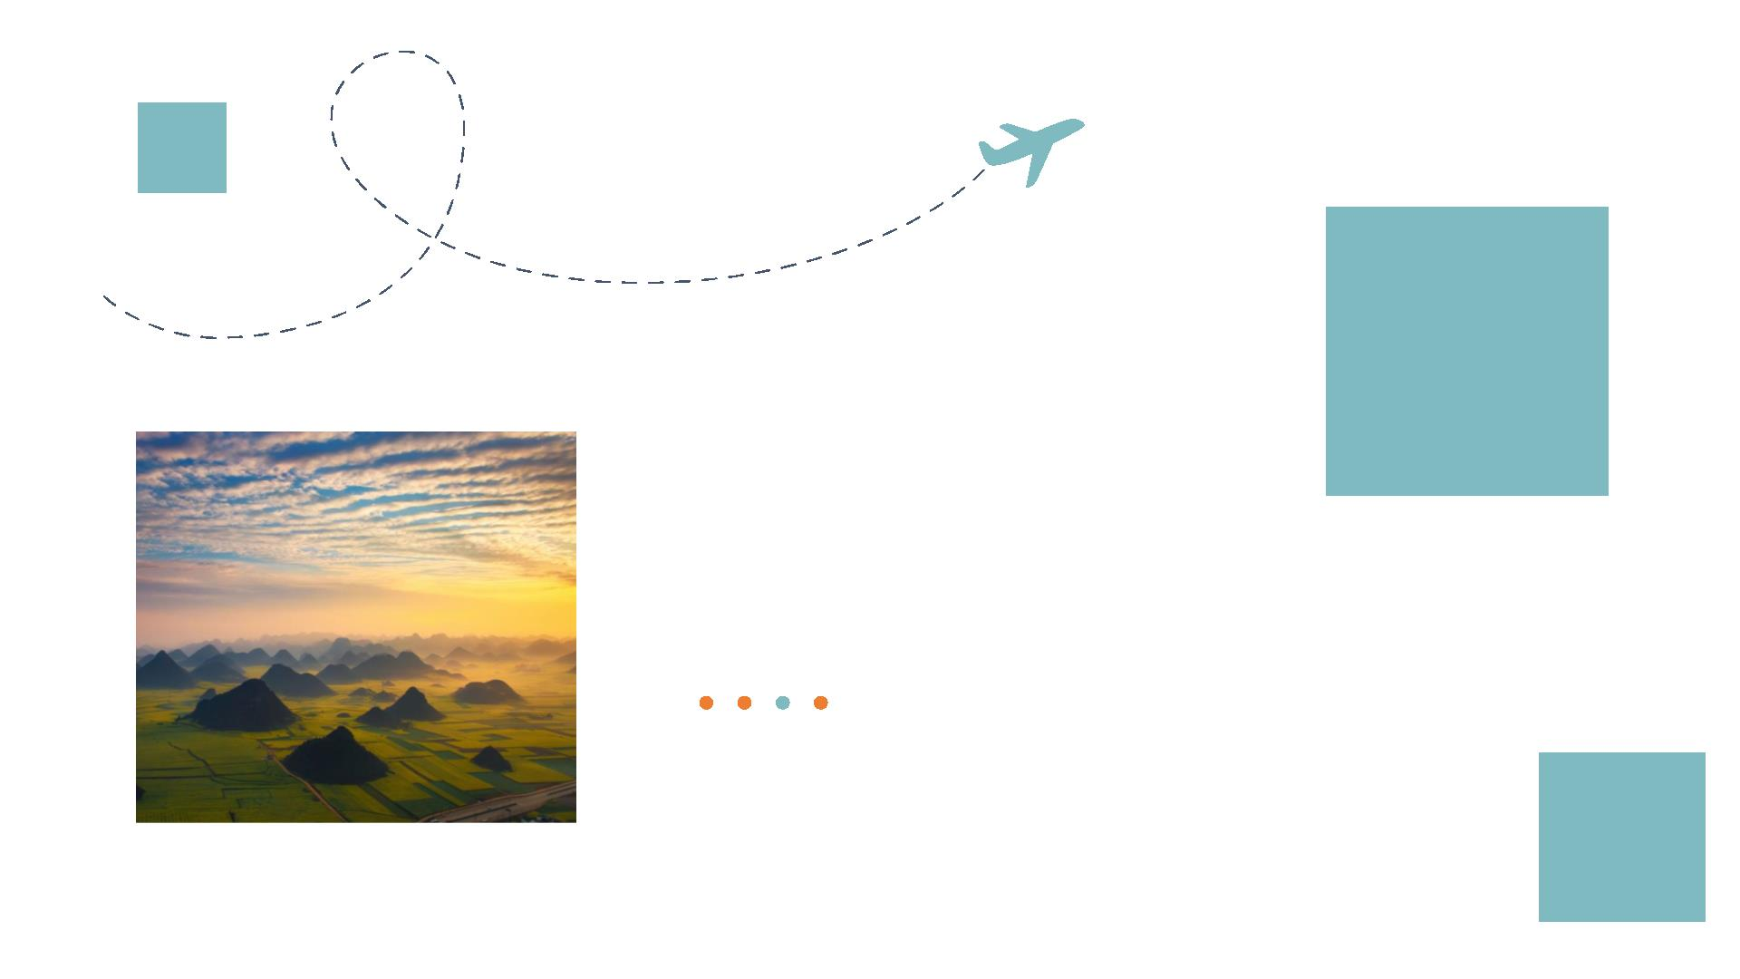
PA RT 04
The “3A” Era

Slide 10

The “3A” Era
What is “3A”?
"3A" is short for "AAA " (Triple-A),
derived from the ESA(Entertainment
Software Association )'s game rating
system, representing top-tier standards.

Slide 11
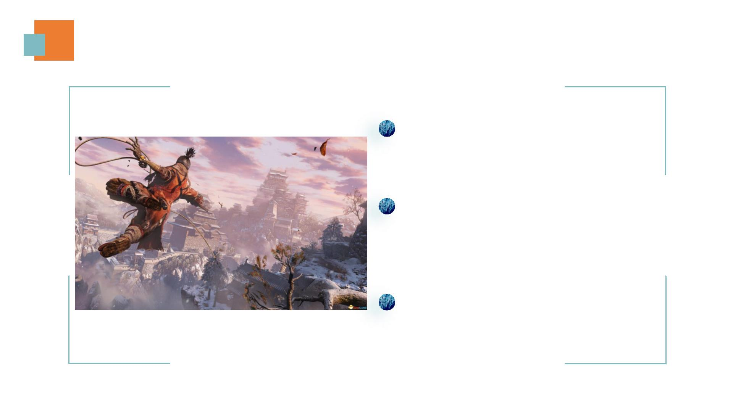
The “3A” Era
High Cost：Research and Development
budgets start at 10 million USD
High Scale：large development teams and
have long development cycles, often
spanning 3 to 7 years.
High Impact： Upon release, they can
achieve substantial commercial success and
cultural influence, often spawning multiple
film, television, and anime intellectual
property (IP) adaptations.

Slide 12

The “3A” Era
Historically, 3A standard was predominantly applied to
high-quality console games. However, an increasing number
of mobile games are now meeting AAA-level production
benchmarks.
Genshin Impact
With technological advancements, mobile
games have gradually reached AAA level
quality, featuring significantly improved visual
fidelity and increasingly diverse gameplay
mechanics, thereby catering to the varied
gaming needs of different audiences.
Honkai：
Star Rail

Slide 13

Thank you for listening

