Slide 1

Written Language: Chinese Culture of History Writing
presenter : Wu Chaoying伍超穎
English Translation

Slide 2

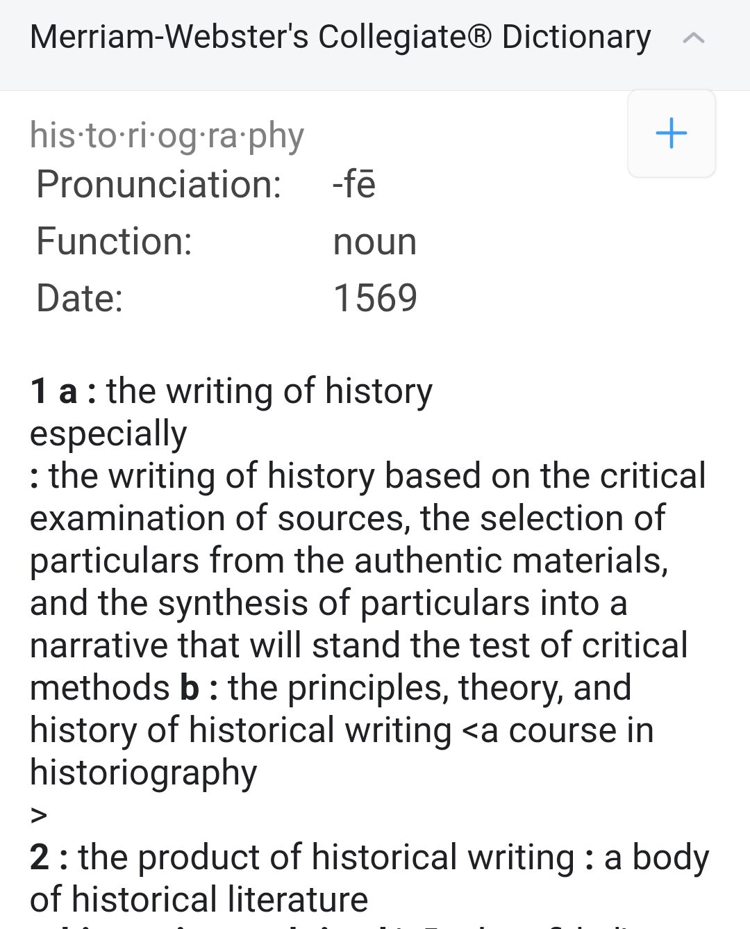
Concept
History writing
It is about how history is written, and it can also be called historiography. It accepts that history is written by people, with an interest, a certain understanding and material reference base.
VS.
History recording
Something that can be objectively written.
4

Slide 3
C
Part 1 The Emergence of History Writing
ONTENTS
目录
Part 2 The Development of History Writing
Part 3 The Modernization of History Writing

Slide 4
P
art 01
The Emergence of History Writing

Slide 5
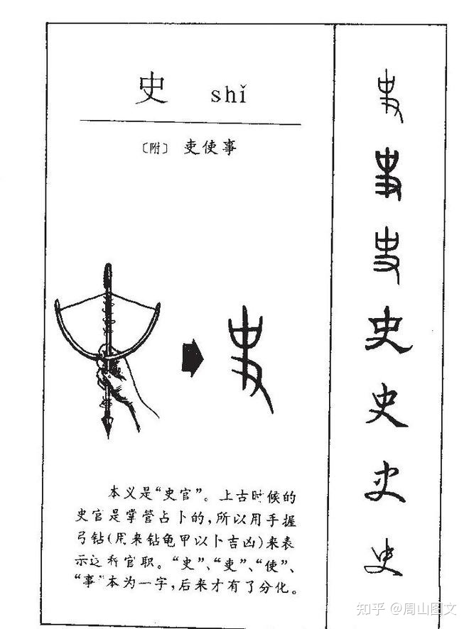
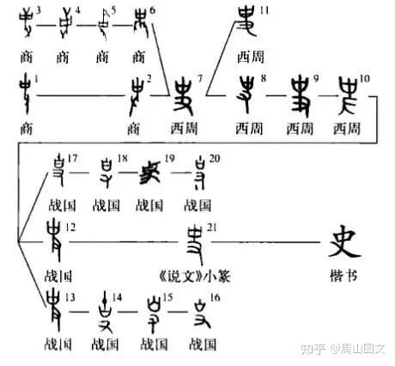
Emergence
Explanation of the character "史"（Shi）

Slide 6
Emergence
Explanation of the character "史"（Shi）
“史，记事者也。” "Shi" means a person who records facts.
——【东汉】许慎《说文解字·史》（Explanation of Script and Elucidation of Characters）
“相如顾召赵御史书曰 ‘某年月日，秦王为赵王击缶’。”
——【西汉】司马迁《史记·廉颇蔺相如列传》（Records of the Historian）
“古之王者，世有史官，君举必书，所以慎言行、昭法式也。左史记言、右史记事。”
—— 【东汉】班固《汉书·艺文志》（Book of Han）
These characters “御史”“左史”“右史”do not mean official historian; People in this position were in charge of paperwork. It was effectively the equivalent of a secretary. Gradually, however, officials in this position came to record political events on a regular basis, and although they did not have the sense to engage in history writing at that time, they unintentionally became recorders and witnesses of history, and were regarded as historians.

Slide 7
Emergence
Evoluton of function of "史"（Shi）
· “史亦巫也”，“由巫而史”——陈梦家《商人的神话与巫术》
The original function of the “史” was to observe and record natural celestial events, which originated from "巫"（Wu） and served as a medium between humans and gods.
· “沮诵、仓颉作书，并黄帝时史官。”——【战国】《世本·作篇》
Since then, paperwork had been the duty of the “史”， like a scribe.
· “夫诸侯之会...无国不记...作而不记，非圣德也。”——【春秋战国】《左传》
In the late Western Zhou and Spring and Autumn Periods, this complex and changing social situation led to a comprehensive expansion of the objects of records to real and political life, and even to the recording of history, and the development of “史” from drafting official documents and archives to compiling history books.

Slide 8
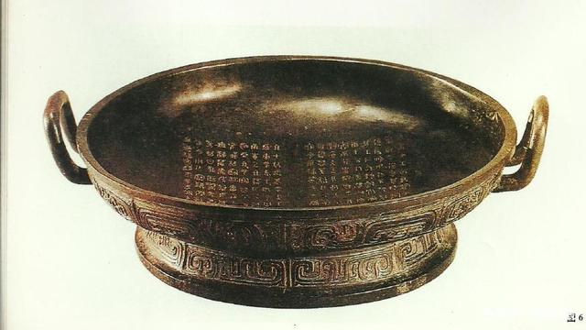
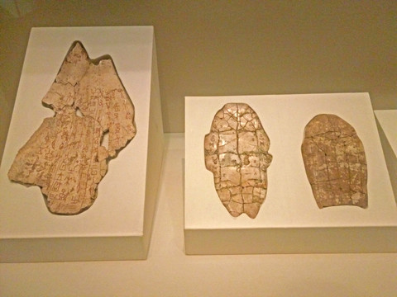
Emergence
The emergence of history writing
The recording of events in Chinese history dates back to the Shang dynasty (c. 1600–1046 BC). Many written examples survive of ceremonial inscriptions, divinations and records of family names, which were carved or painted onto tortoise shell or bones.
The first conscious attempt to record history in China may have been the inscription on the Zhou dynasty(c. 1046–256 BC) bronze Shi Qiang pan（史墙盘）.

Slide 9
P
art 02
The Development of History Writing

Slide 10
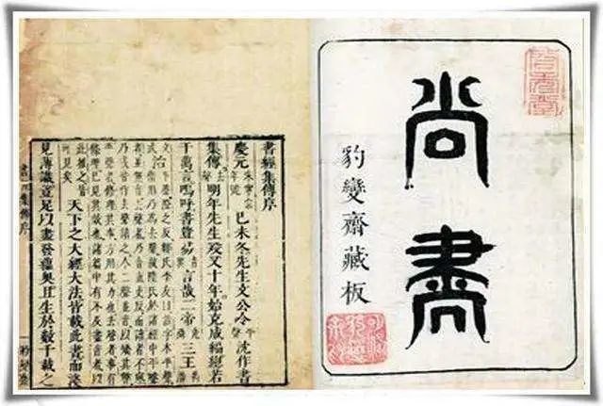
Development
The oldest surviving history texts:
Book of Documents《尚书》
It is a compilation of documents drafted by "史"（scribe）. During the Spring and Autumn Period, it was compiled by Confucius.
It is an important history text, which recorded important historical facts of the ancient times.

Slide 11
Development
Styles of history books
《春秋》(Spring and Autumn Annals)
《左传》(Zuo Qiuming’s Commentary on Spring and Autumn Annals)
《资治通鉴》(Comprehensive Mirror for Aid in Government)
编年体 This is a style of Chinese history books recorded in chronological order. The earliest surviving documents originated in China during the Spring and Autumn Period and are extremely numerous.
国别体 It is a narrative of historical events according to different states.
纪传体 This is a style of history book compilation that reflects historical events with characters as the outline and time as the supplement. Its outstanding feature is that it has a large number of biographies as its central content, which is a further combination of remembering words and events.
断代体 Its main feature is that it records history in only a certain period or dynasty.
纪事本末体 It is a style of history book that focuses on events and brings together relevant thematic materials. The first creator was Yuan Shu（袁枢） of the Southern Song Dynasty.
《国语》(Discourses of the States by Zuo Qiuming in the Spring and Autumn Period)
《战国策》(Intrigues of the Warring States by Liu Xiang in the Western Han Dynasty)
《史记》(Records of the Historian by Sima Qian in the Western Han Dynasty)
《汉书》(Book of Han by Ban Gu in the Eastern Han Dynasty)
《明史纪事本末》(The Historical events in Ming Dynasty)

Slide 12
Development
《春秋》(Spring and Autumn Annals)
《左传》(Zuo Qiuming’s Commentary on Spring and Autumn Annals)
《资治通鉴》(Comprehensive Mirror for Aid in Government)
编年体
国别体
《国语》(Discourses of the States by Zuo Qiuming in the Spring and Autumn Period)
《战国策》(Intrigues of the Warring States by Liu Xiang in the Western Han Dynasty)
Some FamousHistory books
纪传体
《史记》(Records of the Historian by Sima Qian in the Western Han Dynasty)
断代体
《汉书》(Book of Han by Ban Gu in the Eastern Han Dynasty)
纪事本末体
《明史纪事本末》(The Historical events in Ming Dynasty)

Slide 13
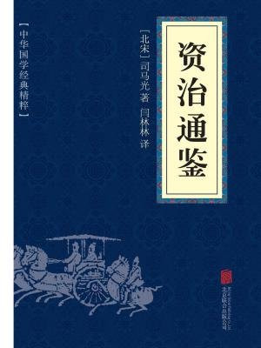
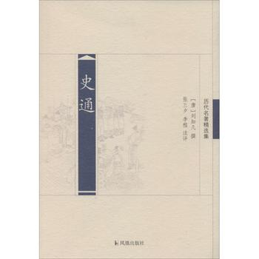
Development
Turnaround and prosperity in the development of historiography
During the glorious age of Tang Dynasty, Liu Zhiji（【唐】刘知幾 661-721年）, a distinguished historiographical critic, wrote the book Shitong《史通》, marking a higher stage of self-consciousness of historians in Chinese historiography.
The Zizhi Tongjian《资治通鉴》 was a pioneering reference work of Chinese historiography. Sima Guang（【北宋】司马光 1019-1086年） was appointed to compile it. It revived the annals and represents the height of prosperity of the historiography in Song Dynasty.

Slide 14
P
art 03
The Modernization of History Writing

Slide 15
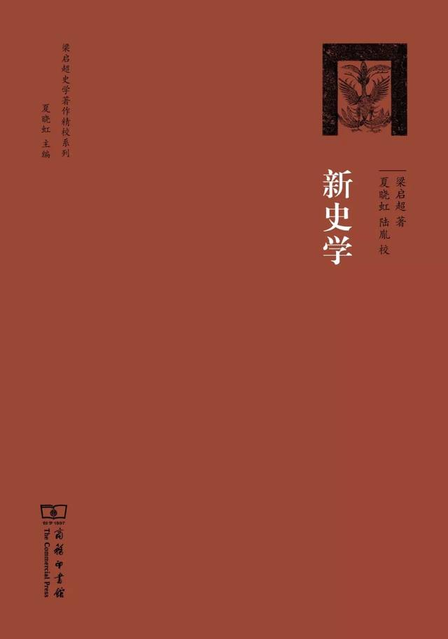
Modernization
Marking the transformation of modern historiography：
The advent of Liang Qichao's New Historiography（梁启超《新史学》）
At the beginning of the 20th century, Liang Qichao set out to revolutionize historiography and published the New Historiography consisting of six essays.
World history
Chinese history

Slide 16




Modernization
Adopting the scientific approach in Chinese historiography
Gu Jiegang and “古史辨学派” that studies history by means of testimony and dialectics.
Wang Guowei、Chen Yinke and “考证学派” that proves traditional historical texts by archaeological materials.
Fu Sinian and “中国兰克学派”、
He Bingsong and “中国鲁滨逊新史学学派”，which works on importing Western historiography and promoting the innovation of historical concepts and methodology.
Li Dazhao、Guo Moruo and “中国马克思主义史学流派” that analyzes Chinese history with Historical Materialism.

Slide 17
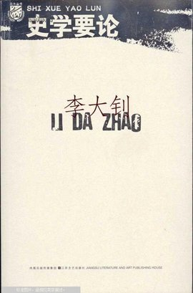
Modernization
Adopting the scientific approach in Chinese historiography
Li Dazhao（李大钊）’s Shi Xue Yao Lun (《史学要论》）
was the first work in China that elaborated the theory of historical materialism and combined it with some specific historical work, a work that opened the way for Marxist historiography in China.

Slide 18
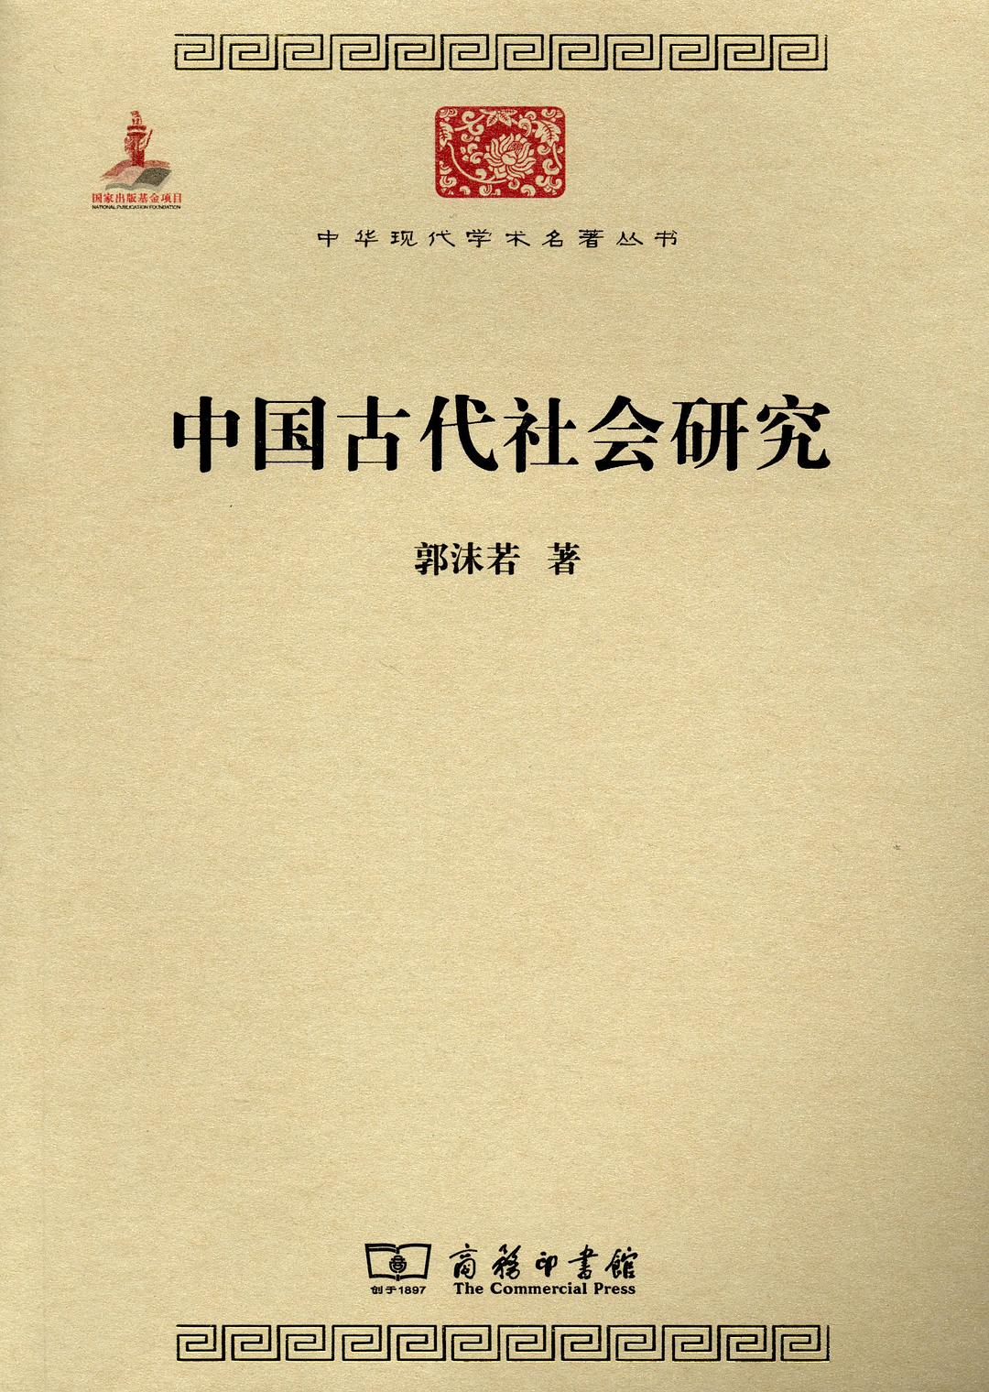
Modernization
Adopting the scientific approach in Chinese historiography
Guo Moruo（郭沫若） pioneered the scientific path of applying Marxist theory to the study of Chinese history.
Study on Ancient Chinese Society （中国古代社会研究）(1930) was the first work by Chinese historians to apply Marxist theory to the systematic exposition of Chinese history.

Slide 19
References
[1] David N. Keightley, "Art, Ancestors, and the Origins of Writing in China", Representations, No. 56, Special Issue: The New Erudition. (Autumn, 1996), pp.68–95 (68).
[2] Naito Konan, History of Chinese Historiography.Shanghai Ancient Books Press.1997.
[3] William G. Boltz, Early Chinese Writing, World Archaeology, Vol. 17, No. 3, Early Writing Systems. (Feb., 1986), pp. 420–436 (436).
[4] Shaughnessy, Edward L. (1991). Sources of Western Zhou History. Berkeley: University of California Press.
[5] 白寿彝，《中国史学史》.北京：北京师范大学出版社.2004.
[6] 陈梦家，《商人的神话与巫术》.《燕京学报》第20期.
[7] 杜维运，《中国史学史》第1册. 上海：商务印书馆.2010.
[8] 瞿林东，《中国简明史学史》. 上海：上海人民出版社.2005.
[9] 谢贵安，《中国史学史》. 武汉：武汉大学出版社.2012.

Slide 20


Question and Thinking
[1]《贞观政要》：“以古为镜，可以知兴替。”
(With history as a mirror, one can know the ups and downs of history.)
[2] Of Studies ，“Histories make men wise.”(读史使人明智。)
What is the significance of learning historiography?
· Methodology
Critical thinking
· Knowledge
Gaining experience
Law of historical development
· Emotional Signficance
Cultural confidence
Patriotism & national spirit
......

Slide 21
THANKS
致谢
presenter : Wu Chaoying伍超穎
English Translation

