Slide 1
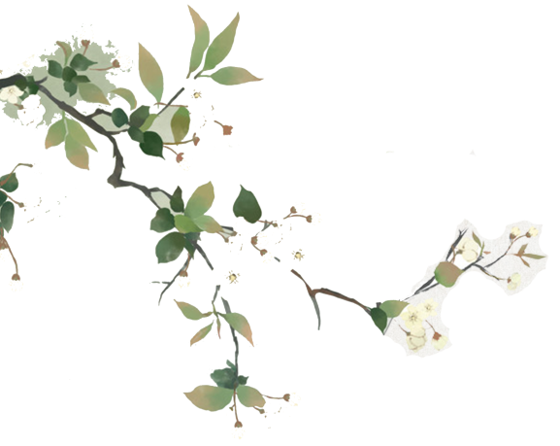


中国经典在西方
Chinese Classics in the West
汇报人：黄琼

Slide 2
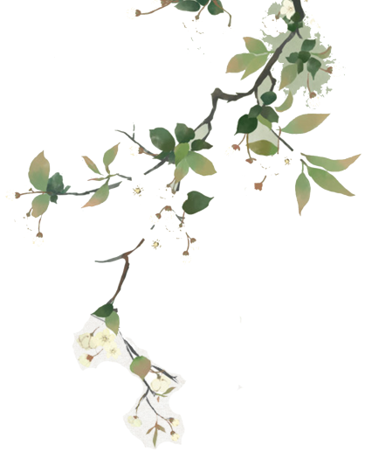


目录
Contents
1
England
2
France
3
Germany
4
Other countries

Slide 3


PART.01
England

Slide 4
In the 19th century, the translation and dissemination of Chinese literature in Britain were completed by missionaries. During this period, the translation and introduction of novels were fragmented and there were many abridged translations. They translate many Chinese novels on different subjects. In 1812, British missionary Robert Morrison translated Sou Shenji（《搜神记》）.
In the 20th century, there appeared many Sinologists in Britain, such as Hawkes and Waley, who made great contributions to the spread of Chinese literature. Clement Egerton translated The Golden Lotus《金瓶梅》. Hawkes translated A Dream of Red Mansions. But the English translation of Water Margin and The Scholars is relatively backward.
The translation, introduction and dissemination of Chinese modern and contemporary novels in Britain are not ideal as a whole, which is consistent with the dissemination and acceptance of modern and contemporary novels abroad. The translation and introduction of modern and contemporary novels are mainly governmental and some folk activities in China, and some Sinologists abroad are engaged in the translation and introduction of modern and contemporary novels.

Slide 5
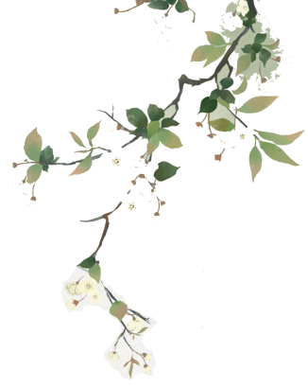


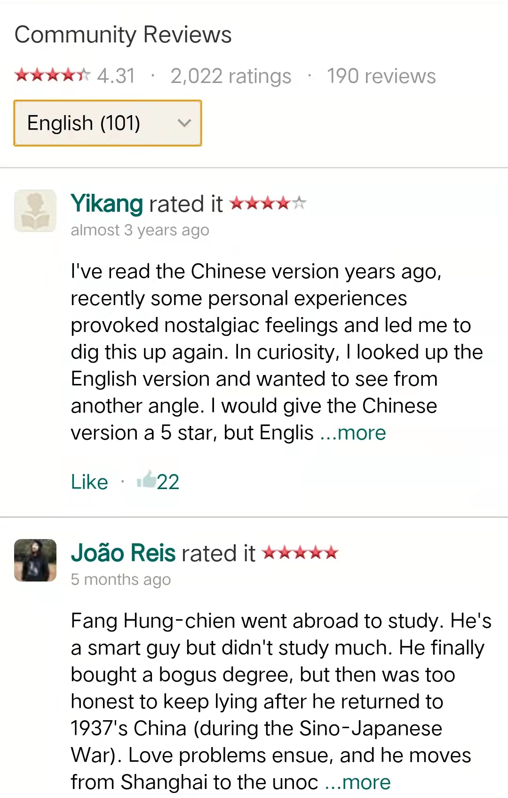


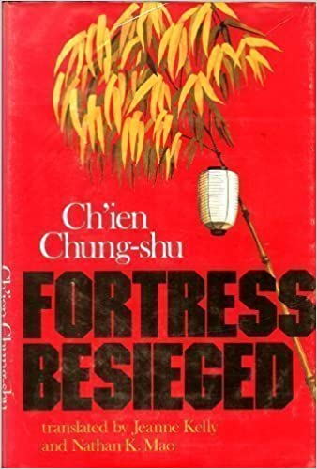
《围城》 Fortress Besieged
1974 Jeanne Kelly
Renditions
First chapter
2004 New Directions
1979 Jeanne Kelly and Nathan K. Mao
Indiana University Press
The first foreign text：Fortress Besieged
2004 Penguin Modern Classics
（Yu 2020 ）

Slide 6
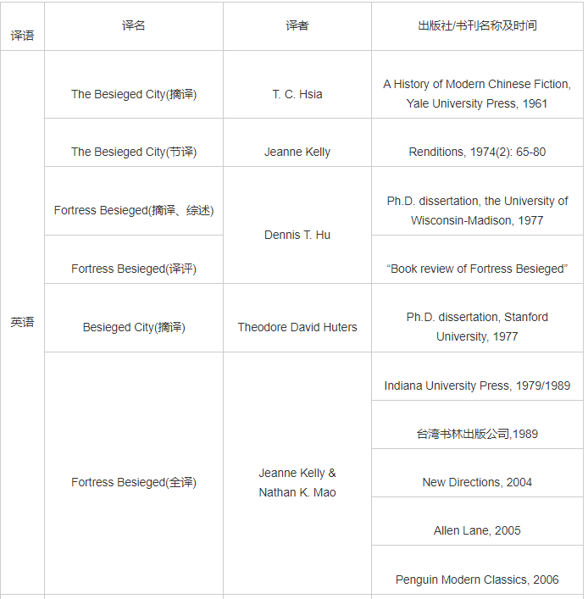
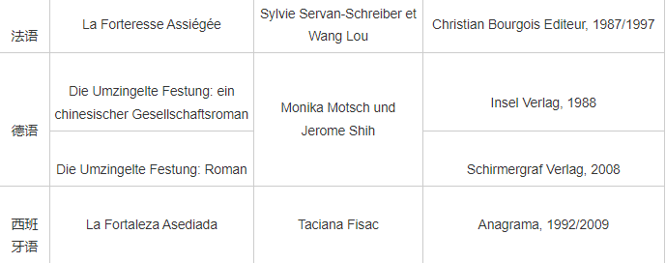

Slide 7
PART.02
France

Slide 8
France
Due to the French tradition to import literature from the African colonies, they are more open to minor kinds of literature. Publishing houses in France are independent and proud to present their readers not so well-known and even exotic authors and works they have scouted themselves.
There are short story collections, poetry collections, prose collections, mostly novels, with lu Xun, Lao She, and Ba Jin being the most popular translations. The Analects of Confucius and other Confucian works（La Optimism de Confucius, Philosophe de La China）were first published in French in 1688 in Paris. In 2015, the complete French translation of Shiji was published in Paris and aroused a strong response in western academic circles. Camel Xiangzi by Lao She has been published in three different translations in France since the first French translation was published in the 1940s.
Yu Hua, Mo Yan, Su Tong, Wang Meng, Wang Shuo, Zhang Xinxin, and other writers’ works have been translated.

Slide 9





France
YU Hua
As one of the most influential contemporary Chinese writers, Yu Hua has also caught the attention of the Western world, with his works translated and awarded in many countries, especially his novel Brothers. "Brothers" is Yu Hua's seventh book published in France
Actes Sud
第七天 2014
Isabelle Rabut（南方书编“中国文学”丛书的主编何碧玉）/Angel Pino
十个词汇里的中国
2010 Isabelle Rabut (Translator), Angel Pino (Translator)
兄弟 2008
Yu Hua (Author), Angel Pino (Translator), Isabelle Rabut (Translator)
Hang 2010
许三观卖血记 1997 Actes Sud
PPT模板 http://www.1ppt.com/moban/

Slide 10
Germany
Germany is a very open literature market. It has a huge part of foreign literature.
There is a growing interest in China, which comes from the economical interactions. A lot of German expats grab a book of Chinese literature because they want to get more familiar with the culture they work in. There is a growing community of Germans who enjoy reading Chinese novels.
Chinese literature in Germany is not representative of Chinese literature in China. There are different reasons for it: One is that the presses decide out of economical reasons themselves which literature seems to have a market in Germany. Another reason is that especially dissident and exiled authors are welcomed abroad, compared to a censored book market in China.
Cao Xueqin Red Chamber Dreams still are considered most important. They are announced by German media as ranking 4th in the eternal global bestseller list.
Tang poetry, modern novels, contemporary novels and contemporary poetry are highly valued in Germany. Especially thanks to the efforts of the retired German sinologist Wolfgang Kubin.

Slide 11


Other countries
Spain(148 works and 130writers)
1. La gnosis taoísta del Tao Te Ching《道德经的真知》 Carmelo Elorduy 1961
2. La Vida y la Muerte Me Están Desgastando（ Life and Death Are Wearing Me Out ）Carlos Ossés (Translator)
Kailas Editorial 2009
（Lan，2020）
Netherlands
More and more contemporary Chinese literary works have been translated directly into Dutch, such as contemporary writers Zhang Jie, Zhang Xianliang, Su Tong and so on.
<= 4-5 books a year
（Yi， 2021）
Italy(Children's Literature and science fictions)

Slide 12
Conclusion
In addition to some very famous Classical Chinese literature, in the dissemination of contemporary Chinese literature, many countries like to translate the works of some writers that are not well-known in China, such as Zhang Xianliang, Mian Mian, etc. Chinese literary classics from the western perspective are different from what Chinese people think, which makes up for the defects of Chinese perspective.
The distribution of translation for foreign languages is uneven, with more French translations. So other countries might take the French translation as a reference to translate it into Dutch, Spanish, and so on.
In the past 20 years, the number of Chinese contemporary literary works translated into English has been increasing steadily, but there are almost no sensational works. Chinese literature has little influence in the West due to many unfavorable factors such as history, society, and culture.

Slide 13
References
耿强. 文学译介与中国文学“走向世界”[D].上海外国语大学,2010.
郑晔. 国家机构赞助下中国文学的对外译介[D].上海外国语大学,2012.
赵征军. 中国戏剧典籍译介研究[D].上海外国语大学,2013.
鲍晓英.从莫言英译作品译介效果看中国文学“走出去”[J].中国翻译,2015,36(01):13-17+126.
高方,许钧.现状、问题与建议—─关于中国文学走出去的思考[J].中国翻译,2010,31(06):5-9+92.
余承法.《围城》海外旅行70年[J].外语学刊,2018(01):116-121.
余承法.失衡的境外“钱学”研究70年(1948—2018)[J].北方工业大学学报,2020,32(06):70-79.
李永东,李雅博.论中国新时期文学的西方接受——以英语视界中的《狼图腾》为例[J].中国现代文学研究丛刊,2011(04):79-89.
杭零,许钧.《兄弟》的不同诠释与接受——余华在法兰西文化语境中的译介[J].文艺争鸣,2010(07):131-137.
高方.从翻译批评看中国现代文学在法国的译介与接受[J].外语教学,2009,30(01):99-103.
周婷.中国现当代文学在意大利的译介出版研究[J].出版广角,2020(05):41-43.
刘敏,曾丽雯.中国文学在荷兰语境中的接受[J].深圳大学学报(人文社会科学版),2009,26(03):11-14.
蓝博.中国现当代文学在西班牙的译介研究[J].对外传播,2020(12):43-47.
易彬,林恪.中西文学的差异主要还是文学传统的不同——荷兰汉学家林恪先生访谈[J].中国当代文学研究,2021(03):214-219.

Slide 14



