Slide 1

中国文化概要
Introduction to Chinese Culture for Bachelor Students of Translation Studies
湖南师范大学 2023年3月2日-2023年3月31日
中国文化基础 周五上午8:00-9:40,604教室；第4-7周，上课时间：周一上午8:00-9:40，周三13:00-14:20；周五13:00-14:20，均在602教室。
助教：
吴漠汀特聘教授 Distinguished Professor Dr. Martin Woesler
湖南师范大学外国学院 Foreign Studies College, Hunan Normal University

Slide 2
 | Topic | %
1 | Beverages: Milk Tea | 76%
2 | Traditional Cuisine: Hotpot | 76%
3 | Traditional and Modern Views on Marriage and Love | 75%
4 | Aesthetic ideals and social customs: Chinese Marriage Customs | 73%
5 | Aesthetic ideals and social customs: The Four Most Handsome Men in Ancient China | 72%
6 | Facial Make-up | 72%
7 | Education: Historical Figures, The Four Talented Women of Ancient China | 71%
8 | Facial Make-up: Cosmetics, Traditional Chinese Make-Up | 70%
9 | Science and Technology: Douyin (Tik Tok) | 70%
10 | Traditional Cuisine: The Art of Chinese Cooking | 70%
11 | Literature: Ancient literature: Chinese Mythology | 68%
12 | Traditional Cuisine: Two Famous Dishes | 67%
13 | Chinese Movies | 67%
14 | Literature: Ancient literature: Chinese Classical Fairy Tales | 66%
15 | Animals: Panda | 65%
16 | Traditional Cuisine: Breakfast Culture of Wuhan | 65%
17 | Science and Technology: Buytogether (PDD) | 65%
18 | Science and Technology: Taobao (淘宝) | 64%
19 | Clothing: Chinese Clothing | 63%
20 | Gender: Wu Zetian: The Only Female Emperor of Imperial China | 63%
21 | Beverages: Tea | 62%
22 | Mythology: Huli-jing | 62%
23 | Architecture: Fengshui in Chinese Architecture | 61%
24 | Silk and porcelain: Celadon and Celadon Song 《青花瓷》歌词 | 61%
25 | Mythology: Gods and Immortals | 60%
26 | Traditional Cuisine: Eight Major Cuisines of China | 60%
27 | Traditional Cuisine: Four Distinct Regional Cuisines | 59%
28 | Aesthetic ideals and social customs: Habits, Ways of Contacting | 58%
29 | Architecture: The Forbidden City | 58%
30 | Money culture: The tradition of Red Envelope and Lucky Money | 58%
31 | Stage entertainment: Crosstalk 相声 | 58%
32 | Traditional Cuisine: Tanghulu, Sugar-coated Haws on a Stick | 58%
33 | Fine Arts: Painting | 57%
34 | Games: Kite Flying | 57%
35 | Traditional Festivals: Spring Festival Couplets | 57%
36 | Traditional Cuisine: Jiaozi | 57%
37 | Astrology: Chinese Astrology | 56%
38 | Literature: Ancient Literature: The Classic of Mountains and Seas | 56%
39 | Social: Round Table Culture | 56%
40 | Science and Technology: Mobile Games (手游) | 56%
41 | Clothing: Cheongsam | 55%
42 | Literature: Ancient literature: Four Folk Stories of Ancient China | 55%
43 | Traditional Festivals | 55%
44 | Astrology: Twelve Animals of the Chinese Zodiac | 54%
45 | Beverages: The Liquor Culture of Ancient China | 54%
46 | Language: Chinese Dialects | 54%
47 | Traditional Cuisine: Tangyuan | 54%
48 | Chinese Economy: rich businessmen | 54%
49 | Aesthetic ideals and social customs: The Culture of Flowers | 54%
50 | National Belief: the Chinese Dream | 54%
51 | Facial Make-up: Face Changing in Sichuan Opera | 53%
52 | Fine Arts: Seal-cutting | 53%
53 | Games: Mahjong: An Ancient Chinese card play | 53%
54 | Worship: Chinese Incense Culture | 53%
55 | Party Culture (celebretations) | 53%
56 | Entertainment: Deyunshe 德云社 | 53%
57 | Clothing: Vintage Clothing | 53%
58 | Garden Culture: Gardens | 52%
59 | Literature: Ancient Literature - Four satirical novels in ancient China | 52%
60 | Literature: Premodern literature - Li Bai's “The River-Merchant's Wife: A Letter” and its translations | 52%
 | Topic | %
1 | Beverages: Milk Tea | 76%
2 | Traditional Cuisine: Hotpot | 76%
3 | Traditional and Modern Views on Marriage and Love | 75%
4 | Aesthetic ideals and social customs: Chinese Marriage Customs | 73%
5 | Aesthetic ideals and social customs: The Four Most Handsome Men in Ancient China | 72%
6 | Facial Make-up | 72%
7 | Education: Historical Figures, The Four Talented Women of Ancient China | 71%
8 | Facial Make-up: Cosmetics, Traditional Chinese Make-Up | 70%
9 | Science and Technology: Douyin (Tik Tok) | 70%
10 | Traditional Cuisine: The Art of Chinese Cooking | 70%
11 | Literature: Ancient literature: Chinese Mythology | 68%
12 | Traditional Cuisine: Two Famous Dishes | 67%
13 | Chinese Movies | 67%
14 | Literature: Ancient literature: Chinese Classical Fairy Tales | 66%
15 | Animals: Panda | 65%
16 | Traditional Cuisine: Breakfast Culture of Wuhan | 65%
17 | Science and Technology: Buytogether (PDD) | 65%
18 | Science and Technology: Taobao (淘宝) | 64%
19 | Clothing: Chinese Clothing | 63%
20 | Gender: Wu Zetian: The Only Female Emperor of Imperial China | 63%
21 | Beverages: Tea | 62%
22 | Mythology: Huli-jing | 62%
23 | Architecture: Fengshui in Chinese Architecture | 61%
24 | Silk and porcelain: Celadon and Celadon Song 《青花瓷》歌词 | 61%
25 | Mythology: Gods and Immortals | 60%
26 | Traditional Cuisine: Eight Major Cuisines of China | 60%
27 | Traditional Cuisine: Four Distinct Regional Cuisines | 59%
28 | Aesthetic ideals and social customs: Habits, Ways of Contacting | 58%
29 | Architecture: The Forbidden City | 58%
30 | Money culture: The tradition of Red Envelope and Lucky Money | 58%
31 | Stage entertainment: Crosstalk 相声 | 58%
32 | Traditional Cuisine: Tanghulu, Sugar-coated Haws on a Stick | 58%
33 | Fine Arts: Painting | 57%
34 | Games: Kite Flying | 57%
35 | Traditional Festivals: Spring Festival Couplets | 57%
36 | Traditional Cuisine: Jiaozi | 57%
37 | Astrology: Chinese Astrology | 56%
38 | Literature: Ancient Literature: The Classic of Mountains and Seas | 56%
39 | Social: Round Table Culture | 56%
40 | Science and Technology: Mobile Games (手游) | 56%
41 | Clothing: Cheongsam | 55%
42 | Literature: Ancient literature: Four Folk Stories of Ancient China | 55%
43 | Traditional Festivals | 55%
44 | Astrology: Twelve Animals of the Chinese Zodiac | 54%
45 | Beverages: The Liquor Culture of Ancient China | 54%
46 | Language: Chinese Dialects | 54%
47 | Traditional Cuisine: Tangyuan | 54%
48 | Chinese Economy: rich businessmen | 54%
49 | Aesthetic ideals and social customs: The Culture of Flowers | 54%
50 | National Belief: the Chinese Dream | 54%
51 | Facial Make-up: Face Changing in Sichuan Opera | 53%
52 | Fine Arts: Seal-cutting | 53%
53 | Games: Mahjong: An Ancient Chinese card play | 53%
54 | Worship: Chinese Incense Culture | 53%
55 | Party Culture (celebretations) | 53%
56 | Entertainment: Deyunshe 德云社 | 53%
57 | Clothing: Vintage Clothing | 53%
58 | Garden Culture: Gardens | 52%
59 | Literature: Ancient Literature - Four satirical novels in ancient China | 52%
60 | Literature: Premodern literature - Li Bai's “The River-Merchant's Wife: A Letter” and its translations | 52%

Slide 3
Cuisine
Beverages
Milk Tea (Tang Yingzi 唐英姿)
Tea (Zeng Jingquan 曾锦泉)
The Liquor Culture of Ancient China (Shu Sijing 舒思靖)
Traditional Cuisine
Hotpot (Liu Xinwen 刘欣雯)

Slide 4
Intercultural Communication
Which country's or region's culture is a great civilization with an unbroken history of more than 5,000 years and will presumably be the globally leading and dominating culture in the 2nd half of the 21st century?
哪个国家或地区的文化是拥有5000多年不间断历史的伟大文明，并且大概会在21世纪下半叶成为全球领先和主导的文化？
5000 还是 6000 还是 4000? 美索不达米亚?
不间断 还是 比别的地区间断？
伟大？在文明方面用评价说明没有文明
领先？主导？需要双方：别的国家和地区怎么想？
21世纪下半叶？恐怕我们还不知道。如果我们要的话，我们要改变自己。

Slide 5
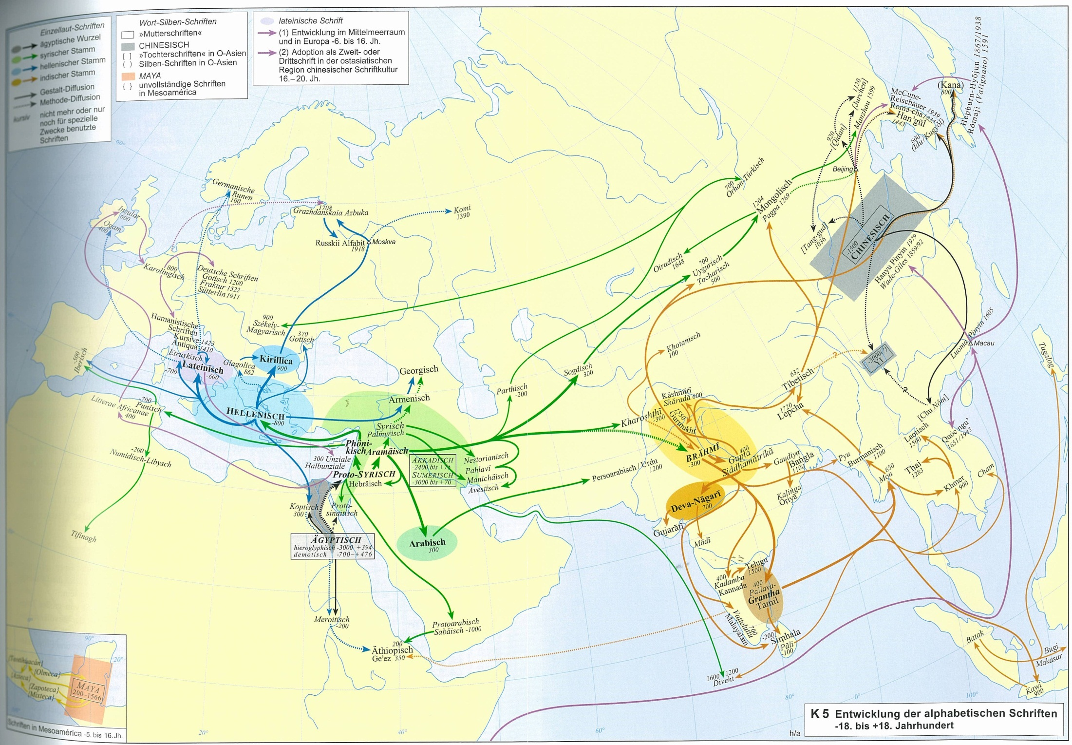

Slide 6
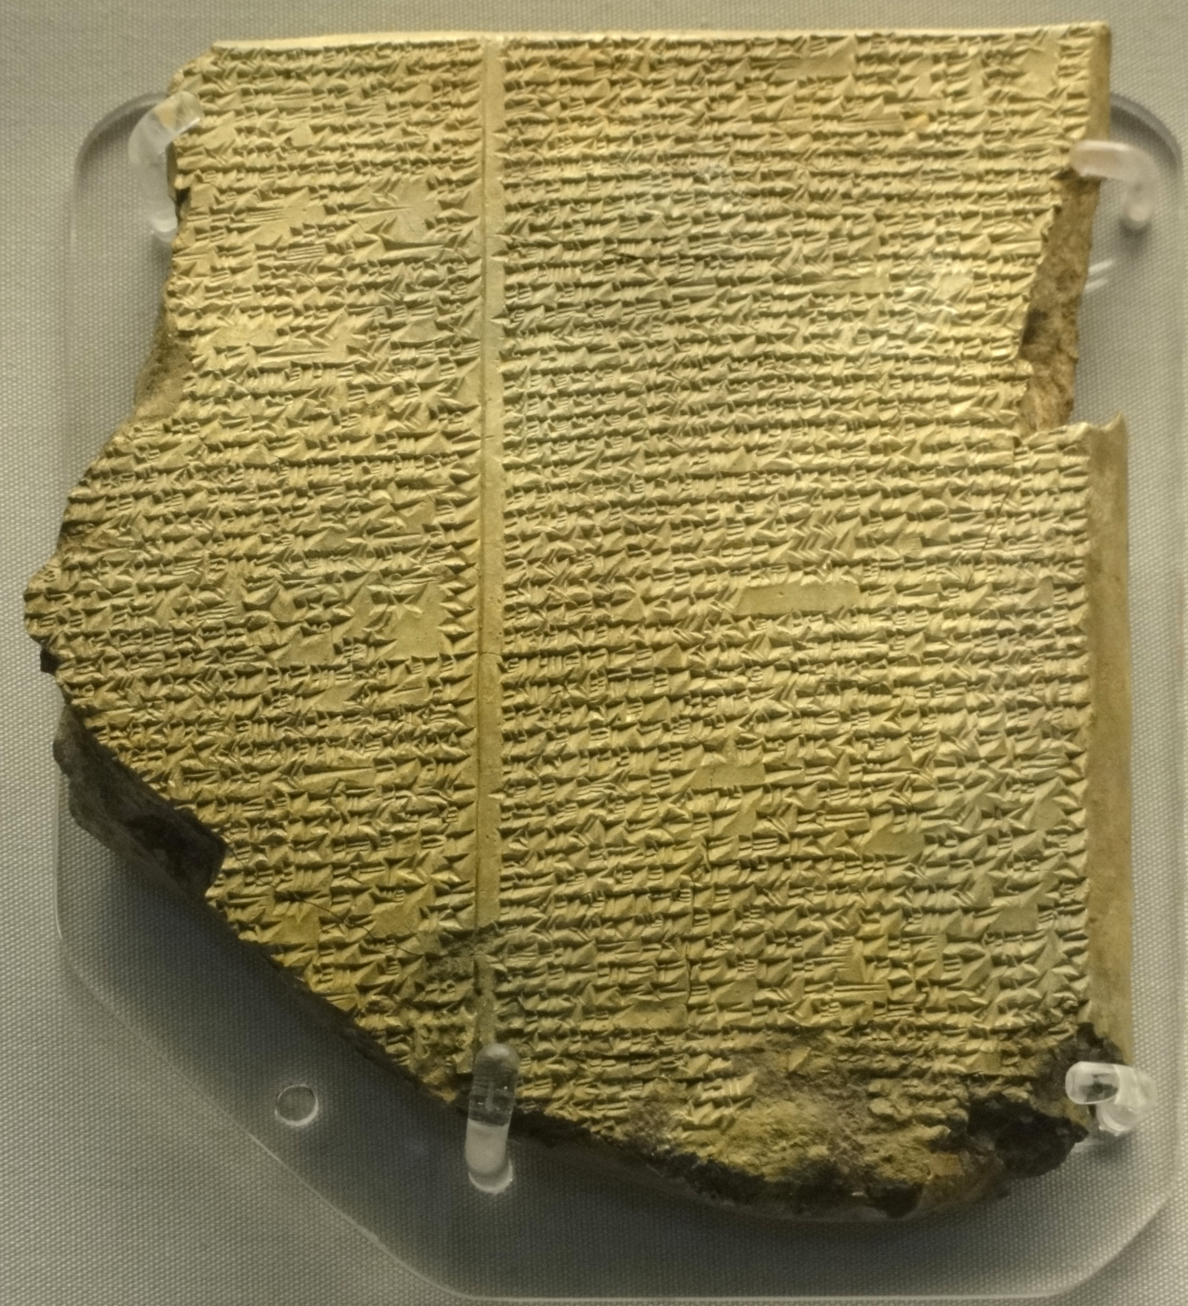
《吉尔伽美什史诗》:11公元前3000
大洪水

Slide 7
-950
Shijing
-350
Shanhai-
jing
Big flood
-440
-3000
800
-1850
Gilgamesh Epos

Slide 8
„Archetype Road“
-3000:Creation, Half Man, Half God, Right of First Night, Gods, Dream Warning, Beauty Seduction, Utopian Paradise, Elixir of Immortality, Image of the Serpent, Dungeon / Hell / Underworld
Gilgamesh Epos

Slide 9
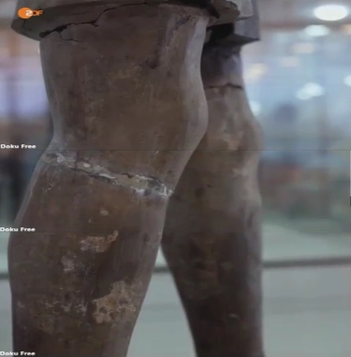

Archetype Road ?
Han-shu
Lin-tao
Theodorus

Slide 10
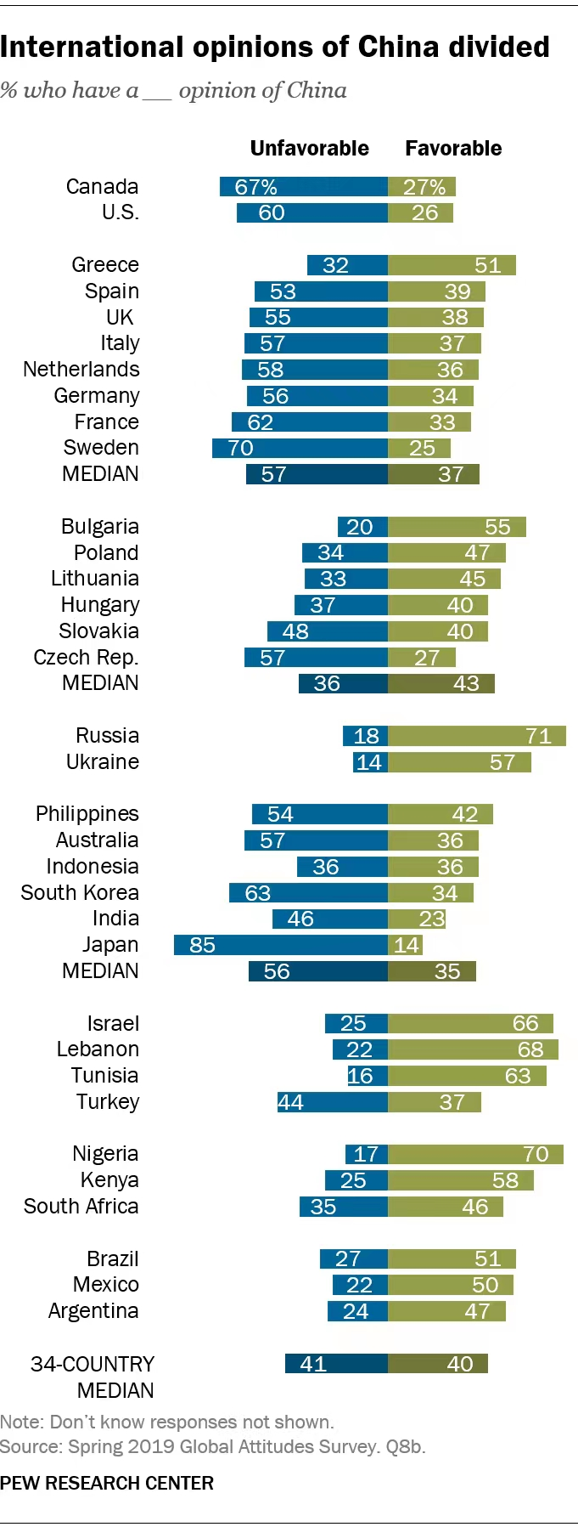

Slide 11
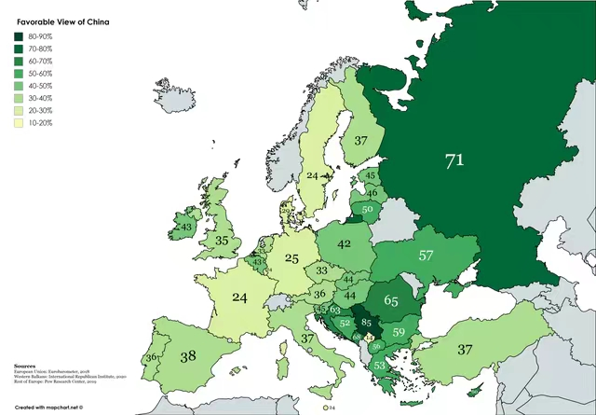
Europe

Slide 12
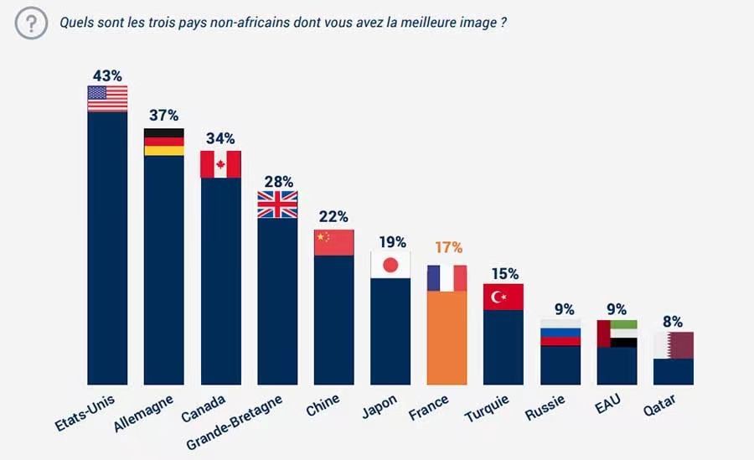
Africa

Slide 13
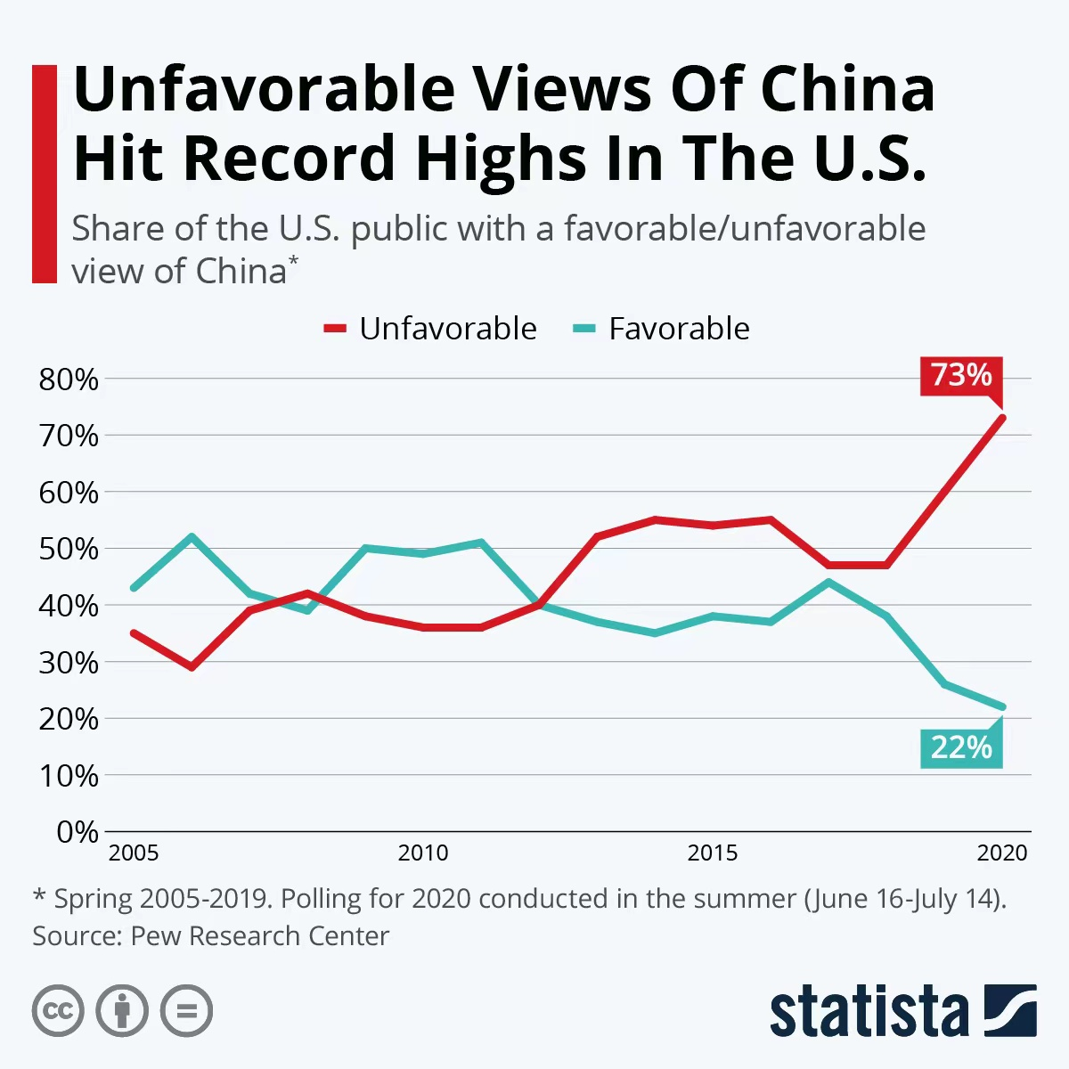
USA

Slide 14
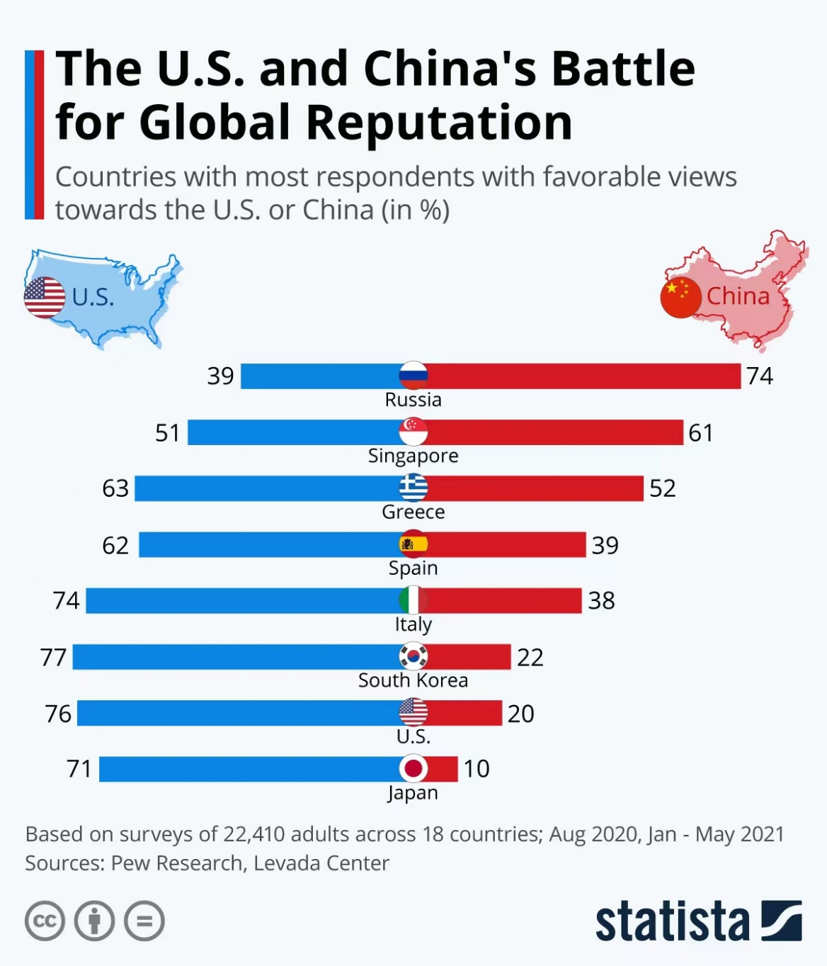
China vs US

Slide 15
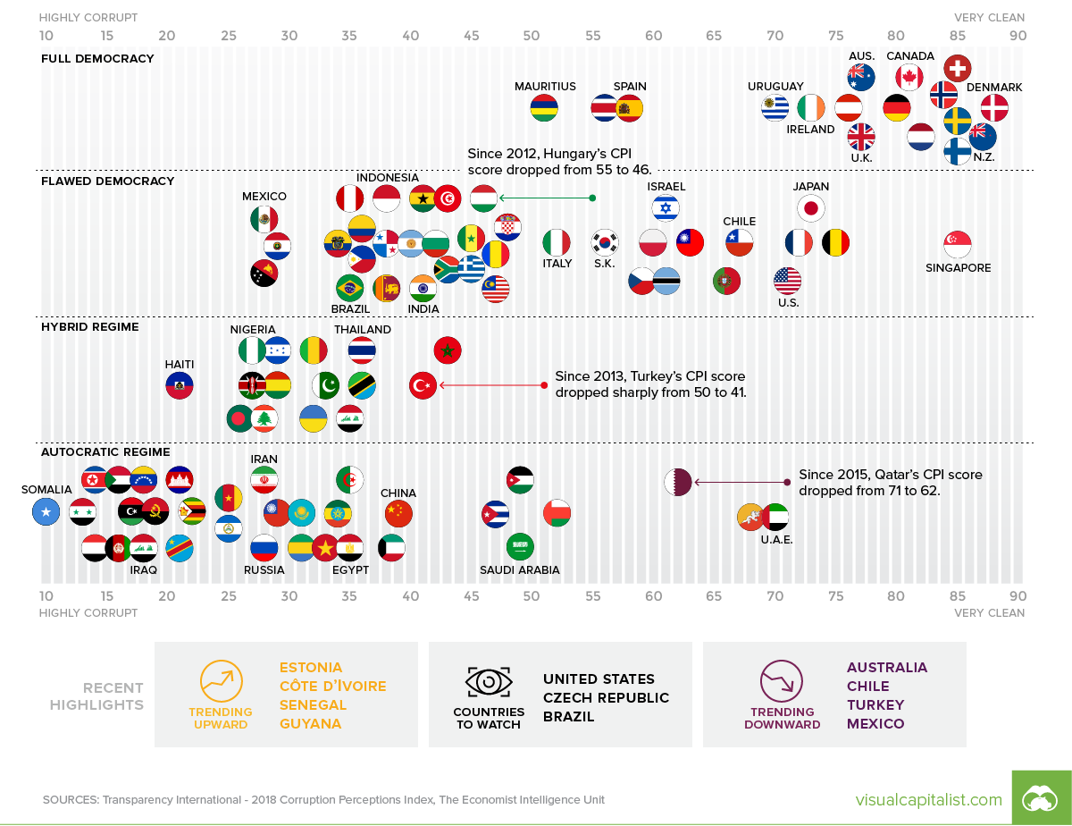
China vs US

Slide 16
纲 要
1, 传统的文化比较模块
2, 新的文化比较模块
3, 跨文化知识的例子
4, 构建全球化能力为国际性事业做准备
5, 讨论

Slide 17
跨文化知识的例子:
常态分布
A
的
文
化
标
准
B
的
文
化
标
准
偶尔 频繁
弱 握手 强
Alexander Thomas 教授的常态分布

Slide 18
中德文化比较
Täglich drei Mahlzeiten. / 三餐
Die Künstlerin Liu Yang 刘扬, geboren 1976 in Peking, eröffnete 2004 nach Absolvieren der Berliner Kunsthochschule in Berlin ihr eigenes Atelier. Sie zeigt die Kulturunterschiede D-C in Symbolen.

Slide 19
Kontakte / 人际关系

Slide 20
Laune Wetter / 心情和天气

Slide 21
Lebensstil / 生活方式

Slide 22
1970
2006
Transport / 交通工具

Slide 23
Senioren im Alltag / 老人的生活方式

Slide 24
Ich / 自我

Slide 25
Sonntags auf der Straße / 周末街景

Slide 26
Das Kind / 孩子

Slide 27
Schönheitsideal / 美丽的标准

Slide 28
Bei Bauchschmer / 胃痛时的饮品

Slide 29
Pünktlichkeit / 准时

Slide 30
Reisen / 旅游

Slide 31
Warteschlange / 排队

Slide 32
Duschzeiten / 淋浴

Slide 33
Vorstellung vom Anderen / 理想中的对方

Slide 34
Meinung / 意见

Slide 35
Party / 聚会

Slide 36
Im Restaurant / 餐厅分贝

Slide 37
Umgang mit Problemen / 处理问题

Slide 38
Neuheiten / 对待新的事物

Slide 39
Ärger / 对待愤怒

Slide 40
Im Trend / 时尚

Slide 41
Chef / 领导

Slide 42

跨文化知识的例子： 观点的转换
0.8

Slide 43
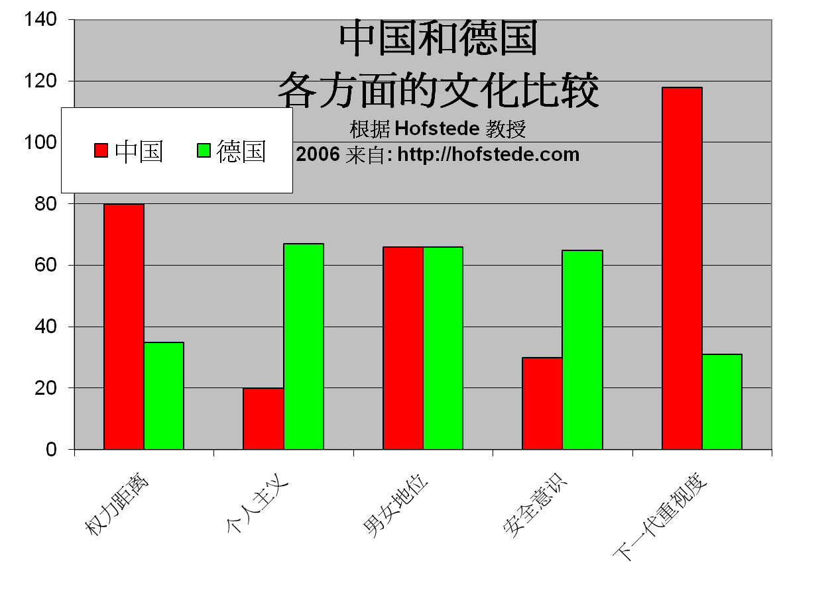
跨文化知识的例子:
类别比较

Slide 44
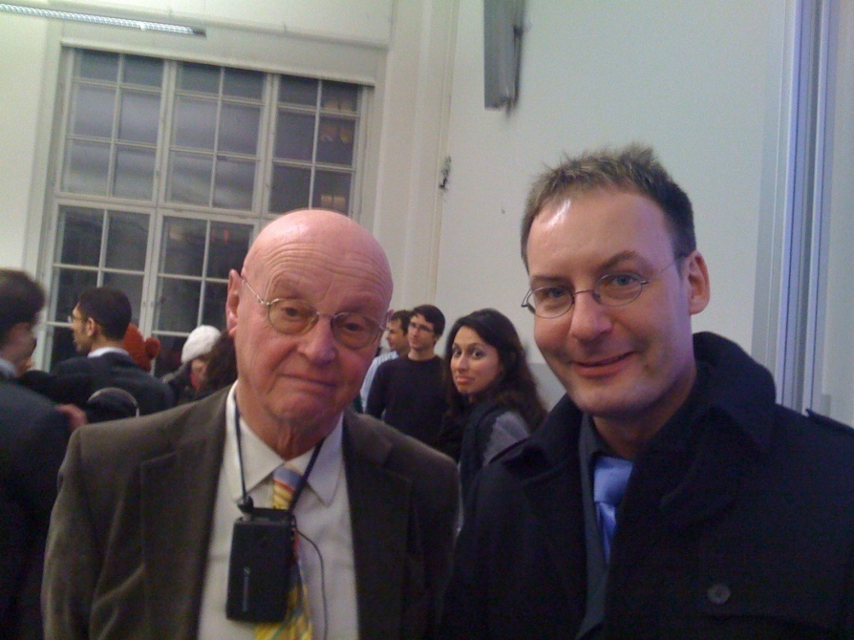

Slide 45
参考文摘
Hall, Edward T. (1977), Beyond Culture, New York: Anchor Book/Doubleday
Hofstede, G. (2006): Lokales Denken, globales Handeln. München:dtv
Oberg , K. (1960): Cultural shock : ajustment to new cultural environments , in Practical Anthropology , Bd . 7 , S . 177 – 182
Thomas, A. (2003): Handbuch interkulturelle Kommunikation und Kooperation, 2 Bde, 2. Aufl. Göttingen: Vandenhoeck & Ruprecht, ISBN 978-3-525-46186-0
Woesler, M. (2006): A new model of intercultural communication - critically reviewing, combining and further developing the basic models of Permutter, Yoshikawa, Hall, Hofstede, Thomas, Hallpike, and the social-constructivism, Europäischer Universitätsverlag, ISBN 978-3-89966-188-0, 52 S.

Slide 46
纲 要
1, 传统的文化比较模块
2, 新的文化比较模块
3, 跨文化知识的例子
4, 构建全球化能力为国际性事业做准备
5, 讨论

Slide 47
构建全球化能力为国际性事业做准备
中国劳工市场日益全球化（许多工作涉及海外，全球各大跨国企业已经进入中国， 海外工作机会，国际投资涌入中国）----跨文化能力不是选择性的，而是必须有的，因为世界已经进入中国。
中国本科生常无法找到让自己满意的工作，所以他们希望深造。
全球趋势：麦肯锡研究发现，生产工人数量在减少（15%），中间商（44%）及高级（41%）的中间商数量在增加
一种解决方法：出国深造（首选：美国；2 . 英国；3. 德国）
-------语言，跨文化经验，个人发展

Slide 48
新的“国际化人才”
麦肯锡的最新研究结果
  “生产人员”数量下降（生产线等）----在美国只有15%，很多工作被机器代替。Web2.0
  “对话互动人员”占统治地位（例如销售人员，中层管理人员）---在美国仍然还有44%
  在互动交流的工作中，需要较高技巧性的部分在增加 (复杂的判断和决定，例如像护士、财务总监、总经理）---今天在美国还占41%，他们在各自级别中获得最高的薪金

Slide 49
如何为00后大学生讲授国际关系课程
第五届教学共同体年会主题报告 | 阎学通
2022年1月8日，由清华大学国际关系研究院与北京大学出版社联合举办的第五届政治学与国际关系教学共同体年会在北京西郊宾馆成功举行。会议采用了线下与线上相结合的模式，来自全国数十所院校的100多位政治学与国际关系学界的人士参加了会议。
清华大学国际关系研究院院长、清华大学文科资深教授阎学通老师发表了题为“如何为00后大学生讲授国际关系课程”的主题报告。阎老师的报告主要分为四个部分。首先，阎老师认为学生的代际差别是十分明显的，当前的本科学生基本上已全部是00后，他们在思想观念、审美标准、价值观上都有独特之处。此外，00后学生身处数字化时代，在获取与掌握信息和知识方面能力更强，这就需要教师改变原有的教学观念，调整教学内容，以虚心的态度与学生沟通和交流。
其次，阎老师总结了00后学生对世界的认识特点，并据此提出了相关的教学参考建议。阎老师认为，00后大学生往往具有强烈的优越感和自信心，常以“居高临下”的心态看待其他国家，以“愿望思维”看待国际事务，认为中国很容易实现对外政策目标。他们常以中国与外国两分的方法看待世界，将中国之外的其他国家视为同一类国家，将和平、道德、公平、正义等人类的普世价值观视为中国独有的传统，认为只有中国是正义的和无辜的，其他国家特别是西方国家是“邪恶”的、西方人对中国有着天然仇恨。另外，00后大学生深受网络观念影响，把经济决定论、阴谋论、债权武器等网红们的观点当作常识。

Slide 50
如何为00后大学生讲授国际关系课程
对此，阎老师建议，在对00后大学生讲授国际关系课程时，一是结合时事传授知识，使学生了解当前客观事实，避免盲目自信；二是进行历史比较，使学生了解当下与以往的区别，认识到历史发展的曲折性；三是帮助学生认识世界的多样性，避免中外两分的认识论；四是帮助学生界定概念，建立共同标准和定义，提高学生参讨论的兴趣和质量；五是运用思维导图，增强学生思维的逻辑性和批判思维能力，降低网红的影响；六是介绍数字时代的新观念或新事物，以网络生活为例，帮助学生了解数字时代的特点。
再次，针对当前疫情下的线上教学，阎老师认为线上教学需要保持学生在线并专注于课堂教学。通常情况下，线上教学课容量小于30人为宜，教师最好要求所有学生开启视频，学生应提前阅读教材了解教学内容。另外，教师还应注意适当减少教学内容，以对话方式教学保持学生的注意力，教学PPT也应多用图解以便于学生理解。
最后，阎老师再次总结和强调了教师在教学中应注意的一些方面，如教师教学应尽可能结合使用新旧版本的教材，课堂上多讨论学生提出的问题，提高学生运用国际关系知识理解和认识现实世界的能力，注意培养和提高学生独立思考的能力。纵向观察中国的历史，认识中国的复杂性，横向比较外部世界，看到世界的多样性。同时还要使学生能够辨别学术观点和网络观点，理解国际关系知识的科学性。
在讨论环节中，阎学通老师结合自己在清华多年来的课程教学实践，与大家分享一些心得体会，并回答了与会者提出的问题。
https://mp.weixin.qq.com/s/GcftpDXIBDFJ26E570VHcg

Slide 51
纲 要
1, 传统的文化比较模块
2, 新的文化比较模块
3, 跨文化知识的例子
4, 构建全球化能力为国际性事业做准备
5, 讨论

Slide 52
Foundations of Chinese Cultures
About Chinese culture around the world: the importance
About the course: the contents
About the studying: preview the unit; answer questions; interpret the text; discuss and translate.
About homework: translate 1 passage per unit
About grading: 20% from homework; 10% from classroom performance; 70% from the final test

Slide 53
About the teaching
1. Tell students to answer the questions after each section and see if they have previewed the text and how well they’ve mastered it.
2. Interpret cultural phenomena and terms and expressions of high frequency in the text.
3. Introduce related topics and invite students to comment.
4. Grade students’ essays.

Slide 54
Questions concerning Introduction
1. How large is China?
2. What are the countries that China borders?
3. What do you know about China’s coastline?
4. What’s China’s climate like?
5. What’s China’s general land surface like?
6. What do you know about China’s vegetation and animal life?

Slide 55
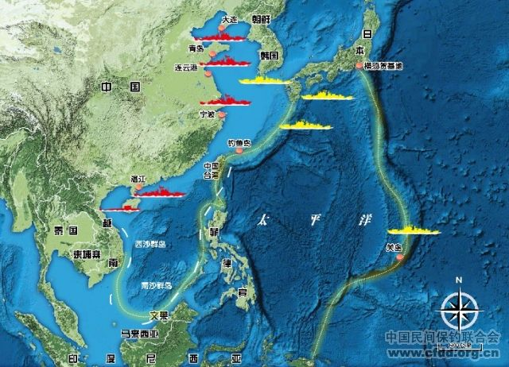
How large is China?

Slide 56
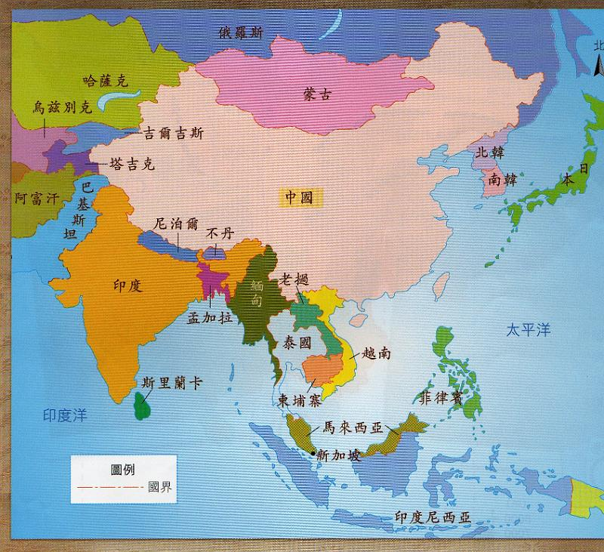
How many countries border China?

Slide 57
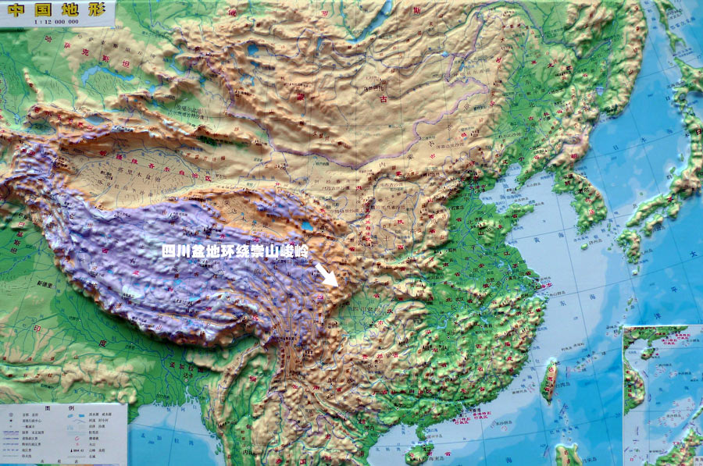
What is China’s land surface like?

Slide 58
1A(1) Geopgraphy: Text
Reading (e.g.: take turns)
Discussion
News (new developments, new vocabulary)
  „Nine-dotted line“
  Islands in the South China sea
  „Greater China“

Slide 59
1B(2) Economic Reform and
Opening Door Policy: We Chat Quiz
Please answer the following questions by sending the information LIVE to the TA Carol – DO NOT POST IN GENERAL GROUP!!!

Slide 60
1B(2) Economic Reform and
Opening Door Policy: We Chat Quiz
Please answer the following questions by sending the information LIVE to the TA Carol – DO NOT POST IN GENERAL GROUP!!!

Slide 61
1B(2) Economic Reform and
Opening Door Policy: We Chat Quiz
What Special Economic Zones can you name?

Slide 62
1B(2) Economic Reform and
Opening Door Policy: We Chat Quiz
What Special Economic Zones can you name?
Shenzhen, Zhuhai, Shanto, Amoy; Yangzi River Delta, Pearl River Delta, Southeast Area of Fujian Province, Bohai Bay; Hainan Island: special economic area; Pudong

Slide 63
1B(2) Economic Reform and Opening Door Policy
New: On August 2019 Xinhua announced 6 new pilot free trade zones in Shandong, Jiangsu, Guangxi, Hebei, Yunnan and Heilongjiang, bringing the total to 18
Source: http://www.xinhuanet.com/english/2019-08/26/c_138339873.htm or https://bit.ly/2n5Cqax

Slide 64
Questions concerning Section B, Unit One
1. When did New China begin to open to the outside world?
2. What changes have taken place in China’s economy?
3. How many special economic zones of China can you name?
4. What progress has been made in China’s economy?
5. What problems are there with the economic development?
6. How shall we adapt state enterprises to the situation?

Slide 65
Questions concerning Section C, Unit One
1. What do you think of Confucius’ saying---“nothing is lofty except schooling?”
2. What do you know about China’s educational system?
3. What do you think of the Hope Project?
4. What do you know about China’s adult education?
5. What progress has been made in traditional Chinese medicine recently?

Slide 66
1C(3) Education and Public Health
Discussion
News?

Slide 67
Preparation for next week
Please prepare all texts, quizzes
Traditional Cuisine: The Art of Chinese Cooking
Traditional Cuisine: Two Famous Dishes
Traditional Cuisine: Breakfast Culture of Wuhan
Traditional Cuisine: Eight Major Cuisines of China

Slide 68
Always here for you!
随时为你们服务
Professor Dr. Martin Woesler
吴漠汀
湖南师范大学特聘教授，博士导师
Office / 办公室: 外国语学院415
国际汉学中心309
Phone / 电话: (150) 1138 8818
(德国+49 178 2073538)
Email / 电子邮件: wmt@hunnu.edu.cn

Slide 69
Thank You

