Slide 1



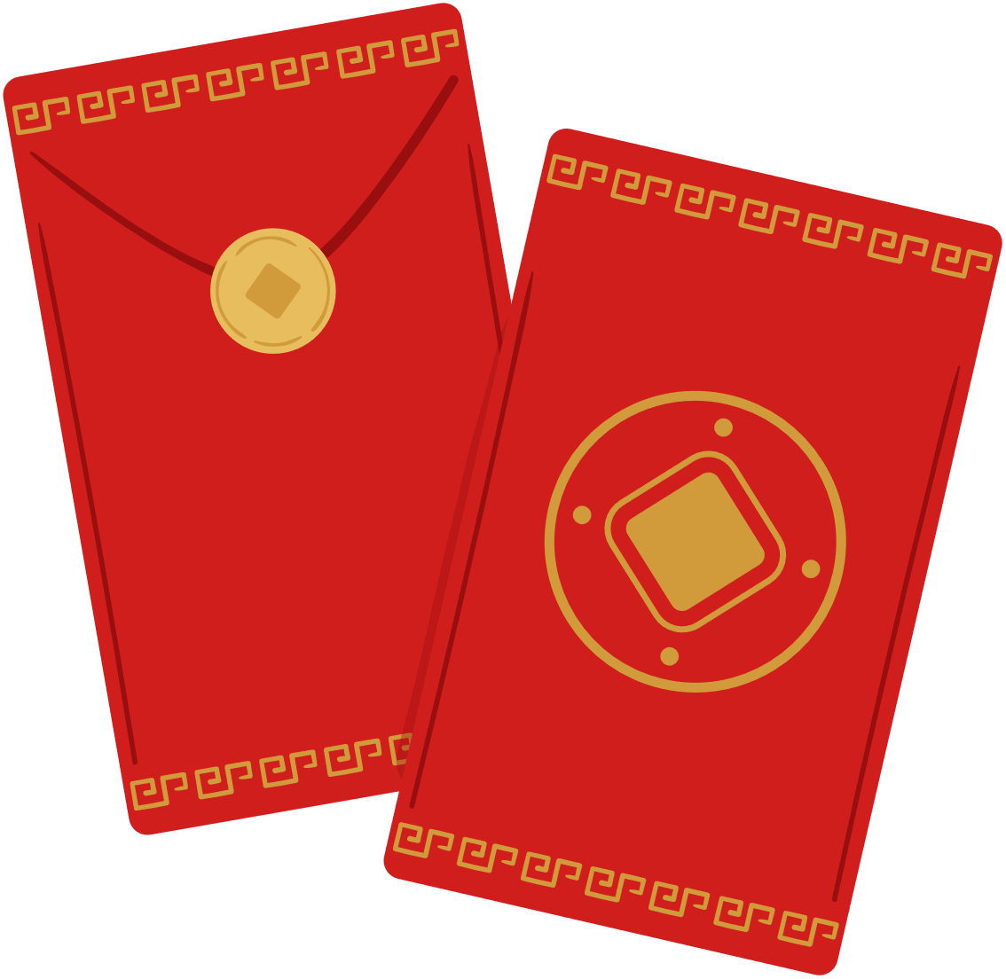
Money culture:
The tradition of Red Envelope and Lucky Money
Chen Pingan / Grace

Slide 2

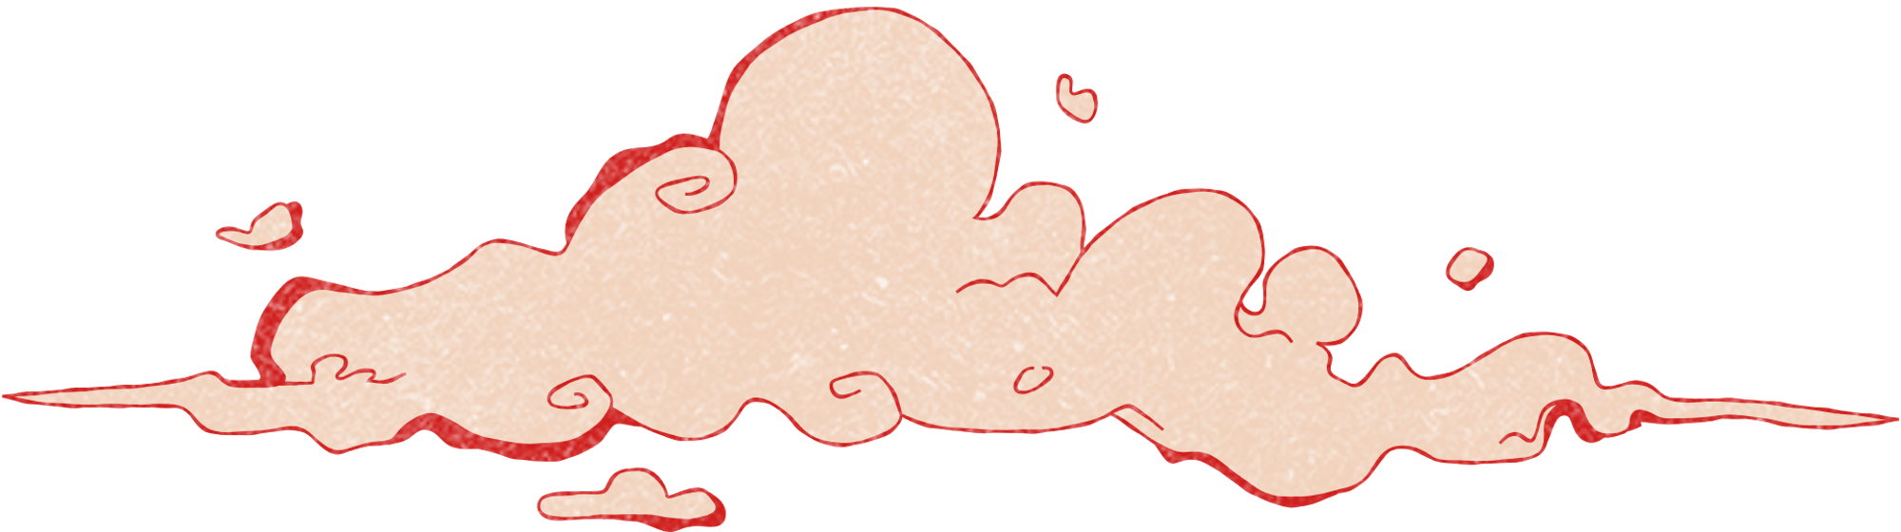

CONTENTS
Part1.Origin of Red Envelopes
Part2.The Symbolism of the Color Red
Part3. Correct Practices for Giving Red Envelopes
Part4. WeChat Red Envelopes
Part5. Things to Avoid

Slide 3


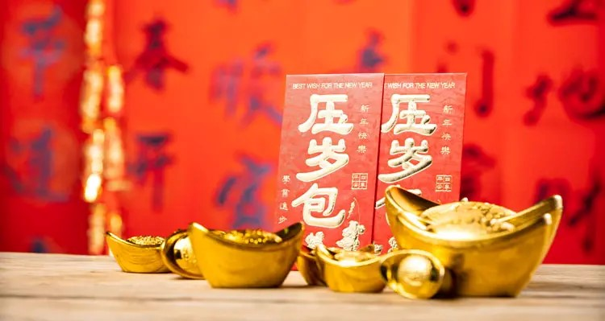
01.
Origin of Red Envelopes

Slide 4
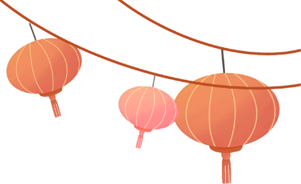
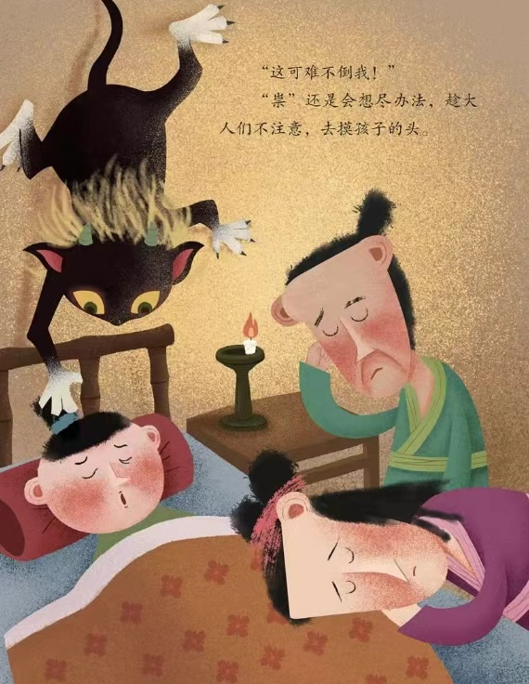
Origin of Red Envelopes
There is a legend about lucky money.
According to legend a monster known as Sui appeared on New Year‘s Eve with the intent of harming children. A sleeping child who was touched by this monster would develop a fever and subsequently become an idiot. However it was said that when their parents prayed sincerely, God sent eight guards disguised as coins to protect them.

Slide 5
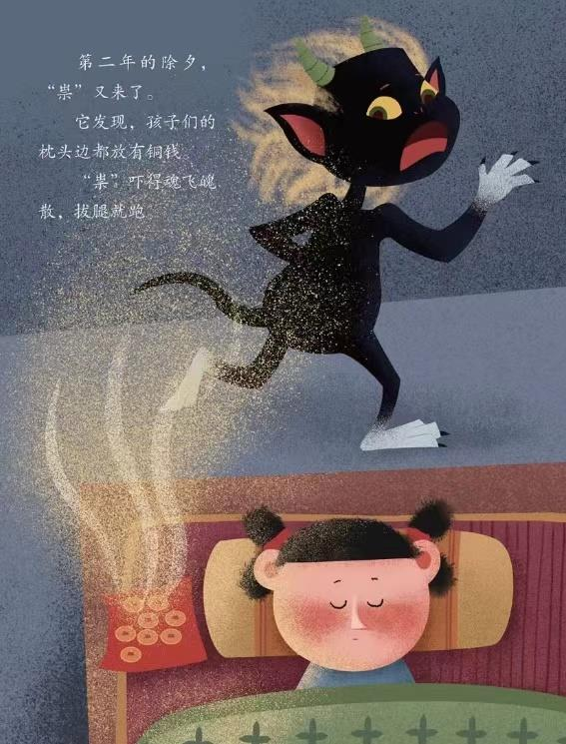
Origin of Red Envelopes
So people threaded eight coins on red string and placed them under the children’s pillows. This became an annual custom and the monster Sui no longer came near. As the Chinese Character Year sui(岁) has the same pronunciation with the monster’s name ‘Sui’（祟）, the people called the coins Ya Sui Qian （压岁钱).
From then on, giving red envelopes became a way to keep children safe and bring good luck.

Slide 6
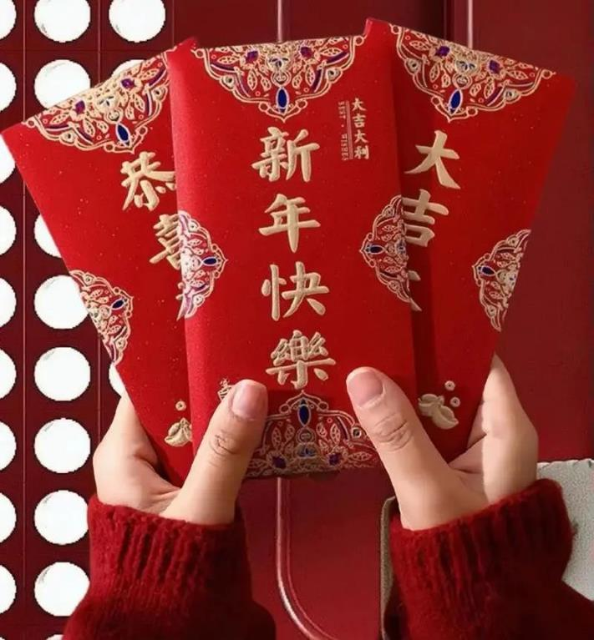
02.
The Symbolism of the Color Red

Slide 7


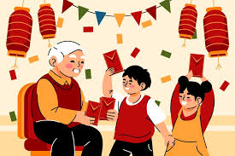
Red symbolizes luck and good fortune in Chinese culture. That is why red envelopes are used during Chinese New Year and other celebratory events.
Other envelope colors are used for other types of occasions. For example, white envelopes are used for funerals.

Slide 8
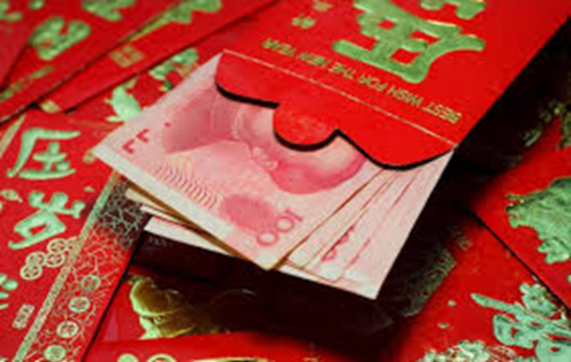
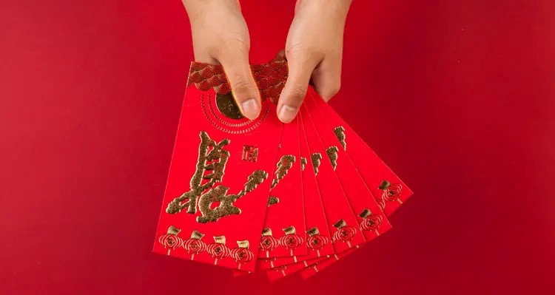
03.
Correct Practices for Giving Red Envelopes

Slide 9



1. Who receives Red Envelopes?
Other Occasions to Give Red Envelopes：
Attending wedding ceremonies
Attending senior people's birthday parties
Visiting a newborn baby
Kids
Elders
Employees
Acquaintances' children

Slide 10

2.How Much to Put in a Red Envelope?
Pleasr tell me where is your hometown?
How much money do your parents usually give to relatives' children in red envelopes during the Spring Festival?
And how much do your parents give in red envelopes when a close relative gets married?

Slide 11
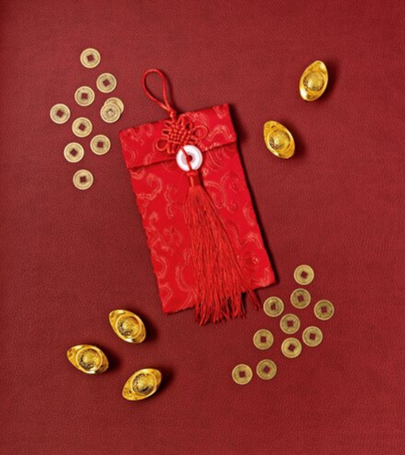
2.How Much to Put in a Red Envelope?
Relative's kids: RMB 200 - 1,000
Other acquaintances' children: RMB 50 - 100
Parents and grandparents: RMB 500 - 2,000
Elder relatives: RMB 300 - 1,000
Employees: RMB 50 - 500

Slide 12

3.How to Give a Red Envelope?
Crisp Bills
Right Moment
Most people will be glad to receive new cash, so you'd better acquire some crisp new notes from banks in advance. Some people will wrap change in the envelope, and so puff up the packet.
Once you arrive at your host's home, you are should pass the red packets to them when shaking hands or greeting each other. If they have children, give the lucky money straight away, too.

Slide 13
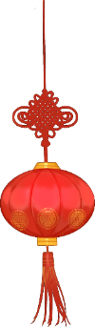

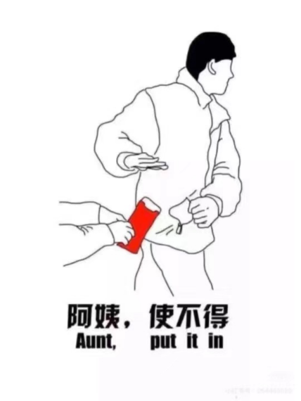
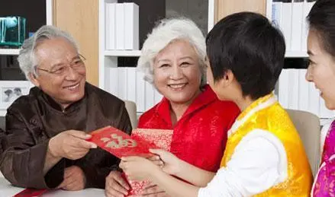
4.Etiquette on Receiving Red Envelopes
1.Always receive your red envelope with both hands. It is impolite to accept a red envelope with just one hand.
2.When you receive a red packet, first you should say thanks and express your blessing to the donor. Never open your red envelope in front of the person who just gave it to you. You should do it in private or when you get home.

Slide 14
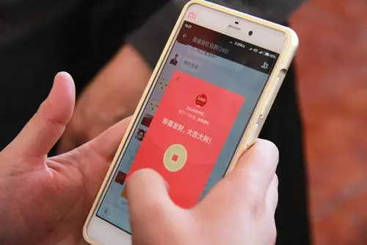
04.
Red Envelopes in Modern Society: The WeChat Red Envelope

Slide 15

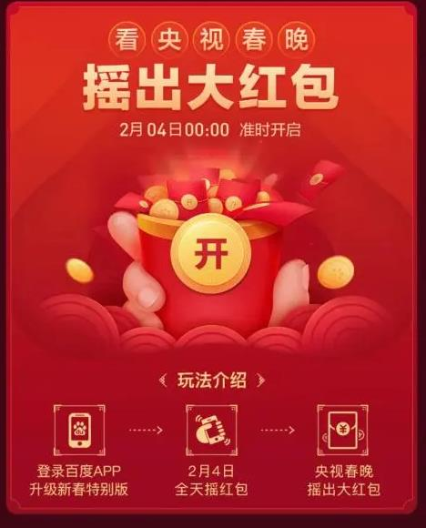
Wechat is now one of the most widely-used social media in China. With a large number of users, the Wechat Red Envelope App has also become popular in recent years. During the Spring Festival, young people are inclined to send Wechat envelopes to each other as a way of greeting. It is fast and convenient way to contact with friends from afar.

Slide 16
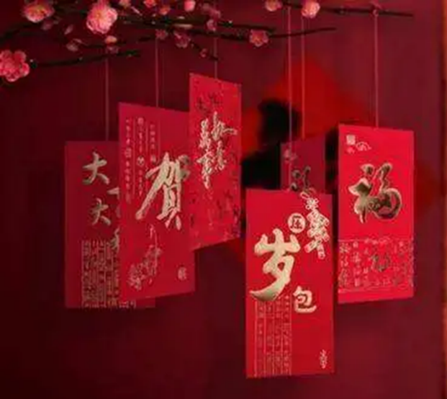


05.
Things to Avoid
Anything with a four is best avoided because four sounds similar to death. Even numbers, except four, are better than odd—as good things are believed to come in pairs. Eight is a particularly auspicious number.
Coins are avoided.

Slide 17
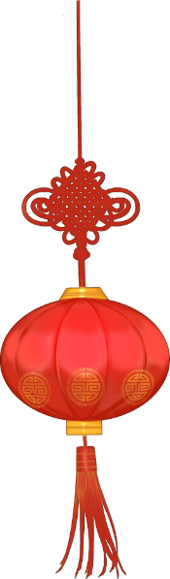






THANKS!

