Slide 1
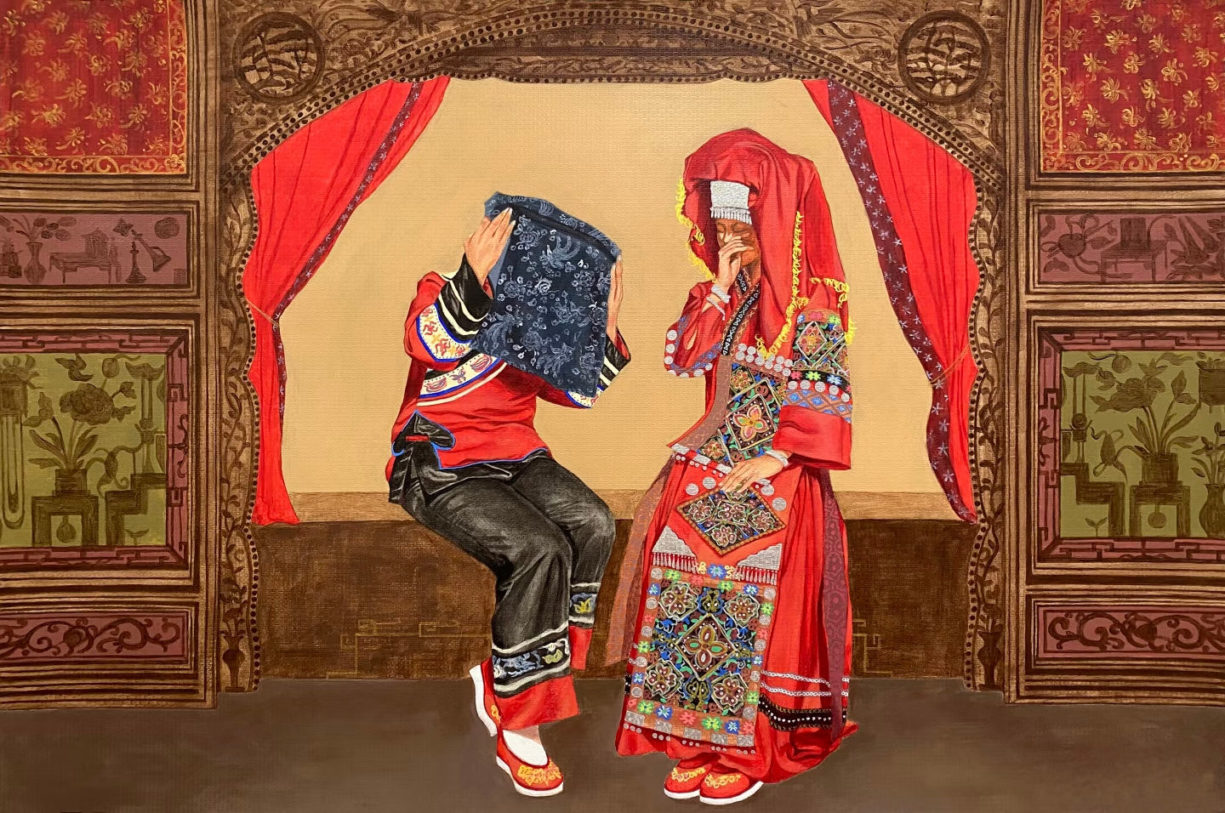
Crying Marriage of Tujia
土家哭嫁

Slide 2
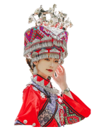
Prologue
Hello everyone, I’m A Ya, a girl from the Tujia ethnic group. Tonight is an unforgettable moment for me. Tomorrow, I will leave the home where I was born and raised and marry into a village beyond the mountains. In our culture, the most important thing for a daughter getting married is not wearing the wedding dress, but crying.

Slide 3
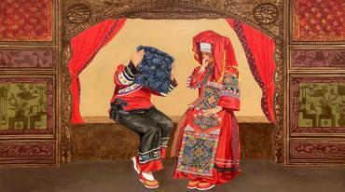
Part 1

Slide 4
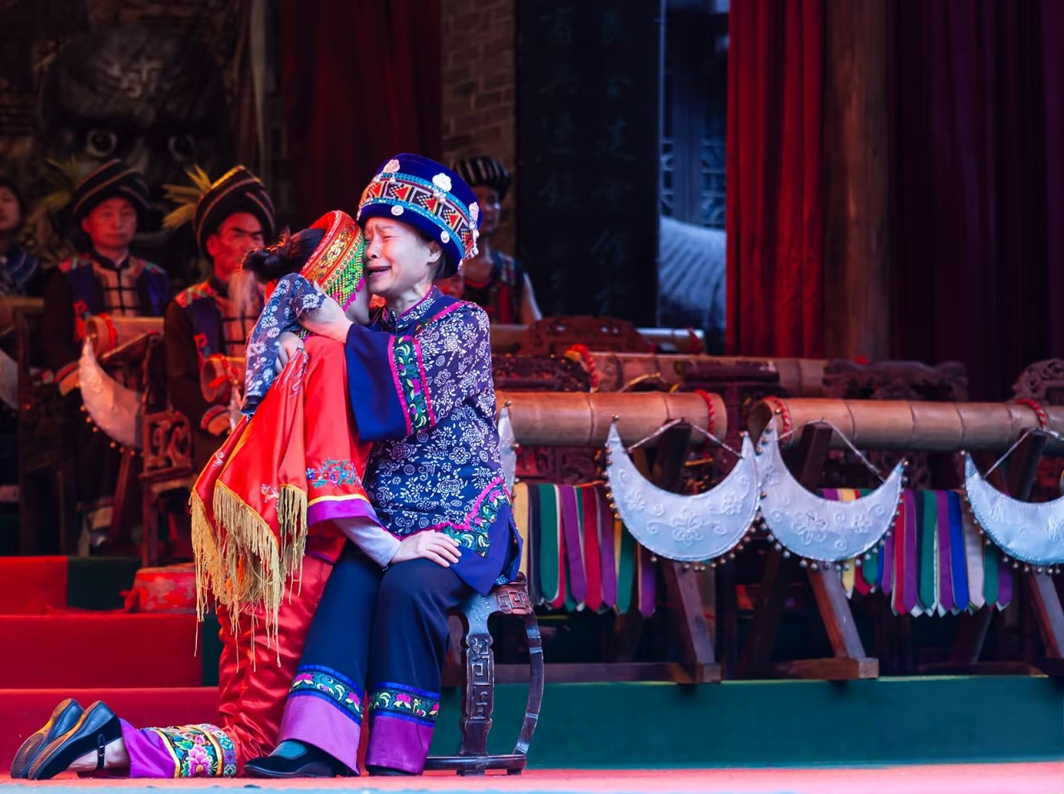
Part 1
Crying Marriage is a traditional ceremony held by Tujia women before they get married.
The bride's mother leads the bride into a state of crying and they cry together.

Slide 5
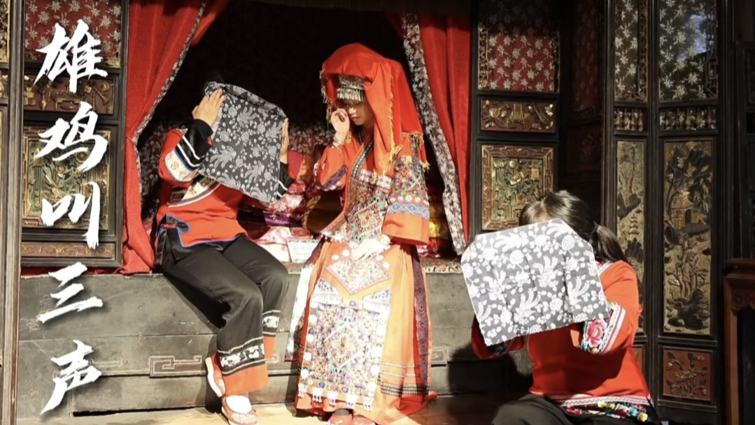

Slide 6
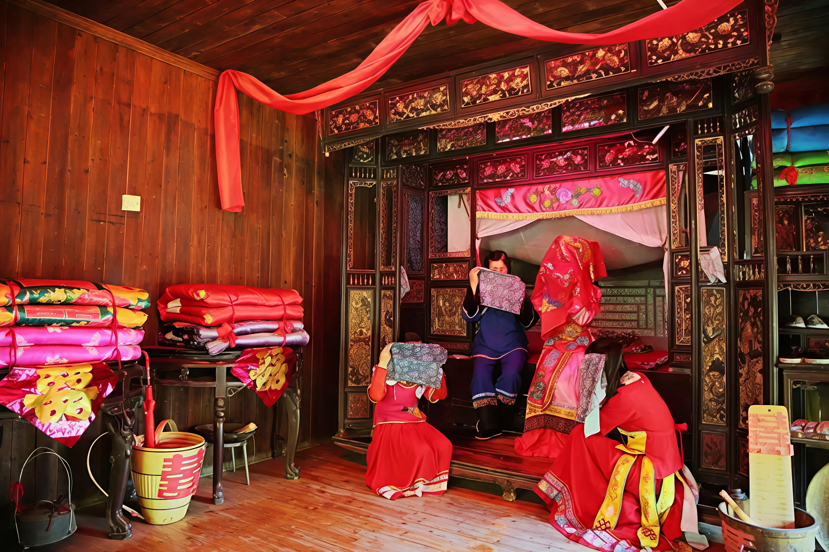
Part 2
The neighbors and other single women come to cry with her, all of them sitting on the bed. While the bride and one of the companies cry aloud, the others weep by the side.

Slide 7
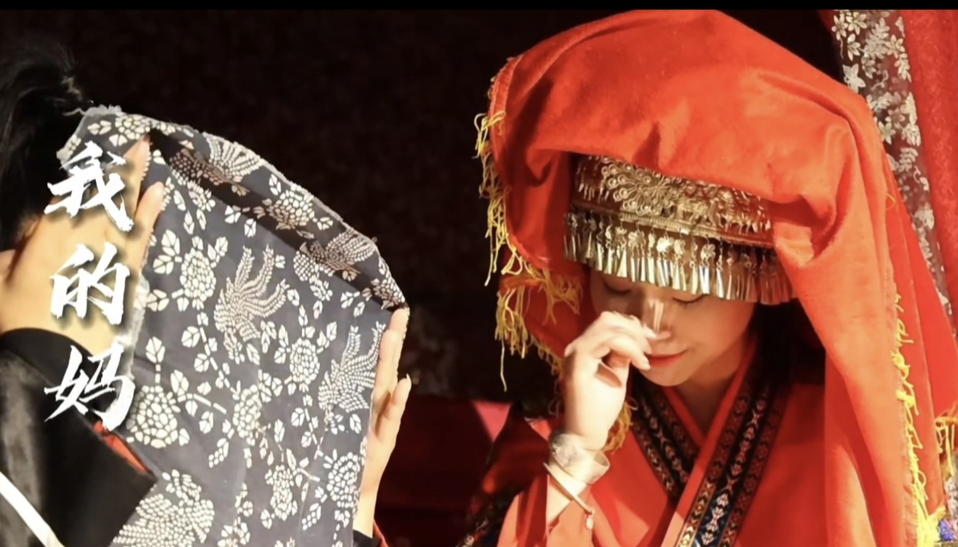

Slide 8
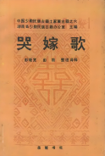
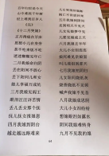
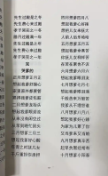
Part 2

Slide 9
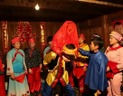

Part 3
The bride’s brother carries her on his back and steps out of the house, with crying relatives behind him.
After that, the bride is sent to the sedan chair to the bridegroom’s house.

Slide 10
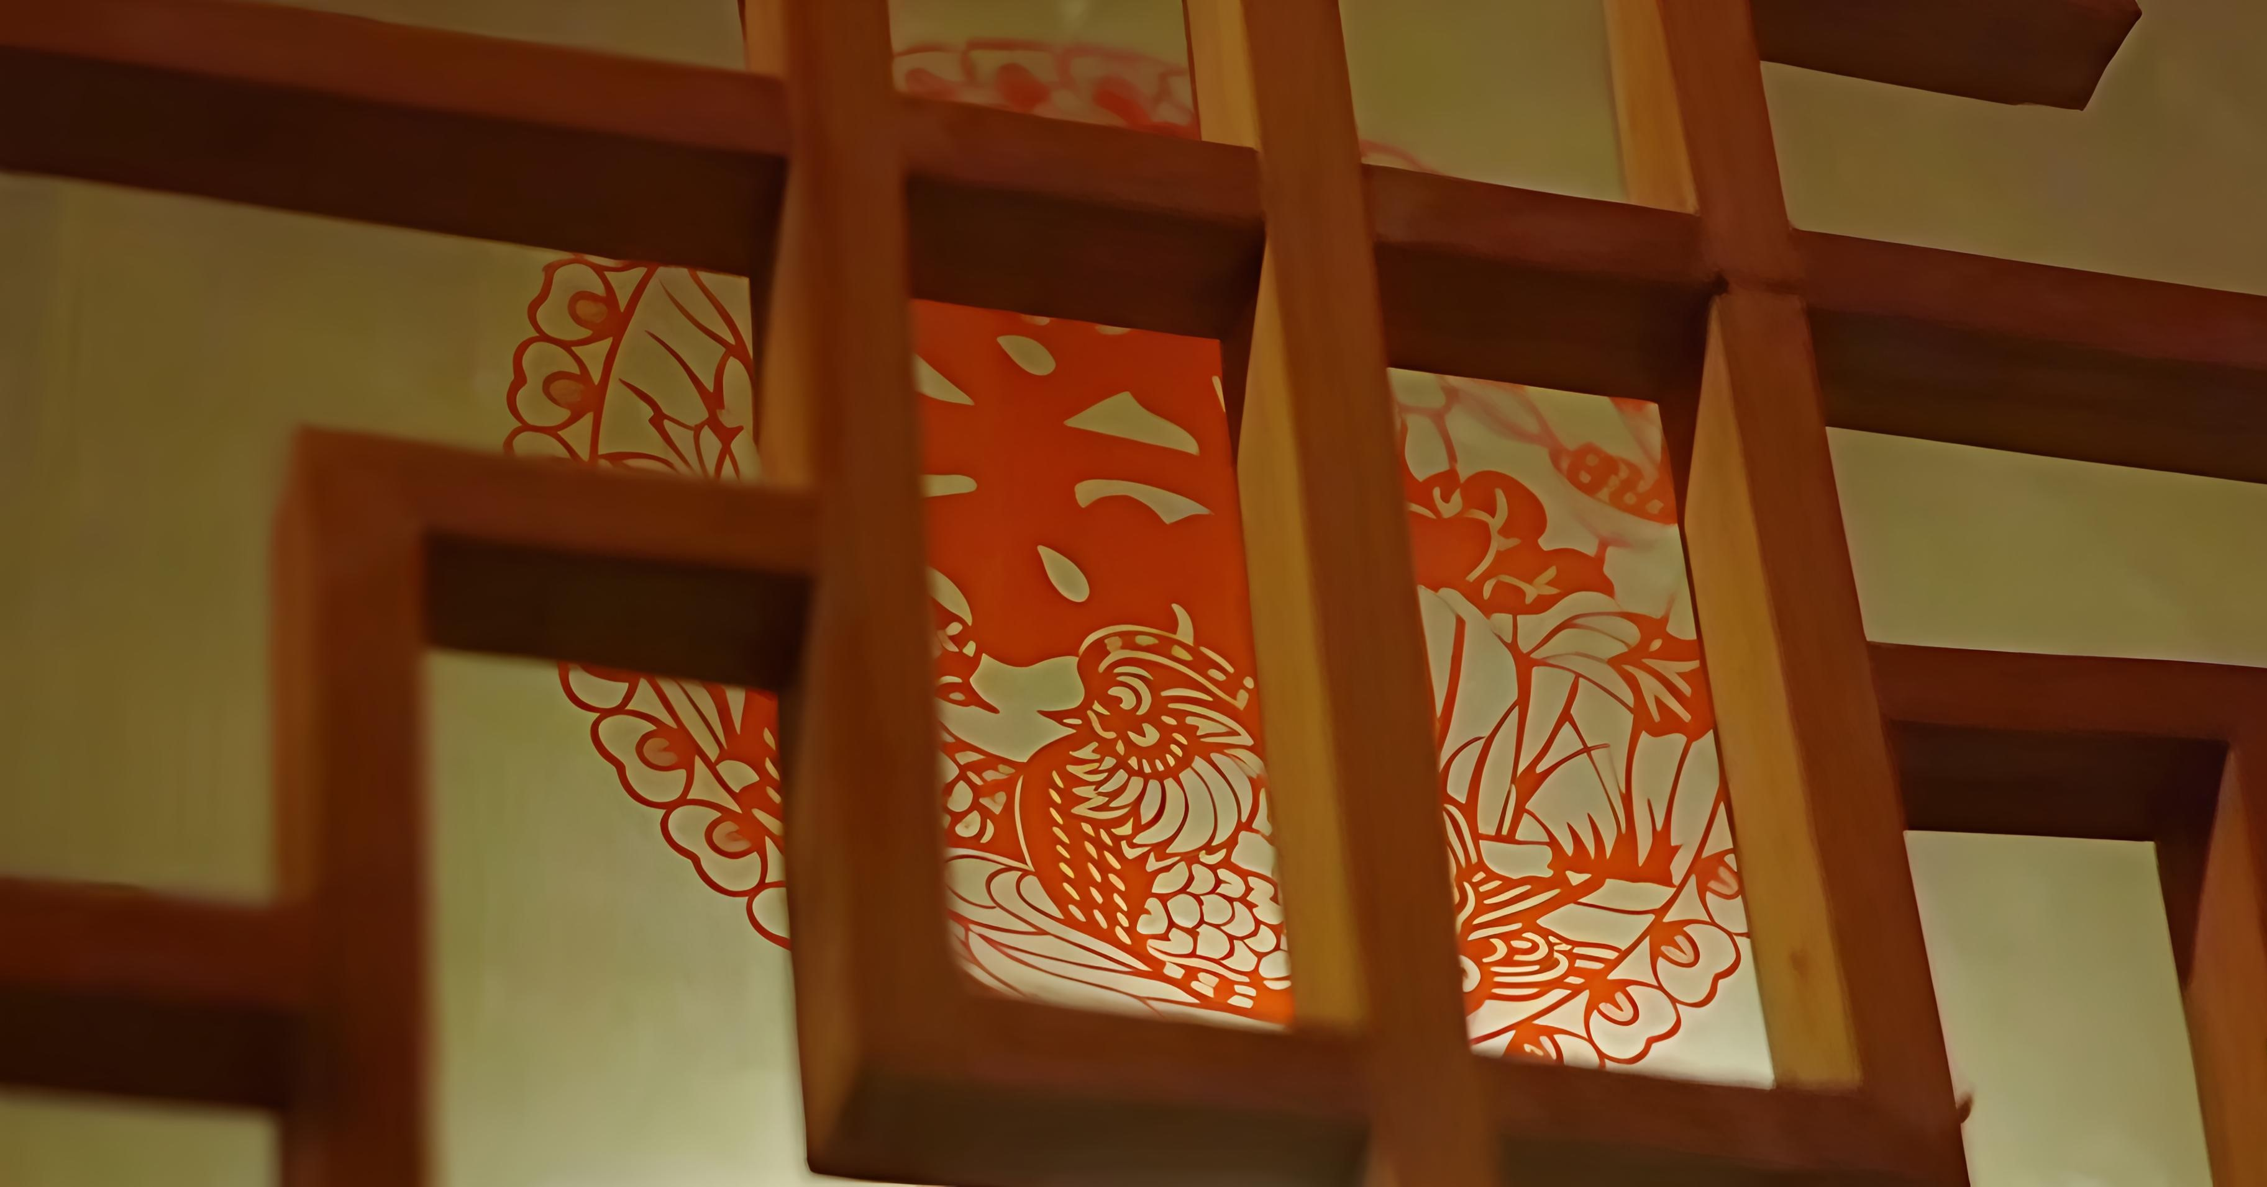
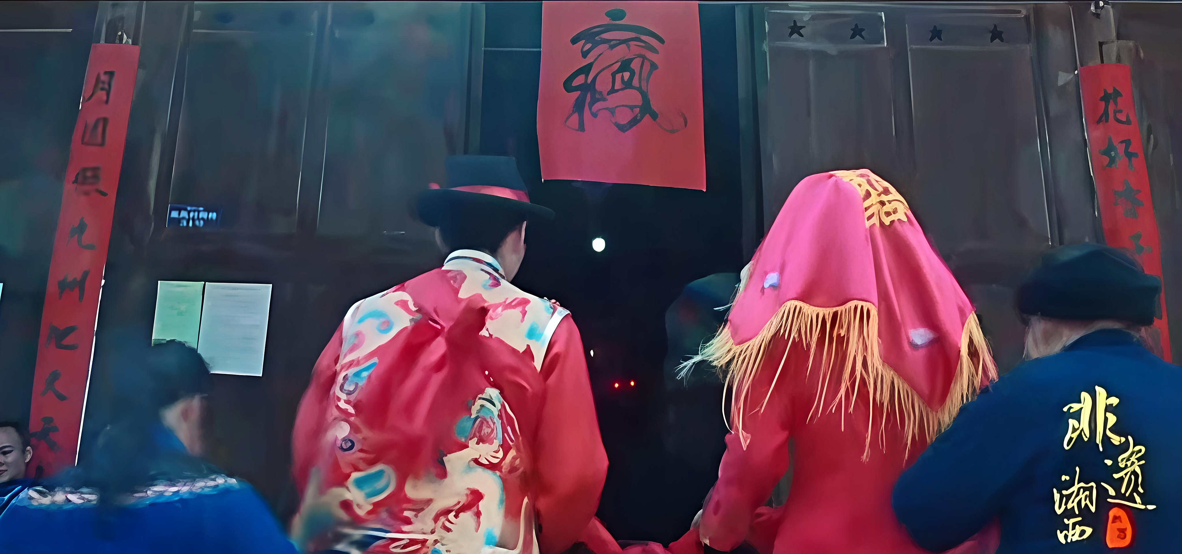
Part 4
1.She cries for her sad fate with low status in the society.
2.Wedding laments show the bride's filial pity and attachment to her parents, siblings and relatives.
3.Crying marriage is seen as an effective tool to deceive evil spirits and protect the peace of family house.

Slide 12

图片视频材料来源：
非遗湘西纪录片、中国语言文化课本、百度、小红书

