Slide 1

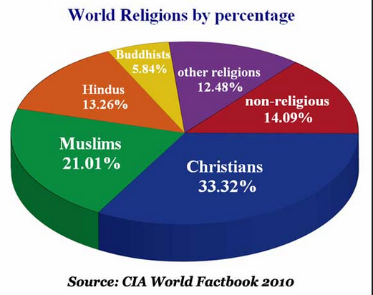
Unit 12 Major Religions

Slide 2
Questions Concerning Section A Buddhism
1. What do you know about Siddharta Gautama? What did he do at the ages of 29 and 35?
2. What are the 4 Noble Truths preached by Gautama?
3. What 8 tenets are included in the Noble 8-Fold Path?
4. What can a Buddhist attain after following the Noble 8-Fold Path?

Slide 3
Questions Concerning Section A Buddhism
Mahayana Buddhism
1. What does Mahayana Buddhism mean?
2. When was it introduced into Han regions? When did it reach its peak?
3. What are its 8 main sects?
4. Can you give examples to show its influences on the Chinese language?
5. What influences has it had on Chinese culture?
6. Can you give examples to show its influences on Chinese music, astronomy, medicine and gymnastics?
7. What are the 4 sacred mountains in China?

Slide 4
Questions Concerning Section A Buddhism
Hinayana Buddhism
1. When was Hinayana Buddhism introduced into China? Where is it popular?
2. Why is it also called pali Buddhism?
3. What does it emphasize?

Slide 5
Questions Concerning Section A Buddhism
Lamaism
1. What is Lamaism?
2. What do the Red, Striped, White, Black and Yellow sects refer to respectively?
3. Which sect is the most powerful? Could you name some of its monasteries?
4. What is the supreme Lamaist leader called?
5. What is a soul boy? How is the correct identity determined?

Slide 6
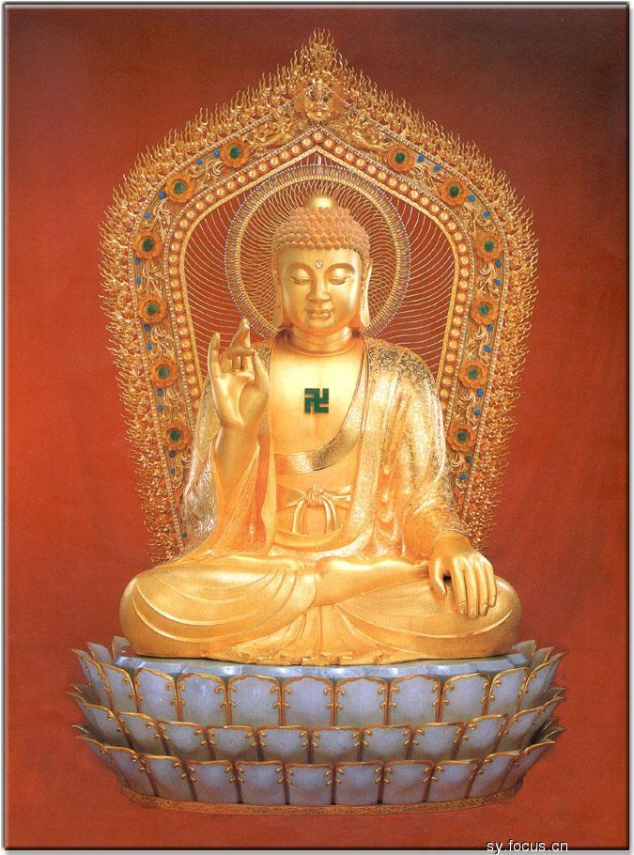
Buddha seated on a lotus throne, with a mark of light on the chest

Slide 7
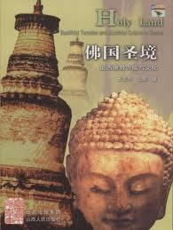
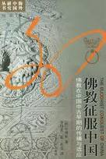
Holy Land & Buddhism Conquering China

Slide 8
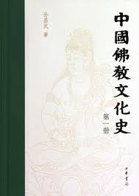
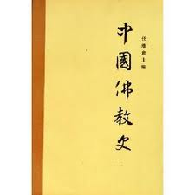

Books on Buddhist influences in China

Slide 9
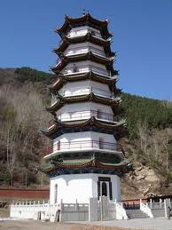
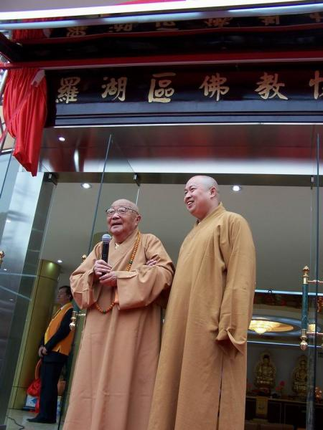
Mahayana Buddhist pagoda & monks

Slide 10
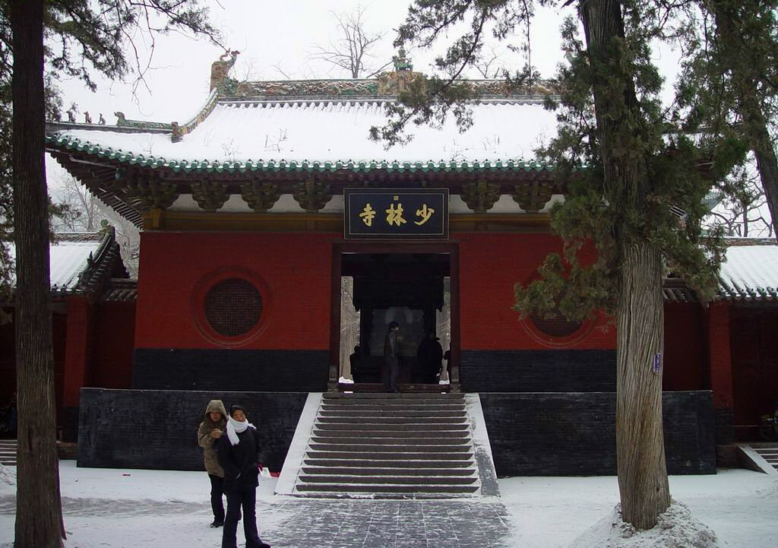
The Shaolin Temple, a Mahayana Buddhist temple

Slide 11
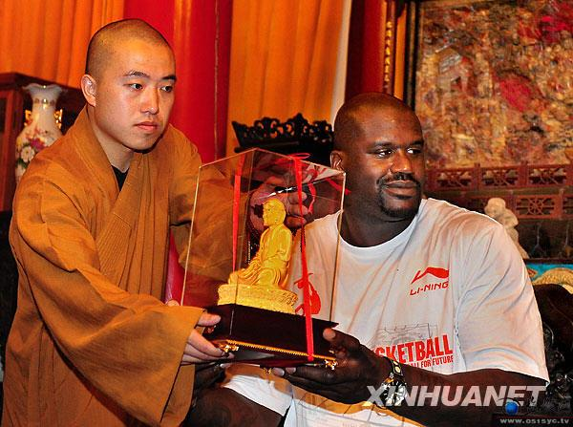
A monk presenting a gift to a NBA star

Slide 12
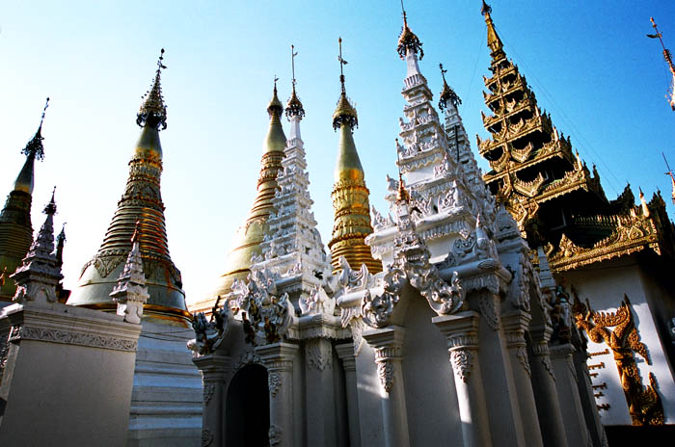
A Hinayana Buddhist temple

Slide 13
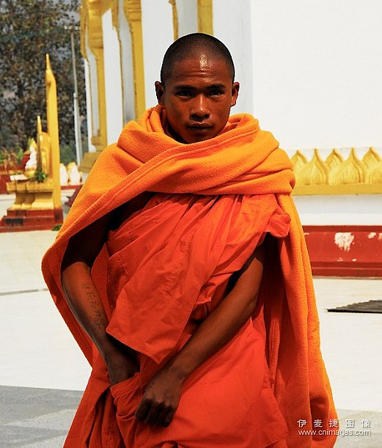
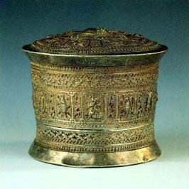
A Hinayana Buddhist monk

Slide 14
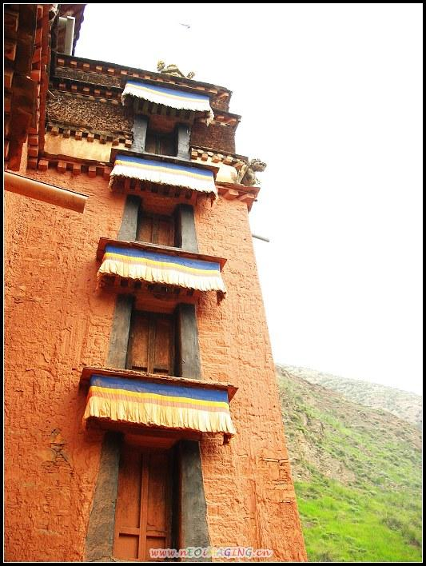
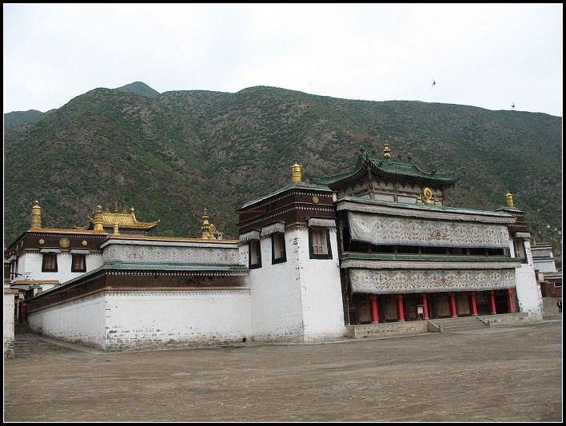
Lamaist monasteries

Slide 15
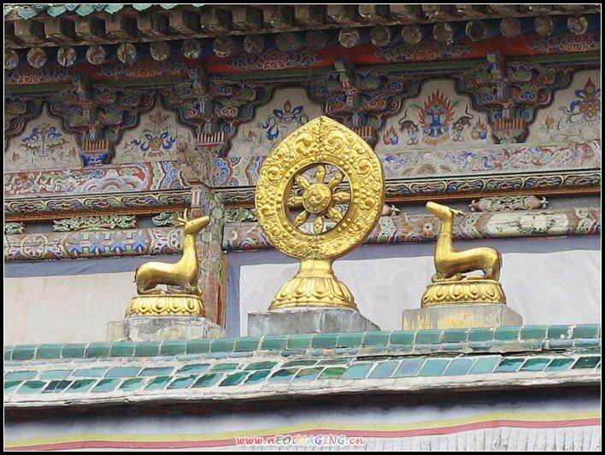
Decorations of the roof of a Lamaist temple

Slide 16
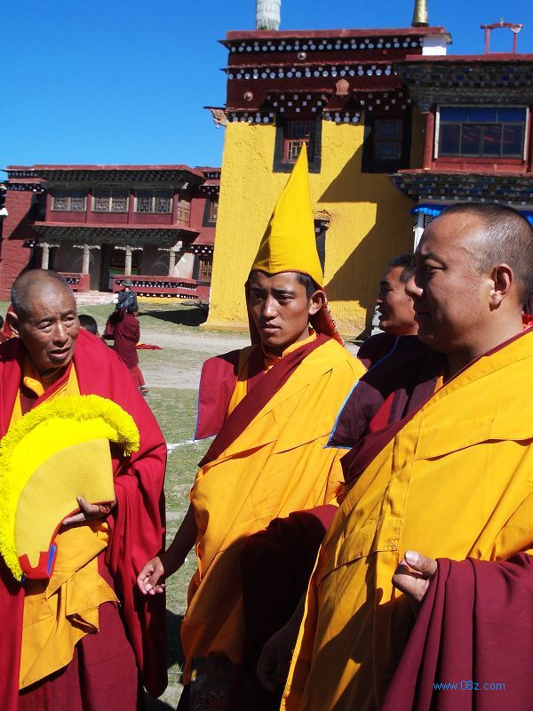
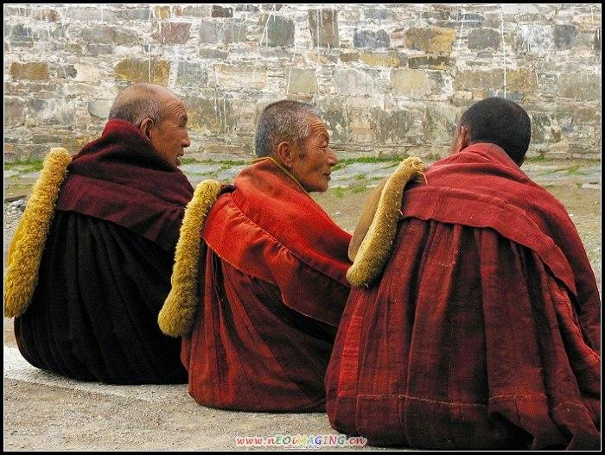
Lamaist monks: the Yellow and Red sects

Slide 17
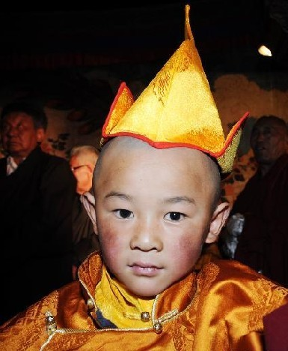
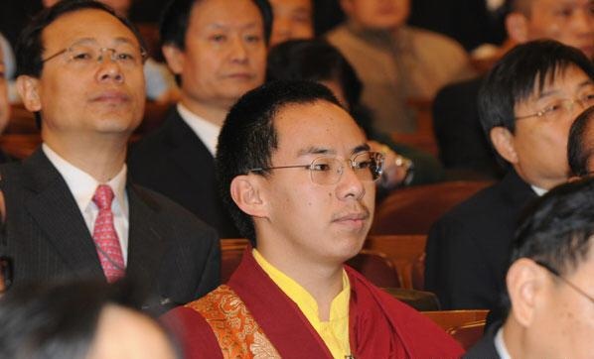
The present Living Buddha as the supreme leader of Tibetan Lamaism

Slide 18
Questions Concerning Section B Daoism (Taoism)
1. Is Daoism the only native major religion in China? When did it come into being? What is it based on?
2. What do you know about Lao Zi and his Classic of the Way and its Power?
3. According to Lao Zi, what are the 3 basic principles of social behavior? What do they mean respectively?
4. What is the Way? What does water suggest in Daoism?
5. What is the cosmos like in Daoism? How does the Way work?
6. What do you know about Daoist sects?

Slide 19
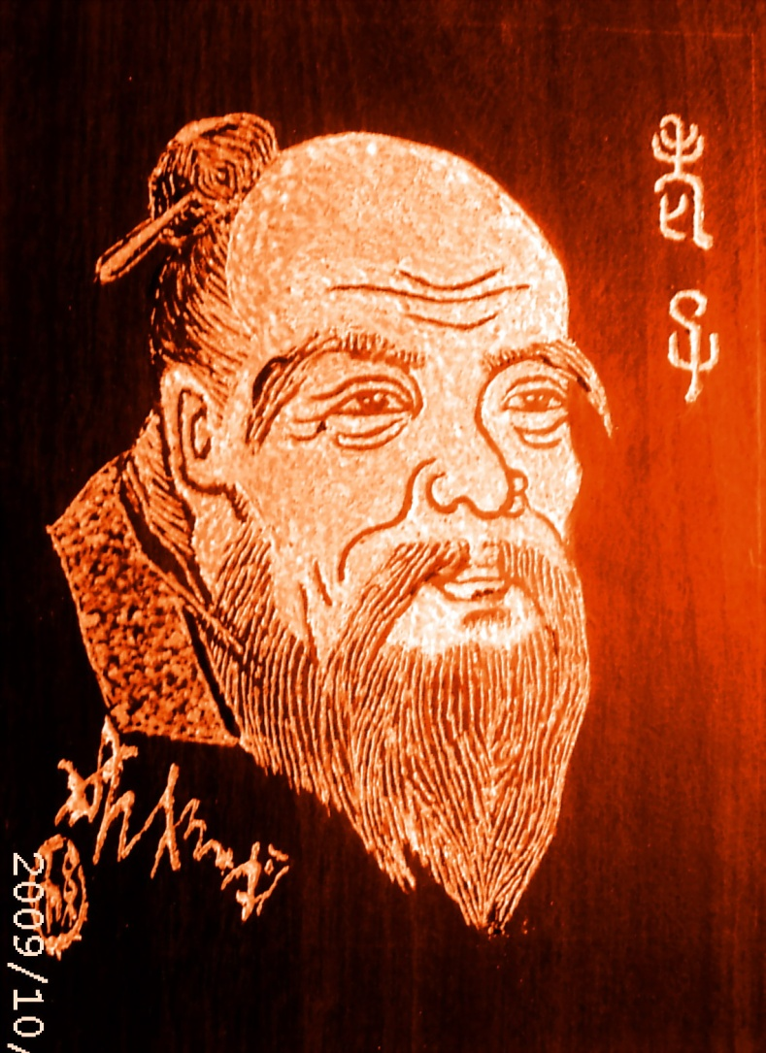
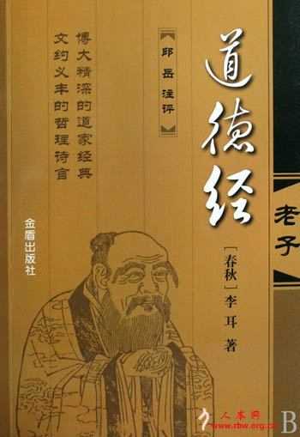
Lao Zi and his Classic of the Way and its Power

Slide 20
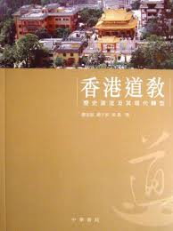
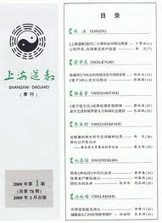
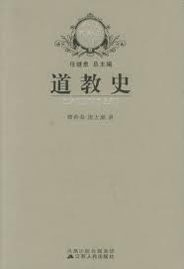
Books on Daoism

Slide 21
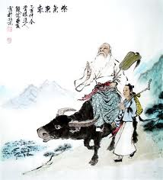
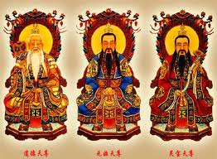
3 gods in Daoism

Slide 22
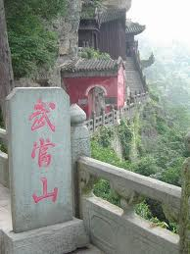
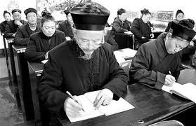
The Sacred Mountain; Daoists

Slide 23
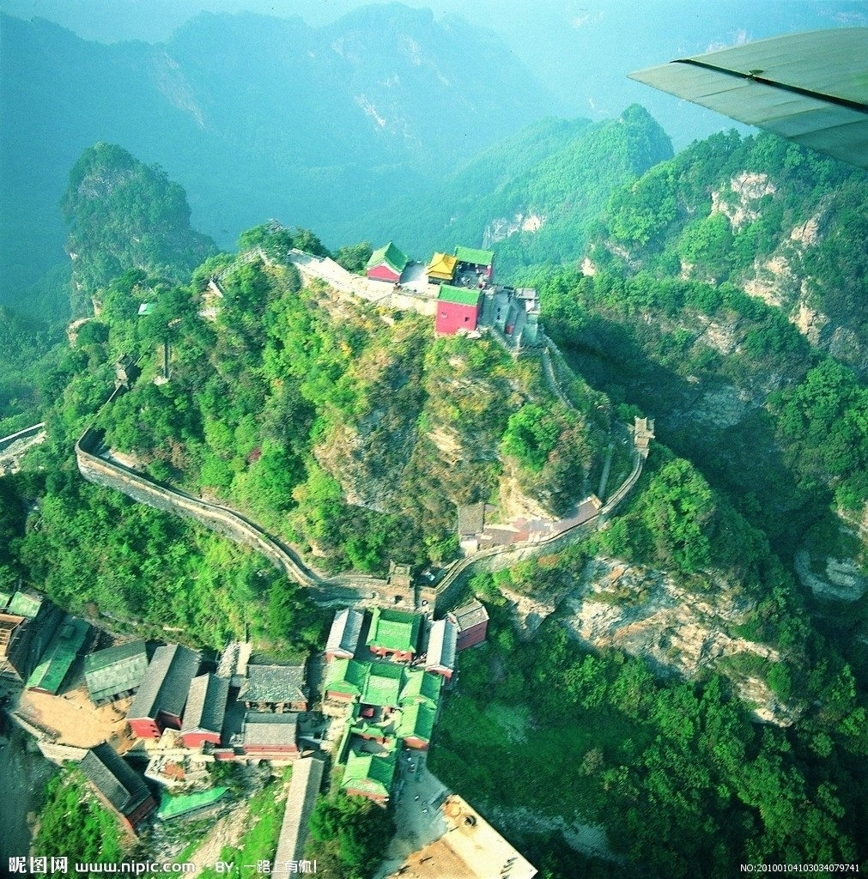
Mt. Wudang, Shiyan, Hubei Province

Slide 24
Questions Concerning Section C Islam
1. What does “Islam” mean? What does “Allah” mean?
2. Who’s the founder of Islam? Where’s the sacred city?
3. Where do most Chinese Moslems live?
4. How did Islam spread in China?
5. What’s the Islamic temple called? What’s the Islamic scripture called?
6. How do Moslems pray?
7. What Islamic festivals are celebrated in China?

Slide 25
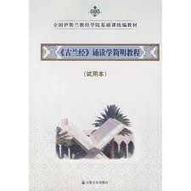
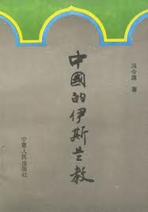
The Koran: an Introduction; Islam in China

Slide 26
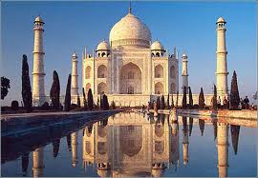
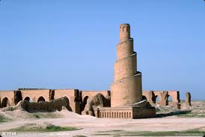
Taj Mahal; Tower of Light

Slide 27
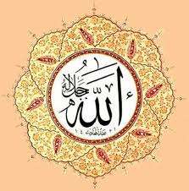
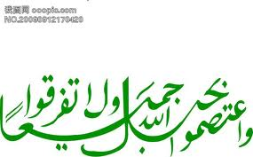
Islamic coat of arms; mark of Allah

Slide 28
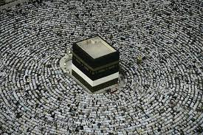
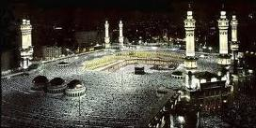
Meca, the sacred city, is crowded with moslems.

Slide 29
Questions Concerning Section D Christianity
1. What are the 3 main divisions of Christianity?
2. When did the Eastern Orthodox Church and the Roman Catholic Church separate? Why?
3. On what do Roman Catholicism and Protestantism disagree?
4. How did Christianity spread in China?

Slide 30

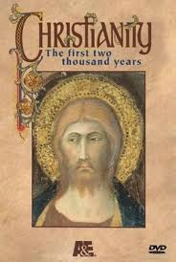
Christian Science Monitor; Christianity

Slide 31
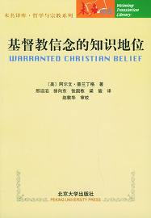
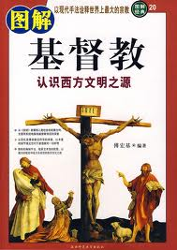
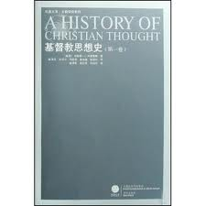
Books on Christianity

Slide 32
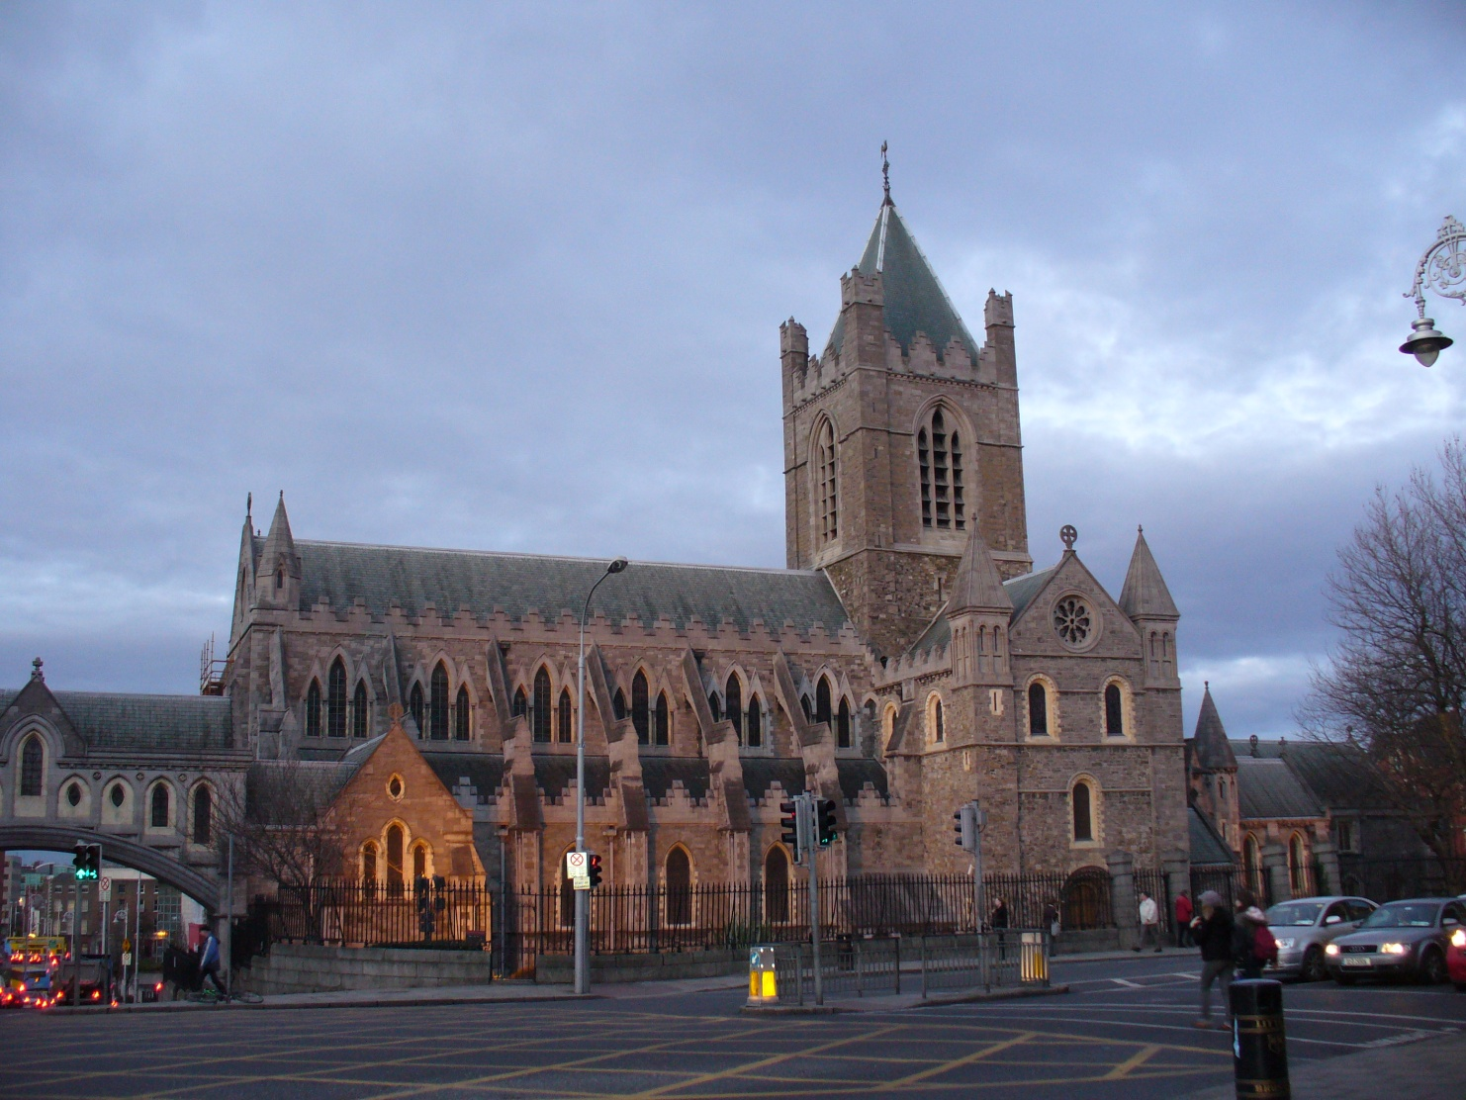
Christ Church, Dublin, Ireland

Slide 33
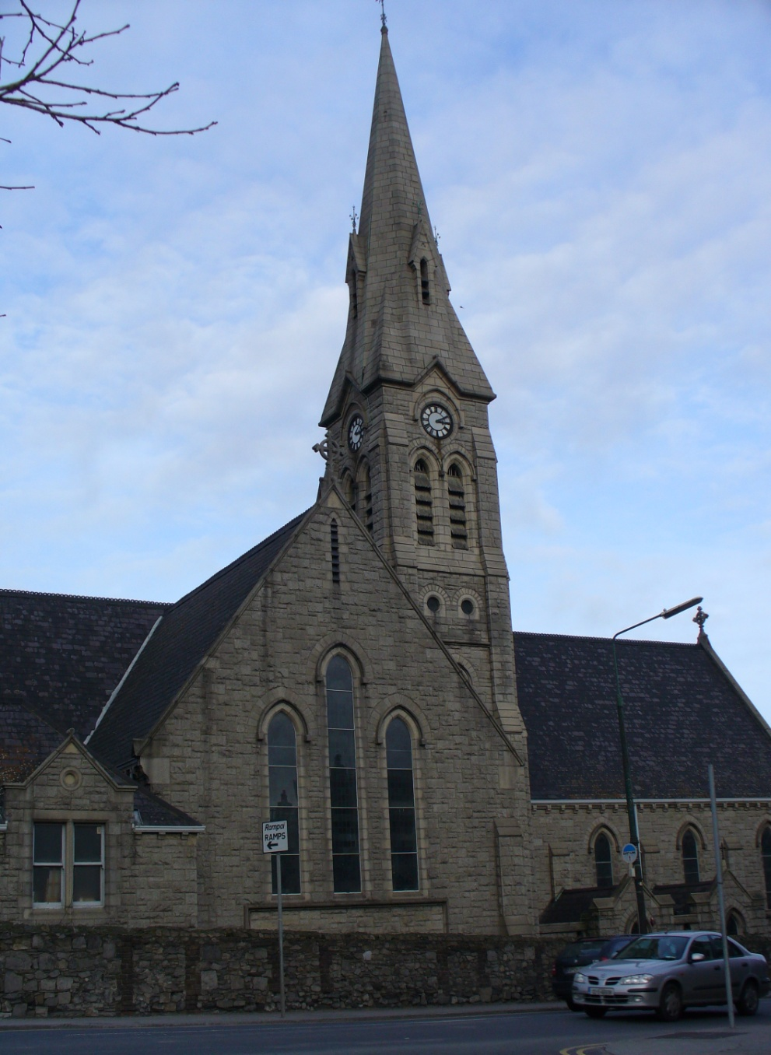
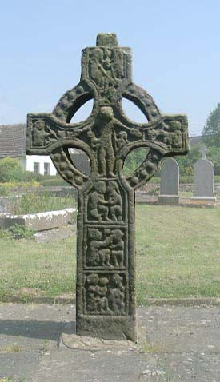
Catholic Church, Ringsend, Dublin

Slide 34
Topics for discussion
1.What inflences has Buddhism had on Chinese Culture?
2.What do you know about the temples in Mt. Hengshan or Mt. Yuelu?
3.What do you know about the Catholic Church in Changsha?

Slide 35
See you next time!

Slide 36
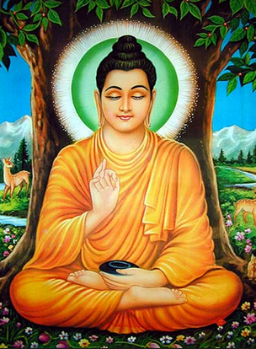
What do you know about Siddharta Gautama? What did he do at the ages of 29 and 35?

Slide 37

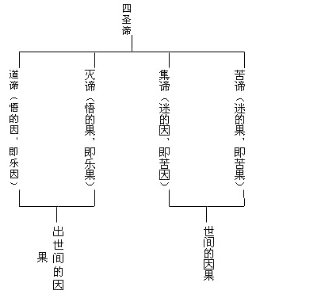
What are the 4 Noble Truths preached by Gautama?

Slide 38
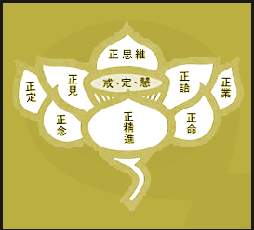
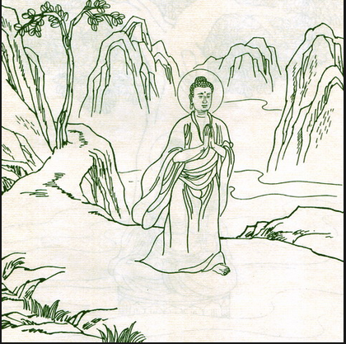
What 8 tenets are included in the Noble 8-Fold Path?

Slide 39
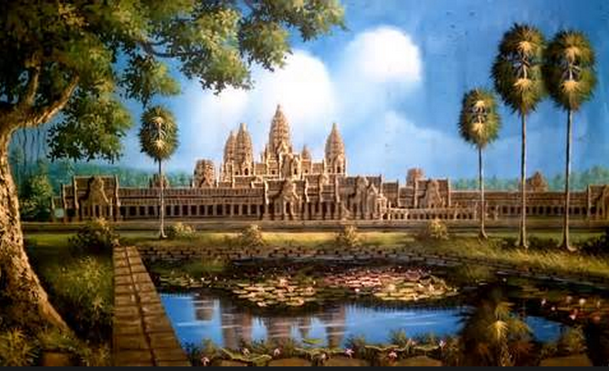
What can a Buddhist attain after following the Noble 8-Fold Path?

Slide 40

What does Mahayana Buddhism mean?

Slide 41

What are the 8 main sects of Chinese Buddhism?

Slide 42




What are the 4 sacred mountains in China?
普陀山
五台山
峨眉山
九华山

Slide 43

When was Hinayana Buddhism introduced into China? Where is it popular?
西双版纳景洪总佛寺

Slide 44

Why is it also called pali Buddhism?
Notes:
The Pali Canon

Slide 45

What is Lamaism?

Slide 46

What do the Red, Striped, White, Black and Yellow sects refer to respectively?
Notes:
图为：“古象雄佛法”发祥地冈底斯神山

Slide 47


Which sect is the most powerful? Could you name some of its monasteries?

Slide 48

What is a soul boy? How is the correct identity determined?
Notes:
图为：十一世班禅

Slide 49

Is Daoism the only native major religion in China? When did it come into being? What is it based on?
Notes:
道教天师道从创教之初，就以老子的《道德经》为根本经典，将其中“道”和“德”作为基本的信仰。道教认为“道”是宇宙万物的本原和主宰，无所不在，无所不包，万物都是从“道”演化而来的。而“德”则是“道”的体现。
三清尊神则是“道”最初的人格化显现，也代表了宇宙创生的三个重要过程（道生一，一生二，二生三，三生万物——道德经），三清化生出天地宇宙和自然诸神，这些称为先天尊神（天尊），乃道所演化，先天既与道体合一，而道法无远弗届充斥无边宇宙，故道教徒祝颂语常曰“无量天尊”，人类通过某些方式可以达到与道合一的境界，这些人称为后天神仙，最高修为者也可以达到天尊。
道教以太上老君（即道德天尊）为教主，也就是老子

Slide 50

What do you know about Lao Zi and his Classic of the Way and its Power?
Notes:
Picture: Stone statue of Laozi at the foot of Mount Qingyuan (清源山,泉州，福建)

Slide 51


According to Lao Zi, what are the 3 basic principles of social behavior? What do they mean respectively?
Notes:
《道德经》：“吾有三宝：一曰慈，二曰俭，三曰不敢为天下先

Slide 52

What is the Way? What does water suggest in Daoism?

Slide 53

What is the cosmos like in Daoism? How does the Way work?

Slide 54

What does “Islam” mean? What does “Allah” mean?

Slide 55


Who’s the founder of Islam? Where’s the sacred city?
Muhammad, shown with a veiled face and halo)
Notes:
The Kaaba (克尔白) , is a cuboid building at the centre of Islam's most sacred mosque, Al-Masjid al-Haram, in Mecca, Saudi Arabia. It is the most sacred point within this most sacred mosque, making it the most sacred location in Islam.

Slide 56


Where do most Chinese Moslems live?

Slide 57


What’s the Islamic temple called? What’s the Islamic scripture called?

Slide 58

How do Moslems pray?

Slide 59

What are the 3 main divisions of Christianity?

Slide 60


When did the Eastern Orthodox Church and the Roman Catholic Church separate? Why?
St. Peter's Basilica, Vatican
The Cathedral of Christ the Saviour in Moscow,
the world's tallest Orthodox church.

Slide 61

On what do Roman Catholicism and Protestantism disagree?
Pope Francis

Slide 62

How did Christianity spread in China?

