Slide 1


Eco-awareness
in
Chinese
Traditional
Culture
汇报人：22英语笔译
曾
晨

Slide 2

目
录
Lead-in
The Philosophy of “Life”
Ecological Aesthetics
Conclusion
Questions

Slide 3


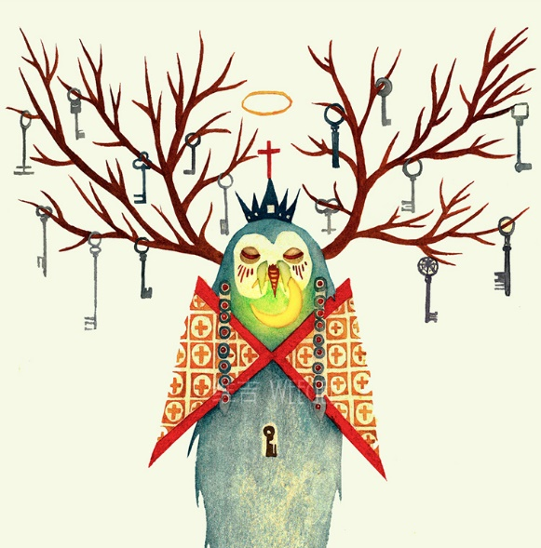
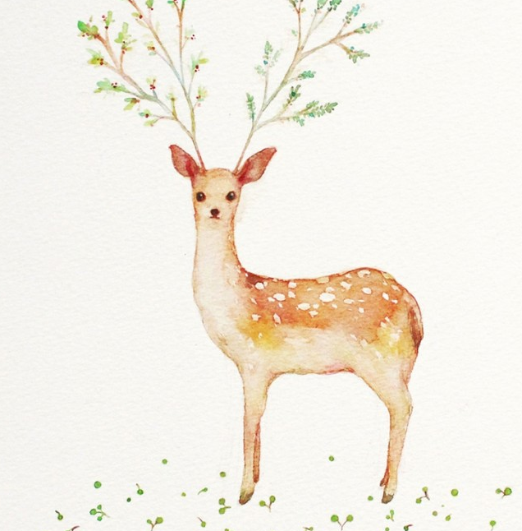
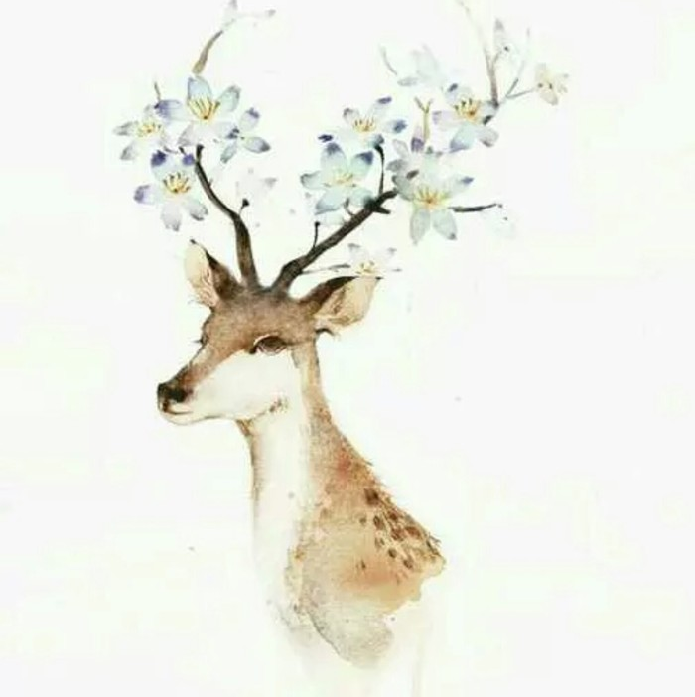
Lead-in
·Nowadays the whole world all pays attention to the protection of environment.
·In the face of increasingly severe eco-crisis, eco- ethnics and eco- philosophy
appeared.
·Chinese traditional culture contains intense eco- consciousness, which is the same as nowadays’ eco- ethnics and eco- philosophy.

Slide 4


The Philosophy of “Life”
Eco-ethics and Eco-philosophy
Confucius
Heaven is the source of all living things.
The creation of life is the“Heavenly Way(天道)”and the“Heavenly Destination(天命).”
Traditional Chinese philosophy is a philosophy of “life”.
The Book of Changes(Yijing)
The continuous creation of life is change（生生之谓易）
The great virtue of Heaven and Earth is creating life
（天地之大德曰生）
Mencius
(One should)love one’s family, love the people, and love all living things in the world.
（亲亲而仁民，仁民而爱物）

Slide 5
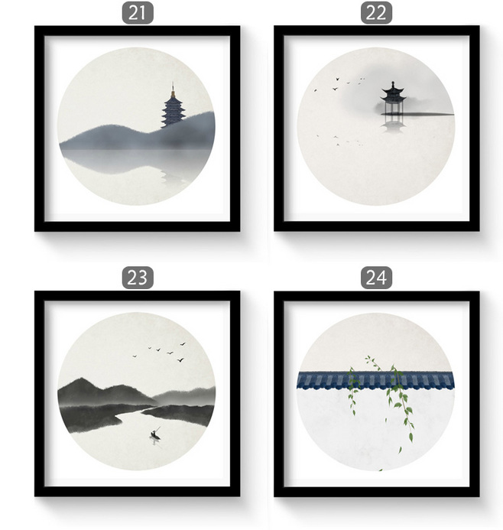
The Philosophy of “Life”
Confucian thinkers of later generations carried on the idea of “Heaven and Earth giving birth to all life”and thus emphasized love for and kindness toward all living things.

Slide 6

Ecological Aesthetics
Ancient Chinese thinkers regarded nature with human beings included in it as the world of life.
All living things in the world have their own life and state of being.
Confucian scholars in the Song and Ming dynasties all enjoyed observing“the state of being of living things.”

Slide 7

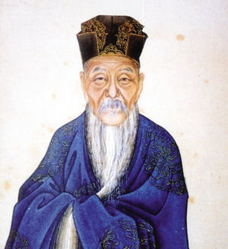
“Life and its state of being is most worthy of appreciation.”（万物之生意最可观）
——Cheng Hao(1032-1085)
Note：
Cheng Hao: 程颢。称明道先生，为程颐兄弟。“二程”为理学的奠基者。

Slide 8
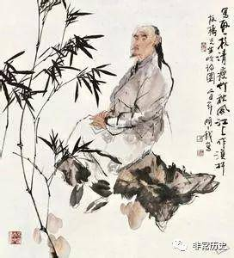
“To draw fish is to draw its liveliness, just like it is swimming. ”
——Wang Gai(1693-1765)
Note：
Wang Gai: 王概。清代著名画家，“扬州八怪”的主要代表，以三绝“诗、书、画”闻名于世的书画家、文学家。

Slide 9
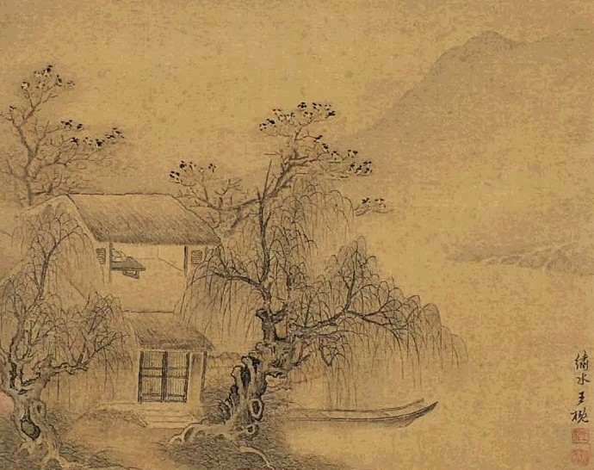
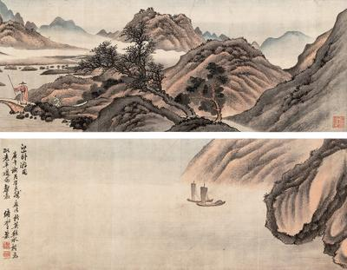
Art

Slide 10
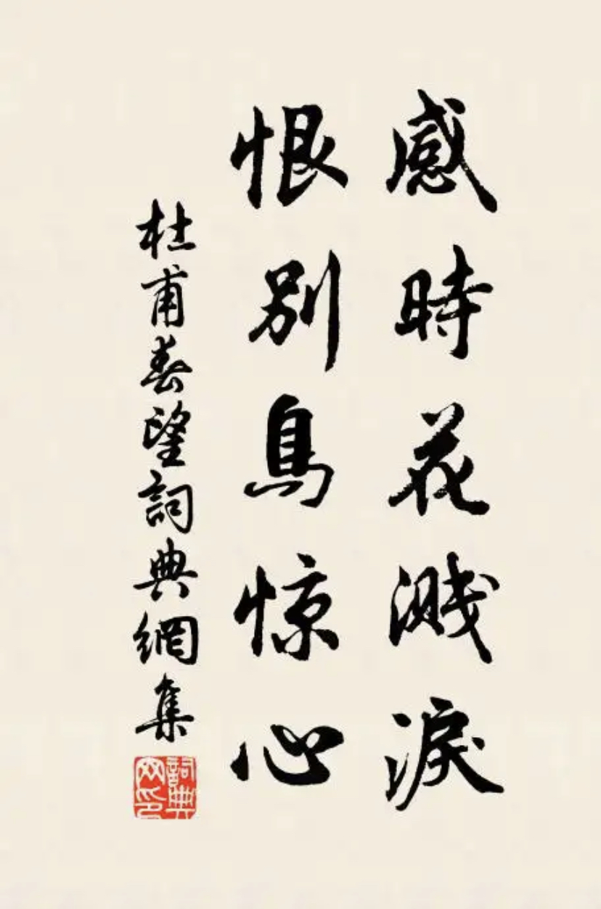
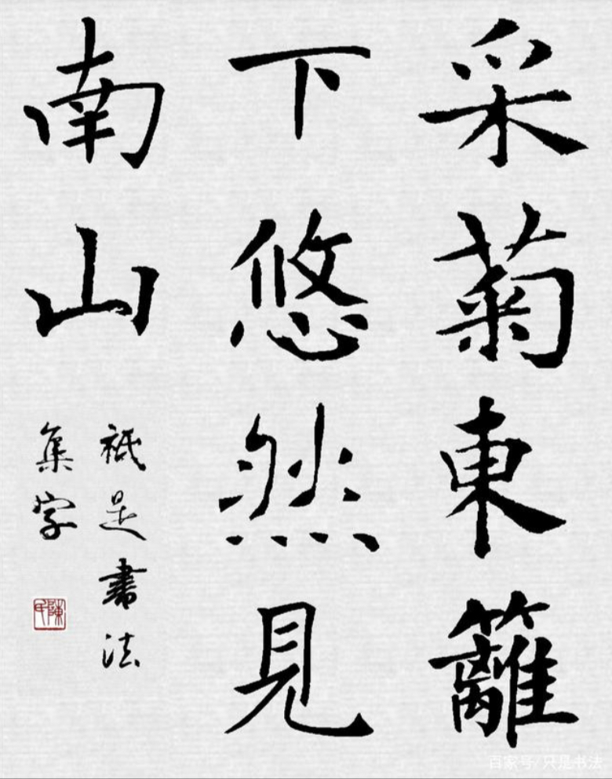
Literature

Slide 11
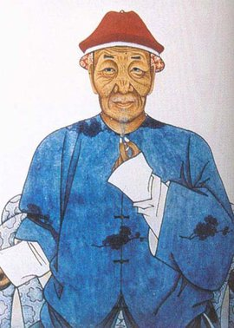
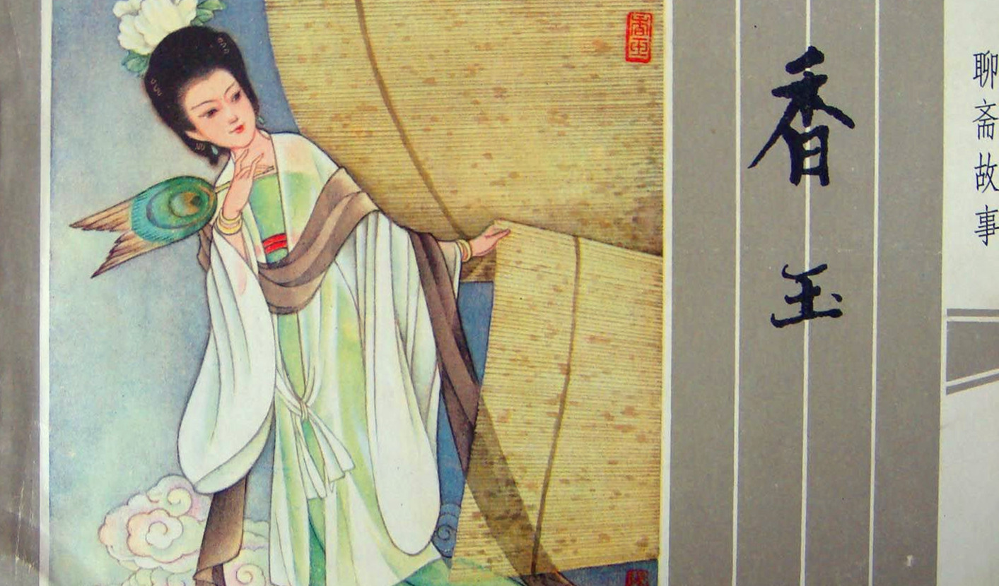
Literature
Note:
1.Pu Songling: 蒲松龄。清代文学家，别号柳泉居士，山东淄川人。
2.Strange Tales from a Chinese Studio:《聊斋志异》。清代文言短篇小说集，蒲松龄撰，合计近500篇。故事来源非常广泛，具有很高的思想价值和独特的艺术风格。

Slide 12




Conclusion
“life” (creating life) in the basic role of universe.
Human and everything are an integrity, belonging to a big life world. Human has no rights to consider himself as the dominator of the world. We should love every creature in the world, make them live and develop according to their own nature.
Every creature (including human) contains vivid life and liveliness, which deserves appreciating the most.
Chinese ancient works of art and literature are full of the love for everything in the world, embody that human and everything belong to a great life world, sharing death and survival, closely related to each other, that is the “eco-beauty”.
Four points

Slide 13

Communication
The following are some quotes from Chinese and foreign poets.
Read them carefully and find out their views about man and nature.
George Pope Morris:
Woodman spare the tree! Touch not a single bough! In youth it sheltered me. And I’ll protect it now.
Francis Bacon:
We cannot command nature except by obeying her.
John Muir:
When one tugs at a single thing in nature, he finds it attached to the rest of the world.
Ralph Waldo Emerson:
The sky is the daily bread of the eyes.
杜甫：泥融飞燕子，沙暖睡鸳鸯。
王维：人鸟不相乱，见兽皆相亲。
辛弃疾：一松一竹真朋友，山鸟山花好弟兄。

Slide 14
Question:
Chinese philosophy has always emphasized immanence(内在性) and unity.
While Western dualism(二元论) leads to opposition between man and nature, Chinese monism(一元论) leads to harmony between the two.
Most Chinese philosophers share this unique view.
Tell what you know about the Chinese idiom Tian Ren He Yi.

Slide 15
References:
《中国语言与文化》
Insights into Chinese Culture
叶朗，中国传统文化中的生态意识
汪爱芝，中国传统文化的生态意识

Slide 16
谢
谢
观
赏
汇报人：Zeng Chen(曾晨)

Slide 17
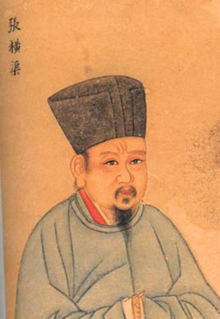
“All people in the world are my brothers and all beings in the world are my companions.”
(民吾同胞，物吾与也）
——Zhang Zai(1020-1077)
Note：
Zhang Zai: 张载，字子厚，北宋哲学家，人称横渠先生。理学支脉“关学”创始人，反对“有生于无”的思想，提出“太虚”即“元气”、“气”，是万物生成的本源。

Slide 18
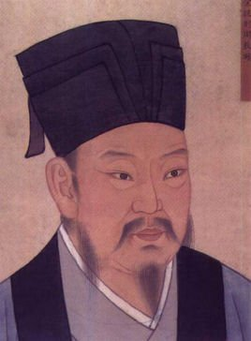
“Heaven creates life through yang and nurtures life through yin.”
(天以阳生万物，以阴成万物）
——Zhou Dunyi(1017-1073)
Note：
Zhou Dunyi: 周敦颐，北宋理学家，曾撰写《太极图书》和《通书》。

Slide 19
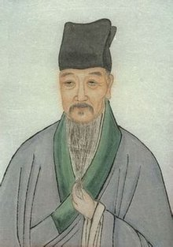
“The nature of life is love.”(生之性便是仁）
——Cheng Yi(1033-1107)
Note：
Cheng Yi: 程颐，称伊川先生，与程颢为兄弟，世称“二程”，同受学于理学创始人周敦颐，后建立了自己的理学体系。

Slide 20
锐旗设计出 品
新年都未有芳华，二月初惊见草芽。
白雪却嫌春色晚，故穿庭树作飞花。
锐旗设计出 品
新年都未有芳华，二月初惊见草芽。
白雪却嫌春色晚，故穿庭树作飞花。
长安大雪天，鸟雀难相觅。其中豪贵家，
捣椒泥四壁。
到处爇红炉，周回下罗幂。暖手调金丝，
蘸甲斟琼液。
醉唱玉尘飞，困融香汗滴。岂知饥寒人，
手脚生皴劈。
锐旗设计出 品
新年都未有芳华，二月初惊见草芽。
白雪却嫌春色晚，故穿庭树作飞花。
锐旗设计出 品
新年都未有芳华，二月初惊见草芽。
白雪却嫌春色晚，故穿庭树作飞花。

