Slide 1
Lu Ban, China’s inventor

Slide 2
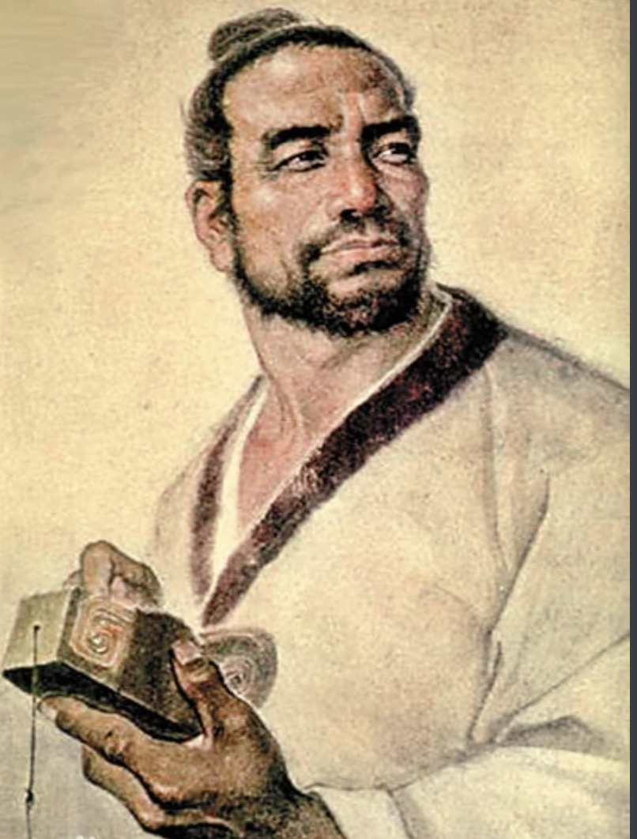
A brief introduction to Lu ban`s life
Lu Ban, a native of the State of Lu during the Spring and Autumn Period, came from a family of artisans and was exposed to handicrafts since childhood.
Actually， his name has become a symbol of the wisdom of the ancient working people.
,

Slide 3
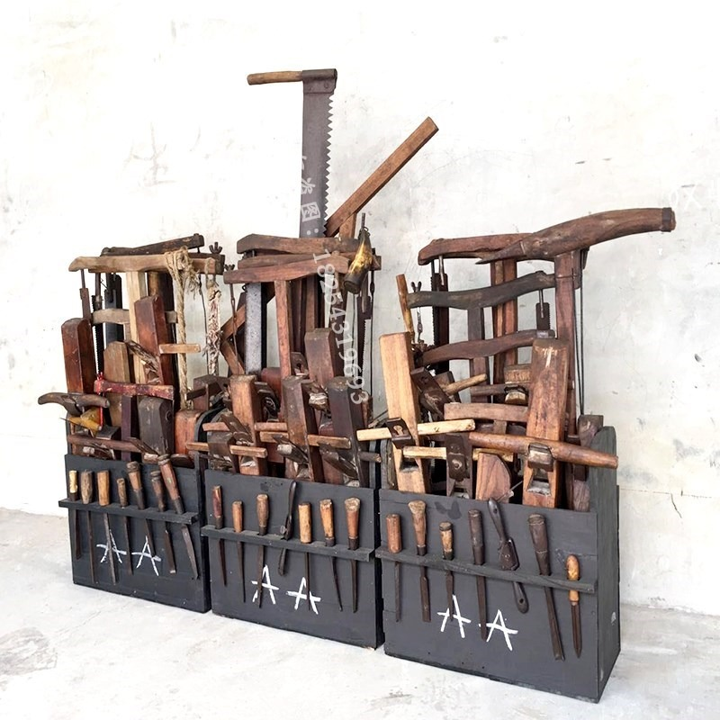
Invention and Creation - Woodworking tools
He invented the saw , the ruler, the ink fountain(墨斗), greatly improved the efficiency of woodworking

Slide 4
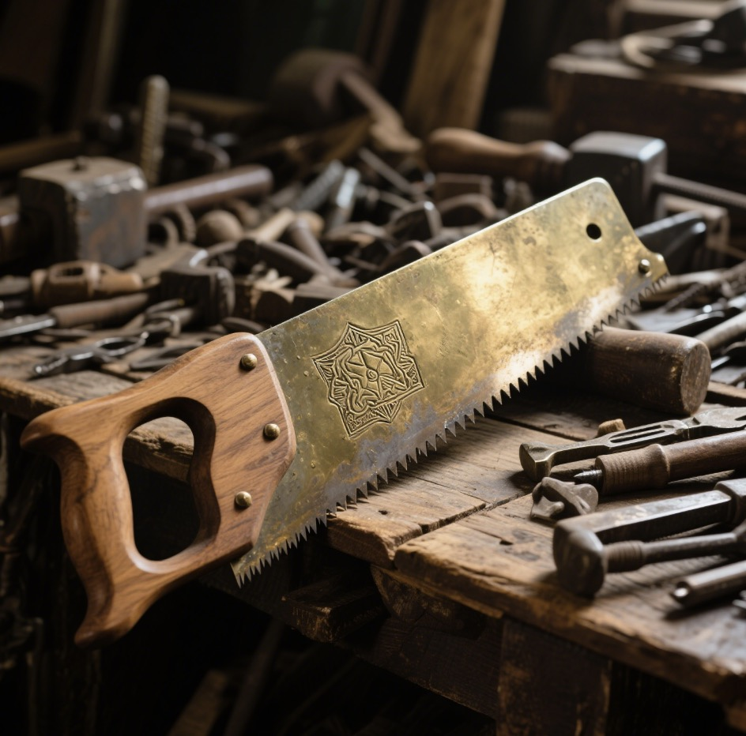
Invention and Creation - Woodworking tools
Legend has it that Lu Ban went up the mountain to cut wood and was scratched by the toothed grass leaves. Inspired by this, he conducted repeated research and experiments, and made a tool with a toothed edge out of an iron sheet. This was the saw, which greatly improved the efficiency of logging.

Slide 5
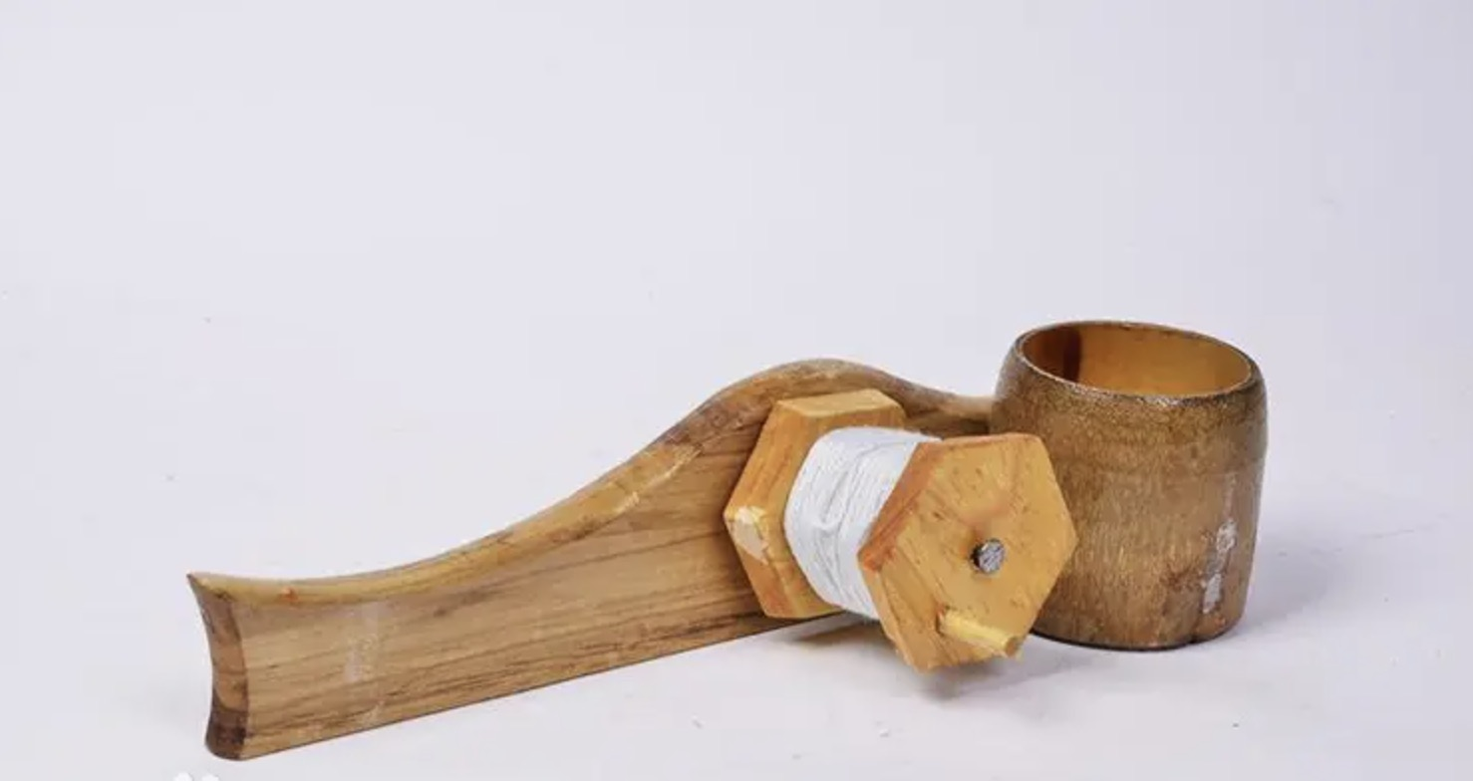
Invention and Creation - Woodworking tools
The ink fountain is an extremely common tool in the traditional Chinese woodworking industry. The fountain is usually used in aspects such as measurement and house construction.

Slide 6
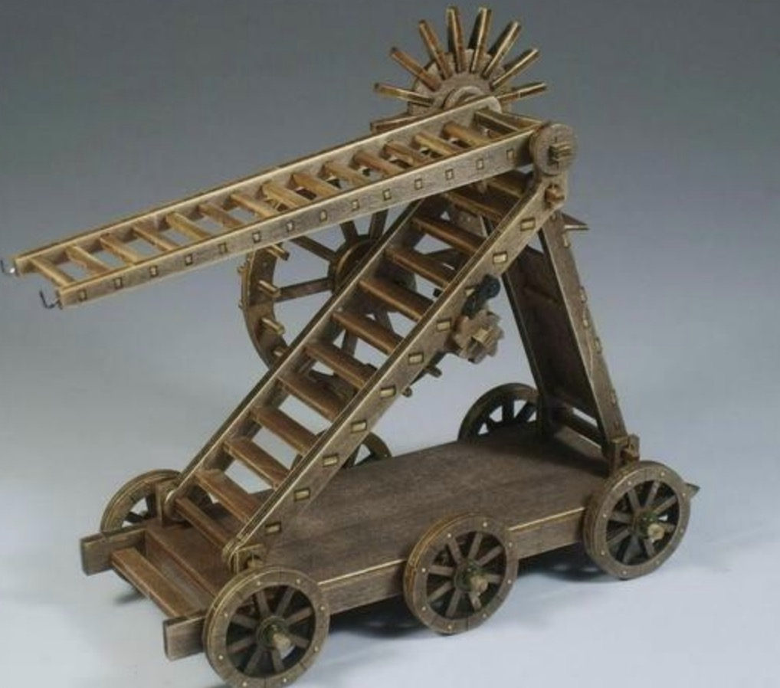
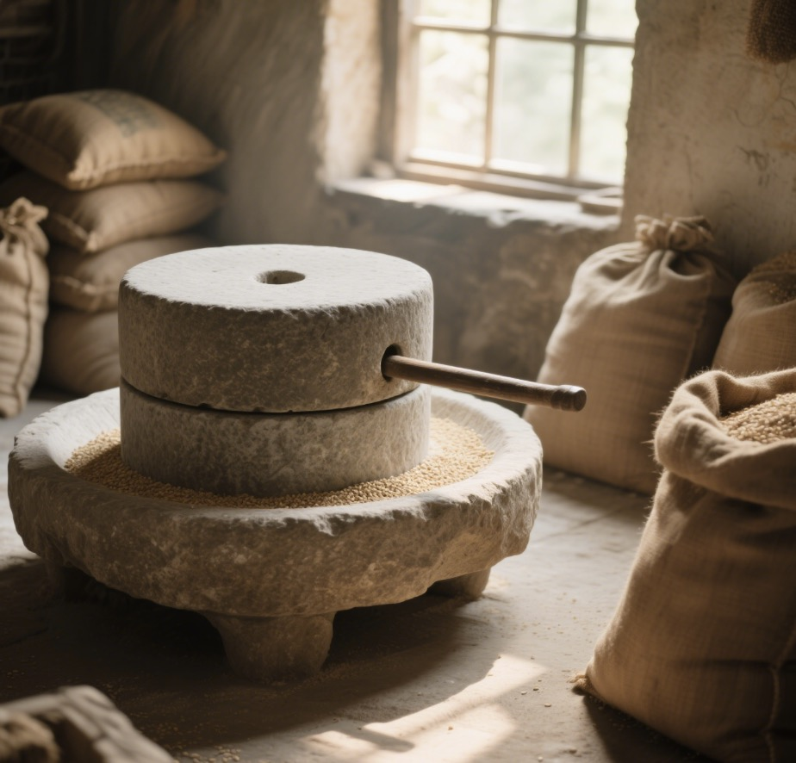
Invention and Creation - Construction machinery
improved Ladders (used for attacking cities)
stone mills (tools for grain processing)
these inventions promote the development in the military and life fields

Slide 7
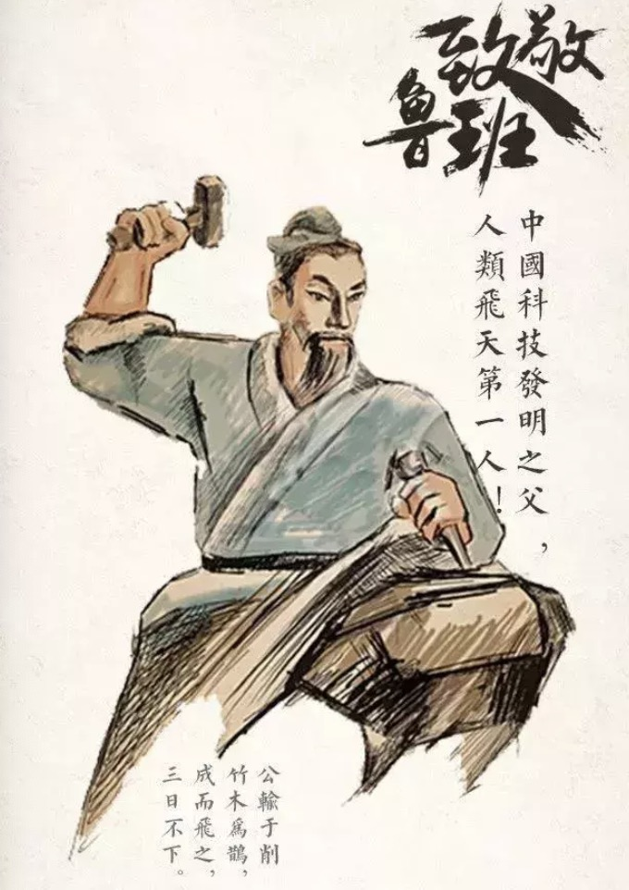
Far-reaching influence in later generations
Lu ban was honored as the "Ancestor of all Trades", he is the founding father of the Chinese craftsmanship industry. The Lu Ban craftsmanship has been passed down from generation to generation

Slide 8
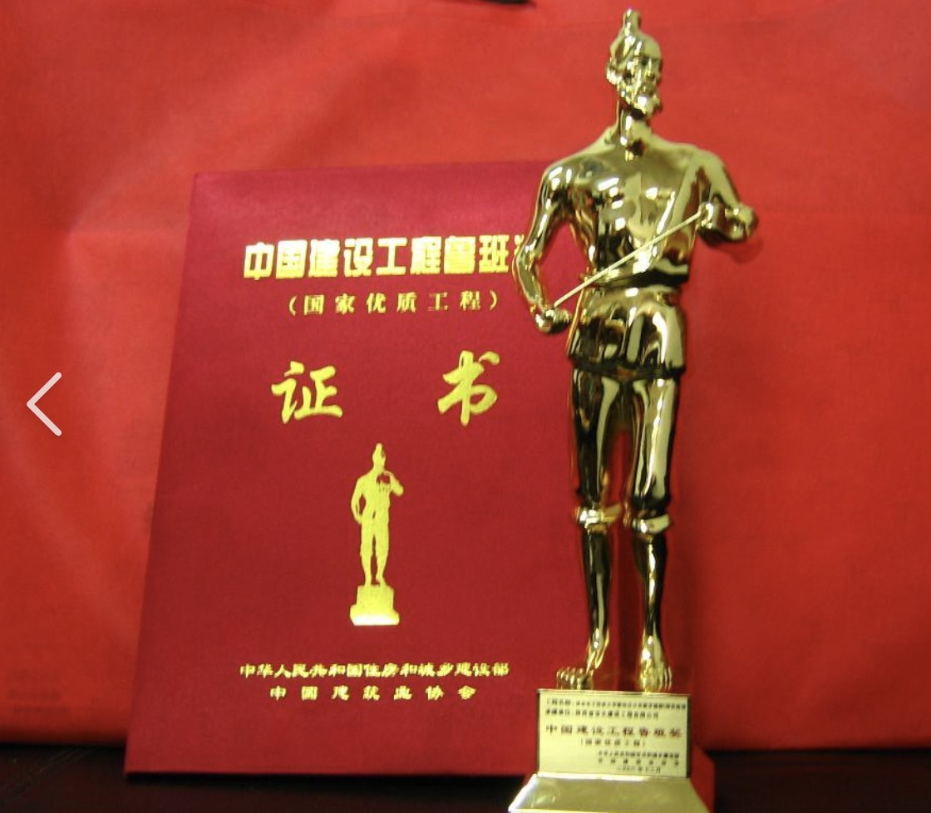
Cultural inheritance and commemoration
In memory of Lu Ban, China has established the Lu Ban Award (the highest honor for engineering quality in China's construction industry), the Lu Ban Temple Fair and the Lu Ban Cultural Festival

Slide 9


THANKS FOR WATCHING
CLASS REPORT

