Slide 1
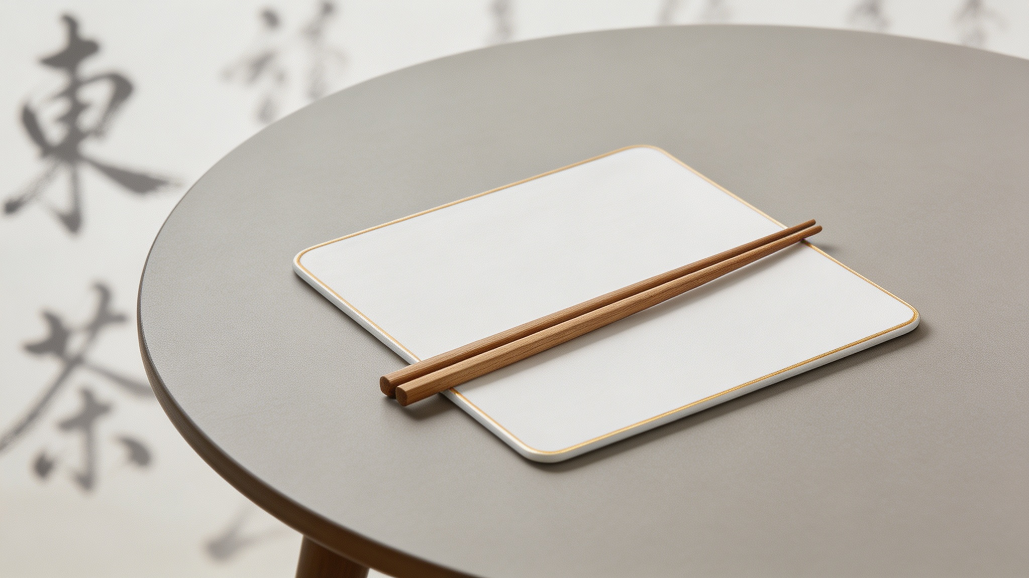
The Logic Behind the Chinese Table Manners
Reporter: Xiang Jiaying
Notes:
大家好，欢迎来到今天的分享。在座的各位，有没有人曾经被提醒过“不要把筷子插在饭里”或者“不要敲碗”？这些看似琐碎的餐桌规矩背后，其实蕴含着深刻的文化逻辑。今天，我不想做说教，而是想和大家一起探索这些简单规则背后的真正原因。让我们一起走进中国的餐桌，理解礼仪背后的逻辑。

Slide 2
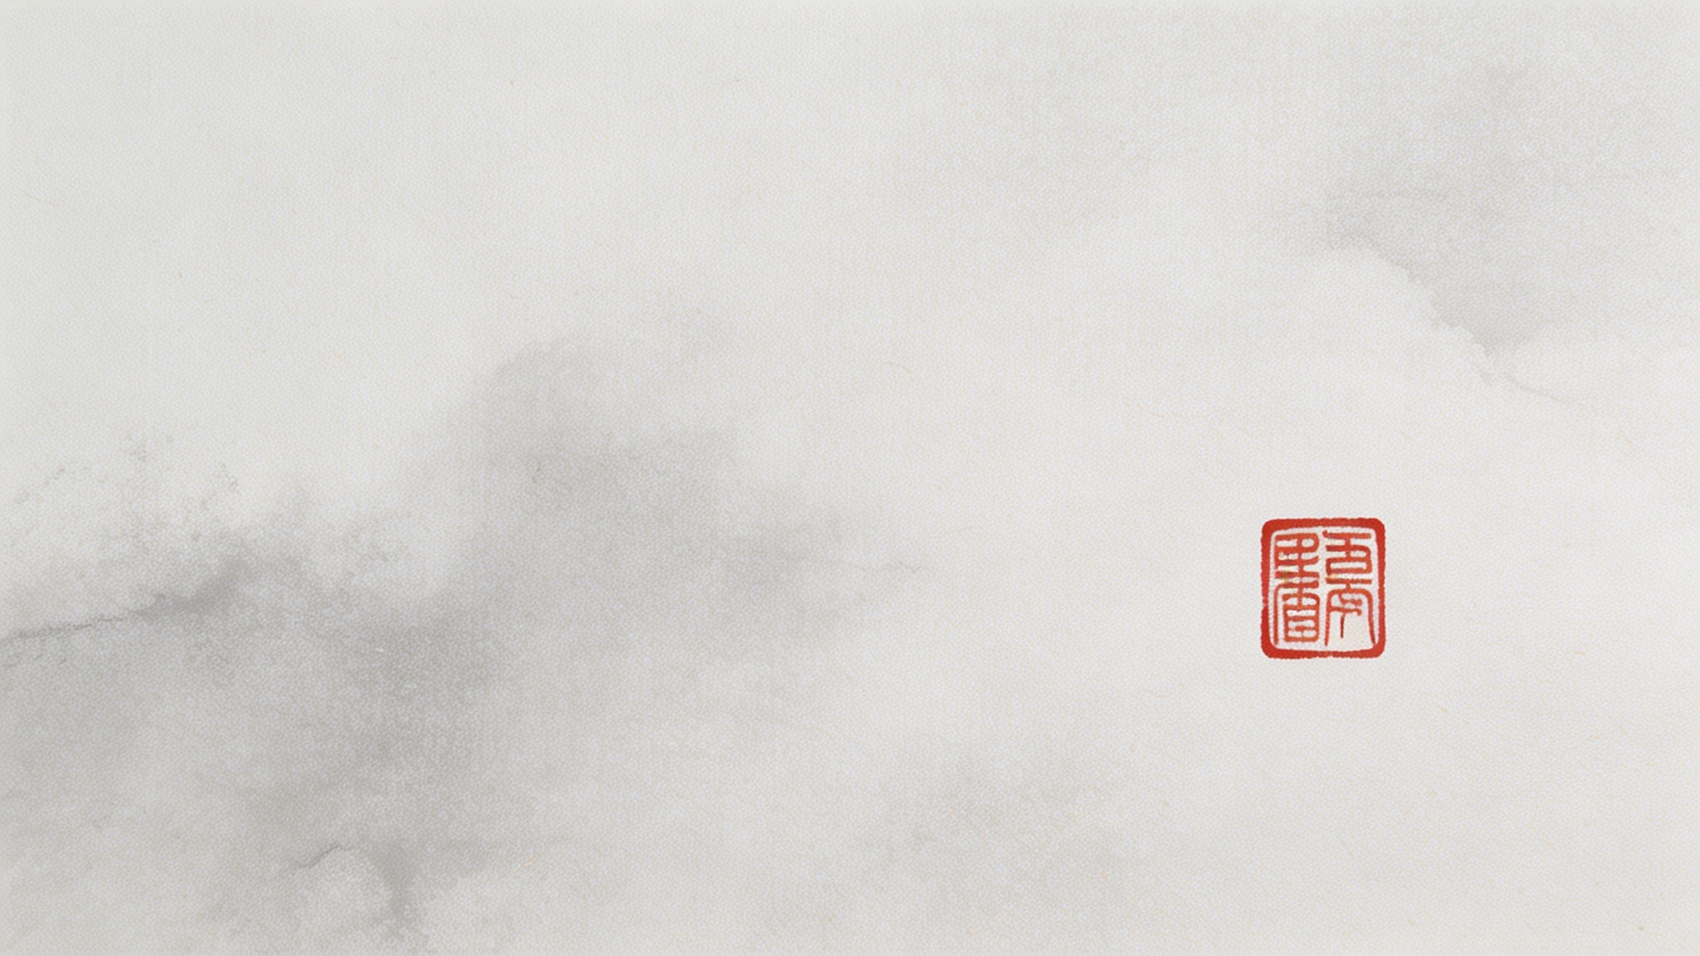
Why Are Chinese Table Manners So Important?
• Respect for age and rank（长幼有序）– the table reflects social order
• Distinction between inside and outside（内外有别）– behavior differs between family and strangers
• Harmony first（以和为贵）– don’t make anyone uncomfortable
“Making others comfortable is making oneself dignified
Notes:
那么，为什么中国的餐桌礼仪如此重要？因为在中国文化中，餐桌就像一个微型社会。你的一举一动，都反映了你对社会秩序的理解，比如对长辈和地位的尊重。同时，在家人和陌生人面前，你的行为也会有所不同。最重要的一点是“和谐至上”，任何可能让他人感到不适的行为都是应该避免的。记住，好的礼仪，本质上是让别人感到舒适，这也是你赢得尊重的方式。

Slide 3
  Tools
2
  Seating
1
3
  Offering Food
5
4
  Leaving the Table
  Eating Behaviors
Notes:
那么，为什么中国的餐桌礼仪如此重要？因为在中国文化中，餐桌就像一个微型社会。你的一举一动，都反映了你对社会秩序的理解，比如对长辈和地位的尊重。同时，在家人和陌生人面前，你的行为也会有所不同。最重要的一点是“和谐至上”，任何可能让他人感到不适的行为都是应该避免的。记住，好的礼仪，本质上是让别人感到舒适，这也是你赢得尊重的方式。

Slide 4
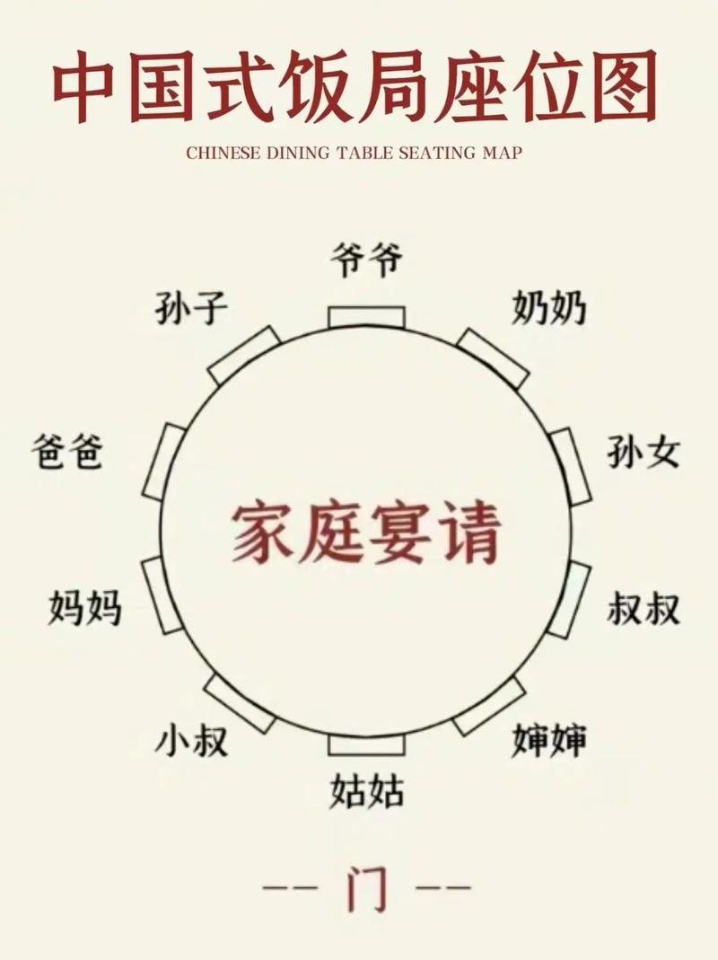
Seating – Where You Sit Says a Lot
Positioning: Main seat faces the door or has the best view, signifying control.
Misstep: Taking the main seat is seen as rude and immature.
Seniority: Elders and hosts sit first and leave first, showing respect.
Misstep: Starting before elders marks you as ill-bred.
Hospitality: Guests are seated in secondary seats to be cared for, not pressured.
Misstep: Insisting on the main seat comes off as arrogant.
“In China, a seat is not a location — it’s an attitude.”
Notes:
在中国的餐桌上，你坐的位置至关重要。这不仅仅是一个物理位置，更是一种态度的体现。主位通常面对着门或者最好的视野，这代表着主人掌控全场。长辈和主人先坐先离席，是对年长者的尊重。而客人则坐在次要位置，这表示他们是被照顾的对象，而不是被施压。所以，记住，在中国，一个座位，蕴含着尊重、秩序和关怀三重意义。

Slide 5
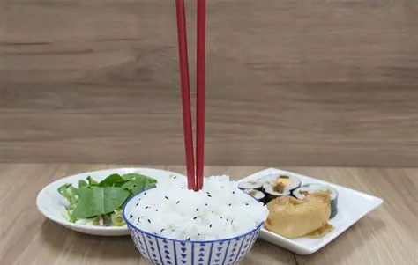
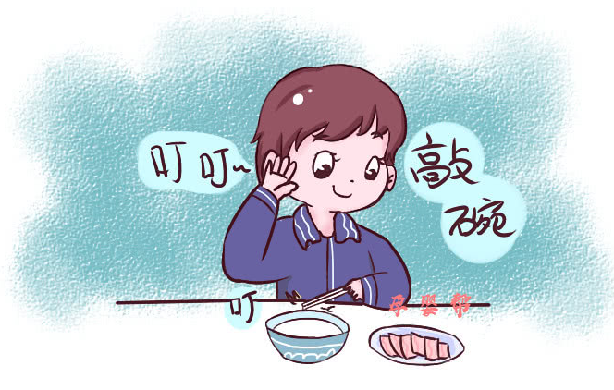
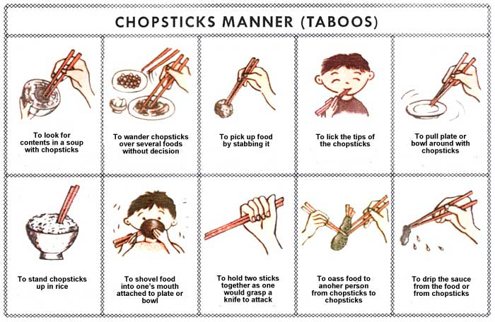
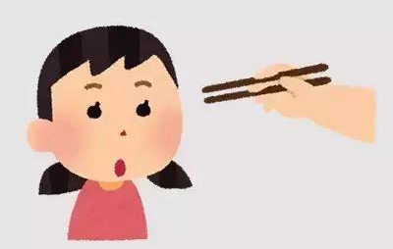
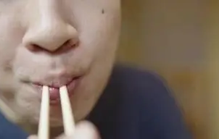
Chopsticks – Daily Tools, Easy Mistakes
Sticking upright in rice
Why: Looks like incense for the dead.
Seen As: Extremely unlucky and disrespectful.
Tapping the bowl
Why: Historically associated with beggars' behavior.
Seen As: Low-class and badly raised manners.
Rummaging
Why: Picking through food shows disregard for others.
Seen As: Selfish and indicative of bad table manners.
Pointing at people
Why: Analogous to pointing a finger in direct blame.
Seen As: Aggressive, crude, and highly offensive.
Sucking chopsticks
Why: Considered unhygienic and unpleasant to watch.
Seen As: Gross, lacking social boundaries and decency.
“Chopsticks are not just tools — they are an extension of your character.”
Notes:
筷子是中国人日常的用餐工具，但它也承载了一半的社交礼仪。很多不经意的小动作，在餐桌上却是大忌。比如，把筷子插在饭里，看起来像给逝者上香，非常不吉利。用筷子敲碗，在过去是乞丐的行为。在菜里翻搅，显得你很自私。用筷子指人，如同用手指责，非常粗鲁。长时间吮吸筷子，则既不卫生也令人不快。所以，请记住，筷子不仅仅是工具，它们是你性格的延伸。

Slide 6
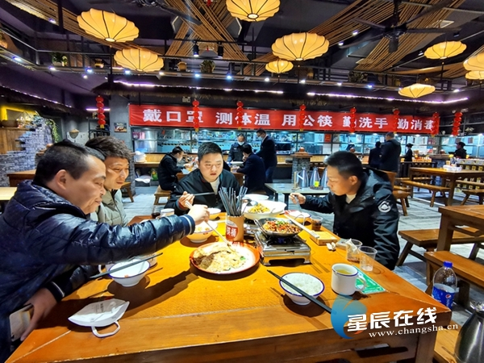
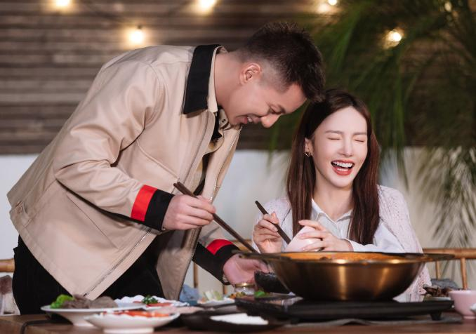
Offering Food – Kindness Can Cross the Line
Verbally Recommending
Using Personal Chopsticks
Intent: Showing warmth and hospitality.
Status: ✅ Normal and appropriate.
Intent: Traditional intimacy.
Now: Seen as unhygienic and intrusive.
Modern Etiquette
Forcing Food on Others
No Serving Chopsticks
Intent: Worried they won't eat enough.
Effect: Feels pushy and stressful.
Intent: Acceptable in past informality.
Now: Seen as careless and unhygienic.
Traditional Gesture
“Traditional: serving shows care. Modern: not serving shows respect.
Using serving chopsticks = warmth + boundaries.”
Notes:
在中国，热情地为他人夹菜是一种传统的表达关心的方式。但这种善意有时会越过界限，造成尴尬。口头推荐菜品是完全正常的。但用自己的筷子给别人夹菜，在过去代表亲密，现在却常被视为不卫生和冒犯。强行给别人夹菜，会给对方带来压力。而不用公筷夹菜，在过去尚可接受，现在则被认为是粗心和不卫生。所以，现代礼仪的智慧在于：使用公筷，既表达了你的热情，又保持了恰当的距离。

Slide 7
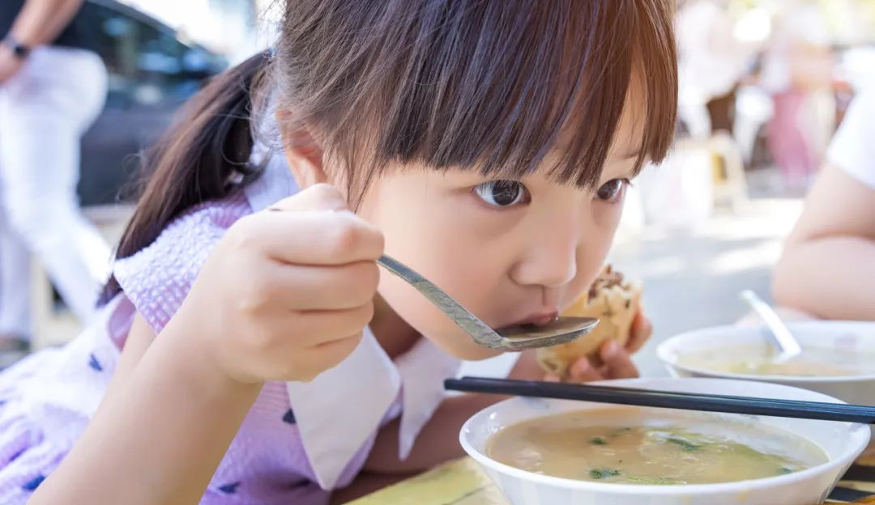
Eating Behaviors – What Your Table Manners Reveal
01. Sipping soup quietly
Why: Don’t disturb others.
Misstep: Loud sipping is seen as crude and unrefined.
02. Digging through dish bottoms
Why: It's considered picking only the best parts.
Misstep: Appears selfish and reflects ugly manners.
03. Hiding when picking teeth
Why: Privacy is essential.
Misstep: Not hiding is viewed as disgusting and ill-bred.
“No one will tell you on the spot — but everyone is silently judging.”
04. Spitting bones directly on table
Why: Basic civilization.
Misstep: Creates a dirty scene and signals a lack of manners.
05. Chewing with mouth closed
Why: Modern social norm.
Misstep: Open-mouthed chewing is seen as low-class and annoying.
Notes:
你吃什么固然重要，但怎么吃更能体现你的素养。安静地喝汤，是为了不打扰他人；在菜里翻找，只挑最好的部分，会显得自私；剔牙时用手或餐巾遮挡，是基本的礼貌；把骨头直接吐在桌上，非常不雅；而张嘴咀嚼，在现代观念中也被视为缺乏教养。这些细节，虽然没人会当场指出，但每个人都在默默观察和评判。

Slide 8
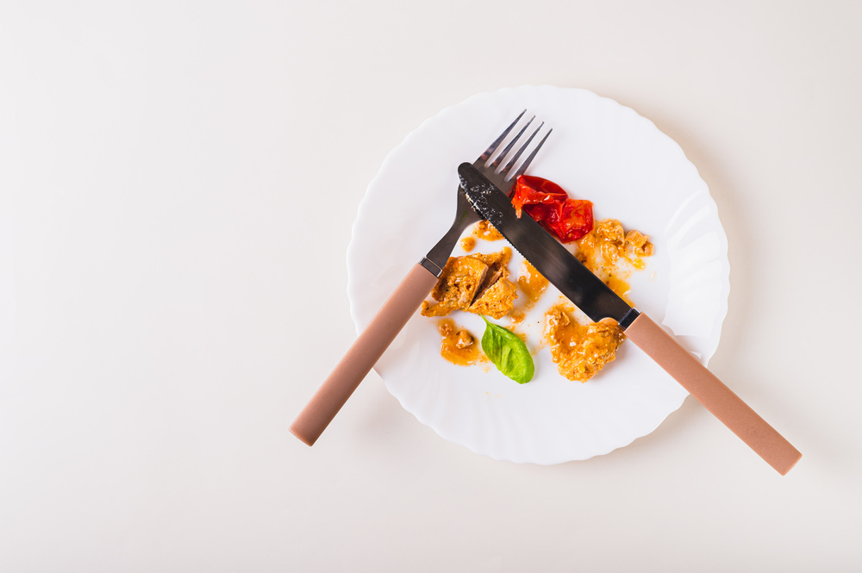
Leaving the Table – A Graceful Exit
Host’s Signal to End
Verbal Courtesy
Action: Host puts down chopsticks first to control the rhythm.
Misstep: Putting yours down first implies rushing others to finish.
Action: Guest explicitly says “I’m full, thank you” to signal a polite exit.
Misstep: Leaving silently without acknowledgment is considered rude.
The Art of Leaving a Little
Boundary of Helpfulness
Action: Leave a small amount of rice to show the host provided abundantly.
Misstep: Leaving too much food implies wastefulness and disrespect to the host.
Action: Offering to clean up is appropriate only for close family or friends.
Misstep: Doing so in formal business settings can cause awkwardness or seem overstepping.
“In China, you don’t say ‘I’m done.’ You say ‘Thank you, I’ve eaten well.’”
Notes:
一个优雅的结尾和一个美好的开始同样重要。在餐桌上，通常由主人先放下筷子，表示用餐节奏的结束。客人吃完后，应该礼貌地说“我吃饱了，谢谢”，而不是一声不吭就离开。碗里留一点饭，表示主人准备得很丰盛，而剩下太多则显得浪费和不尊重。至于帮忙收拾，这通常只适用于亲密的家庭场合，在商务宴请中这么做可能会显得尴尬，甚至越界。记住，在中国，不说“我吃完了”，而说“谢谢，我吃得很好”。

Slide 9
Why Chinese Tables Don’t Allow “Total Freedom”
All Manners Point to One Thing: Boundaries
Respect
Elders and hosts come first.
Harmony
Don’t make anyone uncomfortable.
Dignity
Your behavior reflects your upbringing.
“
Chinese tables are not against freedom — but your freedom must not make others uncomfortable.
Notes:
现在我们可以理解，为什么中国的餐桌不允许“绝对的自由”。所有这些礼仪，都指向一个核心概念：边界。这包括对长辈和主人的尊重，对营造和谐氛围的追求，以及对个人教养和尊严的维护。中国的餐桌文化并不反对自由，它反对的是那种会让他人感到不适的、无边界的自由。

Slide 10
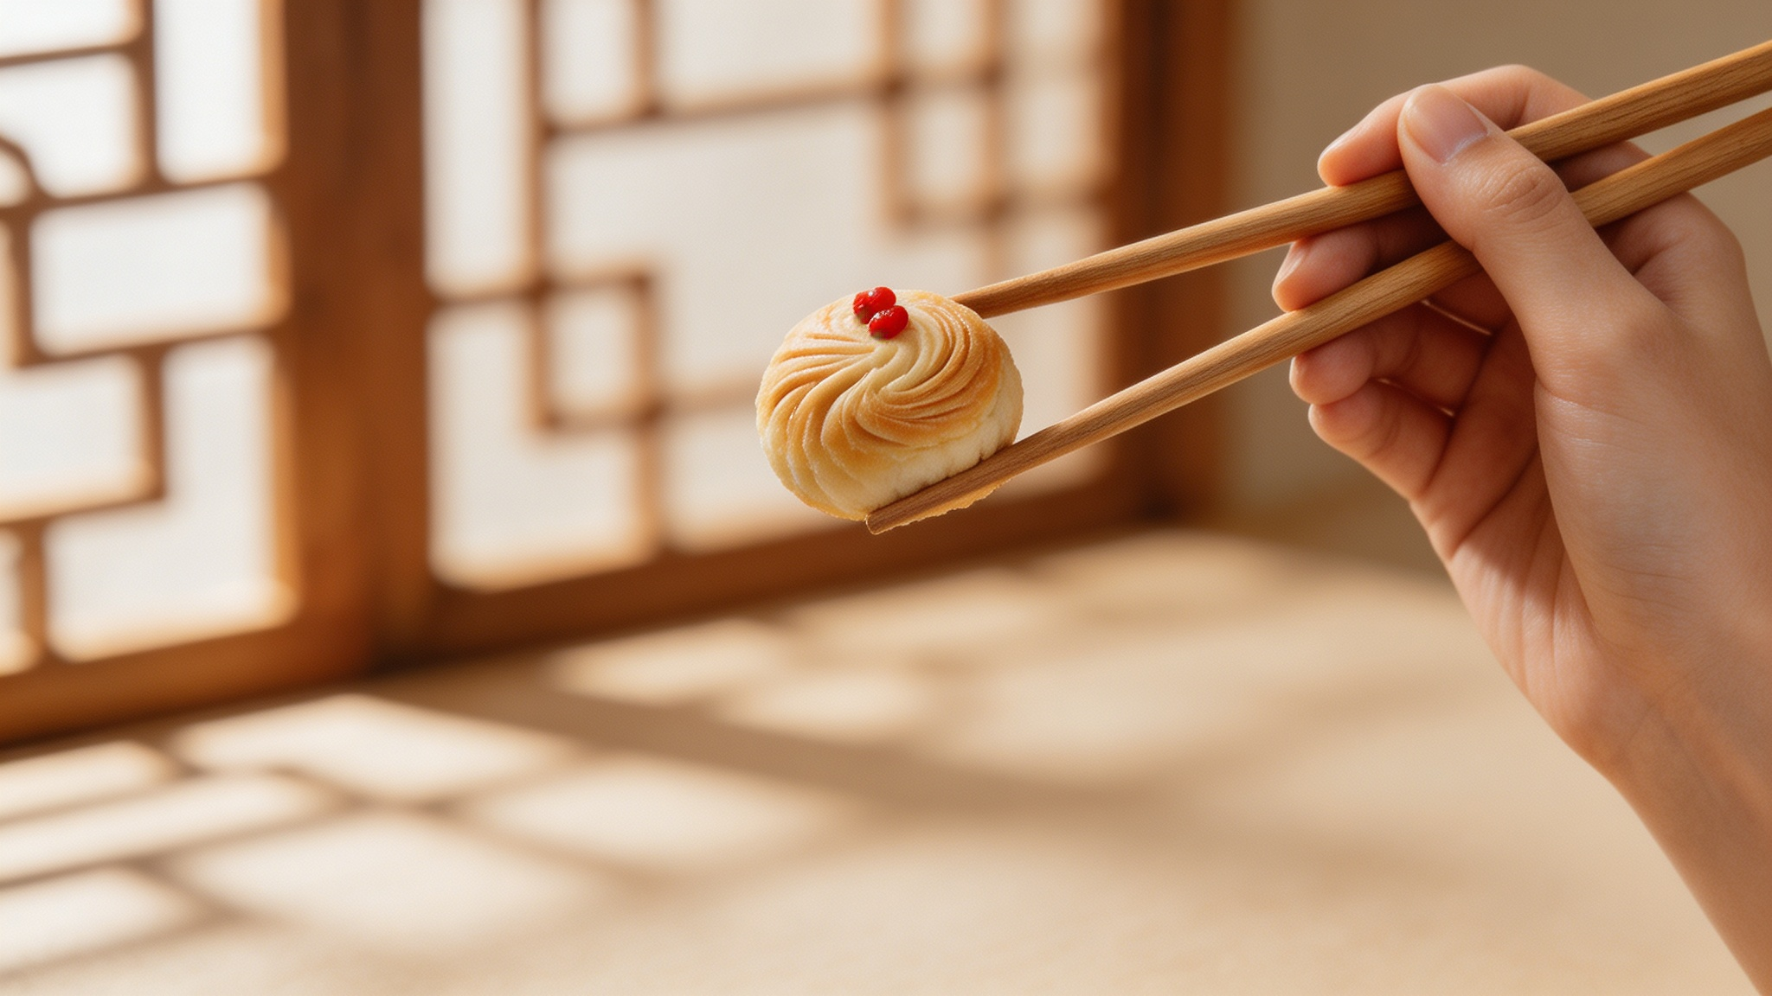
Manners Are Not to Stress You
They’re to Help You Be Decent
“When you care for others at the table, they will care for you in return.”
Thank You
Notes:
最后，我想说，礼仪不是为了给你压力，而是为了帮助你更好地与人相处，让你在社交中脱颖而出。请记住这句话：“当你在餐桌上关心他人时，他们也会反过来关心你。” 下次当你坐在中式圆桌旁时，你不必做到完美，但你会明白为什么有些人受欢迎，而有些人则被默默疏远。感谢大家的聆听，现在是问答环节。

